Slide 1
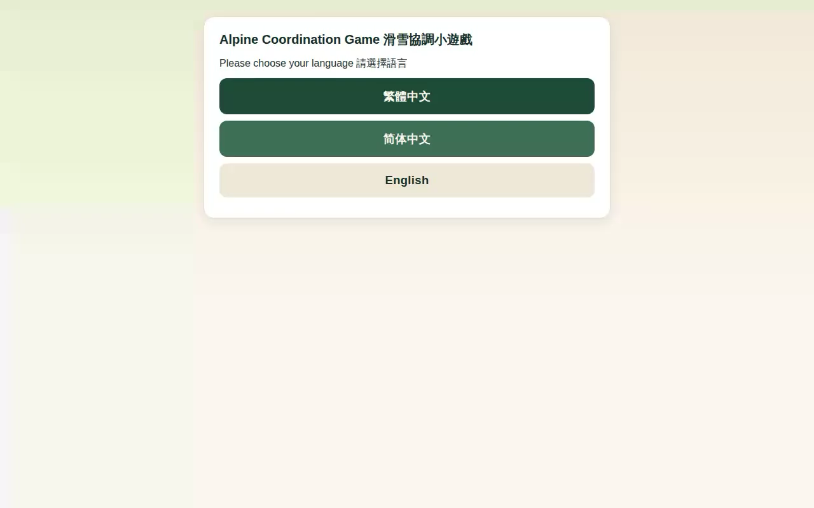
RESEARCH UPDATE 8 — FINAL REVIEW BEFORE ORAL EXAMINATION
Gamification as Proactive Approach for Continuous Improvement and Innovation Enhancement
Failure-associated non-return in gamified fall-risk assessment for older adults — and the engineering response to it
Sidney K. T. Tam (2021 – extended one semester 26-27)
Doctor of Engineering (EngD) candidate
Department of Industrial and Systems Engineering, PolyU
Chief Supervisor: Prof. Chi Fai (Benny) Cheung
The AI-assisted skiing game (Stage 2 build)
Last review before oral examination · Research period ends October 2026
Notes:
30 sec. Good afternoon. This is my final progress review before the oral examination. The programme asks how gamification serves continuous improvement when a promising health technology meets difficulty in the field — gamified fall-risk assessment with older adults, and what happens after an adverse first experience.

Slide 2
The research briefly
One problem, followed through three empirical stages
The problem. An installed fall-risk assessment (FRA) station stood under-used for a decade despite clinical value. The research examines adverse first experiences as a possible contributor to limited repeat use — the question is continued voluntary engagement, not initial acceptance.
S1
Critical review & survey
S2
Gamified deployment
S3A
Decoupled deployment
Guangzhou facility
June–August 2025 · 8 weeks
Hong Kong cohort · remote
Surveyed 200 residents (population 280). Retrospective accounts of adverse first experiences followed by non-return; TAM and Octalysis framing.
Thirty residents (62–84) played an AI-assisted skiing game whose weight-shift control also fed FRA measurement. Prospective observation of engagement.
120 adults, desktop game decoupled from clinical measurement. End-of-window participation 93.3% (112/120, returned dropouts counted as participating); 15 of 23 initial dropouts returned.
SS-293 · ICMSS 2026 (accepted)
Paper 2 · JIKM (under review)
Paper 3 · prepared
Changes in cohort, setting, delivery and input modality across stages prevent causal isolation. Stage 3B data collection commenced in August 2026; deployed procedures and returned records are being checked against the Stage-3B protocol before final classification and analysis (slide 9).
Sidney K.T. Tam | EngD Final Review (Update 8, rev. F) | PolyU ISE | September 2026
2
Notes:
70 sec. Walk the three stages: the survey that surfaced the phenomenon; the eight-week gamified deployment; the decoupled deployment whose contrast motivates — but does not prove — the framing account. Note the defined Stage-3 endpoint: end-of-window participation, 112 of 120, returners counted as participating — not uninterrupted retention. If asked why Stage 3 has two parts: 3A tested removing the verdict; 3B tests measurement made survivable by design; separate labelled collections keep the reported 3A record untouched. On Stage 3B, state only the interim account: collection commenced in August 2026; deployed procedures and returns are being checked against the protocol before classification and analysis.

Slide 3
The central observation
Stage 2 — what the archived record supports, stated at its evidential level
70.0%
26.7%
+4.03
No return
of participants had three or fewer recorded completed runs (95% CI 52.1–83.3%)
had a single recorded completed run (95% CI 14.2–44.4%)
mean change, InBody FRA composite (higher = better), n = 30 pairs, 95% CI 0.47–7.60, paired t p = .028
documented among low-engagement participants within the window — therapist-observed; the archive holds aggregate run counts, not dated visits
Measurement provenance: “before” = standard-mode FRA assessment at first attendance; “after” = the index generated at the final attended gameplay episode (timing varies by participant; an index is produced even with few completed runs). Both values are the same index on the same scale (higher = better); the standard-mode vs gameplay context difference is a stated limitation. Not an eight-week pre/post design.
The coexistence that drives the thesis: positive feedback and recorded balance-index gains coexisted with limited recorded use in this cohort. That coexistence does not establish durable learning or clinical benefit — it defines the engineering problem.
The ≤3 / ≥4 run split is a retrospectively defined classification used for descriptive analysis — not an optimal threshold.
Sidney K.T. Tam | EngD Final Review (Update 8, rev. F) | PolyU ISE | September 2026
3
Notes:
80 sec. Three quantitative tiles plus one deliberately qualitative one: non-return rests on contemporaneous therapist observation, because the archive keeps aggregate run counts without dates. If asked whether these players will come back: my interpretation is that return is unlikely — but the record supports only 'no documented return within the window', so that is what the thesis claims. Walk the provenance line: baseline was a standard-mode FRA test; the after-index came from the final attended episode.

Slide 4
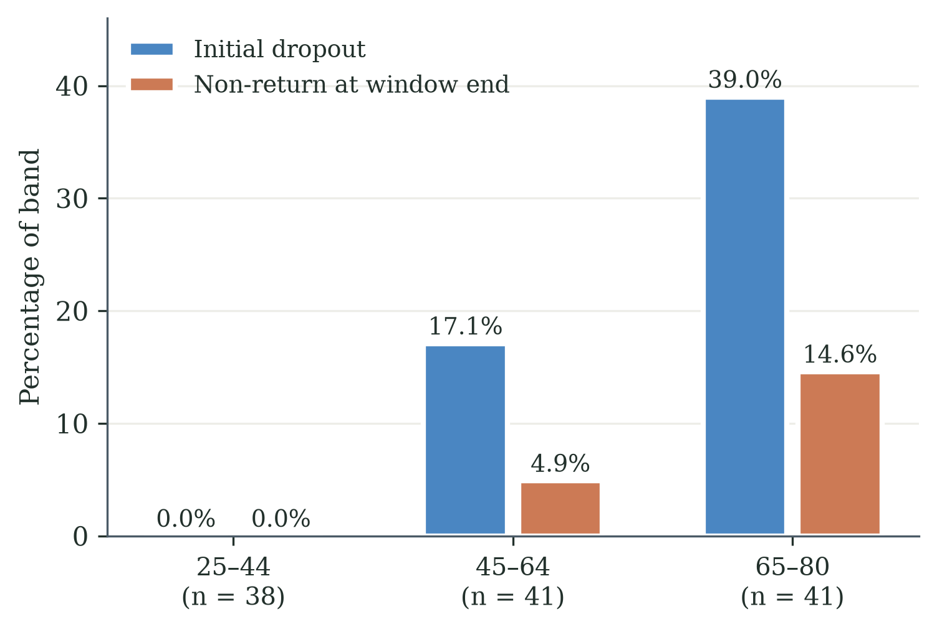
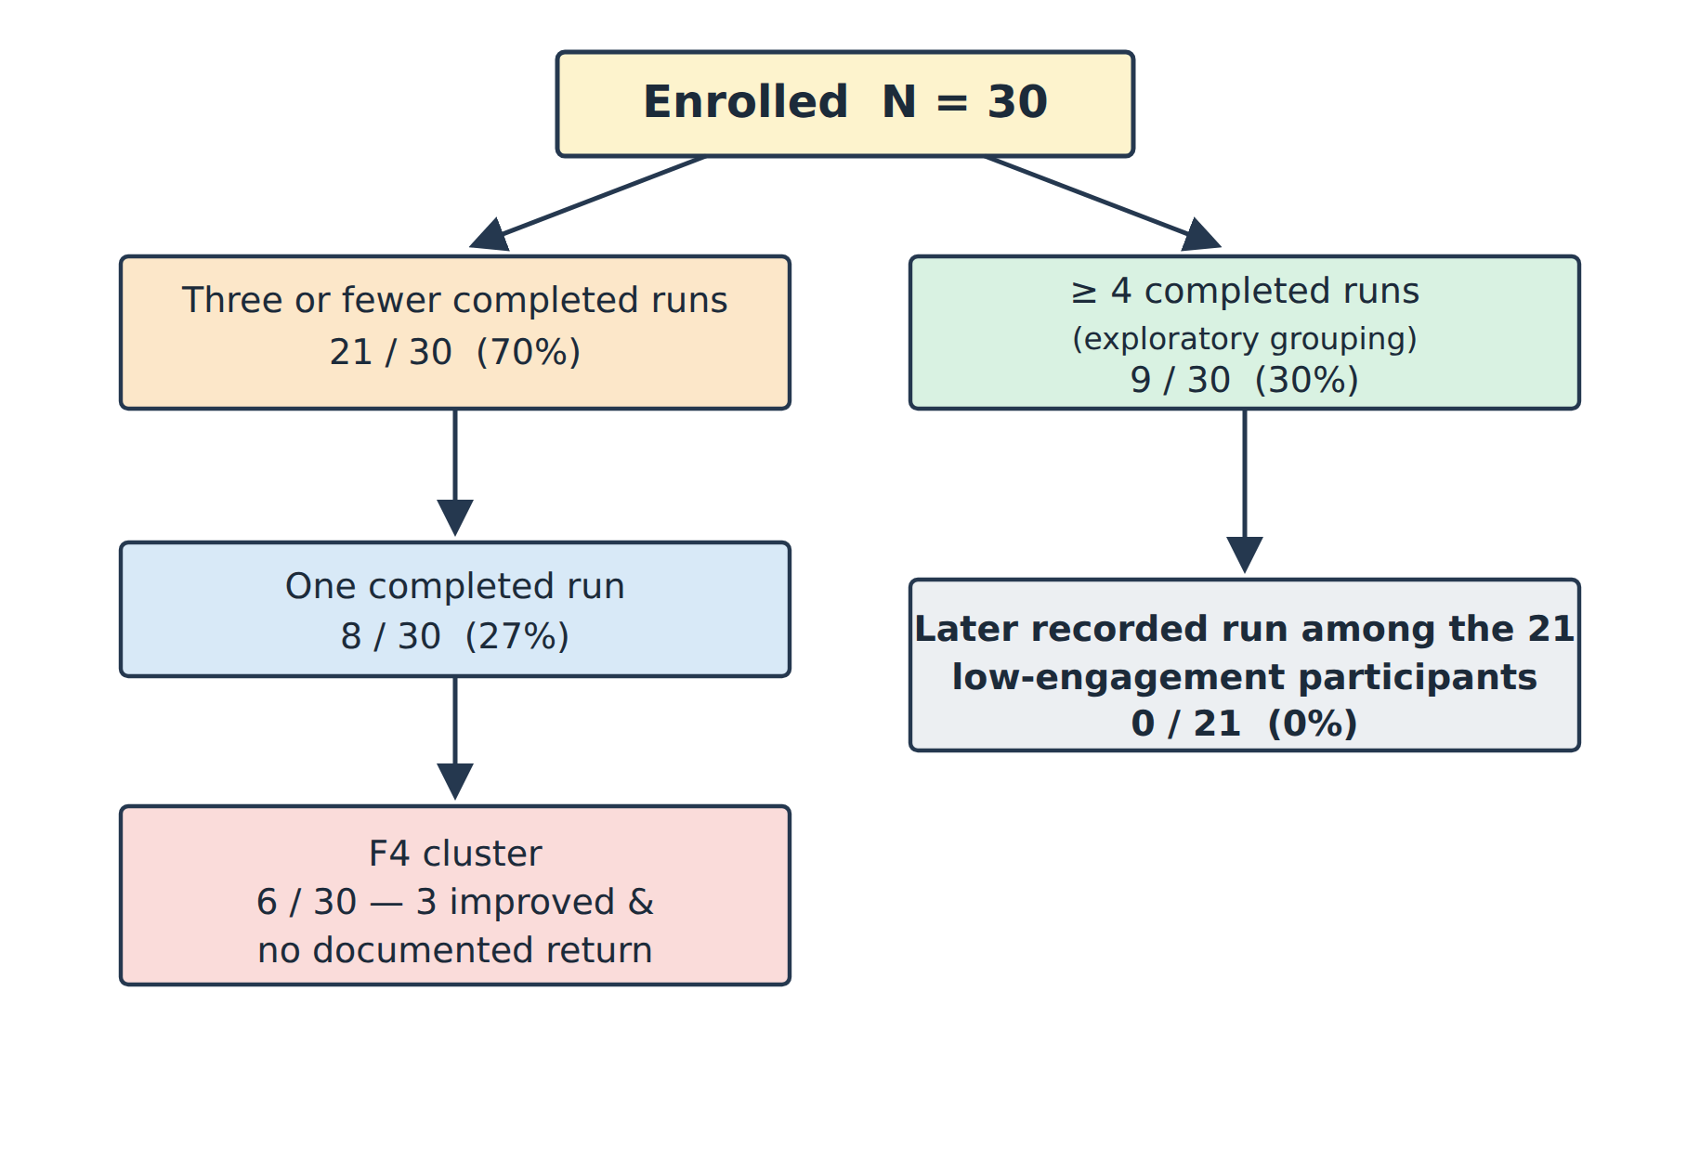
Evidence to date — Stages 2 and 3A
The completed-record results the later stages build on
Stage 2 — participant flow (thirty residents, eight weeks)
Stage 3A — initial dropout vs observed non-return by age band (120 adults)
 | Stage 2 — coupled (verdict visible) | Stage 3A — decoupled (no verdict)
Engagement | 70.0% ≤3 recorded runs; 26.7% single run; no documented return within window | End-of-window participation 93.3% (112/120); 15 of 23 initial dropouts returned
Outcome note | Recorded index change +4.03 (95% CI 0.47–7.60) coexisting with limited use | Initial dropout rose with age; observed non-return converged low in every band
Sidney K.T. Tam | EngD Final Review (Update 8, rev. F) | PolyU ISE | September 2026
4
Notes:
60 sec. The two completed evidence bases side by side: the coupled deployment where use collapsed despite recorded gains, and the decoupled deployment where participation held across bands. Same game family, opposite engagement outcomes - the contrast that motivates the framing account and Stage 3B. Keep the caveat ready: cohort, setting, delivery and modality all changed, so this is motivation, not causal proof.

Slide 5
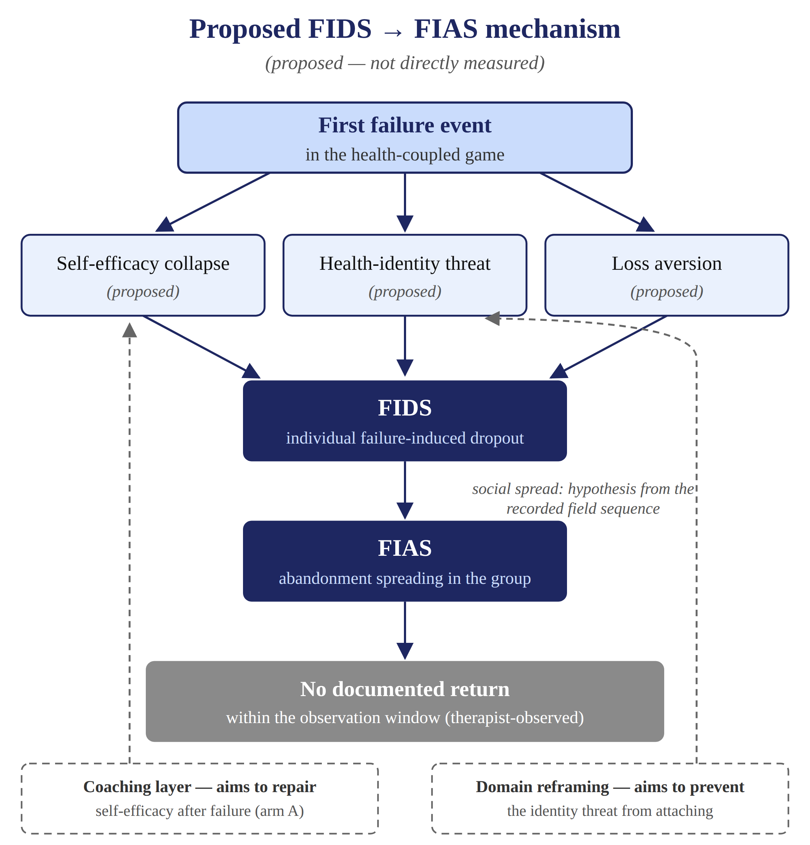
Proposed mechanism: FIDS → FIAS
Our proposed descriptive construct — mechanisms are hypotheses, not measured results
Field sequence (contemporaneous notes)
gains acknowledged → recurring failures → gave up despite gains
FIAS — proposed descriptive construct
an adverse verdict experience, followed by non-return in the group
Candidate boundary condition
engagement predictions may not transfer under clinical coupling
Design response (Chapter 7)
calibrated difficulty · trajectory display · coaching → Stage 3B
Simplified deck version — full model: Figure 7 of Paper 2.
Sidney K.T. Tam | EngD Final Review (Update 8, rev. F) | PolyU ISE | September 2026
5
Notes:
75 sec. The construct story: what the field notes record, what FIAS names as our proposed construct, and the two calibrated theoretical claims. The figure is deliberately simplified for projection; the paper carries the fuller theoretical anchors. Keep the register: proposed, candidate, hypothesis — and social spread is explicitly a hypothesis from the recorded sequence.
Full text moved from the slide (say, don't show):
Field sequence (contemporaneous notes)
Players acknowledged FRA benefits and recorded gains; recurring in-game failures across second and third runs; gave up despite gains; remaining players saw the group thin out and left too. The sequence is documented; interpersonal influence was not individually traced, so social spread stays a hypothesis.
FIAS — proposed descriptive construct
Names the pattern: an adverse verdict experience in a health-coupled game, followed by non-return. Emerged from Stage-2 fieldwork; held to Chapter 4 onward by the writing-logic standard.
Candidate boundary condition
The decoupling comparison suggests gamification theory's engagement predictions may not transfer when play is coupled to a clinical verdict — a candidate boundary condition, not a law.
Design response (Chapter 7)
Three design principles, each tracing a documented field problem to a design decision: calibrated difficulty, trajectory display, coaching. Stage 3B evaluates their combined effect.

Slide 6
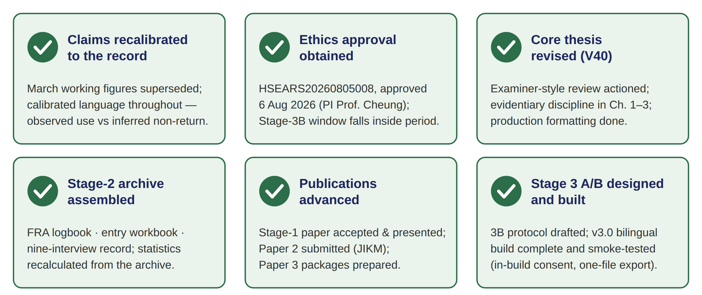
Progress since the last review (March 2026)
Core thesis revised; remaining work detailed on slide 11
Sidney K.T. Tam | EngD Final Review (Update 8, rev. F) | PolyU ISE | September 2026
6
Notes:
60 sec. Frame as movement since March. Lead with recalibration — own it as a strengthening. On ethics, give the chronology unprompted: the approval was issued August 2026, after the Stage-2 fieldwork, on an application that disclosed the procedures as conducted; the approval period covers Stage 3B prospectively. That is the honest statement — do not claim the period alone proves prior coverage.
Full card text moved from the slide (details for Q&A):
Claims recalibrated to the record
The March working figures (“82% never returned”, 18.4-hour median, “pattern confirmed”) are superseded: claims now rest on the archived record, in calibrated language — observed use distinguished from inferred non-return.
Ethics approval obtained
HSEARS20260805008 approved 6 Aug 2026 (PI Prof. Cheung); stated approval period 16 Jun 2024 – 30 Oct 2026. Approval post-dates the Stage-1/2 fieldwork and was obtained with the conducted procedures disclosed; the Stage-3B window falls inside the period. Memo archived; available for panel inspection.
Core thesis revised (V40)
Examiner-style review actioned; forward-results discipline applied to Ch1–3; evidentiary appendices built; production formatting done. Remaining evidence work — slide 8.
Stage-2 archive assembled
FRA logbook with stable player IDs; questionnaire entry workbook; nine-interview record (therapist-conducted, Aug–Sep 2025, self-selected acceptors — per the archived logbook and workbook; paper forms being collected); sensitivity analysis recalculated from the archive (arithmetic verification, n=30 vs n=29).
Publications advanced
Stage-1 paper accepted and presented (ICMSS 2026); Paper 2 submitted to JIKM after a systematic ten-point revision; Paper 3 packages prepared for two candidate venues.
Stage 3 A/B designed and built
New since March 2026: protocol drafted, v3.0 bilingual build complete and smoke-tested (in-build consent, silent A/B arms, one-file export, no external calls).
Sidney K.T. Tam | EngD Final Review (Update 8, rev. B) | PolyU ISE | September 2026

Slide 7
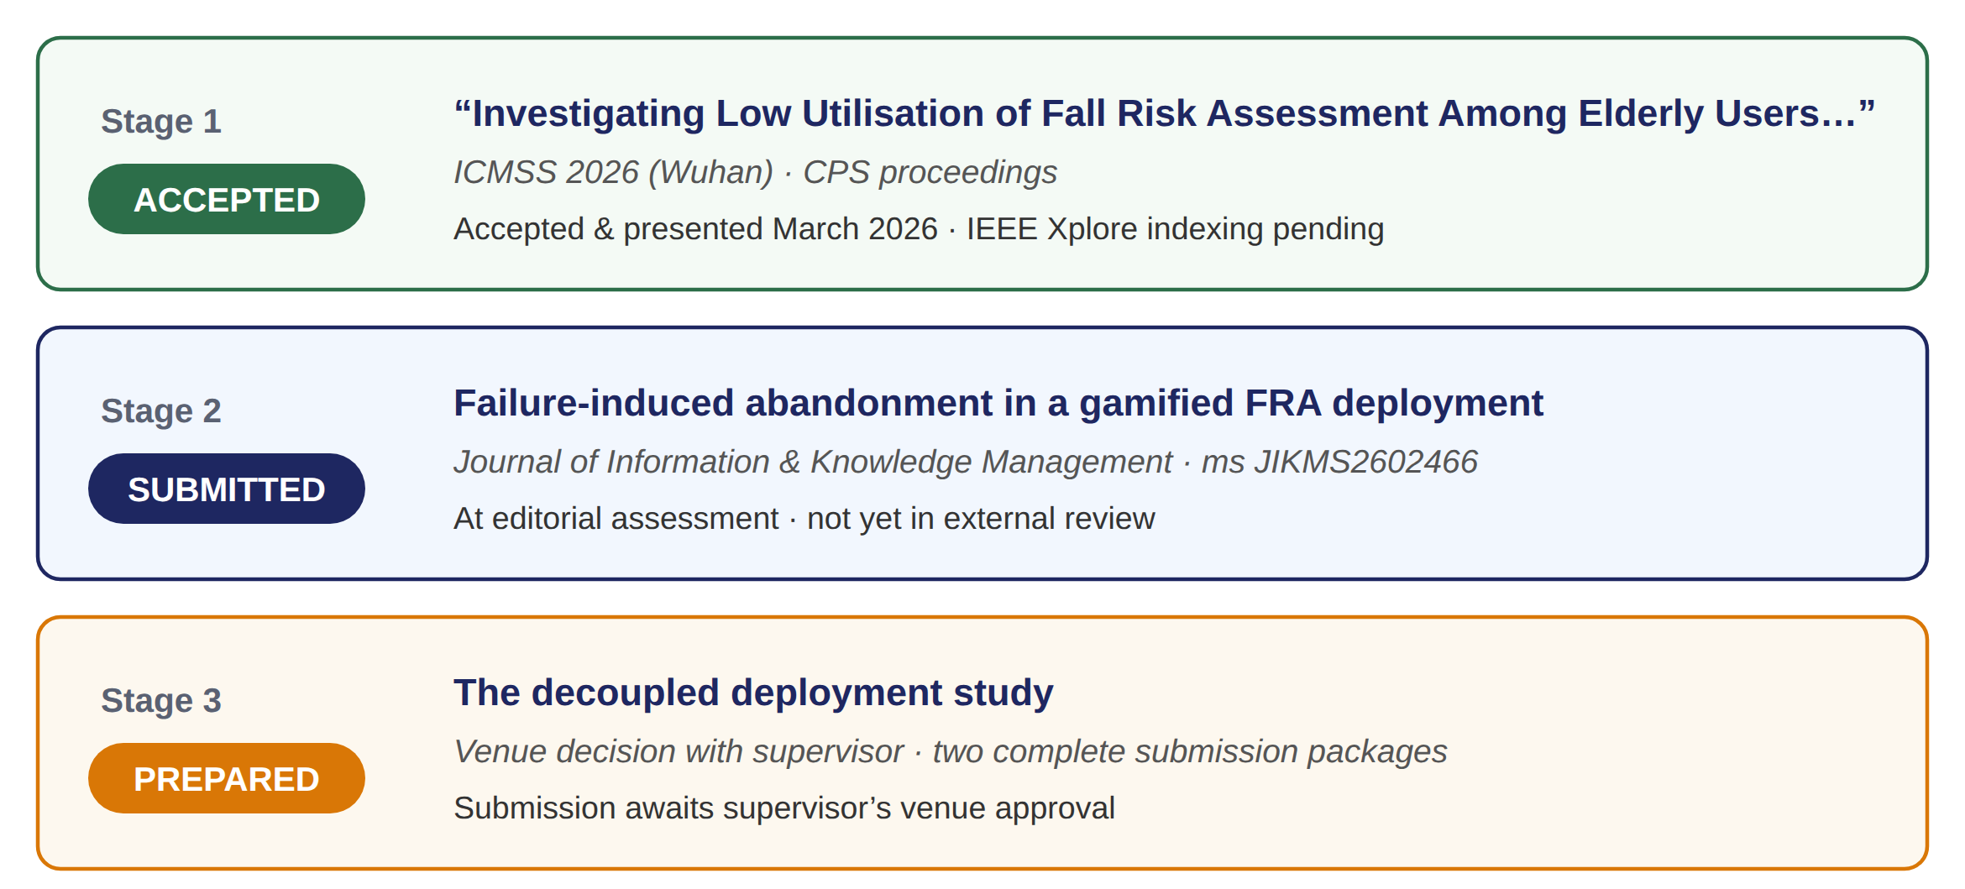
Publications
One paper per stage, one venue per paper — status per the dated record
Sidney K.T. Tam | EngD Final Review (Update 8, rev. F) | PolyU ISE | September 2026
7
Notes:
50 sec. Statuses match the dated records: acceptance letter for Stage 1 (indexing pending); Paper 2 submitted 9 September, still at editorial assessment; Paper 3 fully prepared for two venues with the choice resting with my supervisor. Mention the prepared methods correction for Paper 2's first revision — it shows the record-reconciliation process working.
Full row text moved from the slide (details for Q&A):
“Investigating Low Utilisation of Fall Risk Assessment Among Elderly Users…”
ICMSS 2026 (Wuhan) · CPS proceedings
Tam & Cheung. Accepted and presented March 2026; IEEE Xplore indexing pending. Camera-ready consent-statement check open.
Failure-induced abandonment in a gamified FRA deployment
Journal of Information & Knowledge Management (JIKM)
Editorial Manager JIKMS2602466; at editorial assessment, not yet in external review. A minor methods-description correction (interview provenance) is prepared for the first revision.
The decoupled deployment study
Venue decision with supervisor
Two complete submission packages (JMIR Serious Games; IEEE Access alternative). Submission awaits the supervisor's venue approval; co-author ORCID needed for the forms.
Companion relationships are declared in each cover letter; the thesis remains the sole complete record.

Slide 8
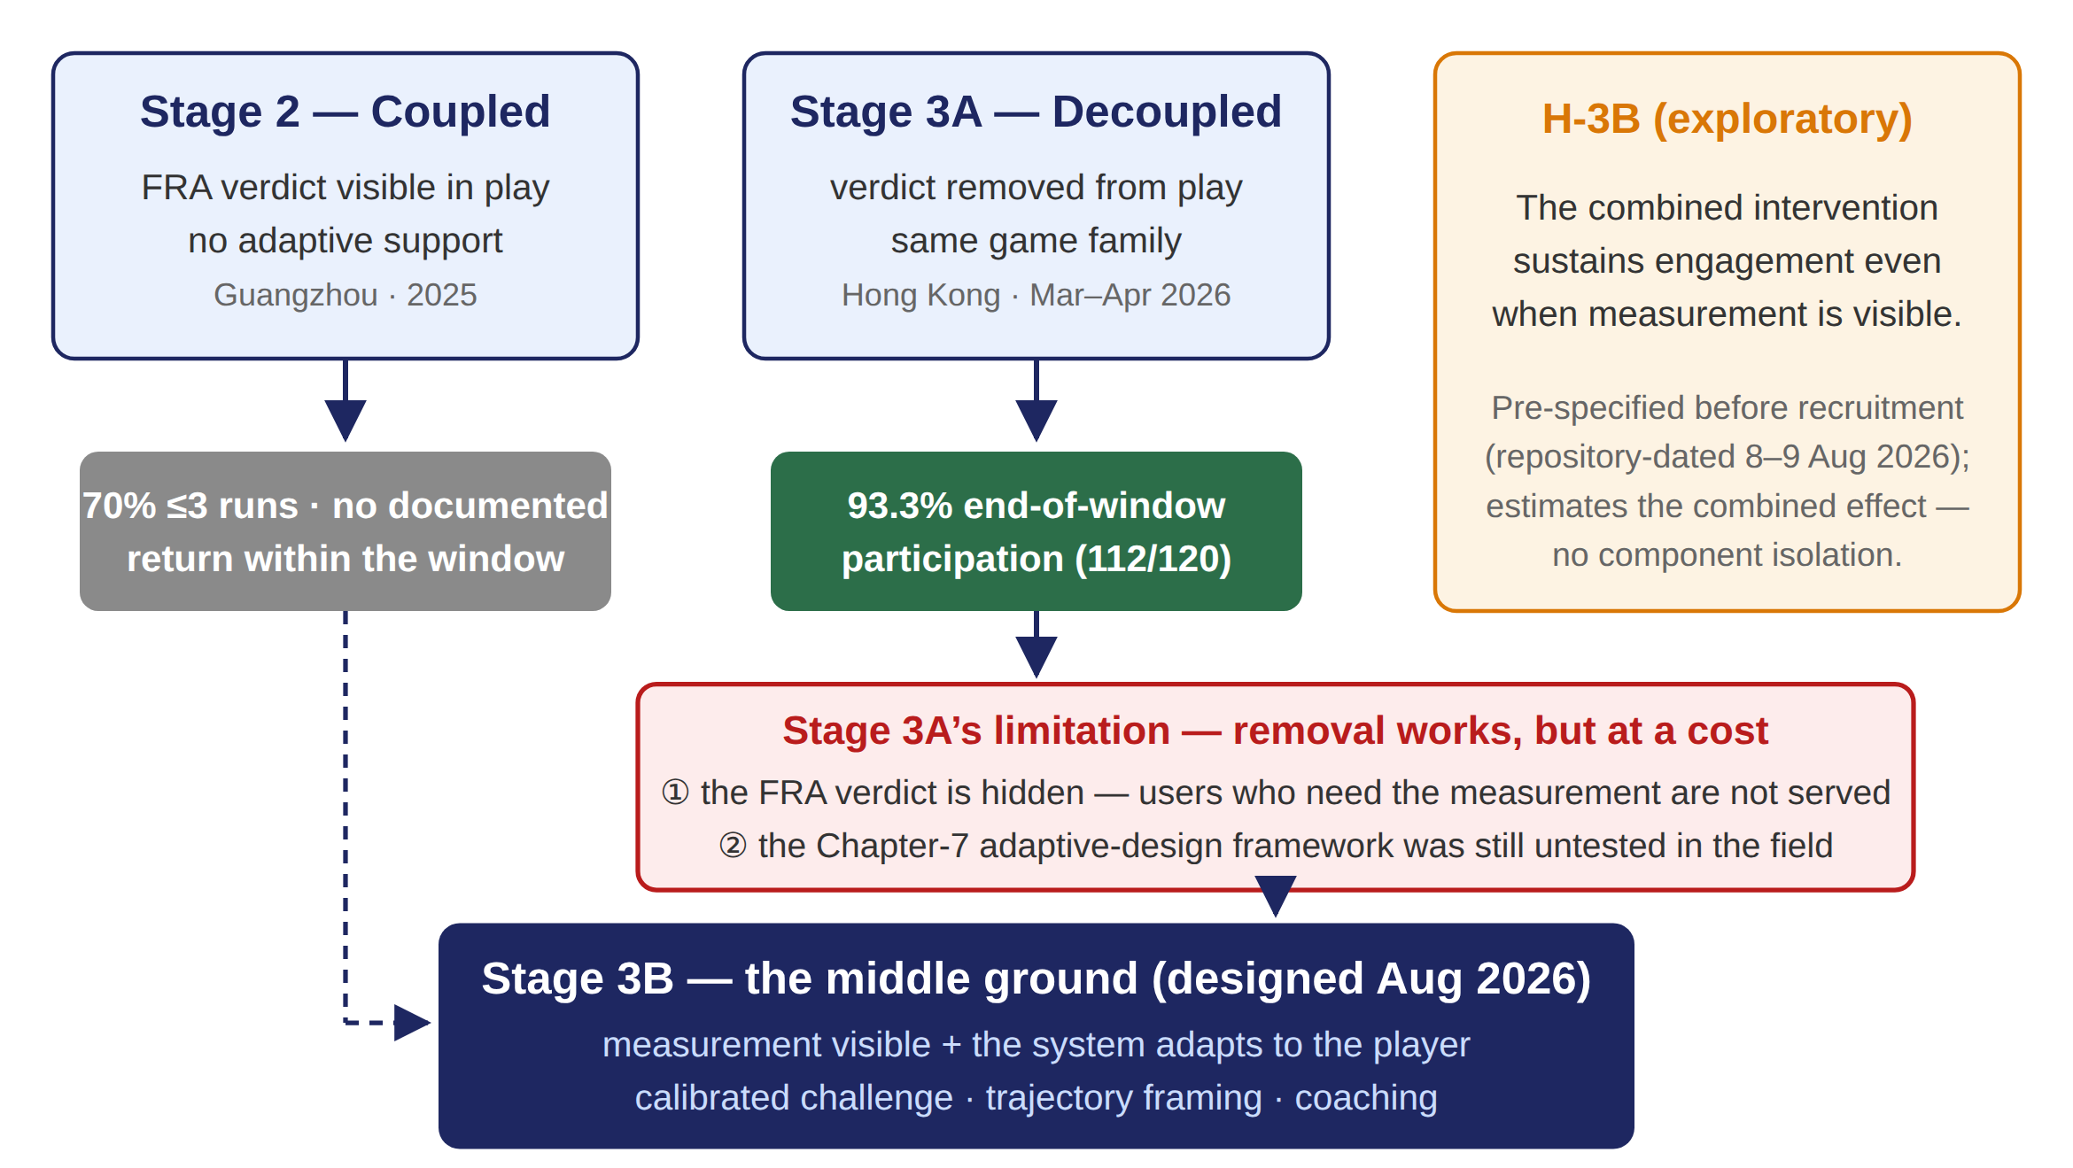
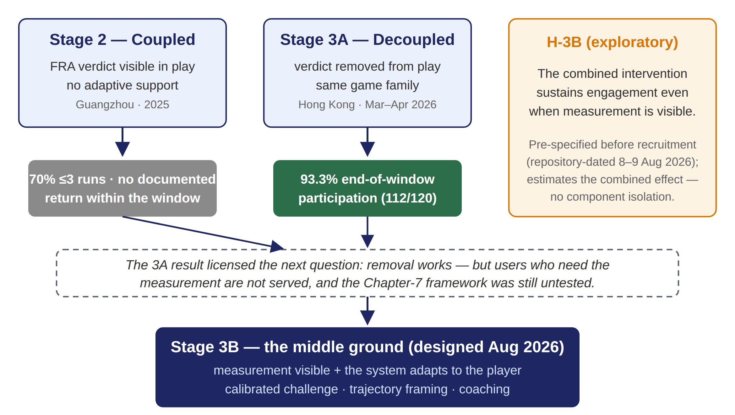
Stage 3A’s limitation — why Stage 3B
Removal worked — but at a cost; Stage 3B is designed as the middle ground
Sidney K.T. Tam | EngD Final Review (Update 8, rev. F) | PolyU ISE | September 2026
Notes:
60 sec. Walk the diagram left to right: coupled deployment - use collapsed; decoupled deployment - participation held; the 3A result licensed the question 3B answers - can measurement stay visible if the system adapts to the player? Designed August 2026, after the 3A results; pre-specified before its own recruitment (repository-dated 8-9 Aug). H-3B is exploratory: combined effect only, no component isolation. Per-protocol participant experience if asked: bilingual v3.0 game, in-build consent, silent random assignment (adaptive calibration + trajectory + coaching vs static), end-screen questionnaire, one-file export, target N >= 40. If challenged on sequence: retrospectively motivated, prospectively specified - the intended logic of a staged programme.
The red box is the answer to ‘what is 3A’s limitation’: ① the decoupled game no longer delivers the FRA measurement users need; ② the Chapter-7 adaptive framework was still untested. Stage 3B restores visible measurement and adds the adaptive supports — designed after the 3A result, pre-specified before recruitment.

Slide 9
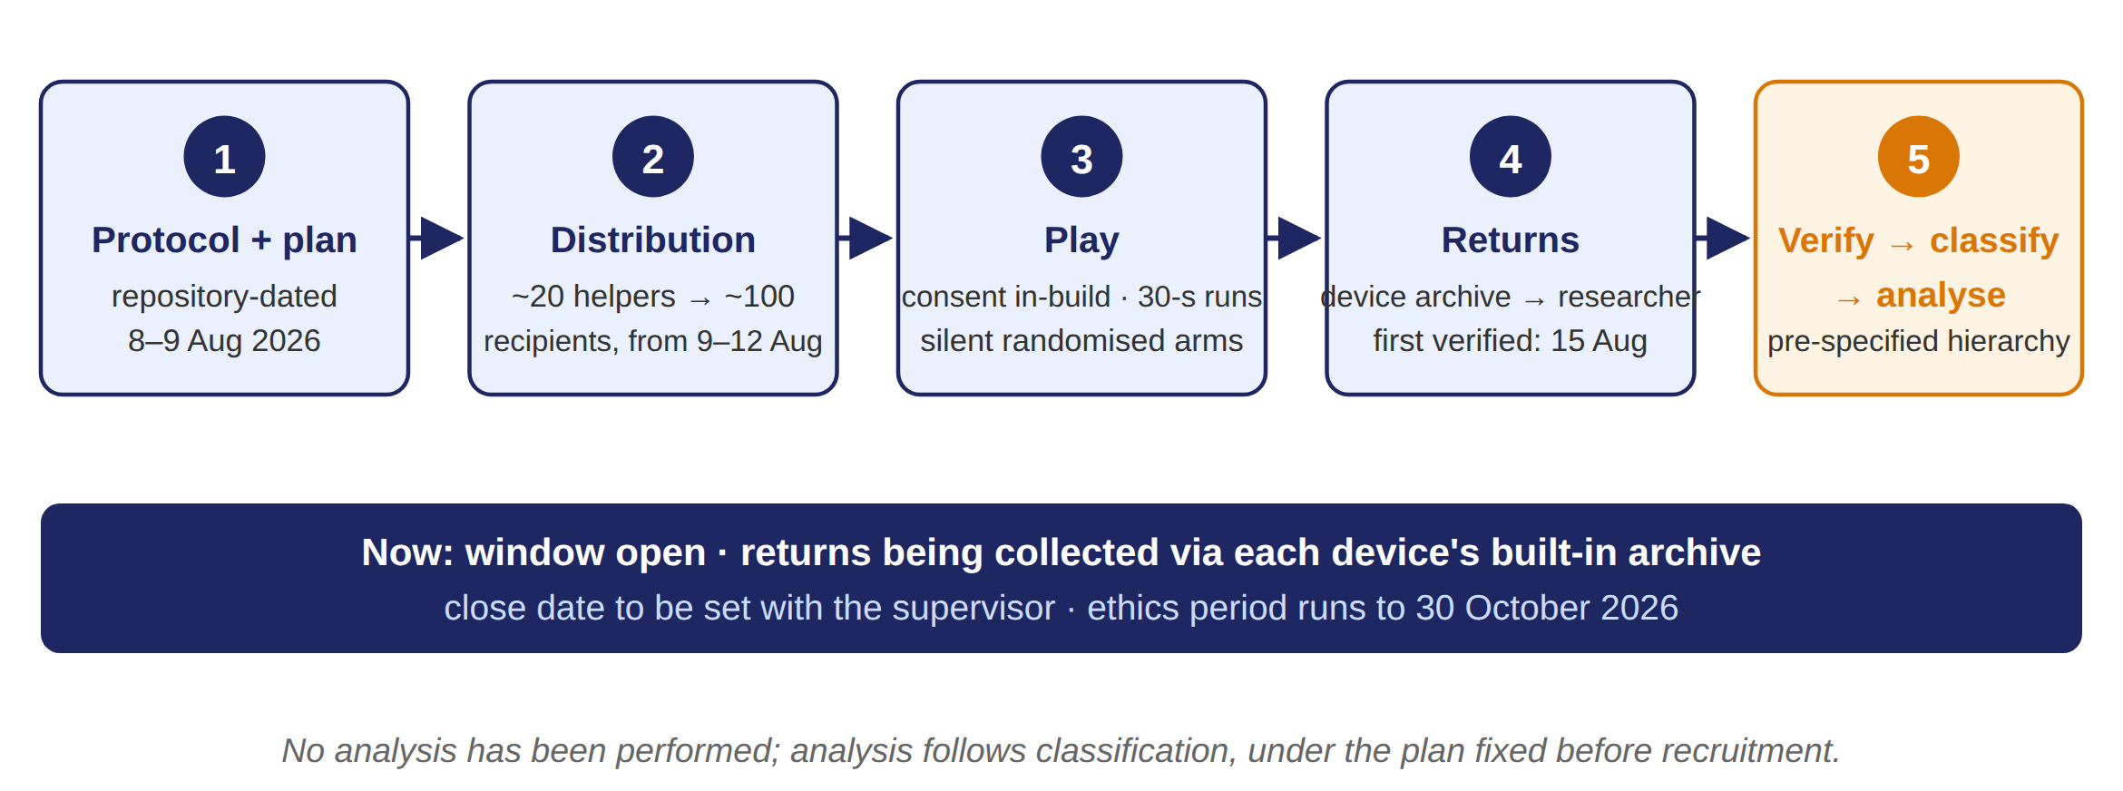
Stage 3B — how it runs and where it stands
Deployment pipeline; analysis gated behind verification and the pre-specified plan
Sidney K.T. Tam | EngD Final Review (Update 8, rev. F) | PolyU ISE | September 2026
Notes:
45 sec. Five steps, one gate: the plan was fixed before distribution; play is consented in-build and silently randomised; returns come back through each device's archive; verification and classification come before any analysis. Status: window open, close date to be set with my supervisor, everything inside the ethics period to 30 October. Deployment records are archived: distribution messages, the deployed device files, and the first verified return with a complete dated chain.

Slide 10
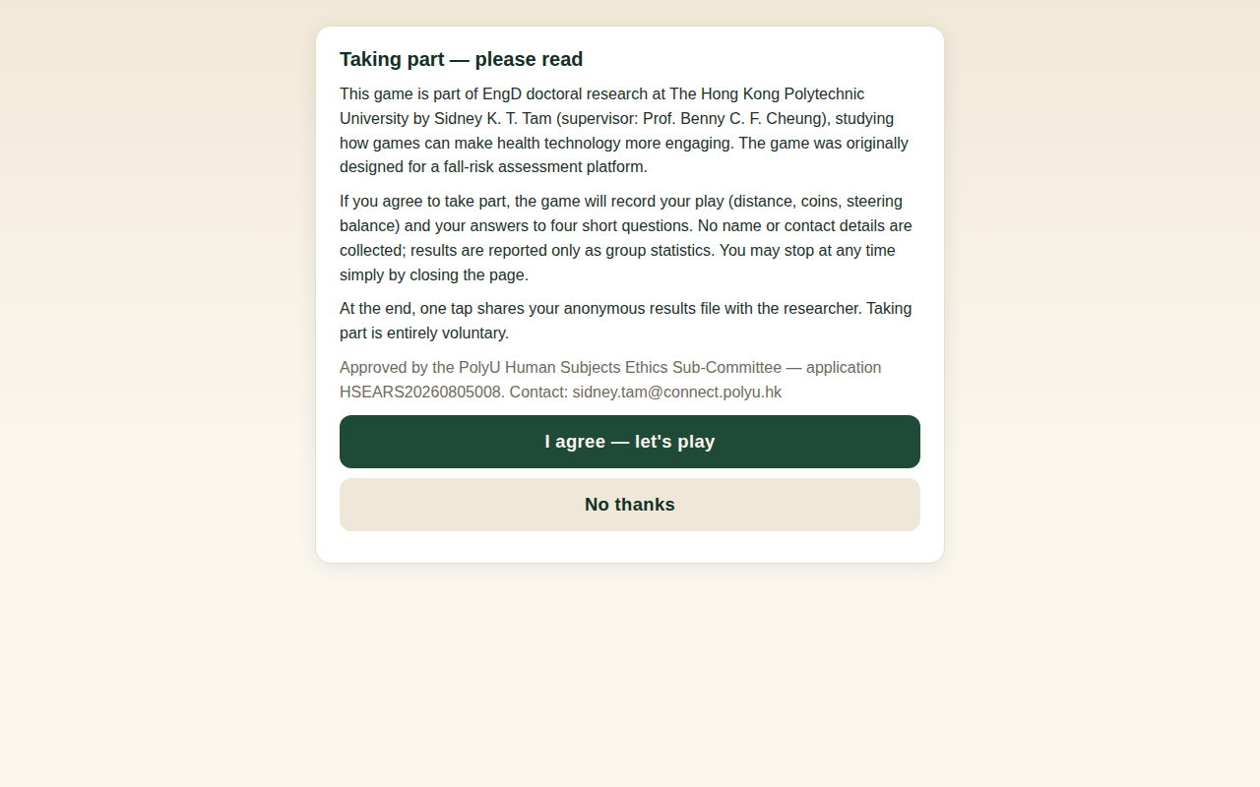
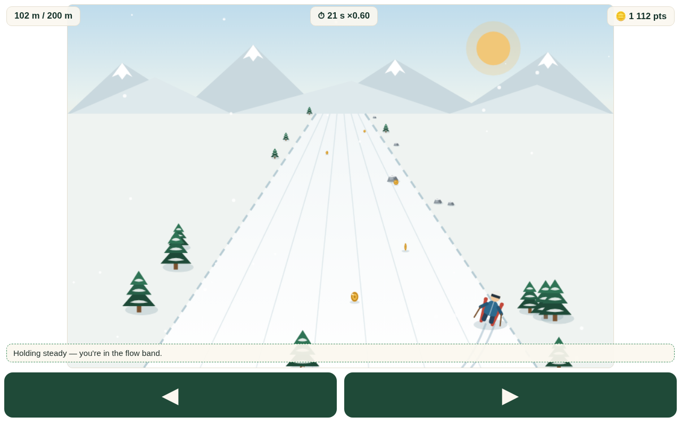
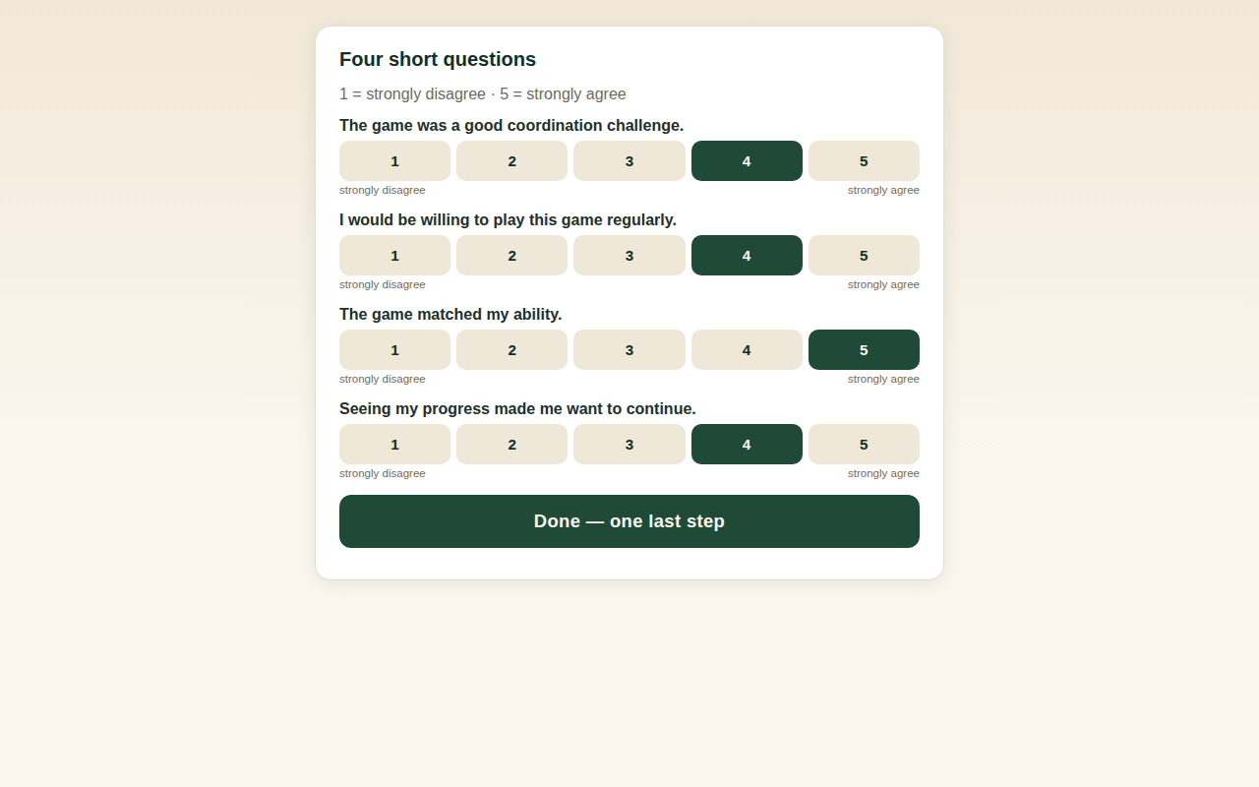
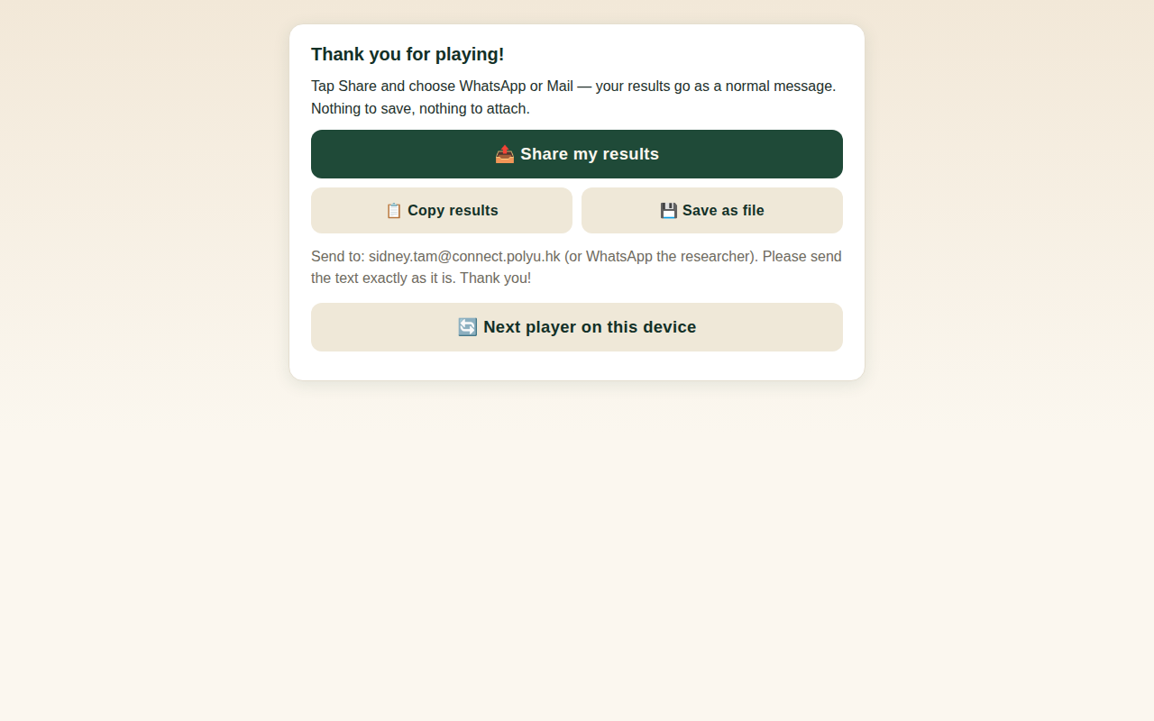
Stage 3B — first evidence from the field
Real artifacts only; analysis awaits window close and classification
In-build consent
30-second run
End-screen questionnaire
Results return
First verified return — complete chain of custody
Game file (device copy DEV2) sent to a distributor by WeChat 10 Aug → participant consented and played 15 Aug (in-build timestamp) → return e-mailed to the researcher the same day → archived as received. Return fields match the deployed build generation exactly (arm, failure-mode, scoring). Enrolment 45–64/F; one session; questionnaire complete.
Deployment status (author records): ~20 distributors reached ~100 recipients; distribution from 9–12 Aug onward, after the analysis plan was fixed in the repository (9 Aug). Returns are being collected via each device's built-in archive; the count will be reported at window close.
Sidney K.T. Tam | EngD Final Review (Update 8, rev. F) | PolyU ISE | September 2026
10
Notes:
60 sec. Everything on this slide is a real artifact: build frames from the deployed game family, and the first verified return with every link dated. Say plainly: no analysis numbers yet - the window is open and analysis follows the pre-specified hierarchy after classification. If the pipeline demonstration is shown, it is the separate SYNTHETIC-labelled pack and must be introduced as synthetic demonstration data, never as results.

Slide 11
Still to complete
Outstanding work and dependencies
Stage 3B (verify, then analyse)
Documentary records
Verify deployed procedures and returns against the protocol → classify
Default: complete and analyse the August deployment as Stage 3B under the pre-specified hierarchy
Contingencies only if verification does not support that classification (supervisor)
Therapist-completed interview forms + details report (requested); after-game questionnaire sheets
Appendix D instrument wording and scale confirmation
Telemetry-retention statement; Appendix G source-to-result manifest and build-lineage rows
Consents & sign-offs
Final production
Two member-check signatures releasing the last consent-gated panel content
Title decision with the supervisor; supervisor's review report
Paper-3 venue decision (supervisor)
Abstract strength-matching rewrite once records land
Forward-results sweep of Ch1–3; single-answer RQ consolidation; non-return evidential-basis sweep
Word-generated ToC/LoF/LoT fields; evidence cut-off declaration
Sidney K.T. Tam | EngD Final Review (Update 8, rev. F) | PolyU ISE | September 2026
11
Notes:
80 sec. The honest gap slide. Say plainly which items are substantive rather than administrative: instrument confirmation can affect interpretation of the questionnaire data; Stage-3B recruitment and results are real dependencies; the non-return evidential-basis sweep aligns thesis and papers with what the archive supports. Invite the panel to add anything they consider missing. Contingency routes are not the plan of record — the August deployment is.

Slide 12
Path to submission
Dependencies and dates against two clocks
12
12
12
Now – late September
October, first half
Mid–late October
Verify the August deployment (deployed file, returns, start date) → classify
Supervisor items: Paper-3 venue; any contingency
Therapist records and instrument scans requested/filed
Stage-3B analysis under the pre-specified hierarchy → §8.8 + diary
Appendix G manifest and lineage rows completed
Member-check content released into §6.12 / Appendix H
Stage-3B write-up finalised to the verified classification
Abstract rewrite; final sweeps; ToC/LoF/LoT fields; Paper-3 submission
Thesis submission → oral examination
Two clocks: the ethics approval period ends 30 October 2026 and bounds any further fieldwork; the thesis submission target is November 2026.
Sidney K.T. Tam | EngD Final Review (Update 8, rev. F) | PolyU ISE | September 2026
12
Notes:
50 sec. Three beats against two clocks. The load-bearing step is verification of the August deployment, then analysis under the pre-specified hierarchy. Any contingency fieldwork is bounded by the ethics expiry and is a supervisor matter.

Slide 13
What the thesis contributes
A named phenomenon (proposed)
FIAS — our proposed descriptive construct for failure-induced non-return in health-coupled games, grounded in a prospectively observed cohort and a documented field sequence. Stands on completed evidence.
A boundary claim for theory (candidate)
Gamification's engagement predictions may not transfer when play is coupled to a clinical verdict — a candidate boundary condition, with the decoupling comparison as motivating evidence. Stands on completed evidence, causally unisolated.
An adaptive-learning response (evaluation in progress)
Three design principles — calibrated challenge, trajectory framing, coaching — embodied in the Chapter-7 adaptive-learning framework: the system adapts to the user, so the user is never presented as failing. Its combined-effect evaluation follows the verified classification of the August Stage-3B deployment.
A reproducible record (assembly continuing)
As-received archives, recalculated statistics (arithmetic verification), calibrated language — an evidential chain an examiner can walk end to end, with the remaining documentary items on slide 11 being filed.
Thank you — I welcome the panel's questions.
Sidney K. T. Tam · EngD candidate, ISE · Supervisor: Prof. C. F. Cheung
Notes:
40 sec. Each contribution card carries its evidential status in its own title: proposed, candidate, under evaluation, completed — the panel sees which conclusions stand on completed evidence and which are contingent on Stage 3B. Close and invite questions. If the panel opens an AI discussion: the rule-agent is a deliberately minimal, fully-logged adaptive-learning loop (sense performance, calibrate challenge, coach), chosen over black-box models for auditability with older users; the candidate's broader view linking adaptive-learning philosophy to the evolution of increasingly general AI systems is offered as discussion, not as a thesis claim - the thesis does not develop or operationalise it.

