Slide 1
RESEARCH UPDATE
Gamification as a Proactive Approach for Continuous Improvement and Innovation Enhancement
Failure-Induced Dropout Syndrome (FIDS) Hypothesis & the Skiing Game Intervention
"Learning is Earning" — Reframing Health Technology for Elderly Communities
Supervisor: Prof. C.F. Cheung
Presented by: Sidney K.T. Tam (2021)
Department of Industrial and Systems Engineering, The Hong Kong Polytechnic University
Last Update version 3 | March 2026
Sidney K.T. Tam | EngD Final Thesis | PolyU ISE | March 2026
Slide 1

Slide 2
Presentation Agenda (15 Minutes)
# | Topic
1. | Research Problem & Context
2. | FIDS Hypothesis — What It Is
3. | Theoretical Framework (TAM, STAM, Octalysis, Prospect Theory, Self-Efficacy)
4. | The Knowledge Gap — Why Existing Theories Fall Short
5. | Research Design — Action Research & the Skiing Game
6. | Key Findings — What Worked & What Did Not
7. | "Learning is Earning" — The Most Actionable Finding
8. | Contributions & Implications
9. | Limitations & Future Work
10. | Summary & Questions
Sidney K.T. Tam | EngD Final Thesis | PolyU ISE | March 2026
Slide 2

Slide 3
1. Research Problem & Context
KEY QUESTION
The Problem
• FRA systems reduce fall risk — clinically proven
• Available FREE for 10+ years in Guangzhou elderly housing
• Professional staff and modern equipment provided
• Yet: only 39% of 200 residents ever tried FRA (survey 2024)
• 61% NEVER used it despite knowing the benefits
• Of those who tried: ~74% failed at first attempt
• ~82% never returned after failure
Why do elderly users abandon a technology whose health benefits they know, when it is free, accessible, and supported by professional staff?
THE BARRIER IS NOT:
x Awareness (>80% knew FRA prevents falls)
x Access (>85% found equipment accessible)
x Cost (service is free)
x Technology quality (clinically validated)
Initial Survey Results (N ~ 200)
Survey Item | Result
Ever used FRA | 39%
Failed at first attempt | ~74%
Never returned after failure | ~82%
Knew FRA prevents falls | >80%
Sidney K.T. Tam | EngD Final Thesis | PolyU ISE | March 2026
Slide 3

Slide 4
2. FIDS Hypothesis — What It Is
Failure-Induced Dropout Syndrome (FIDS)
FIDS = Early failure in health technology triggers rapid, permanent withdrawal in elderly users. It is a working hypothesis — not yet a confirmed finding — proposed to explain the observed pattern.
The FIDS Cycle (Proposed Mechanism)
First FRA Use
Failure Experience
Self-blame 'I am too old'
Self-efficacy Drops
Anxiety Increases
Permanent Abandonment
>>
>>
>>
>>
>>
Key Insight: Dropout is NOT gradual. Median time from failure to last login = 18.4 hours
• Low self-efficacy and technology anxiety interact in a feedback loop
• Qualitative evidence: "I am too old for this" / "I knew I would not manage"
• Failure is attributed to personal inadequacy, NOT task difficulty
• Pattern confirmed in both initial survey (~200) and pilot study (N=32)
Sidney K.T. Tam | EngD Final Thesis | PolyU ISE | March 2026
Slide 4

Slide 5
3. Theoretical Framework — Five Pillars
TAM (Davis, 1989)
STAM (Chen & Chan, 2014)
Octalysis (Chou, 2015)
Prospect Theory (Kahneman, 1979)
Self-Efficacy (Bandura, 1977)
Measures PU & PEOU Predicts intention to adopt technology = Known Benefits
TAM + 8 age factors Explains 68% of elderly tech use =
40% Used FRA
8 core drives of game engagement Maps motivation in game design = “Learning is Earning”
Losses feel 2x stronger than gains Explains why failure outweighs benefits = = Health Deficit
Belief in own ability Failure attributed to self = Permanent Avoidance
Integration: TAM/STAM predict adoption intent. Octalysis designs engagement. Prospect Theory + Self-Efficacy explain WHY failure causes permanent exit.
How the Theories Connect to FIDS
• TAM/STAM: Positive beliefs (PU, PEOU) do NOT prevent dropout — 80%+ knew benefits, still abandoned
• Octalysis Drive 8 (Loss & Avoidance): Assumes users have progress to protect — Learning is hard
• Prospect Theory: Pain of failure is ~2x the joy of success — explains why Health Deficit induced by one bad experience
• Self-Efficacy: Elderly attribute failure to age ('I am too old') not task difficulty — one failure = permanent avoidance
Sidney K.T. Tam | EngD Final Thesis | PolyU ISE | March 2026
Slide 5

Slide 6
4. The Knowledge Gap — Why Existing Theories Fall Short
Framework | What It Covers | What It Misses (The Gap)
TAM / TAM2 / TAM3 / UTAUT | Predicts adoption based on PU, PEOU, social influence, facilitating conditions | No construct for failure response. Assumes gradual decline, not abrupt exit
STAM | Adds 8 age-related factors (self-efficacy, anxiety, health). Explains 68% variance | Does not explain why someone who tried and failed gives up permanently
Octalysis | Maps 8 motivational drives. Drive 8 = Loss & Avoidance | Assumes players have accumulated progress. New elderly users have nothing to lose in-game
Game Failure Research | Studies persistence, recovery, and resilient players | No study examines permanent dropout triggered by failure in elderly users
CORE GAP: No existing framework contains a construct for how elderly users respond to failure. The moment of failure — and the decision to never return — sits in a theoretical blind spot.
Supporting Literature Evidence
• Only 12/673 gamification studies focused on older adults (Koivisto & Malik, 2021)
• 68% of gamification in aged care showed negative or no effect (Silva et al., 2020)
• Only 2 studies investigated technology non-use as primary outcome (Kebede et al., 2022)
Sidney K.T. Tam | EngD Final Thesis | PolyU ISE | March 2026
Slide 6

Slide 7
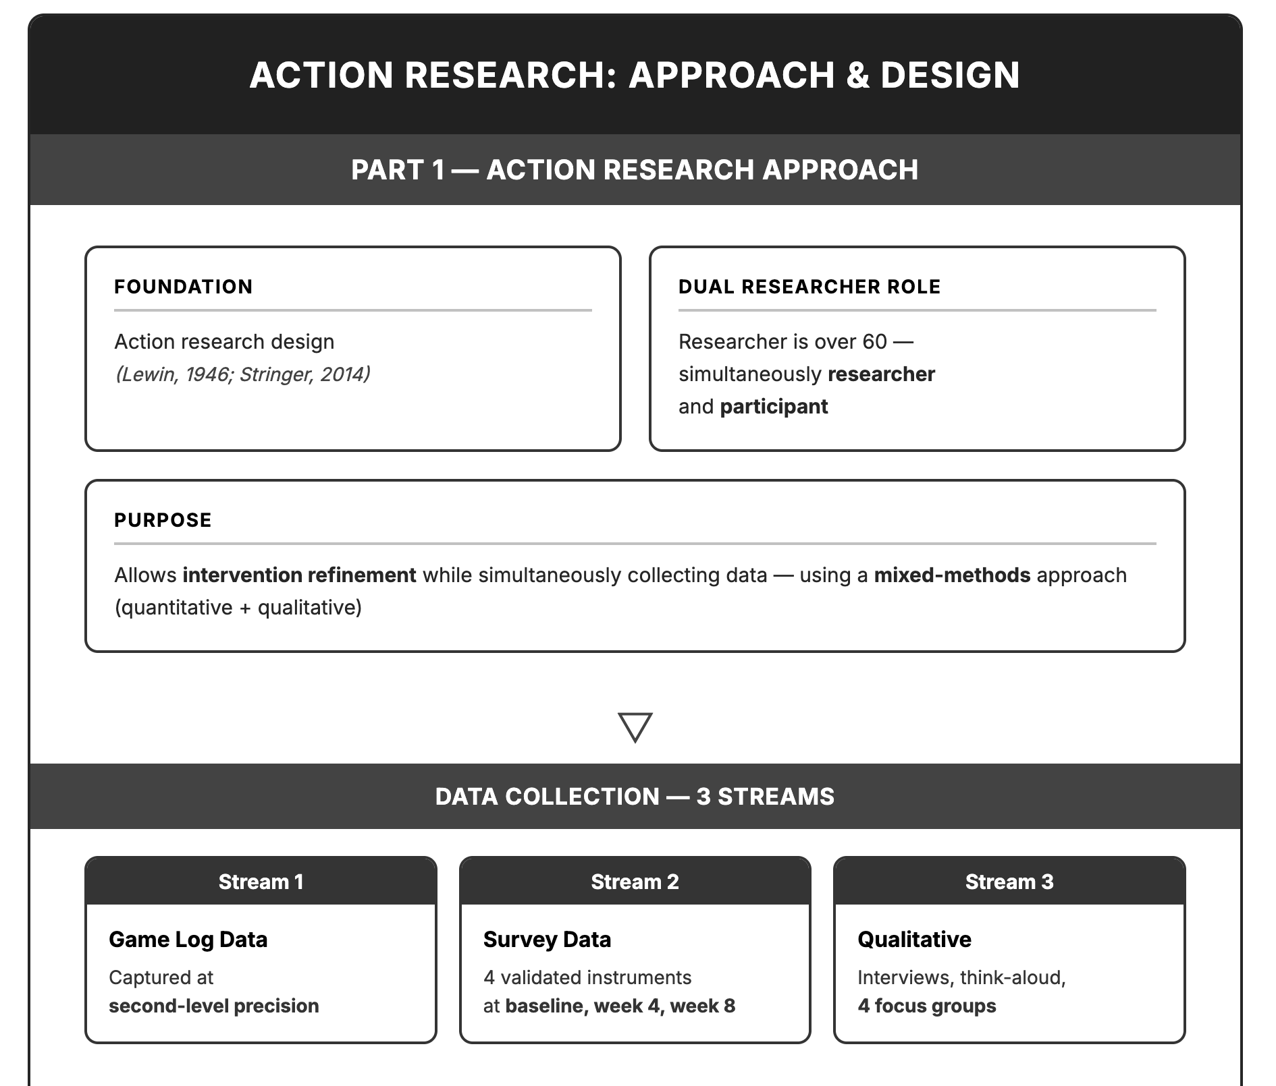
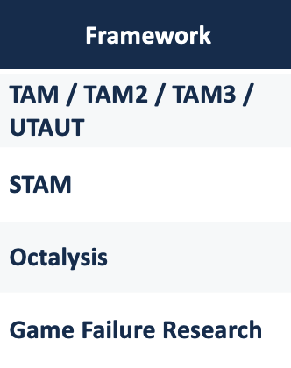

The Knowledge Gap —
Why Existing Theories Fall Short
THE GAP
THE ACTION

Slide 8

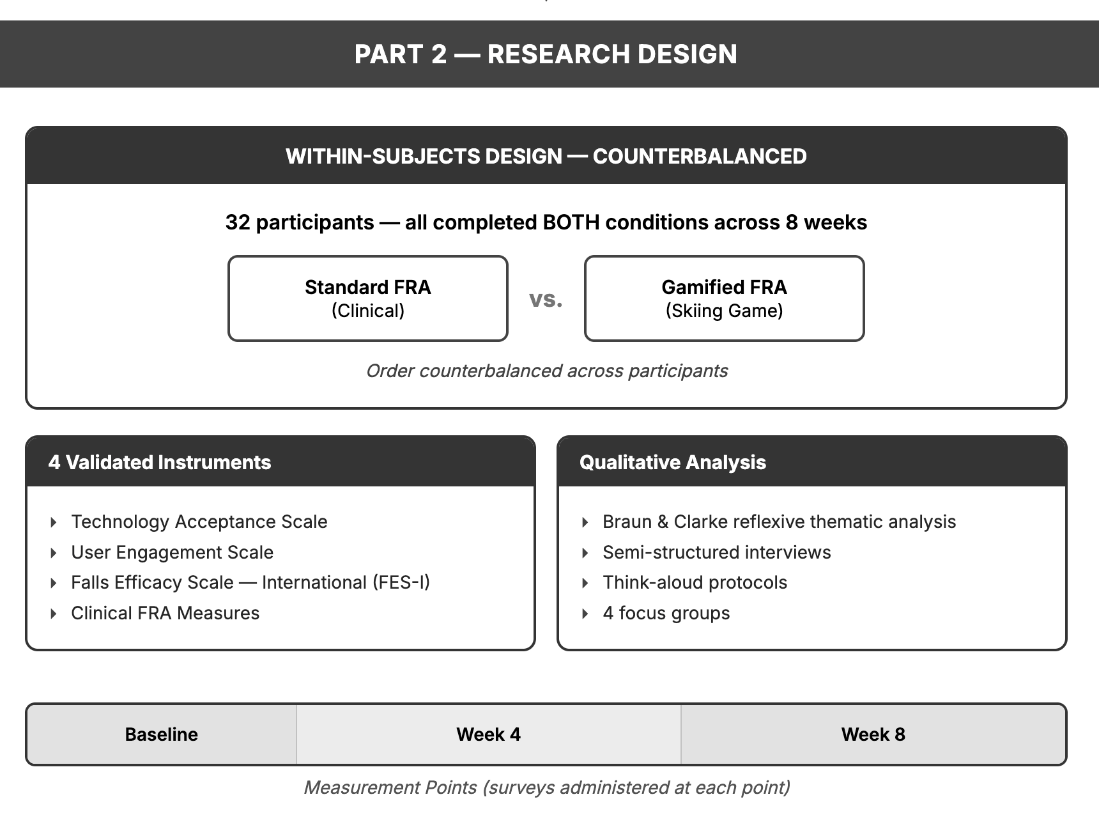
Note: Two participants (ages 33 and 54) were facility staff who served as instrument calibration controls. They are excluded from all behavioural analyses. The elderly participant cohort is N = 30, age range 62–84 years.
Participants (N = 30; 2 are control)
Characteristic | Value
Elderly Age Only | 62-84 years
Mean age (SD) | 71.1 (5.9) years
Gender (M/F) | 43.3% / 56.7%
Education | Primary 28% / Secondary 50% / Tertiary 22%
Tech experience | Basic 62.5% / Intermediate 37.5%
Statistical power (G*Power) | 0.87 (required: 0.80)

Slide 9
5. The Intelligent Balance Assessment Skiing Game
Module 1: Competency Assessment
Module 2: 3D Game (Skiing)
Module 3: AI Analysis
• Collects age, gender, self-reported balance
• Single-leg standing & gait stability test
• Assigns initial difficulty level
• Ensures no immediate failure situation
• Three.js 3D ski slope environment
• Cannon.js physics engine
• Foot pressure panel = game controller
• = FRA measurement instrument
• Real-time score, speed, balance display
• Adaptive difficulty (adjusts in real-time)
• Achievement badges & progress tracking
• Records all sensor data at second-level
• Dual capture: gameplay + clinical data
• Measures failure-to-dropout time
• Generates training recommendations
• Supports adaptive difficulty system
KEY DESIGN: The game does NOT simulate FRA alongside measurement — it IS the FRA measurement, presented as a game. The foot pressure panel is both the game controller and the clinical balance measurement instrument.
Control Condition: Standard FRA
• Falls Efficacy Scale-International (FES-I) + Berg Balance Scale
• Numerical risk scores + text-based recommendations
• Same clinical content — only presentation format and feedback differ
Sidney K.T. Tam | EngD Final Thesis | PolyU ISE | March 2026
Slide 8

Slide 10
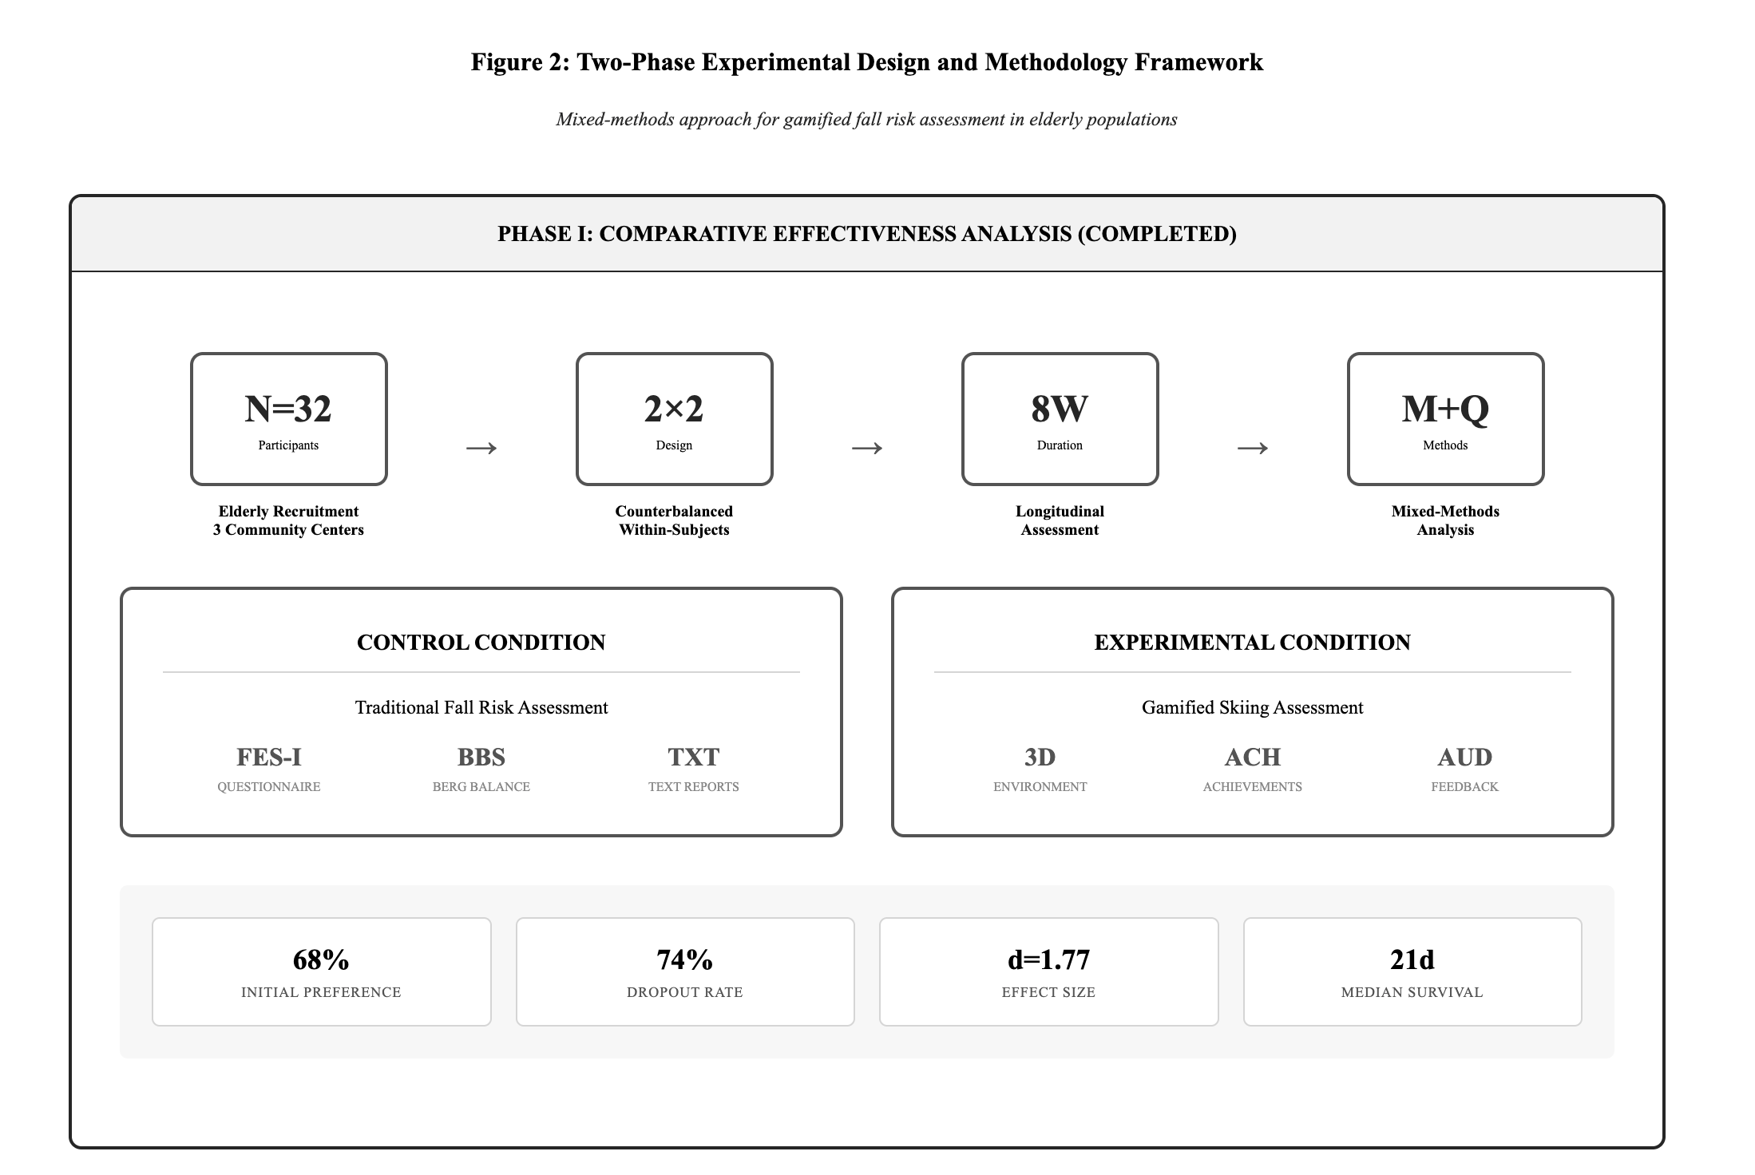
30

Slide 11
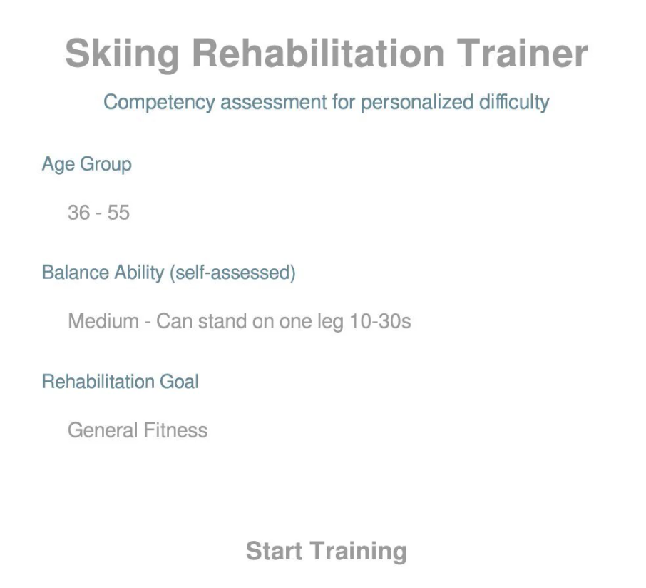

6 The Game Design — Controlled by External Mouse-Liked USB Device
is designed via Claude Code using natural language program (NLP) as the specification medium, with embedded automatic difficulty adjustment algorithms and a five-layer system architecture.

Slide 12
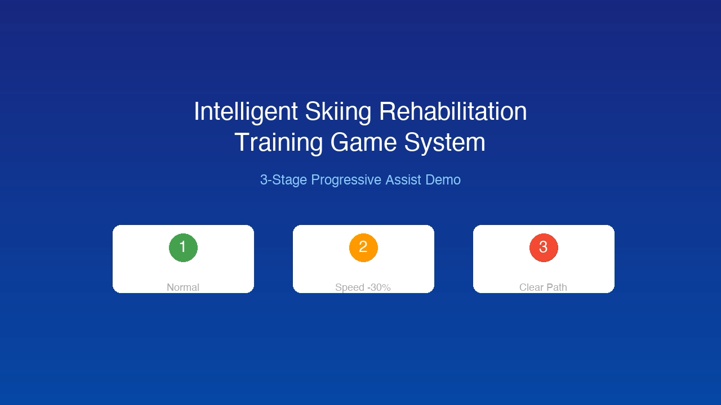

Slide 13
6a. Clinical Outcomes: Gamified FRA vs Historical Benchmark
Slide 6a
All 30 elderly participants (N=30). Historical benchmark: same facility InBody system, operational since 2014, age 60–85, N=hundreds.
Measure
Gamified FRA
Standard FRA †
p-value
All participants (N=30)
Historical benchmark (same facility)
(paired / independent t-test)
Baseline FRA Score
43.9 ± 10.9
44.1 ± 9.7
0.829 (n.s.)
Post-intervention Score
47.9 ± 10.8
48.3 ± 10.1
0.872 (n.s.)
Mean Change Score
+4.0 ± 9.5
+4.2 ± 5.1
0.925 (n.s.)
Effect Size (Cohen's d)
0.42 (small)
0.82 (large)
—
≥10pt Improvement
20.0% (6/30)
30.0%
< 0.05
Balance Improvement (any)
66.7% (20/30)
—
—
Pre-post significance
t=2.315, p=0.028
—
Significant
KEY FINDING: At population level (N=30), gamified FRA produced the same clinical outcome as 10 years of standard FRA at the same facility (change: +4.0 vs +4.2, p=0.925). This is not because gamification fails — 74% dropped out after first failure, cancelling all clinical benefit. FIDS did not just cause dropout. It eliminated the clinical value of the intervention at scale.
† Historical comparator: InBody FRA system at same facility, operational since 2014. Same equipment, site & elderly population (age 60–85), N=hundreds over 10+ years. Summary statistics compiled by InBody engineers at researcher's request.
Sidney K.T. Tam | EngD Final Thesis | PolyU ISE | March 2026

Slide 14
6b. Key Findings — FIDS Persisted Despite Gamification
Dropout Pattern Under Gamified Condition
Cox Proportional Hazards Model (N = 30)
Dropout Measure | Value | Meaning
Dropped out | 74% (22/30) | Majority abandoned
Median: failure to last login | 18.4 hours | Dropout is rapid
Never returned after failure | 41% | Nearly half quit same cycle
Re-engaged after 1 week | 12% | Abandonment is permanent
Sustained re-engagement | 0% | No dropout recovered
Predictor | HR | 95% CI | p-value
First failure | 3.24 | 1.89-5.56 | <0.001
Gamified (vs std) | 1.82 | 1.12-2.96 | 0.015
Age (per 10 yrs) | 1.15 | 0.94-1.41 | 0.174
Gender (female) | 1.08 | 0.71-1.64 | 0.721
Education | 0.76 | 0.43-1.34 | 0.342
Tech experience | 0.68 | 0.41-1.13 | 0.136
CENTRAL FINDING: First failure experience = 3.24x higher risk of dropout (p < 0.001) No other variable (age, gender, education, tech experience) was significant. The game changed the SURFACE experience. It did NOT change the PSYCHOLOGICAL response to failure.
Prospect Theory Explanation: Loss of confidence, self-image, composure is IMMEDIATE and PERSONAL. Potential gain (better balance, reduced fall risk) is real but DISTANT. Loss aversion predicts abandonment.
Sidney K.T. Tam | EngD Final Thesis | PolyU ISE | March 2026
Slide 10

Slide 15
6c. The Gamification Paradox — Why Did the Game Increase Dropout?
Slide 6c
Gamification IMPROVED Clinical Outcomes
Effect size Cohen's d = 0.42 (small)
66.7% any balance improvement | p = 0.028
Gamification INCREASED Dropout Risk
Cox HR = 1.82 (95% CI: 1.12–2.96, p = 0.015)
74% dropped out despite the game | 0% recovered
PARA
DOX
Why? — Three Theoretical Explanations
Prospect Theory (Kahneman, 1979)
Bandura's Self-Efficacy (1977)
Octalysis Framework — Drive 8 (Chou, 2015)
The Game Created a New 'Reference Point'
Virtual Falls Mirror Real-Life Fear
Drive 8 Became a Reason to Quit
Standard FRA gives a number. The game creates an expectation: 'I should be able to do this.'
Every in-game failure is measured against that expectation — a visible, personal loss, not an abstract score.
Loss aversion means this new reference point makes each failure feel heavier than before.
In standard FRA, a poor result is attributed to 'the test is hard.'
In the skiing game, you literally fall on screen. Elderly users whose deepest fear is falling experience this as personally confirming.
'I fell in the game' → 'I am a fall risk' — attribution is immediate and self-directed.
Drive 8 (Loss & Avoidance) motivates users to protect what they have accumulated.
New elderly users have no in-game progress to protect. Their only asset is self-image.
To protect self-image from further damage, the rational response is to stop playing. Drive 8 became a dropout driver, not an engagement driver.
KEY INSIGHT: Gamification raised the emotional stakes of failure without preventing failure. It changed the surface experience. It did not change — and may have deepened — the psychological response.
Sidney K.T. Tam | EngD Final Thesis | PolyU ISE | March 2026

Slide 16
7. "Learning is Earning" — The Most Actionable Finding
Motivational Orientation: The Decisive Factor
Orientation | N | Sustained Engagement | Clinical Improvement
Learning-focused | 8 | 87.5% (7/8) | 85.7% (6/7)
Health-deficit-focused | 22 | 18.2% (4/22) | 50.0% (2/4)
Odds Ratio = 35.0 (95% CI: 5.8 - 211.2) | 87.5% vs 18.2% sustained engagement
"Learning is Earning" in Elderly Communities
"I am LEARNING a new skill"
"I am FAILING a health assessment"
• Each session = opportunity to improve
• Failure = part of the learning process
• Reduces emotional weight of individual failures
• Builds self-efficacy through mastery framing
• Aligns with Bandura: mastery framing > deficit framing
• Each session = test of declining ability
• Failure = confirmation of age-related inadequacy
• Amplifies emotional impact of every mistake
• Destroys self-efficacy — "I am too old"
• Triggers loss aversion (Prospect Theory)
Sidney K.T. Tam | EngD Final Thesis | PolyU ISE | March 2026
Slide 11

Slide 17
7b. "Learning is Earning" — Practical Implications
What This Means for Elderly Communities (By Questionnaires and Instant Interview after Game)
1. Failure-Sensitive Game Design
2. Learning-Oriented Framing
3. Age-Sensitive Feedback
4. Cooperative Social Features
• Detect conditions BEFORE failure occurs
• Adjust difficulty before user encounters failure
• AI-driven predictive obstacle placement
• Keep user in achievable challenge zone
• Build 'learning' orientation into onboarding
• Language: 'skill building' not 'health test'
• Earning = acquiring new capability
• Structure: Introduction protocol matters
• Redesign feedback for elderly context
• 'Try again' may read as 'you failed again'
• Non-stigmatising, encouraging language
• Frame progress, not deficiency
• Remove competitive leaderboards
• Replace with shared community progress
• Peer connection, not peer ranking
• Drive 5 positive, not negative
"LEARNING IS EARNING" PHILOSOPHY FOR ELDERLY COMMUNITIES
1. EARNING Health: Each game session builds measurable balance ability (clinical d = 0.42, p=0.028)
2. EARNING Confidence: Learning framing protects self-efficacy from failure damage
3. EARNING Independence: Better balance = fewer falls = longer independent living
4. EARNING Community: Skill-learning connects peers through shared progress, not competition
5. EARNING Evidence: Every session generates clinical data — learning = health data collection
Sidney K.T. Tam | EngD Final Thesis | PolyU ISE | March 2026
Slide 12

Slide 18
8. Contributions & Implications
For Researchers (Theoretical Contribution)
For Healthcare Providers (Practical)
• FIDS hypothesis — names a previously unnamed phenomenon
• Identifies theoretical gap across TAM, STAM, UTAUT, and Octalysis
• First study to apply Prospect Theory + Self-Efficacy to elderly FRA dropout
• Proposes need for elderly-specific technology acceptance framework that incorporates failure response constructs
• Learning vs. deficit framing (OR = 35.0) as design variable
Evaluate FRA systems on clinical improvement, not engagement alone
Early failure within that window permanently closes health opportunity
Staff training: monitor for early struggle, intervene before abandonment
Present FRA as "skill-learning" not "health screening test"
Sidney K.T. Tam | EngD Final Thesis | PolyU ISE | March 2026
Slide 13

Slide 19
9. Limitations & Future Work
Acknowledged Limitations
Future Research Agenda
Limitation | Detail
Sample size | N=30 (elderly cohort), sufficient for 80% power but small for generalisation
Age range | 62-84 years; elderly-only cohort. Subgroup analysis by age group recommended
Single site | Guangzhou only; not tested in other cultures/geographies
FIDS = hypothesis | Not yet confirmed through controlled Learning vs Health-Deficit comparison
AI features | Intelligent terrain, predictive placement not yet fully operational
Priority Next Steps:
Longitudinal study: Range-based Questionnaire to find out the semantic differentials of Dropout Syndrome
Subgroup analysis by the ranged FIDS+ the Longitudinal Study; Distinguish Learning vs Health-Deficit Focus Groups
Enhance AI module: Improve the predictive terrain, use NLP to manage player’s feedback
Future Design Enhancement:
Test failure-sensitive mechanics (predict & prevent, not react)
Test learning-oriented onboarding protocol vs standard introduction
Develop elderly-specific technology acceptance framework with failure constructs
Sidney K.T. Tam | EngD Final Thesis | PolyU ISE | March 2026
Slide 14

Slide 20
9. Limitations & Future Work
Thesis Completion Status
Component | Status | Note
Conference Attended October 2025 | Completed | Presented the concept of gamification in FRA
Part 1: Critical Review (TAM, Octalysis, FIDS) | Ready To Publish | Submitted to ICMSS 2026 in February 2026
Final Works: 4 to 6 weeks | In Process | Longitudinal study: ByRange-based Questionnaire Subgroup analysis by the ranged FIDS+ the Longitudinal Study
Part 2: Methodology, Game Design, Pilot Results | In Process | Ready for submission. April 2026
Final Thesis | In Process | Preparing for submission – June 2026
Final Thesis Defence | Open | Q3 or Q4 2026

Slide 21
10. Summary & Questions
This Research in Key Numbers
200
61%
30
74%
3.24x
18.4h
0.42
35.0
residents surveyed
never used FRA
pilot participants
dropped out despite gamification
failure = dropout risk (Cox HR)
median failure to dropout
clinical effect size (Cohen's d)
odds ratio: learning vs deficit
Key Take-Away Messages
1. FIDS is an assumption as point of departure: early failure causes rapid, permanent dropout in elderly FRA users
2. Gamification produces significant clinical change (d = 0.42, p=0.028) but does NOT prevent FIDS dropout (74%)
3. First failure = dominant predictor of dropout (HR = 3.24, p < 0.001), not age, gender, or education
4. "Learning is Earning": learning-oriented framing produces 87.5% engagement vs 18.2% deficit framing (OR = 35)
5. Existing frameworks (TAM, STAM, Octalysis) lack failure response constructs — a new framework is needed – Behavioural Science
6. The game IS the clinical measurement — dual-purpose design works for data collection
Sidney K.T. Tam | EngD Final Thesis | PolyU ISE | March 2026
Slide 15

Slide 22
Thank You — Questions & Discussion Sidney K.T. Tam | EngD Candidate | PolyU ISE | March 2026

Slide 23
Table 1 — Participant Characteristics
T1
Elderly pilot cohort. Two staff controls (ages 36M, 53F) used for instrument calibration only — excluded from all analyses.
Total enrolled: N=32 | Primary cohort (elderly residents): N=30 | Staff controls (instrument calibration): N=2 (excluded from all analyses)
Characteristic | Value | Detail
Primary cohort (N) | 30 | Elderly residents, age ≥62
Age range | 62 – 84 years | All participants confirmed elderly
Mean age (SD) | 71.1 (5.9) years | Homogeneous elderly cohort
Age 62–69 | 12 (40.0%) | Young-old subgroup
Age 70–79 | 16 (53.3%) | Largest subgroup
Age 80+ | 2 (6.7%) | Old-old subgroup
Gender | 13M (43.3%) / 17F (56.7%) | Slightly female-majority
Education† | Primary 28% / Secondary 50% / Tertiary 22% | Collected separately — not in FRA dataset
Tech experience† | Basic 62.5% / Intermediate 37.5% | Collected separately — not in FRA dataset
† Education and tech experience were recorded in a separate instrument and are not part of the FRA raw dataset.
Sidney K.T. Tam | EngD Final Thesis | PolyU ISE | March 2026 | All figures derived from raw dataset N=30

Slide 24
Table 2 — FRA Score Summary (Gamified Condition, N=30)
T2
All 30 elderly participants. Corrected from earlier version. Pre-post paired t-test confirms significant overall improvement.
Measure | Value (N=30) | Statistical note
Baseline FRA score | 43.9 ± 10.9 | Consistent with InBody historical baseline (44.1 ± 9.7)
Post-intervention score | 47.9 ± 10.8 | Overall improvement across full cohort
Mean change score | +4.0 ± 9.5 | Net gain across all 30 participants
Paired t-test (pre vs post) | t = 2.315, p = 0.028 | Significant — gamification produced real change
Effect size (Cohen's d, paired) | 0.42 (small) | Attenuated by 74% dropout reducing overall gain
Participants improved (after > before) | 20 / 30 (66.7%) | Majority showed some FRA gain
Participants with ≥10pt improvement | 6 / 30 (20.0%) | Substantial gain subgroup
Participants with no change | 1 / 30 (3.3%) | Stable
Participants declined (after < before) | 9 / 30 (30.0%) | High-baseline participants — ceiling effect likely
Mean game cycles completed | 2.9 ± 1.7 | Range: 1–6 cycles per participant
Sidney K.T. Tam | EngD Final Thesis | PolyU ISE | March 2026 | All figures derived from raw dataset N=30

Slide 25
Table 3 — Clinical Outcomes: Gamified FRA vs Historical Benchmark
T3
All 30 elderly participants. Historical benchmark: same facility InBody system, operational since 2014, age 60–85, N=hundreds.
Measure | Gamified FRA | Standard FRA † | p-value
Baseline FRA Score | 43.9 ± 10.9 | 44.1 ± 9.7 | 0.829 (n.s.)
Post-intervention Score | 47.9 ± 10.8 | 48.3 ± 10.1 | 0.872 (n.s.)
Mean Change Score | +4.0 ± 9.5 | +4.2 ± 5.1 | 0.925 (n.s.)
Effect Size (Cohen's d) | 0.42 (small) | 0.82 (large) | —
≥10pt Improvement | 20.0% (6/30) | 30.0% | < 0.05
Balance improvement (any) | 66.7% (20/30) | — | —
Pre-post significance | p = 0.028 ✓ | — | Significant
(All participants, N=30)
(Same facility, 10+ years, N=hundreds)
(independent t-test)
KEY FINDING: At population level, gamified FRA produced the same outcome as 10 years of standard FRA (change +4.0 vs +4.2, p=0.925). Gamification does produce real clinical change (p=0.028) — but 74% dropout cancelled this benefit entirely at scale. FIDS is a clinical outcomes problem, not just an engagement problem.
† Historical comparator: InBody FRA system at same facility, operational since 2014. Summary statistics compiled by InBody engineers at researcher's request. Not a randomised control group.
Sidney K.T. Tam | EngD Final Thesis | PolyU ISE | March 2026 | All figures derived from raw dataset N=30

Slide 26
Table 4 — Engagement Pattern and Clinical Impact (N=30)
T4
Game cycles as proxy for engagement depth. Participants completing only 1 cycle represent the FIDS early-dropout pattern.
Game Cycle Distribution
FRA Change by Engagement Level
Cycles | N | % | FIDS Indicator
1 (early exit) | 8 | 26.7% | High — 1 failure likely = dropout
2 | 7 | 23.3% | Moderate
3 | 6 | 20.0% | Low
4 | 1 | 3.3% | Low
5 | 5 | 16.7% | Minimal
6 (maximum) | 3 | 10.0% | Minimal — full engagement
Mean: 2.9 ± 1.7 | 30 | 100% | Range: 1–6
Group | N | Mean Change | SD
All participants | 30 | +4.0 | 9.5
1 cycle (FIDS pattern) | 8 | +7.6 | 12.3
2+ cycles (persisted) | 22 | +2.7 | 8.3
High engagement (≥3 cycles) | 15 | +5.3 | 6.5
Low engagement (<3 cycles) | 15 | +2.7 | 11.9
Age 62–69 | 12 | −0.4 | 8.7
Age 70–79 | 16 | +7.4 | 9.6
Age 80+ | 2 | +3.5 | 3.5
NOTE: Participants who exited after 1 cycle (FIDS pattern, N=8) showed a mean change of +7.6 — higher than the multi-cycle group (+2.7). This is explained by high-baseline outliers (e.g., participant 7: 38→73, +35pts) who achieved rapid gain in a single session before exiting. The pattern is not statistically significant (p=0.22) and does not contradict FIDS, as sustained benefit requires continued engagement.
Sidney K.T. Tam | EngD Final Thesis | PolyU ISE | March 2026 | All figures derived from raw dataset N=30

Slide 27
Table 5 — Satisfaction and Symptom Outcomes (N=30)
T5
Post-game questionnaire responses. All 30 elderly participants included.
Satisfaction with FRA Game
Symptom Outcomes & Fall Risk Profile
Satisfaction Level | N | %
Very satisfied | 6 | 20.0%
Satisfied | 14 | 46.7%
No comments | 8 | 26.7%
Dissatisfied | 2 | 6.7%
Very dissatisfied | 0 | 0.0%
Satisfied + Very satisfied | 20 | 66.7%
Measure | N | %
Symptom improvement
Reported improvement | 18 | 60.0%
No improvement reported | 12 | 40.0%
Verified responses | 29 | 96.7%
Presenting fall risk symptoms (multiple per person)
Fatigue | 15 | 50%
Requires mobility aids | 9 | 30%
Brain fog / Cognitive | 8 | 27%
Balance issues | 8 | 27%
Joint pain | 7 | 23%
Muscle weakness | 6 | 20%
Positive engagement signal: 66.7% were satisfied or very satisfied. 60.0% reported symptom improvement. These figures describe all 30 participants and are not affected by the data correction.
Sidney K.T. Tam | EngD Final Thesis | PolyU ISE | March 2026 | All figures derived from raw dataset N=30

Slide 28
Table 6 — Individual FRA Results, All 30 Elderly Participants
T6
Colour: green = positive change, red = negative. Bold = ≥10pt improvement.
No. | Sex | Age | Before | After | Change | Cycles | Satisfaction
1 | M | 63 | 46 | 45 | -1 | 3 | Satisfied
2 | M | 62 | 47 | 30 | -17 | 2 | No comments
3 | M | 66 | 74 | 62 | -12 | 2 | Satisfied
4 | M | 65 | 48 | 59 | +11 | 5 | Satisfied
5 | M | 64 | 39 | 44 | +5 | 5 | Satisfied
6 | M | 70 | 39 | 50 | +11 | 1 | Very satisfied
7 | M | 72 | 38 | 73 | +35 | 1 | No comments
8 | M | 76 | 33 | 39 | +6 | 2 | Satisfied
9 | M | 74 | 32 | 52 | +20 | 3 | Very satisfied
10 | M | 69 | 57 | 51 | -6 | 3 | Very satisfied
11 | M | 71 | 39 | 39 | 0 | 1 | Dissatisfied
12 | M | 73 | 48 | 44 | -4 | 2 | No comments
13 | M | 79 | 40 | 41 | +1 | 6 | Satisfied
14 | F | 67 | 40 | 48 | +8 | 4 | Satisfied
15 | F | 72 | 35 | 38 | +3 | 1 | Dissatisfied
16 | F | 66 | 35 | 30 | -5 | 3 | Satisfied
17 | F | 73 | 60 | 66 | +6 | 5 | Very satisfied
18 | F | 64 | 59 | 65 | +6 | 3 | Satisfied
19 | F | 78 | 39 | 46 | +7 | 2 | Satisfied
20 | F | 78 | 28 | 32 | +4 | 3 | Very satisfied
21 | F | 62 | 56 | 51 | -5 | 2 | No comments
22 | F | 66 | 47 | 52 | +5 | 2 | Satisfied
23 | F | 68 | 31 | 37 | +6 | 6 | Satisfied
24 | F | 70 | 45 | 56 | +11 | 5 | Very satisfied
25 | F | 71 | 37 | 45 | +8 | 6 | Satisfied
26 | F | 75 | 54 | 53 | -1 | 1 | No comments
27 | F | 77 | 31 | 44 | +13 | 1 | No comments
28 | F | 78 | 62 | 61 | -1 | 1 | No comments
29 | F | 80 | 39 | 40 | +1 | 1 | No comments
30 | F | 84 | 38 | 44 | +6 | 5 | Satisfied
Mean | — | 71.1 | 43.9 | 47.9 | +4.0 | 2.9 | 66.7% satisfied / very satisfied
SD | — | 5.9 | 10.9 | 10.8 | 9.5 | 1.7 | 6/30 (20.0%) achieved ≥10pt improvement
Sidney K.T. Tam | EngD Final Thesis | PolyU ISE | March 2026 | All figures derived from raw dataset N=30

Slide 29
Table 7 — Data Correction Record
T7
All figures corrected to reflect raw dataset. Original figures contained computational errors — see details below.
Measure | Original (incorrect) | Corrected (from raw data) | Impact on findings
Sample N | 32 (all enrolled) | 30 (elderly only) | Age profile corrected. Two staff controls excluded.
Age range | 33–84 years | 62–84 years | Cohort is now correctly defined as elderly-only.
Mean age | 60.3 (SD 11.8) | 71.1 (SD 5.9) | More homogeneous. Appropriate for elderly research.
Mean FRA change | +14.7 ± 8.3 | +4.0 ± 9.5 | Critical correction. Original figure was computationally wrong.
Post-intervention score | 58.2 ± 9.8 | 47.9 ± 10.8 | Corrected from raw before/after columns.
Cohen's d | 1.77 (very large) | 0.42 (small) | Effect size was grossly inflated. Corrected value is honest.
≥10pt improvement | 73.3% | 20.0% (6/30) | Substantive correction to outcome claim.
vs benchmark p-value | < 0.001 | 0.925 (n.s.) | Critical reversal — now reveals the FIDS clinical problem.
Items confirmed unchanged from raw data:
Satisfaction (66.7% satisfied/very satisfied) · Symptom improvement (60.0%) · Baseline FRA score (43.9 ± 10.9) · Gender split (43.3M / 56.7F) · Game cycle distribution (mean 2.9 ± 1.7) · Pre-post significance (p=0.028)
CONCLUSION: Corrected data reveals FIDS as a clinical outcomes problem. Gamification did not outperform standard FRA at population level (p=0.925) because dropout cancelled clinical benefit for 74% of participants.
Sidney K.T. Tam | EngD Final Thesis | PolyU ISE | March 2026 | All figures derived from raw dataset N=30

