Slide 1
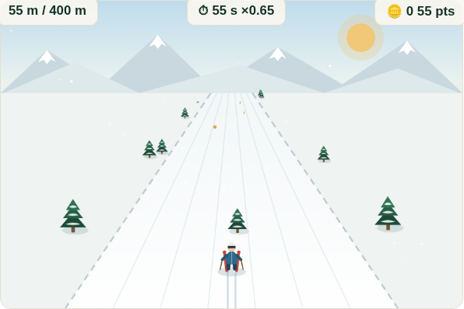
RESEARCH UPDATE 8 — FINAL REVIEW BEFORE ORAL EXAMINATION
Gamification as Proactive Approach for Continuous Improvement and Innovation Enhancement
Failure-induced abandonment in gamified fall-risk assessment for older adults —
and the engineering response to it
The AI-assisted skiing game (Stage 2 build)
Sidney K. T. Tam
Doctor of Engineering (EngD) candidate
Department of Industrial and Systems Engineering, PolyU
Chief Supervisor: Prof. Chi Fai (Benny) Cheung
Last review before oral examination · Research period ends October 2026
Notes:
30 sec. Good afternoon. This is my final progress review before the oral examination. The programme asks how gamification serves continuous improvement when a promising health technology meets difficulty in the field — concretely, gamified fall-risk assessment with older adults, and what happens after an adverse first experience.

Slide 2
The research at a glance
One problem, followed through three empirical stages
The problem. An installed fall-risk assessment (FRA) station stood under-used for a decade despite clinical value. The binding constraint is not initial acceptance — it is continued voluntary engagement after an adverse experience.
S1
Critical review & survey
S2
Gamified deployment
S3
Decoupled deployment
Guangzhou facility
June–August 2025 · 8 weeks
Hong Kong cohort · remote
Surveyed 200 residents (population 280). Retrospective accounts of adverse first experiences followed by non-return; TAM and Octalysis framing.
Thirty residents (62–84) played an AI-assisted skiing game whose weight-shift control also fed FRA measurement. Prospective observation of engagement and non-return.
120 adults, desktop game decoupled from clinical measurement. End-of-window retention 93.3% overall; 15 of 23 initial dropouts returned voluntarily.
SS-293 · ICMSS 2026
Paper 2 · JIKM
Paper 3 · JMIR Serious Games
Changes in cohort, setting, delivery and input modality across stages prevent causal isolation — the contrast motivates a framing hypothesis, tested next in Stage 3B.
Sidney K.T. Tam | EngD Final Review (Update 8) | PolyU ISE | September 2026
2
Notes:
75 sec. Walk the three stages briefly: the survey that surfaced the phenomenon; the eight-week gamified deployment where the abandonment pattern was observed prospectively; and the decoupled deployment whose retention contrast motivates — but does not prove — the framing hypothesis. Emphasise the calibrated claim in the strip at the bottom.

Slide 3
The central observation
Stage 2 — thirty residents, eight weeks, every claim anchored to the archived record
70.0%
26.7%
0 / 21
+4.03
of participants had three or fewer recorded completed runs (95% CI 52.1–83.3%)
had a single recorded completed run (95% CI 14.2–44.4%)
low-engagement participants with any later recorded run within the window (95% CI 0.0–15.5%)
mean recorded balance-index change, 95% CI 0.47–7.60, paired t p = .028
The paradox that drives the thesis: recorded index scores improved, participants acknowledged the assessment's usefulness — and most still did not return. Users satisfied with the game abandoned the service that measured them. This coexistence does not establish durable learning or clinical benefit; it defines the engineering problem.
Terminology is deliberate: “recorded completed runs” and “documented non-return within the observation window” — the archive records runs, not visits, and no participant was followed after the window.
Sidney K.T. Tam | EngD Final Review (Update 8) | PolyU ISE | September 2026
3
Notes:
90 sec. Four numbers, then the paradox. Point out the calibrated vocabulary line at the bottom — this is a direct response to the examination review: observed use is distinguished from inferred abandonment throughout the thesis and papers.

Slide 4
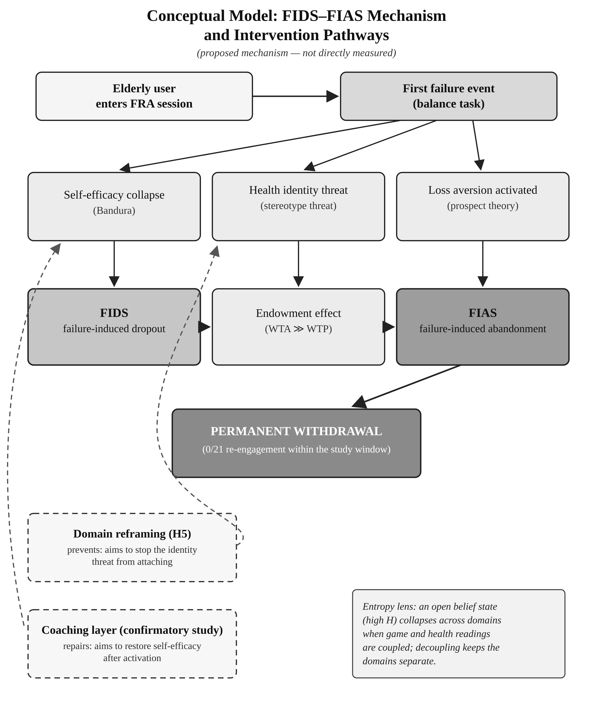
Proposed mechanism: FIDS → FIAS
A descriptive, non-diagnostic construct — mechanisms remain hypotheses, not measured results
Field sequence (contemporaneous notes)
Players acknowledged FRA benefits and recorded gains; recurring in-game failures across second and third runs; gave up despite gains; remaining players saw the group thin out and abandoned too.
Failure-Induced Abandonment Syndrome
Proposed to name the pattern: an adverse verdict experience in a health-coupled game, followed by non-return that spreads socially. Emerged from Stage-2 fieldwork; held to Chapter 4 onward by the writing-logic standard.
Candidate boundary condition
The decoupling comparison suggests gamification theory's engagement predictions may not transfer when play is coupled to a clinical verdict — stated as a candidate boundary condition, not a law.
Design response (Chapter 7)
Adaptive-learning framework: calibrated difficulty, trajectory display, coaching — the middle ground between coupled and decoupled designs. Stage 3B is its first field deployment.
Figure: conceptual model (from Paper 2) — labelled as proposed, not directly measured.
Sidney K.T. Tam | EngD Final Review (Update 8) | PolyU ISE | September 2026
4
Notes:
90 sec. The construct story: what the field notes recorded, what FIAS names, and the two calibrated theoretical claims — candidate boundary condition and the Chapter 7 design response. Keep the register: proposed, candidate, hypothesis.

Slide 5
Progress since the last review (March 2026)
Thesis V40 closed except items awaiting records or the Stage-3B window
✓
Claims recalibrated to the record
The March working figures (“82% never returned”, 18.4-hour median, “pattern confirmed”) are superseded: every claim now rests on the archived record, in calibrated language — observed use vs inferred abandonment.
✓
Ethics approval secured
HSEARS20260805008 approved 6 Aug 2026; PI Prof. Cheung; approval period 16 Jun 2024 – 30 Oct 2026 covers all conducted stages and the Stage-3B window. Memo archived.
✓
Thesis of record closed (V40)
Examiner-style review actioned (major-revision items closed), forward-results discipline applied to Ch1–3, evidentiary appendices built, all tables/figures production-formatted.
✓
Stage-2 evidentiary archive completed
FRA logbook with stable player IDs, questionnaire entry workbook, nine-interview record; sensitivity analysis independently reproduced (n=30 vs n=29); provenance documented as-received.
✓
Publications advanced
Stage-1 paper presented and accepted (ICMSS 2026); Paper 2 revised through a systematic ten-point round and submitted to JIKM; Paper 3 package built for JMIR Serious Games.
✓
Stage 3B designed and built
New since March: protocol drafted, v3.0 bilingual build complete and smoke-tested (in-build consent, silent A/B arms, one-file export, no external calls).
Sidney K.T. Tam | EngD Final Review (Update 8) | PolyU ISE | September 2026
5
Notes:
75 sec. Frame everything as movement since the March review the panel saw. Lead with the recalibration card — own it as a strengthening: the March deck carried working figures that the archival record could not support, and the thesis now claims only what the record shows. Then ethics, the closed V40, and the publication advances.

Slide 6
Publications
One paper per stage, one venue per paper — no results duplicated across the three
Stage 1
“Investigating Low Utilisation of Fall Risk Assessment Among Elderly Users…”
ICMSS 2026 (Wuhan) · IEEE Xplore (CPS)
Tam & Cheung. Critical review through TAM and Octalysis; presented March 2026. Camera-ready consent-statement check pending.
ACCEPTED
Stage 2
Failure-induced abandonment in a gamified FRA deployment
Journal of Information & Knowledge Management (JIKM)
Submitted via Editorial Manager (JIKMS2602466). Fully revised: data dictionary, sensitivity analysis, calibrated terminology, NASSS positioning, complete declarations.
UNDER REVIEW
Stage 3
The decoupled deployment study
JMIR Serious Games
Submission package complete (named sections, structured abstract, figures within 1200×1200). Awaiting one administrative clearance, then submits this month. Co-author ORCID needed for the form.
READY TO SUBMIT
Companion relationships are declared in each cover letter; the thesis remains the sole complete record.
Sidney K.T. Tam | EngD Final Review (Update 8) | PolyU ISE | September 2026
6
Notes:
60 sec. One paper per stage, one venue per paper. Stage 1 accepted and presented; Stage 2 under review at JIKM; Stage 3 package ready for JMIR Serious Games this month. If asked about venues: JMIR Serious Games impact factor 4.7; JIKM indexed and scoped to knowledge management, which carries the KM contribution.

Slide 7
In the field now: Stage 3B
First deployment of the Chapter 7 adaptive-learning framework — the committed final stage
H-3B: adaptive calibration + trajectory display + coaching sustain engagement even when measurement is visible — the middle ground of the design space made real.
What Stage 3B completes
§8.8 rewritten from proposed to first-deployment-conducted
Programme diary (Table 9.1) final cells
Tests the thesis's central psychological mechanism claim prospectively
Last empirical input before the final production pass
Design Two-arm randomised comparison, silently assigned: adaptive rule-agent + trajectory + coaching vs static difficulty, no coach. Target N ≥ 40.
Build v3.0 bilingual (繁中/EN), smoke-tested: recorded in-build consent citing the approval, D1/D2 + framework items on the end screen, one-file JSON export, resume-on-reload, no external calls during play.
Window ~4 weeks within August–October 2026, inside the approved ethics period (to 30 Oct 2026).
Remaining gate Supervisor sign-off on the protocol, then recruitment begins.
Sidney K.T. Tam | EngD Final Review (Update 8) | PolyU ISE | September 2026
7
Notes:
75 sec. Stage 3B is deliberately scoped: a mini-deployment, not a replication — it tests whether the design framework holds engagement with measurement visible. Build and ethics are done; the only gate left is the protocol signature, and the window fits inside the approved period.

Slide 8
Still to complete
Every open item is scheduled — none blocks another
Stage 3B
Documentary records
Protocol sign-off → recruit → run the ~4-week window
Results written into §8.8 and the programme diary
Scans of the two Stage-2 paper instruments (after-game questionnaire; nine-person interview form) + as-administered wording confirmation
Appendix D instrument wording and scale confirmation
Telemetry-retention statement; source-to-result manifest and build-lineage rows (Appendix G)
Consents & sign-offs
Final production
Two member-check signatures releasing the last consent-gated panel content
Title decision with the supervisor (ethics memo now documents the official registered title)
Supervisor's review report
Abstract strength-matching rewrite once records land
Forward-results sweep of Ch1–3; single-answer RQ consolidation
Word-generated ToC/LoF/LoT fields; evidence cut-off declaration
JMIR submission metadata + co-author ORCID
Sidney K.T. Tam | EngD Final Review (Update 8) | PolyU ISE | September 2026
8
Notes:
90 sec. The honest gap slide — four groups. Nothing here is analytically open; these are records to file, signatures to collect, one deployment to run, and mechanical production steps. Invite the panel to flag anything they consider missing from this list.

Slide 9
Path to submission
Six weeks of scheduled work to the October 2026 deadline
1
2
3
Mid-September
Late Sep – mid Oct
Mid–late October
Paper 3 submitted to JMIR Serious Games
Stage-3B protocol signed; recruitment opens
Instrument scans and consent forms filed
Stage-3B deployment window (~4 weeks)
Appendix G manifest and lineage rows completed
Member-check content released into §6.12 / Appendix H
Stage-3B results → §8.8 + programme diary
Abstract rewrite; final A0 sweep; ToC/LoF/LoT fields
Thesis submission → oral examination
Every dependency is already in hand: ethics coverage runs to 30 October 2026, the build is tested, and the archive is reproducible.
Sidney K.T. Tam | EngD Final Review (Update 8) | PolyU ISE | September 2026
9
Notes:
60 sec. Three beats to the deadline. The point to land: the critical path is short and fully unblocked — the only external dependencies are the supervisor's signature and two member-check consents.

Slide 10
What the thesis contributes
A named phenomenon
FIAS — a descriptive construct for failure-induced abandonment in health-coupled games, grounded in a prospectively observed cohort and a documented field sequence.
A boundary claim for theory
A candidate boundary condition: gamification's engagement predictions may not transfer when play is coupled to a clinical verdict — with the decoupling comparison as motivating evidence.
An engineering response
The adaptive-learning design framework and three design principles; Stage 3B is its first field test.
A reproducible record
As-received archives, independently reproduced statistics, calibrated language throughout — an evidential chain an examiner can walk end to end.
Thank you — I welcome the panel's questions.
Sidney K. T. Tam · EngD candidate, ISE · Supervisor: Prof. C. F. Cheung
Notes:
45 sec. Close on the four contributions, then stop talking and invite questions. If time runs short earlier, this slide plus the gaps slide are the two that must not be rushed.

