Slide 1




Device-to-Device Load Balancing for Cellular Networks
Lei Deng, Ying Zhang, Minghua Chen,
Jack Y. B. Lee, Ying Jun (Angela) Zhang
Zongpeng Li
Lingyang Song

Slide 2
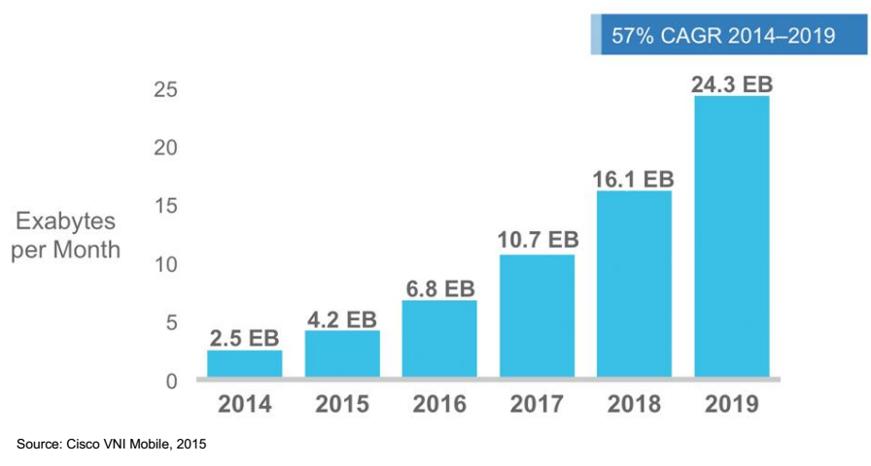
Mobile Data Traffic Is Skyrocketing
Increased Mobile Data
V.S.
Limited Radio Spectrum
Cisco Forecasts 24.3 EB per Month of Mobile Data Traffic by 2019
A 10x Increase over 2014
24.3 EB (Exabyte) = 40% of Monthly Global Fixed-Internet Traffic in 2014
Notes:
Exabyte: /ˈɛksəˌbaɪt/
Mobile Data Traffic is through cellular networks.
For example, in 2014, 4.7 exabytes of mobile data traffic were generated, while 2.2 exabytes (46%) of mobile data traffic were offloads to fixed internet through Wi-Fi or Femtocell, which is not counted here.
Global Internet Traffic means Global Fixed-Internet Traffic.
See table 1 of Cisco Visual Networking Index: Forecast and Methodology, 2014–2019.

Slide 3
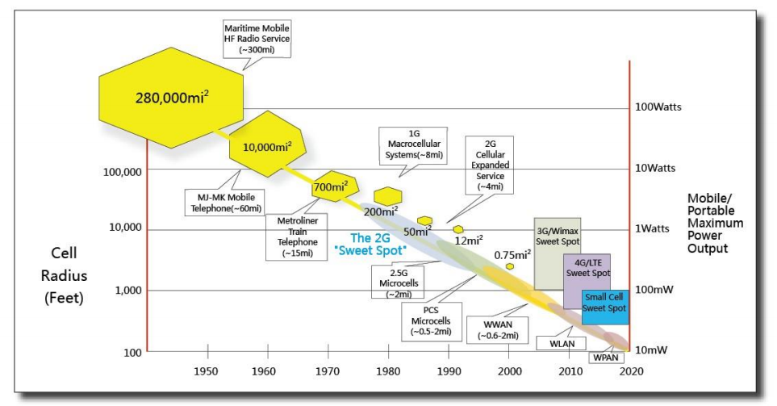
The Cell Size Is Shrinking
The Trend of Shrinking Cells (Source: ZTE Article)
Small Cell Improves Spectrum Spatial Efficiency
yet Degrades Spectrum Temporal Efficiency
Notes:
Source: http://wwwen.zte.com.cn/endata/magazine/ztetechnologies/2012/no5/articles/201209/t20120912_343888.html
100 feet = 30.48m
Radius ['reɪdɪəs]

Slide 4
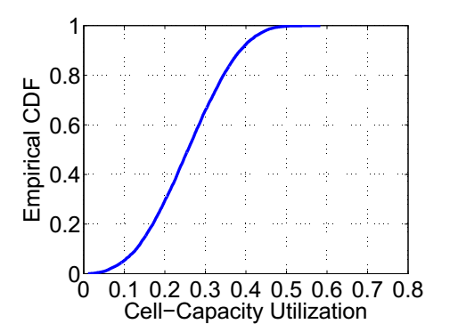
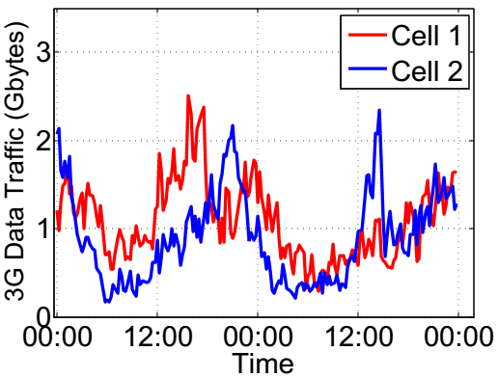
Case Study: SmarTone
Average Cell Radius: 200m
Non-synchronized Peak Traffic
Avg Utilization: 25%
Low Spectrum Temporal Efficiency!
Load Balancing Can Potentially Increase Spectrum Temporal Efficiency
We Advocate Device-to-Device Load Balancing
(D2D LB) Scheme
Notes:
Traffic = Voice + Video + Data (Both Uplink and Downlink)
Cell-Capacity Utilization per day = avg traffic / peak traffic per day [A vector]
Cell-Capacity Utilization = mean(Cell-Capacity Utilization per day)
Note that I replace the non-syn peak fig. Here I use the HSUPA+HSDPA data,
which is much larger than R99UL+R99DL. Clearly, we can see the 15-min
traffic is in the scale of gigabytes, if we use HSUPA+HSDPA data.

Slide 5
Example: Without D2D Load Balancing
X
Peak Traffic: 3
Spectrum Temporal Utilization: 50%

Slide 6
Example: With D2D Load Balancing
Peak Traffic: 3 2
4 Extra D2D Transmissions
Spectrum Temporal Utilization: 50% 100%

Slide 7


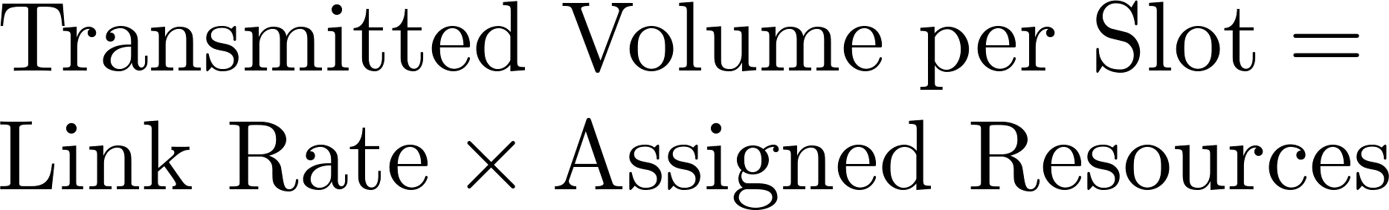
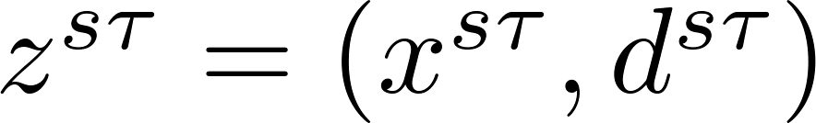
System Model
Network topology
Directed graph
Link rate
Traffic demand pattern (Uplink)
user
volume
deadline
start-time
All traffic should reach any BSs before expiration!

Slide 8
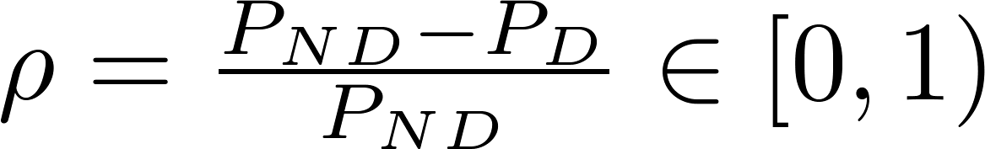


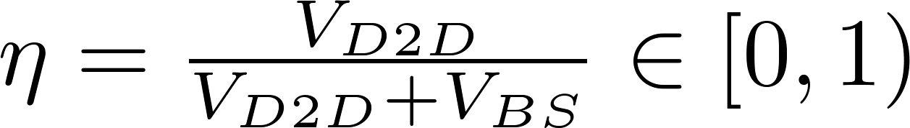


Performance Metrics
Sum peak traffic/resource reduction (Benefit)
is the minimal sum peak traffic without D2D
is the minimal sum peak traffic with D2D LB
D2D traffic overhead ratio (Cost)
is the sum volume of all D2D traffic
is the sum volume of all user-BS traffic
We optimize the benefit
and characterize the corresponding cost

Slide 9

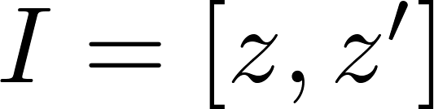
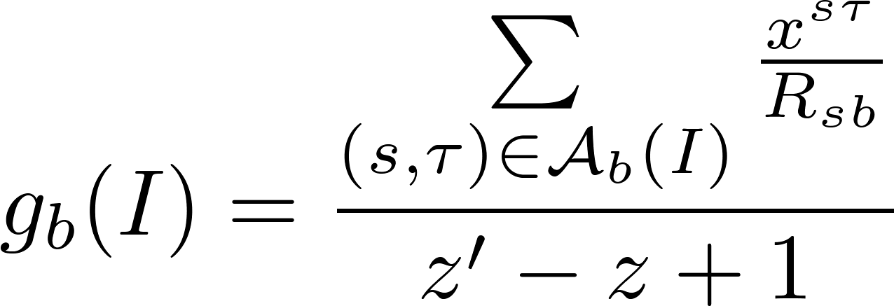
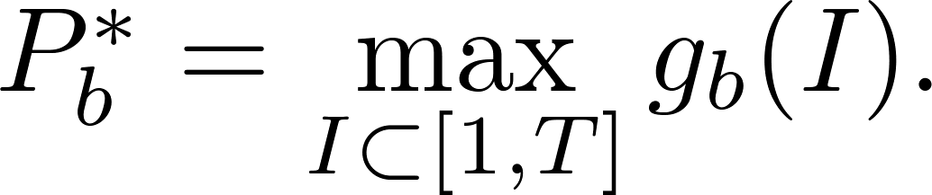
Minimize Sum Peak Traffic: No D2D
We can use YDS algorithm to get the minimal peak traffic of any BS
Define the intensity of
an interval as
Theorem:
F. Yao, A. Demers and S. Shenker, "A scheduling model for reduced CPU energy," in Proc IEEE FOCS, 1995.

Slide 10
Minimize Sum Peak Traffic: D2D LB
All BSs Are Coupled!
A Large-Scale LP
No Efficient Algorithm Now

Slide 11
Limitations of Conceivable Approach
No closed-form expression
Minimal sum peak traffic with/without D2D LB
Sum peak traffic reduction
No efficient algorithm
Minimal sum peak traffic with D2D LB
Hard to get insights of the benefit of D2D LB

Slide 12
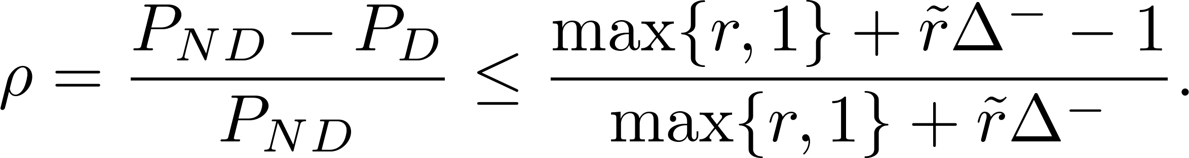
Sum Peak Traffic Reduction: Upper Bound
Theorem: For an arbitrary network topology and an arbitrary traffic pattern,
Captures the link-rate
advantages of intra-cell D2D links over the user-BS links
Captures the BS-level network connectivity and traffic aggregation capability
Captures the link-rate
advantages of inter-cell D2D links over the user-BS links

Slide 13

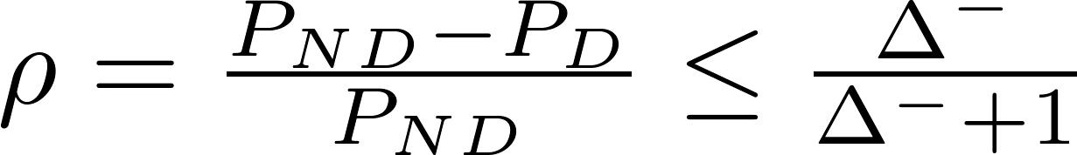
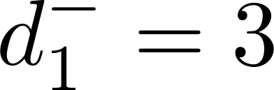
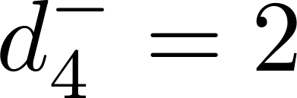




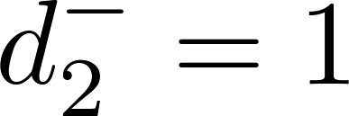
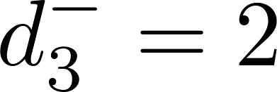
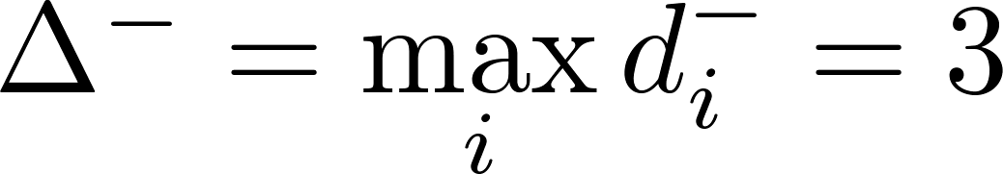
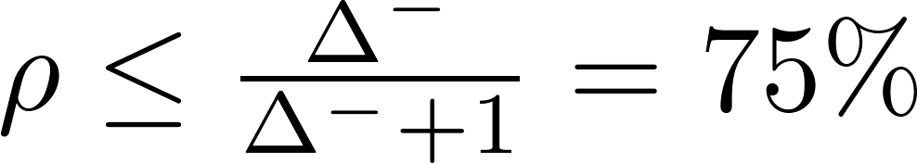
Sum Peak Traffic Reduction: Upper Bound
Corollary: If , then we have
Network Topology
D2D Communication Graph (BS-level)
Indegree
Max Indegree:

Slide 14

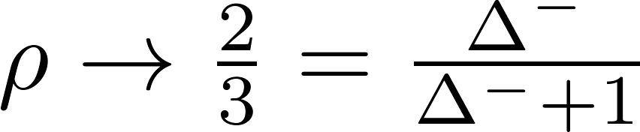

Discussions
Corollary:
evaluates the traffic aggregation capability
The more traffic each BS aggregates for other BSs, the more statistical multiplexing gain
How good is this upper bound?
in the ring topology
i.e., tight under ring topology ( )

Slide 15
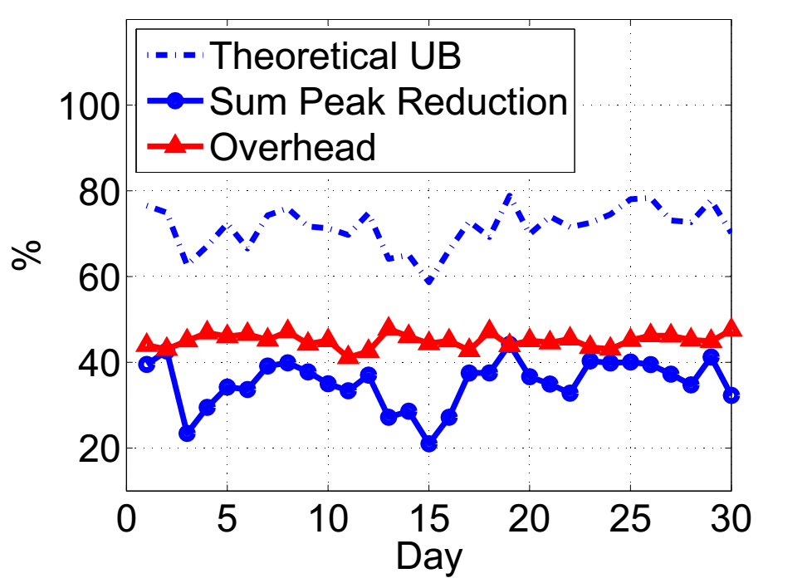
Trace-driven Simulation: Benefit and Cost
Benefit: 35%
Cost: 45%

Slide 16
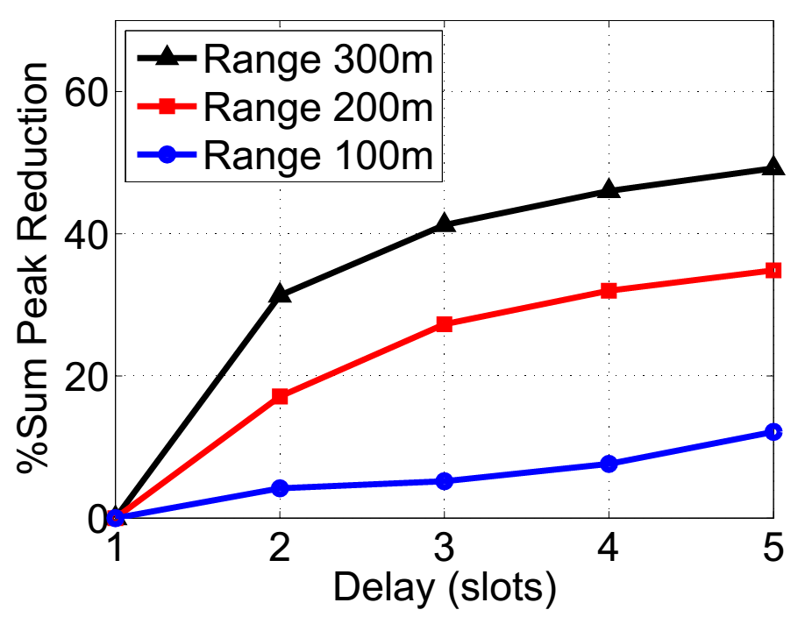
Effects of Traffic Delay and Commu. Range

Slide 17
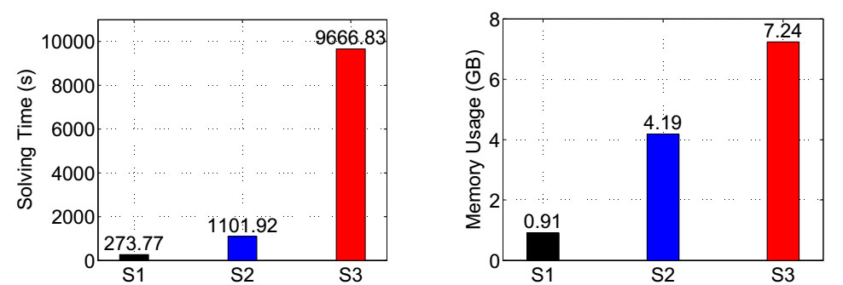
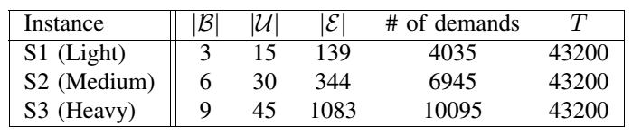
Computational Cost of Large-Scale LP

Slide 18
Conclusion
Advocate the concept of D2D load balancing
Define the performance metrics for both benefit and cost
Theoretical upper bound for arbitrary settings
Real-world trace-driven simulations

Slide 19
Future Work
Design efficient algorithms for sum peak traffic minimization with D2D LB
Design incentive mechanisms for D2D users
Distributed/Online scheduling algorithms
Refine the physical-layer channel model and relax some assumptions

Slide 20
Q&A
Thank you!

Slide 21
Backup Slides

Slide 22
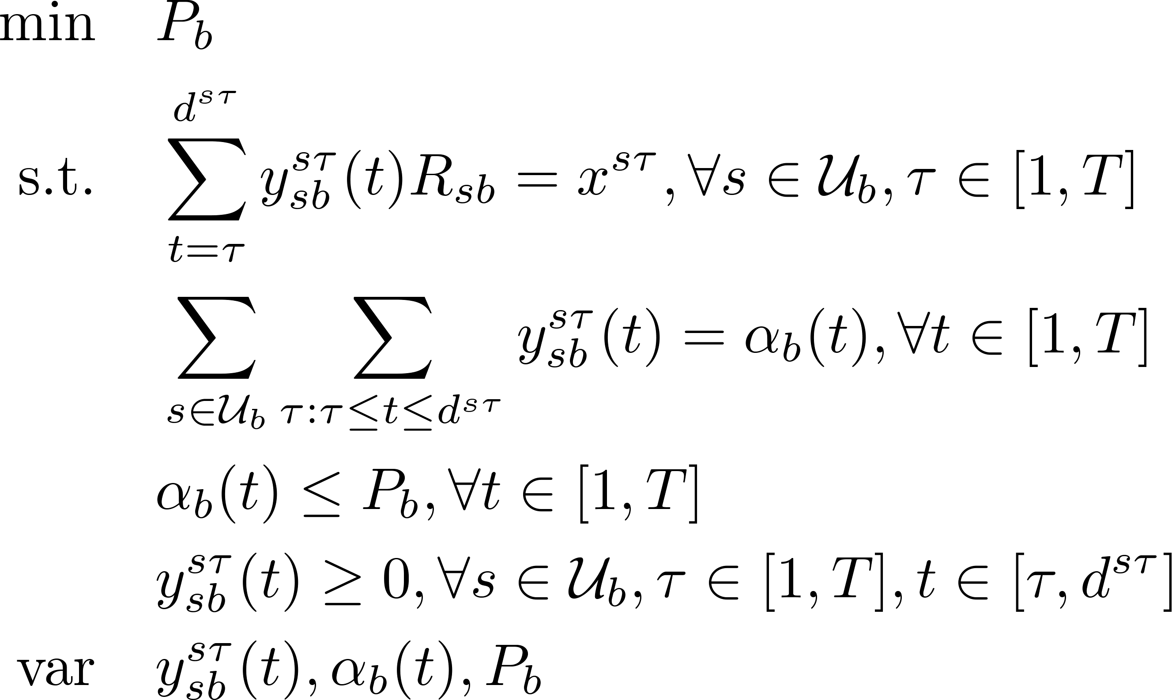
Minimize Sum Peak Traffic: No D2D

Slide 23
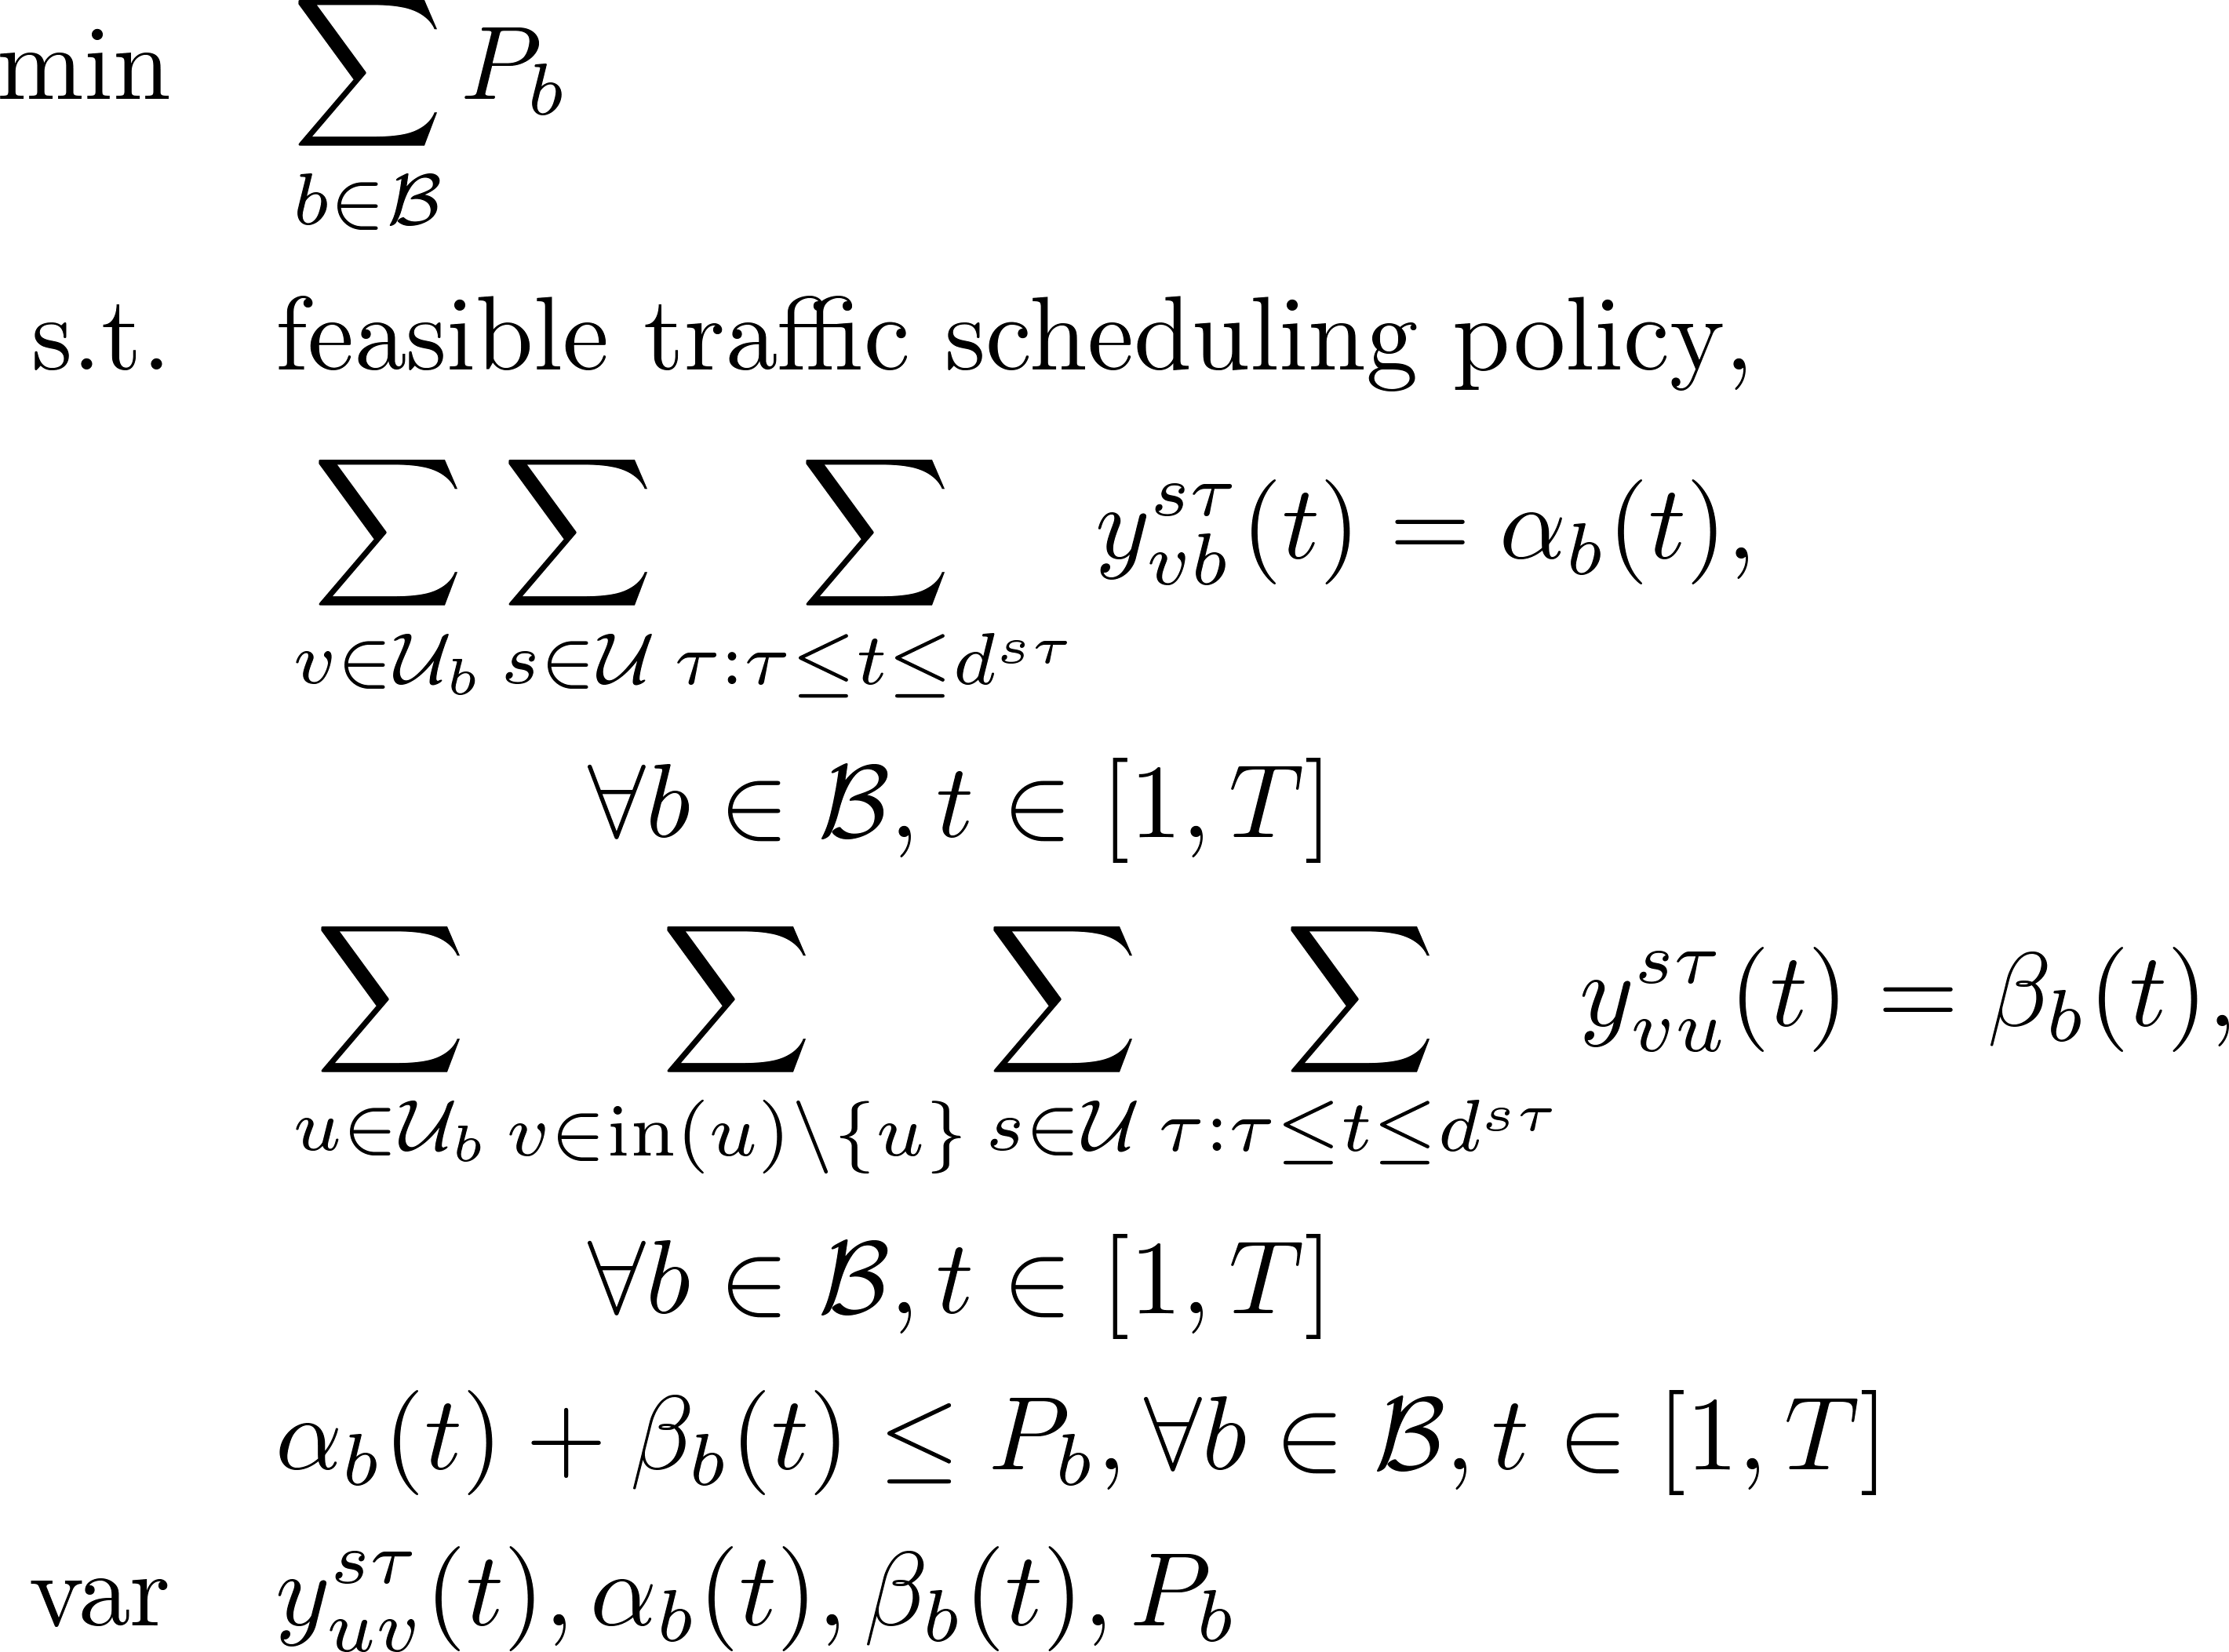
Minimize Sum Peak Traffic: D2D

Slide 24

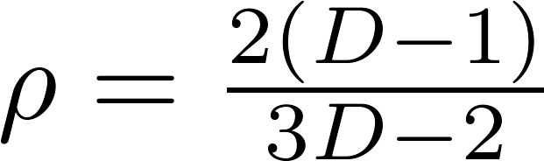
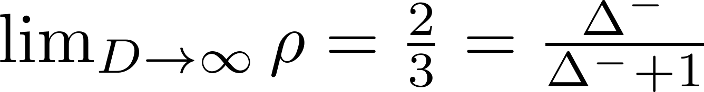
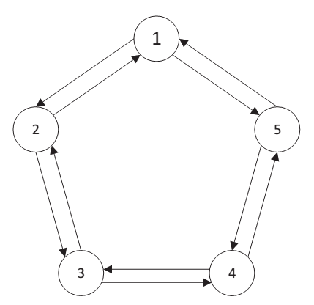
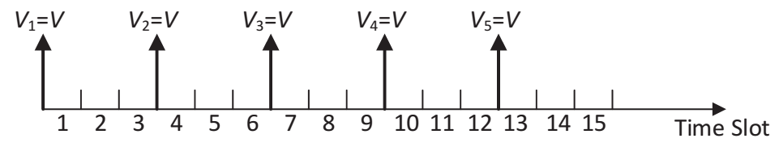

Ring Topology
For any , there exists a ring topology and a traffic demand pattern such that
The bound is asymptotically tight

Slide 25
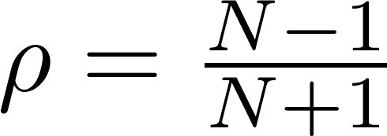
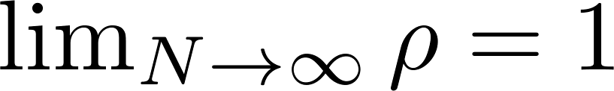

Complete Topology
In a N-BS complete topology, there exists a traffic demand pattern such that
In the best case, we can achieve 100% sum peak traffic reduction!

Slide 26


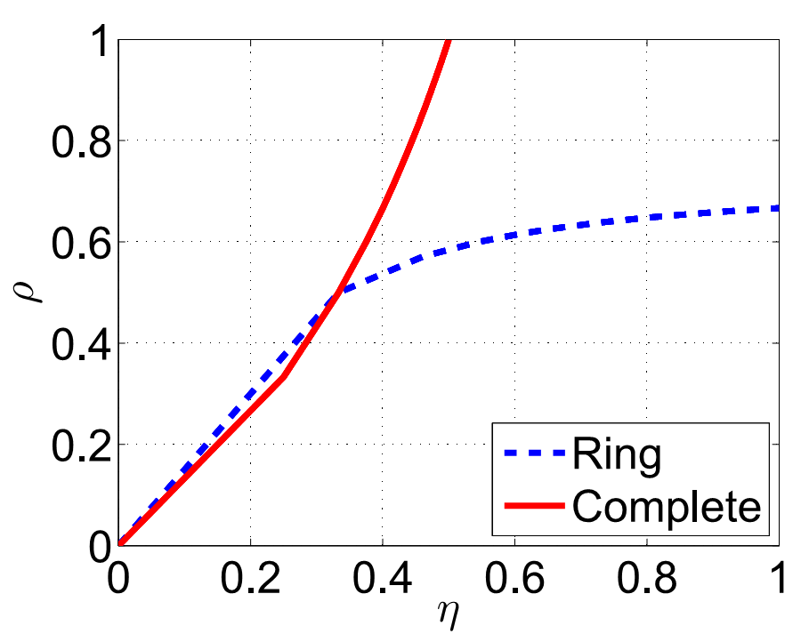
Tradeoff between Benefit and Cost
Tradeoff between sum peak traffic reduction and overhead ratio

