Slide 1

Map Your News
Agile Meeting

Slide 2
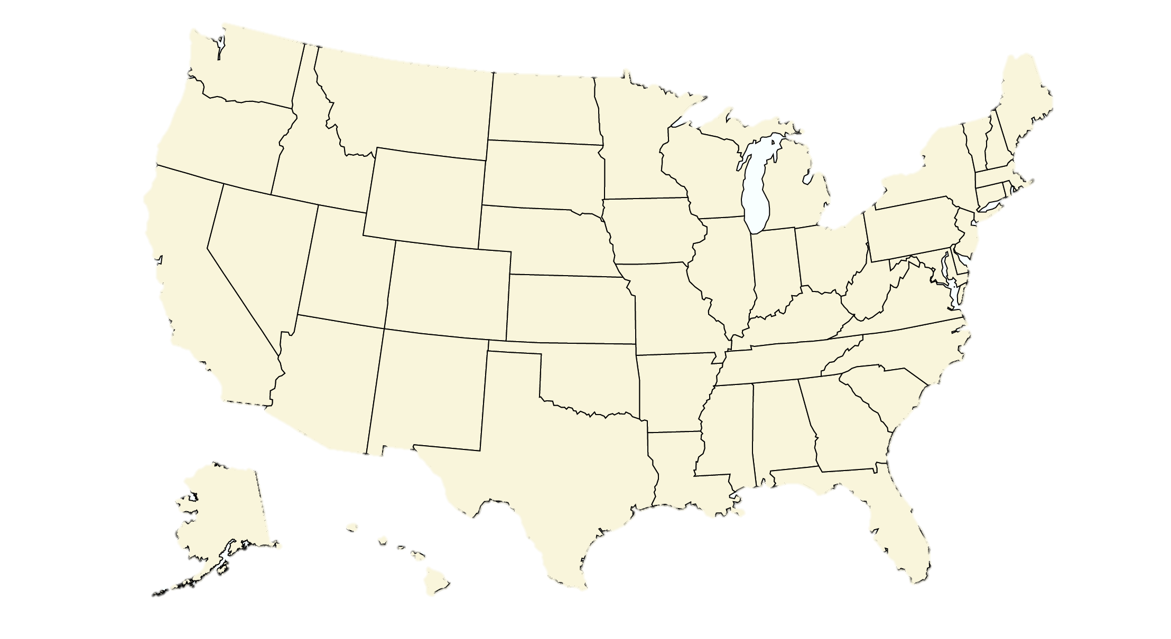

Website Appearance
-Long lines drive Colorado lawmakers to eye outsourcing (The Denver Post)
-Colorado Climate plan keeps the right focus (The Denver Post)
Notes:
1. Upon user click of a state news headlines will appear specific to that state. There will also be links to that news. The news will feed from Google News.

Slide 3
Data Flow
User interface - website
Rethink
Database
-stores information polled by user for quick access for 2nd poll
Google News API

