Slide 1
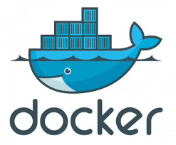
Docker

Slide 2
Virtual Machine
Helps us run more than 1 machine on a single host.
Builds his own OS Kernel for the new machine.
Pros:
We interact with the virtual machine threw GUI .
Because virtual machine builds his own kernel for every image we can run any OS we would like on any OS Host.
Cons:
Because virtual machine builds his own kernel for every image it is cost heavy for every image you’re running.
Must define the amount of RAM the machine will use, which can cause a waste of Ram.

Slide 3
Solution to the cons of Virtual Machine
We saw virtual machine is a tool for running other machines on a single host, but because for every image the virtual machine builds his own OS Kernel it is a resource heavy tool.
So what can we do if we want to run 10 or 20 or 100 images on the same host and minimize the resources cost?

Slide 4
Comparing Containers with Virtual Machines
Docker is a company that developed a free open source technology (anyone can contribute to it).
Instead of defining for every image his own kernel, docker runs images in a small unit called container that sits on the host kernel and interacts with the kernel with the docker daemon.
Pros:
Lightweight, small, fast
Isolated workspace
Big Open Source community.
Uses the host resources – so no need to allocate RAM to the image.
Cons:
Runs on the host kernel which might cause troubles (for example when running linux images on a windows host)
No gui – interacts with the machine via Terminal only.
Images are read only – means any change made while running the image wont be saved (can be a pro sometimes).

Slide 5
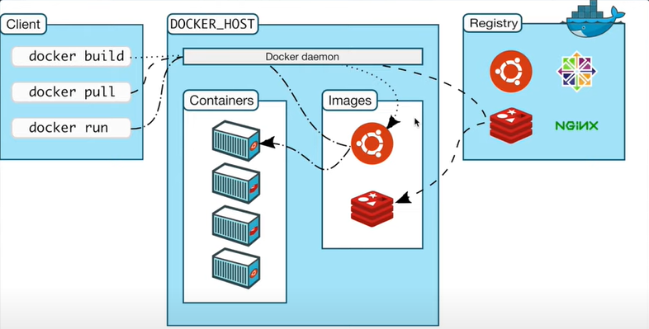
Docker architecture
Notes:
Docker uses a client-server architecture. The Docker client talks to the Docker daemon, which does the heavy lifting of building, running, and distributing Docker containers. The Docker client and daemon can run on the same system, or a Docker client can connect to a remote Docker daemon. Another Docker client is Docker Compose, that lets to work with applications consisting of a set of containers.

Slide 6
Get started with Docker
Guides: https://docs.docker.com/get-started/overview/
First download and install Docker desktop. The official site for download docker desktop: https://www.docker.com/
If get the message "Docker Desktop stopped..." see https://stackoverflow.com/questions/71084718/docker-desktop-stopped-message-after-installation
Run Docker locally.
Download a Git client if you don’t have.
Create a Docker ID for free to access Docker Hub which is the world’s largest library and community for container images, if you don’t have one.
Use an IDE or a text editor to edit files. Docker recommends using Visual Studio Code. In the Visual Studio Code → Extensions: Install Docker + Remote(Dev) - Containers

Slide 7
Docker concepts
Docker Desktop is an easy-to-install application that enables to build and share containerized applications and micro service.
Docker hub is a public registry for pulling the required images those created by others and published in a registry (→ Explore)
Image is a read-only template with instructions for creating a Docker container. Often, an image is based on another image, with some additional customization.
Container is a runnable instance of an image. We can create, start, stop, move, or delete a container using the Docker API or CLI. We can connect a container to one or more networks, attach storage to it, or even create a new image based on its current state. A container is defined by its image. It can be run on local machines, virtual machines or deployed to the cloud.
Dockerfile is used to build own (container) image and run it. It’s simply a text-based file with no file extension.
Docker Compose is a tool that was developed to help define and share multi-container applications. With Compose, we can create a YAML file to define the services and with a single command, can spin everything up or tear it all down.
docker-compose.yml is a root YAML file of the app project in the Docker Compose. It contains the list of services (or containers) and the definition of these services we want to run as part of our application.
Volumes provide the ability to connect specific filesystem paths of the container back to the host machine. By creating a volume and attaching (often called “mounting”) it to the directory, the data is stored in, we can persist the data to the host .

Slide 8
Docker basics
Docker build #used to build images
Docker compose #used to run images
Docker run #used to run containers
Docker exec #used to run commands or open shell on a running container
Docker ps -a #used to monitor all containers
Notes:
Some commands and examples how use docker commands to the CLI or to the local command-line session (terminal):
Add image (ubuntu, last version) locally from the configured registry (Docker Hub): docker pull ubuntu:latest
View the images that are existed in the locally: docker images
Remove image: docker image rm <the-image-id>
Example to great new container named [MyUbuntu] using image named [ubuntu] and run this container in an interactive bash shell:
docker run -it --name MyUbuntu Ubuntu
Check the running Ubuntu container by some shell commands in an interactive bash shell (terminal):
See files and folders in ubuntu: ls
Create file in ubuntu: touch file.txt
View a content of the file: cat /file.txt
Exit from the container: ctl+D
Close this terminal: docker exec
To get the container’s ID are running: docker ps
To get the container’s ID are existed: docker ps -a
Start container: docker start <the-container-id>
Stop container: docker stop <the-container-id>
Pause container: docker pause <the-container-id>
Unpause container: docker unpause <the-container-id>
Remove container (if the container has stopped): docker rm <the-container-id>
Stop and remove a container in a single command: docker rm -f <the-container-id>
Kill container (not recommended): docker kill MyUbuntu
Example to start an ubuntu container that will create a file named /data.txt with a random number between 1 and 10000:
docker run -d ubuntu bash -c "shuf -i 1-10000 -n 1 -o /data.txt && tail -f /dev/null“
This command starts a bash shell and invoke two commands (why we have the &&). The first portion picks a single random number and writes it to /data.txt. The second command is simply watching a file to keep the container running.
To view file from terminal that is running a shell in the Ubuntu container:
docker exec <container-id> cat /data.txt
Start another ubuntu container (the same image):
docker run -it ubuntu ls /
Example to containerize first application: https://docs.docker.com/get-started/02_our_app/
docker run -d -p 80:80 docker/getting-started
-d flag is used to run the new container in “detached” mode (in the background).
-p flag is used to create a port mapping between the host’s port (a number is before”:”) to the container’s port (a number is after ”:”)
============================
Command to create file: touch Dockerfile
https://github.com/seed-labs/seed-labs/blob/master/manuals/docker/docker.md
Create a volume by using the ”docker volume create [NAME_VOLUME]” command
Give the volume a name, and mount it to /etc/todos in the container, which will capture all files created at the path:
docker run -dp 3000:3000 --mount type=volume, src=[NAME_VOLUME], target=/etc/todos [NAME_CONTAINER]
Find where is Docker storing my data when I use a volume:
docker volume inspect [NAME_VOLUME]

Slide 9
Exercise
Open the Labsetup attached in the moodle via terminal.
Use “docker version” command to see if docker is installed.
Run program Docker Desktop. Check if Server Docker Desktop are running by “docker version” command .
Use “docker-compose build” to create images
Use “docker-compose up” to run the images defines in the YAML file.
Use “docker ps –a” and check if the container with names seed-attacker,hostB-10.9.0.6,hostA-10.9.0.5 are running.
Use ”docker exec –it <container id> /bin/bash” to open terminal on a single container
Use ifconfig and search for the interface that represent each container and find the containers ip.
Use ping <container ip> from the container you opened the bash in to the other containers.
If all 3 containers are running, ping should be working properly.

Slide 10
Some commands
Use “ctrl+D” to stop the interactive container session.
Use “Ctrl+C” to stop all the containers . After to remove all the containers, use “docker-compose down”.
Use “docker info” command to see information about all containers.
Use “docker ps” command to see the running containers.
Use ”docker stop <container id>” to stop a single container
Use ”docker start <container id>” to start a single container
Use ”docker pause <container id>” to pause a single container
Use ”docker unpause <container id>” to unpause a single container
Use ”docker kill <container id>” to kill a single container (not recommended).
Use “docker images” ” command to see all images.
Use “docker image rm <the-image-id>” command to remove image.

Slide 11
Special Settings for Containers
Volumes – Since the code needs to run inside the container, we need to get the code into the container. The easiest way is to create a shared folder between the host machine and the container. This is done through volumes in Docker. In the Docker Compose file, add the following entry to a container:
volumes:
- ./hostfolder:/containerfolder
Host Mode - allows the container to see all the traffics (to sniff packets among other containers). In the Docker Compose file, add the following entry to a container:
network_mode: host
Copy files between container and host – use “docker cp” command. For example:
// From host to container
$ docker cp file.txt <the-container-id>:/containerfolder/
$ docker cp folder <the-container-id>:/containerfolder
// From container to host
$ docker cp <the-container-id>:/containerfolder//file.txt .
$ docker cp <the-container-id>:/containerfolder/folder .

