Slide 1
SOCCER SCANNER System Diagrams
Author: Leif Heaney
22 August 2025

Slide 2
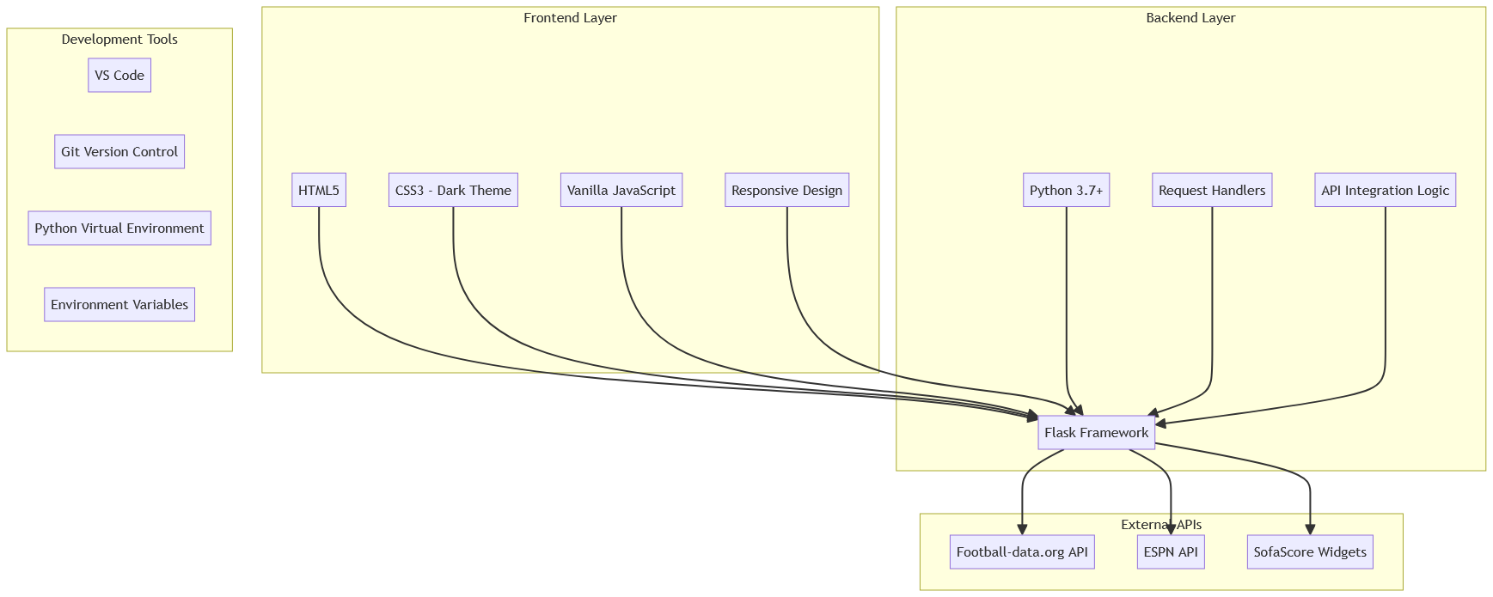
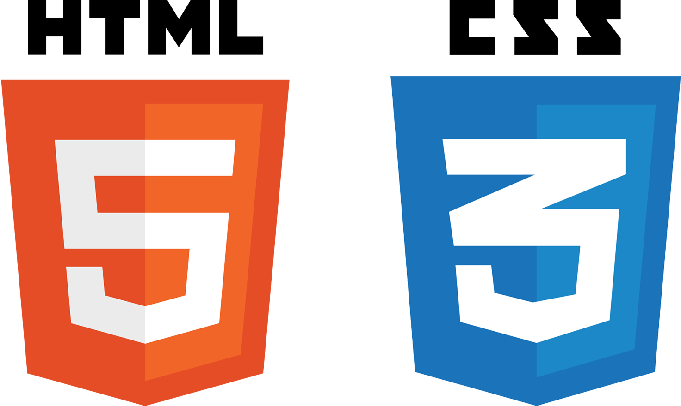






Tech Stack Diagram
Overview of the technology layers and tech stack, including the frontend, backend, external APIs, and development tooling. This diagram depicts how they interact at runtime and clarifies dependencies between client assets, Flask, and third‑party services.

Slide 3

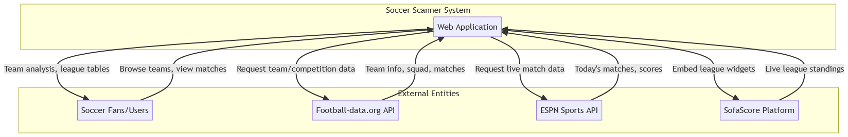

Context Diagram
Defines the system boundaries and depicts how users and external platforms (football‑data.org, ESPN, SofaScore) exchange information with the Soccer Scanner web app.

Slide 4
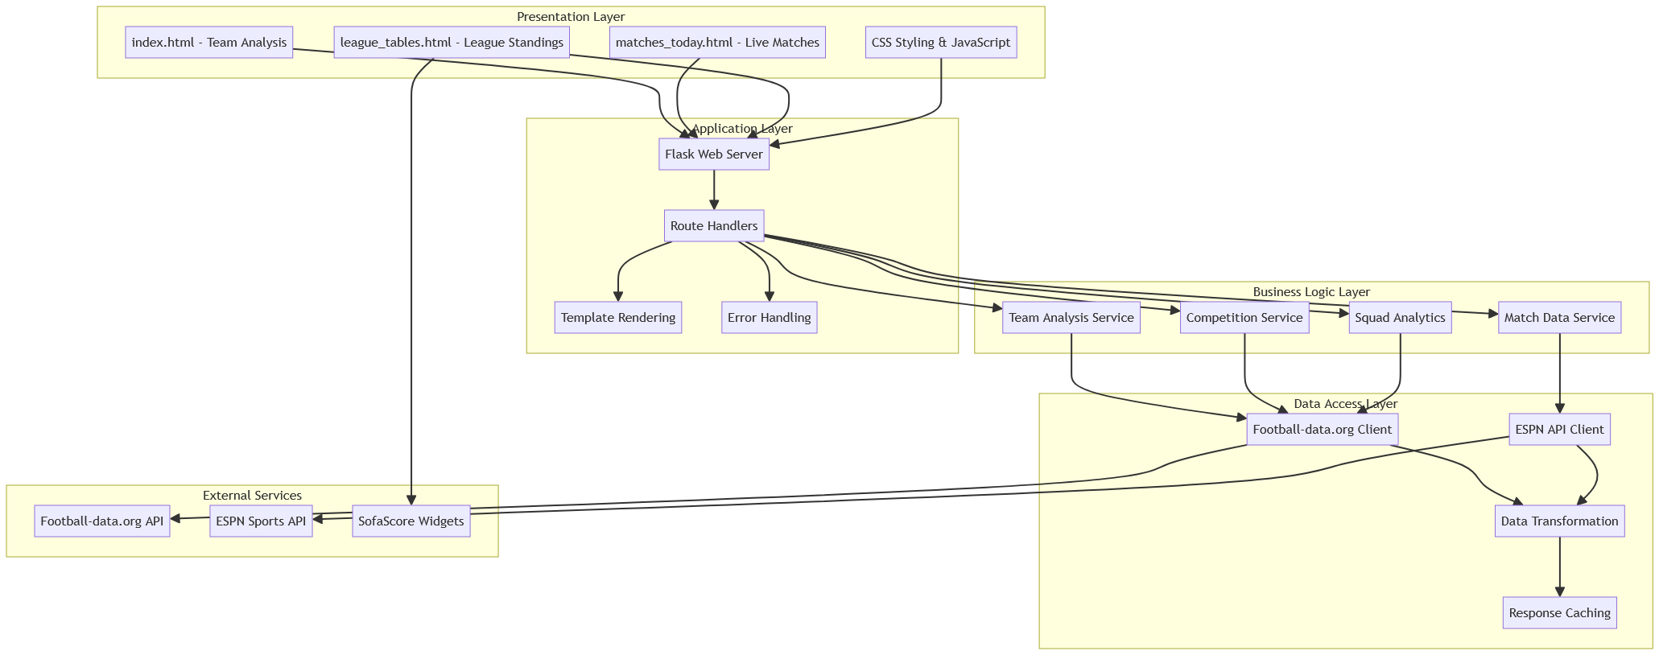
System Architecture Diagram
Highlights the layered architecture of the application: Presentation, Application, Business Logic, Data Access. Integrations with external service are included as well. This diagram emphasizes separation of concerns/handlings, data transformation, and response caching.

Slide 5
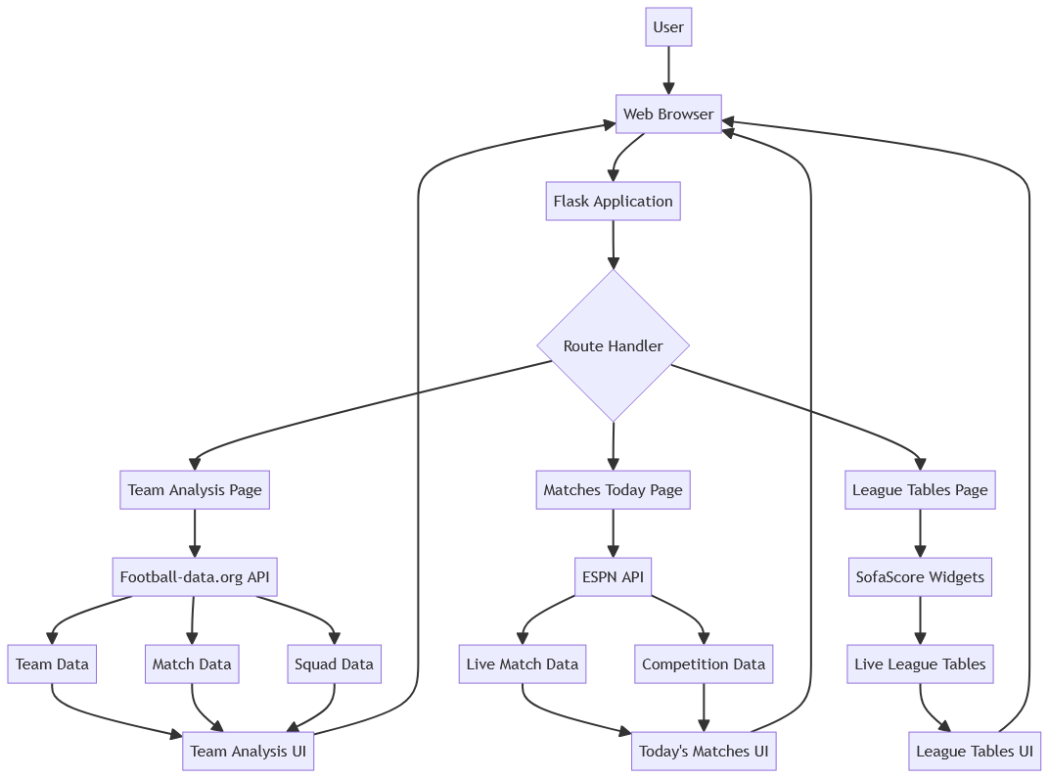
Data Flow Diagram
End‑to‑end data movement from the user’s browser through Flask routes to external APIs, returning processed views for (chosen) Team Analysis, Today’s Matches, and League Tables. This diagram depicts how API responses are handled and transformed into UI components.

Slide 6
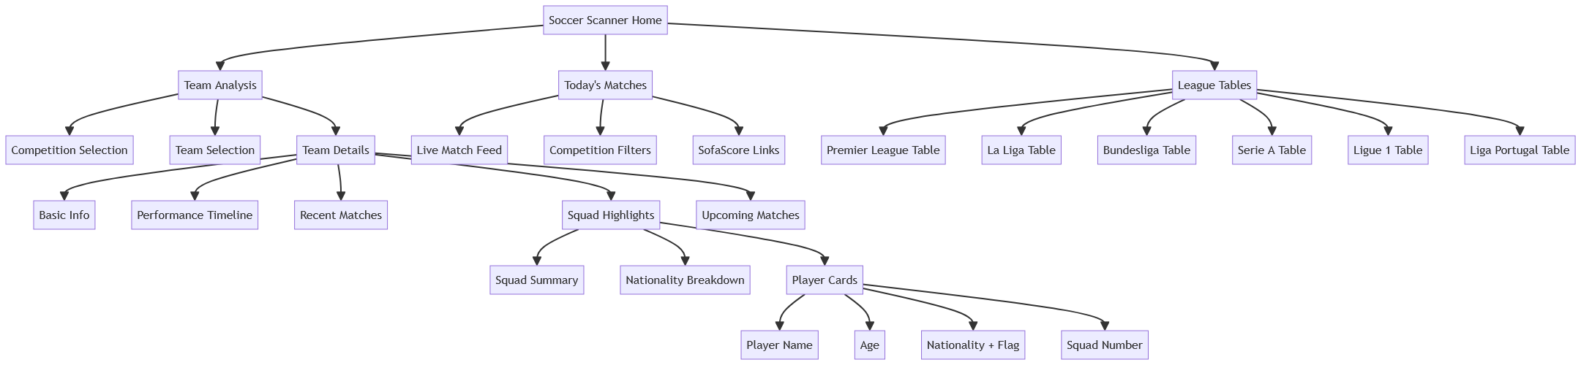
Information Architecture Diagram
Maps the site’s navigation hierarchy from the “Home” to different feature areas (pages) and deep‑link content like squad highlights and player cards. Aligns page structure with user tasks.

Slide 7
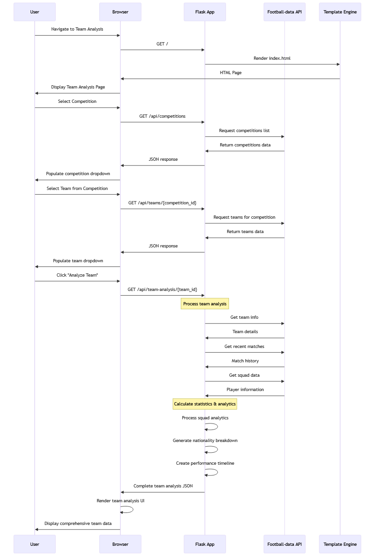
UML Sequence Diagram Team Analysis Flow
Step‑by‑step flow from page load through competition/team selection to generating analytics and rendering results. Captures API requests, server‑side processing, and UI updates.

Slide 8
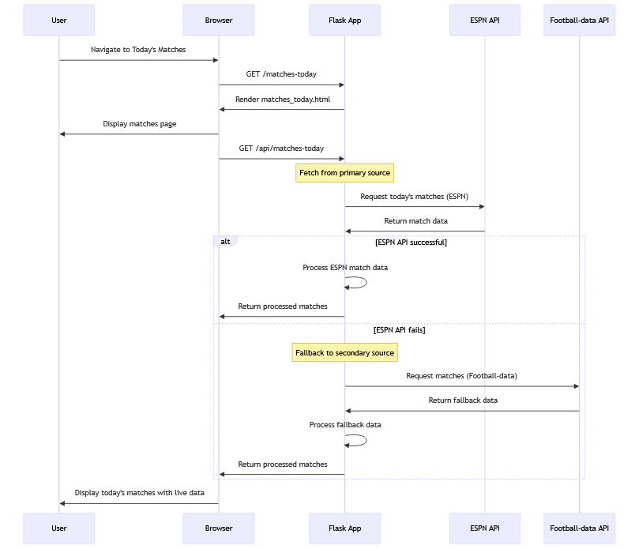
UML Sequence Diagram Today's Matches Flow
Illustrates fetching live matches with ESPN as the primary source and Football‑data.org as fallback. Includes error‑handling paths and return of processed data to the UI.

Slide 9
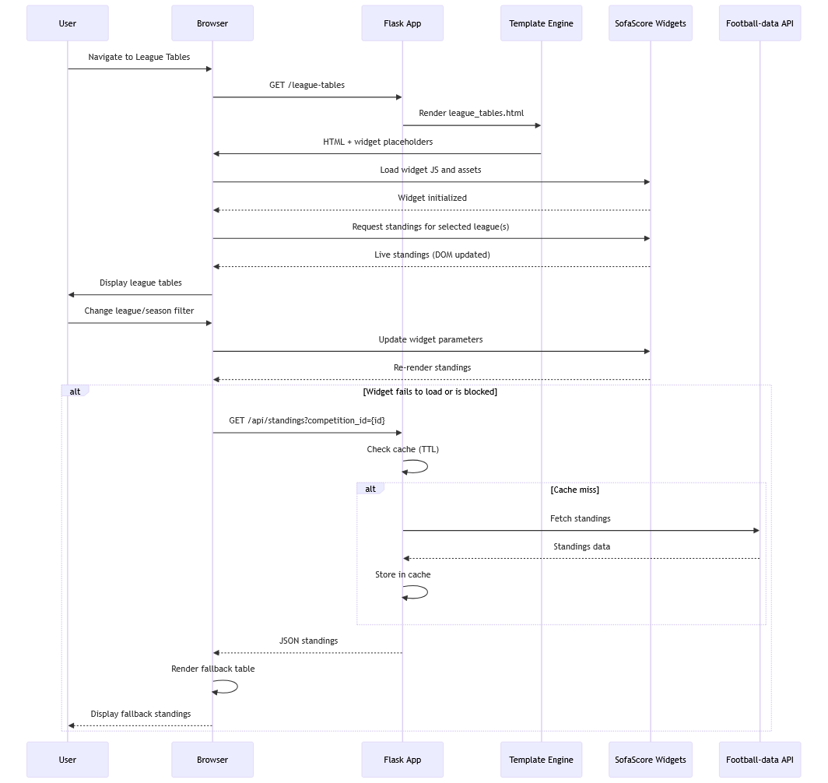
UML Sequence Diagram Today's Matches Flow
Illustrates the process of fetching live matches with ESPN as the primary source and Football‑data.org as fallback. Includes error‑handling paths and return of processed data to the UI.

