Slide 1
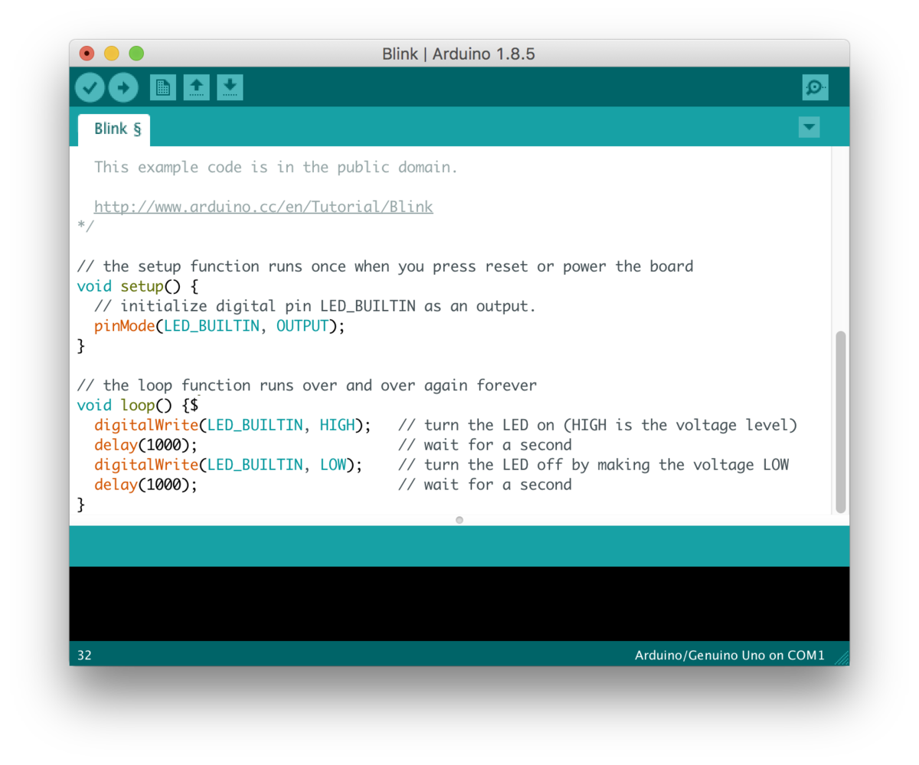
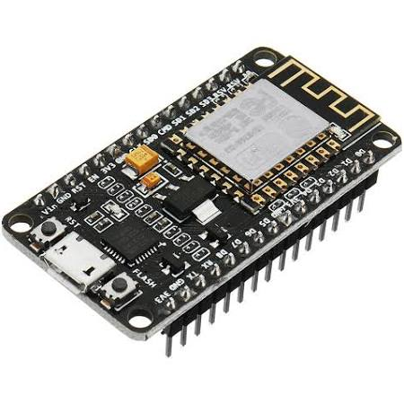
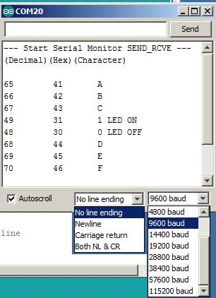
Node MCU recap

Slide 2
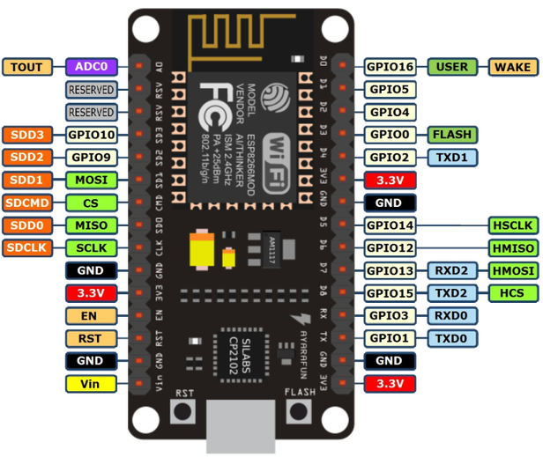
Oversigt over nodemcu

Slide 3

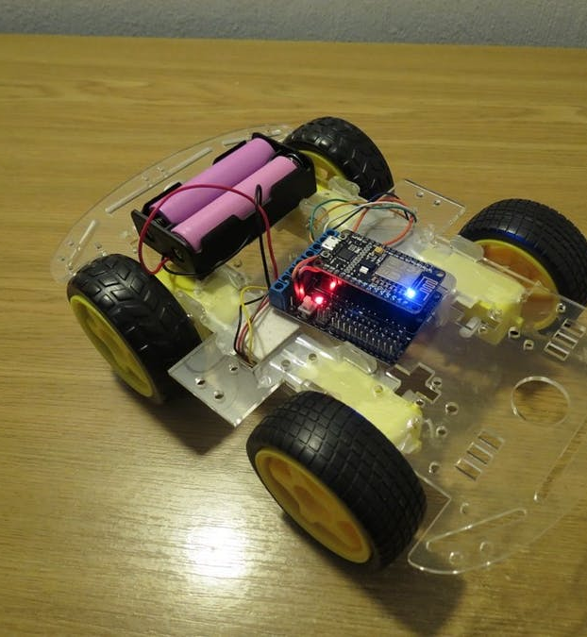
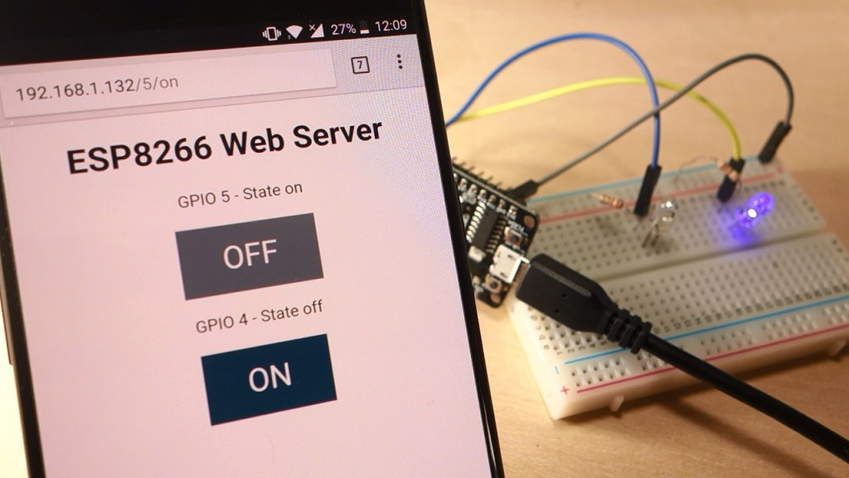

Slide 4
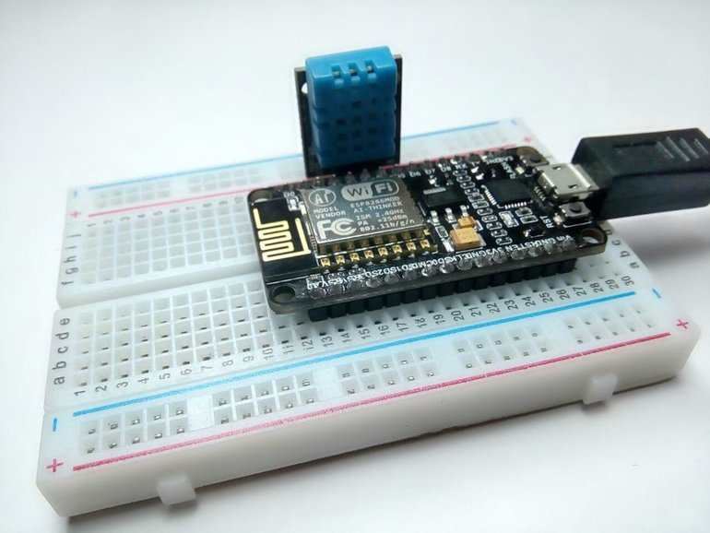
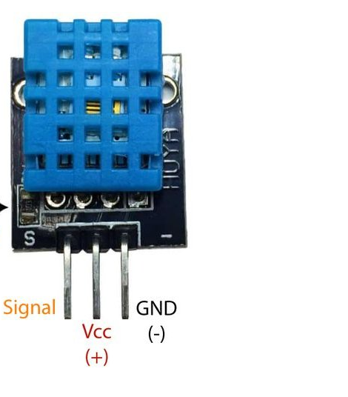
https://www.instructables.com/id/Interface-DHT11-Humidity-Sensor-Using-NodeMCU/

Slide 5
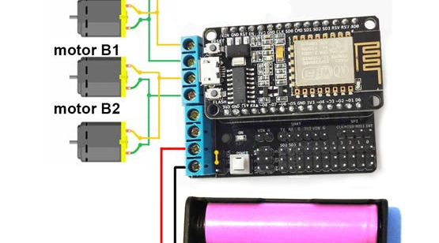

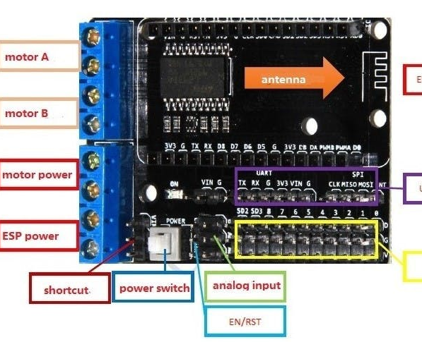
Fjernstyret bil
https://www.hackster.io/andrewf1/simplest-wifi-car-using-esp8266-motorshield-37501e

Slide 6
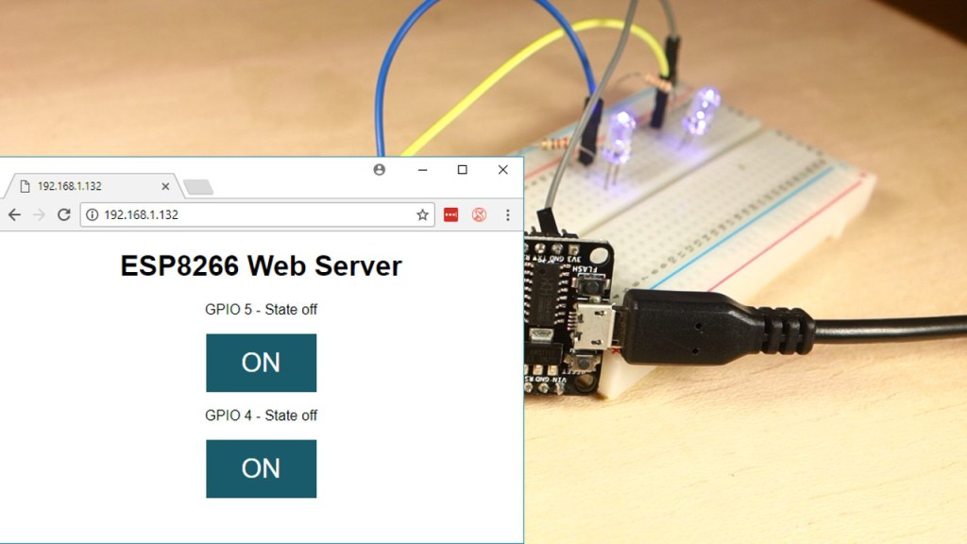
https://randomnerdtutorials.com/esp8266-web-server-with-arduino-ide/

Slide 7

Wifi jammer
https://github.com/spacehuhn/esp8266_deauther

