Slide 1
Elements of Data Processing
Week 3 : Workshop 3
Lecturer: Chris Ewin

Slide 2
Agenda
HTML and XML
XML nodes and syntax
Questions 5-8 (Jupyter Notebook)

Slide 3
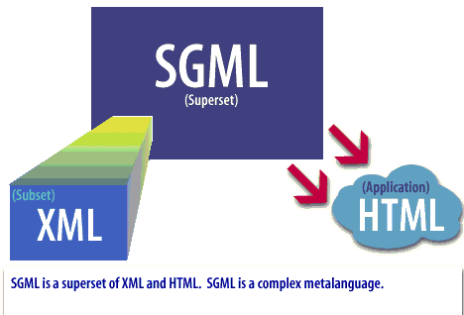
HTML vs XML: Similarity
Both are web markup languages.
Both are originated from SGML. [Standardized General Markup Language]
Tags are basic building blocks of both HTML and XML documents.

Slide 4
HTML vs XML: Difference
HTML tags are predefined tags where as XML tags are user defined tags.
HTML tags are limited number of tags where as XML tags are extensible.
HTML tags are case insensitive where as XML tags are sensitive.
HTML tags are meant for displaying the data but not for describing the data where as XML tags are meant for describing the data.
HTML focuses on how data looks where as XML focuses on what data is.

Slide 5
When HTML or XML
HTML is about displaying data, XML is about describing information.
HTML:
HTML was developed to display data about to focalize on the way that data looks.
HTML markup is concerned with presentation in the browser for humans to view.
Markup vocabulary is fixed.
XML
XML was developed to describe data and to focalize on what the data represent.
XML for applications such as data exchange, integration, export into other formats, where semantics is needed, etc
XML is extensible and markup (elements and attributes) can be defined by users and their purpose is to specify the semantics of the data so that it is machine processable.
XML store data - HTML present it.

Slide 6
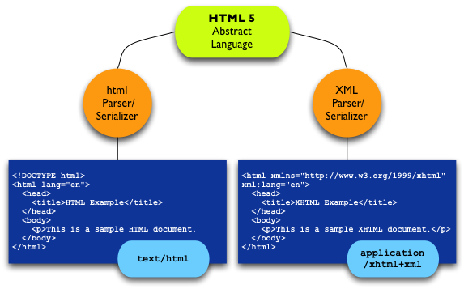
HTML syntax vs XML syntax

Slide 7
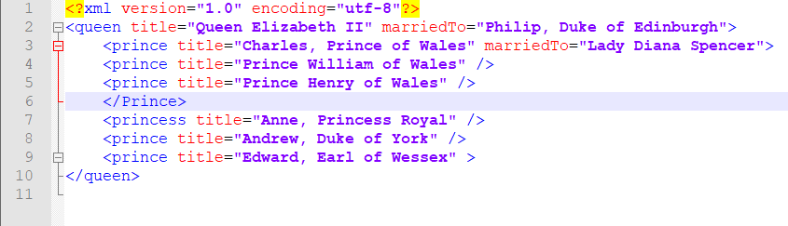
XML

Slide 8
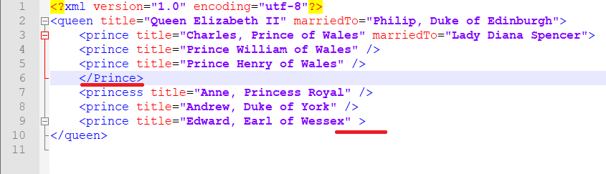
XML

Slide 9
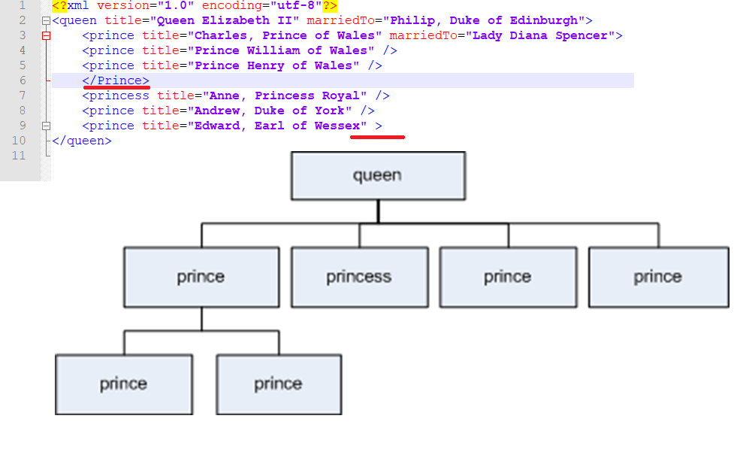
XML Tree

Slide 10


XML Elements
An XML element is everything from (including) the element's start tag to (including) the element's end tag.
<queen></queen>
<prince />
An element can contain:
text
attributes
other elements
or a mix of the above

Slide 11
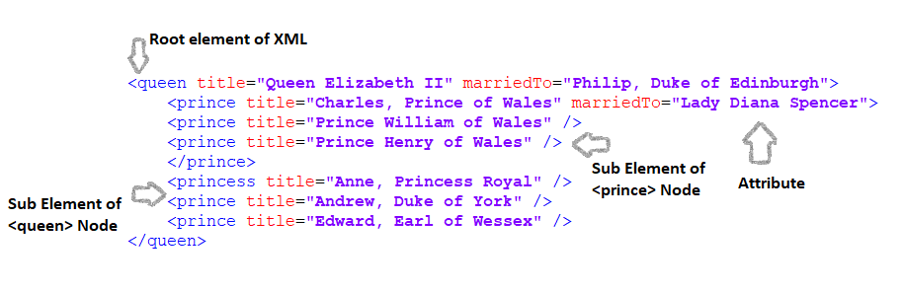
XML Elements

Slide 12
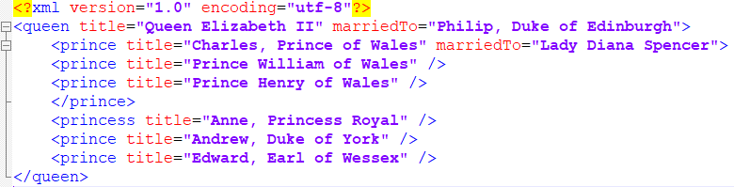
XML Elements
<prince> has attributes
(title="Charles, Prince of Wales",
marriedTo="Lady Diana Spencer“)
<queen> and <prince> have element contents, because they contain elements.

Slide 13
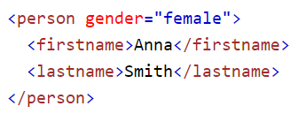
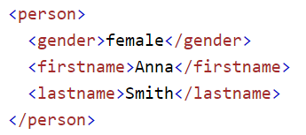
XML Elements VS Attributes
Gender is an attribute and an element.
Are there circumstances where it would be worthwhile to make it an attribute?
Notes:
Some of the problems with attributes are:
attributes cannot contain multiple values (child elements can)
attributes are not easily expandable (for future changes)
attributes cannot describe structures (child elements can)
attributes are more difficult to manipulate by program code
attribute values are not easy to test against a DTD
If you use attributes as containers for data, you end up with documents that are difficult to read and maintain. Try to use elements to describe data. Use attributes only to provide information that is not relevant to the data.
Sometimes I assign ID references to elements. These ID references can be used to access XML elements in much the same way as the NAME or ID attributes in HTML.
The ID in these examples is just a counter, or a unique identifier, to identify the different notes in the XML file, and not a part of the note data.
What I am trying to say here is that metadata (data about data) should be stored as attributes, and that data itself should be stored as elements.

Slide 14
XML Elements
Why title is an attribute and not an element?
When would it be worthwhile to make it an element?

Slide 15
XML Elements
Why is prince an element and not an attribute?
Are there circumstances where it would be worthwhile to make it an attribute?

Slide 16

Exercise 5 - 8

Slide 17
Thank You

