Slide 1
Elements of Data Processing
Workshop 4
Lecturer: Chris Ewin

Slide 2
Agenda
Data types
Mean, Median, Interquartile
Boxplot
Outliers and Suspected Outliers

Slide 3
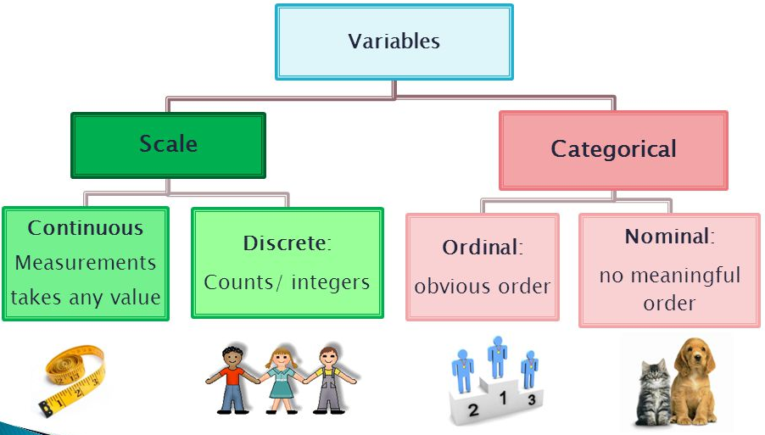
Data Type

Slide 4
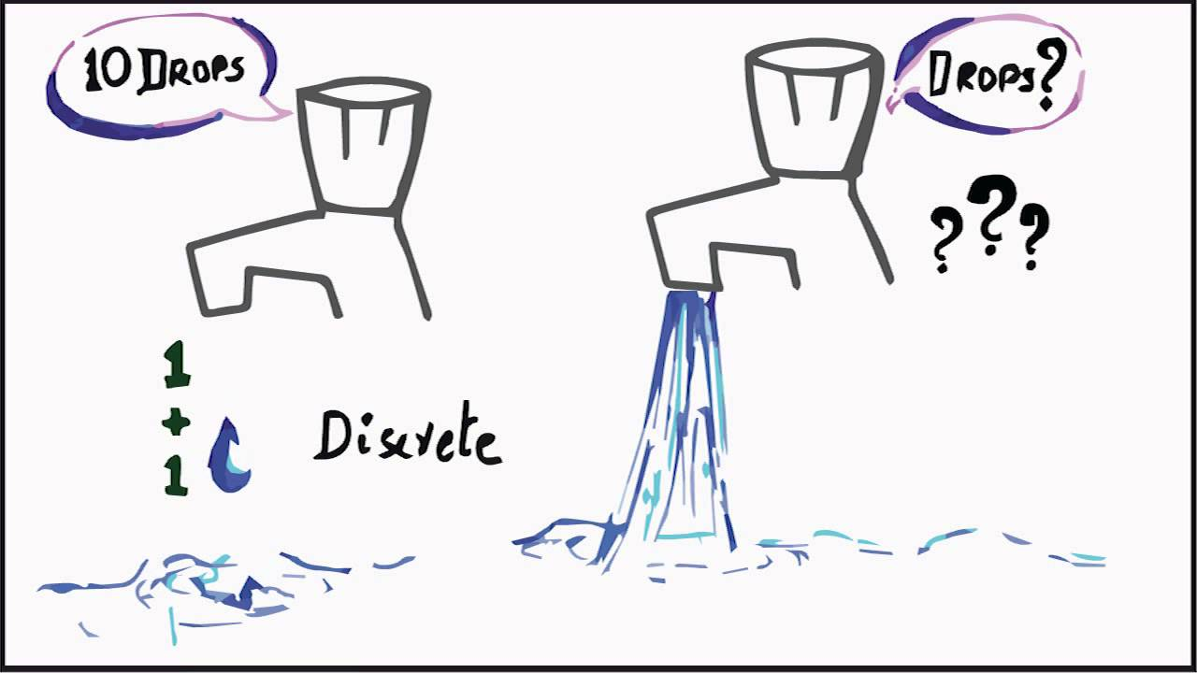
Data Type

Slide 5
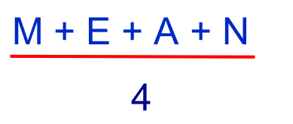
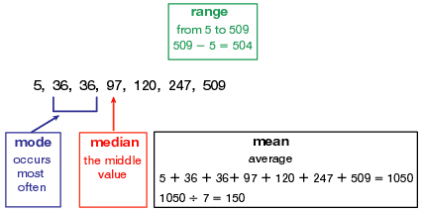
Mean of Data

Slide 6
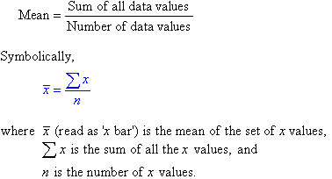
Mean of Data

Slide 7
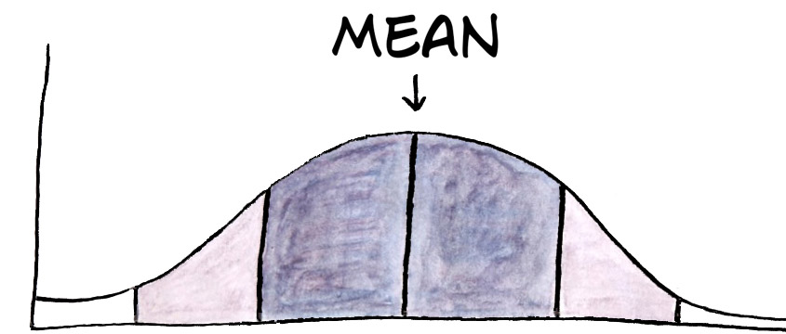
What does mean represent?
Mean or average means:
It represent usual, ordinary, nominal, typical or regular.
Most of the scores or age of people will fall within certain range, which is usually we call average.

Slide 8
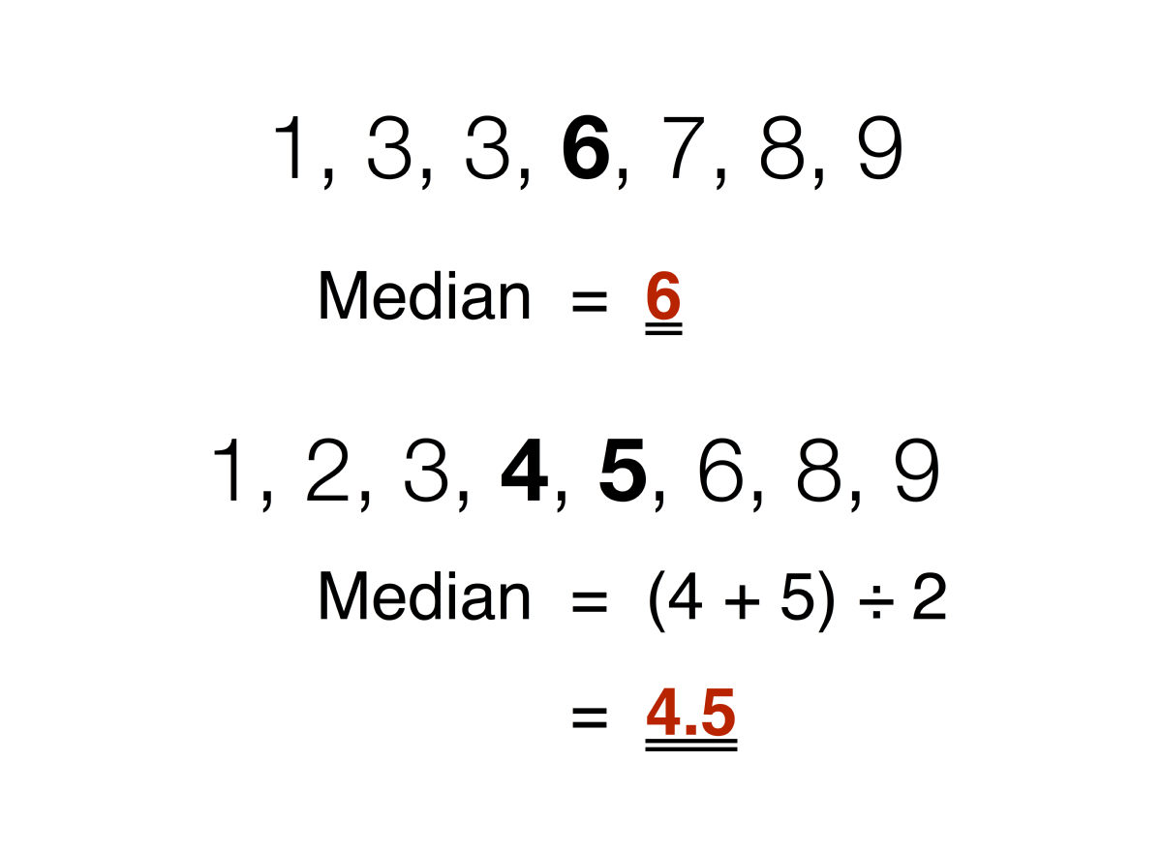
Median of Data

Slide 9
Quartile Q1 and Q2
Q1 is the "middle" value in the first half of the rank-ordered data set.
Q2 is the median value in the set.
Q3 is the "middle" value in the second half of the rank-ordered data set

Slide 10
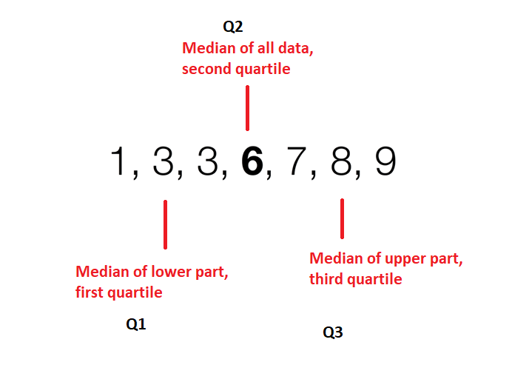
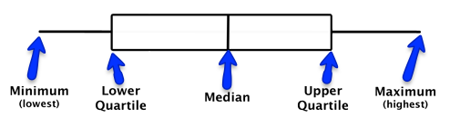
Quartile Q1 and Q2

Slide 11
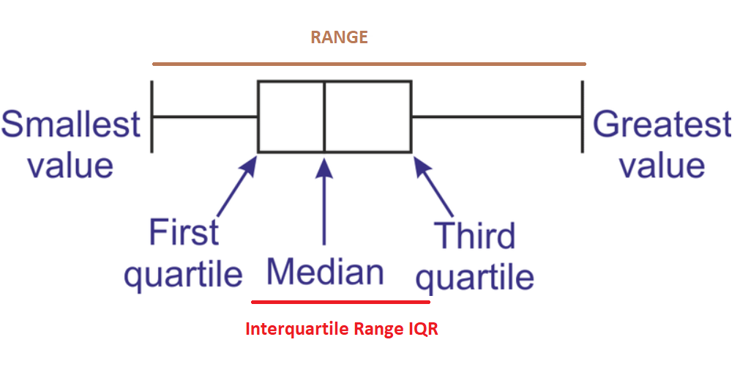
Interquartile Range IQR
The interquartile range (IQR) is a measure of variability, based on dividing a data set into quartiles.

Slide 12
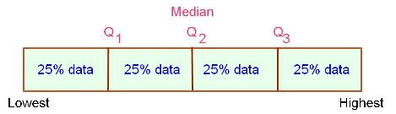
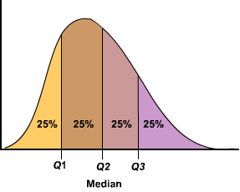
Percentage Distribution
The interquartile range is a measure of where the “middle fifty” is in a data set

Slide 13
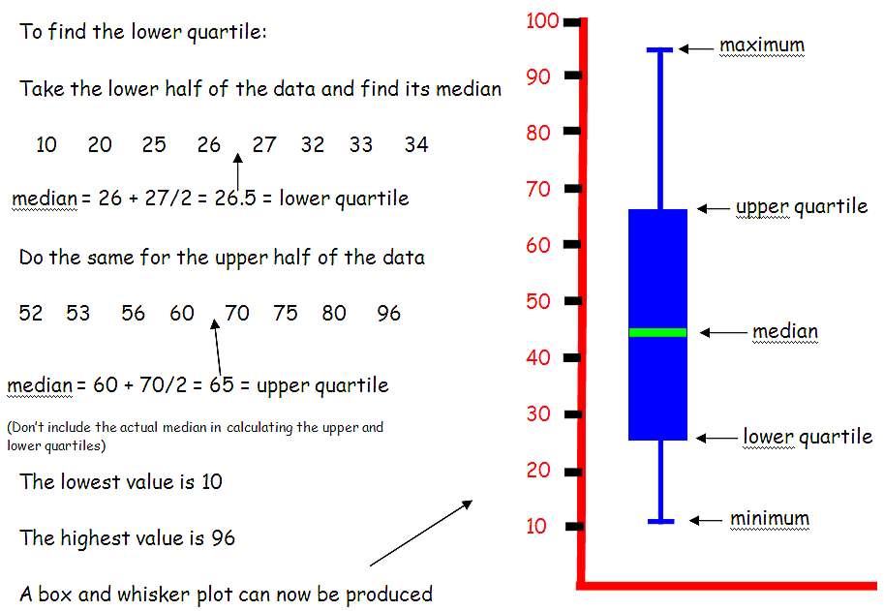
Box plot

Slide 14
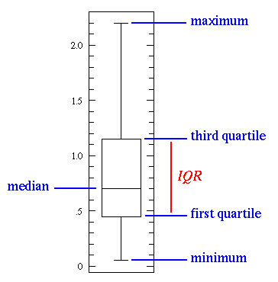
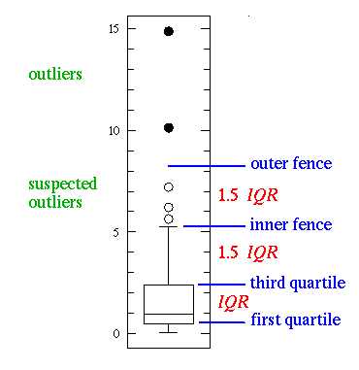
Outliers and Suspected Outliers

Slide 15
Thank You

