Slide 1
Week 5
EDP

Slide 2
Blocking Question1
M N NUMBER OF COMPARISON = M*N
MAX MATCHES =3
TOTAL comparison non matches= M * (N-1)
= 3 *(5-1) =12
number of comparison with non matches – ( number of comparison with matches)
= (3*5) – (3)
= 15-3
= 12
1
2
3
4
2
3
1
5

Slide 3
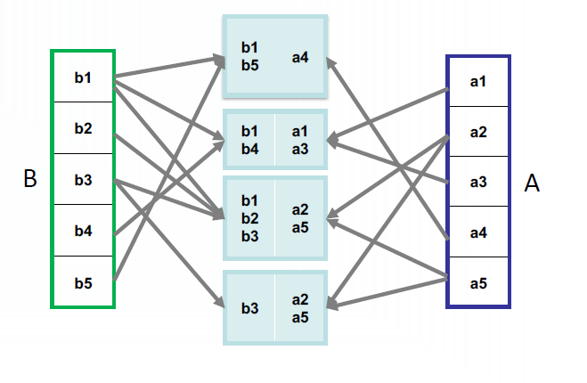
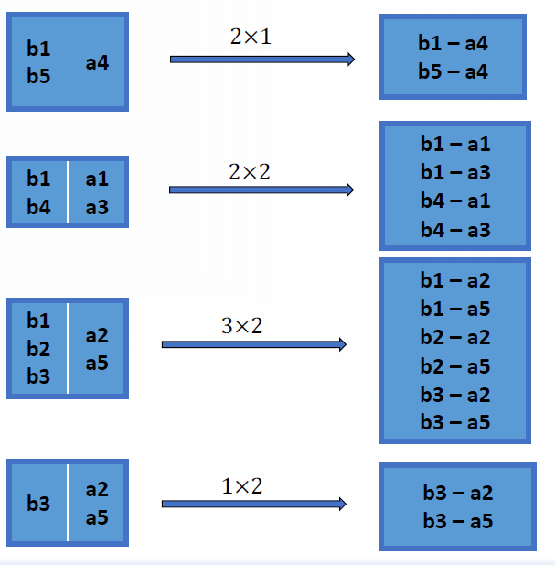
Single Linkage

Slide 4
Single Linkage
What is the smallest possible number of comparisons?
A
1
2
3
4
B
1
2
3
4
6
2
35
4
6
2
35
4
Number of Comparison 0

Slide 5
Single Linkage
What is the smallest possible number of comparisons that will return all matches? What is the value of b?
M comparison
B= min (m) max (N)
1-1
A
B
1
2
3
2-2
1
2
3
4
3-3
4

Slide 6
Single Linkage
What is the largest possible number of comparisons?
A
B
1
2
3
4
1 -6
2 -2
3-35
4-4
6
2
35
4
Number of Comparison M * N (B=1)

Slide 7
Single Linkage
If records are evenly allocated to b blocks, how many comparisons will be needed?
# of elements of Data base A in block
= M/b
# of elements of Data base B in block
= N/b
(m/b) * (n/b) * b
Number of comparison = (m/b) * (n/b) * b
A
B
1-6
2-3
1
2
3
4
6
2
35
4
3-35
4-4

Slide 8
Single Linkage
What is the advantage with a large b? What is the advantage with a small b?
Large b : Fast, inaccurate
Small b : slow, accurate
A
B
1
2
3
4
1 -6
2 -2
3-35
4-4
6
2
35
4
A
B
1-6
2-35
1
2
3
4
6
2
35
4
3-2
4-4

Slide 9
Single Linkage
In practice, a record is assigned to more than one block and records are not evenly allocated to blocks. How would this your analysis of large b vs small b?
Dominant block size is the bottleneck for efficiency. So, even if b is large, the blocking can still lead to inefficiency record linkage
Small b tends to correspond to inefficiency; but it does not automatically guarantee accuracy.

Slide 10
Single Linkage
What is the advantage of records being assigned to multiple blocks?
A
B
1-35
2-6
A
B
1-35
2-6
1
2
3
4
6
35
2
4
1
2
3
4
6
35
2
4
3-2
4-4
3-2
4-4
2

Slide 11
Data Duplication
Explain how the data duplicate detection problem relates to the data linkage problem. What are the major differences?
Data duplicate detection refers to finding records in the same dataset that belong to the same entity. For example in a medical dataset if a patient changed their name, we would like the history to link back to the same user. Thus in structured databases (or csv’s) we could have two records from the same patient with different names although having identical data otherwise,
What are the major differences? ( When we match in the same dataset it is more likely that we have to do fuzzy (approximate) matching - as in the name change example. There could also be privacy issues if the matching is not done properly. How do we do matching without snooping at data? ).

Slide 12
Question 3
One may evaluate the output of a data linkage system according to how many records are linked correctly and how many records are linked incorrectly.
What are the reasons two records could be linked incorrectly?
They do not correspond to the same entity. E.g. two persons with accidentally the same name, but not the same date of birth)

Slide 13
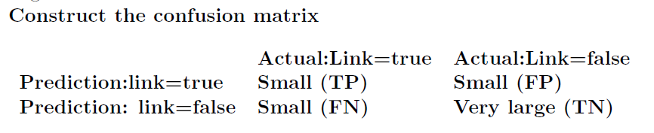
Question 4
Suppose a false positive (FP) is two records that are linked by the system, which
a human believes should not have been linked. Suppose a false negative (FN) is
when two records are not linked by the system, which a human believes should
have been linked. A true positive (TP) is two records linked by the system which
a human believes should have been linked and a true negative (TN) is two records
not linked by the system which a human believes should not have been linked.
What are the relative sizes of the categories TP, TN, FP, FN? In practice, how
might one calculate these sizes?

Slide 14
Question 5
It is desirable to minimize both FP and FN, but it may be difficult to minimize both simultaneously. Give an example application where minimizing FP is more important than minimizing FN. Give an example application where minimizing FN is more important than minimizing FP.
Centrelink scenario? Don`t want bogus matches between centrelink benefit record and employer income record because it brings grief to the person mistakenly sent a letter claiming money is owed (Centrelink seemed to be minimizing FN though!)
– Give an example application where minimising FN is more important than minimising FP (mailing list – target people with email about alumni opportunities, based on similarity of their name to historical enrolment list. Want to maximise the number of people reached (Reduce FN) and less concerned about emailing someone wrongly (FP)

Slide 15
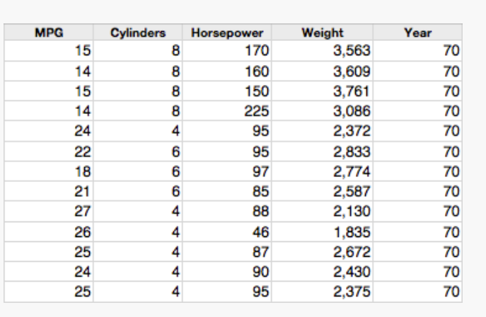
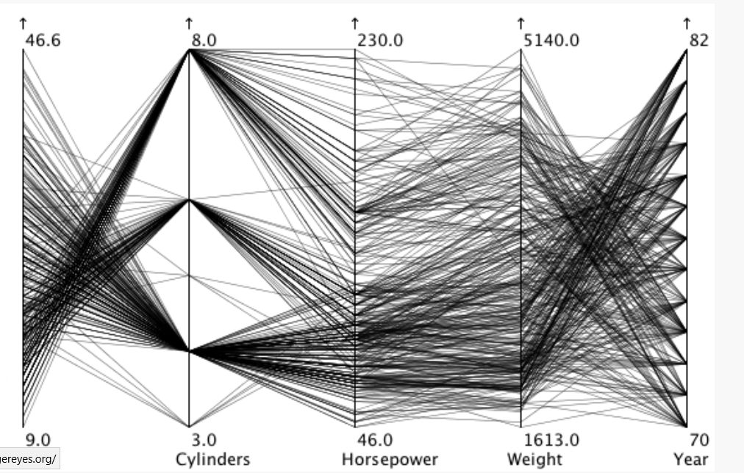
Parallel Coordinates
Notes:
correlation is much more direct between cylinders and horsepower: more cylinders means more horses. There are some crossing lines here as well, of course, so more cylinders do not always mean more power, but the general trend is clearly there.
Between horsepower and weight, the situation is similar: more horsepower means heavier cars in general, but there is some spread in the values of course.
Finally, the lines between weight and year cross over a lot, indicating that cars got lighter over the years

