Slide 1
Elements of Data Processing
Workshop 2

Slide 2
How do you describe data succinctly?
Compute numbers that summarise the data
Make pictures to look at; humans are very good at analysing information in a visual format

Slide 3
Data Type
Types of data
Continuous
Math operations can be performed
Discrete
Categorical (no ordering)
Ordinal (order is explicitly imposed)

Slide 4
Simple descriptive statistics
Count (N)
Sum
Min
Max
Average
Frequency
Variance, Standard deviation

Slide 5
Central tendency
Data has a distribution Typical value, centre, or location of the distribution
Mean
Median
Mode
Notes:
The mode of a set of data values is the value that appears most often. If X is a discrete random variable, the mode is the value x (i.e, X = x) at which the probability mass function takes its maximum value. In other words, it is the value that is most likely to be sampled.

Slide 6
Dispersion (variability)
The extent to which a distribution is stretched
Range
Variance
Standard deviation
Quartiles and percentiles

Slide 7
Dispersion (variability)
Variance
The calculation of variance uses squares because
It weights outliers more heavily than data very near the mean.
And prevents differences above the mean from canceling out those below, which can sometimes result in a variance of zero.

Slide 8
Dispersion (variability)
Standard deviation
A statistic that looks at how far from the mean a group of numbers is, by using the square root of the variance.
If the points are further from the mean, there is a higher deviation within the date; if they are closer to the mean, there is a lower deviation. So the more spread out the group of numbers, the higher the standard deviation.

Slide 9
Standard deviation vs variance
Standard deviation
looks at how spread out a group of numbers is from the mean, by looking at the square root of the variance.
The variance
measures the average degree to which each point differs from the mean—the average of all data points.
The standard deviation (σ) is simply the (positive) square root of the variance.
Because of the squaring, the variance is no longer in the same unit of measurement as the original data.
Taking the root of the variance means the standard deviation is restored to the original unit of measure and therefore much easier to measure.

Slide 10
Dispersion (variability)
Percentiles
Percentiles divide a data set into 100 equal parts. A percentile is simply a measure that tells us what percent of the total frequency of a data set was at or below that measure.
From this same perspective, the median, which has 50% of the observations at or below it, is the 50th percentile.
The pth percentile of a distribution is the value such that p percent of the observations fall at or below it.

Slide 11
Dispersion (variability)
Quartiles
As the name suggests, quartiles break the data set into 4 equal parts.
The first quartile, Q1, is the 25th percentile. The second quartile, Q2, is the 50th percentile. The third quartile, Q3, is the 75th percentile. It's important to note that the median is both the 50th percentile and the second quartile, Q2.

Slide 12
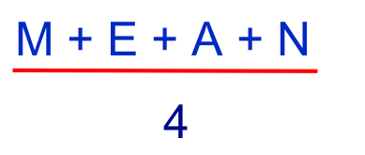
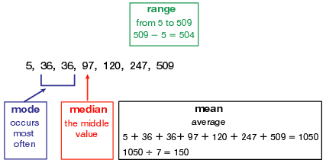
Mean of Data

Slide 13
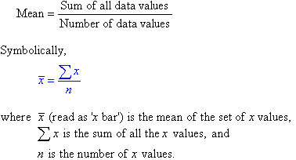
Mean of Data

Slide 14
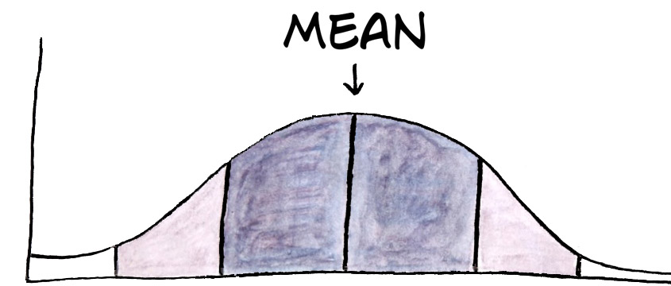
What does mean represent?
Mean or average means:
It represent usual, ordinary, nominal, typical or regular.
Most of the scores or age of people will fall within certain range, which is usually we call average.

Slide 15
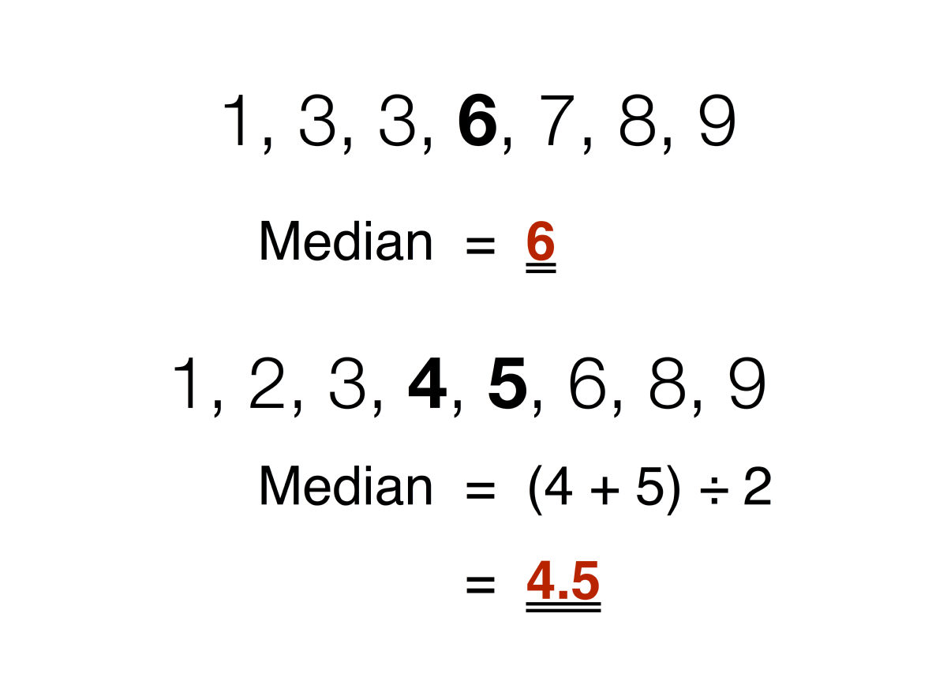
Median of Data

Slide 16
Quartile Q1 and Q2
Q1 is the "middle" value in the first half of the rank-ordered data set.
Q2 is the median value in the set.
Q3 is the "middle" value in the second half of the rank-ordered data set

Slide 17
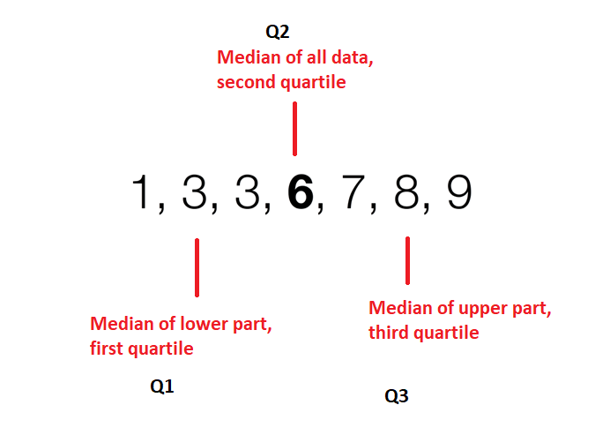
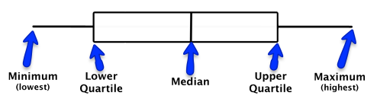
Quartile Q1 and Q2

Slide 18
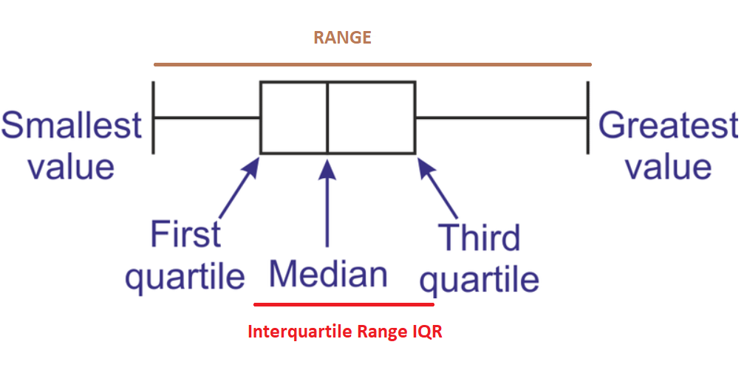
Interquartile Range IQR
The interquartile range (IQR) is a measure of variability, based on dividing a data set into quartiles.
The interquartile range is calculated as the difference between the third quartile and the first quartile.

Slide 19
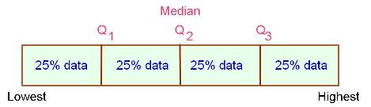
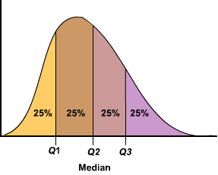
Percentage Distribution
The interquartile range represents the central portion of the distribution, and is a measure of where the “middle fifty” is in a data set

Slide 20
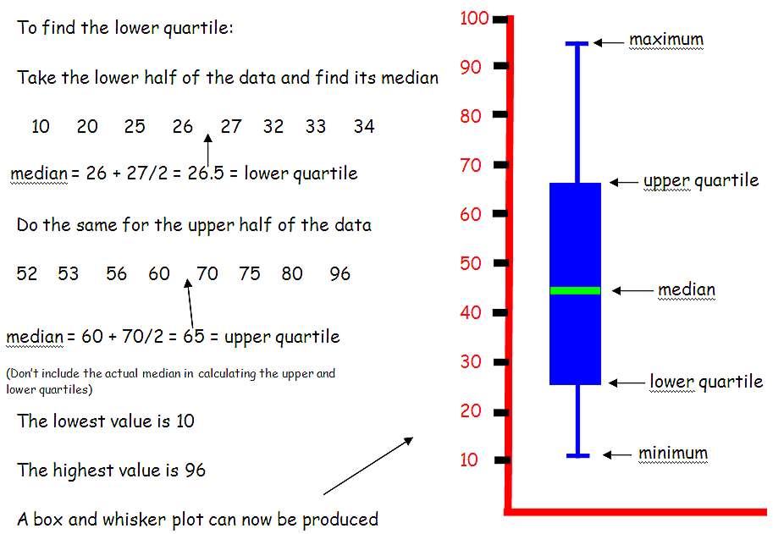
Box plot

Slide 21
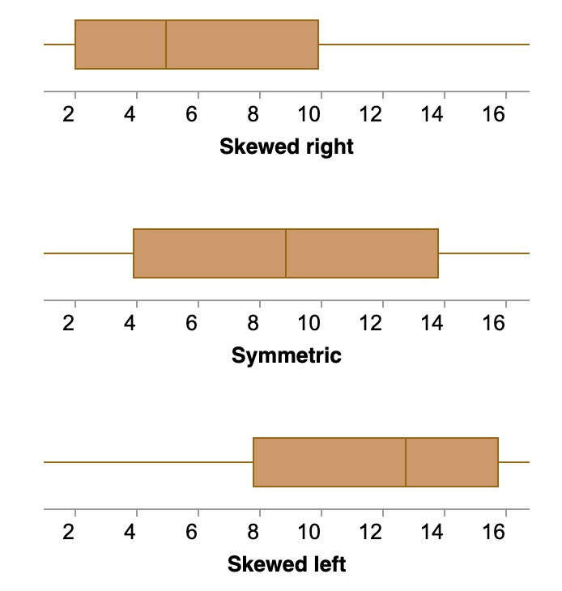
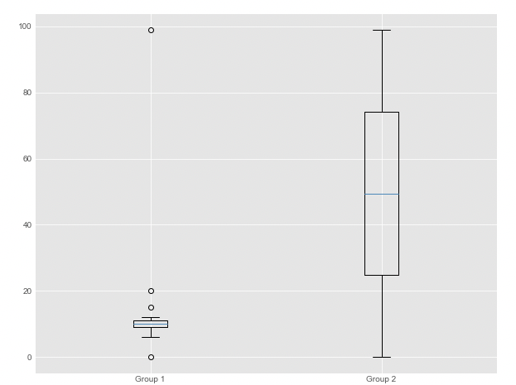
Box plot
Symmetric or skewed
Tightly or loosely grouped
Notes:
Skewed data show a lopsided boxplot, where the median cuts the box into two unequal pieces. If the longer part of the box is to the right (or above) the median, the data is said to be skewed right. If the longer part is to the left (or below) the median, the data is skewed left.

Slide 22
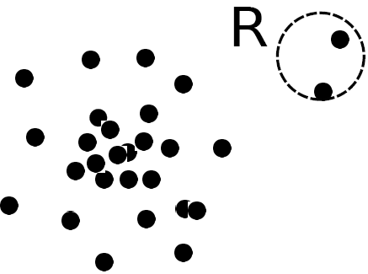
Outlier analysis
Outlier: A data object that deviates significantly from the normal objects as if it were generated by a different mechanism (Hawkins, 1980)
From a statistics perspective
Normal (non-outlier) objects are generated using some statistical process
The outlier objects deviate from this generating process

Slide 23
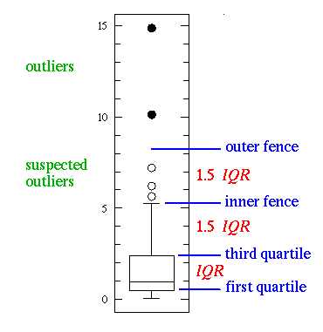
Outliers and Suspected Outliers
Suspected outliers (open black) : > 1.5×𝐼𝑄𝑅 above Q3 or belowQ1
Outliers (filled black) : > 3×𝐼𝑄𝑅 above Q3 or below Q1
Whiskers (inner fence)
‘Minimum’: Lowest number within 1.5 × 𝐼𝑄𝑅 of Q1
‘Maximum’: Highest number within 1.5 × 𝐼𝑄𝑅 of Q3

Slide 24
Thank You

