Slide 1
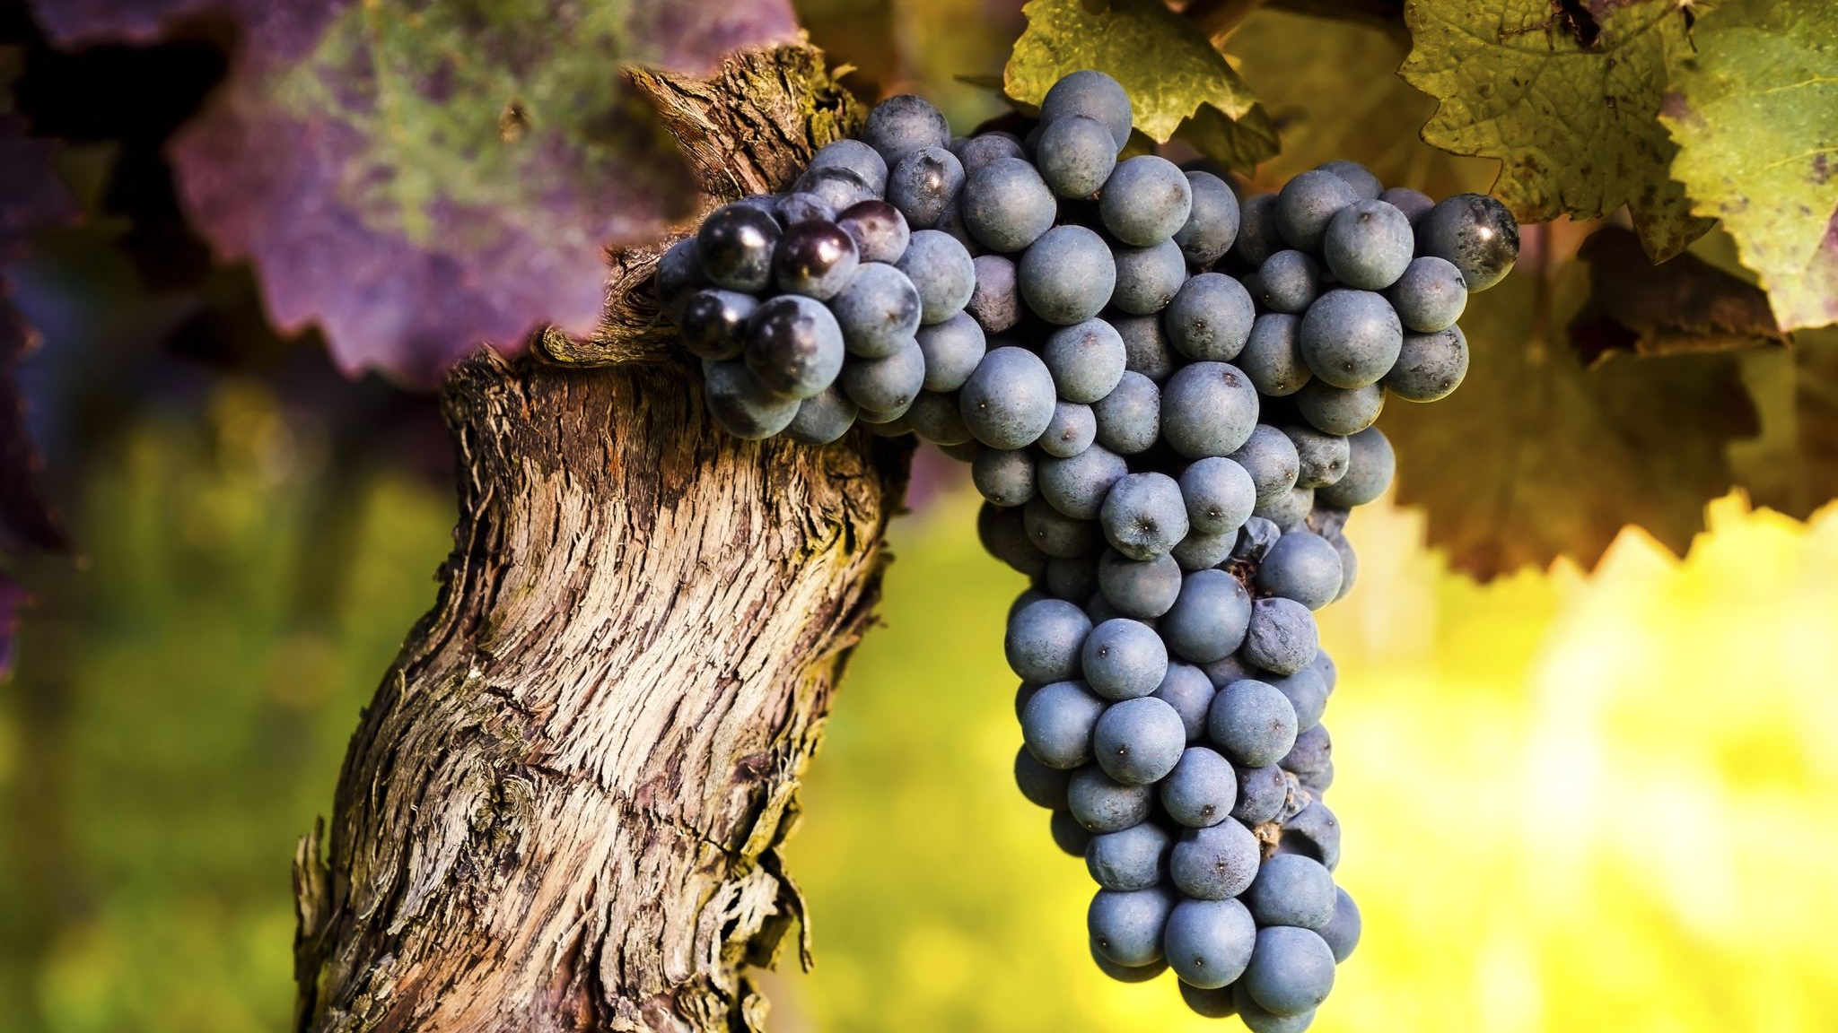
Wine Quality
Leighann Robinson
DS 160 SP 23

Slide 2
Why I Choose this topic
I chose the topic of wine quality for my final project because the distillation process and alcohol industry have always been topics that are interesting to me.
Although I'm not the biggest fan of wine, I find it interesting how different years and the different types can cause differences in taste and overall quality for consumers.

Slide 3
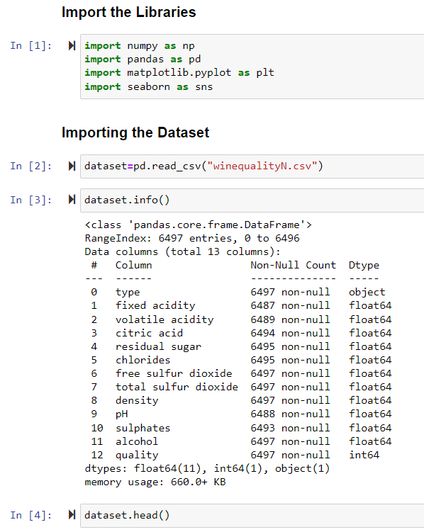
Importing the libraries & LOADING THE DATASET
Started by importing the necessary libraries for working with regression
Imported the dataset and saved it to the name "dataset"
Checked the info and head of the data to better see the layout of the columns

Slide 4
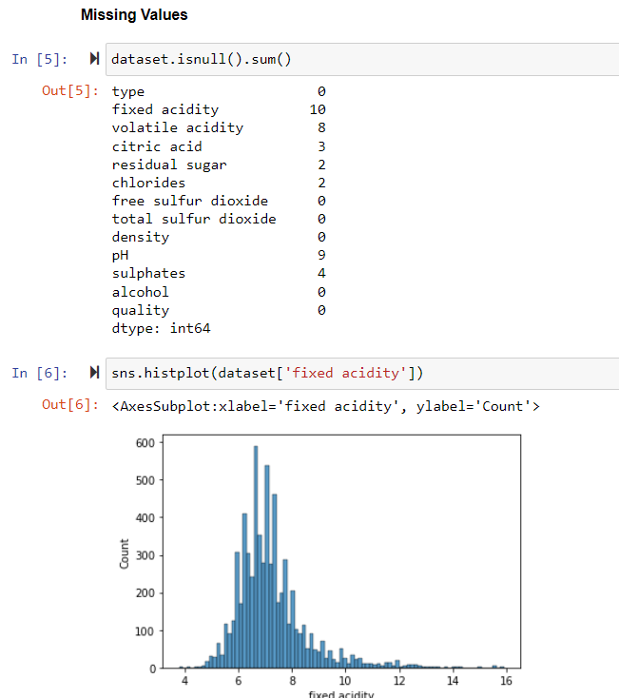
Data Preprocessing
The dataset that I used contained null values that needed to be imputed
Each column that had missing values were plotted using a histogram, and were imputed using either the mean or median

Slide 5
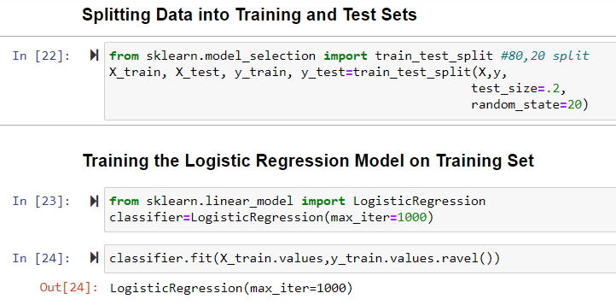
Splitting the Data & Training the model
The dependent variable for my testing was type of wine.
The train test split for the dataset is part of what I manipulated to see different results for the accuracy of the model.
80-20 split, random state 20
85-15 split, random state 20
70-30 split, random state 20
80-20 split, random state 1
Passing max_iter=1000 in the model was to set a maximum number of times for the entire passing of the training data through the algorithm.

Slide 6
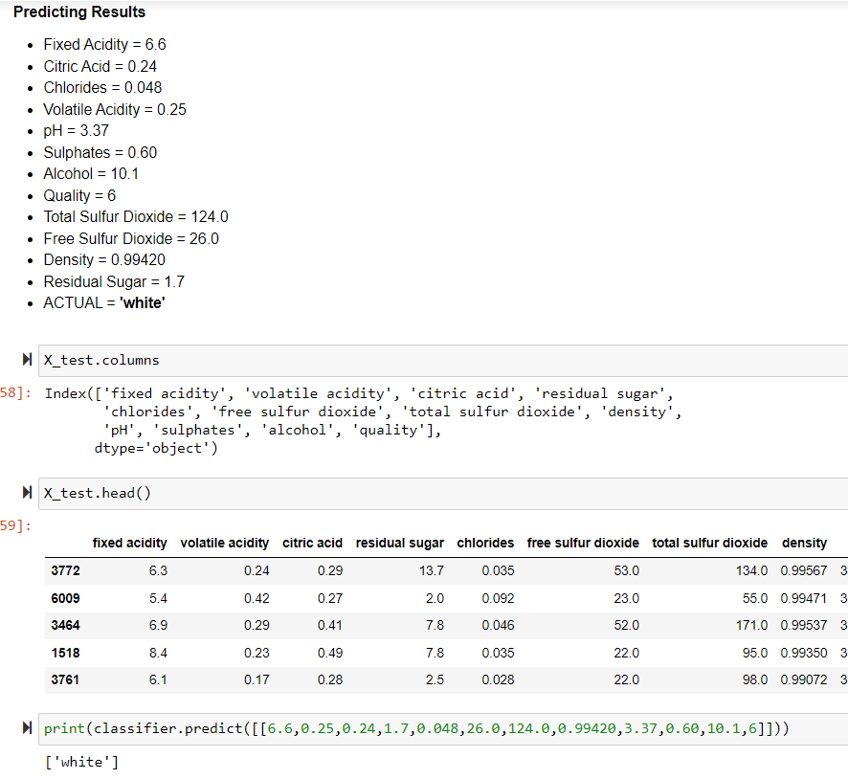
Testing the Model
Using the classifier.predict() function, I used the model to predict the type of wine for an entry with the measurements listed above "ACTUAL"
The model selected the correct type of wine for the measurements

Slide 7
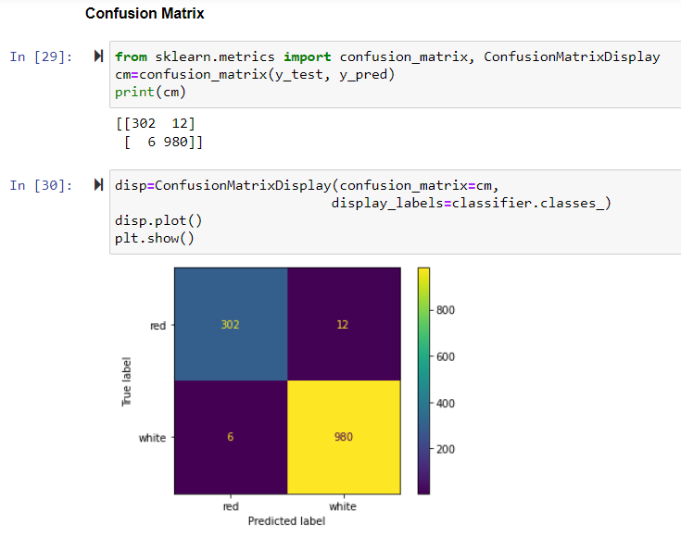
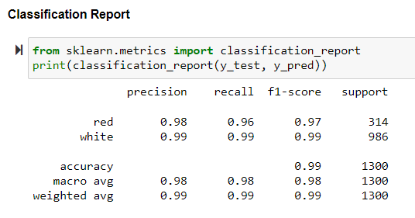
80-20 split Cm & Classification Report
Confusion Matrix:
302 Red wines predicted Red (TN)
12 Red wines predicted White (FP)
6 White wines predicted Red (FN)
980 White wines predicted White (TP)
Classification Report:
0.99 Accuracy
Precision of 0.98 (Red) & 0.99 (White)

Slide 8
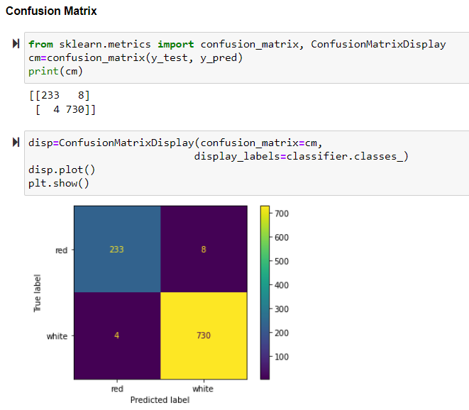
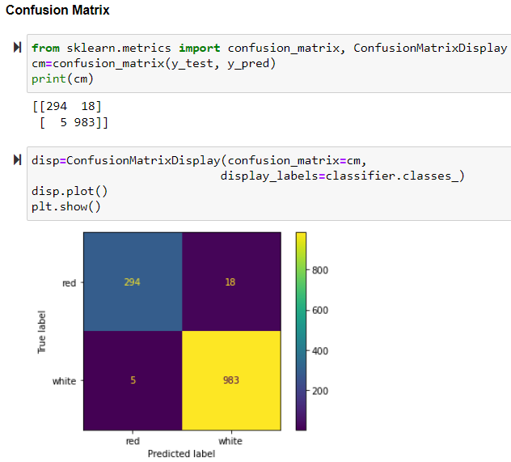
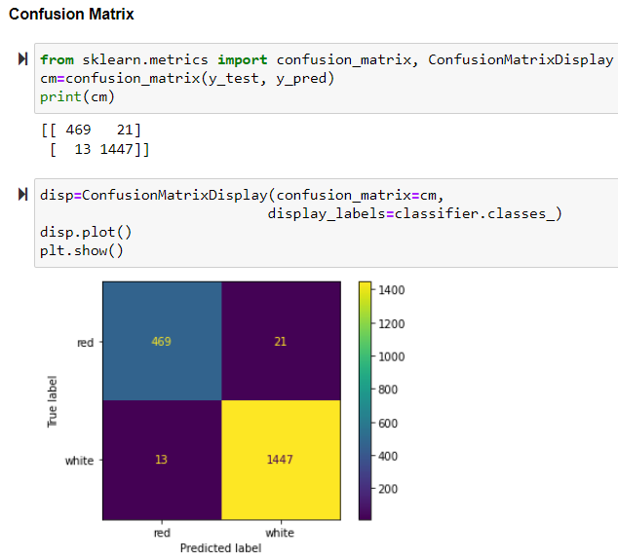
Comparison of Confusion Matrices
70-30 split
463 True negatives
21 False positives
13 False negatives
1447 True positives
80-20 split, random state = 1
294 True negatives
18 False positives
5 False negatives
983 True positives
85-15 split
233 True negatives
8 False positives
4 False negatives
730 True positives

Slide 9
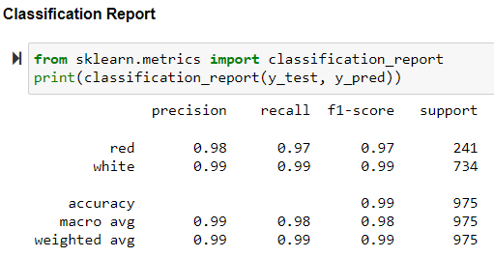
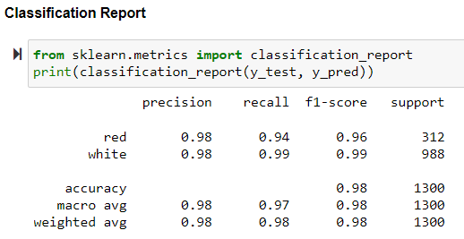
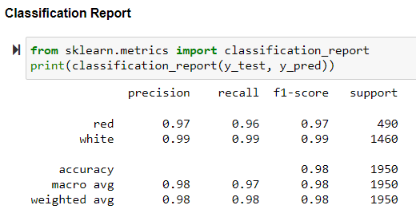
Comparison of Classification Reports
85, 15 split
80, 20 split
Random state = 1
70-30 and 80-20 with random state 1 all have a lower accuracy than that of the original 80-20 split with random state 20.
85-15 split has an accuracy of 0.99 like the original but has greater precision and recall values.
70, 30 split

Slide 10
Conclusion
The best iteration of the data that I had based solely on the classification reports was the 85-15 split using random state 20.
This iteration had the best overall precision, recall, and accuracy values of the four iterations I conducted.
However, this iteration also had the fewest number of support values from the data which could possibly cause the findings to be skewed.
Because of this difference, I believe that the original 80-20 split is most accurate.

Slide 11
Questions?

