Slide 1
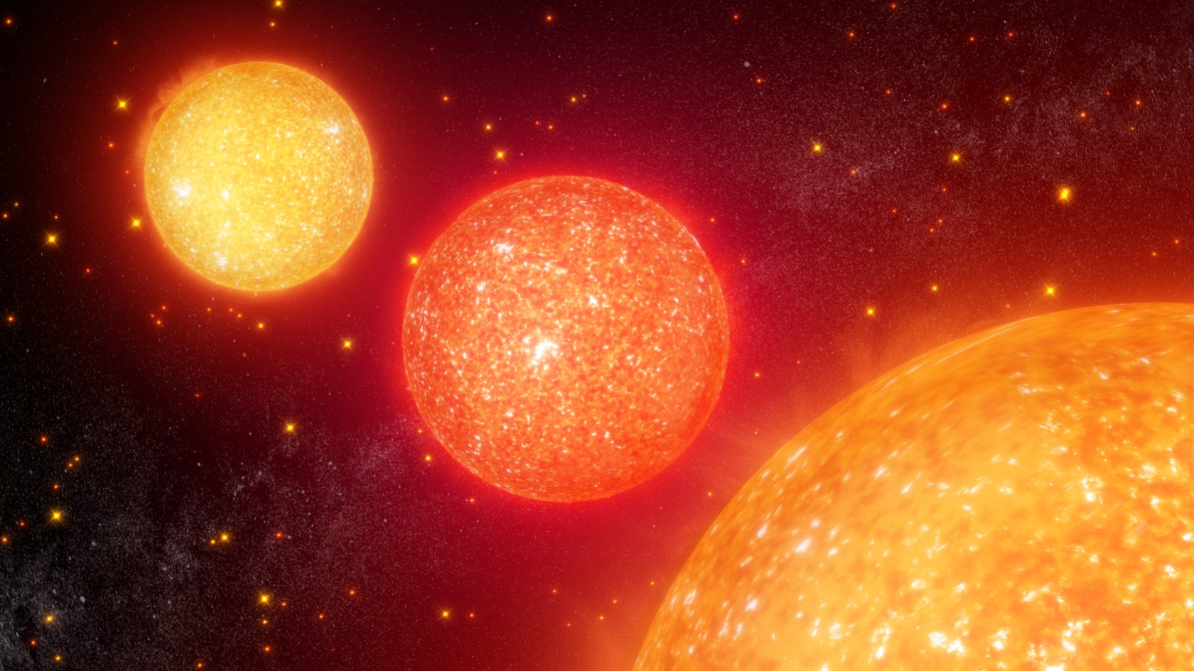
Stellar Label Estimates Through Use of Machine Learning
Mason Beaty and Leigh Harwell
Mentor: Dr. Hayden
NASA SVS | TESS Tunes into an All-sky ‘Symphony’ of Red Giants

Slide 2
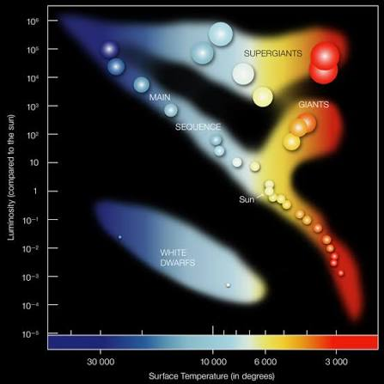
Red Giant Stars
Red giants are stars that exhaust the hydrogen in their core and have now started to burn it in its outer layers. Eventually these stars have a helium flash and burn helium in their core.
Red giants are significant to galactic archaeology.
They are very bright, allowing us to see them from large distances
Allow us to map out the structure of the Milky Way
Key observables in understanding how our Galaxy has formed and evolved
Wikipedia contributors. (n.d.). Red giant. In Wikipedia. Retrieved July 20, 2026, from https://en.wikipedia.org/wiki/Red_giant
Image credit: Chandra :: Educational Materials :: Pulsating Variable Stars and the Hertzsprung-Russell Diagram
Notes:
Our main focus for the project is on Red Giant stars. These stars are significant due to the brightness of these stars allowing us to observe them from far distances, they are also some of the oldest stars being one of the last stages of a stars life cycle this can give us information about the structure of the milky way and understanding how it formed and evolved.

Slide 3
Red Giant Stars
Red giants are stars that exhaust the hydrogen in their core and have now started to burn it in its outer layers. Eventually these stars have a helium flash and burn helium in their core.
Red giants are significant to galactic archaeology.
They are very bright, allowing us to see them from large distances
Allow us to map out the structure of the Milky Way
Key observables in understanding how our Galaxy has formed and evolved
However there are two different types of Red Giants.
Wikipedia contributors. (n.d.). Red giant. In Wikipedia. Retrieved July 20, 2026, from https://en.wikipedia.org/wiki/Red_giant
Image credit: Chandra :: Educational Materials :: Pulsating Variable Stars and the Hertzsprung-Russell Diagram
Notes:
However there are two different types of red giants.

Slide 4
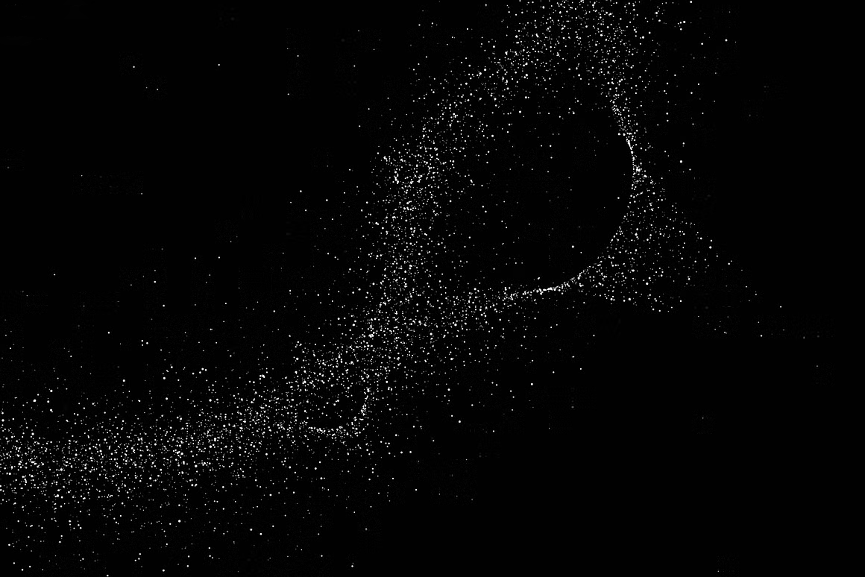
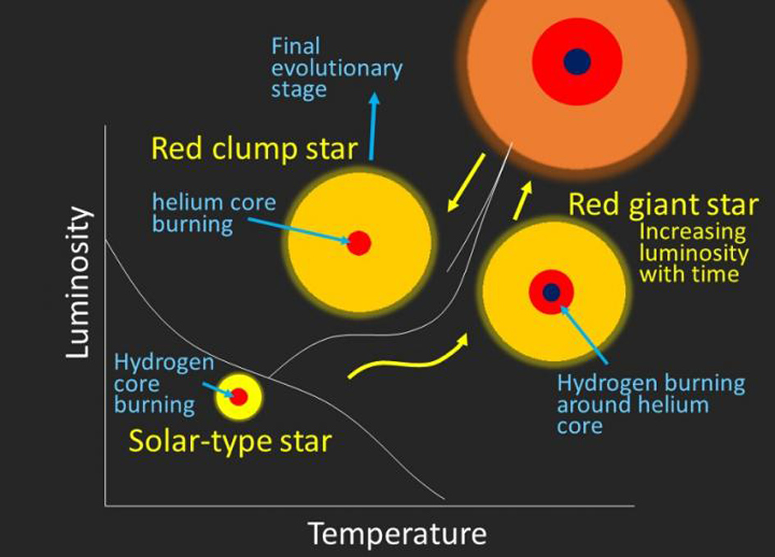
Red Giant Branch vs Red Clump Stars
Red Giant Stars
Red Clump Stars
The stars will pulsate differently. Best classification method is through Asteroseismology
RGB
Hydrogen burning shell
Low period spacing
RC
Star that ignites helium fusion in their cores resulting in a “helium flash”
High period spacing
Hawkins, K., Ting, Y.-S., & Rix, H.-W. (2017). Photospheric diagnostics of core helium burning in giant stars. arXiv e-prints, arXiv:1712.02405 (Accepted to The Astrophysical Journal).
Notes:
Stars in the red giant branch are stars that have started to expand due to them now burning hydrogen in shells around the core rather than in the core. Stars in the red clump branch are stars that have started to burn helium in their cores and are the final evolutionary stage of a stars life cycle. Therefore RC stars are far older than RGB stars.

Slide 5
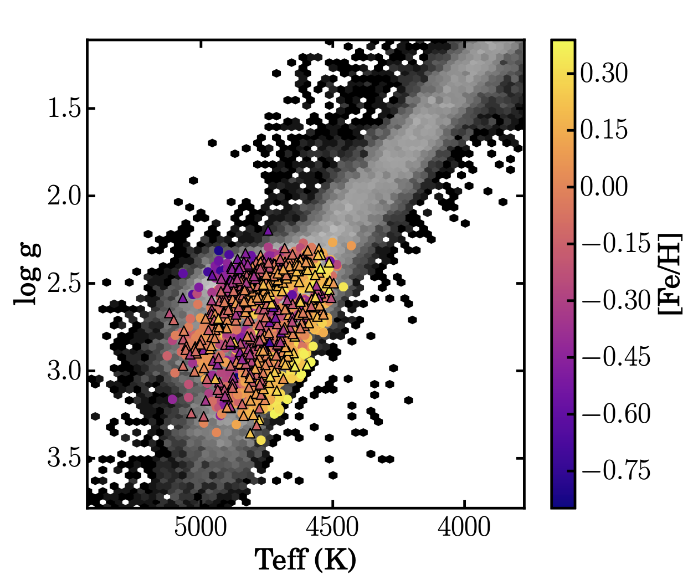
Red Giant Branch vs Red Clump Stars
Red Giant Stars
Red Clump Stars
Best classification method through Asteroseismology (different t=lum and diff ages)
RGB
High mass Hydrogen burning shell
Low period spacing
RC
High-Mass star that ignites helium fusion in their cores resulting in a “helium flash”
High period spacing
Hawkins, K., Ting, Y.-S., & Rix, H.-W. (2017). Photospheric diagnostics of core helium burning in giant stars. arXiv e-prints, arXiv:1712.02405 (Accepted to The Astrophysical Journal).
Notes:
However there is a problem when it comes to identify which red star is which type of giant. RGB and RC stars of similar size and temperature are indistinguishable, They will often overlap on the HR diagram. This makes it very hard to define the stars type purely through spectra like we can with other types of stars. However there is one way to identify them through a period spacing variable. With RGB stars having a lower period than RC stars.

Slide 6
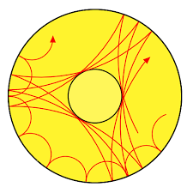
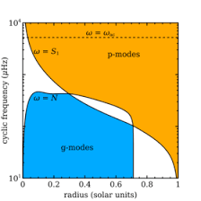

Asteroseismology
Oscillations in stars from near-surface convection can have either or both p-mode or g-mode characteristics
Stronger coupling between g-mode and p-mode leading to appearance of observable mixed modes in oscillation spectrum
  This can be caused by RC stars core having lower density than a RGB star
Period spacing are the time intervals between a star's mixed modes (p-mode and g-mode), vibrations that combine the characteristics of sound waves and gravity waves inside the star.
P-mode
G-mode
Associated with stellar envelope with pressure as a restoring force
Probe its core with buoyancy as a restoring force.
Bedding Tim, Huber Daniel. “ASTR 5970 Lecture 16-Seismology.”https://docs.google.com/presentation/d/1n4gnIVjk0QskgZYAVGrrYui_9yyZ9EoGr3Z9NKOY4KY/edit?slide=id.g2feb84dece6_0_122#slide=id.g2feb84dece6_0_122
Ness et al. 2016, "Spectroscopic Determination of Masses (and Implied Ages) for Red Giants," The Astrophysical Journal, 823:114 https://iopscience.iop.org/article/10.3847/0004-637X/823/2/114/pdf
Notes:
Period spacing is found through asteroseismology, which is the study of star quacks (earthquakes on stars). This is caused by the pressure caused by convection and the gravity acting against each other keeping the star from collapsing in on itself. This is where we get the period spacing which is the period between oscillations caused by the mixed mode of pressure and gravity. This allows us to determine what it occurring inside the star and then that can allow us to identify weather it is a RGB or an RC star.

Slide 7
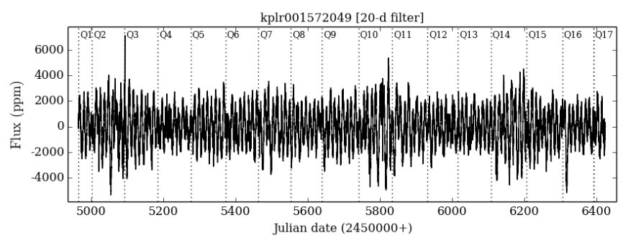
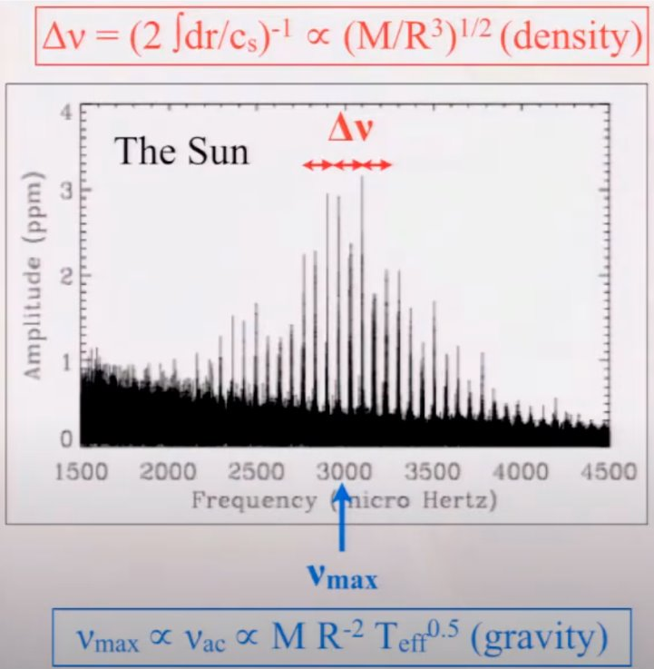
How We Get Data
Asteroseismology uses the frequency of stellar oscillations which creates very small changes in the luminosity of a star, probing the interior of the star
Taking a fourier transform of the light curve provides a power spectrum for oscillations
Light Curve for a Kepler Star
Solar Oscillation Power Spectrum
Star Clusters: Inside the Universe's Stellar Collections - NASA Science​

Slide 8
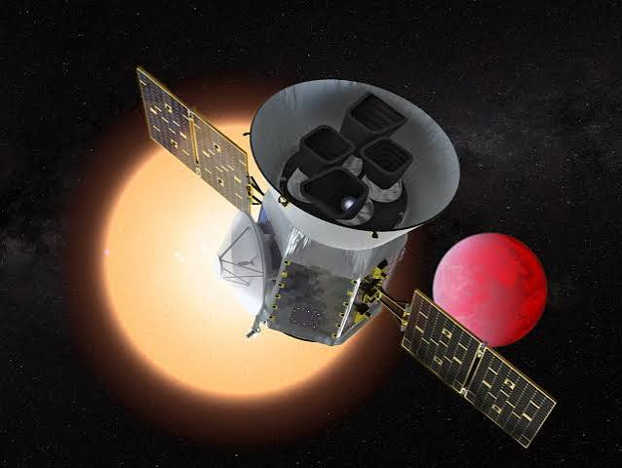
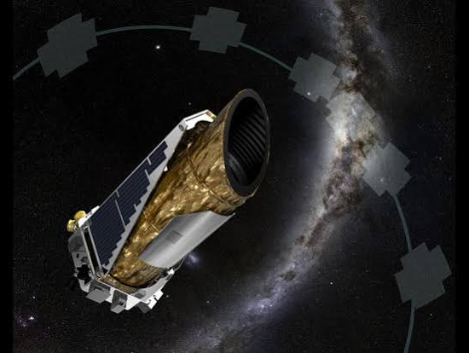
Kepler and TESS
TESS
Kepler’s ultra-sensitive photometers capture the rhythmic pulses of the stars brightness.
TESS (Transiting Exoplanet Survey Satellite) has a secondary mission for gathering continues brightness measurements of stars.
Kepler
Krapfl, M. (2019, November 19). NASA's TESS helps astronomers study red-giant stars, examine a too-close planet. Iowa State University News Service. https://www.news.iastate.edu/news/nasas-tess-helps-astronomers-study-red-giant-stars-examine-too-close-planet
Cermak, A. (2026, January 5). Kepler / K2. NASA Science. https://science.nasa.gov/mission/kepler/
Brill, J. (2026, February 10). Asteroseismology using the Galactic Bulge Time Domain Survey. NASA Science. https://science.nasa.gov/mission/roman-space-telescope/asteroseismology-using-the-galactic-bulge-time-domain-survey/
Huber, D., Chaplin, W. J., Christensen-Dalsgaard, J., Gilliland, R. L., Kawaler, S. D., Kjeldsen, H., & Working Groups of the Kepler Asteroseismic Science Consortium (KASC). (2013). Asteroseismology with NASA's Kepler mission. American Astronomical Society Meeting Abstracts, 221, 301.01. https://ui.adsabs.harvard.edu/abs/2013AAS...22130101H/abstract
Notes:
The data that we are using is collected by space mission telescopes such as Kepler and TESS. One of their many missions is to observe the period spacing of red giants. For our project we are specifically looking at data collected by Kepler. This is one of the many missions that requires both these telescope to be space missions, for asteroseismology we can not use a telescope on earth's surface due to the atmosphere impacting the light curve from the star which can result in a lot of error in the data. Kepler has observed the sky for astro seismic data over a span of a few years which allows it to have accurate seismic labeling for the star.

Slide 9
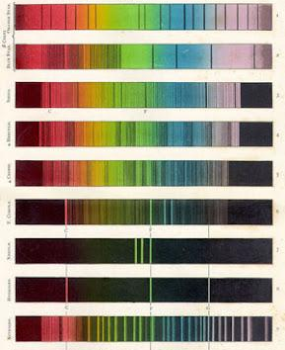

APOGEE
A large-scale, stellar spectroscopic survey conducted in the near infrared portion of the electromagnetic spectrum.
The survey provides spectra that can then be used to derive effective temperature, surface gravity, and metallicity of the observed stars emission and absorption lines.
Sloan Digital Sky Survey. (n.d.). APOGEE. SDSS Data Release 17. Retrieved July 20, 2026, from https://www.sdss4.org/dr17/irspec/
Notes:
We are also using data collected in the apogee survey. This survey contains spectra from stars from all over the night skiing. The spectra allows us to observe the absorption and emission lines and use that to derive the metallicity (metals are any element that is not hydrogen or helium in astrophysics), effective temperature and surface gravity.

Slide 10
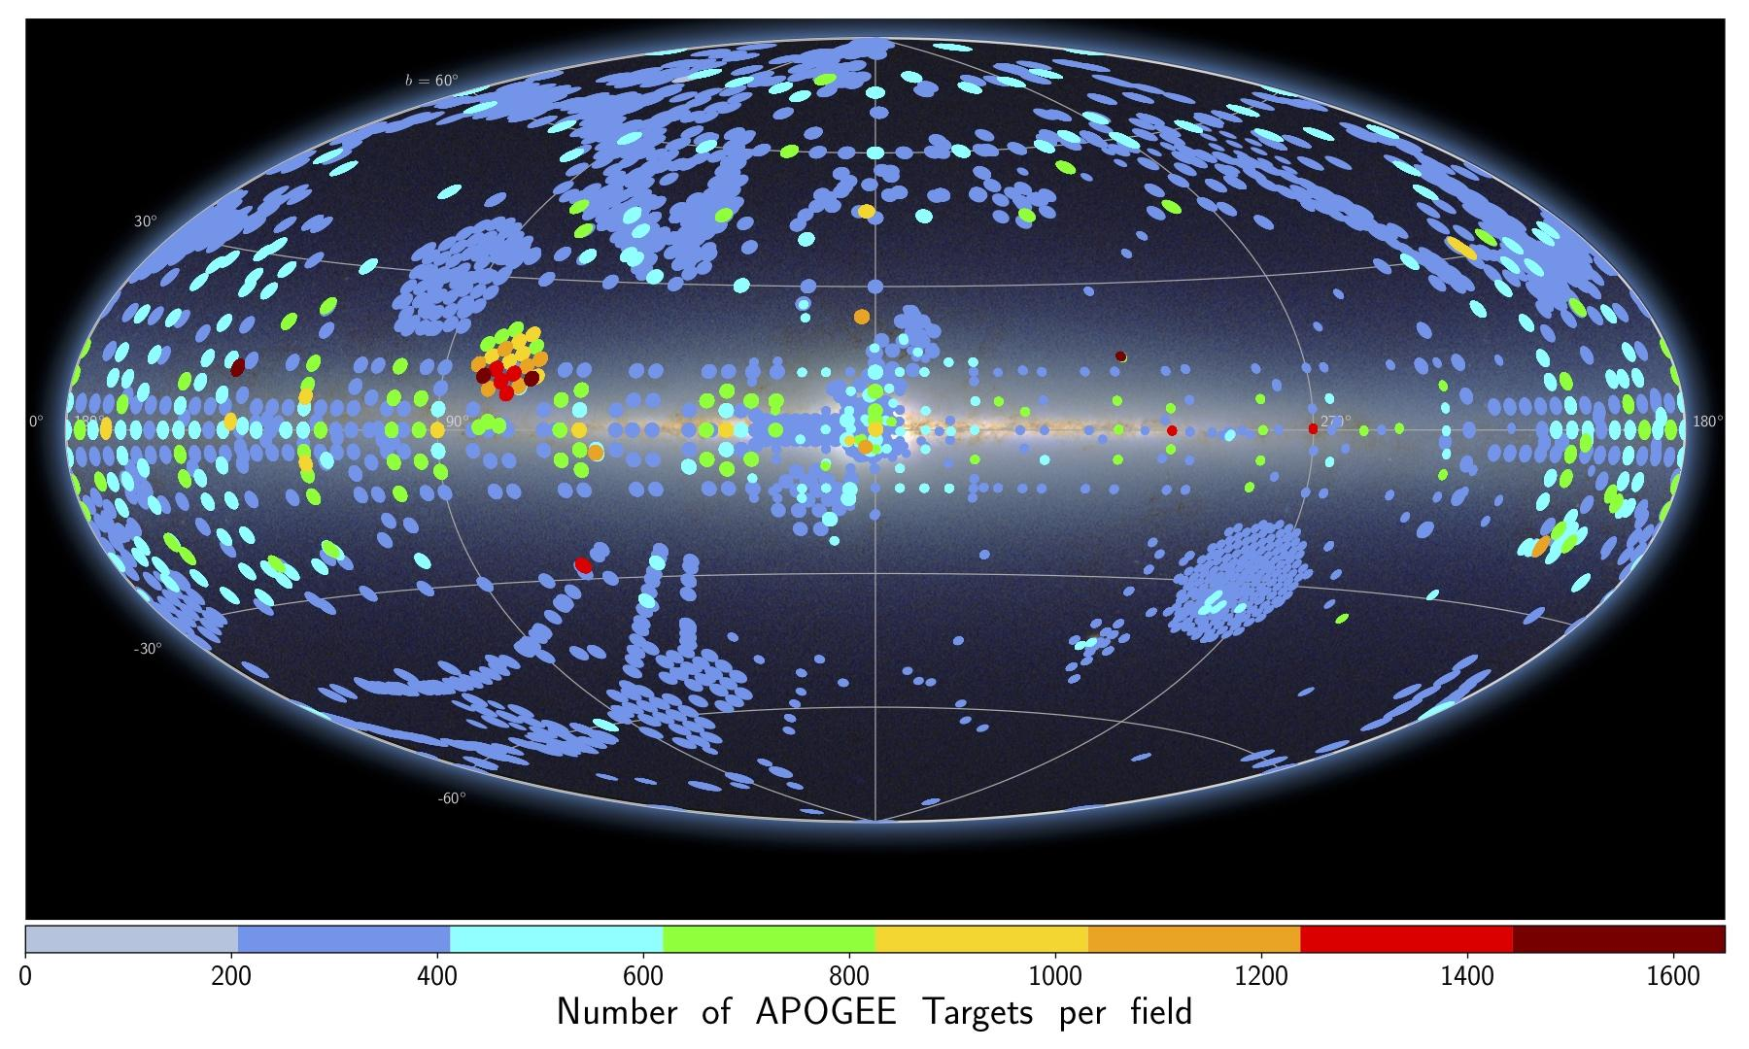
Main Problem
There are millions of spectral data, with emission and absorption lines containing information about temperature, surface gravity, elemental abundances, and more
  Goal: link spectra and seismic data
​
This however this does not help us when it comes to differentiating between stars in the Red Giant Branch and in the Red Clump of the HR diagram
  More luminous therefore more data
  These are two different stages in a giants life cycle.
  Important for: Stellar ages and Mass loss
Kepler Field
APOGEE observation fields on an all-sky image. Each field is color-coded by the number of targets in that field.
Notes:
However unlike APOGEE, Kepler has only been able to collect data on a small portion of the sky due to the long observation times that it required to get accurate seismic data from a stars light curve. With Kepler's observation field being this small clump of dots. This means that we do not have a lot of astro seismic data but APOGEE has data from observation fields all over the sky. Which in turn means that we do not have a lot of red giants properly/accurately identified are RGB or RC.

Slide 11
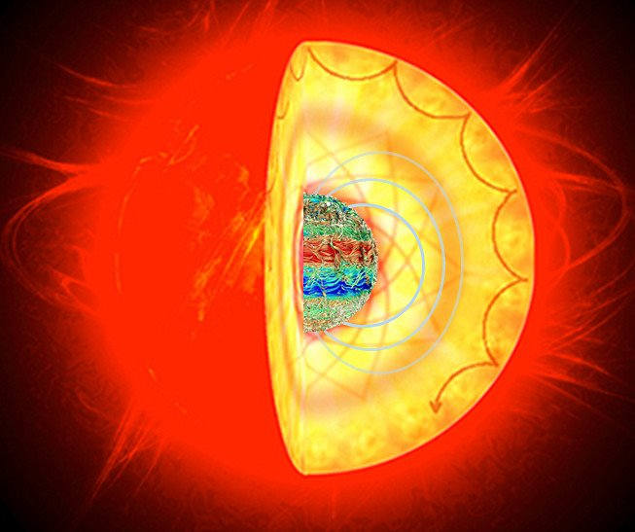

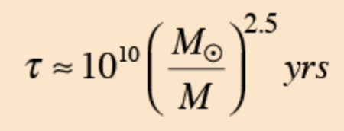
Main Problem
Mass can be estimated through seismic scaling relations in asteroseismology
Age is one of the hardest characteristics to determine about a star
Different masses (along with their evolutionary phases) can provide information on how fast stars burn their fuel, giving a huge constraint on stellar age
Can we use spectra to encode this information?
Ness, M., Hogg, D. W., Rix, H.-W., Martig, M., Pinsonneault, M. H., & Ho, A. Y. Q. (2016). Spectroscopic
determination of masses (and implied ages) for red giants. The Astrophysical Journal, 823(2), 114.
Image credit: Rafael A.García (SAp CEA),Kyle Augustson (HAO), Jim Fuller (Caltech) & Gabriel Pérez (SMM,IAC), Photograph from AIA/SDO.​

Slide 12
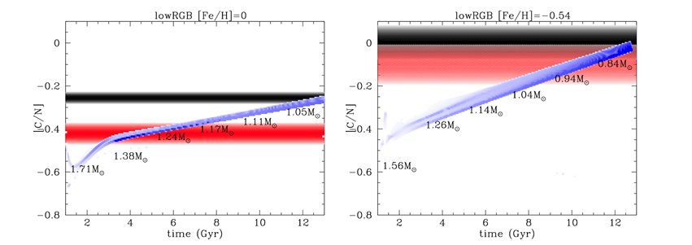
Other Indicators and Methods
Dredge-ups mix CN-processed material to the surface, lowering [C/N] over time​
Different evolutionary states will have different types of CN mixing due to things such as a helium flash ​
Age can also be estimated through gyrochronology or isochrone fitting​
Asteroseismology is a better method, reducing uncertainty gaps that are up to 1-2 GYA
Masseron, T., & Gilmore, G. (2015). “Carbon, nitrogen and α-element abundances determine the formation sequence of the Galactic thick and thin discs.” Monthly Notices of the Royal Astronomical Society, 453(2), 1855–1866.

Slide 13
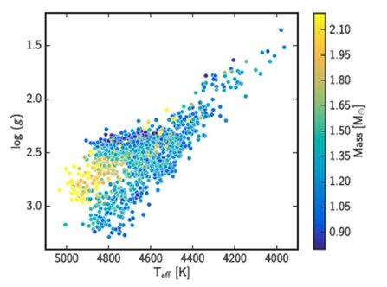
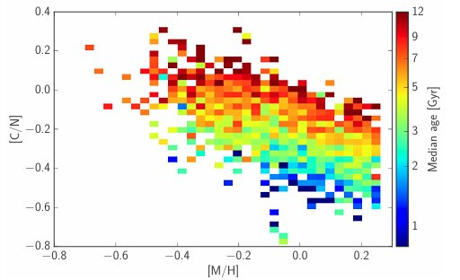
TheCannon
TheCannon is a machine learning tool that can learn the
relationship between a star's spectra and its known
physical properties
The training set is Kepler seismic data and APOGEE spectra
Steps of use:
Get and format data
Use reference set to fit a spectral model (training)
Make sure the model is sensible, perform a leave-n-out cross-validation
Then use it to infer labels from all the other spectra in the dataset (testing)
Once seismic masses are found for a few stars, those
stars can then train stars with no mass data
M. Martig et al. 2015 Red giant masses and ages derived from carbon and nitrogen abundances
Notes:
For our research we are using the machine learning tool known as TheCannon. TheCannon is given data from both kepler and APOGEE and uses training labels that make up 80%-85% of the the data and test labels 15%-20% of the data. It will also be trained to identify multiple labels like effective temperature, surface gravity and metallicity (or more) which it will predict and use to help make its period spacing prediction more accurate. The tool using this data to identify differences in RGB and RC of similar properties spectra and what correlation it might have compared to the astro seismic data. Once it has been trained on this data set it should be able to predict the period spacing of each star separating the stars into the two types of red giants.

Slide 14
Goal of TheCannon
Spectra should therefore be able to encode information regarding the evolutionary states, masses, and ages of stars
​
Machine Learning Process
Training data with known spectral and seismic data
TheCannon fits a generative
model, learning how each pixel
fits each label​
A new trained model is
produced ​
Data with unknown
labels is introduced ​
"Which labels best reproduce
this star using the trained model?"​
TheCannon infers new labels for this new data ​

Slide 15
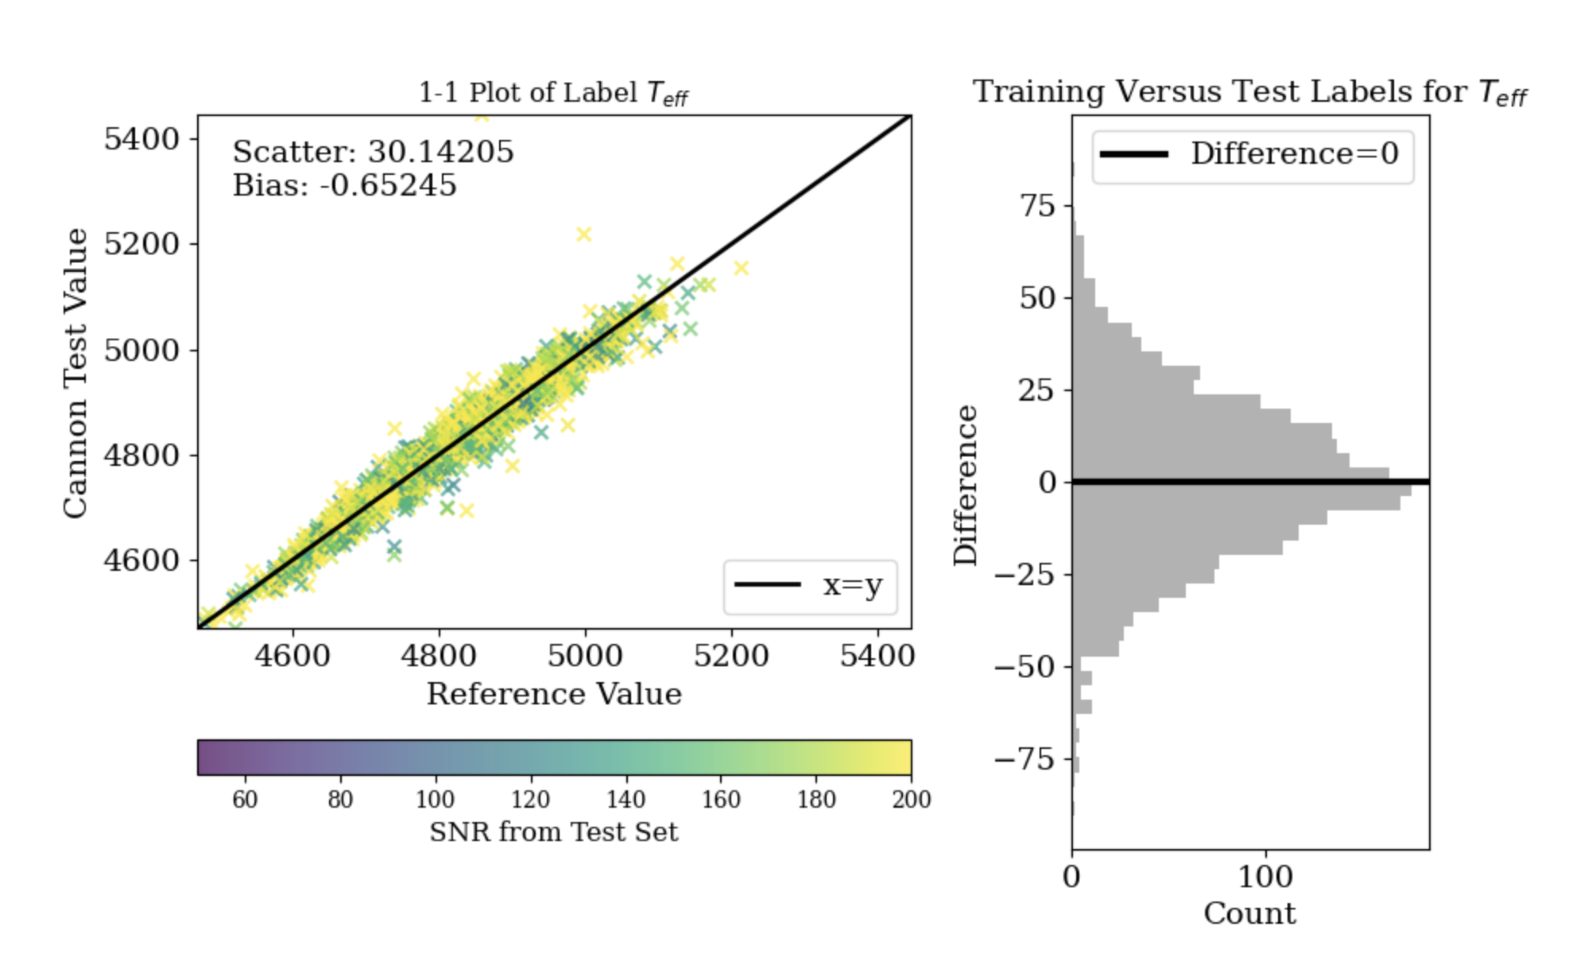
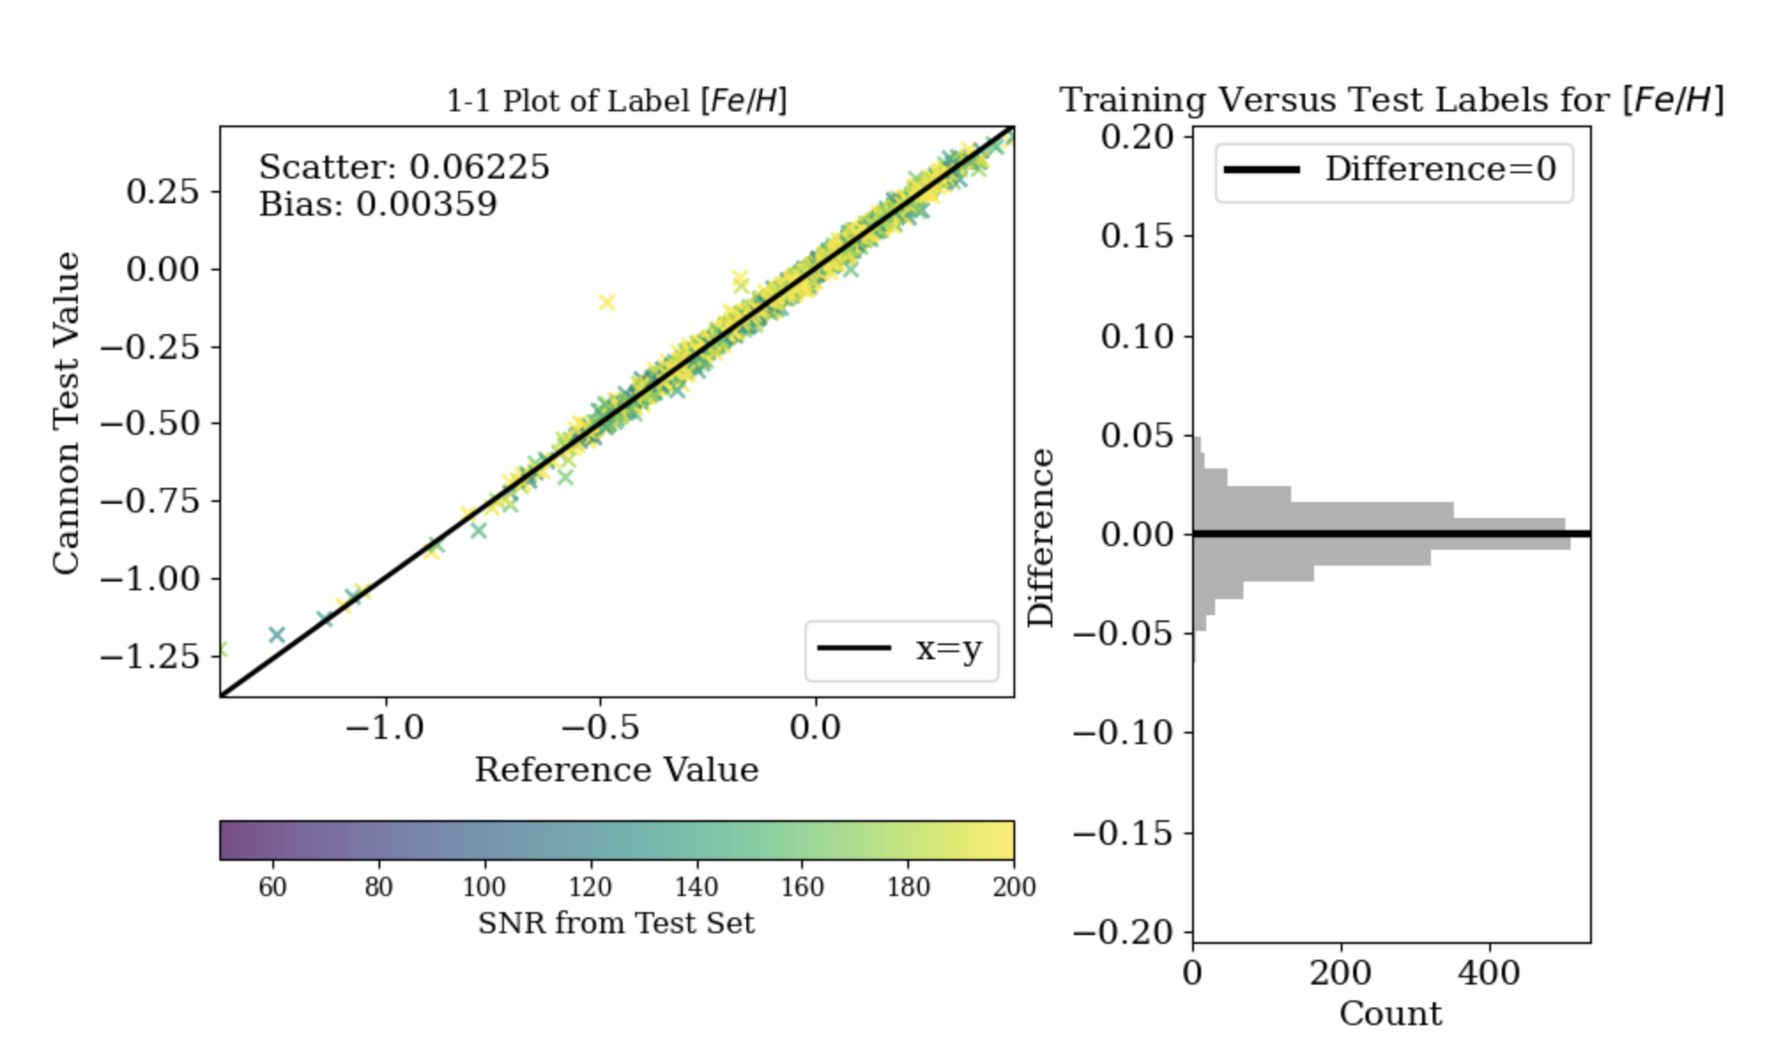
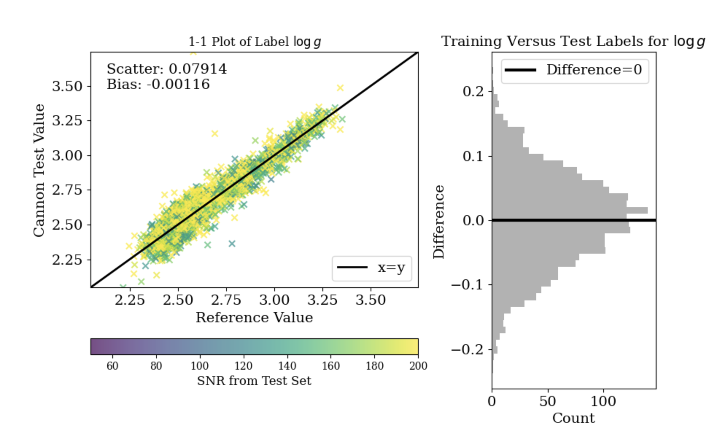
Results
Some of the 1-to-1 plots from TheCannon of labels that I chose to train it on to help constrain the label estimates of period spacing to be more accurate.
Trained on effective temperature, surface gravity (log scaled), and iron and magnesium ratio from the stars spectra. This is how well TheCannon predicted these labels.
1-1 Plot of Label T_eff (K)
Cannon Test Value
Reference Values
1-1 Plot of Label [Fe/H]
1-1 Plot of Label Log g
Cannon Test Value
Cannon Test Value
Reference Values
Reference Values
Notes:
After training TheCannon was able to make one-to-one plots comparing the reference values and the predicted values it found. The effective temperature has the best scattering compared to some of my other labels with TheCannon being most accurate. Over all TheCannon was able to predict each label with success and this shows that the training worked and that it has good fitting.

Slide 16
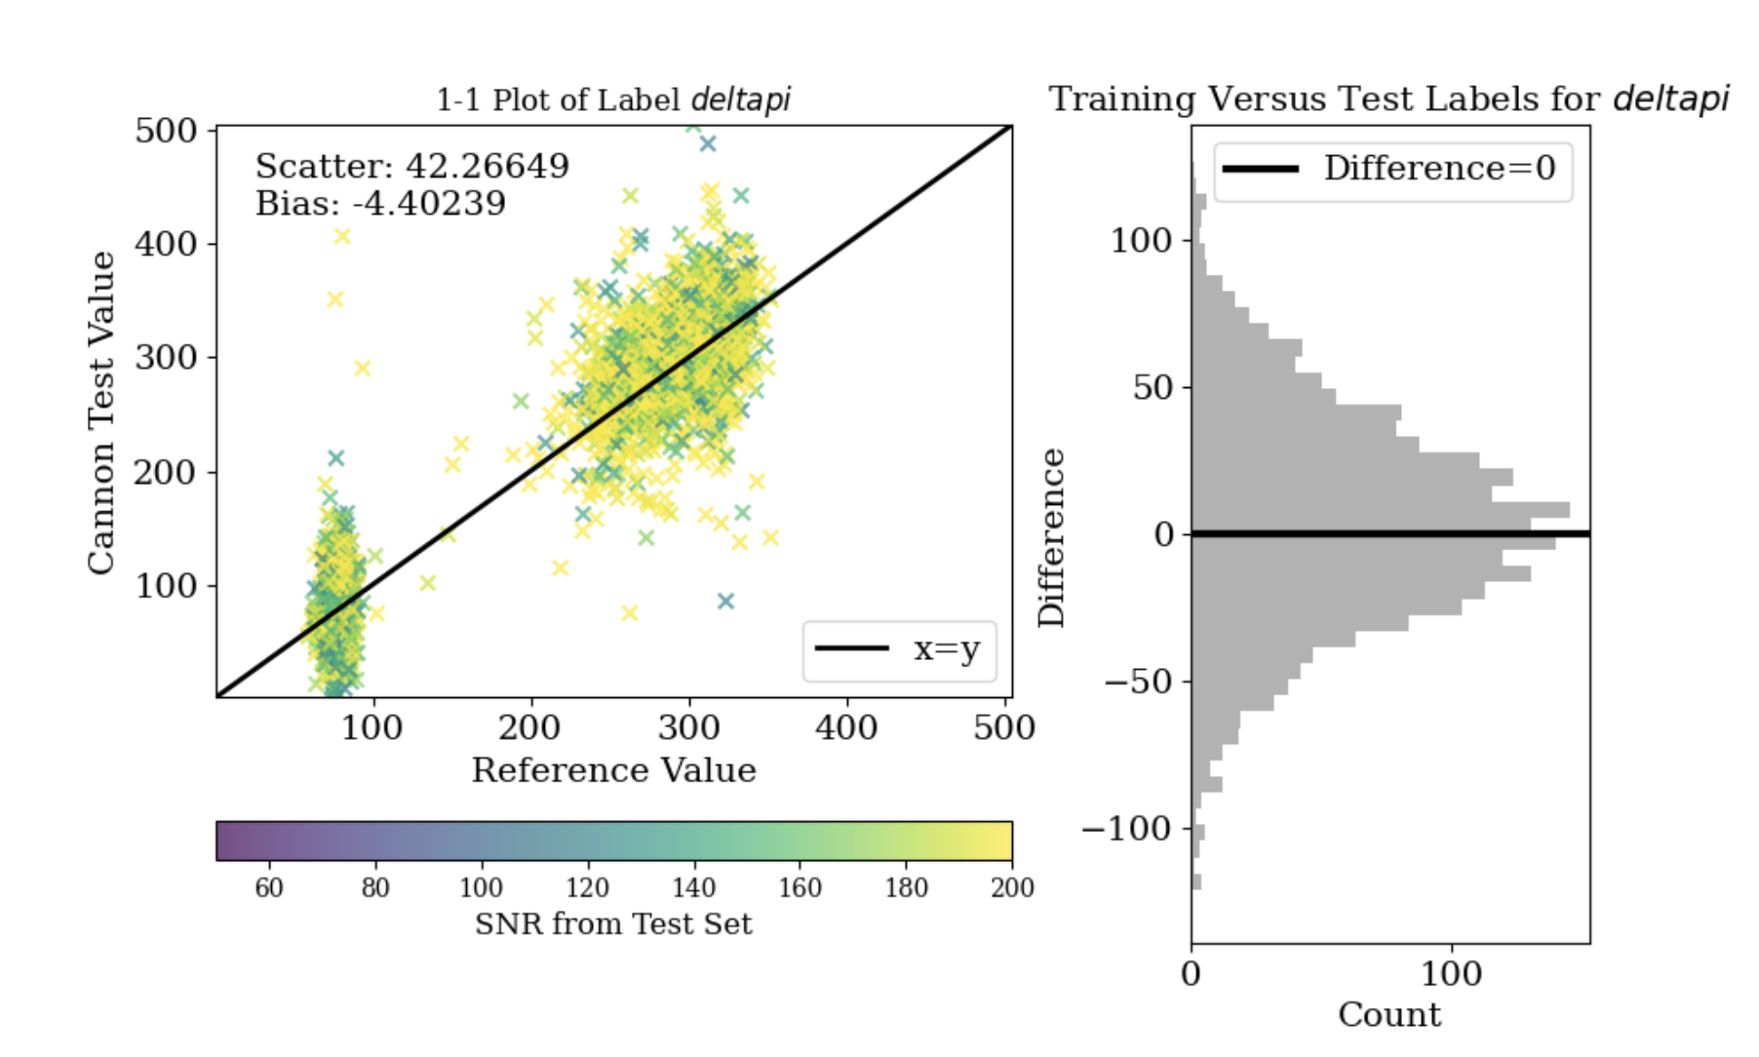
Results
I was able to end up with an accurate model with the original cannon model where the separation between the RGB and RC stars being pretty evident and the histogram presenting like a gaussian. However the scattering of this one is bad.

Slide 17
Results
I was able to end up with an accurate model with the original cannon model where the separation between the RGB and RC stars being pretty evident and the histogram presenting like a gaussian. However the scattering of this one is bad.
RC stars
RGB Stars

Slide 18
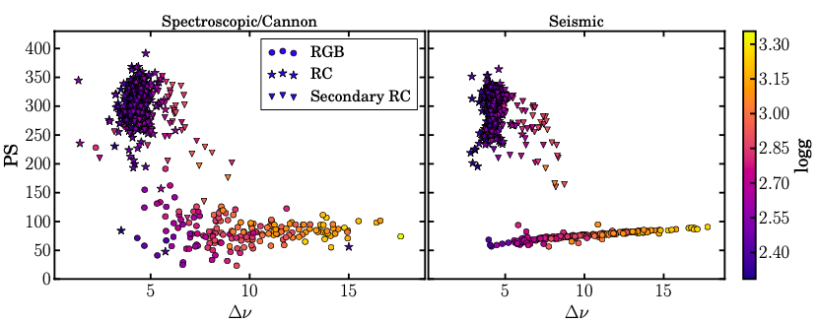
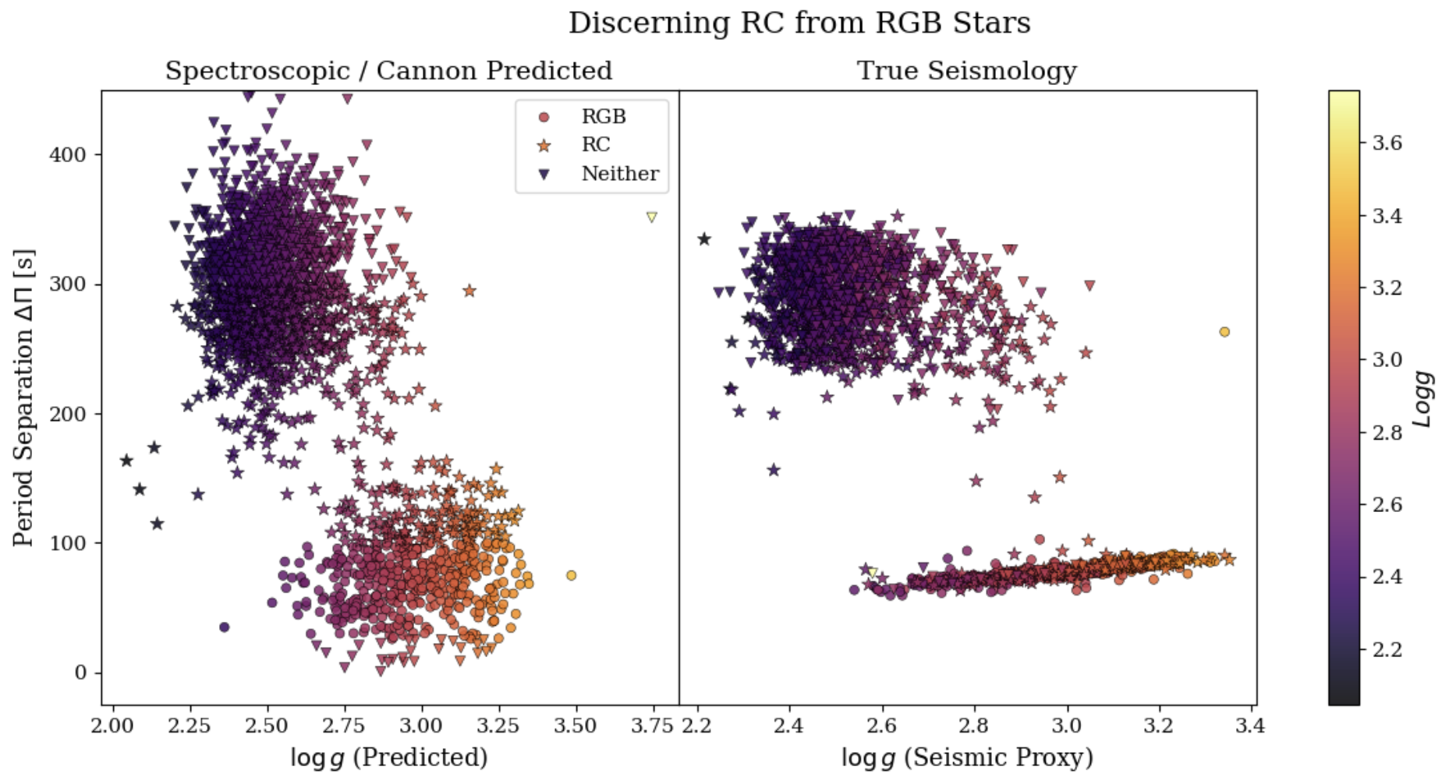
Results Right After Training
I then tried to recreate a plot from Hawkins to see how well TheCannon model can predict the labels for period spacing. Unlike the the papers, TheCannon models our predictions a little less accurate as shown with how low some of the values for period spacing are.
Predicted RGB: 413 True num RGB: 582
Predicted RC: 944 True num RC: 840
169 under RGB and over 104 for RC
Hawkins, K., Ting, Y.-S., & Rix, H.-W. (2017). Photospheric diagnostics of core helium burning in giant stars. arXiv e-prints, arXiv:1712.02405 (Accepted to The Astrophysical Journal).
Notes:
This plot is from some of the literature we read for back ground where they used TheCannon estimate period spacing as well with a much smaller data set.

Slide 19
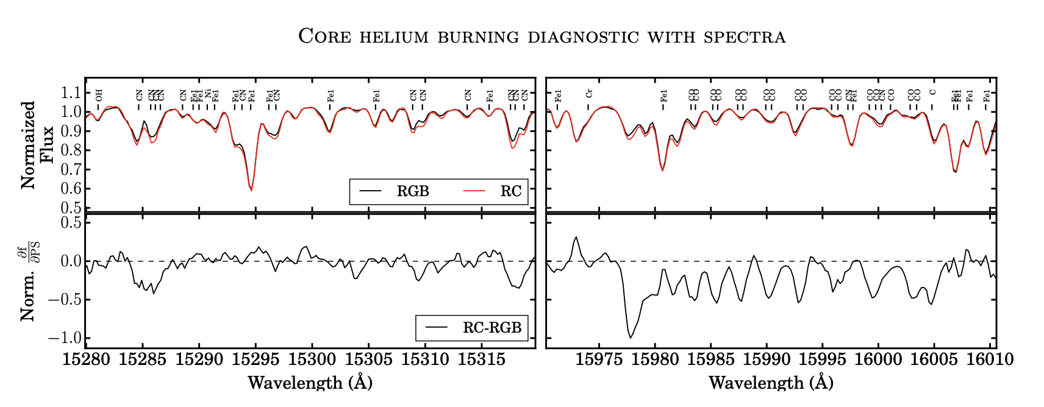
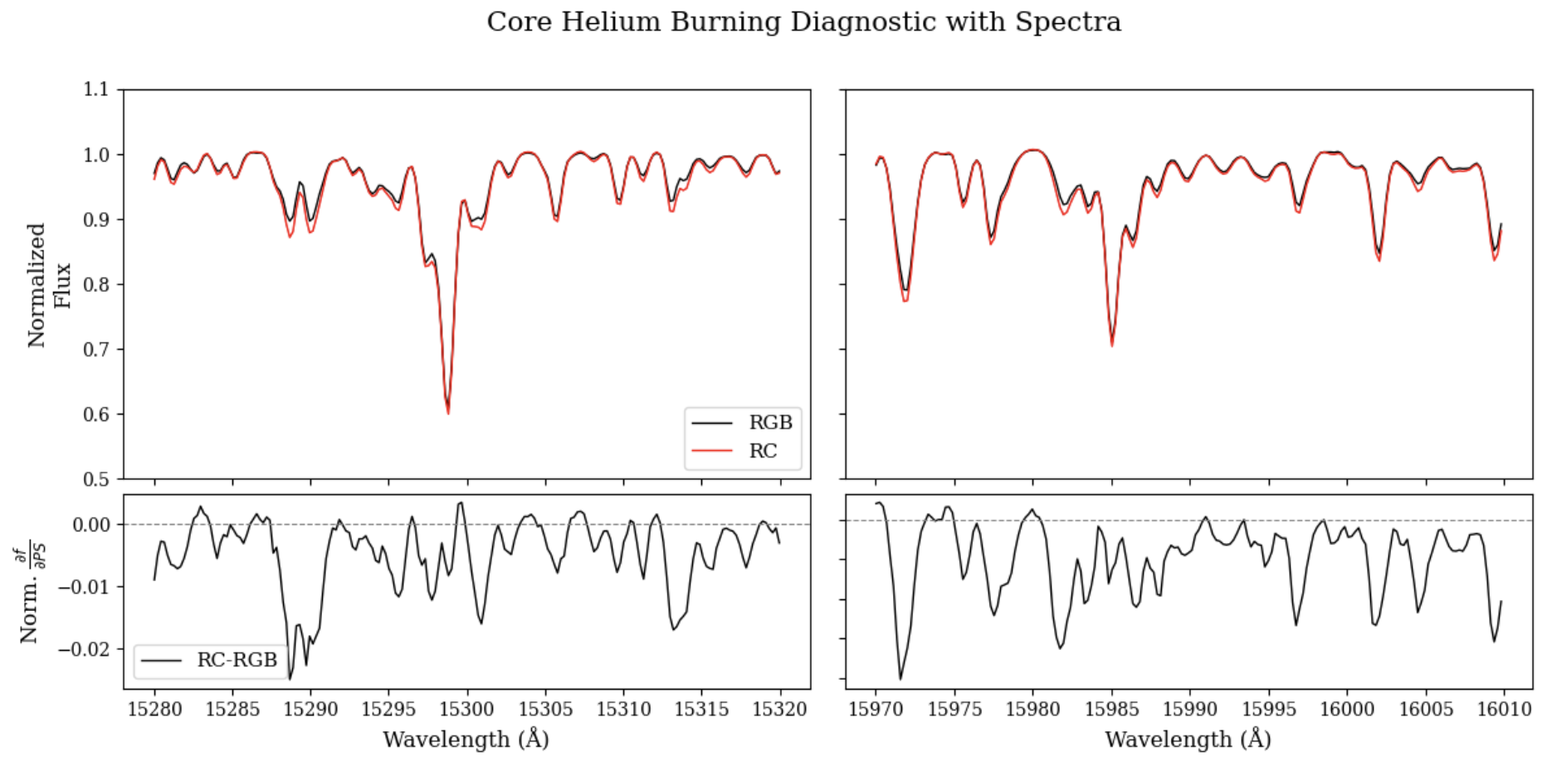
Why does this work?
The spectral region area shows that the differences between RGB and RC stars lie mostly around molecular CN and CO line features.
Likely a result of extra mixing from the red giant branch bump to the helium flash causing RC stars to be lower in their carbon to nitrogen ratio compared to RGB stars of similar parameters.
Hawkins, K., Ting, Y.-S., & Rix, H.-W. (2017). Photospheric diagnostics of core helium burning in giant stars. arXiv e-prints, arXiv:1712.02405 (Accepted to The Astrophysical Journal).

Slide 20
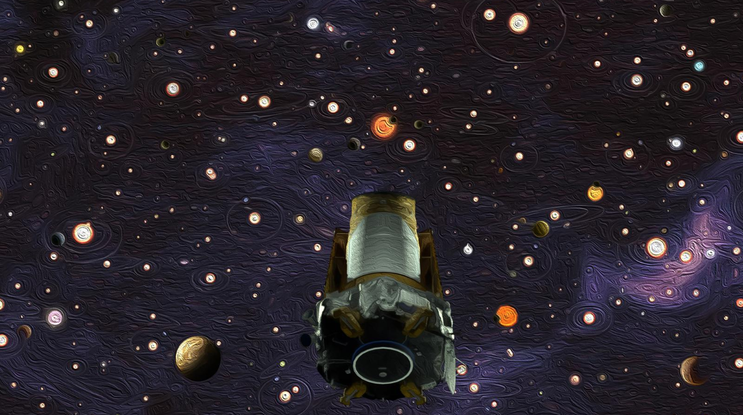
K2 Data
Kepler mission was repurposed into Kepler 2, using the pressure of sunlight to maintain observations of different fields along the ecliptic plane​​
Would greatly increase training set size for asteroseismic data ​
NASA/Ames Research Center/W. Stenzel/D. Rutter​

Slide 21
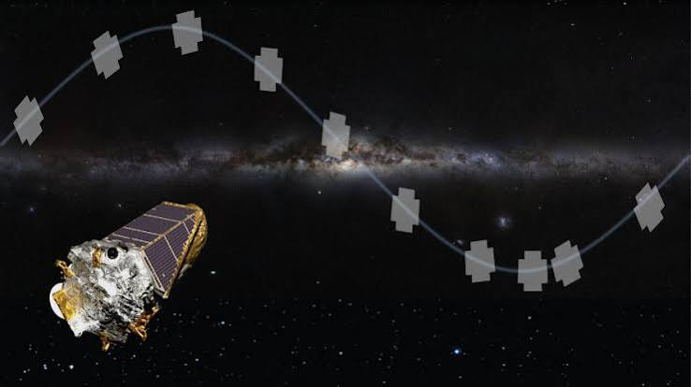
Now going further
We plan to compare TheCannon’s predicted labels with the data that the K2 telescope found to see if TheCannon can predict these labels more accurately rather than a short (3 month long) observation mission. We can use our current model to check how well this works!
Cermak, A. (2026, January 5). Kepler / K2. NASA Science. https://science.nasa.gov/mission/kepler/

Slide 22
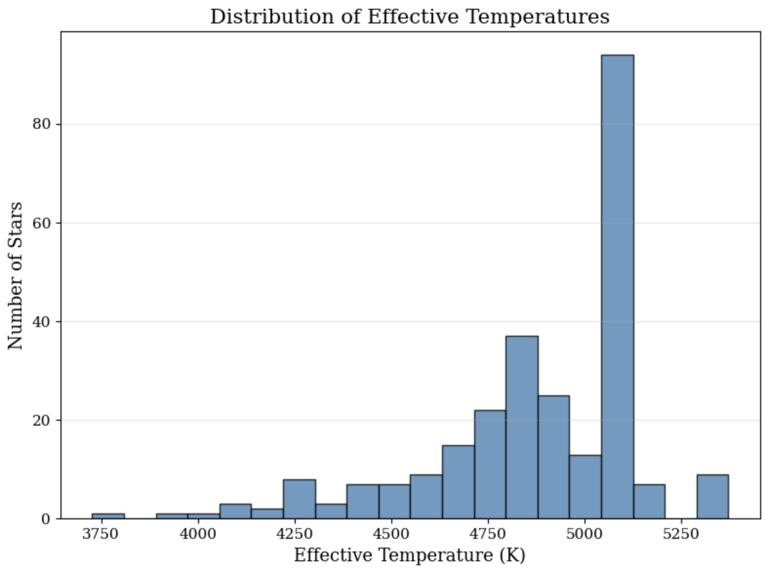
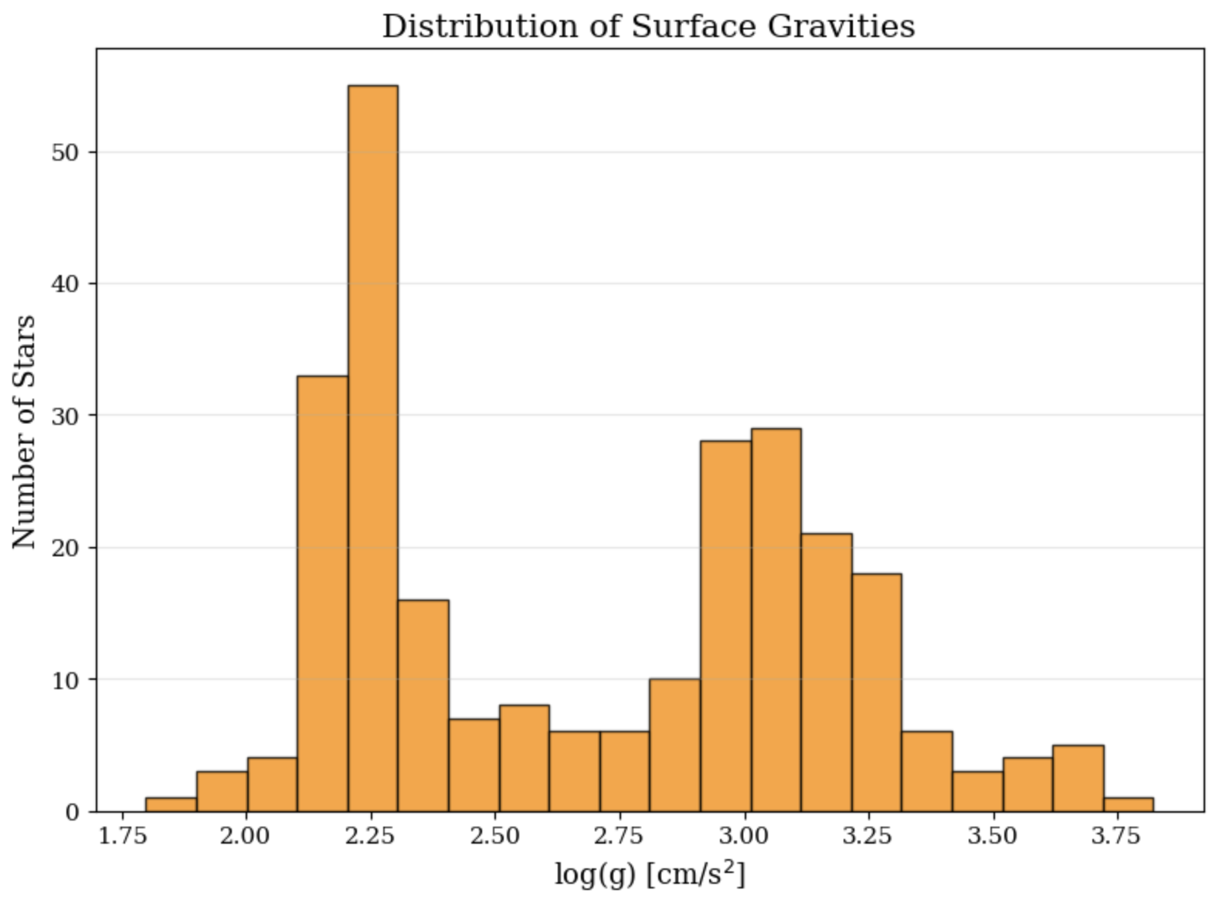
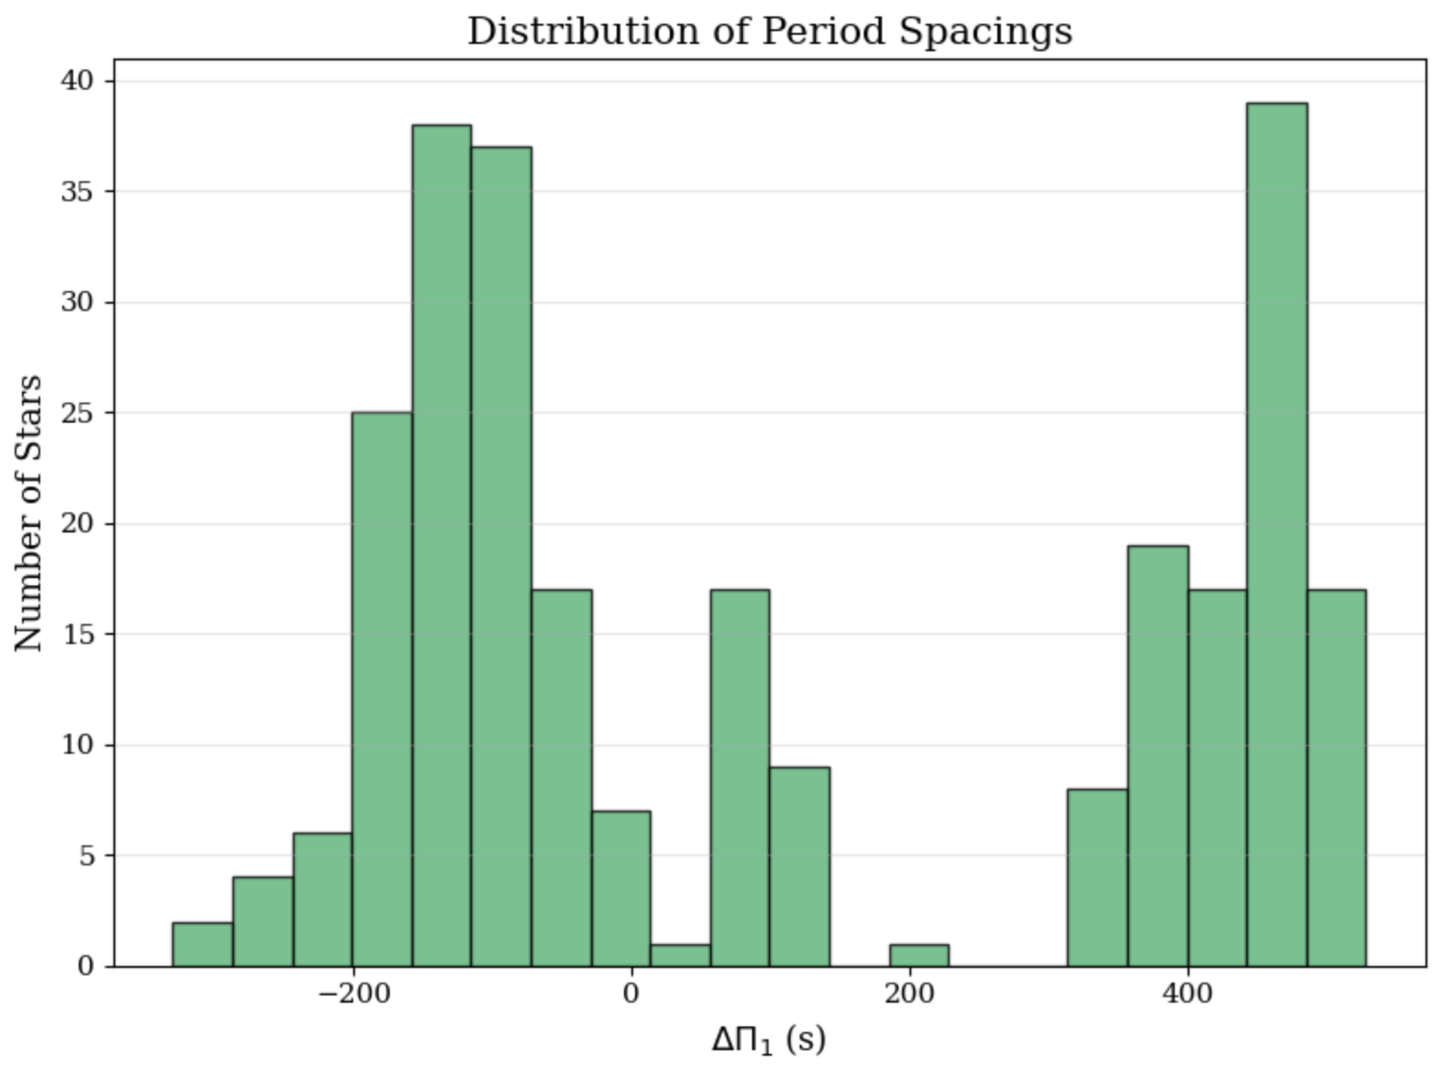
Results with new data
Histogram over effective temperature and the number of stars. This shows us that the model can predict the temperature of the stars and it’s what we would expect.
Histogram over surface gravity and the number of stars. This tells us that the model can predict the surface gravity of the star quiet well. (too high, need no more than 3.5~3.4) (plot good in gray and bad in color on an hr plot)
This histogram shows the different period spacing vs the number of stars and with so many stars located in a negative range of period spacing this tells us that this data set does not just contain RGB or RC stars

Slide 23
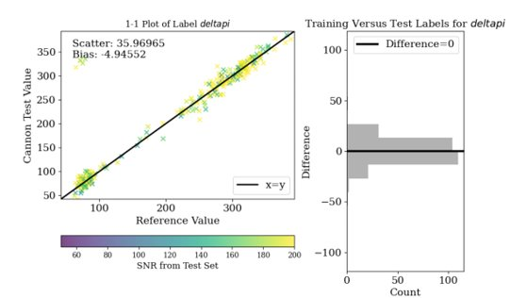
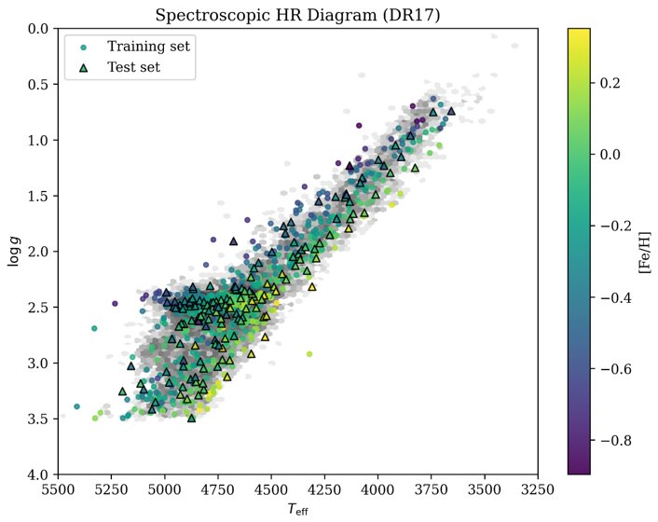
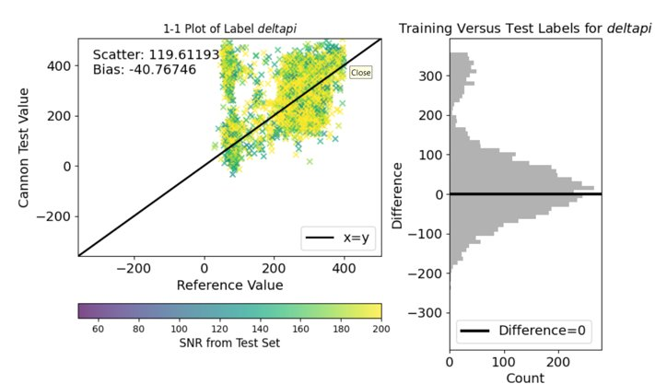
Issues with Previous Model
1-1 Plot of Label deltapi
Cannon Test Value
Reference Values
1-1 Plot of Label deltapi
Model was previously training on the same set of stars​
Fundamental issues when trying to apply the Kepler data ​
20% of each evolutionary class used test set and not used during training and found scatter/bias on it to get an honest estimate
Cannon Test Value
Reference Values

Slide 24
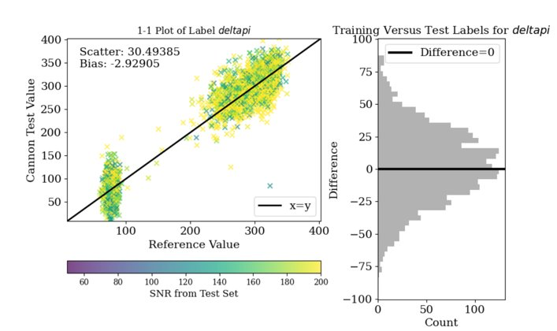
Updated Model
Fixed SNR mismatching ​
Removed data limits ​
Stricter normalization step for flux at each pixel Helps TheCannon's model be more accurate ​
Swapped a label matrix ID look up with a data table ​
​
1-1 Plot of Label deltapi
Cannon Test Value
Reference Values
Yay!

Slide 25
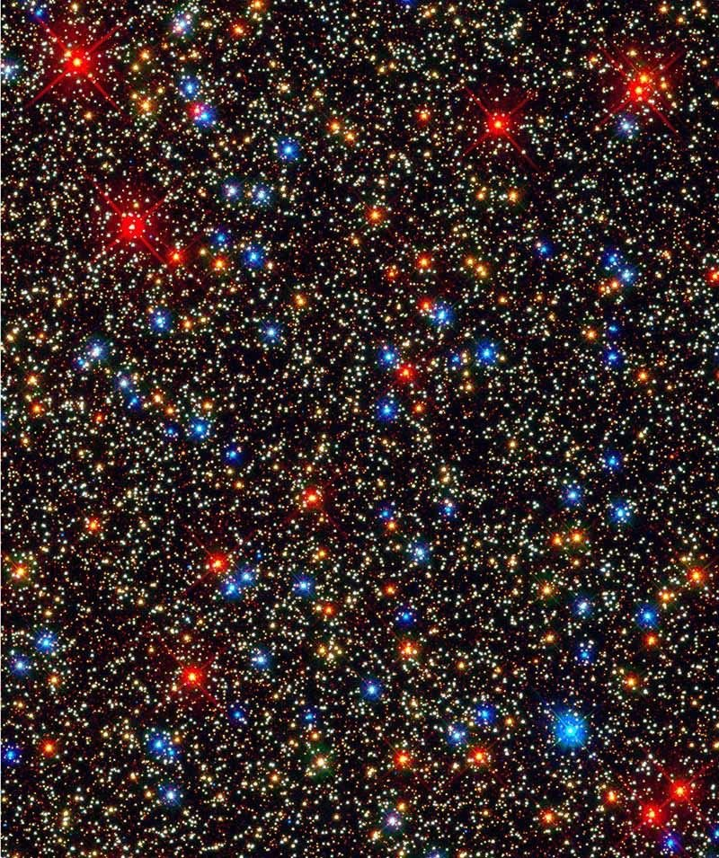
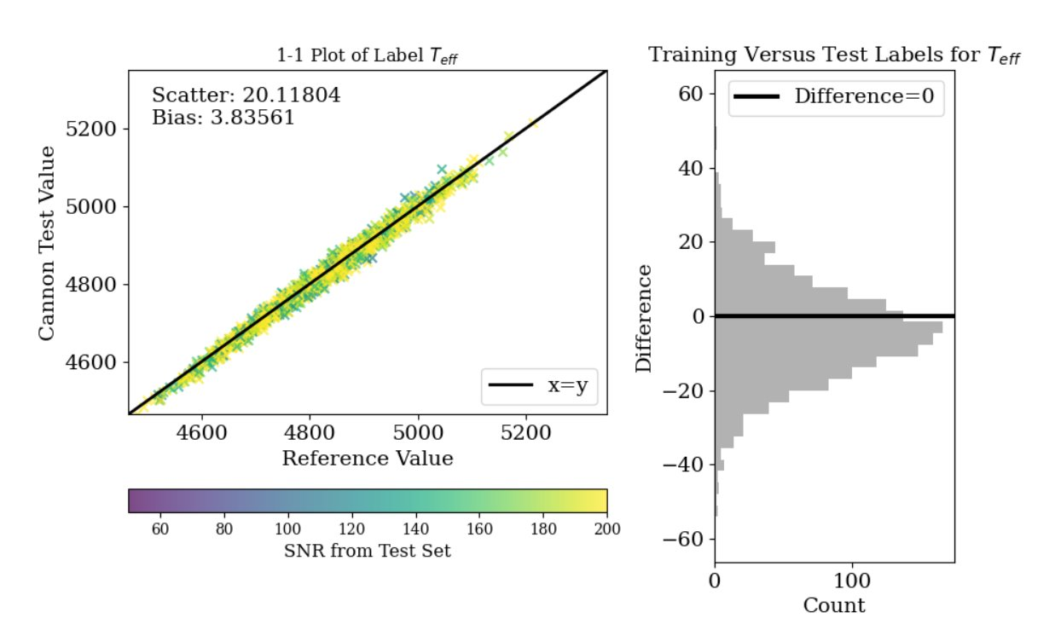
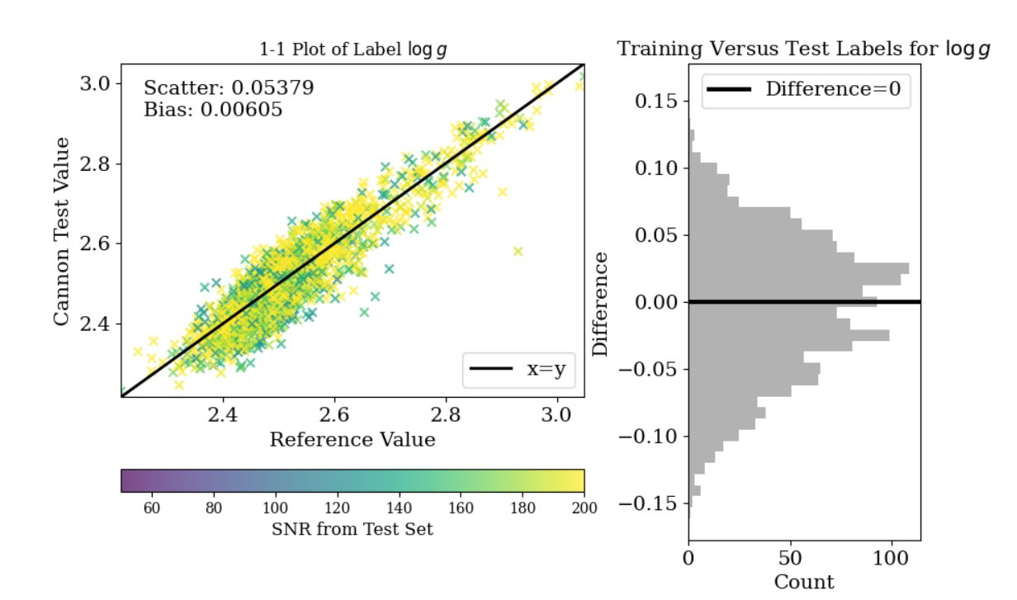
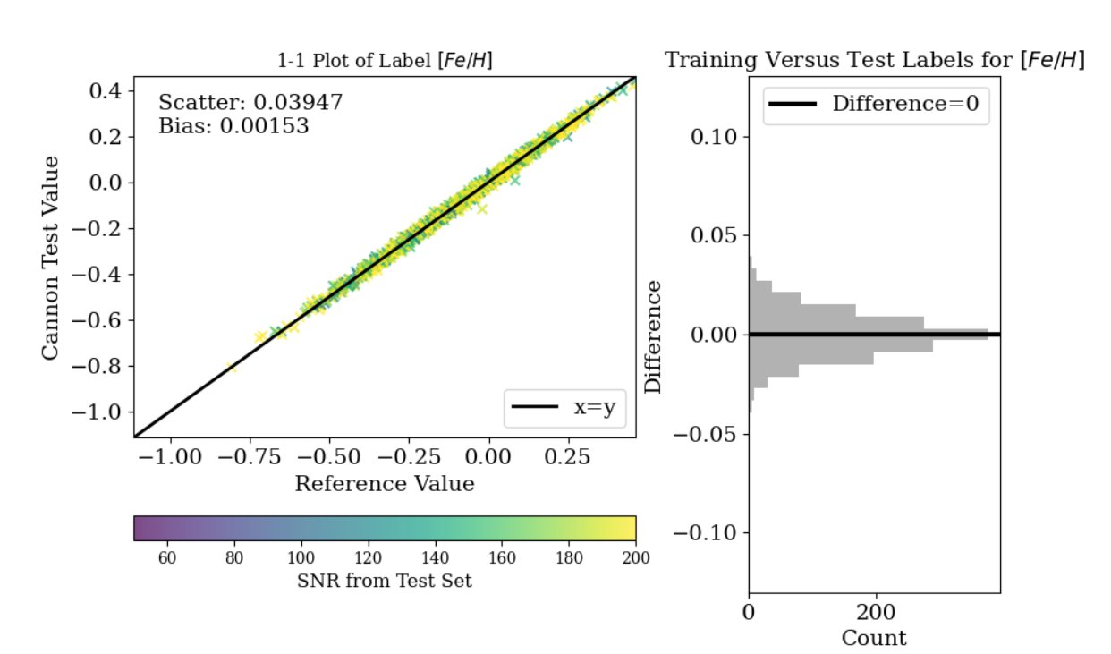
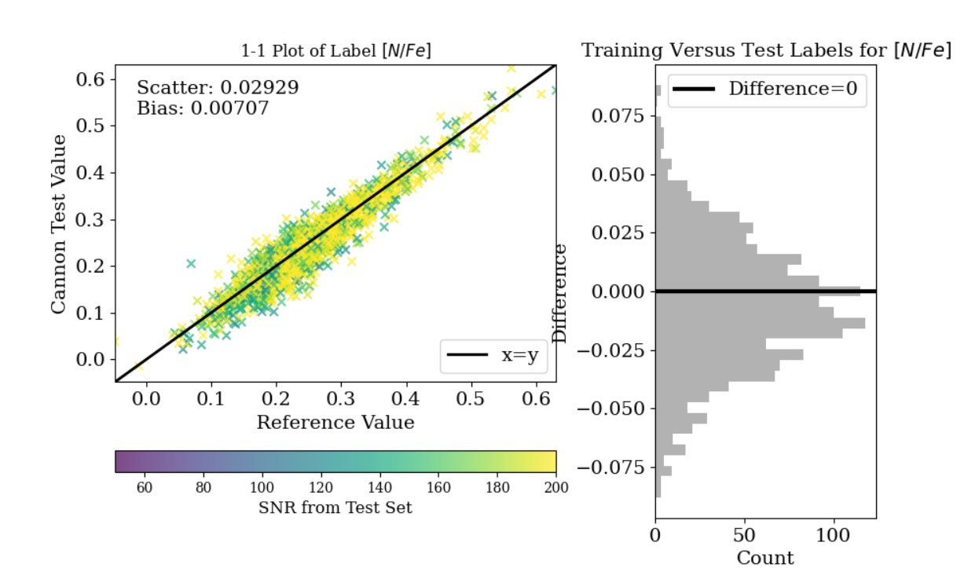
1-1 Plot of Label T_eff
1-1 Plot of Label Log g
Cannon Test Value
Cannon Test Value
Kelvin (K)
Reference Values
Reference Values
1-1 Plot of Label [Fe/H]
1-1 Plot of Label [N/Fe]
Cannon Test Value
Cannon Test Value
Reference Values
Reference Values

Slide 26
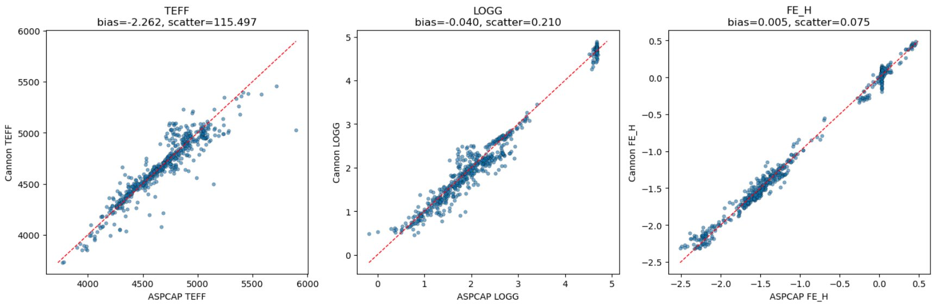
TheCannon 2
Written by Andy Casey ​
Able to predict more labels without overfitting​
Only uses a coefficient if it improves the overall fit via regularization

Slide 27
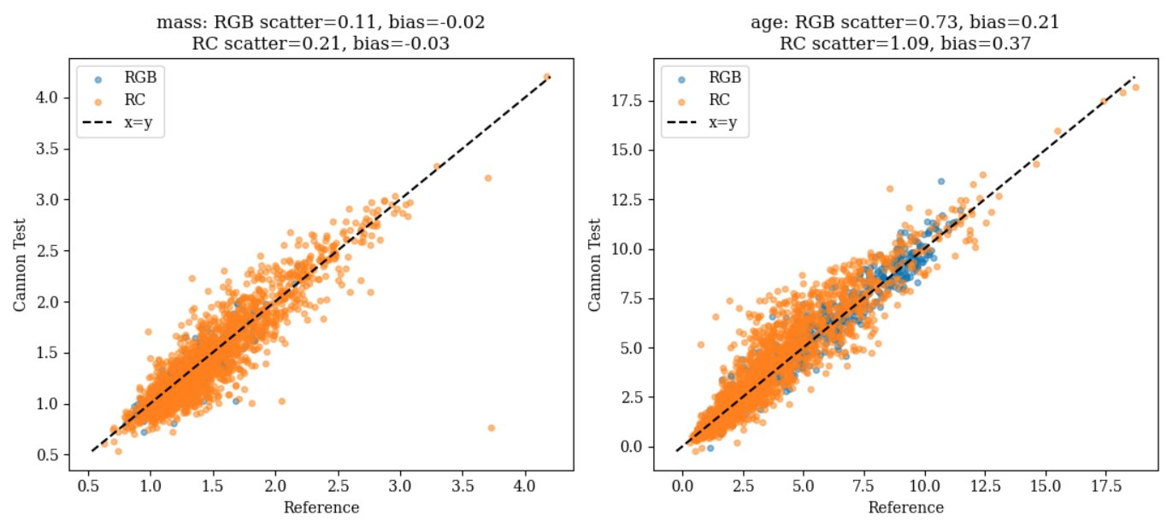
Training Mass and Age
Mass and age data encoded in the asteroseismic data​
Created an evolutionary split to separate RC and RGB stars ​
Incorporated split into data mask​
Train with separate models, [C/N] trends for RC and RGB are not the same, so mixing the sample could increase scatter

Slide 28
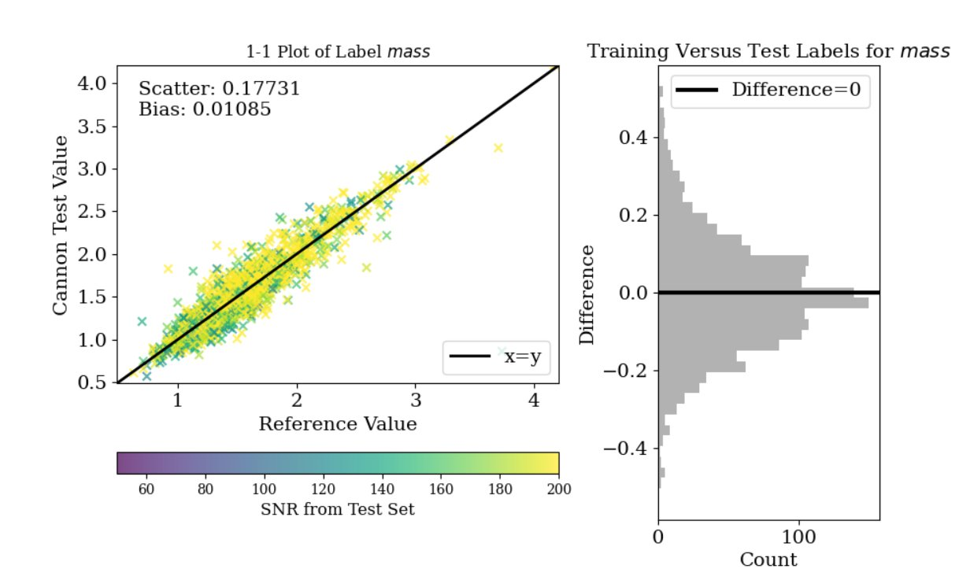
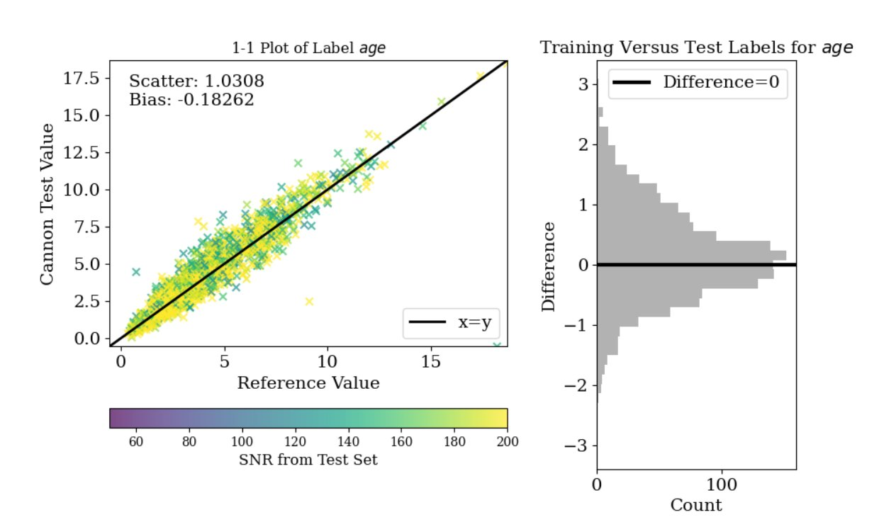
RC Model
1-1 Plot of Label mass
1-1 Plot of Label age
Cannon Test Value
Cannon Test Value
M☉
Gya
Reference Values
Reference Values
Splitting into separate RC
and RGB models reduced
scatter for both populations ​
Mass scatter dropped 19% ​
Age scatter dropped 6%

Slide 29
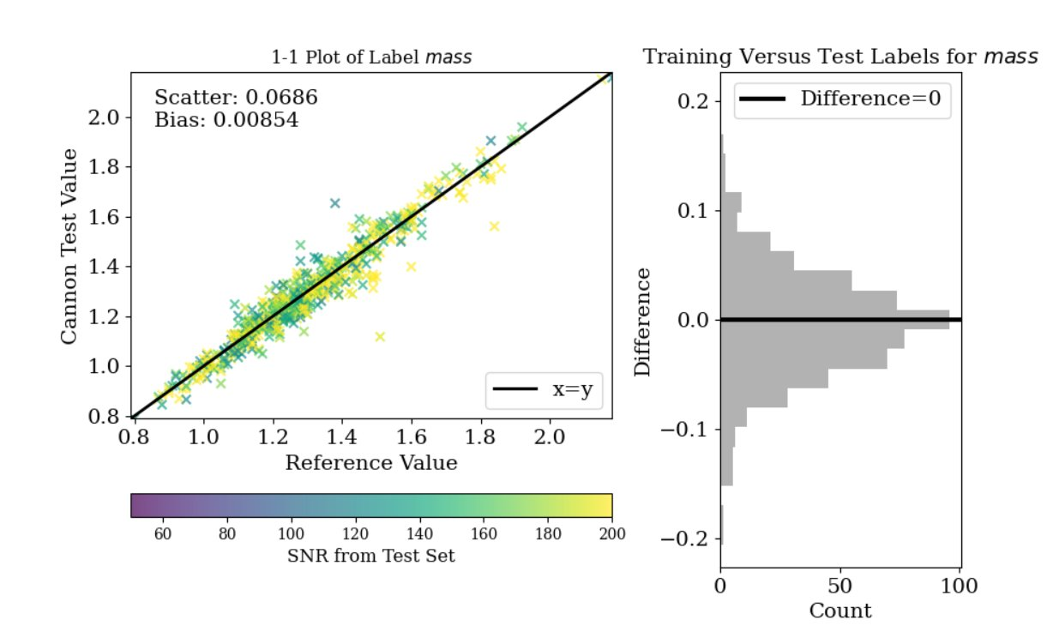
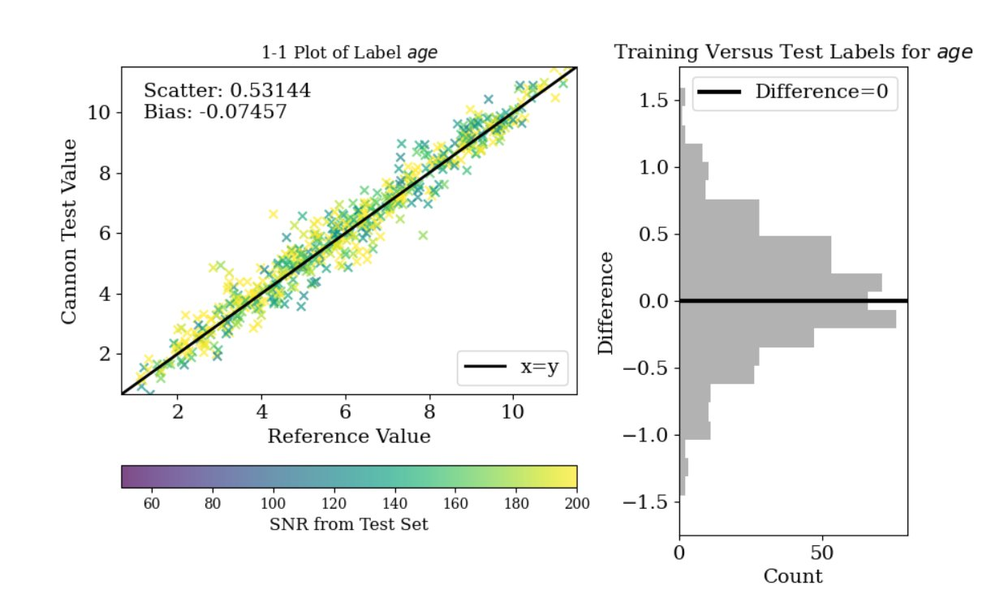
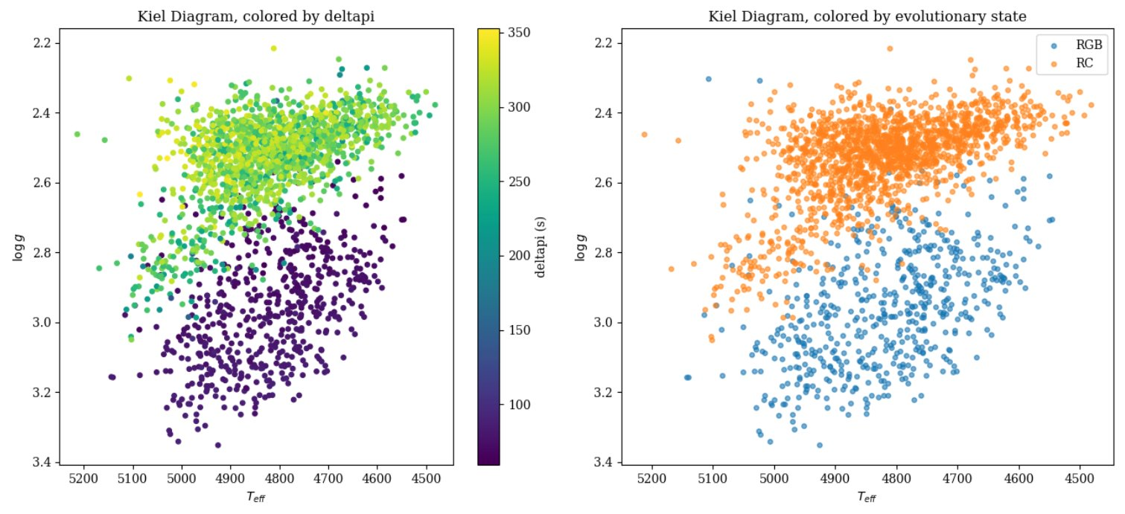
RGB Model
1-1 Plot of Label mass
1-1 Plot of Label age
Cannon Test Value
Cannon Test Value
M☉
Gya
Reference Values
Reference Values
Mass scatter dropped 46%​
Age scatter dropped 27%
Kiel diagram shows similarities of RC and RGB stars in logg and temperature space but easily separable by distinguishing deltapi

Slide 30
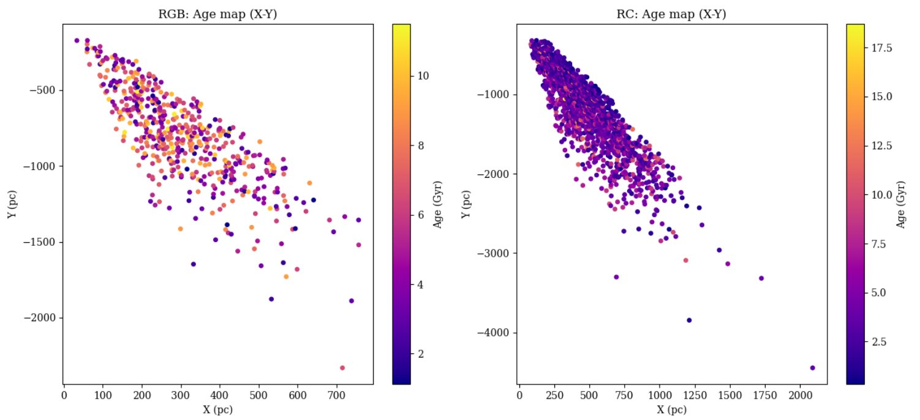
Stellar Age Map
Using the stars positions (right ascension, declination, and distance via parallax) ​
Does not reveal too much for this specific dataset
Kepler stares at a small fixed patch of sky, while the stars all sit in a narrow cone pointing in one direction from the Sun​
Kepler Field

Slide 31
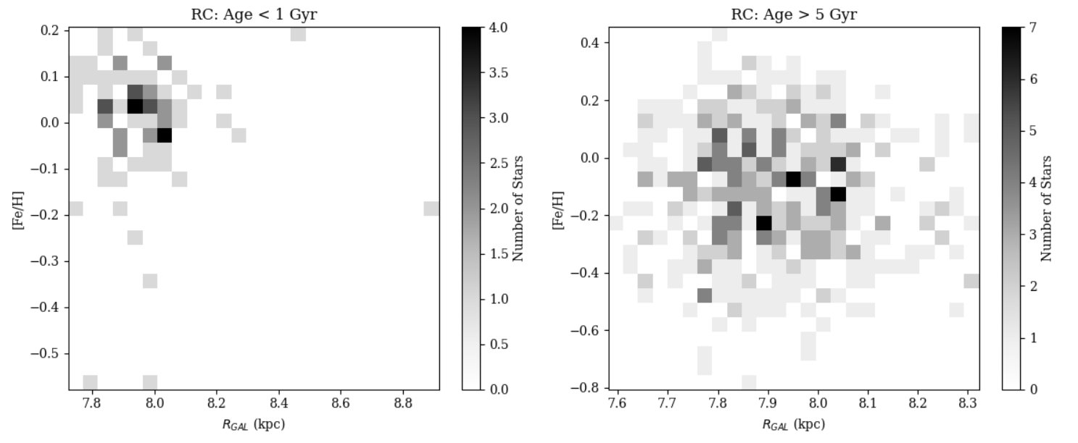
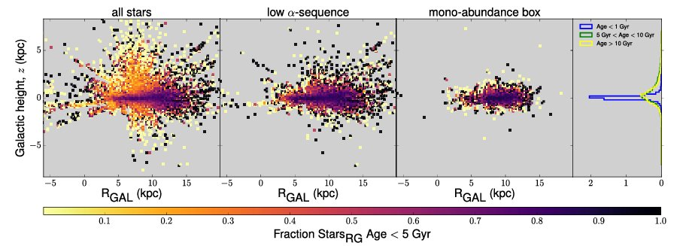
Expansion into the Milky Way
Multiple fields adds more asteroseismic giants, directly reducing the noise ​
Broader sky coverage = Galactic mapping​
Kepler data combined with all APOGEE stars can turn a single-field plot into an actual map of galactic features in relation to age with 5 times the data than before ​wi
Ness, M., Hogg, D. W., Rix, H.-W., Martig, M., Pinsonneault, M. H., & Ho, A. Y. Q. (2016). Spectroscopic determination of masses (and implied ages) for red giants. The Astrophysical Journal, 823(2), 114.​

Slide 32
Summary
Created a working model of TheCannon
Applied asteroseismic data from Kepler to APOGEE spectra
Distinguished Red Giant Branch and Red Clump stars based on period spacing
Predicted whether stars are RGB or RC stars
Predicted mass and age data by training separate an RGB and RC model
Created age and spatial maps
Moving forward, applying Kepler 2 data and the larger APOGEE catalog to our trained model

Slide 33

Questions?

