Slide 1
Stellar Label Estimates through use of Machine Learning
G. Leigh Harwell
June 2026

Slide 2
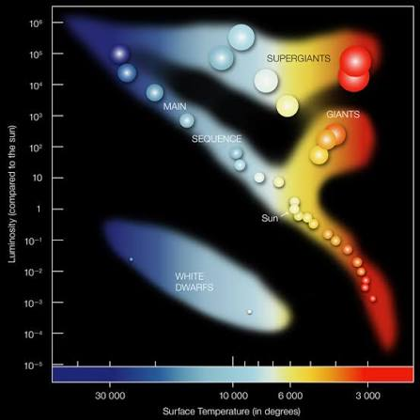
Red Giant Stars
Red giants are stars that exhaust the hydrogen in their core and have now started to burn it in its outer layers. Eventually these stars have a helium flash and burn helium in their core.
Red giants are significant to galactic archaeology.
They are very bright, allowing us to see them from large distances
Allow us to map out the structure of the Milky Way
Key observables in understanding how our Galaxy has formed and evolved
Wikipedia contributors. (n.d.). Red giant. In Wikipedia. Retrieved July 20, 2026, from https://en.wikipedia.org/wiki/Red_giant
Image credit: Chandra :: Educational Materials :: Pulsating Variable Stars and the Hertzsprung-Russell Diagram

Slide 3
Red Giant Stars
Red giants are stars that exhaust the hydrogen in their core and have now started to burn it in its outer layers. Eventually these stars have a helium flash and burn helium in their core.
Red giants are significant to galactic archaeology.
They are very bright, allowing us to see them from large distances
Allow us to map out the structure of the Milky Way
Key observables in understanding how our Galaxy has formed and evolved
However there are two different types of Red Giants.
Wikipedia contributors. (n.d.). Red giant. In Wikipedia. Retrieved July 20, 2026, from https://en.wikipedia.org/wiki/Red_giant
Image credit: Chandra :: Educational Materials :: Pulsating Variable Stars and the Hertzsprung-Russell Diagram

Slide 4
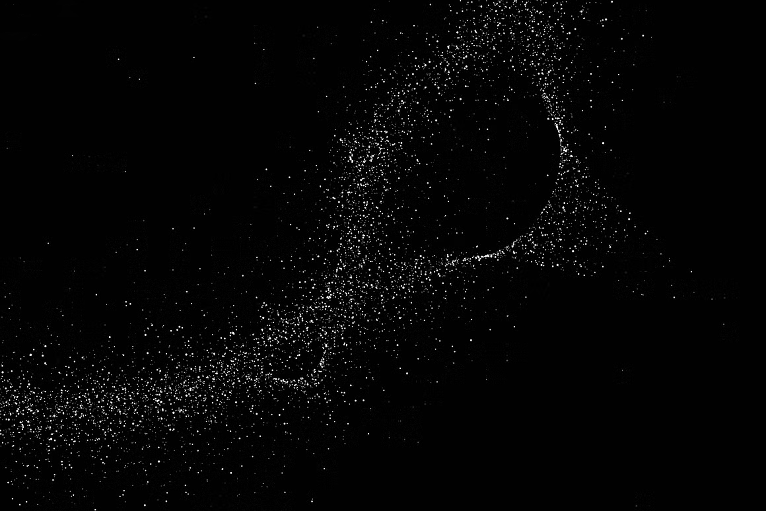
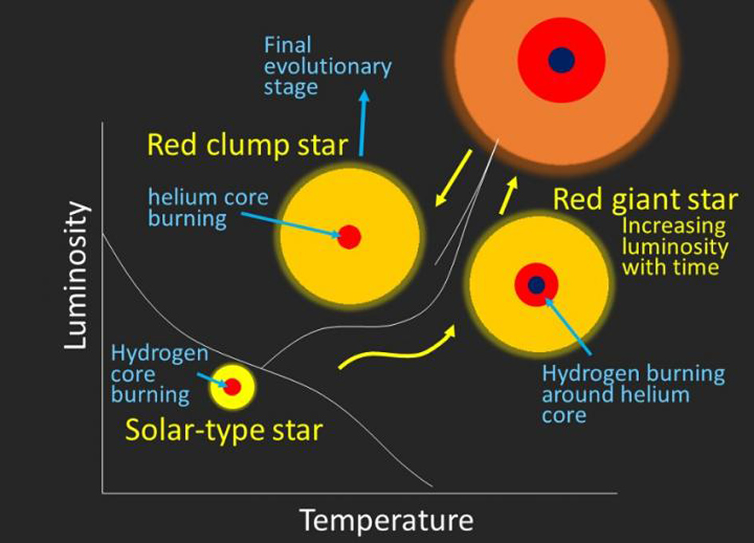
Red Giant Branch vs Red Clump Stars
Red Giant Stars
Red Clump Stars
Best classification method through Asteroseismology
RGB
High mass Hydrogen burning shell
Low period spacing
RC
High-Mass star that ignites helium fusion in their cores resulting in a “helium flash”
High period spacing
Hawkins, K., Ting, Y.-S., & Rix, H.-W. (2017). Photospheric diagnostics of core helium burning in giantstars. arXiv e-prints, arXiv:1712.02405 (Accepted to The Astrophysical Journal).

Slide 5
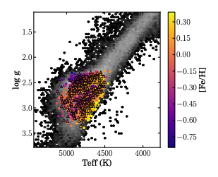
Red Giant Branch vs Red Clump Stars
Red Giant Stars
Red Clump Stars
Best classification method through Asteroseismology
RGB
High mass Hydrogen burning shell
Low period spacing
RC
High-Mass star that ignites helium fusion in their cores resulting in a “helium flash”
High period spacing
Hawkins, K., Ting, Y.-S., & Rix, H.-W. (2017). Photospheric diagnostics of core helium burning in giantstars. arXiv e-prints, arXiv:1712.02405 (Accepted to The Astrophysical Journal).
Notes:
Cant tell them apart just with things we measure from spectra

Slide 6
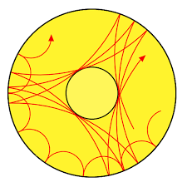
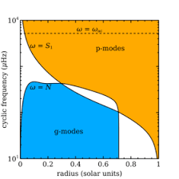

Asteroseismology
Oscillations in stars from near-surface convection can have either or both p-mode or g-mode characteristics
Stronger coupling between g-mode and p-mode leading to appearance of observable mixed modes in oscillation spectrum
  This can be caused by RC stars core having lower density than a RGB star
Period spacing are the time intervals between a star's mixed modes (p-mode and g-mode), vibrations that combine the characteristics of sound waves and gravity waves inside the star.
P-mode
G-mode
Associated with stellar envelope with pressure as a restoring force
Probe its core with buoyancy as a restoring force.
Bedding Tim, Huber Daniel. “ASTR 5970 Lecture 16-Seismology.”https://docs.google.com/presentation/d/1n4gnIVjk0QskgZYAVGrrYui_9yyZ9EoGr3Z9NKOY4KY/edit?slide=id.g2feb84dece6_0_122#slide=id.g2feb84dece6_0_122
Ness et al. 2016, "Spectroscopic Determination of Masses (and Implied Ages) for Red Giants," The Astrophysical Journal, 823:114 https://iopscience.iop.org/article/10.3847/0004-637X/823/2/114/pdf

Slide 7
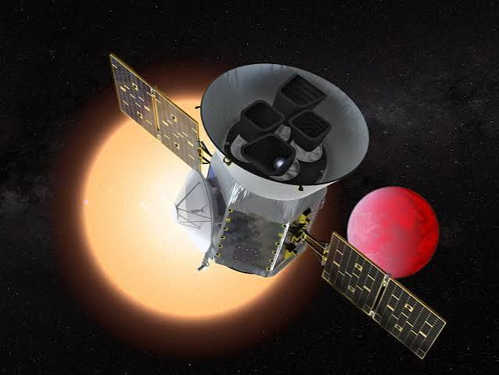
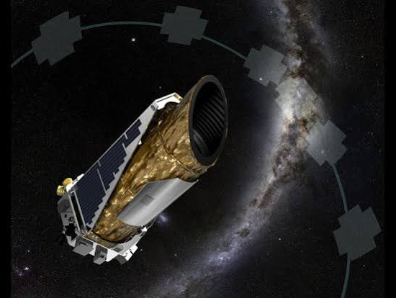
Kepler and TESS
TESS
How we do seismology?
By measuring the light curve to track the changes in the flux due to convection in the star. Then take the radial velocity curve to get the timescale of the oscillations.
Kepler’s ultra-sensitive photometers capture the rhythmic pulses of the stars brightness.
TESS (Transiting Exoplanet Survey Satellite) has a secondary mission for gathering continues brightness measurements of stars.
Krapfl, M. (2019, November 19). NASA's TESS helps astronomers study red-giant stars, examine a too-close planet. Iowa State University News Service. https://www.news.iastate.edu/news/nasas-tess-helps-astronomers-study-red-giant-stars-examine-too-close-planet
Cermak, A. (2026, January 5). Kepler / K2. NASA Science. https://science.nasa.gov/mission/kepler/
Brill, J. (2026, February 10). Asteroseismology using the Galactic Bulge Time Domain Survey. NASA Science. https://science.nasa.gov/mission/roman-space-telescope/asteroseismology-using-the-galactic-bulge-time-domain-survey/
Huber, D., Chaplin, W. J., Christensen-Dalsgaard, J., Gilliland, R. L., Kawaler, S. D., Kjeldsen, H., & Working Groups of the Kepler Asteroseismic Science Consortium (KASC). (2013). Asteroseismology with NASA's Kepler mission. American Astronomical Society Meeting Abstracts, 221, 301.01. https://ui.adsabs.harvard.edu/abs/2013AAS...22130101H/abstract
Kepler

Slide 8

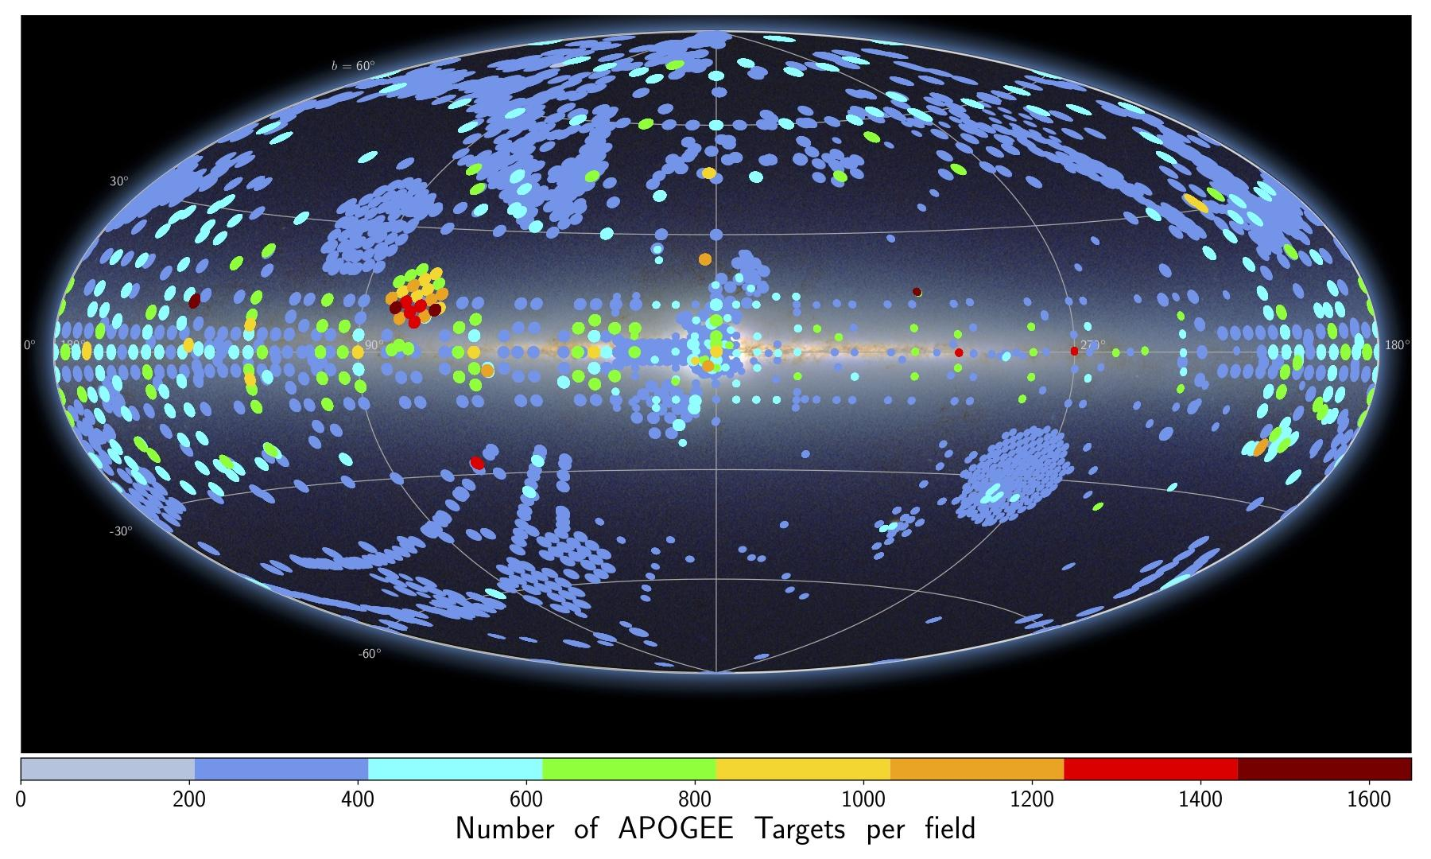
APOGEE
A large-scale, stellar spectroscopic survey conducted in the near infrared portion of the electromagnetic spectrum.
The survey provides spectra that can then be used to derive effective temperature, surface gravity, and metallicity of the observed star.
APOGEE observation fields on an all-sky image. Each field is color-coded by the number of targets in that field.
Sloan Digital Sky Survey. (n.d.). APOGEE. SDSS Data Release 17. Retrieved July 20, 2026, from https://www.sdss4.org/dr17/irspec/

Slide 9
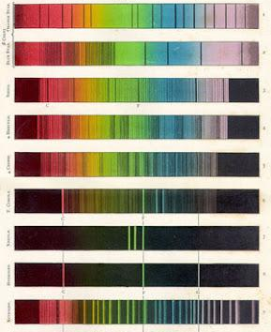
Main Problem
Millions of spectra exist for known stars, with emission and absorption lines containing information about temperature, surface gravity, elemental abundances, and more
​
This however this does not help us when it comes to differentiating between stars in the Red Giant Branch and in the Red Clump of the HR diagram
  More luminous therefore more data
  These are two different stages in a stars life cycle.
  Important for: Stellar ages and Mass loss

Slide 10
Main Problem
Millions of spectra exist for known stars, with emission and absorption lines containing information about temperature, surface gravity, elemental abundances, and more
​
This however this does not help us when it comes to differentiating between stars in the Red Giant Branch and in the Red Clump of the HR diagram
  More luminous therefore more data
  These are two different stages in a stars life cycle.
  Important for: Stellar ages and Mass loss
What if we can link seismology and spectra?

Slide 11
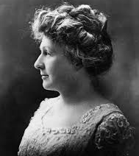
TheCannon
Using a set of reference objects to train predictions on and then use to predict these labels for a new data set that does not include these labels in the surve.
Named after Annie Jump Cannon, American astronomer that logged spectra
Steps of use:
Get and format data
Use reference set to fit a spectral model (training)
Make sure the model is sensible, perform a leave-n-out cross-validation
Then use it to infer labels from all the other spectra in the dataset (testing)
Ness et al. 2015, "The Cannon: A Data-Driven Approach to Stellar Label Determination," The Astrophysical Journal, 808:16 https://iopscience.iop.org/article/10.1088/0004-637X/808/1/16/pdf

Slide 12
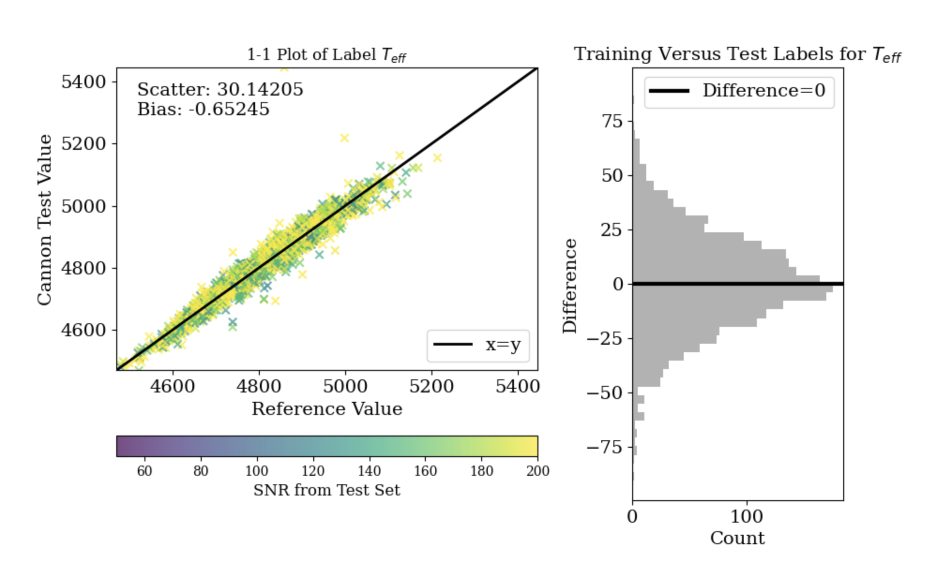
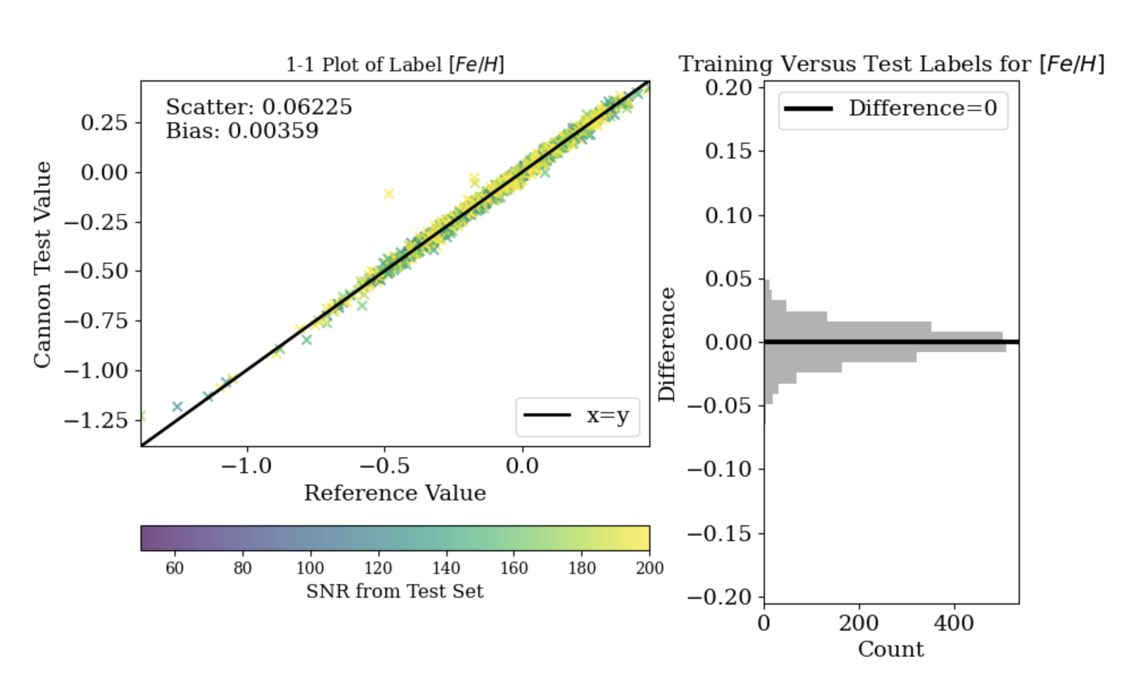
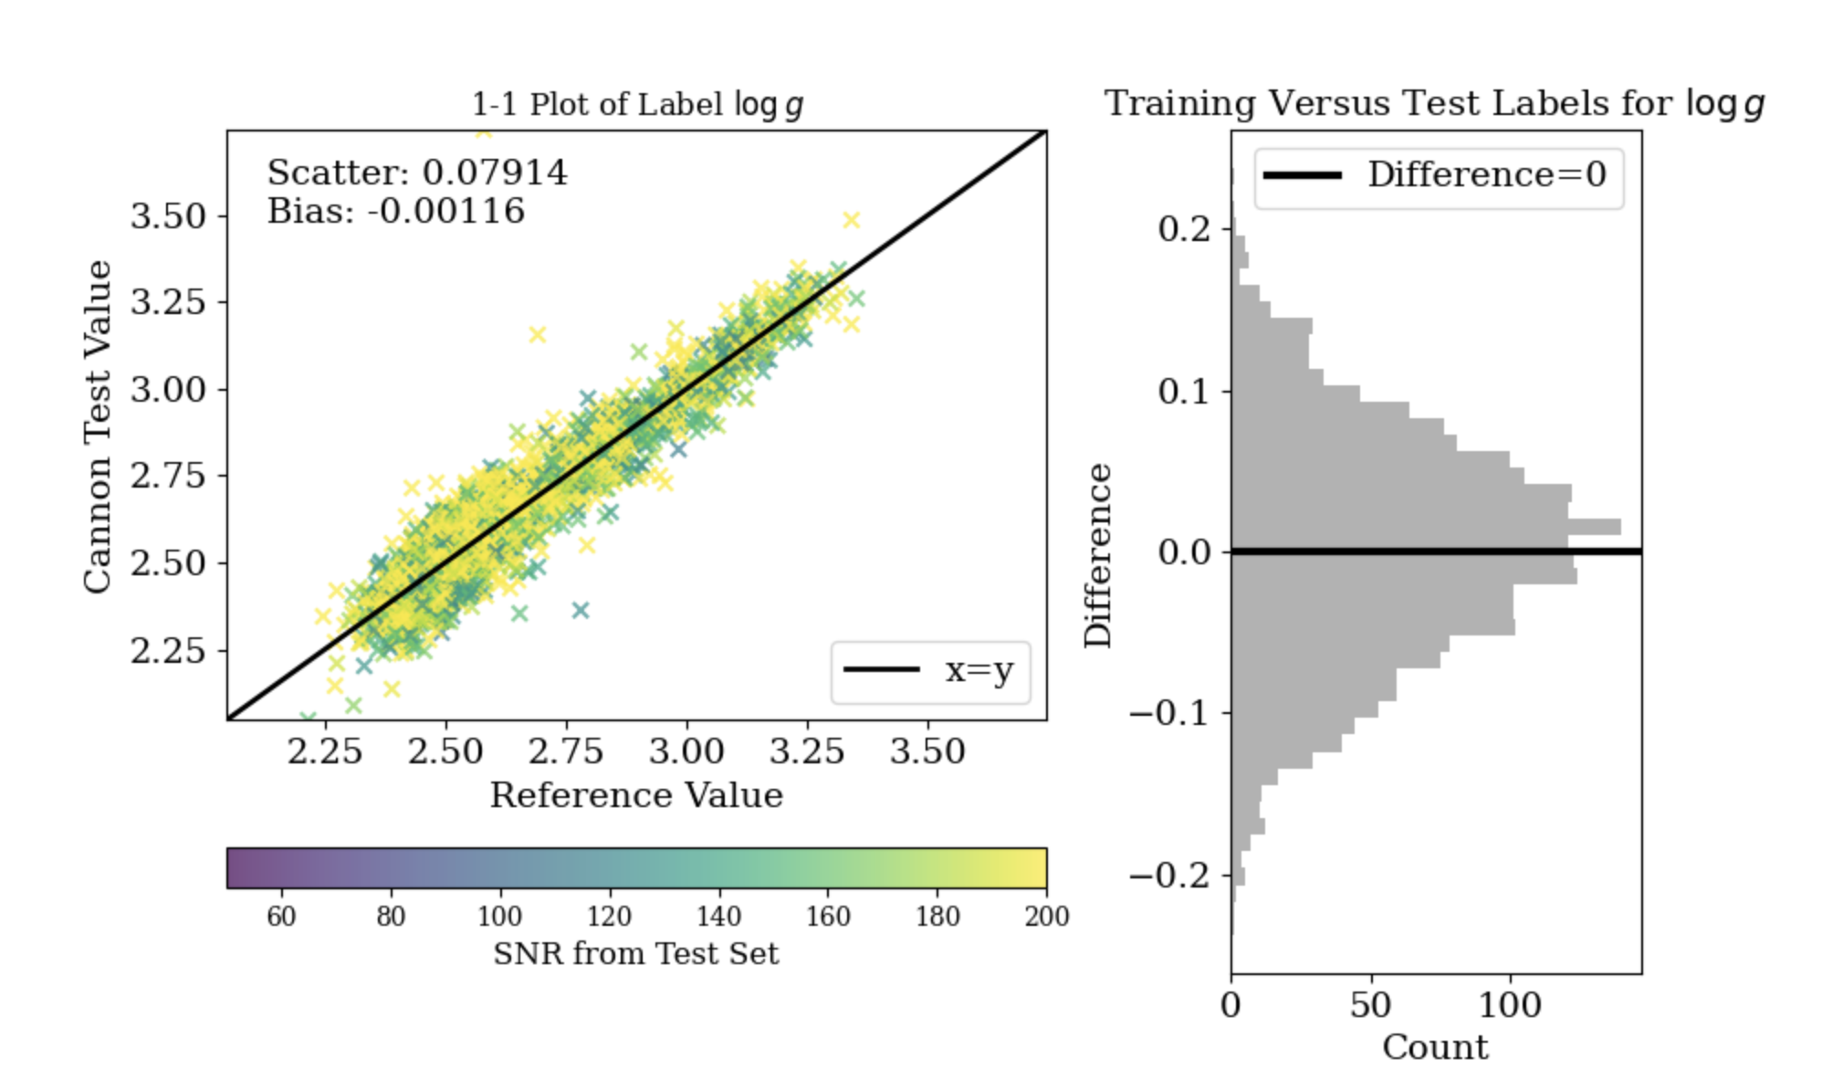
Results
These are some of the one-to-one plots from TheCannon of labels that I chose to train it on to help constrain the label estimates of period spacing to be more accurate..
Trained on effective temperature, surface gravity (log scaled), and iron and magnesium ratio from the stars spectra. This is how well TheCannon predicted these labels.

Slide 13
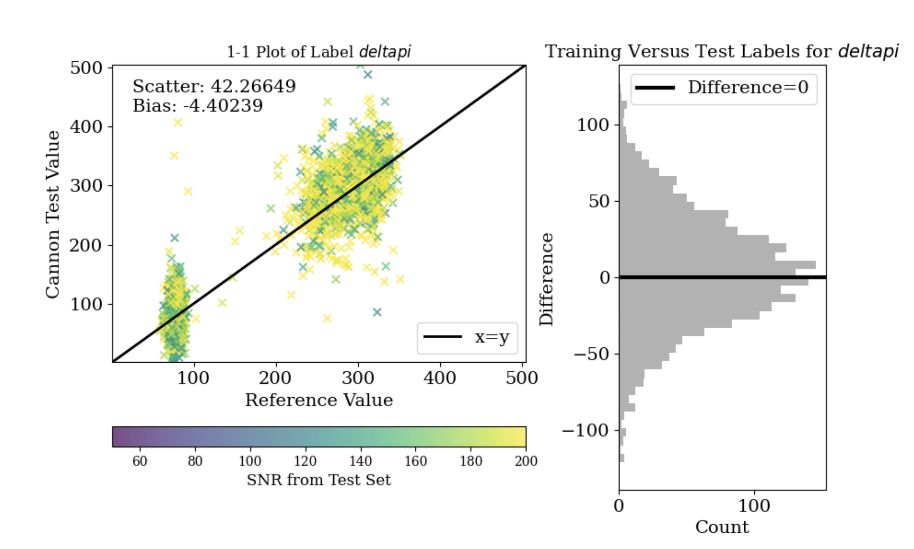
Results
I was able to end up with an accurate model with the original cannon model where the separation between the RGB and RC stars being pretty evident and the histogram presenting like a gaussian. However the scattering of this one is bad.

Slide 14
Results
I was able to end up with an accurate model with the original cannon model where the separation between the RGB and RC stars being pretty evident and the histogram presenting like a gaussian. However the scattering of this one is bad.
RC stars
RGB Stars

Slide 15
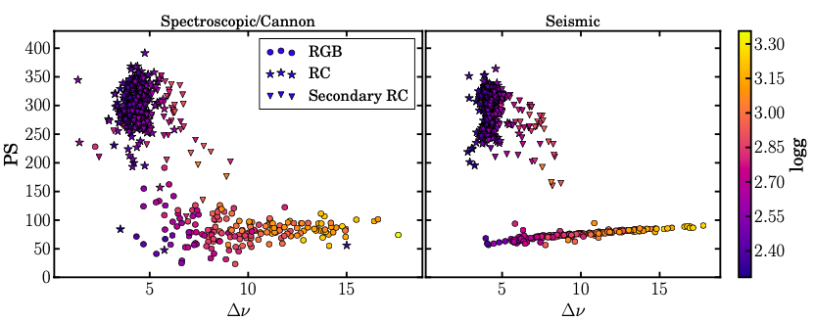
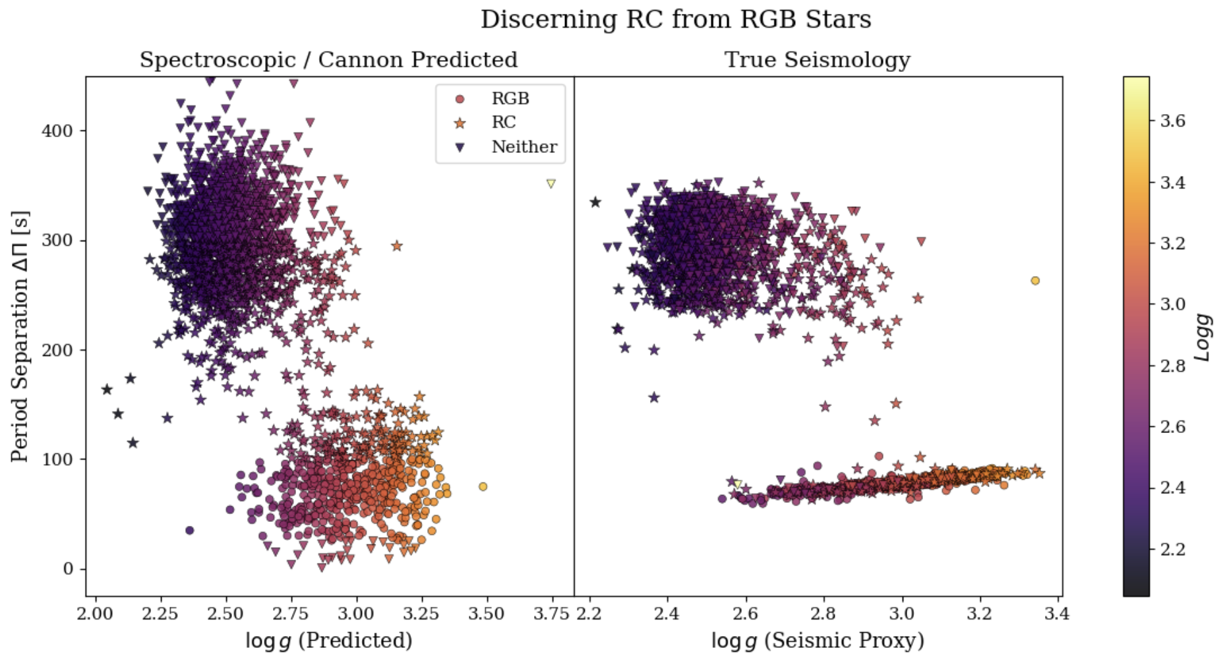
Results right after training
I then tried to recreate the plot from the Hawkins paper to see how well TheCannon model can predict the labels for period spacing. Unlike the the papers cannon model ours predictions are a little less accurate as shown with how low some of the values for period spacing are.
Predicted RGB: 413 True num RGB: 582
Predicted RC: 944 True num RC: 840
Hawkins, K., Ting, Y.-S., & Rix, H.-W. (2017). Photospheric diagnostics of core helium burning in giantstars. arXiv e-prints, arXiv:1712.02405 (Accepted to The Astrophysical Journal).

Slide 16
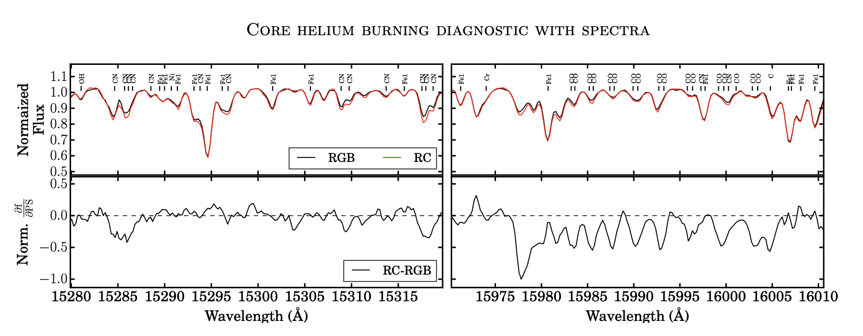
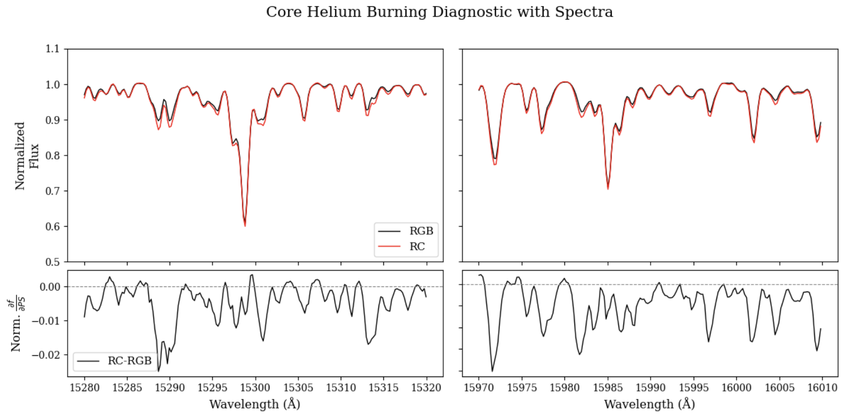
Why does this work?
The spectral region area show that the differences between RGB and RC stars lie mostly around molecular CN and CO line features.
Likely a result of extra mixing from the red giant branch bump to the helium flash causing RC stars to be lower in their carbon to nitrogen ratio compared to RGB stars of similar parameters.
Hawkins, K., Ting, Y.-S., & Rix, H.-W. (2017). Photospheric diagnostics of core helium burning in giantstars. arXiv e-prints, arXiv:1712.02405 (Accepted to The Astrophysical Journal).

Slide 17
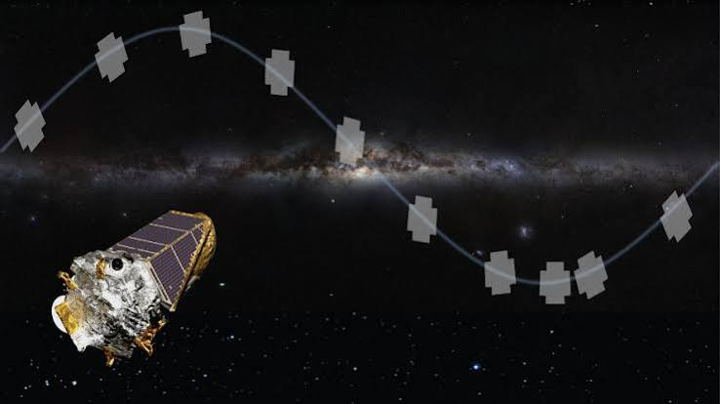
Now going further
Now we are currently trying to cut down the data to exclude the main sequence and dwarf stars so the model is only predicting on RGB and RC. Once we have that, we plan to compare TheCannon’s predicted labels with the data that the kepler two telescope found to see if TheCannon can predict these labels more accurately than a short (3 month long) observation mission. Use model to check how good it is.
Cermak, A. (2026, January 5). Kepler / K2. NASA Science. https://science.nasa.gov/mission/kepler/

Slide 18
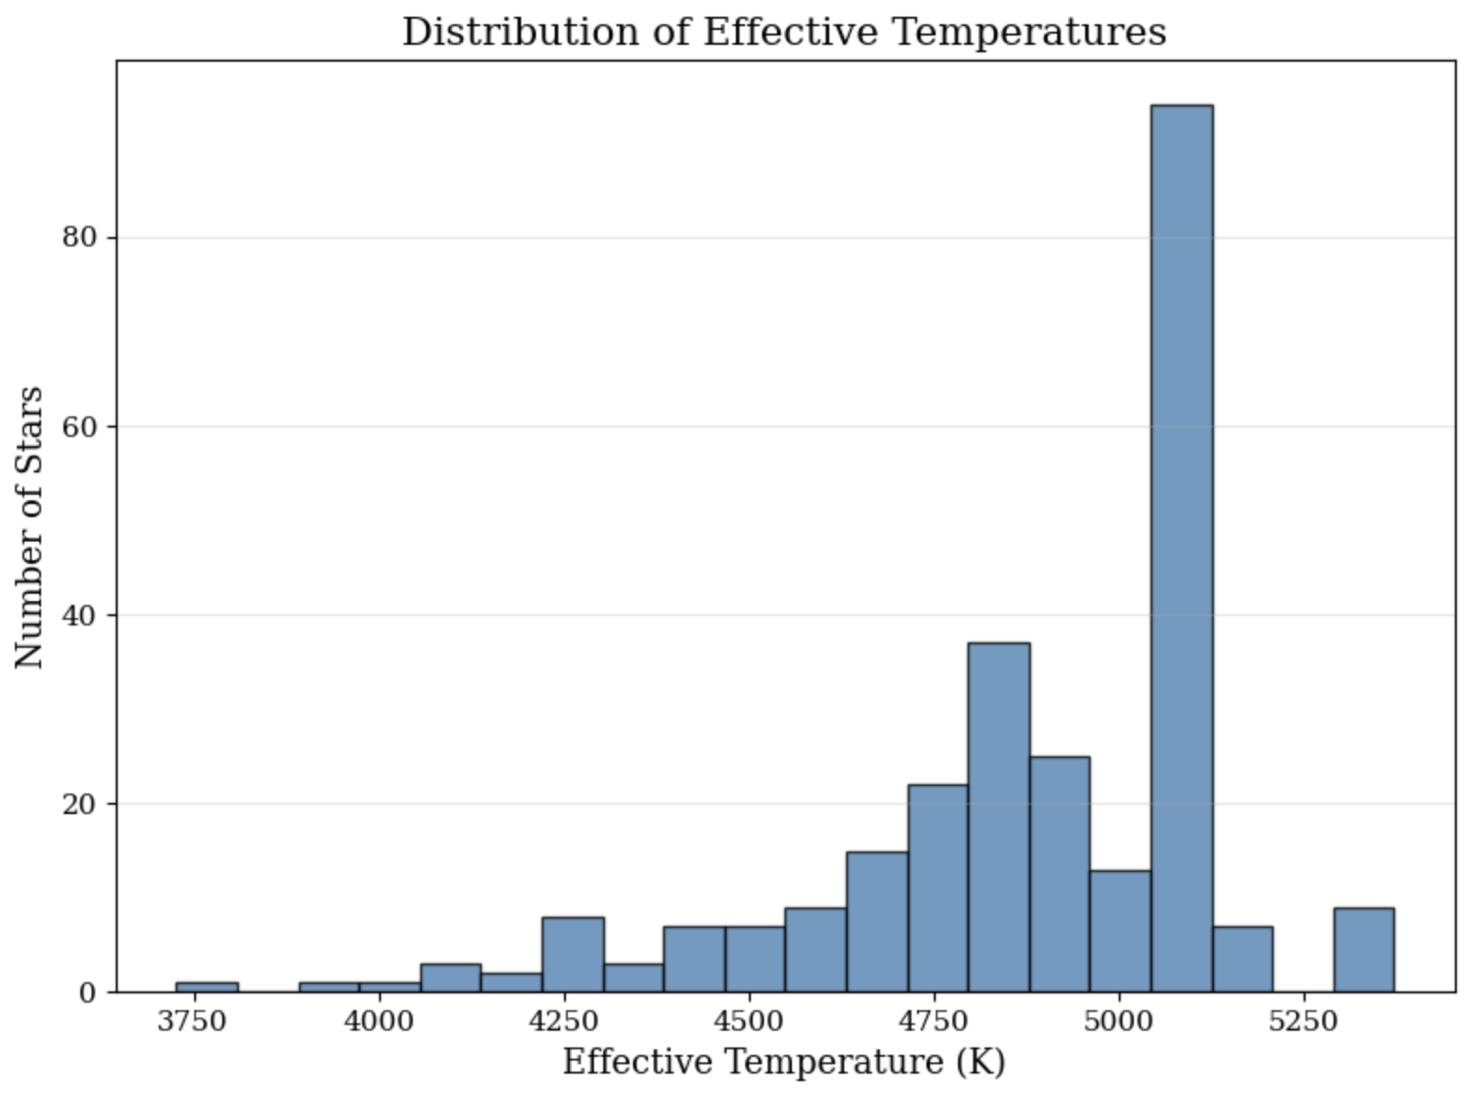
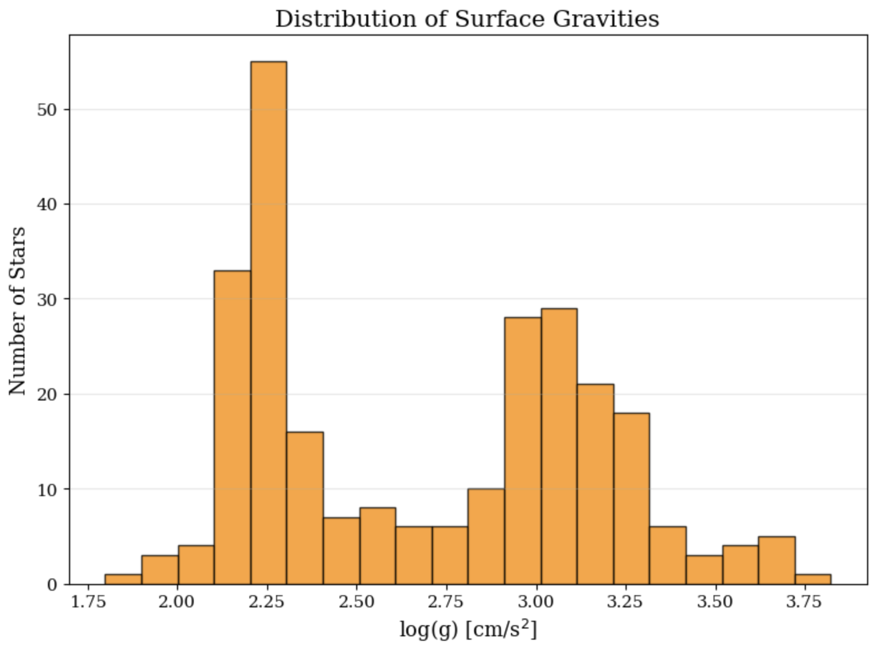
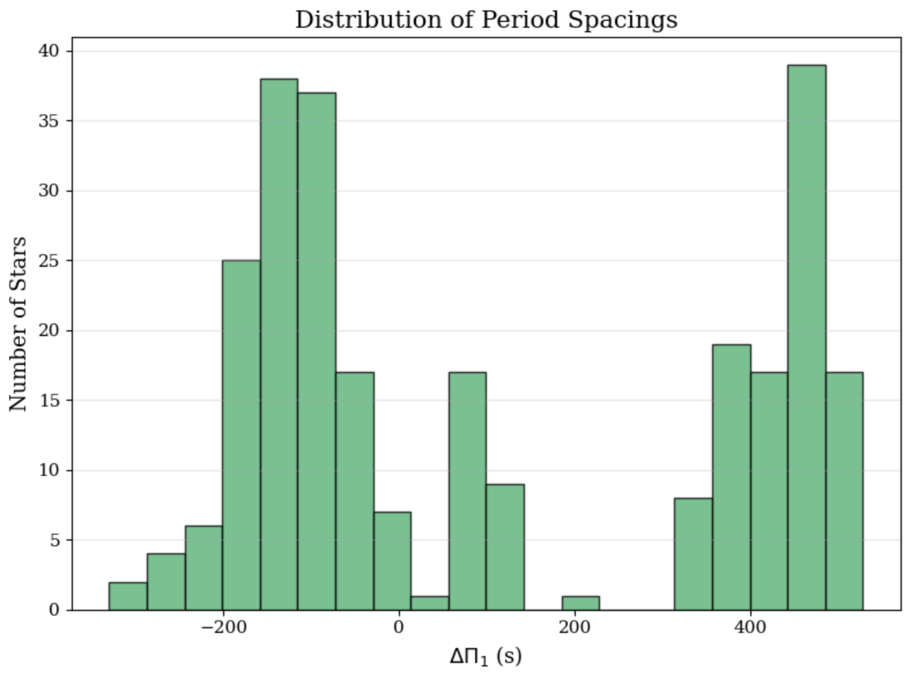
Results with new data
Histogram over effective temperature and the number of stars. This shows us that the model can predict the temperature of the stars and it’s what we would expect.
Histogram over surface gravity and the number of stars. This tells us that the model can predict the surface gravity of the star quiet well. (too hight need non more than 3.5~3.4) (plot good in gray and bad in color on an hr plot)
This histogram shows the different period spacing vs the number of stars and with so many stars located in a negative range of period spacing this tells us that this data set does not just contain RGB or RC stars

Slide 19
Questions?

Slide 20
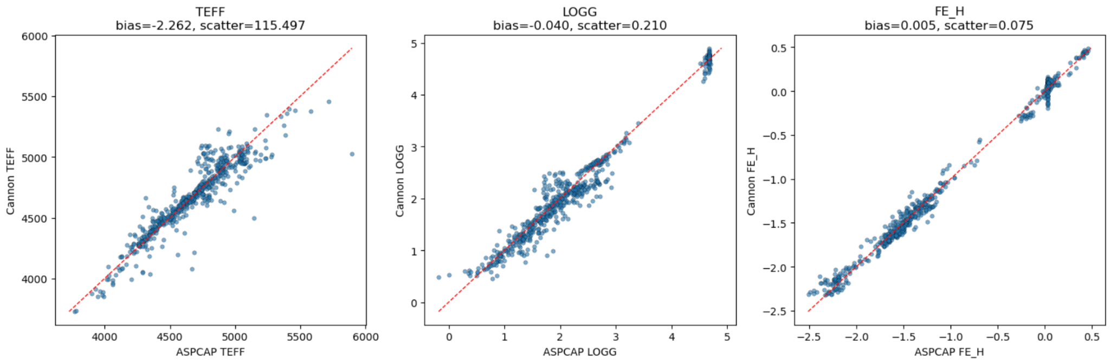
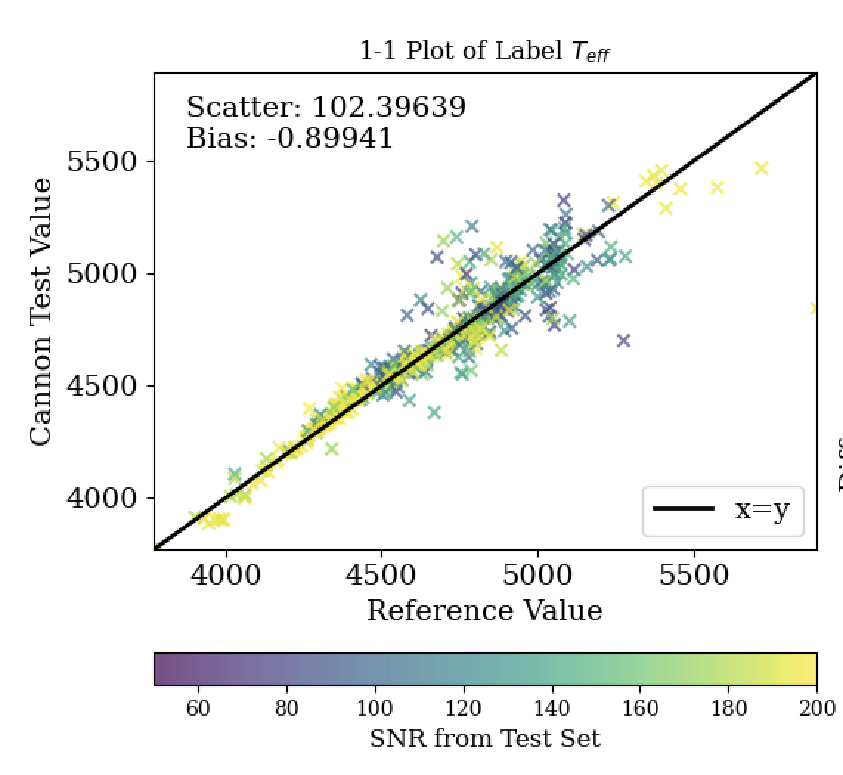
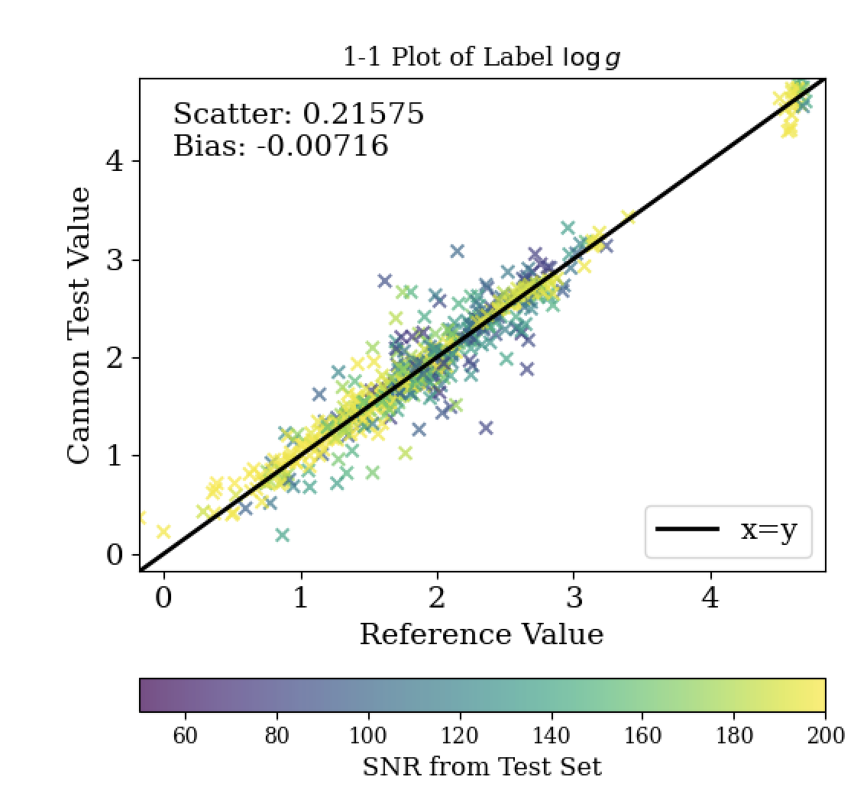
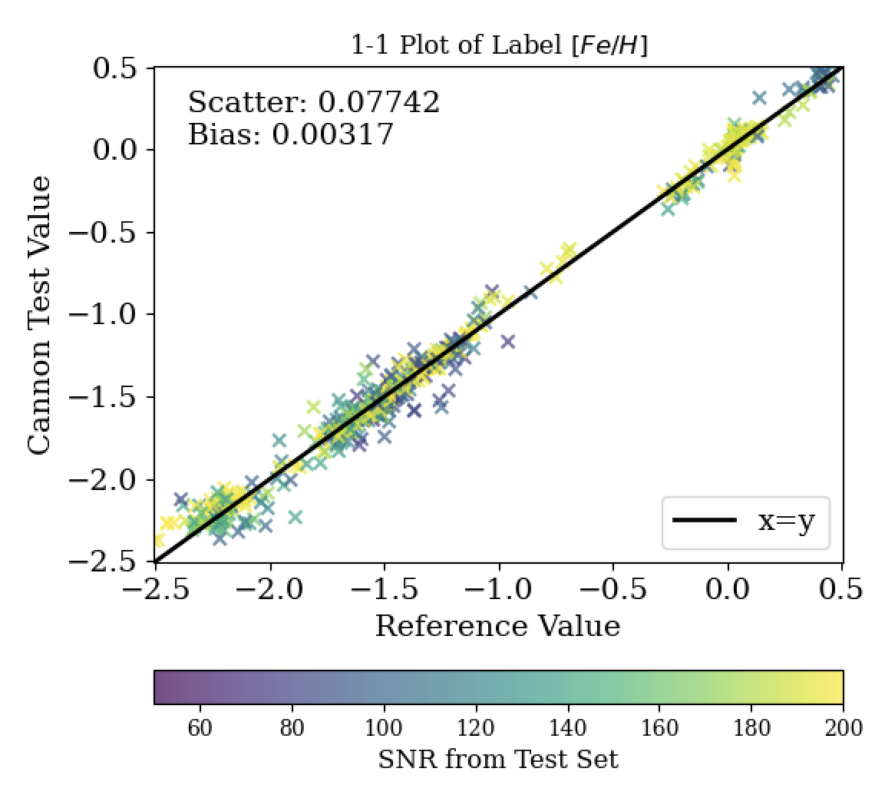
TheCannon 1 vs TheCannon 2
Improves on the number of labels it can be trained (up to 17 labels), (need more) and has regularization built in to prevent overfitting,
Teff: TheCannon 2 has a little more bias and has more scattering (~13 more scattering)
Logg: TheCannon 2 has a little more bias but the scattering is about 0.005 less than from the original cannon
Fe/H: TheCannon 2 has a little more bias but about the same scattering
There are currently some other technical issues with working with TheCannon 2.

