Slide 1
Competition of Social Opinions on Two Layer Networks (Finding key nodes)
Notes:
Previously, I show you that updating rules make different states of two layers.
Today, I would give a supplementary explanation about updating rules and consider what the dynamics order and updating rules means in real world.
And, now I am trying to find key nodes and edges. I will show you my progress. But my progress is very slow.

Slide 2
Research Processing
Interconnected Competing network Modeling
- Basic Model(RR-RR network) Analysis
- Providing index for measuring consensus
* AS, AS_total, PCR, NCR, CR, CI
Comparing with different structural networks
- Basic Model(RR-RR network) Analysis
- Providing index for measuring consensus
Comparing with different updating rules(dynamics order)
- Basic Model(RR-RR network) Analysis
- Providing index for measuring consensus
Finding key nodes on two-layer networks
Initial Condition for finding key node in each layer
- Two layers are made of BA networks with 2048 nodes and 1 external edge.
- Parameters :
Layer A : p = 0.3(0.2), v = 0.3(0.4)(negative consensus)
Layer B : p = 0.5, v = 0.5(positive consensus)
Notes:
To find important nodes on two-layer networks, it is investigated which nodes have more influence on changing average states of network by unchanging the nodes states.
Method is like this way.
all nodes are ranked by node centralities, and the ratio of unchanged nodes are increased according to ranked order, until the average states of network have different states.
When the ratio of unchanged nodes according to node centrality is the least, that centrality is the most influential property for interconnected network.
As initial condition for finding key node in layer A, each layer is made of BA network with 2048 nodes and 1 external edge. Parameter values are like p=0.3, v=0.3.

Slide 3
Finding key nodes in each layer
Method : unchanging the states of nodes
Initial Condition for finding key node in each layer
- Two layers are made of BA networks with 2048 nodes and 1 external edge.
- Parameters :
Layer A : p = 0.3(0.2), v = 0.3(0.4)(negative consensus)
Layer B : p = 0.5, v = 0.5(positive consensus)
① As initial conditions, layer is selected to find key nodes and parameters are
also selected that simulation result is opposite state with layer.
② The centralities of all nodes are calculated and ranked as orders.
③ The ratio of unchanged nodes are increased according to ranked order
until the average state of network have different states.
Notes:
To find important nodes on two-layer networks, it is investigated which nodes have more influence on changing average states of network by unchanging the nodes states.
Method is like this way.
all nodes are ranked by node centralities, and the ratio of unchanged nodes are increased according to ranked order, until the average states of network have different states.
When the ratio of unchanged nodes according to node centrality is the least, that centrality is the most influential property for interconnected network.
As initial condition for finding key node in layer A, each layer is made of BA network with 2048 nodes and 1 external edge. Parameter values are like p=0.3, v=0.3.

Slide 4
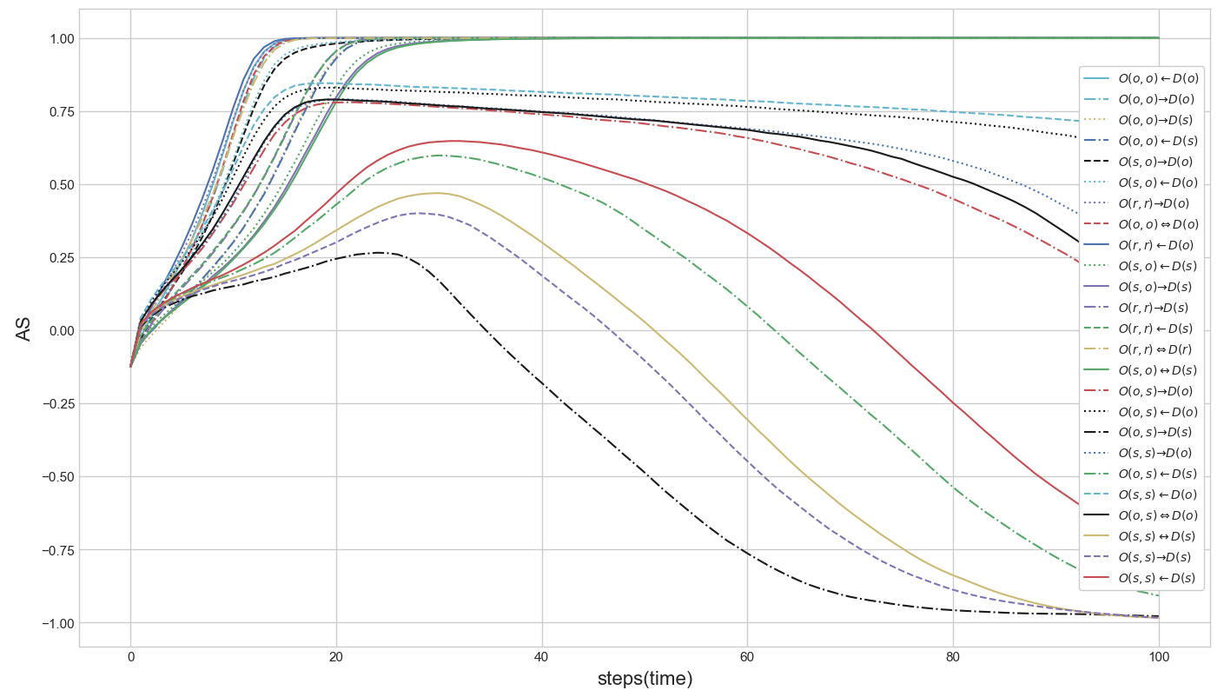
Total simulation result of updating rules with AS
Notes:
This is total simulation result of updating rules with Average State of two layers.
According to updating rules, Average states are different. But it is hard to classify the results. So I try to use other index for measuring consensus.

Slide 5
Analyzing updating rules
Orders between layers
- There is no difference between orders of layers, though there exists tiny
consensus time gap. Regardless of which layer works previously,
simulation results are almost same.
Orders between nodes
- In layer A dynamics, when two nodes are connected, probability p and q are applied.
- Orders of nodes can be analyzed as communication or decision-making methods.
Sequential : discussion, conversation
Simultaneous : vote, election
Orders between edges of each node in layer A
- As future work, the key nodes and edges are investigated
- Orders of edges can be analyzed as characteristics of nodes.
Sequential : rash nodes(changing states whenever edges are activated)
Simultaneous : considerate nodes(changing states after considering all cases)
Notes:
Analyzing updating rules
Orders between layers
There is no difference between orders of layers, though there exists tiny consensus time gap. Regardless of which layer works previously, simulation results are almost same.
Orders between nodes
Orders of nodes can be analyzed as communication methods or decision-making methods.
In sequential order, nodes have enough time to observe how other nodes change and to affect their states. It seems to have discussion and conversation.
In simultaneous order, nodes don’t have enough time to observe how other nodes change and to affect their states. It seems to have a vote or election.
Orders between edges of each node in layer A
Orders of edges can be analyzed as characteristics of nodes. In sequential order, nodes change their states whenever their edges are activated. We can call them rash nodes.
But, in simultaneous order, after nodes consider all edges, they change their states. We can call them considerate nodes.

Slide 6

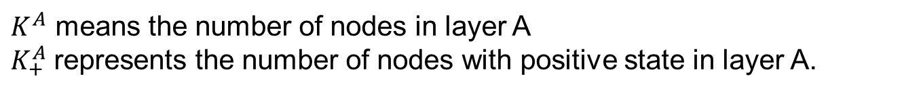
Consensus Index
$$CI=\frac{K_{+}^{A}⋅K_{−}^{B}+K_{−}^{A}⋅K_{+}^{B}}{K^{A}⋅K^{B}}$$
$K^{A}$ means the number of nodes in layer A
$K_{+}^{A}$represents the number of nodes with positive state in layer A.
With CI, it could be measured how close the network state is to consensus.
CI ≈ 1 : separated coexistence(layer A : all positive, layer B : all negative)
CI ≈ 0 : positive or negative consensus
CI ≈ 0.5 : mixed coexistence
Notes:
I provide new index for measuring consensus.
This is the consensus index. KA means the number of nodes in layer A. K plus A represents the number of nodes with positive state in layer A.
With CI, it could be measured how close the network state is to consensus.
If Ci is close to 1, it means separated coexistence like layer A has all positive states, but layer B has all negative states.
If CI is close to 0, it means positive or negative consensus.
And, if CI is close to 0.5, it means mixed coexistence.

Slide 7
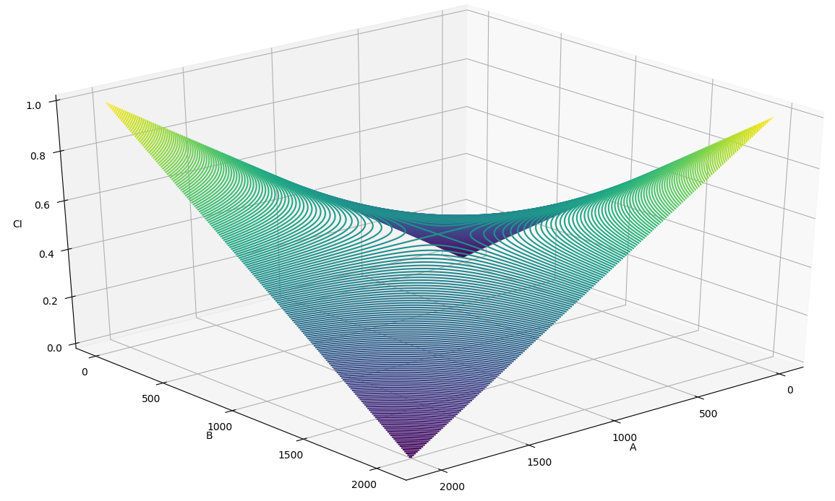

Consensus Index
CI values according to all $K_{+}^{A}$ and $K_{+}^{B}$
Notes:
This figure is CI values according to All K plus A and K plus B. Same orientation in two layers makes CI 0. Opposite orientation between two layers makes CI 1. And Mixed orientation in two layers makes CI close to 0.5.

Slide 8
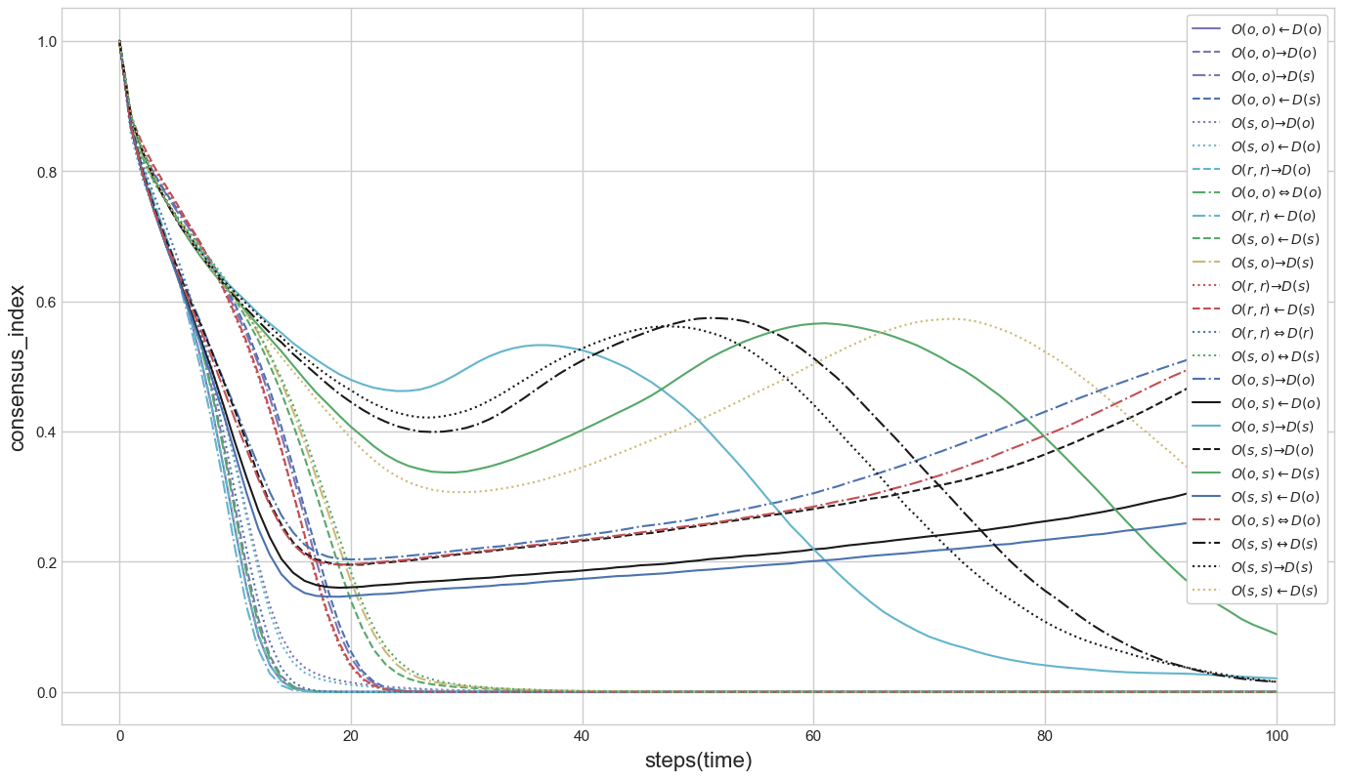
Analyzing updating rules
① Branch point
③ Branch point
② Branch point
Notes:
With CI, simulation results are researched like this figure.
We can find out 3 branch points. The results are very clear to analyze.

Slide 9
Analyzing updating rules
Div. |  | States | Orders
① Branch point | ② Branch point : Sequential order of node in layer B | Fast positive consensus : Sequential order of edge | O(r, r) ← D(o) O(r, r) → D(o) O(o, o) ← D(o) O(o, o) ⇔ D(o) O(o, o) → D(o) O(r, r) ⇔ D(r) O(s, o) ← D(o) O(s, o) → D(o)
 |  | Coexistence : Simultaneous order of edge | O(s, s) ← D(o) O(o, s) ← D(o) O(s, s) → D(o) O(o, s) ⇔ D(o) O(o, s) → D(o)
 | ③ Branch point : Simultaneous order of node in layer B | Slow positive consensus : Sequential order of edge | O(r, r) → D(s) O(r, r) ← D(s) O(o, o) → D(s) O(o, o) ← D(s) O(s, o) ← D(s) O(s, o) → D(s) O(s, o) ↔ D(s)
 |  | Slow negative consensus : Simultaneous order of edge | O(s, s) ← D(s) O(o, s) ← D(s) O(o, s) → D(s) O(s, s) → D(s) O(s, s) ↔ D(s)
Notes:
There are three branch points. In the first branch point, the results are divided according to whether order of nodes in layer B is sequential or simultaneous.
In the second and third branch point, the results are divided according to whether order of edges in layer A is sequential or simultaneous.
As the results, there are 4 categories such as fast positive consensus, slow positive consensus, coexistence and slow negative consensus.

Slide 10
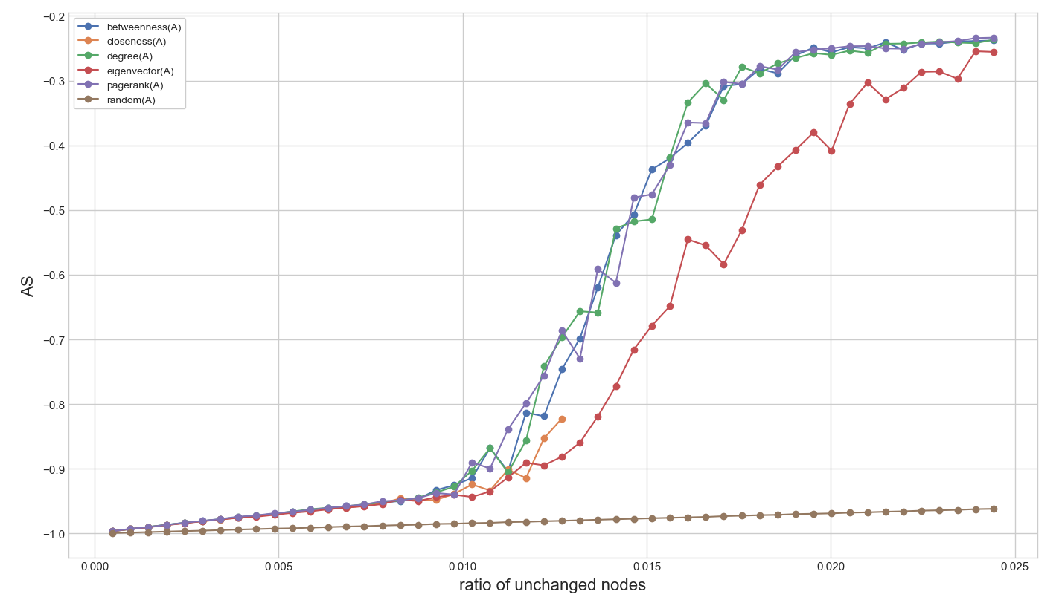
Finding key nodes in each layer
Notes:
In this simulation, 1st ~ 50th nodes according to ranked order are unchanged.
This simulation is not finished. But eigenvector centrality is a little slow to change the state.
It need to do more simulation with changing layer and parameters.

Slide 11
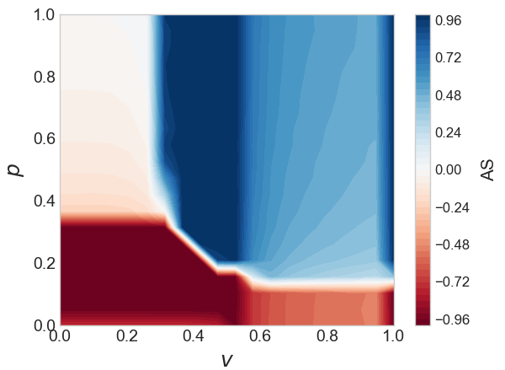

Slide 12
Future Research
Finding key edge
- Based on edge properties, such as jaccard index, degree product, edge-
betweenness, it would be investigated that which properties have more
influence to change the state of two-layers by removing edges.
Developing better algorithm for finding key nodes and edges.
- After analyzing the simulation results, better algorithms are provided for
finding key nodes and edges.
Notes:
As future research.
Next, I try to find key edges.
To find important edges on two-layer networks, it is investigated which edges have more influence on changing the average states of network by removing edges. All edges are ranked according to edge properties, such as jaccard index, degree product, edge-betweenness, and node centrality-based properties. And the ratio of removed edges is increased according to ranked order. And various simulations are implemented by removing internal edges, external edges, or mixed edges.
And, I try to develop better algorithm for finding key nodes and edges. After analyzing the simulation results, better algorithms are provided for finding key nodes and edges.

Slide 13
Thank you
Notes:
Thank you.

