Slide 1
Competition of Social Opinions on Two Layer Networks (Finding key nodes)
Notes:
Today, I would give a explanation about my total research progress and talk about finding key nodes on two layers

Slide 2
Research Processing
Interconnected Competing network Modeling
- Basic Model(RR-RR network) Analysis
- Providing index for measuring consensus
* AS, AS_total, PCR, NCR, CR, CI
Comparing with different structural networks
- Changing the number of external edges : Hierarchical Model
- Changing the number of internal edges
- Changing the structure on each layer : BA or RR
Comparing with different updating rules(dynamics order)
- Simultaneous updating rule vs Sequential updating rule
- Simulating 25 updating rules on two-layers
Finding key nodes on two-layer networks
Initial Condition for finding key node in each layer
- Two layers are made of BA networks with 2048 nodes and 1 external edge.
- Parameters :
Layer A : p = 0.3(0.2), v = 0.3(0.4)(negative consensus)
Layer B : p = 0.5, v = 0.5(positive consensus)
Notes:
This is my research processing.
My research is divided by 4 topics.
3 topics are already finished, Now I am researching about finding key nodes on two-layer networks.
First, I provided interconnected competing network modeling and index for measuring consensus.
Second, The basic model was compared with different structural networks by changing the number of external edges, the number of internal edges,
And the structure such as Barabasi Albert, random regular network.
Third, the models were compared with different updating rules such as simultaneous updating rule, or sequential updating rule.
Today, Previously, I will give you short explanation about updating rules, and then talk about finding key nodes on two-layer networks.

Slide 3
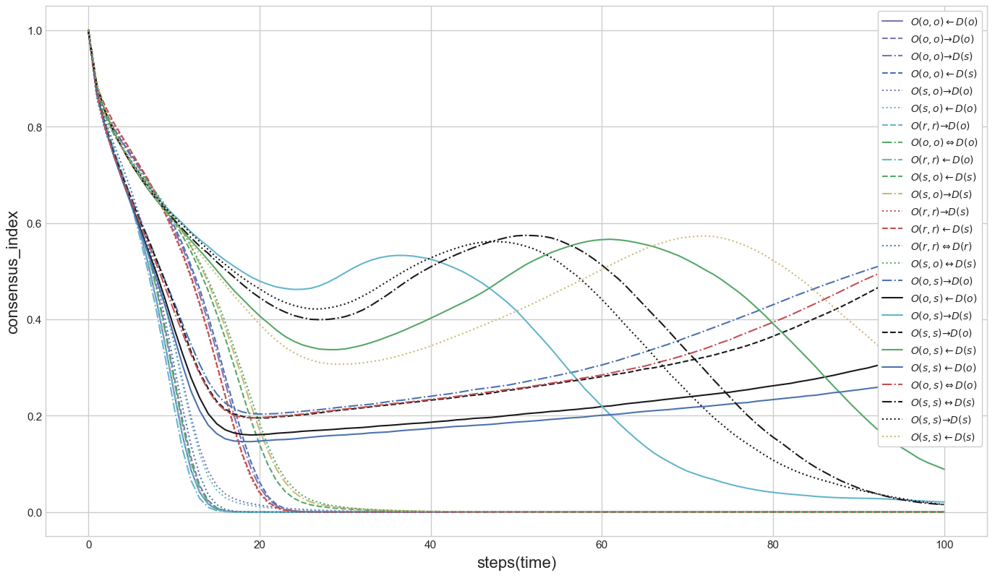
Analyzing updating rules
① Branch point
③ Branch point
② Branch point
Notes:
With different updating rules, simulation results are researched like this figure.
We can find out 3 branch points. The results are very clear to analyze.

Slide 4
Analyzing updating rules
Div. |  | States | Orders
① Branch point | ② Branch point : Sequential order of node in layer B | Fast positive consensus : Sequential order of edge | O(r, r) ← D(o) O(r, r) → D(o) O(o, o) ← D(o) O(o, o) ⇔ D(o) O(o, o) → D(o) O(r, r) ⇔ D(r) O(s, o) ← D(o) O(s, o) → D(o)
 |  | Coexistence : Simultaneous order of edge | O(s, s) ← D(o) O(o, s) ← D(o) O(s, s) → D(o) O(o, s) ⇔ D(o) O(o, s) → D(o)
 | ③ Branch point : Simultaneous order of node in layer B | Slow positive consensus : Sequential order of edge | O(r, r) → D(s) O(r, r) ← D(s) O(o, o) → D(s) O(o, o) ← D(s) O(s, o) ← D(s) O(s, o) → D(s) O(s, o) ↔ D(s)
 |  | Slow negative consensus : Simultaneous order of edge | O(s, s) ← D(s) O(o, s) ← D(s) O(o, s) → D(s) O(s, s) → D(s) O(s, s) ↔ D(s)
Notes:
There are three branch points. In the first branch point, the results are divided according to whether order of nodes in layer B is sequential or simultaneous.
In the second and third branch point, the results are divided according to whether order of edges in layer A is sequential or simultaneous.
As the results, there are 4 categories such as fast positive consensus, slow positive consensus, coexistence and slow negative consensus.

Slide 5
Analyzing updating rules
Orders between layers
- There is no difference between orders of layers, though there exists tiny
consensus time gap. Regardless of which layer works previously,
simulation results are almost same.
Orders between nodes
- In layer A dynamics, when two nodes are connected, probability p and q are applied.
- Orders of nodes can be analyzed as communication or decision-making methods.
Sequential : discussion, conversation
Simultaneous : vote, election
Orders between edges of each node in layer A
- As future work, the key nodes and edges are investigated
- Orders of edges can be analyzed as characteristics of nodes.
Sequential : rash nodes(changing states whenever edges are activated)
Simultaneous : considerate nodes(changing states after considering all cases)
Notes:
Analyzing updating rules
Orders between layers
There is no difference between orders of layers, though there exists tiny consensus time gap. Regardless of which layer works previously, simulation results are almost same.
Orders between nodes
Orders of nodes can be analyzed as communication methods or decision-making methods.
In sequential order, nodes have enough time to observe how other nodes change and to affect their states. It seems to have discussion and conversation.
In simultaneous order, nodes don’t have enough time to observe how other nodes change and to affect their states. It seems to have a vote or election.
Orders between edges of each node in layer A
Orders of edges can be analyzed as characteristics of nodes. In sequential order, nodes change their states whenever their edges are activated. We can call them rash nodes.
But, in simultaneous order, after nodes consider all edges, they change their states. We can call them considerate nodes.

Slide 6
Finding key nodes in each layer
Method : unchanging the states of nodes
Initial Condition for finding key node in each layer
- Two layers are made of BA networks with 2048 nodes and 1 external edge.
- Parameters :
Layer A : p = 0.2, v = 0.4(originally, negative consensus)
Layer B : p = 0.5, v = 0.5(originally, positive consensus)
① As initial conditions, layer is selected to find key nodes and parameters are
also selected that simulation result is opposite state with layer.
② The centralities of all nodes are calculated and ranked as orders.
③ The ratio of unchanged nodes are increased according to ranked order
until the average state of network have different states.
Notes:
Next topic, finding key nodes in each layer.
To find important nodes on two-layer networks, it is investigated which nodes have more influence on changing average states of network by unchanging the nodes states.
Method is like this way.
all nodes are ranked by node centralities, and the ratio of unchanged nodes are increased according to ranked order, until the average states of network have different states.
When the ratio of unchanged nodes according to node centrality is the least, that centrality is the most influential property for interconnected network.
As initial condition for finding key nodes, each layer is made of BA network with 2048 nodes and 1 external edge.
For finding key nodes on layer A, parameter values are like p=0.2, v=0.4.
For finding key nodes on layer B, parameter values are like p=0.5, v=0.5.

Slide 7
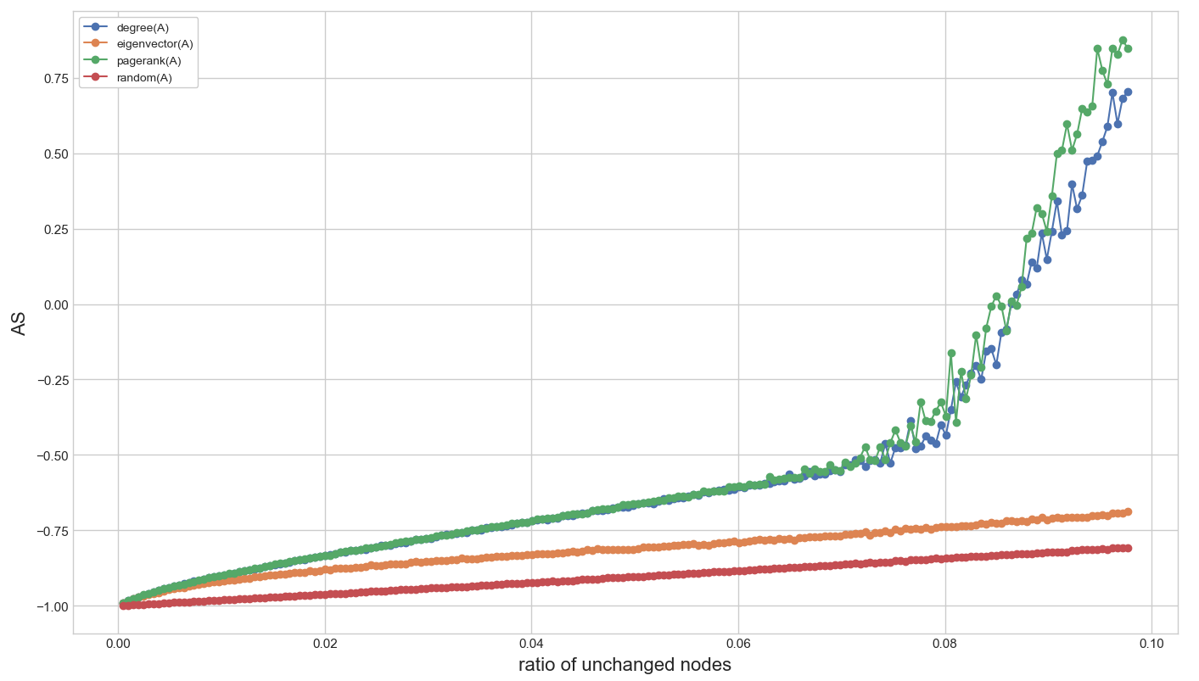
Finding key nodes in layer A
BA(4,092)-BA(4,092) network, p=0.2, v= 0.4
Pagerank > degree > eigenvector > random
Notes:
This is the result for finding key nodes in layer A
When the number of total edges is 4,092, the efficient method is ranked as pagerank, degree, eigenvector, random.

Slide 8
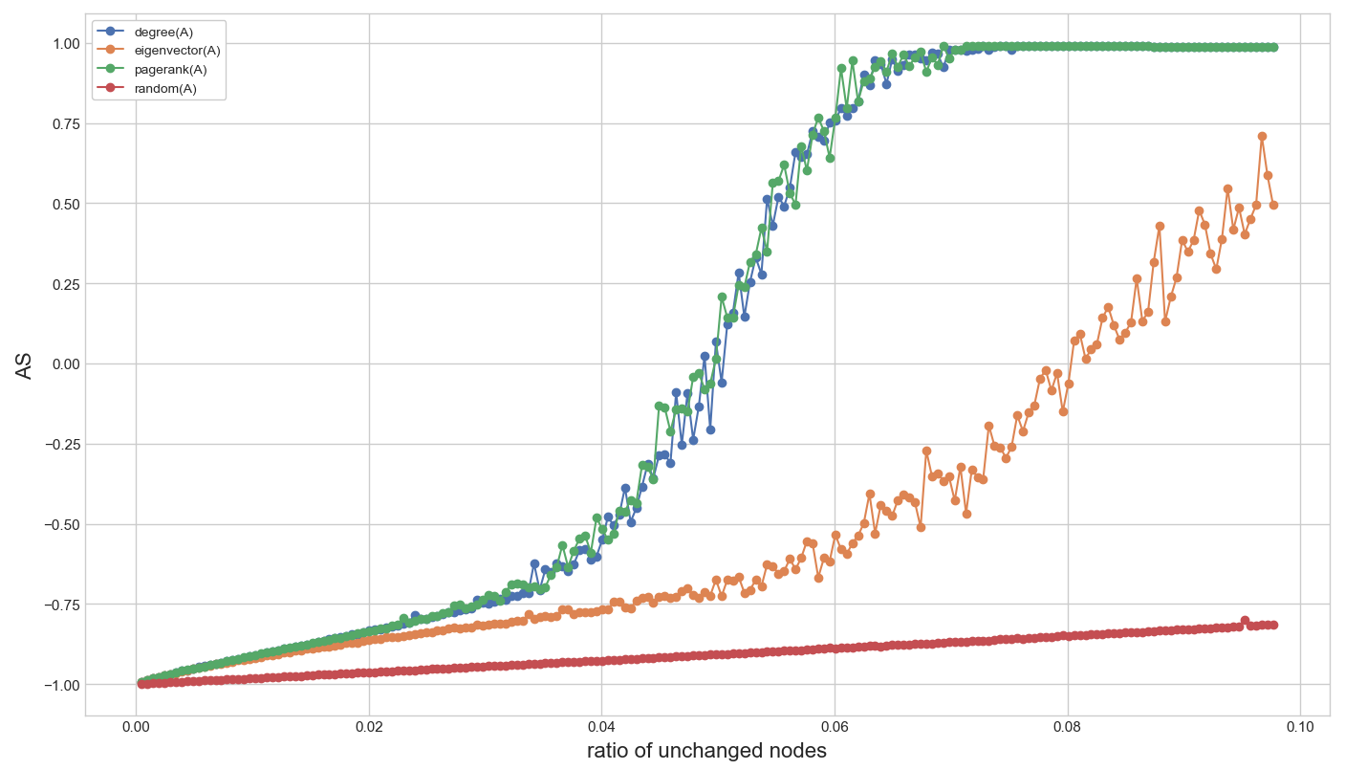
Finding key nodes in layer A
BA(6,135)-BA(6,135) network, p=0.2, v= 0.4
Pagerank = degree > eigenvector > random
Notes:
When the number of total edges is 6,135, pagerank and degree method is almost same. And total orientation is easier to change than previous one.

Slide 9
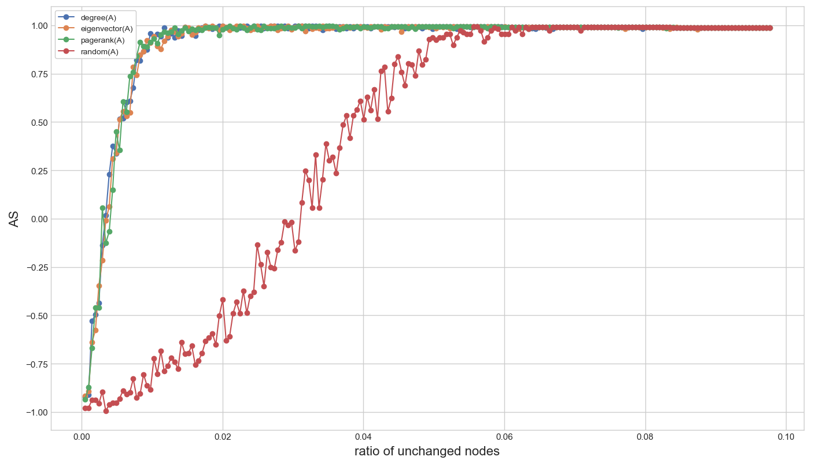
Finding key nodes in layer A
BA(8,176)-BA(8,176) network, p=0.2, v= 0.4
Pagerank = degree = eigenvector > random
Notes:
When the number of total edges is 8,176, pagerank, degree, and eigenvector method is almost same. And total orientation is much easier to change than previous one.

Slide 10
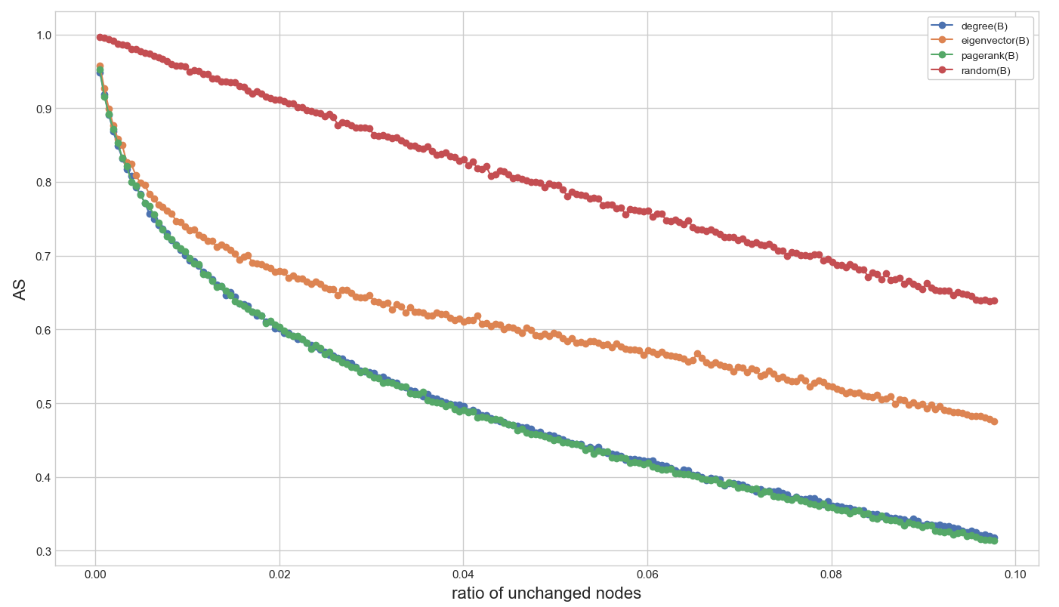
Finding key nodes in layer B
BA(4,092)-BA(4,092) network, p=0.5, v= 0.5
Pagerank = degree > eigenvector > random
Notes:
This is the result for finding key nodes in layer B
When the number of total edges is 4,092, the efficient method is ranked as pagerank, degree, eigenvector, random.

Slide 11
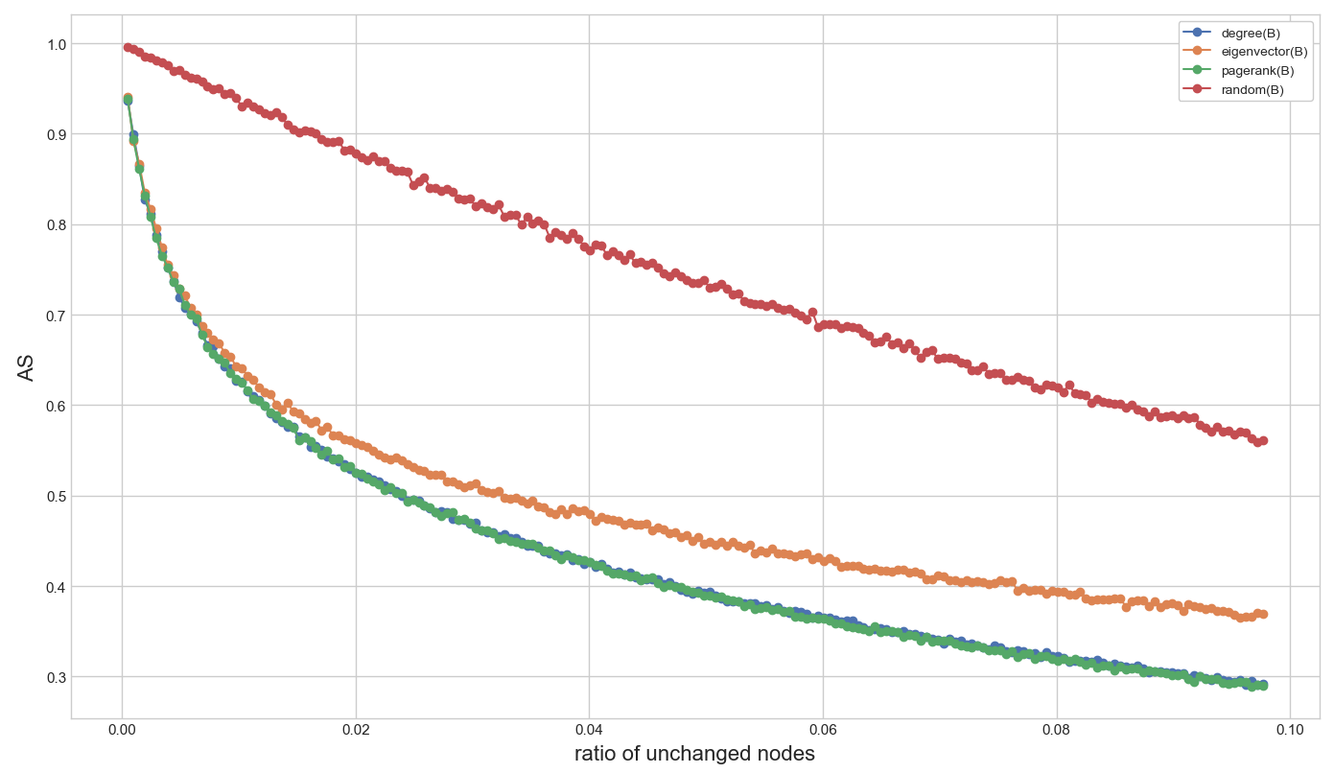
Finding key nodes in layer B
BA(6,135)-BA(6,135) network, p=0.5, v= 0.5
Pagerank = degree > eigenvector > random
Notes:
When the number of total edges is 6,135, the efficient method is ranked as pagerank, degree, eigenvector, random.
This chart is more curved than previous one.

Slide 12
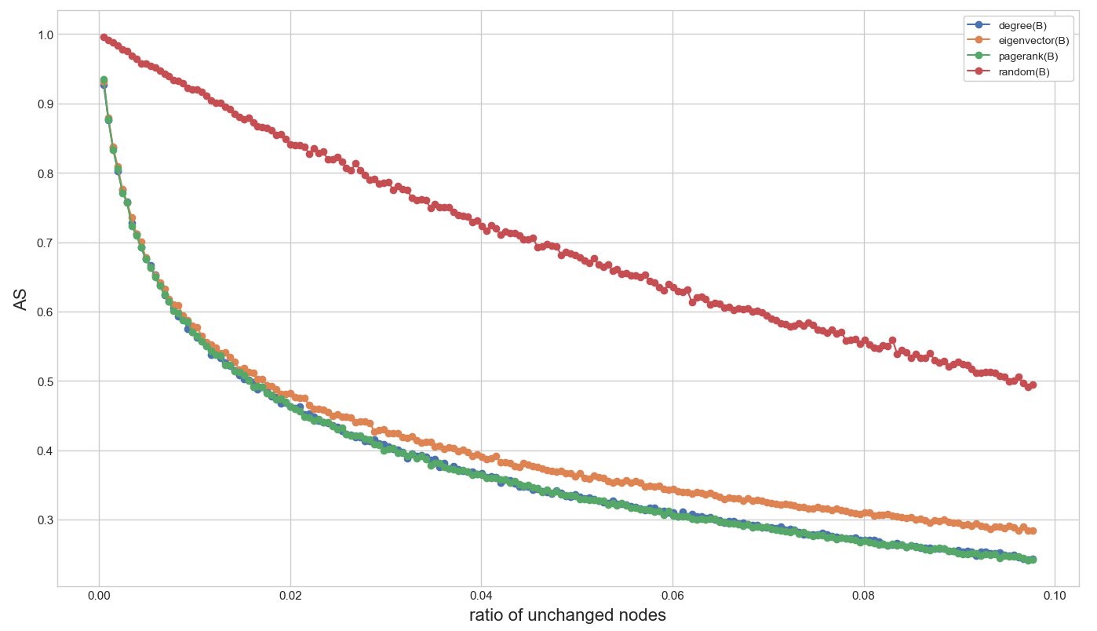
Finding key nodes in layer B
BA(8,176)-BA(8,176) network, p=0.5, v= 0.5
Pagerank = degree = eigenvector > random
Notes:
When the number of total edges is 8,176, the efficient method is ranked as pagerank, degree, eigenvector, random.
This chart is much more curved than previous one.

Slide 13
Analysis for finding key nodes
Relation between key nodes and the number of edges
- As the number of edges on layers increases, the orientation of layer is easy to
change though the ratio of unchanged node is small.
* the number of edges : 8,176 → the ratio of unchanged node = 0.01, orientation changed
* the number of edges : 6,136 → the ratio of unchanged node = 0.07, orientation changed
Efficient Method for finding key nodes
- Pagerank > degree > eigenvector > random
* when the number of edges is very large, all methods have the same influence.
(except random method)
Notes:
Analysis for finding key nodes.
Analyzing the relation between key nodes and the number of edges, as the number of edges on layers increases, the orientation of layer is easy to change though the ratio of unchanged node is small.
And, as efficient method for finding key nodes, the rank is like this, pagerank, degree, eigenvector, and random.

Slide 14
Analysis for finding key nodes
Comparison between layer A and layer B
Layer A | Layer B
Very fast for changing the orientation When the ratio of unchanged node is more than certain rate, it is very fast to change the orientation. (Group has more efficient) | Very slow for changing the orientation When the ratio of unchanged node is more than certain rate, it is very slow to change the orientation. (Individual has more efficient)
Notes:
Next, Comparing between layer A and layer B for finding key nodes,
For layer A, layer orientation are changed very fast. When the ratio of unchanged node is more than certain rate, it is very fast to change the orientation.
So to speak, if it has group for unchanged state, total orientation is easy to change.
For layer B, layer orientation are changed very slow, When the ratio of unchanged node is more than certain rate, it is very slow to change the orientation.
So to speak, though it has group for unchanged state, total orientation is not easy to change.

Slide 15
Future Research
Finding key node with different conditions
- finding key nodes on two-layer network with different edges
* ex) BA(4,092)-BA(8,176) or BA(8,176)-BA(4,092)
- finding key nodes on hierarchical models
* HM(16) with BA networks
- Considering other methods for keynodes
* betweenness, closeness
Developing better algorithm for finding key nodes and edges.
- After analyzing the simulation results, better algorithms are provided for
finding key nodes and edges.
Notes:
As future research.
Next, I try to find key node with different conditions such as two-layer network with different edges, hierarchical models, and consider other methods like betweenness, closeness.
Next, If I find better algorithms, I will provide more efficient method for finding key nodes.

Slide 16
Thank you
Notes:
Thank you.

