Slide 1
To-Do List Web Application
Leighton Manning

Slide 2
Concept
Second project, focusing on the MVP and what was a must.
Decided to plan the backend so that I could design the front end accordingly.
Had a look at a couple of ideas online.

Slide 3
Sprint Plan
Knew there needed to be two parts so I decided that I’d split the sprints into two as mentioned before with back-end first.
By the end of the sprints I was hoping to achieve a fully working to-do list creator with both front and back end.

Slide 4
Consultant Journey
Technologies used before.
Java, Git, JUNIT+Mockito, Maven
New technologies used this time
Spring, HTML, CSS, JavaScript, Selenium, Sonarqube, Postman/SwaggerUI

Slide 5
CONTINUOUS INTEGRATION
Using Git for my version control using git bash
Utilised the feature branch model, using main dev and feature-”concept”.
Once features are complete merged back into dev. Finally into main.
Was good to be able to split front/back/testing into different branches.

Slide 6
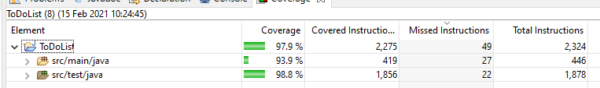
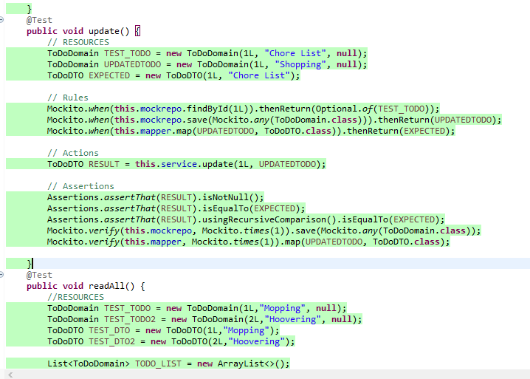
Testing
JUNIT TESTING.
Testing my service classes for Tasks
and ToDos.
Focus point for me this time.

Slide 7
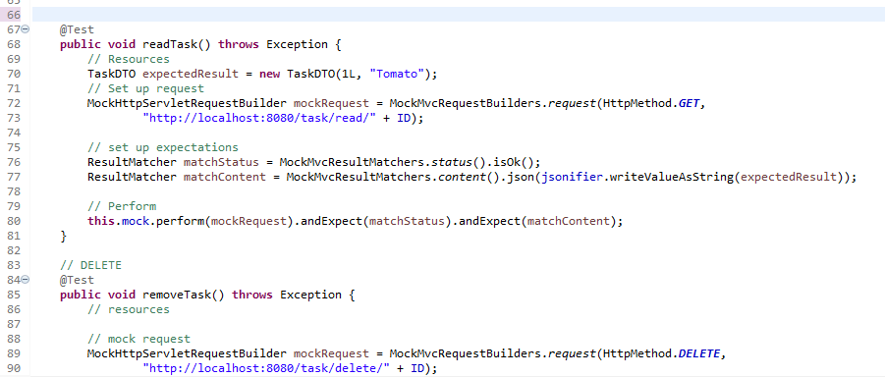
Testing continued
Integration Testing
To prove that each integration of the application is functioning as expected
Done on the Controller classes.
Using Junit+Mockito

Slide 8
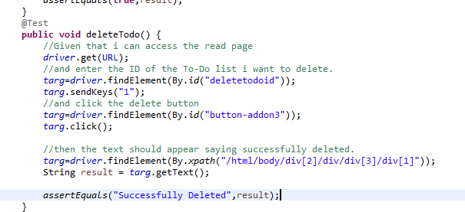
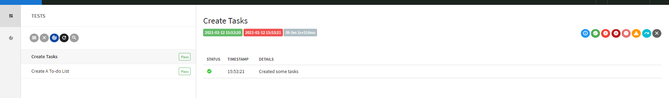
Testing continued
Selenium
Testing my front end using selenium to automate the web browser
Testing the front-end works as expected
Added an extent report.

Slide 9
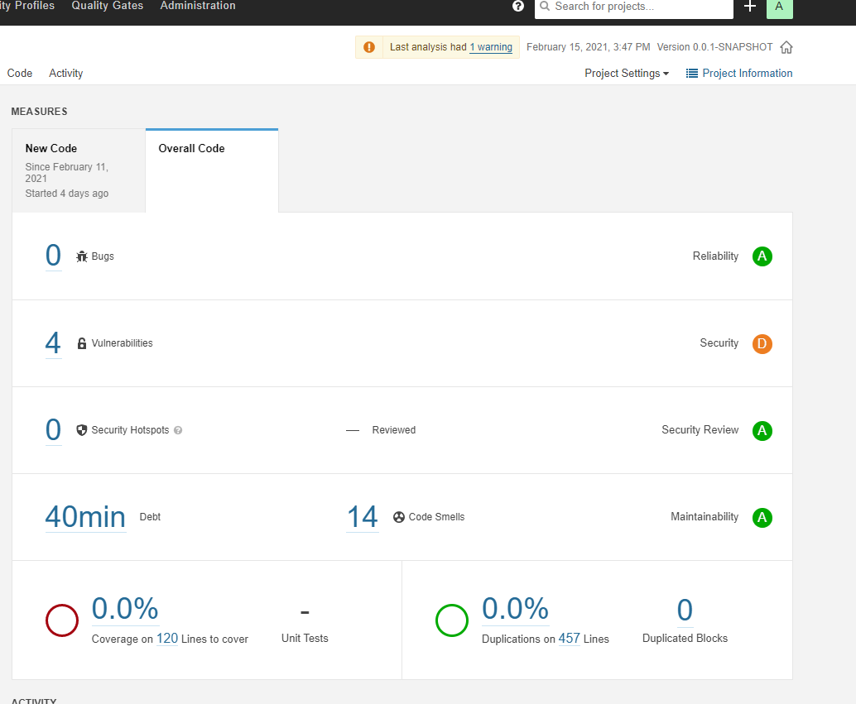
Sonarqube
Used for static analysis of my code.
Makes sure that bugs and security issues are caught
Using best practice
Worked to remove code smells and bugs.

Slide 10
dEMONSTRATION
I’m going to run through a couple of user stories.

Slide 11
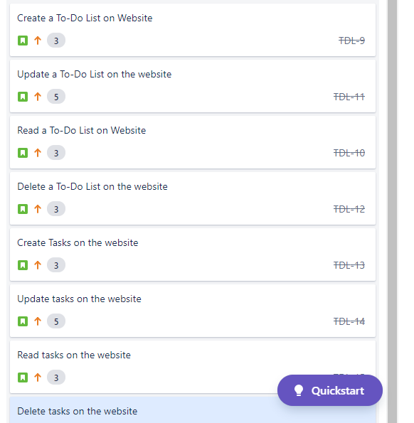
Sprint Review
Using Jira
I completed all the user stories I set for the project.
Worked on the backend first, then moved to front end as planned
Estimated using story points
Wanted to customise the front-end more. More Javascript.

Slide 12
Sprint Retrospective
Both sprints went well. Completed in time and they focused on what my program MUST have via MoSCoW
Some of the story points I gave the tasks where a little on the low side and took longer than expected.
Overall I managed my time well, will work on improving user story estimations.

Slide 13
Conclusion
I think overall the project went well. Using lots of new technologies but also building on the knowledge that I learnt from the previous project.
Future steps would be to continue developing my skills using both front end and backend technologies going forward. Using these towards future projects in the academy and for myself.

Slide 14
QUESTIONS
Thanks for listening

