Slide 1
EIDETIC 3D LSTM: A MODEL FOR VIDEO PREDICTION AND BEYOND
Tsinghua University, Google AI
ICLR 2019

Slide 2
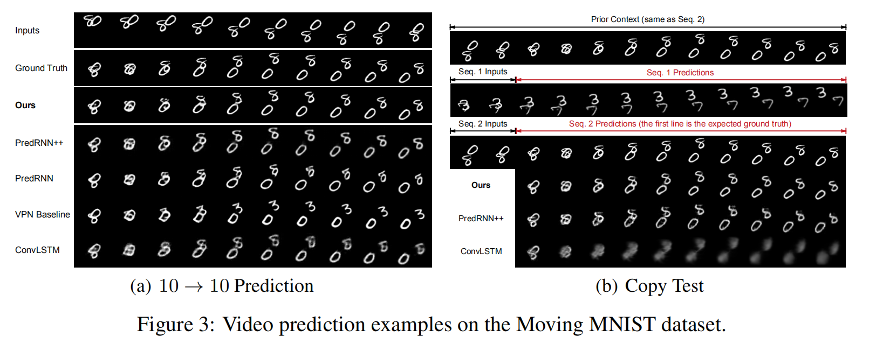
E3D-LSTM
Introduction
In real life, many data have both temporal and spatial features, such as the human body's motion trajectory, continuous frame video, etc.

Slide 3
E3D-LSTM
Motivation
Each time point corresponds to a set of data, and the data often has certain spatial characteristics.
Therefore, in order to perform classification, prediction and other work on such time series data, it is necessary to model and extract features in temporal and spatial.

Slide 4
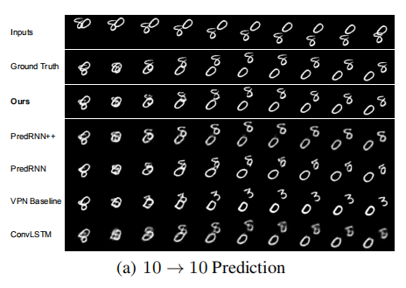
E3D-LSTM
Motivation
Spatiotemporal predictive learning, though long considered to be a promising self-supervised feature learning method, seldom shows its effectiveness beyond future video prediction.
In this paper, they proposed a novel Semantic segmentation method, called Eidetic 3D LSTM (E3D-LSTM) that integrates 3D convolutions into RNNs.
The encapsulated 3D-Conv makes local perceptrons of RNNs motion-aware. For long-term relations, they make the present memory state interact with its historical records via a gate-controlled self-attention module.

Slide 5
E3D-LSTM
Contribuction
This paper presented the E3D-LSTM model based on 3D conv recurrent units for video prediction task.
In this model, they integrated 3D-Convs into state transitions to perceive short-term motions and designed a memory attentive module controlled by recurrent gates to capture the long-term video frame interaction.
Experimental results demonstrate that the E3D-LSTM model performs favorably against the state-of-the-art methods on video prediction and early activity recognition tasks.

Slide 6
E3D-LSTM
EIDETIC 3D LSTM: A MODEL FOR VIDEO PREDICTION AND BEYOND

Slide 7
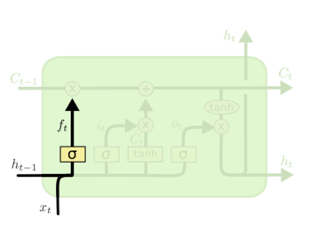
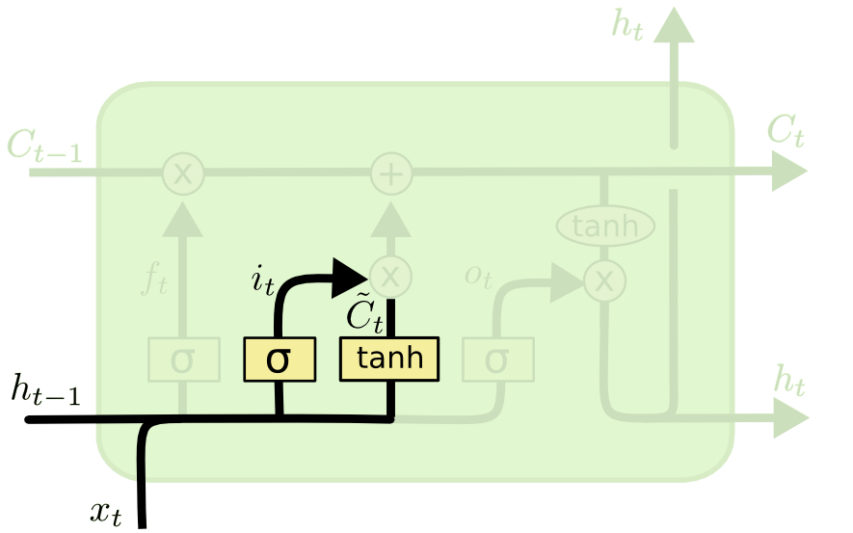
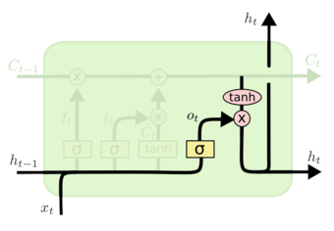




Background
LSTM
Forget gate
Input gate
Output gate

Slide 8
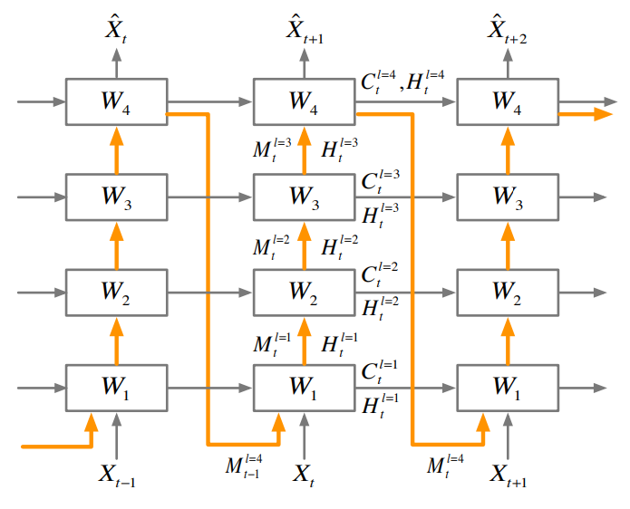
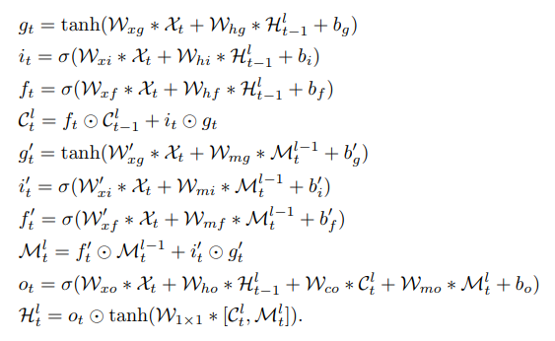
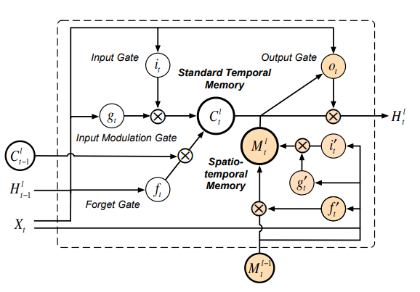
Background
Spatiotemporal LSTM

Slide 9
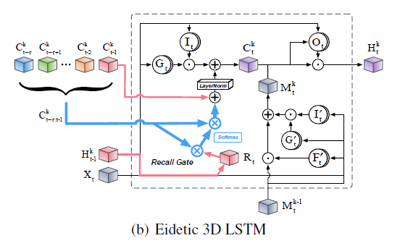
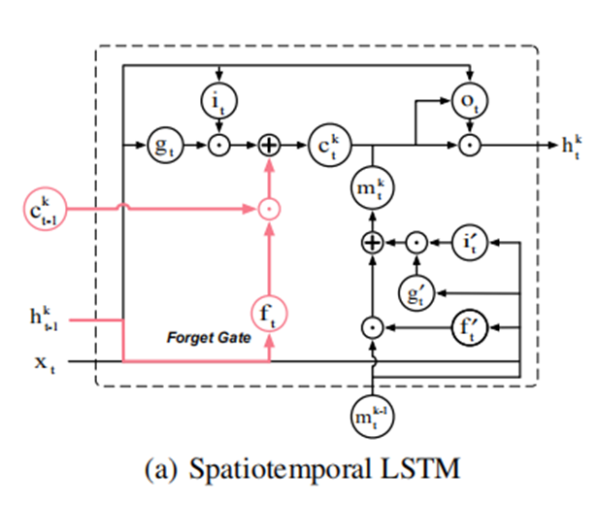
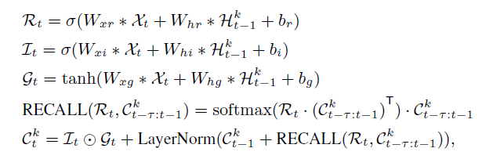
E3D-LSTM
Proposed Method

Slide 10
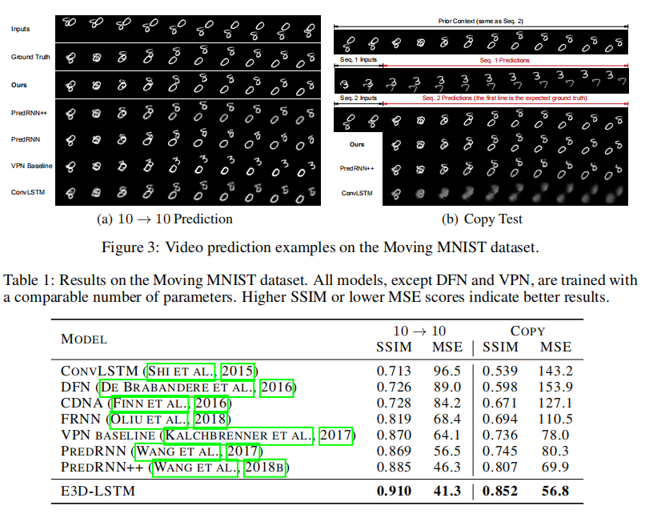
E3D-LSTM
Experimental Result:

Slide 11
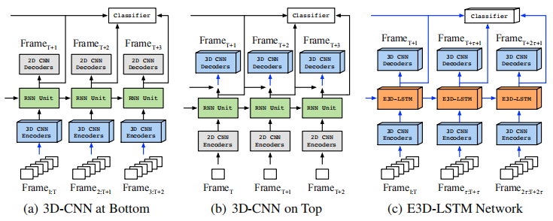
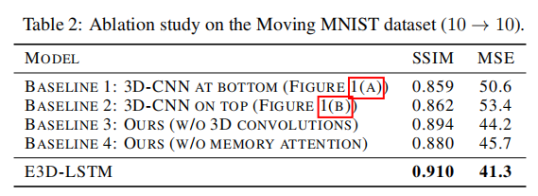
E3D-LSTM
Experimental Result:

Slide 12
Reference
Spatio-Temporal Convolutional LSTMs
http://papers.nips.cc/paper/6689-predrnn-recurrent-neural-networks-for-predictive-learning-using-spatiotemporal-lstms.pdf
Eidetic 3D LSTM: A Model for Video Prediction and Beyond
https://openreview.net/forum?id=B1lKS2AqtX

Slide 13
Thanks

