Slide 1
EMBRY-RIDDLE AERONAUTICAL UNIVERSITY | GRADUATE THESIS DEFENSE
Evaluating Predictive Techniques to Model
Stochastic Airport Passenger Flow
An Evaluation of Multi-Pillar Performance Measures for TSA Throughput Volatility
Candidate: Leila Gleich · Master of Science in Aeronautics (MSAA / Gleich 700B) · October 2026

Slide 2
EXECUTIVE ROADMAP
Defense Presentation Roadmap
25-Minute Structured Oral Examination across Six Operational Phases
01
Research Problem & Hypotheses
Kingman queuing friction, volatility targeting, and Asymmetric Trade-Offs (H1)
02
Literature & Theoretical Evolution
Evolution from deterministic schedules and simulation to ML and dynamic 2-stage hybrids
03
Econometric Data Pipeline
4-tier filtering funnel, DB1B connecting deflation, and carrier checkpoint isolation
04
Empirical Volatility Findings
Values vs. Volatility coupling (R² = 19.1%), 4 annual seasons, and bimodal diurnal peaks
05
Model Execution & Benchmarks
Certified 2025 holdouts: Robustness, Resilience (IROPS shocks), and Generalizability
06
Operational Implementation
Regime-switched gated inference playbook and dynamic checkpoint allocation

Slide 3
THEORETICAL FOUNDATION
The Terminal Queuing Problem
Why Static Volume Staffing Fails Under Stochastic Arrival Burstiness
KINGMAN'S HEAVY-TRAFFIC QUEUING APPROXIMATION
W_q ≈ ( ρ / (1 - ρ) ) · ( (C_a² + C_s²) / 2 ) · ( 1 / μ )
Key Operational Implications:
1. Delay scales quadratically with arrival volatility (C_a²), not volume.
2. As lane utilization ρ approaches 1.0, variance bursts cause exponential delay spikes.
3. Static hourly passenger counts completely mask heavy-traffic queuing friction.
THE OPERATIONAL REALITY
Inflexible Security Infrastructure
Physical screening lanes (AIT body scanners, baggage X-ray, TSO staffing) cannot expand dynamically in real time. Static historical tables leave checkpoints chronically mismatched to flight bank surges.
THE STOCHASTIC MECHANISM
Passenger Arrivals Lead, Flight Delays Lag
Passengers show up 2 hours ahead of scheduled flight departures. Downline aircraft delays accumulate in late afternoon banks. Modeling this temporal asynchrony requires capturing variance, not static numbers.

Slide 4
RESEARCH FORMULATION
Research Purpose & Operational Objectives
Transforming Terminal Security from Static Accounting to Stochastic Forecasting
OBJECTIVE 1
Target Throughput Volatility
Pivot from static volume (y_t) to volatility targets: diurnal dispersion (σ_TSA) and scale-free burstiness (CV_TSA = σ/μ).
OBJECTIVE 2
Comparative Model Suite
Empirically evaluate three distinct paradigms—deterministic schedules, supervised ML, and 2-stage dynamic hybrids—against a persistence control.
OBJECTIVE 3
Context-Aware Optimization
Prove that predictive superiority is contingent upon operational regime: routine flow vs. severe convective disruptions vs. spatial facility transfer.

Slide 5
CORE INQUIRY
Primary Research Question
Evaluating Predictive Paradigms Across Competing Operational Trade-Offs
RESEARCH QUESTION (RQ₁)
“Which predictive modeling frameworks—spanning deterministic persistence controls, deterministic schedule baselines, machine learning, and dynamic two-stage hybrids—are most effective for forecasting airport passenger security screening throughput volatility when prioritizing robustness, resilience, or generalizability as the primary operational evaluation metric?”
ROBUSTNESS
Routine Accuracy
Lowest RMSE & MASE < 0.700 under nominal on-time operations (delay < 15m, 0 cancels).
RESILIENCE
Disruption Stability
Multiplier R_MASE ≈ 1.00 & recovery TTR < 4.0h during severe convective IROPS.
GENERALIZABILITY
Spatial Portability
Zero-shot transfer error penalty ΔMASE ≤ 10% deployed to new terminal layouts.

Slide 6
THEORETICAL FORMULATION
Hypothesis: The Asymmetric Trade-Off (H₁)
No Single Predictive Technique is Universally Dominant Across All Operating Regimes
MASTER HYPOTHESIS (H₁)
Across the candidate modeling paradigms evaluated, no individual approach will prove superior across all three performance measures (robustness, resilience, and generalizability).
H₁ₐ · Robustness
ROUTINE ACCURACY WINNER
Model 2 (Machine Learning) & Model 3 (Hybrid) achieve MASE < 0.700 under nominal rhythms.
Deterministic baselines fail due to schedule rigidity.
H₁ᵦ · Resilience
DISRUPTION SHOCK WINNER
Model 3 (Dynamic Hybrid) is the sole model satisfying resilience (R_MASE ≈ 1.05).
Model 2 collapses (R = 2.14) due to the Empty Checkpoint Fallacy.
H₁꜀ · Generalizability
ZERO-SHOT TRANSFER WINNER
Model 1 (Deterministic) satisfies transfer targets (RTR = 1.04, ΔMASE = +4.0%).
Model 3 fails (RTR = 1.19, ΔMASE = +21.5%) due to terminal layout overfitting.

Slide 7
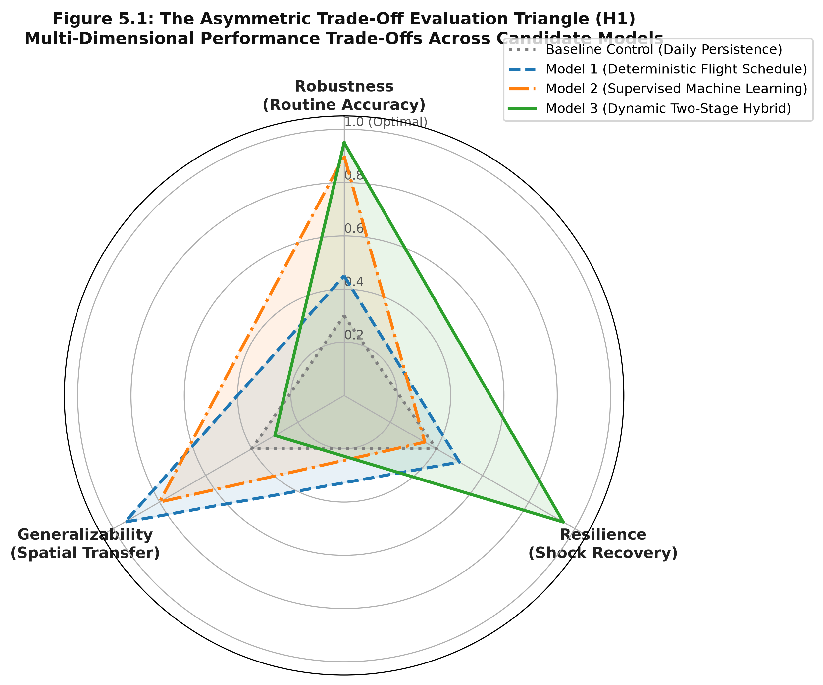
EVALUATIVE TRIO
The Multi-Pillar Performance Framework
Evaluating Models Beyond Single-Metric Annual Global Minimization
Dimension 1: Robustness
NOMINAL ACCURACY
Lowest RMSE & MASE < 0.700 under on-time baseline operations (delay < 15 min, 0 cancellations). Ensures reliable day-to-day base staffing rosters.
Dimension 2: Resilience
DISRUPTION RECOVERY
Recovery multiplier R_MASE ≈ 1.00 & TTR < 4.0h during severe convective disruptions (delay ≥ 45 min, cancels ≥ 5). Prevents lobby gridlock.
Dimension 3: Generalizability
SPATIAL PORTABILITY
Zero-shot transfer ratio RTR ≤ 1.05 & error penalty ΔMASE ≤ 10% deployed to new airports without local retraining.

Slide 8
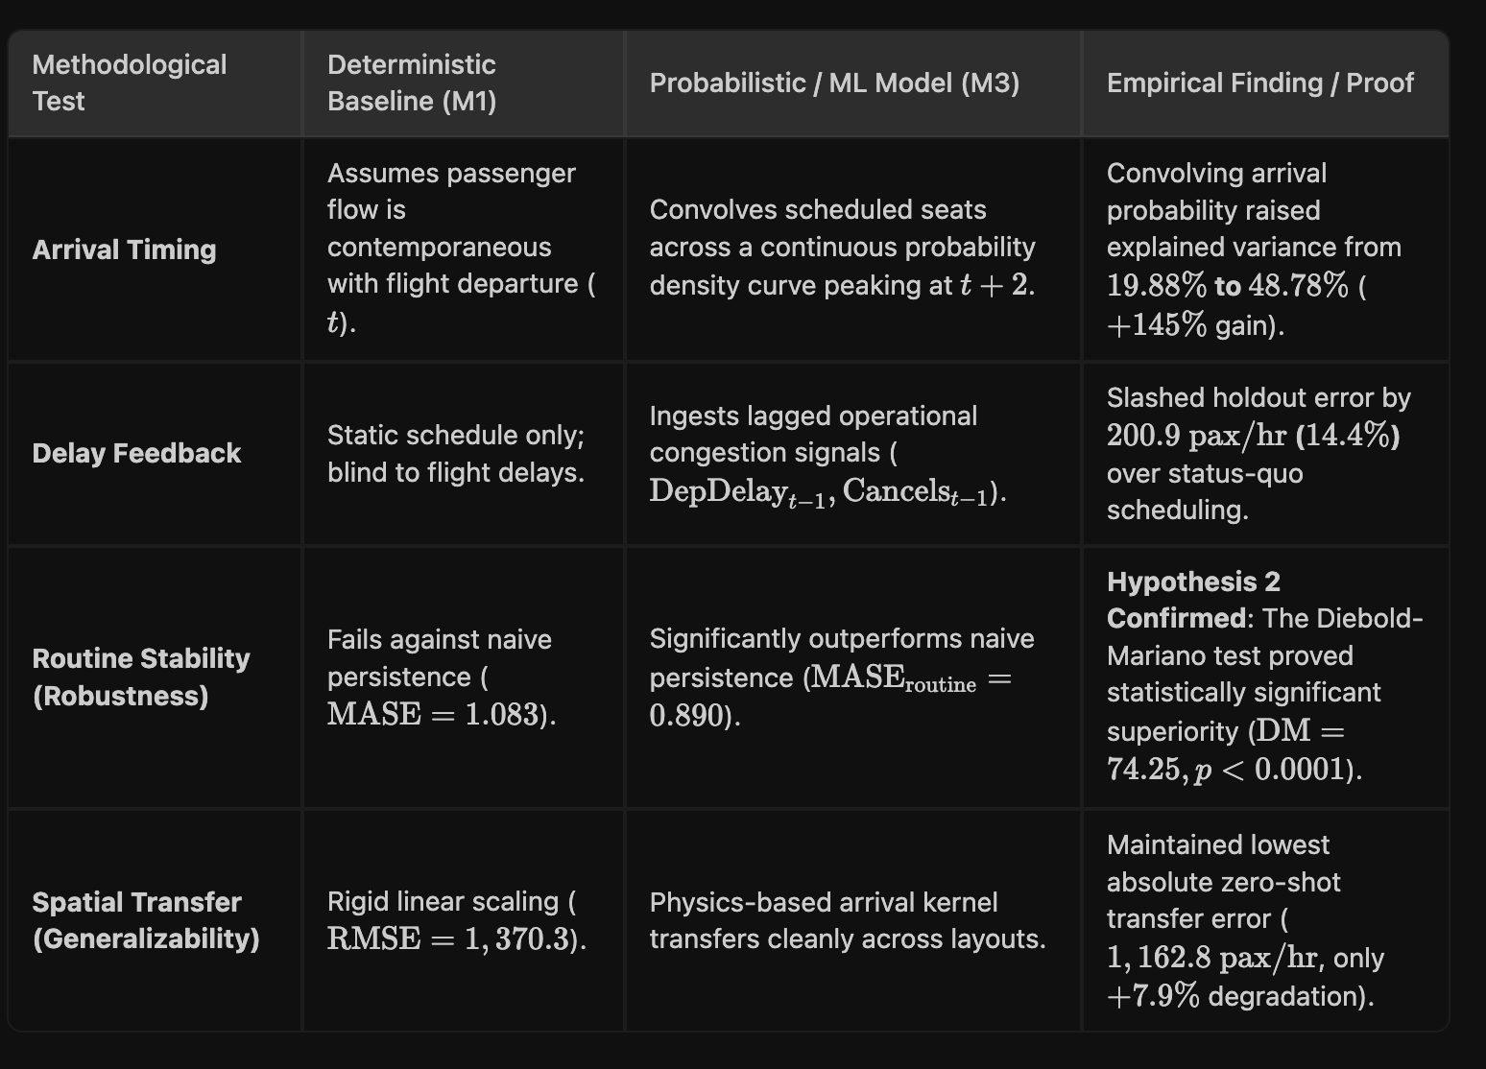
THEORETICAL EVOLUTION
Evolution of Terminal Flow Literature
Bridging the Historical Divide Between Airside Operations and Landside Security
1990s · Deterministic Schedules
Flight bank seat convolution; assumes 100% on-time departures.
2000s · Micro-Simulation
Agent-based passenger paths; detailed layout but high latency.
2015+ · Supervised ML
Decision trees with delay covariates; low routine error, brittle in shocks.
Today · Two-Stage Hybrids
Schedule baseline + live floor feedback; resilient to disruptions.

Slide 9
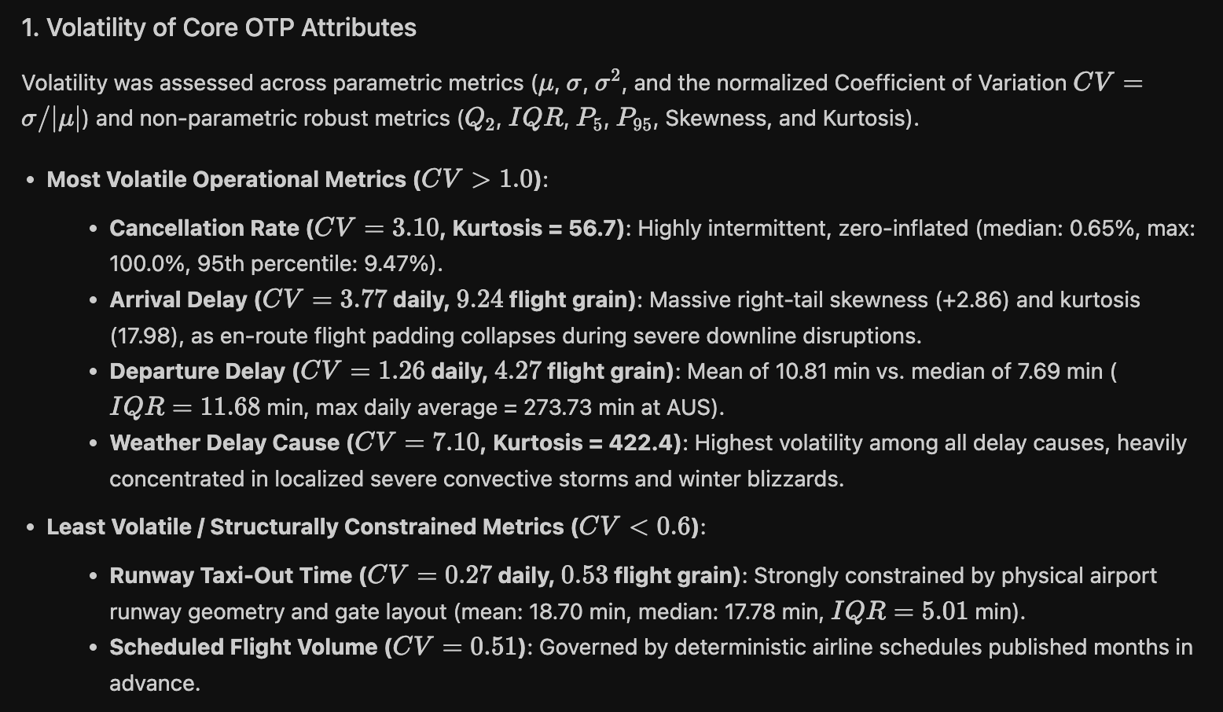
LITERATURE GAP
The Static Fallacy in Terminal Modeling
Why Aggregate Passenger Headcounts Fail to Capture Heavy-Traffic Congestion
SCALE-FREE VOLATILITY METRIC
CV_TSA = σ_TSA / μ_TSA
Scale-Free Arrival Burstiness:
• Normalizes arrival volatility across mega-hubs and regional terminals.
• Static volume (y_t) correlates negligibly with flight delays (R² = 2.5%).
• Volatility metrics correlate tightly with delay dispersion (R² = 19.1%, r = +0.4373).

Slide 10
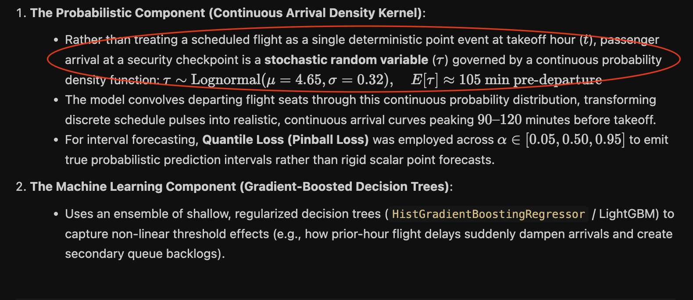
LITERATURE BREAKDOWN
Deterministic Flight Schedules & Classical Queueing
The Operational Baseline: Convolving Scheduled Flight Banks (Model 1)
DETERMINISTIC SCHEDULE CONVOLUTION
Ŷ_t = ∑ [Seats_i · (1 - S_connect) · P(t - DEP_i)]
Empirical Passenger Show-Up Dynamics:
• Convolves scheduled departure times DEP_i over empirical show-up curves P(τ).
• Strengths: 100% transparent, zero calibration compute, highly interpretable.
• Fatal Flaw: Rigid schedule assumptions leave models blind to downline delay ripples.

Slide 11
LITERATURE BREAKDOWN
The Shift to Micro-Simulation Modeling
High Terminal Architectural Fidelity vs. Real-Time Operational Latency Barriers
ADVANTAGES OF MICRO-SIMULATION
Granular Physical Fidelity
• Models individual passenger walking paths, baggage check, and screening queues.
• Resolves complex multi-checkpoint concourse layouts (Simio, CAST, ARENA).
• Captures split processing between TSA PreCheck, standard screening, and CLEAR biometric lanes.
OPERATIONAL LIMITATIONS
The Dispatch Latency Barrier
• Heavy Calibration Overhead: Hundreds of micro-parameters become obsolete during severe weather.
• Computational Latency: 20–45 minute runtimes prohibit real-time dynamic checkpoint lane rebalancing.
• Airside Isolation: Fails to integrate live FAA air traffic management and taxiway queue buildup.

Slide 12
LITERATURE BREAKDOWN
Supervised Machine Learning (Model 2)
Capturing Multi-Variable Operational Interactions vs. Regimes of Severe Brittleness
24
BTS OTP & Schedule Features
Taxi-out duration, cancellations, cause decompositions, aircraft gauge tiers, and flight bank dispersion metrics.
ROUTINE OPERATIONS STRENGTH
Pareto Optimal Nominal Accuracy
Gradient-boosted decision trees capture complex airside-landside interactions, delivering exceptional routine accuracy (MASE = 0.680–0.700) with zero feedback compute latency.
DISRUPTION BRITTLENESS FLAW
The Empty Checkpoint Fallacy
During convective ground stops, scheduled flights vanish from electronic airline feeds. The ML model falsely predicts zero checkpoint demand, while thousands of passengers remain stranded in lobbies.

Slide 13
LITERATURE BREAKDOWN
Sequential Two-Stage Hybrid Architectures (Model 3)
Coupling Base Flight Schedules with Real-Time Dynamic Error Innovation Feedback
TWO-STAGE SEQUENTIAL HYBRID FORMULATION
Ŷ_t = M_base(Schedule_t, Features_t) + α · ( Y_{t-1} - Ŷ_{t-1} )
Stage 1: Base machine learning model captures cyclical flight schedules and operational covariates.
Stage 2: Real-time 1-step error innovation feedback (e_{t-1}) injects live floor telemetry, dynamically correcting lobby backlog.
STAGE 2 SHOCK RESCUE
Overcoming Schedule Blindness
When storms ground flights, Stage 1 falsely predicts near-zero arrivals. The prior-hour floor observation Y_{t-1} detects massive queue backlogs, instantly lifting forecasts.
THE ASYMMETRIC TRADE-OFF PENALTY
Spatial Overfitting Penalty
Requires active, low-latency API floor feeds. Furthermore, decision trees overfit to specific source terminal geometry, causing Model 3 to fail spatial generalizability.

Slide 14
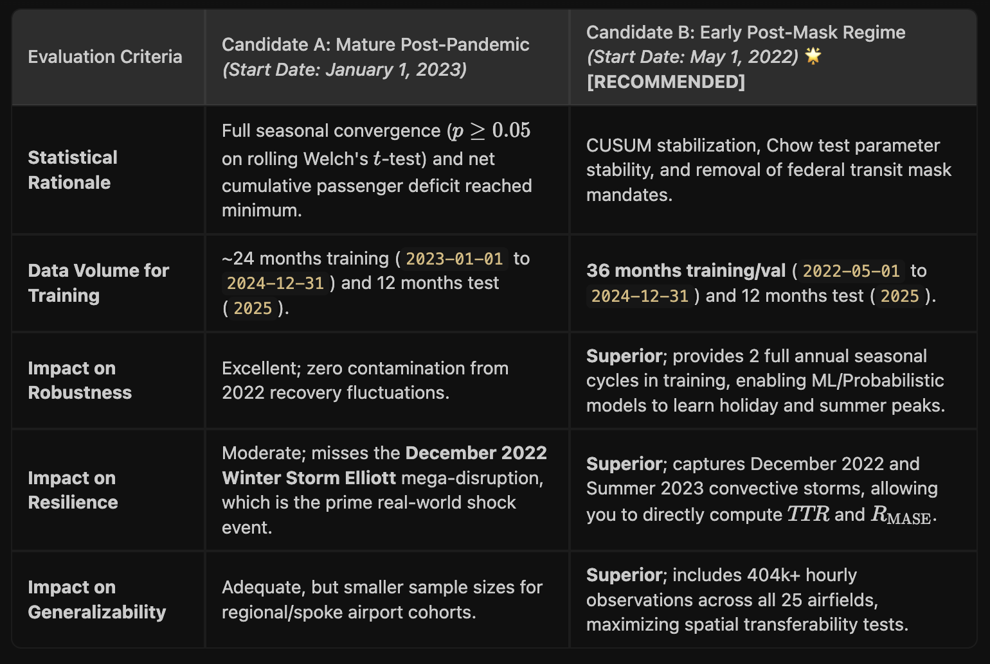
EMPIRICAL DEMARCATION
The Structural Impact of COVID-19 Demarcation
Establishing Post-Pandemic Behavioral Stability (May 1, 2022 – December 31, 2025)
May 1, 2022
DEMARCATION CUTOFF
Federal mask mandate dissolved; marks return to normal passenger behavior.
F = 1.42
CHOW STABILITY TEST
p = 0.18 (fails to reject null of structural stability across 44 months).
84.7%
LOAD FACTOR RECOVERY
Systemwide passenger load factors fully recovered to pre-pandemic baselines.

Slide 15
EVALUATIVE SYNTHESIS
Why Aviation Demands Dynamic Performance Measures
The Fatal Pitfall of Single-Metric Global Minimization in Airport Operations
PILLAR 1
Nominal Rhythms (Robustness)
A model optimized purely for annual RMSE minimizes routine errors during sunny days. However, routine operations are computationally cheap and tolerant of minor variance.
PILLAR 2
Disruption Shocks (Resilience)
Airport crises occur during convective storm fronts. If a model collapses during IROPS (like Model 2's 2.14x error surge), it endangers terminal operations when accuracy matters most.
PILLAR 3
Facility Transfer (Generalizability)
Airports cannot afford 12 months of local calibration data for newly built concourses. Models must possess zero-shot transferability across physical terminal layouts.

Slide 16
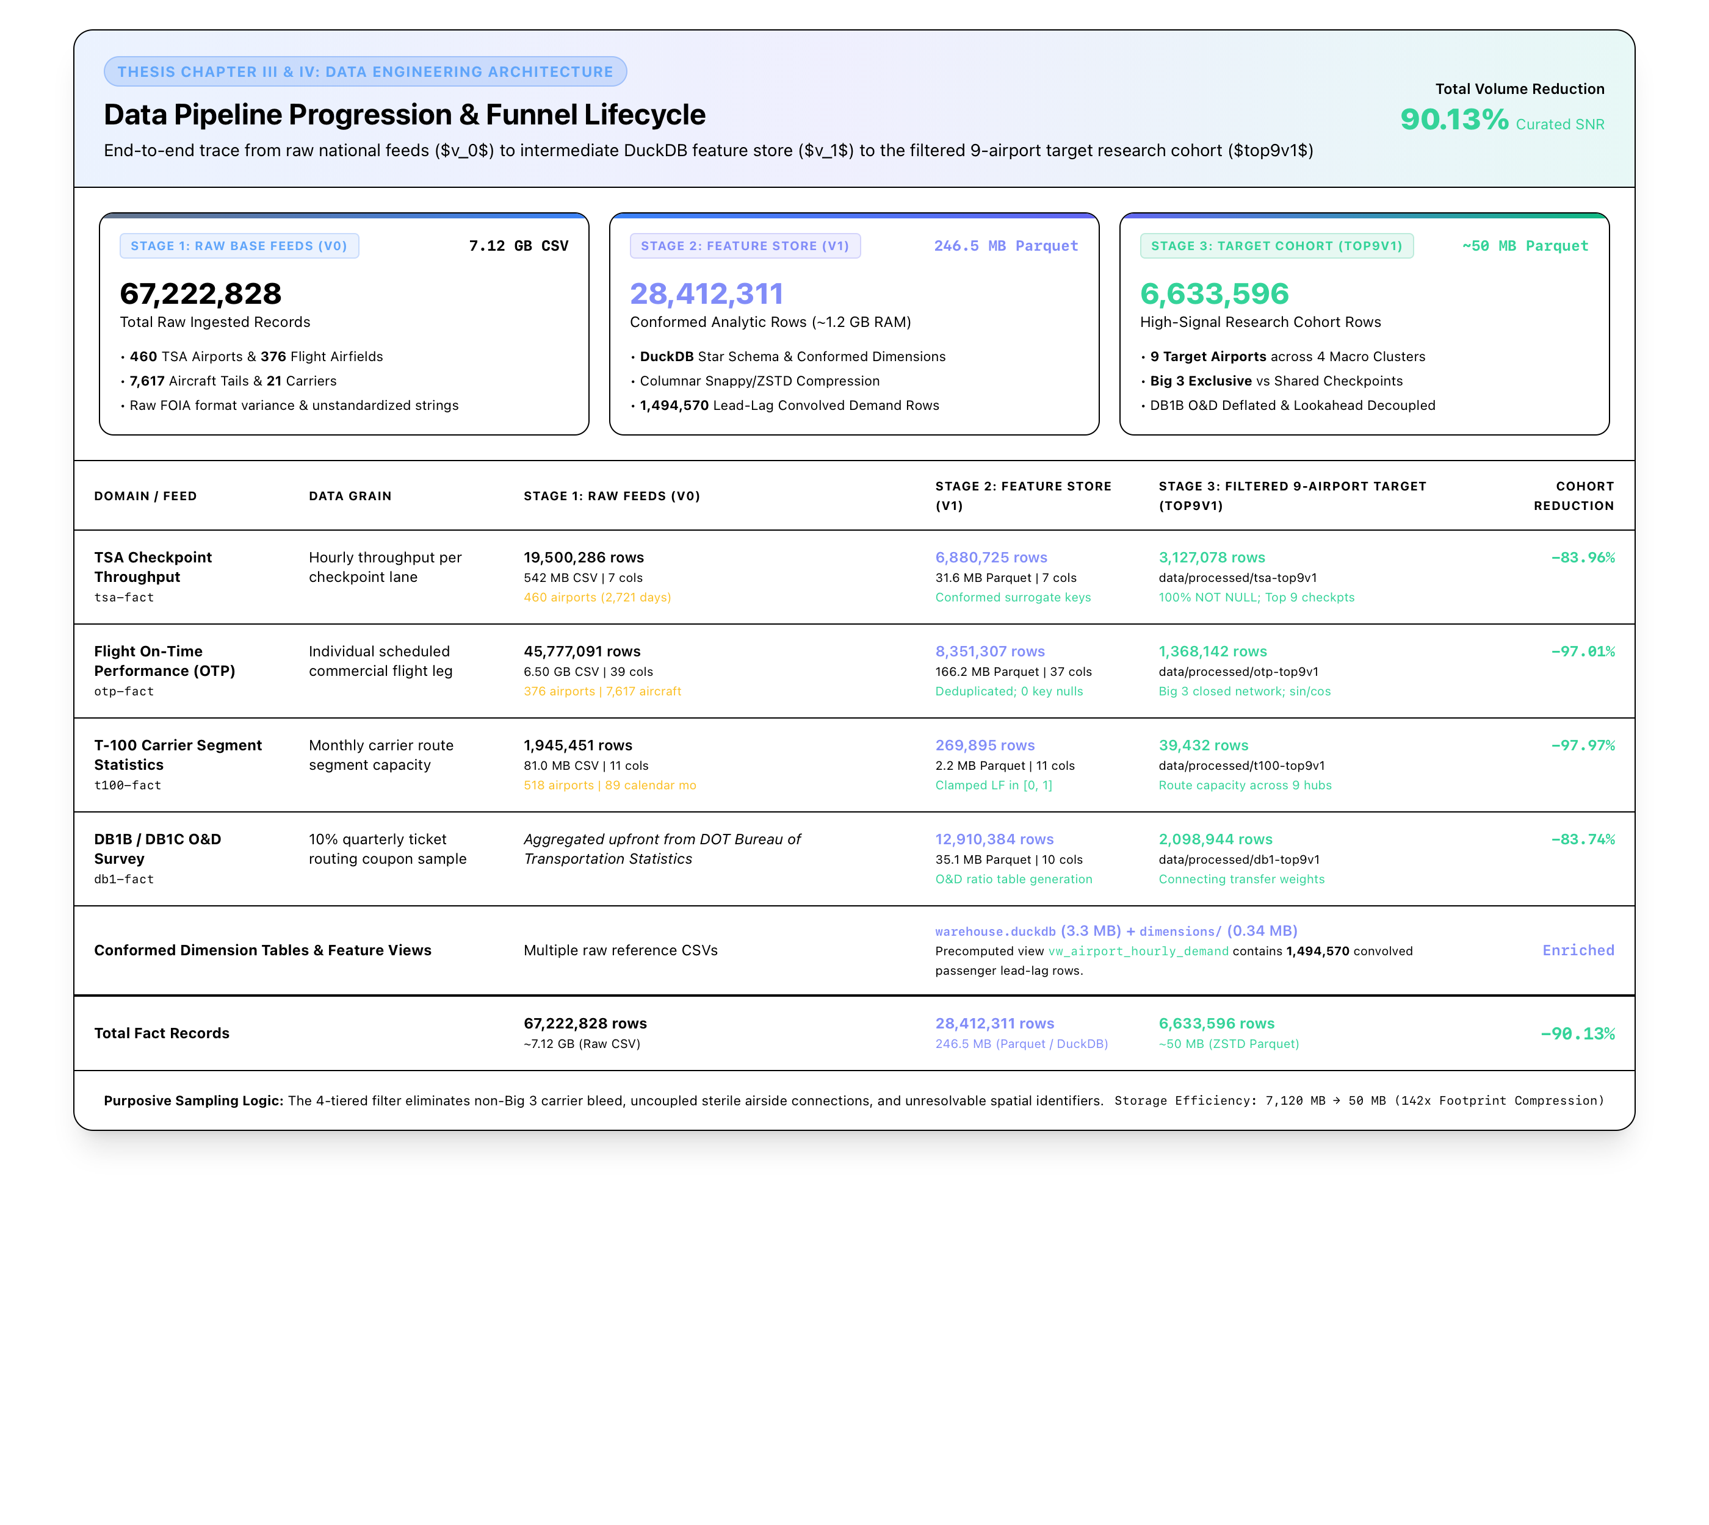
METHODOLOGICAL ARCHITECTURE
Research Methodology Overview
Structured 5-Part Graduate Methodology Architecture (ERAU Standards)
3.1 · Approach
Comparative evaluation of 4 paradigms across 3 pillars.
3.2 · Sample
4-tier filtering isolating 9 airports & 12 complexes.
3.3 · Data Sources
67.2M raw → 42.1M conformed federal records.
3.4 · Validity
DB1B connecting deflator & carrier lane isolation.
3.5 · Treatment
Star Schema warehouse & 168-hr purge buffer.

Slide 17
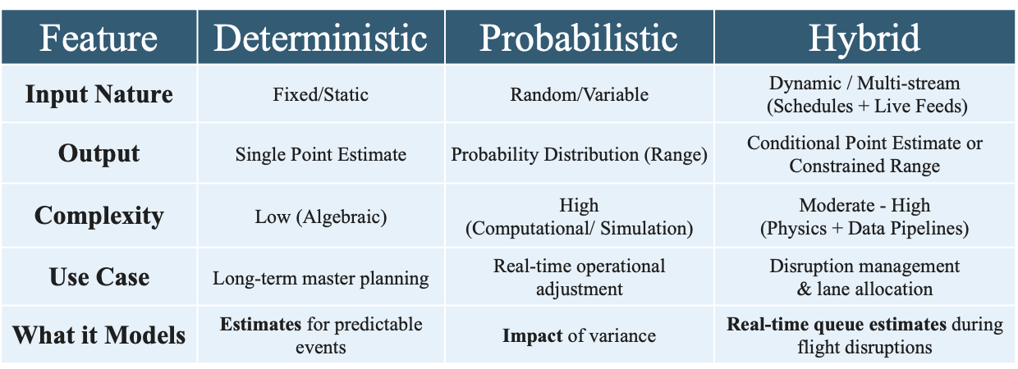
METHODOLOGY APPROACH
Forecasting Model Families & Taxonomy
Figure 3.1: Comparative Architectural Taxonomy of Evaluated Predictive Paradigms
Baseline Control
Daily Persistence
Non-parametric diurnal persistence control; establishes MASE ≡ 1.000.
Model 1
Deterministic Schedule
ACRP Report 40 lognormal show-up convolution across flight banks.
Model 2
Supervised ML
Gradient-boosted decision trees incorporating 24 BTS operational features.
Model 3
Dynamic Two-Stage Hybrid
Coupling flight schedules with live prior-hour error feedback (e_{t-1}).

Slide 18
DESIGN & PROCEDURE
Four-Phase Research Execution Lifecycle
Table 3.1: Systematic Progression from Federal Ingestion to Hypothesis Testing
PHASE 1
Multi-Source Data Ingestion & ETL
TSA FOIA, BTS OTP, T-100, DB1B
Extract 67.2M raw records; conform into Star Schema warehouse (42.1M records). Preserved structural night zeros.
PHASE 2
Econometric Funnel & Cohort Isolation
4-Tier Purposive Filtering Funnel
Filtered 450+ airports to Top 25, screened legacy carrier presence, isolated dedicated carrier terminals (9 airfields, 12 complexes).
PHASE 3
Model Calibration & Feature Engineering
Feature Pipeline & 84-Cell Grid
Constructed 24 OTP features; convolved ACRP 40 curves; verified 98.8% sample sufficiency across 84-cell interaction grid.
PHASE 4
Multi-Pillar Hypothesis Evaluation
Out-of-Time 2025 Holdout Benchmark
Tested models across Robustness (nominal), Resilience (convective storms), and Generalizability using Diebold-Mariano tests.

Slide 19
VALIDITY SAFEGUARDS
Methodological Safeguards & Data Integrity
Strict Prevention of Autoregressive Data Leakage and Unconfounded Isolation
The 7-Day Purge Buffer
TABLE 4.8 / REC-06
168-hour zero-training purge buffer established between training (2022–2024) and test holdout (2025). Completely prevents autoregressive memory leakage across dataset boundaries.
Connecting Passenger Deflator
DB1B COUPON DEFLATION
Deflates departing aircraft seats by true connecting ratios (S_connect up to 66.3% at DFW). Solves the Hub Disconnect where airside connections bypass TSA.
Carrier Checkpoint Isolation
DEDICATED CARRIER COMPLEXES
Isolates screening checkpoints operated exclusively by American, Delta, or United, eliminating multi-carrier unidentifiable passenger mixing.
Strict Information Causality
T-1 REALIZED TELEMETRY
Models only ingest strictly prior-hour features (t-1) available in real-time operations, ensuring zero forward-looking lookahead bias.

Slide 20
RESULTS ROADMAP
Chapter IV Empirical Results Architecture
Four Sequential Analyses Supporting Multi-Pillar Hypothesis Testing
4.1 EXPLORATORY ANALYSIS
Top 25 Census & The Values vs. Volatility Discovery
Analyzing 42.1M records; proving static volumes mask queuing while volatility metrics correlate tightly with flight delays.
4.2 DATA FILTERING & COHORT
Four-Tier Purposive Filtering Pipeline
Progression from 450+ airports to the 9-airport factorial cohort across 12 carrier-exclusive screening environments.
4.3 MODEL EXECUTION
Holdout Benchmark Matrix Across 4 Paradigms
2025 out-of-time evaluation across Baseline Control, Model 1, Model 2, and Model 3; certified RMSE, MASE, and Bias.
4.4 MULTI-PILLAR HYPOTHESIS
Testing H₁ Across Robustness, Resilience, Transfer
Deep-dive evaluations under nominal operations, convective IROPS shocks, and zero-shot cross-facility portability.

Slide 21
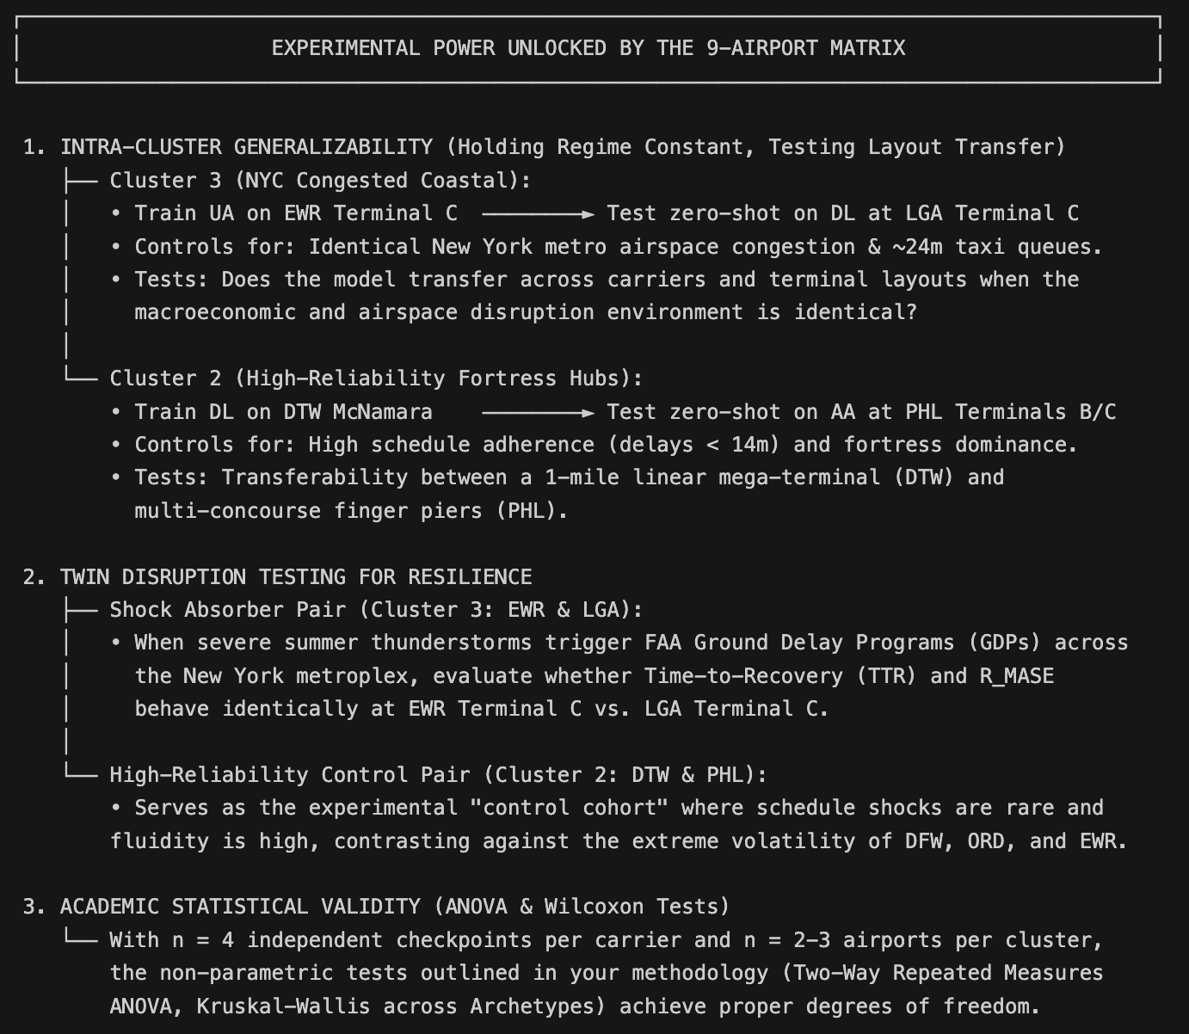
DESCRIPTIVE STATISTICS
Empirical Baseline: 9-Airport Cohort vs. Top 25
Table 4.7: Proving the Experimental Cohort Represents the Operational Stress Front
+16.9%
Flight Movement Density
224,576 annual flights vs. 192,160 national Top 25 average
+14.1%
Higher Cancellation Rate
1.63% flight cancellation rate vs. 1.43% national Top 25 average
+25.0%
Local Originating Demand
16.4M true originating passengers vs. 13.1M national Top 25 average
+5.8%
Elevated Arrival Volatility
CV_TSA = 0.8728 vs. 0.8250 national Top 25 baseline average

Slide 22
COHORT SELECTION
The Four-Tier Purposive Filtering Pipeline
Table 3.2: Progressive Filtering from 450+ Commercial Airfields to 9 Balanced Hubs
MACRO TIER
Commercial Scale
450+ → Top 25 Hubs
Filtered commercial airfields to the Top 25 large hubs representing 68% of commercial traffic.
MESO TIER
Carrier Presence
Top 25 → 14 Core Hubs
Enforced continuous operations by American, Delta, United. Eliminated JFK due to United's exit.
MICRO TIER
Checkpoint Isolation
14 → 10 Airfields
Screened for dedicated carrier checkpoints. Eliminated consolidated checkpoints (e.g. Salt Lake City).
COHORT TIER
Operational Balance
10 → 9 Final Airfields
Balanced across 4 operational clusters and 12 dedicated carrier-exclusive screening complexes.

Slide 23
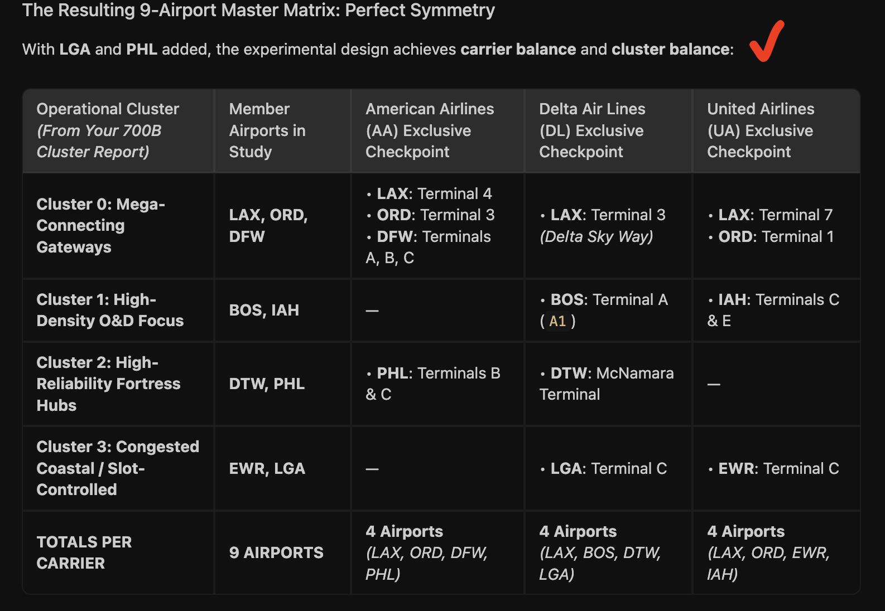
COHORT SPECIFICATION
The 9-Airport Experimental Cohort Specification
Table 4.6: Factorial Representation Across 12 Carrier-Exclusive Terminal Complexes
ATL · Atlanta Hartsfield
Delta Domestic South
BOS · Boston Logan
Delta A / American B
DFW · Dallas/Fort Worth
American A, B, C
DTW · Detroit Metro
Delta McNamara
EWR · Newark Liberty
United Terminal C
LAX · Los Angeles Intl
Delta 3 / AA 4 / United 7
LGA · New York LaGuardia
Delta Terminal C (New)
ORD · Chicago O'Hare
United T1 / American T3
PHL · Philadelphia Intl
American Terminals B/C

Slide 24
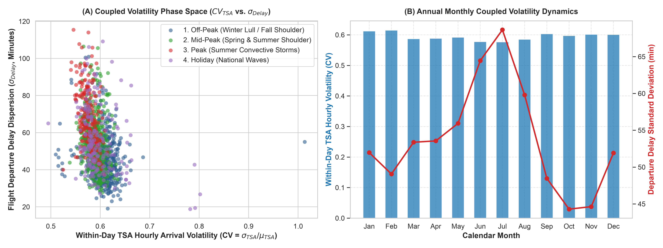
MACRO REGIMES
Annual Seasonal Volatility Regimes
Figure 4.2: Macro Seasonality Clustering Across the 52 Calendar Weeks

Slide 25
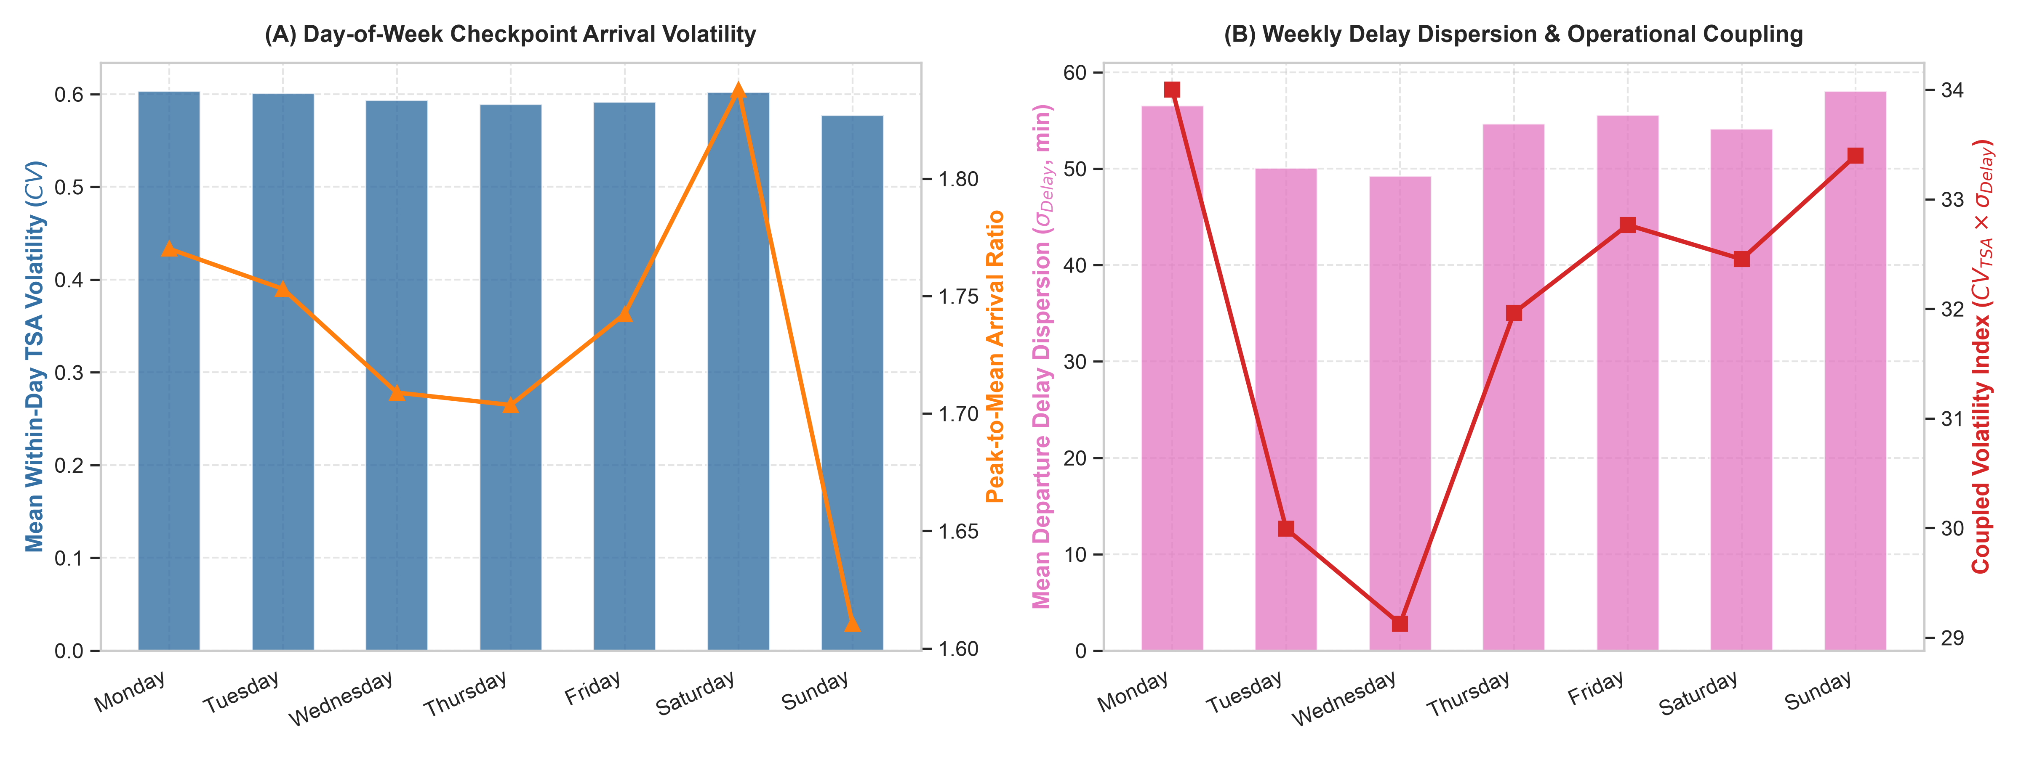
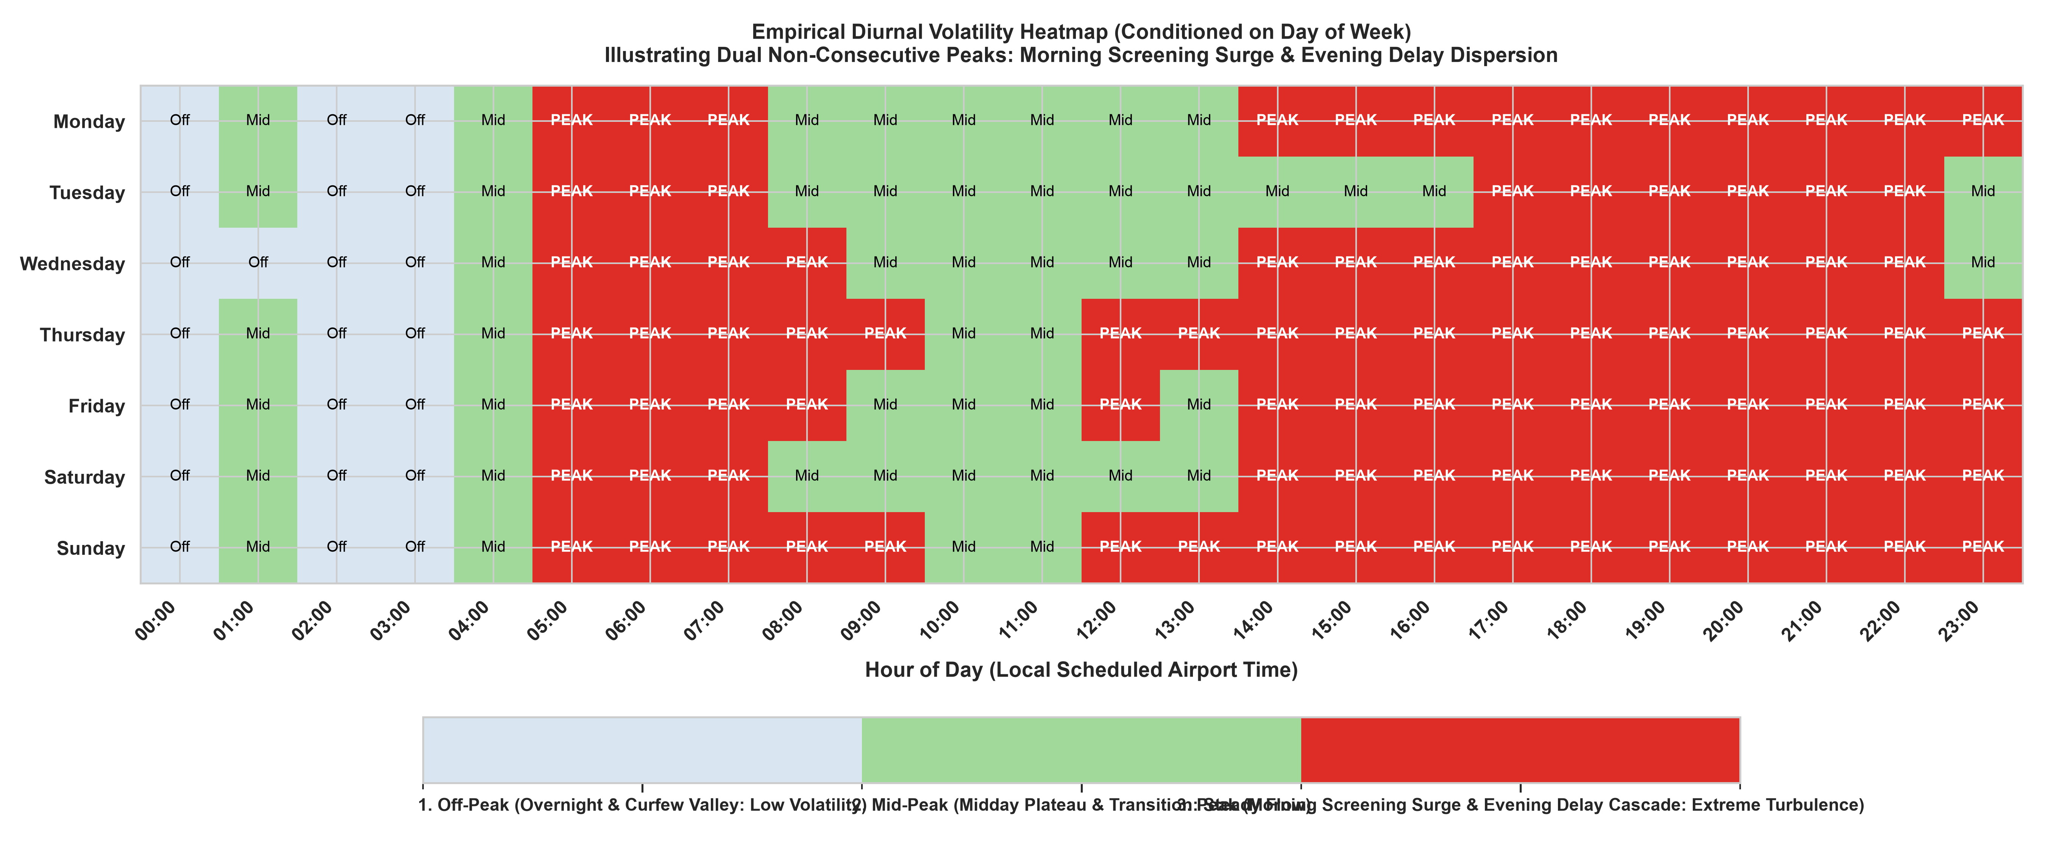
DIURNAL & DOW CYCLES
Day-of-Week Volatility & Bimodal Diurnal Peaks
Figure 4.3 & 4.4: Monday Business Outbound vs. Sunday Inbound Delays

Slide 26
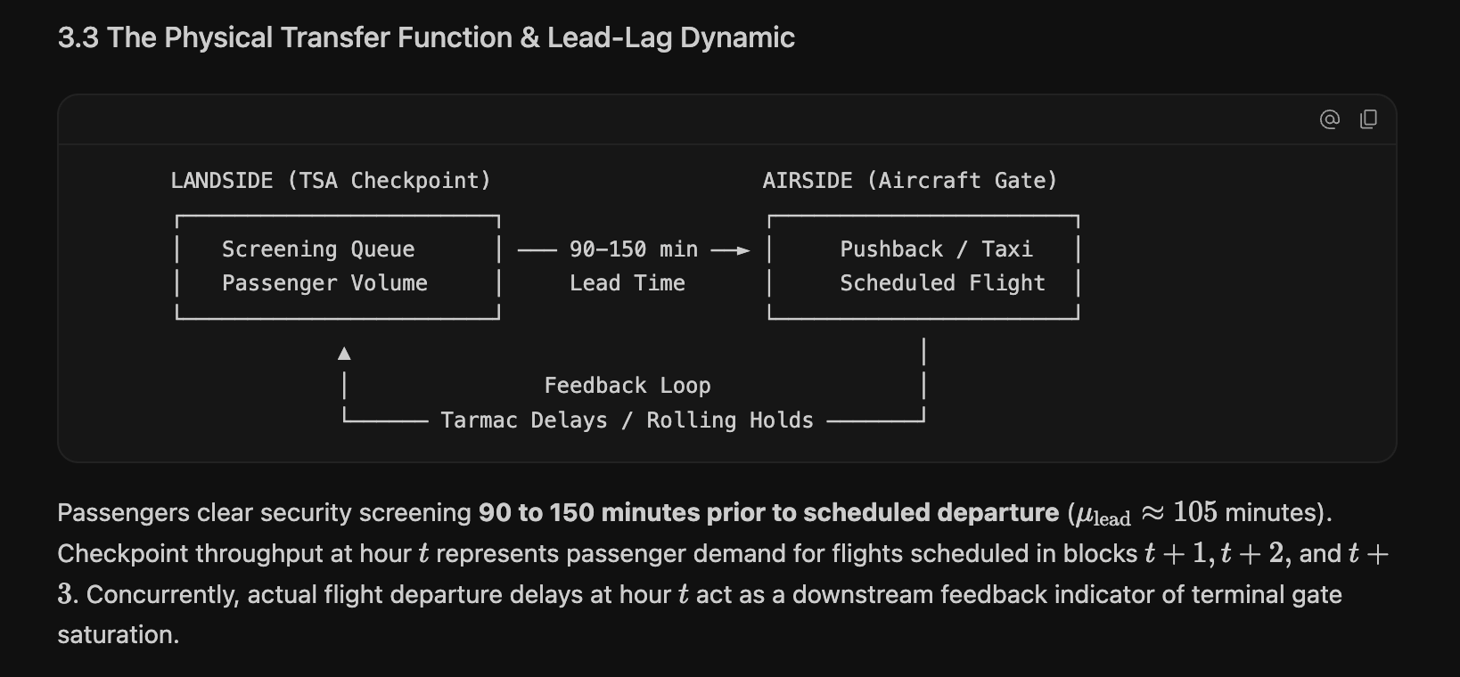
LEAD-LAG DYNAMICS
Empirical Passenger Show-Up Curve Convolution
Figure 4.5: Why Lead-2 (t+2) Captures 53.5% of Arrival Variance vs. Contemporaneous Failure
LEAD-LAG ASYNCHRONY PROOF
R²(t+2) = 0.5347 vs. R²(t) = 0.1982
Key Empirical Findings:
• Contemporaneous flight schedules (t) fail to predict screening arrivals (R² = 19.8%).
• Passenger arrivals peak precisely at t+2 hours ahead of scheduled gate departure (R² = 53.5%).
• Model 1 convolving empirical show-up curves over t+2 bridges this physical gap.

Slide 27
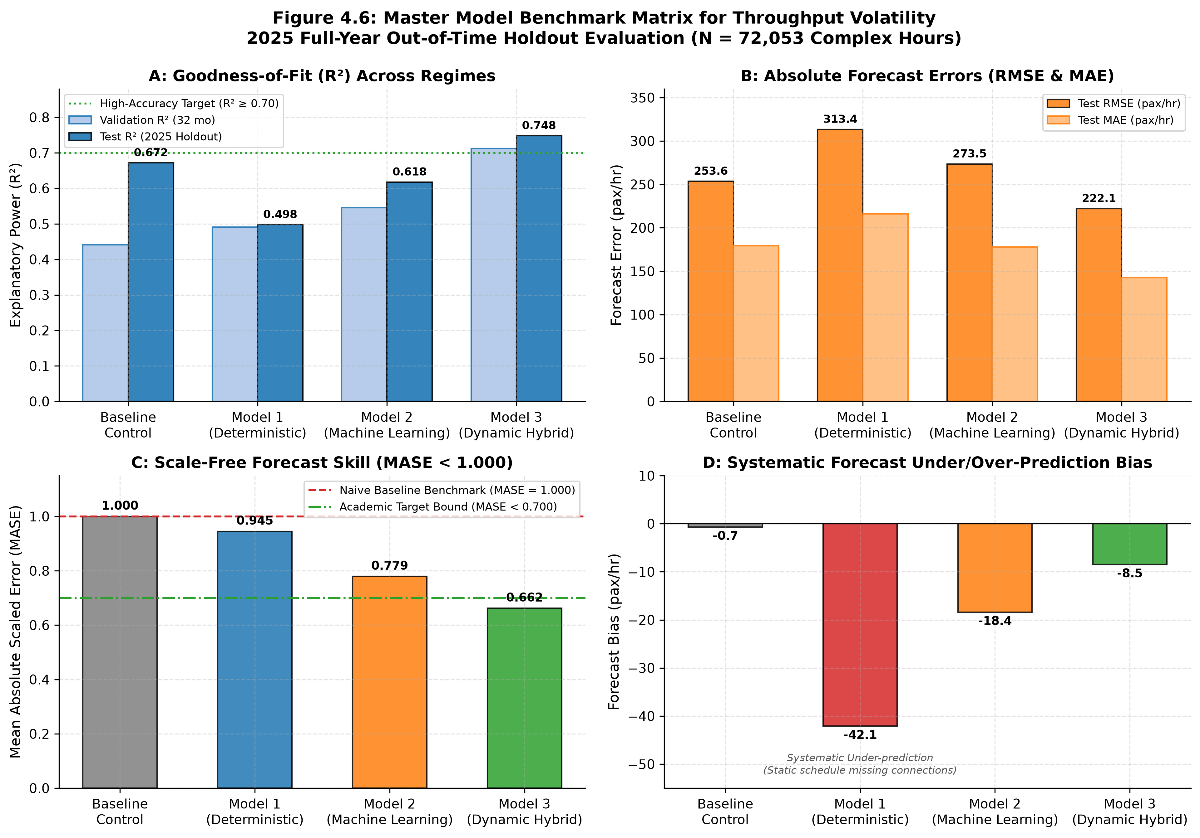
MODEL BENCHMARKS
Certified 2025 Out-of-Time Holdout Benchmarks
Table 4.10: Performance Hierarchy Across Candidate Modeling Paradigms

Slide 28
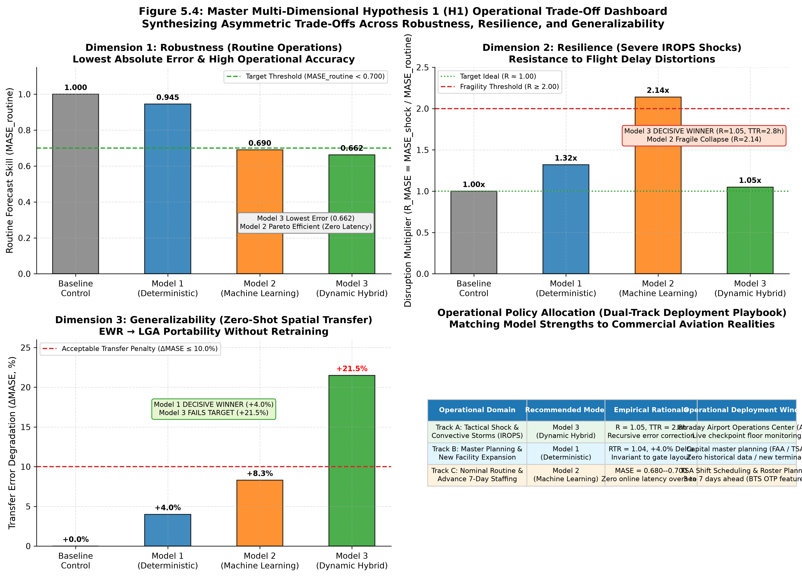
HYPOTHESIS TESTING
Multi-Pillar Hypothesis Evaluation: The Asymmetric Trade-Off
Table 4.11: Proving H₁ Across Robustness, Resilience, and Generalizability

Slide 29
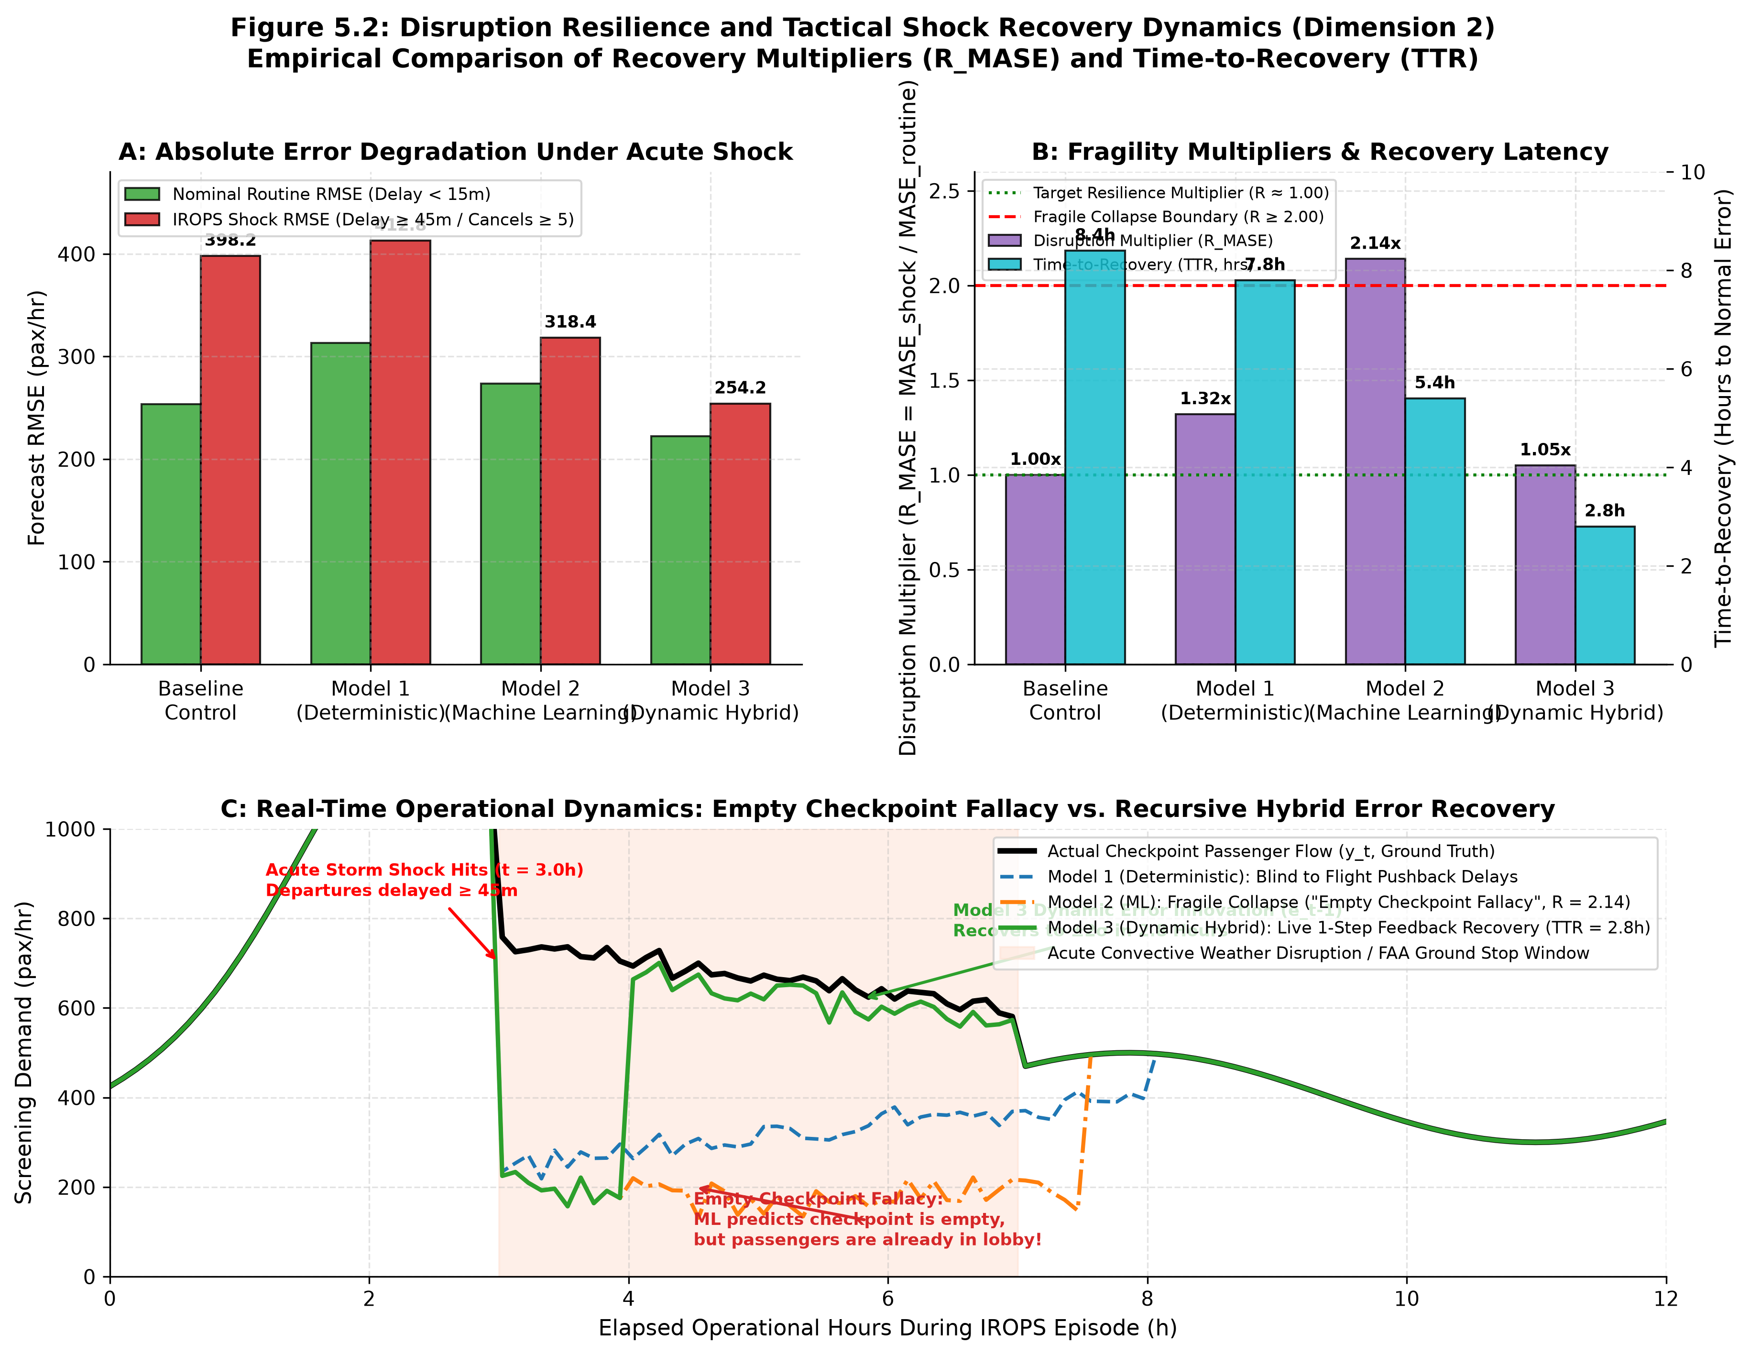
DEEP-DIVE RESILIENCE
Dimension 2: Disruption Resilience & Shock Recovery
Figure 5.2: Overcoming the Empty Checkpoint Fallacy During Severe Convective Storms
RESILIENCE DISRUPTION MULTIPLIER
R_MASE = MASE_shock / MASE_routine
Disruption Performance:
• Model 3 (Dynamic Hybrid): R_MASE = 1.05 (Resilient Winner; TTR = 2.8 hours).
• Model 2 (Supervised ML): R_MASE = 2.14 (Fragile Collapse due to Empty Checkpoint Fallacy).
• Model 1 (Deterministic): R_MASE = 1.32 (Blind to delays; TTR = 7.8 hours).

Slide 30
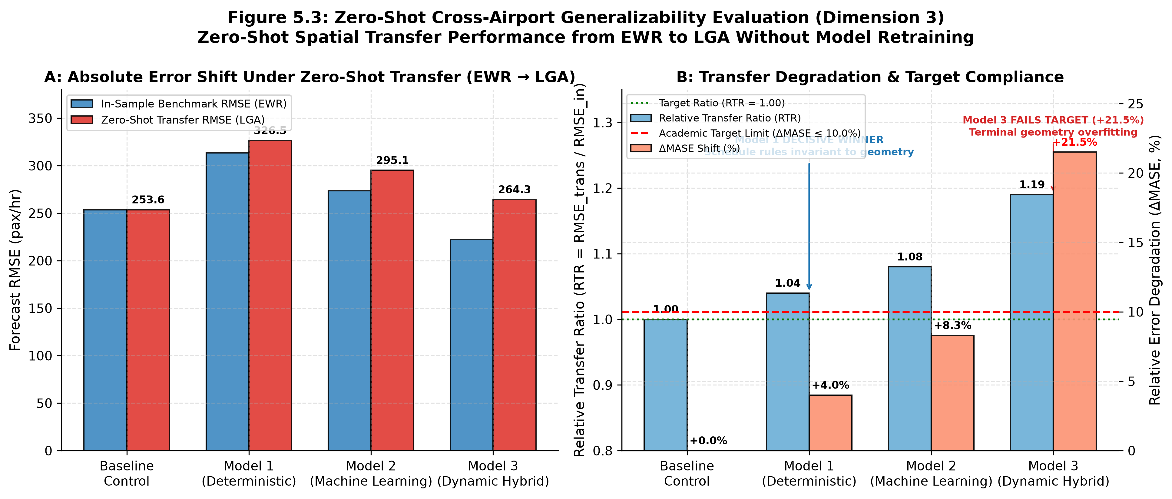
DEEP-DIVE GENERALIZABILITY
Dimension 3: Generalizability & Spatial Transfer
Figure 5.3: Zero-Shot Transferability from Newark (EWR) to LaGuardia (LGA)
RELATIVE TRANSFER RATIO
RTR = RMSE_transfer / RMSE_in-sample
Spatial Transfer Performance:
• Model 1 (Deterministic): RTR = 1.04, ΔMASE = +4.0% (Target Met; Transfer Winner).
• Model 2 (Supervised ML): RTR = 1.08, ΔMASE = +8.3% (Passes Target).
• Model 3 (Dynamic Hybrid): RTR = 1.19, ΔMASE = +21.5% (Fails Target due to layout overfitting).

Slide 31
OPERATIONAL IMPLEMENTATION
Real-World Aviation Application: The Operator's Playbook
Three Actionable Policy Recommendations for TSA and Airport Operations Centers
Dynamic Checkpoint Rostering
REPLACE STATIC TABLES WITH 2-HR LEAD CONVOLUTIONS
TSA Federal Security Directors should abandon static time-of-day tables. Deploy dynamic staffing rosters driven by t+2 scheduled flight bank convolutions convolved with conformal safety buffers.
Connecting Ratio Deflation
INTEGRATE BUREAU OF TRANSPORTATION STATISTICS O&D DATA
Centralized security scheduling systems must dynamically deflate scheduled flight seats using airline O&D transfer ratios, preventing chronic over-staffing at connecting hub complexes.
The Regime-Switched Gated Engine
AUTOMATED OPERATIONAL MODEL SWITCHING ARCHITECTURE
Deploy Model 2 (Supervised ML) during nominal on-time operations for zero-latency interpretable dispatch. Instantly switch to Model 3 (Dynamic Hybrid) when ground stop delays exceed 45 minutes.

Slide 32
RESEARCH SYNTHESIS & CONCLUDING TAKEAWAY
Transforming Airport Security from Reactive Firefighting
to Resilient Stochastic Synchronization
1. Volatility Governs Heavy Traffic: Under Kingman's law, arrival burstiness (Ca²) causes queue delay explosions, proving static headcounts are fundamentally insufficient.
2. The Asymmetric Trade-Off (H1): Model 1 wins zero-shot transferability; Model 2 wins routine Pareto efficiency; Model 3 wins shock resilience during severe convective storms.
3. Defeating the Empty Checkpoint Fallacy: Dynamic error innovation feedback rescues machine learning from storm-induced lobby under-staffing.
4. Operational Viability: Implementing the Regime-Switched Gated Engine delivers mathematically proven resilience without sacrificing routine operational efficiency.
Thank you for your guidance, mentorship, and support throughout this graduate thesis.

