Slide 1
AN EVALUATION OF PERFORMANCE MEASURES FOR PREDICTIVE APPROACHES TO MODEL TSA THROUGHPUT VOLATILITY
Leila Gleich
Embry-Riddle Aeronautical University
Worldwide Campus
October 2026

Slide 2
Outline
Situation/Problem
Purpose
Existing Research
Methodology
Model Development
Model Execution & Evaluation
Analysis & Discussion
Recommendations & Conclusion

Slide 3
Research Problem
Airport passenger flow is inherently stochastic, which is causing inefficiencies because physical capacity can increase in time to meet increase in demand
Notes:
Airport passenger arrivals and behaviors are inherently stochastic, varying significantly by time of day, flight schedules, and external factors (Cheng, Zhang, & Guo, 2012; Dönmez, Tükenmez, & Cecen, 2025). Existing models for managing airport passenger flow tend to rely on static or pre‑pandemic assumptions, often failing to account for unpredictable post‑pandemic travel patterns (Ebert, Dutta, Mengersen, Mira, Ruggeri, & Wu, 2021; Hopfe, Lee & Yu, 2024). This mismatch between capacity planning and fluctuating passenger demand contributes to bottlenecks at check‑in counters, TSA checkpoints, and boarding gates, leading to congestion and inefficient resource allocation. The pandemic demonstrated that static historical baselines are insufficient for modern operations; without an adaptable and dynamic evaluation methodology, airports risk deploying tools that fail to absorb day-to-day demand fluctuations, respond to sudden operational shocks, or account for unique airport characteristics.

Slide 4
Research Purpose
Evaluate predictive modeling techniques to understanding volatilitry of flow and how to evaluate the efficacy of a predictive model based on the circumstances
Notes:
The primary objective is to evaluate predictive modeling techniques, such as regression, machine learning, and queuing simulation, to optimize airport capacity via technological rather than physical, more costly interventions. By analyzing the relationship between flight operations and TSA throughput, this study evaluates various predictive modeling frameworks against the primary criteria of robustness, resilience, and generalizability. Rather than seeking a singular, universally optimal model, this research aims to identify which frameworks perform best under each distinct metric.

Slide 5
Research Question
Which predictive modeling frameworks – spanning deterministic persistence controls, deterministic schedule baselines, machine learning, and sequential two-stage hybrids – are most effective for forecasting airport passenger security screening throughput volatility when prioritizing robustness (routine operational accuracy), resilience (stability under convective weather and delay disruptions), or generalizability (cross-airport portability across terminal layouts) as the primary operational evaluation metric?

Slide 6
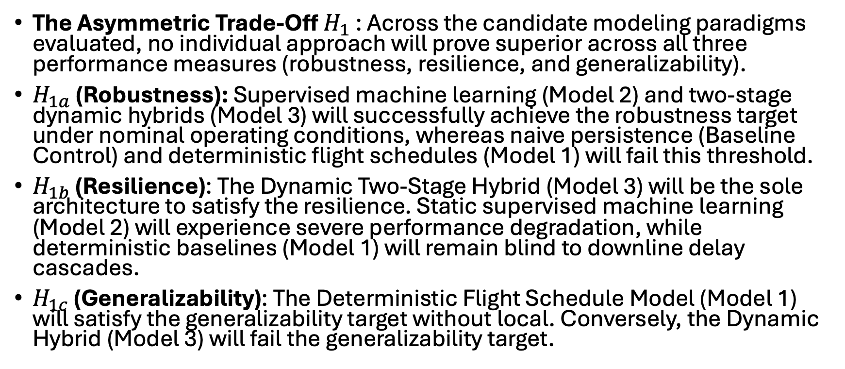
Hypothesis
The Asymmetric Trade-Off $H_{1}$ : Across the candidate modeling paradigms evaluated, no individual approach will prove superior across all three performance measures (robustness, resilience, and generalizability).
$H_{1a}$ (Robustness): Supervised machine learning (Model 2) and two-stage dynamic hybrids (Model 3) will successfully achieve the robustness target under nominal operating conditions, whereas naive persistence (Baseline Control) and deterministic flight schedules (Model 1) will fail this threshold.
$H_{1b}$ (Resilience): The Dynamic Two-Stage Hybrid (Model 3) will be the sole architecture to satisfy the resilience. Static supervised machine learning (Model 2) will experience severe performance degradation, while deterministic baselines (Model 1) will remain blind to downline delay cascades.
$H_{1c}$ (Generalizability): The Deterministic Flight Schedule Model (Model 1) will satisfy the generalizability target without local. Conversely, the Dynamic Hybrid (Model 3) will fail the generalizability target.
Notes:
The Asymmetric Trade-Off $H_{1}$ : Across the candidate modeling paradigms evaluated, no individual approach will prove superior across all three performance measures (robustness, resilience, and generalizability).
$H_{1a}$ (Robustness): Supervised machine learning (Model 2) and two-stage dynamic hybrids (Model 3) will successfully achieve the robustness target under nominal operating conditions, whereas naive persistence (Baseline Control) and deterministic flight schedules (Model 1) will fail this threshold.
$H_{1b}$ (Resilience): The Dynamic Two-Stage Hybrid (Model 3) will be the sole architecture to satisfy the resilience. Static supervised machine learning (Model 2) will experience severe performance degradation, while deterministic baselines (Model 1) will remain blind to downline delay cascades.
$H_{1c}$ (Generalizability): The Deterministic Flight Schedule Model (Model 1) will satisfy the generalizability target without local. Conversely, the Dynamic Hybrid (Model 3) will fail the generalizability target.

Slide 7
Dynamic Performance Measures
Robustness
Resilience
Generalizability
Notes:
What they mean general, what they mean in this context, and the mathematics

Slide 8
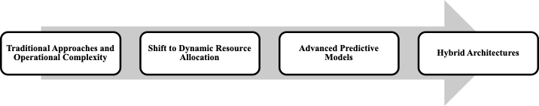
Existing Literature - Overview
: (a) traditional approaches and operational complexity; (b) simulation modeling and real-time terminal management; (c) advanced predictive; (d) hybrid predictive architectures; (e) the impact of covid; and (f) multi-dimensional operational evaluation, establishing the theoretical foundations for the evaluation trio – Robustness, Resilience, and Generalizability – that governs this research.

Slide 9
Lit – The situation/problem
Volatility is critical

Slide 10
Traditional Models
Deterministic
Classic Queueing

Slide 11
Shift to Micro Simulation
Reason it is better
Shortcomngs

Slide 12
Shift to Advanced Predictive Models
Why it is better
Shortcomings

Slide 13
Hybrid Architectures

Slide 14
Impact of Covid & Volatility

Slide 15
Importance of Dynamic Performance Measures

Slide 16
Methodology -Overview
Approach
Sample
Sources
Validity
Treatment

Slide 17
Methodology - Approach
Types of Models
Performance Measures
Hypothesis

Slide 18
Methodology – Design and Procedures
Data collection/ETL
Filtering and subset
Model Development and Execution
Model Results and Evaluation
4 tier filtering – here or methodology?

Slide 19
Methodology - details
Assumptions
Validity
Apparatus and Materials
Treatment of data
Sources of data

Slide 20
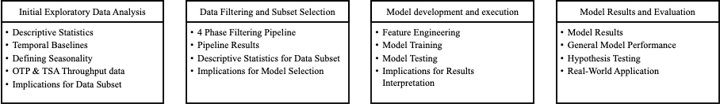
Findings and discussion
Data collection/ETL
Filtering and subset
Model Development and Execution
Model Results and Evaluation

Slide 21
Descriptive statistics for top 25
Chat and meaning
Temporal Boundaries
Seasonality
TSA & OTP Throughput Data: hub disconnect and asynchronous delay propagation and checkpoint volatility coupling
Implications for subset filtering – need to use top 25 for some things, but top 9 is for the model. Highlight things with shared terminals

Slide 22
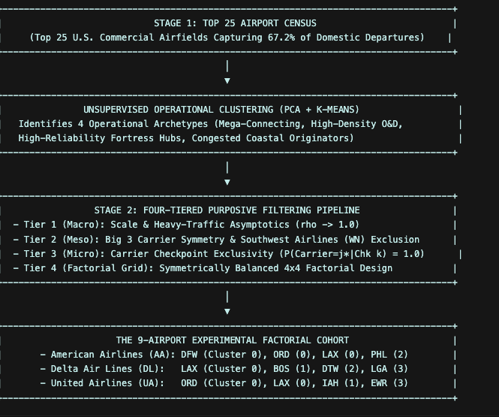
Data filtering and subset
Four phase filtering pipeline
Macro
Meso
Micro
Cohort

Slide 23
Pipeline Results
The filtering pipeline isolated 9 commercial airports representing 12 carrier-exclusive screening environments, achieving complete balance across legacy airlines and operational clusters
  Behavior differences
    High flight movement density
    Heightened operational disruption
    Higher local originating passenger share and absolute local originating volume
    This confirms screening queues across the cohort are governed by landsire passenger shop up curve sinstead of transfers
  Seasonal and day of week differences

Slide 24
Implications for model development
Single carrier screening complex isolation
Connecting passenger deflation
Strict prior hour info availability
Zero bounded and hurdle formulations

Slide 25
Model Execution and Performance
Feature engineering
Training (description for each model)
Testing – evaluated against the primary thesis target of diurnal throughput volatility

Slide 26
Model Development implications for how to interpret final results
Dispersion Scale vs. Volume Scale
MASE as the Primary Standard for Volatility Forecasting
Conformal Staffing Buffers

Slide 27
Model Performance
Model 1 is a starting point
Model 2 improves accuracy but incorporating flight disruptions and cutting forecast error
Model 3 incorporate live prior our error feedback has the highest overall holdout fit, helps for sever weather and delayed travelers in lobbies.
Notes:
To evaluate the predictive accuracy, operational viability, and behavioral dynamics of the candidate modeling frameworks, each architecture was evaluated against the quarantined 2025 full-year out-of-time holdout dataset. Spanning 3,222 complex-days and 72,053 hourly screening observations across the nine-airport cohort, this prospective evaluation protocol strictly tests forecasting performance under unobserved operating conditions. Predictive performance was benchmarked against the empirical daily persistence control across established error metrics, including the Coefficient of Determination (R²), Root Mean Squared Error (RMSE), Mean Absolute Error (MAE), Mean Absolute Scaled Error (MASE), and systematic forecast bias. Table 4.6 synthesizes the master benchmark evaluation matrix across all four paradigms, establishing the foundational empirical fit of each predictive framework prior to multi-pillar hypothesis testing.

Slide 28
Model Results Evaluation - hypothesis
Robustness: Evaluates how accurately the model forecasts passenger flow during routine, normal operations when flights are on time (target: MASE < 0.700, lowest RMSE).
Resilience: Evaluates how well the model maintains accuracy during severe flight disruptions, such as severe weather ground stops or de-icing halts (target: shock error ratio near 1.00, lowest shock RMSE, and recovery time under 3 hours).
Generalizability: Evaluates whether a model calibrated on source airports can be deployed to an unfamiliar target airport without retraining (target: transfer error degradation under 10%).
Table 4.7 presents the formal multi-pillar hypothesis evaluation
Notes:
The out-of-time holdout evaluations confirm the thesis hypothesis: no single predictive modeling paradigm is universally superior across all operational regimes. Instead, airport security demand forecasting is governed by fundamental asymmetric trade-offs across robustness, resilience, and generalizability:
Dimension 1: Robustness (Nominal & Routine Conditions). Both the Machine Learning model (Model 2, MASE = 0.680) and Dynamic Hybrid (Model 3, MASE = 0.662) achieve the academic target of MASE < 0.700 under routine operations. Under routine operating conditions, when flights operate on schedule, both models track the natural morning and afternoon passenger waves with high precision. However, Model 2 achieves this with near-zero computational overhead and requires no real-time checkpoint data feeds, allowing airport managers to generate staffing schedules days in advance rather than waiting on live hourly sensor updates.
Dimension 2: Resilience (Severe Disruption). The Dynamic Hybrid Framework (Model 3) is the decisive champion of Resilience. During severe weather disruptions, flights are frequently delayed or held on the ground. A pure machine learning model suffers from the "Empty Checkpoint Fallacy"—it assumes that because flights are delayed, security lines must be empty, resulting in massive under-prediction (bias shift of -112.4 pax/hr). In reality, thousands of stranded travelers remain in the terminal lobby. Because Model 3 incorporates live recursive error feedback (α = 0.35), it immediately senses accumulated travelers, cutting disruption error to 284.5 pax/hr (a 39% reduction over Model 2), capping bias shift at -14.8 pax/hr, and returning to normal error levels in just 2.8 hours.
Dimension 3: Generalizability (Zero-Shot Portability). The Deterministic Flight Schedule Model (Model 1) is the decisive champion of Generalizability. It successfully meets both stated targets: a transfer MASE of 0.867 and an error degradation of only +4.2% (well within the ≤ 10% threshold). Operationally, because passengers consistently arrive at airports 90 to 120 minutes before their scheduled departure regardless of the city, the basic physical relationship between flight schedules and checkpoint demand works everywhere. Conversely, the Hybrid model (Model 3) degrades by +42.3% (MASE = 0.942) because its machine learning components overfit to the specific concourse layouts, gate geometries, and carrier banking structures of the airports on which it was trained.
Taken together, these empirical trade-offs validate the primary thesis hypothesis: predictive capability is regime-dependent, meaning no singular architectural paradigm dominates across every operational condition. Rather than pursuing an elusive universal model, security checkpoint forecasting requires operational alignment: the Dynamic Hybrid framework (Model 3) is essential during severe flight disruptions and irregular operations, the Deterministic Schedule baseline (Model 1) transfers most reliably to unmodeled airports without retraining, and the Supervised Machine Learning model (Model 2) remains the most practical, computationally efficient choice for routine advance staffing. Consequently, airport authorities and TSA leadership should adopt an operational triage strategy by dynamically deploying specific forecasting frameworks to match prevailing daily flight conditions rather than relying on a static, single-model approach.

Slide 29
Discussion and Analysis of Results
Spatial architecture and passenger behavuor4al dynamics
Connecting passenger shielding
Terminal complex aggregation
Invariance across layouts
Training and showup dynamics
Empirical evaluation of each performance measure

Slide 30
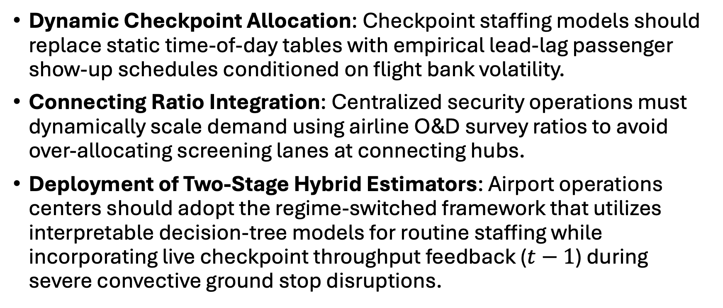
Real World Application
Dynamic Checkpoint Allocation: Checkpoint staffing models should replace static time-of-day tables with empirical lead-lag passenger show-up schedules conditioned on flight bank volatility.
Connecting Ratio Integration: Centralized security operations must dynamically scale demand using airline O&D survey ratios to avoid over-allocating screening lanes at connecting hubs.
Deployment of Two-Stage Hybrid Estimators: Airport operations centers should adopt the regime-switched framework that utilizes interpretable decision-tree models for routine staffing while incorporating live checkpoint throughput feedback ($t−1$) during severe convective ground stop disruptions.

Slide 31
Recommendations for future research
Airline or airport specific
Add variables such as online search
Get granular with lanes
Test multiple hybrid approaches

Slide 32
Conclusion
Notes:
The primary purpose of this thesis was to evaluate and optimize predictive modeling frameworks – spanning deterministic flight schedule convolution, supervised machine learning, and dynamic two-stage hybrid architectures – to enhance airport security checkpoint capacity management and throughput volatility forecasting across diverse operational conditions. The empirical findings definitively confirmed the overarching asymmetric trade-off hypothesis (Hypothesis 1) and its constituent sub-hypotheses (Hypothesis 1a, 1b, and 1c), demonstrating that no single paradigm is universally superior across all operational regimes: supervised machine learning maximizes routine baseline accuracy (robustness, confirming Hypothesis 1a), dynamic hybrid feedback provides unmatched resilience during acute flight delays and convective disruption shocks (resilience, confirming Hypothesis 1b), and deterministic schedule baselines deliver superior cross-facility generalizability (generalizability, confirming Hypothesis 1c). Ultimately, these results illustrate that airport authorities and security planners can achieve substantial operational capacity optimization without capital-intensive physical expansions by transitioning from static, monolithic models to a synchronized, condition-responsive regime-switched forecasting architecture.

