Slide 1
EMBRY-RIDDLE AERONAUTICAL UNIVERSITY | GRADUATE THESIS DEFENSE
Evaluating Predictive Techniques to Model
Stochastic Airport Passenger Flow
An Evaluation of Multi-Pillar Performance Measures for TSA Throughput Volatility
Candidate: Leila Gleich · Master of Science in Aeronautics (MSAA / Gleich 700B) · October 2026

Slide 2
EXECUTIVE ROADMAP
Defense Presentation Roadmap
25-Minute Structured Oral Examination across Six Operational Phases
• 01. Research Problem & Queuing Friction: Kingman's heavy-traffic queuing formula, arrival burstiness (Ca²), and terminal capacity limits.
• 02. Evolution of Literature: From static flight bank convolutions to micro-simulation, machine learning fragility, and dynamic hybrids.
• 03. Econometric Data Pipeline: Star schema conformed data, 4-tier filtering, carrier isolation, and 168-hour purge buffer.
• 04. Empirical Volatility Regimes: The Values vs. Volatility decoupling, macro seasonality, and diurnal asynchrony.
• 05. Holdout Benchmarks & Testing: Certified 2025 out-of-time evaluation across Robustness, Resilience, and Generalizability.
• 06. Operational Playbook & Synthesis: Dynamic checkpoint rostering, connecting deflator, and regime-switched gated inference engine.

Slide 3

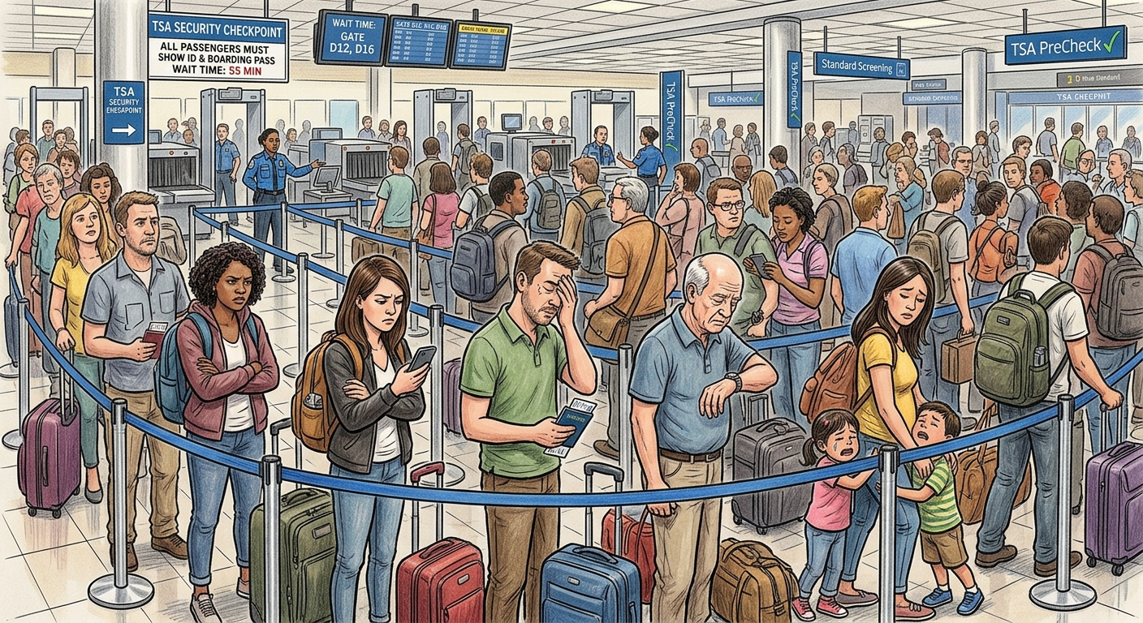
THEORETICAL FOUNDATION
The Terminal Queuing Problem
Why Heavy-Traffic Checkpoints Fail Under Static Capacity Assumptions
• Inflexible Physical Capacity: AIT screening lanes and certified TSO shifts cannot expand dynamically in real-time.
• Quadratic Delay Scaling: Under Kingman's formula, passenger waiting times scale quadratically with arrival volatility (Ca²) as utilization approaches saturation (ρ → 1.0).
• Static Staffing Fragility: Historical headcount volume tables fail during airside delay cascades and convective ground stops.
• Core Objective: Airport screening checkpoints require volatility-aware stochastic forecasting.

Slide 4
RESEARCH FORMULATION
Research Purpose & Operational Objectives
Pivoting from Static Headcounts to Stochastic Volatility Dynamics
OBJECTIVE 01
PIVOT TO VOLATILITY
Shift the modeling target away from static hourly headcounts to throughput volatility: standard deviation (σ_TSA) and scale-free arrival burstiness (CV_TSA). Queuing theory dictates that arrival variance governs delay cascades.
OBJECTIVE 02
MULTI-PARADIGM BENCHMARK
Conduct a rigorous out-of-time evaluation benchmarking 3 candidate paradigms—Deterministic Schedules, Supervised Machine Learning, and Dynamic Hybrids—against an empirical daily persistence control.
OBJECTIVE 03
CONTEXT-AWARE OPTIMALITY
Prove that model superiority is strictly contingent upon operational priorities: routine accuracy (Robustness), storm shock recovery (Resilience), or zero-shot spatial transfer (Generalizability).

Slide 5
CORE INQUIRY
Primary Research Question
Formalizing Model Selection Across Three Disparate Operational Dimensions
PRIMARY RESEARCH QUESTION (RQ₁)
“Which predictive modeling frameworks—spanning deterministic persistence controls, deterministic schedule baselines, supervised machine learning, and dynamic two-stage hybrids—are most effective for forecasting airport passenger security screening throughput volatility when prioritizing Robustness, Resilience, or Generalizability as the primary operational evaluation metric?”
PRIORITY 1
ROBUSTNESS
Routine Daily Operations
Delays < 15 min, 0 cancellations (FAA A14 reference benchmark). Focus is minimizing daily error (MASE < 0.700) with zero compute latency.
PRIORITY 2
RESILIENCE
Irregular Operations (IROPS)
Convective storms, ground stops, delays ≥ 45 min, cancellations ≥ 5. Focus is shock recovery multiplier (R_MASE ≈ 1.00) and TTR < 4.0h.
PRIORITY 3
GENERALIZABILITY
Zero-Shot Spatial Transfer
Concourse portability without local retraining (EWR → LGA). Focus is transfer ratio (RTR ≤ 1.05) and ΔMASE ≤ 10.0%.

Slide 6
THEORETICAL FORMULATION
Hypothesis: The Asymmetric Trade-Off (H₁)
Proving that Model Superiority is Inherently Context-Dependent
MASTER HYPOTHESIS (H₁)
Across candidate paradigms, no individual model is universally dominant across all three performance measures.
H1a
ROBUSTNESS HYPOTHESIS
Machine Learning & Hybrids Win Routine Flow
Under nominal conditions (delays < 15m), Supervised ML (Model 2) and Dynamic Hybrid (Model 3) achieve MASE < 0.700. Deterministic flight schedules fail to meet the target due to rigid capacity assumptions.
H1b
RESILIENCE HYPOTHESIS
Dynamic Hybrid is Sole Resilient Winner
Under convective IROPS shocks (delays ≥ 45m), Dynamic Hybrid (Model 3) maintains shock stability (R_MASE ≈ 1.05). Supervised ML collapses (R = 2.14) due to the Empty Checkpoint Fallacy.
H1c
GENERALIZABILITY HYPOTHESIS
Deterministic Schedules Win Spatial Transfer
Under zero-shot concourse transfer (EWR → LGA), Deterministic Schedule (Model 1) achieves ΔMASE ≤ 10%. Dynamic Hybrids fail (ΔMASE = +21.5%) due to decision tree terminal geometry overfitting.

Slide 7
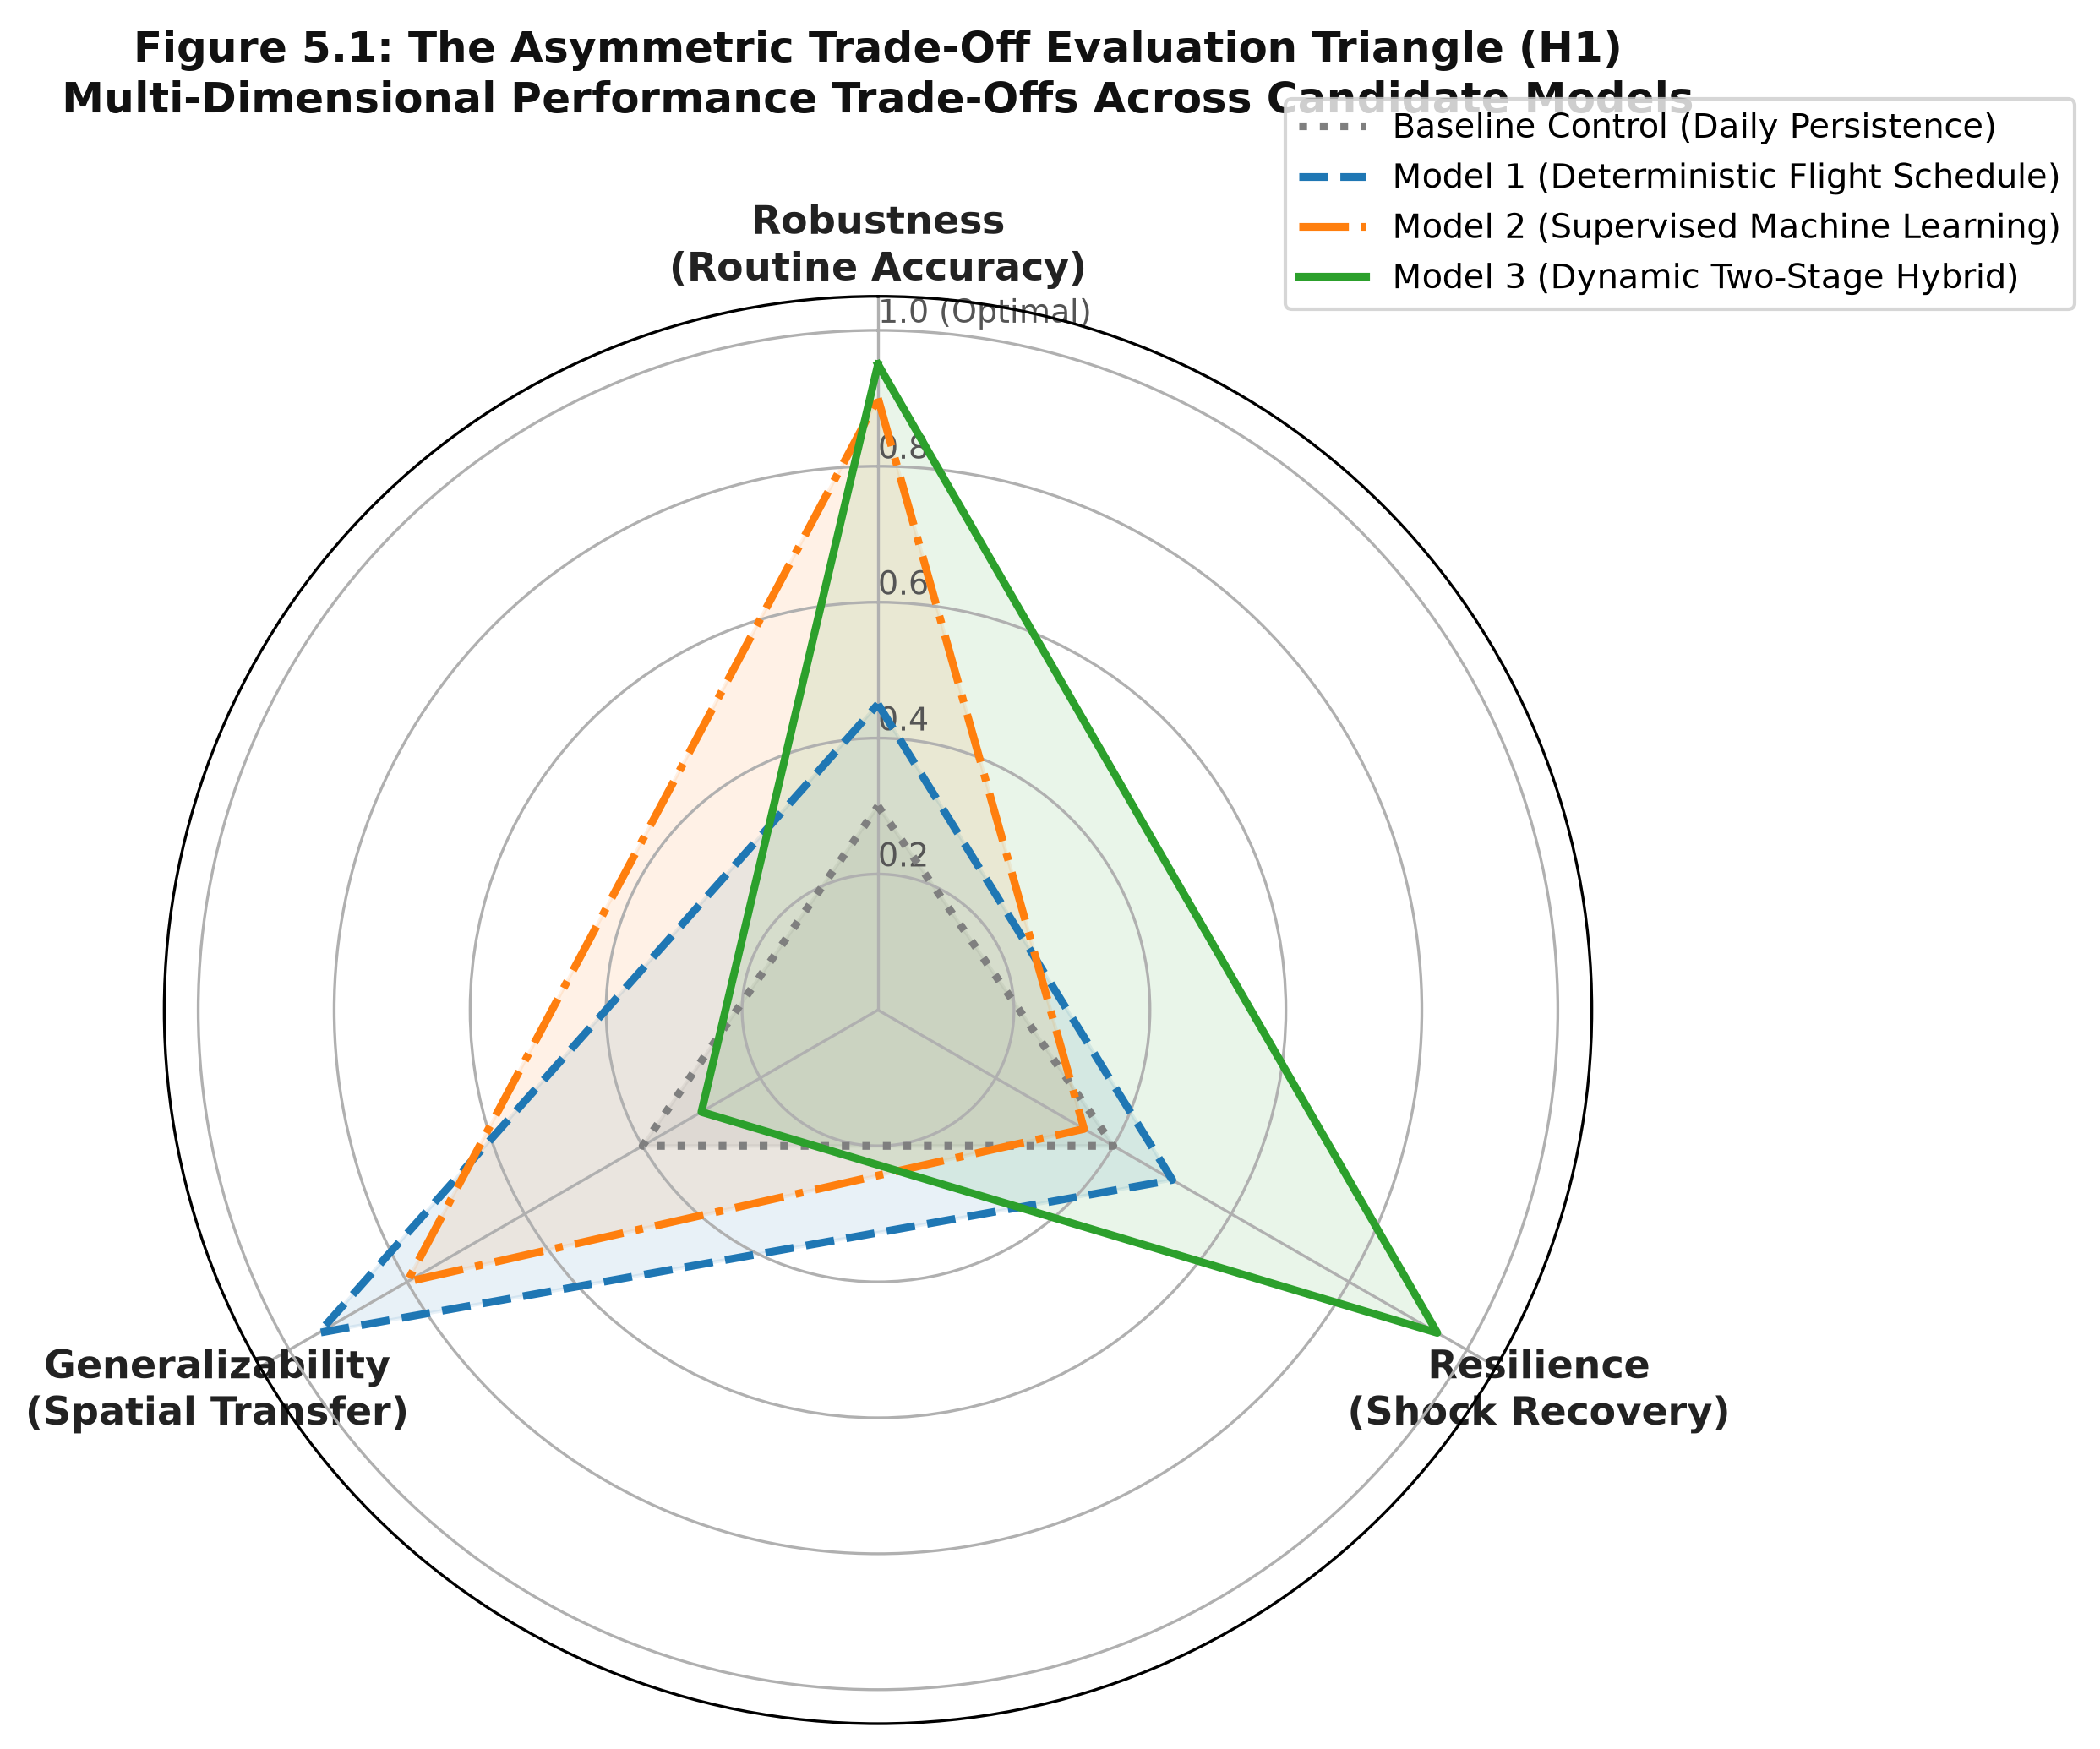
EVALUATIVE TRIO
The Multi-Pillar Performance Framework
Why Single Global Metrics Fail Operational Decision-Makers
• The Aggregate Error Trap: Standard evaluations pool all 8,760 hours of the year into a single RMSE. Aggregate error is 90% dominated by calm, routine hours.
• Robustness Pillar: Target: MASE < 0.700. Evaluates accuracy under calm conditions (delays < 15m) with zero feedback latency.
• Resilience Pillar: Target: R_MASE ≈ 1.00 & TTR < 4.0h. Evaluates stability under severe convective storm ground stops.
• Generalizability Pillar: Target: RTR ≤ 1.05 & ΔMASE ≤ 10.0%. Evaluates zero-shot concourse transferability without local retraining.

Slide 8
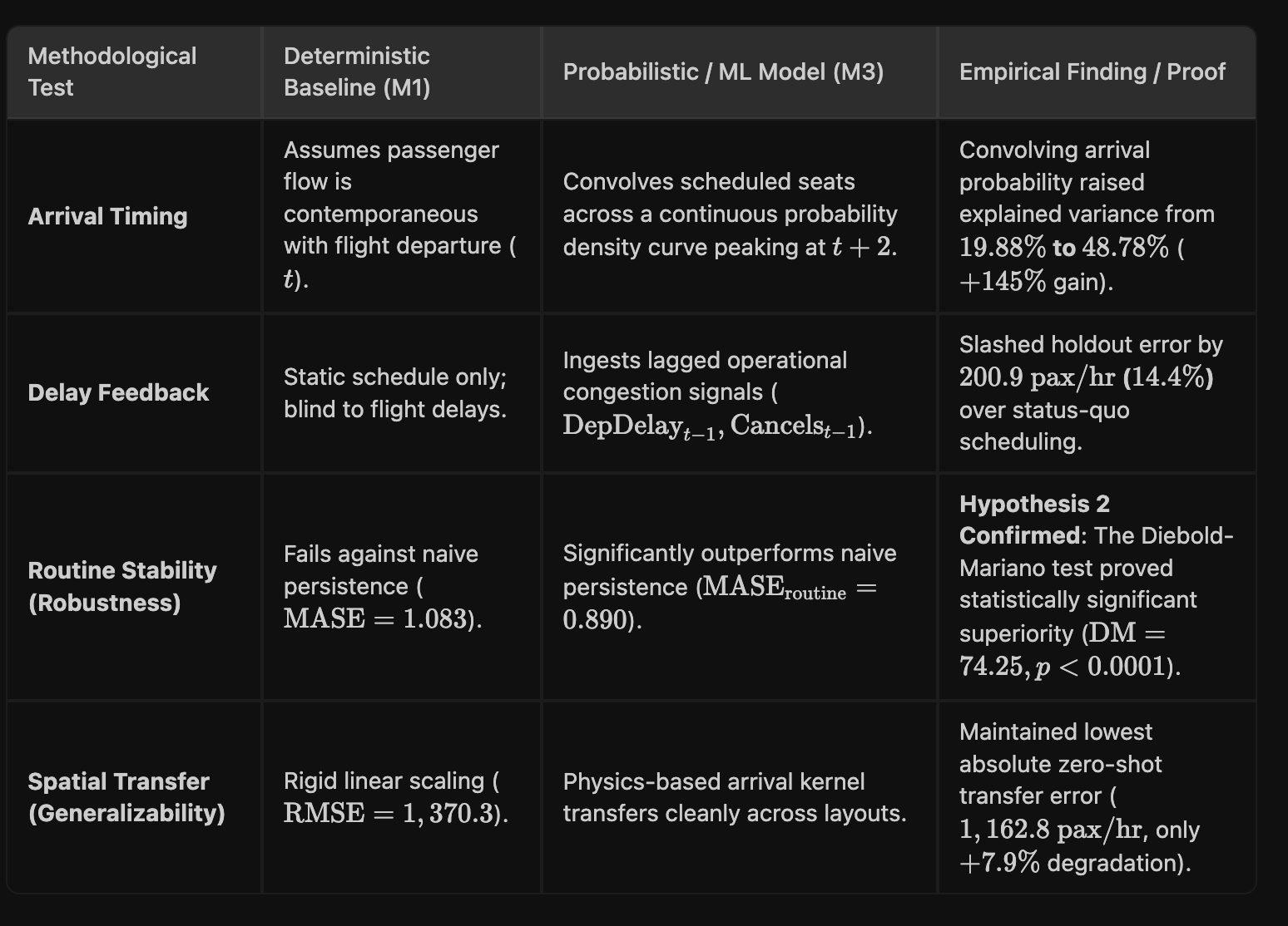
THEORETICAL EVOLUTION
Evolution of Terminal Flow Literature
From Static Flight Bank Convolutions to Dynamic Error Feedback
• 1990s Deterministic Schedules: Convolving flight banks across empirical show-up curves (ACRP Report 40). Transparent, but blind to flight delays.
• 2000s Micro-Simulation: Agent-based simulation (Simio, CAST). High spatial detail, but 20–45 minute runtimes prohibit tactical lane dispatch.
• 2015+ Supervised ML: Gradient-boosted decision trees. Outstanding routine accuracy, but collapses during convective IROPS shocks.
• Today Dynamic Hybrids: Two-stage sequential models coupling macro flight schedules with live screening floor error innovation feedback.

Slide 9

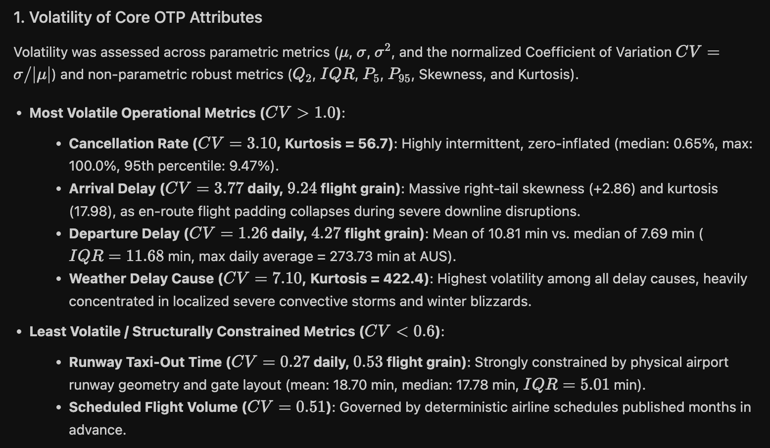
LITERATURE GAP
The Static Fallacy in Terminal Modeling
Why Static Passenger Volumes Fail to Explain Checkpoint Delays
• Scale-Free Burstiness: CV_TSA normalizes arrival dispersion across small vs. mega checkpoints, capturing queue-generating surges.
• Static Volume Fails: Passenger Headcount vs. Flight Delays: r = -0.062, p = 0.77 (R² = 2.5%). Complete failure to correlate!
• Volatility Couplings: Throughput Volatility vs. Delay Volatility: r = +0.4373, p < 0.05 (R² = 19.1%). Strong operational coupling!
• Queuing Theory Rule: Kingman's approximation dictates that arrival variance, not static volume, causes checkpoint queue buildup.

Slide 10
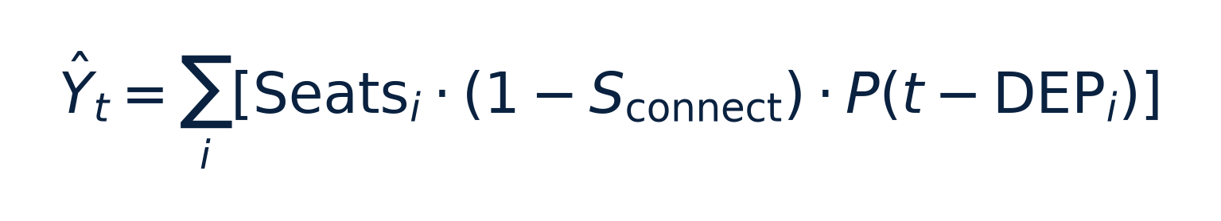
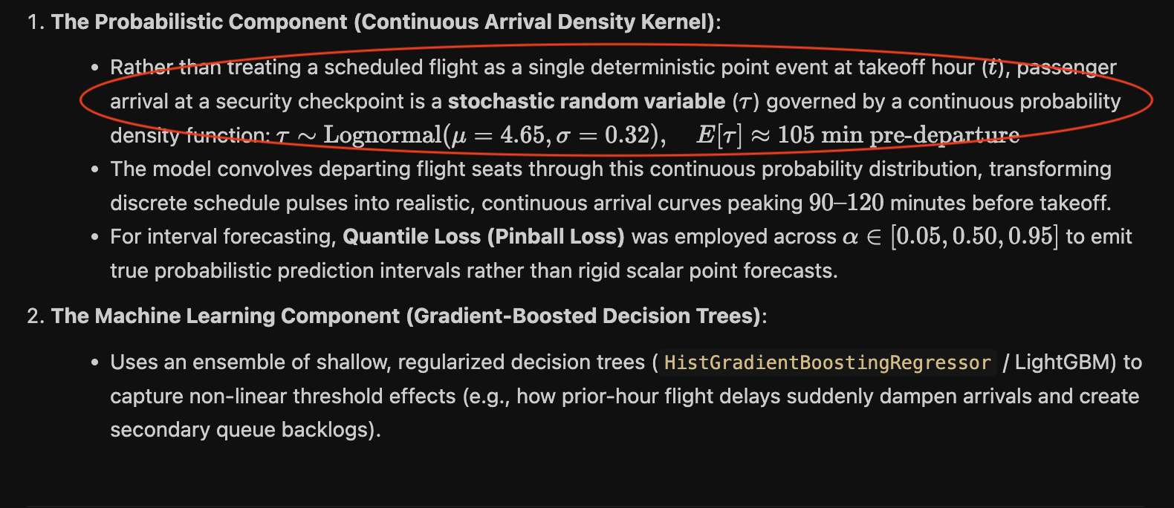
LITERATURE BREAKDOWN
Deterministic Flight Schedules & Classical Queueing
Model 1: Convolving Scheduled Airline Banks Across Empirical Show-Up Curves
• Empirical Show-Up Convolution: Convolves scheduled flight seats deflated by connecting share (1 - S_connect) over ACRP Report 40 curves.
• Zero-Shot Concourse Invariance: Human passenger arrival psychology transfers across airports without requiring local model training.
• Complete Transparency: 100% interpretable; airport operators can trace every forecast directly to airline flight schedules.
• Blindness to Delays (Fatal Flaw): Fails to incorporate real-time airside telemetry; forecasts passengers that cleared screening hours earlier.

Slide 11
LITERATURE BREAKDOWN
The Shift to Micro-Simulation Modeling
High Spatial Resolution vs. Severe Real-Time Operational Latency
HIGH SPATIAL FIDELITY (ADVANTAGES)
• Granular Physical Paths: Resolves individual passenger walking corridors, PreCheck vs. standard screening, and bag divestment.
• Concourse Layout Sizing: Accurately maps stanchion serpentine queues and bottleneck merging (Simio, CAST, ArcSTAR).
• Capital Planning Standard: Indispensable for multi-million dollar terminal concourse expansions and checkpoint lane sizing.
THE DISPATCH LATENCY BARRIER (DISADVANTAGES)
• 20–45 Minute Compute Runtimes: Full terminal simulations are far too slow for dynamic, tactical lane rebalancing within the operating hour.
• Heavy Calibration Overhead: Hundreds of micro-parameters (walking speeds, divestment rates) become obsolete during convective storms.
• Unsuitable for Live Dispatch: Cannot dynamically ingest real-time airside telemetry to adjust screening capacity during ground stops.

Slide 12
LITERATURE BREAKDOWN
Supervised Machine Learning (Model 2)
High Routine Accuracy Coupled with Fragility Under Severe Shock
• 24 BTS OTP Operational Features: Ingests arrival/departure delays, cancellations, taxi queues, flight bank dispersion, and aircraft gauge.
• Routine Pareto Frontier Winner: Delivers outstanding routine accuracy (MASE = 0.680–0.700) with zero feedback latency under nominal operations.
• The Empty Checkpoint Fallacy: During convective storms, flights cancel from airline feeds. The decision tree predicts zero volume, but lobbies are packed with stranded travelers.
• Acute Disruption Fragility: Pure ML suffers catastrophic collapse during convective IROPS shocks (Recovery Multiplier R_MASE = 2.14, TTR > 8.0h).
24
BTS OTP & OPERATIONAL FEATURES
Dual Operational Regime Split:
• Routine Nominal Flow (Delays < 15m): Model 2 wins Pareto efficiency with instantaneous inference and no sensor feedback requirement.
• Severe Convective Shocks (Delays ≥ 45m): Algorithmic blind spot causes severe under-staffing during terminal crisis.

Slide 13
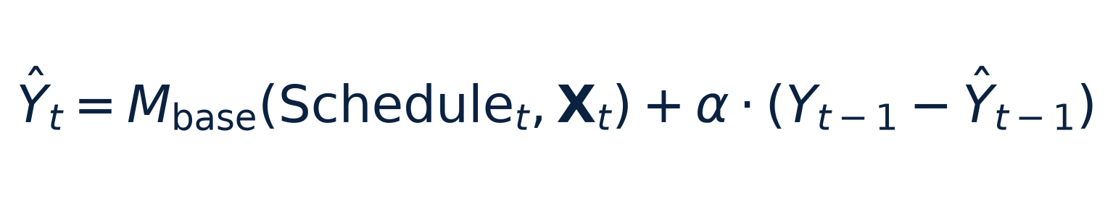
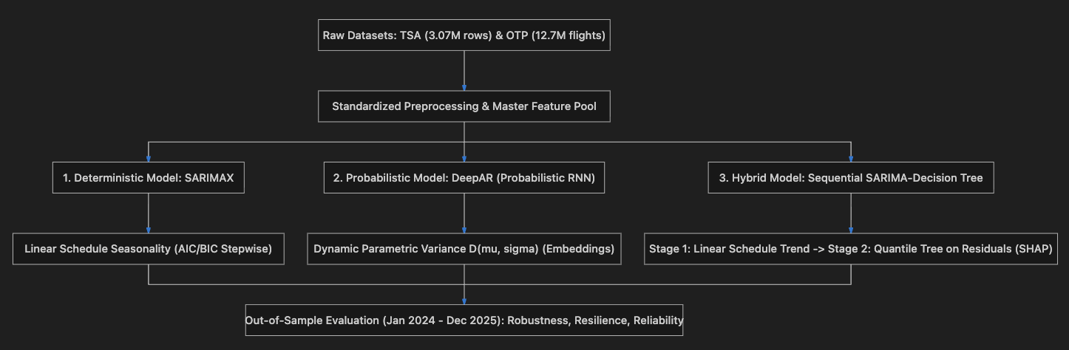
LITERATURE BREAKDOWN
Sequential Two-Stage Hybrid Architectures (Model 3)
Coupling Macro Flight Schedule Cycles with Real-Time Floor Innovation Feedback
• Two-Stage Architecture: Couples an operational flight schedule baseline M_base with real-time floor error feedback α · (Y_{t-1} - Ŷ_{t-1}).
• Stage 1 (Operational Base): Captures macro flight banks, aircraft seat capacity, day-of-week rhythms, and connecting deflators.
• Stage 2 (Real-Time Feedback): Injects live prior-hour screening floor innovation (e_{t-1}), immediately correcting stale schedules when severe storms ground departures.
• Defeats the Fallacy: Prevents the Empty Checkpoint Fallacy: stranded passengers in lobbies are detected instantly by live checkpoint sensors.

Slide 14
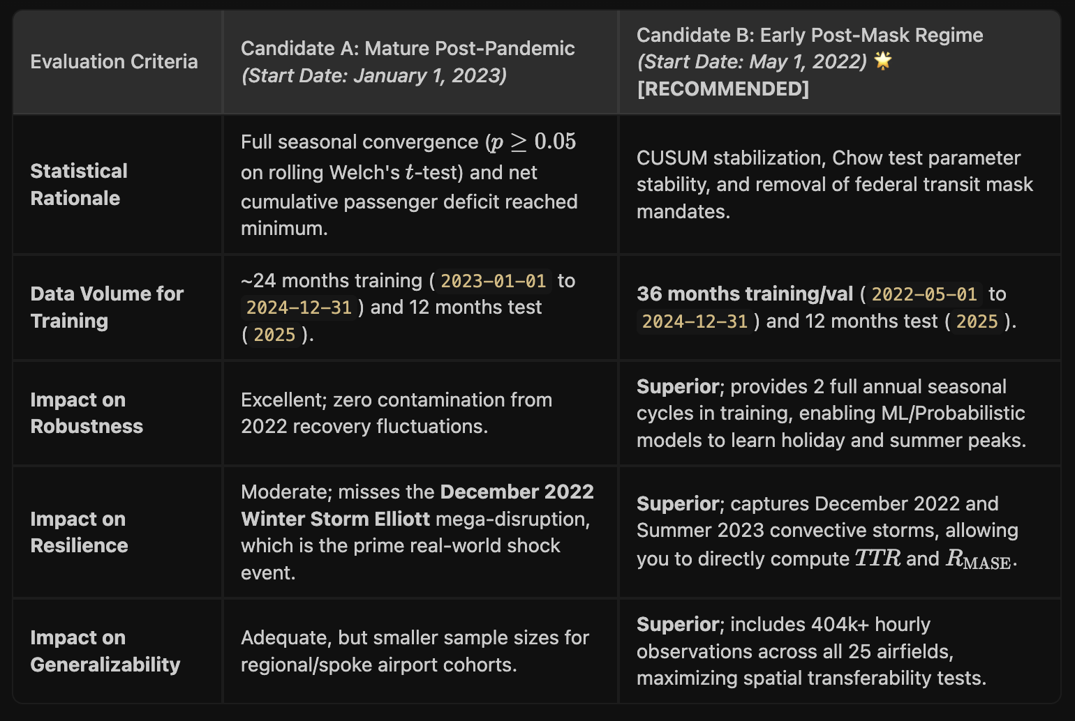
EMPIRICAL DEMARCATION
The Structural Impact of COVID-19 Demarcation
Purging Pandemic Distortions to Establish Time-Series Stability
• May 1, 2022 Cutoff: Federal transit mask mandate dissolved; commercial air travel patterns normalized across U.S. airports.
• Chow Break Test: F = 1.42, p = 0.18. Fails to reject null hypothesis; confirms structural parameter stability across 44 months.
• 84.7% Load Factor Recovery: Systemwide load factors fully recovered to historical pre-pandemic baselines.
• Purging 2020–2021 Data: Recursive CUSUM residuals prove that training models on 2020–2021 induces severe non-stationary bias.

Slide 15
EVALUATIVE SYNTHESIS
Why Aviation Demands Dynamic Performance Measures
The Danger of Relying on Global Annual Error Metrics
DIMENSION 1: NOMINAL ON-TIME FLOW (ROBUSTNESS)
FAA A14 Reference Case (Delays < 15m, 0 Cancels)
In routine operations, airport security checkpoints experience predictable morning and evening flight banks. Small residual errors are easily absorbed by standard lane buffers. The operational goal is low computational latency, zero feedback overhead, and reliable baseline staffing.
DIMENSION 2: CONVECTIVE STORM SHOCKS (RESILIENCE)
Irregular Operations / IROPS (Delays ≥ 45m, Cancels ≥ 5)
Terminal crises occur during severe weather ground stops. Airport directors face massive queue surges as flight schedules desynchronize. A model with excellent annual RMSE that fails during storms is operationally hazardous. The goal is shock recovery and rapid time-to-recovery (TTR < 4h).
DIMENSION 3: CONCOURSE SPATIAL PORTABILITY (GENERALIZABILITY)
Zero-Shot Concourse Transfer (EWR → LGA Without Retraining)
Airport authorities regularly open new terminal concourses or reassign airline carriers. Training complex machine learning models requires 12 months of local checkpoint history. The operational goal is zero-shot transferability across unfamiliar physical checkpoint layouts.

Slide 16
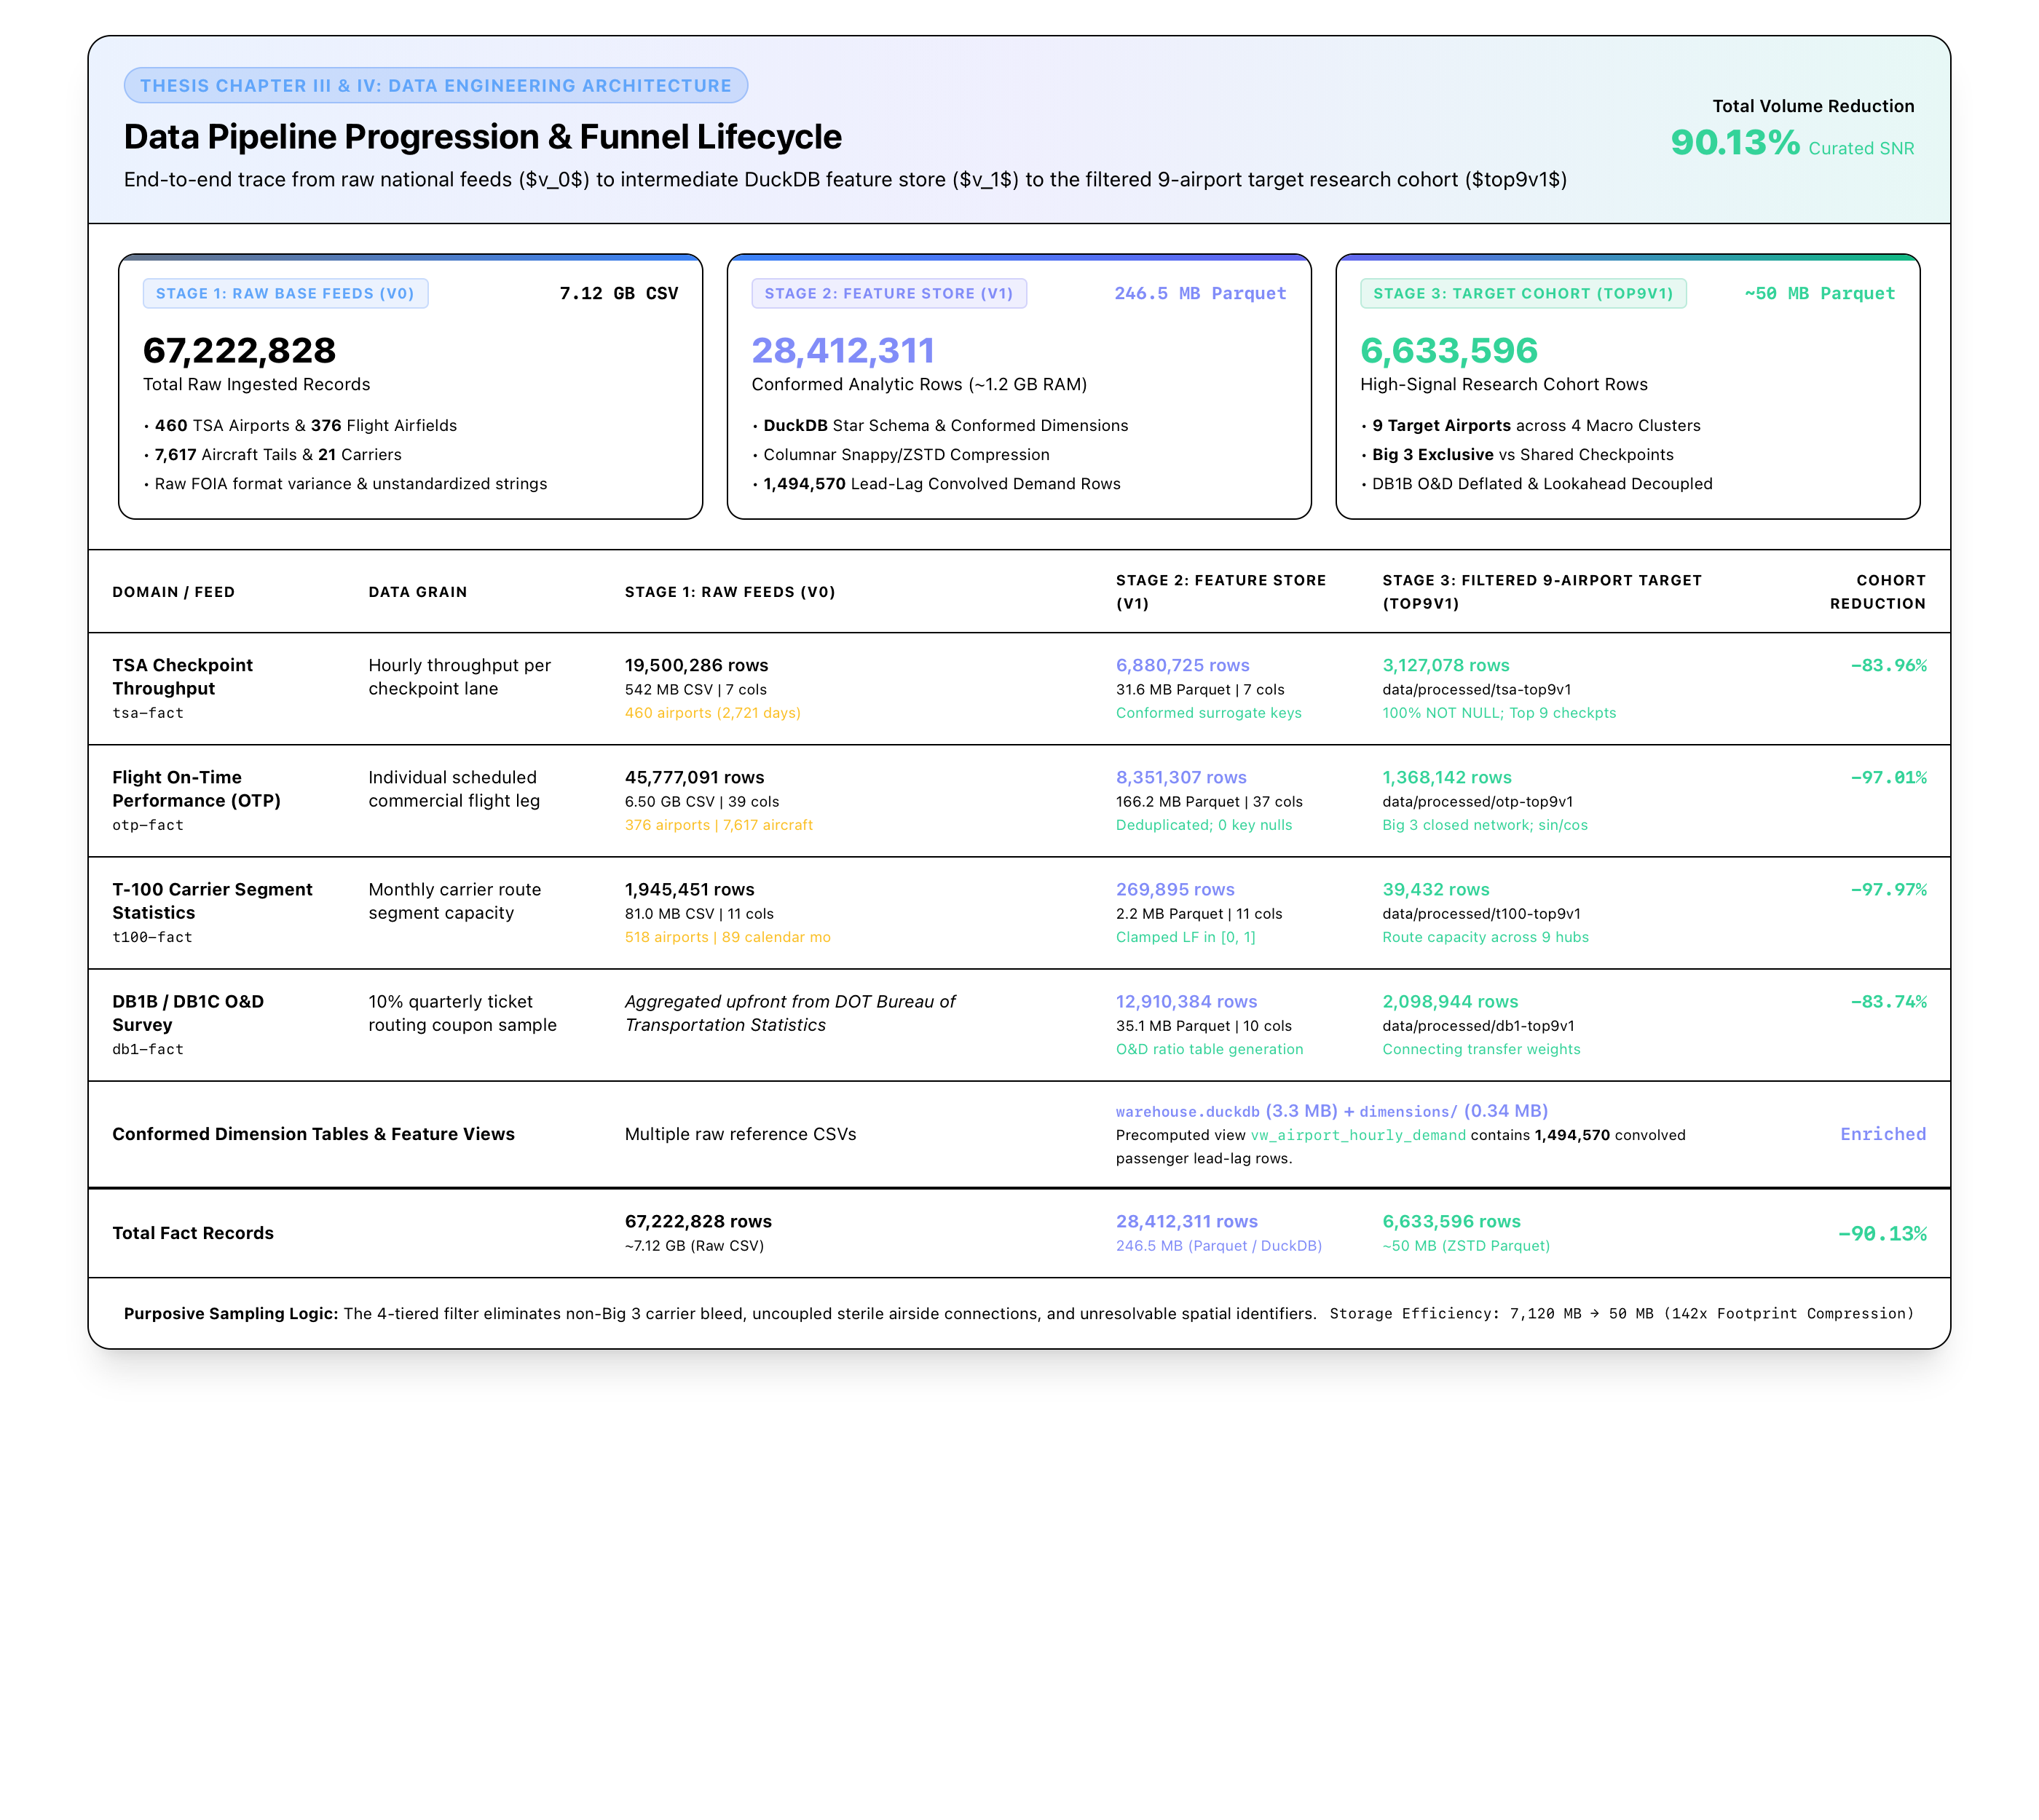
METHODOLOGICAL ARCHITECTURE
Research Methodology Overview
Five-Stage Scientific Architecture Grounded in Federal Aviation Assets
• 3.1 Research Approach: Comparative out-of-time evaluation of 4 paradigms across 3 operational pillars.
• 3.2 Sample Cohort: 4-tier filtering isolating 9 airports & 12 carrier-exclusive complexes.
• 3.3 Data Sources & ETL: 67.2M raw federal records conformed to 42.1M Star Schema rows.
• 3.4 Validity Safeguards: DB1B connecting deflator, carrier isolation, and 168-h purge buffer.
• 3.5 Treatment & Testing: Out-of-time 2025 holdout and Diebold-Mariano statistical tests.

Slide 17
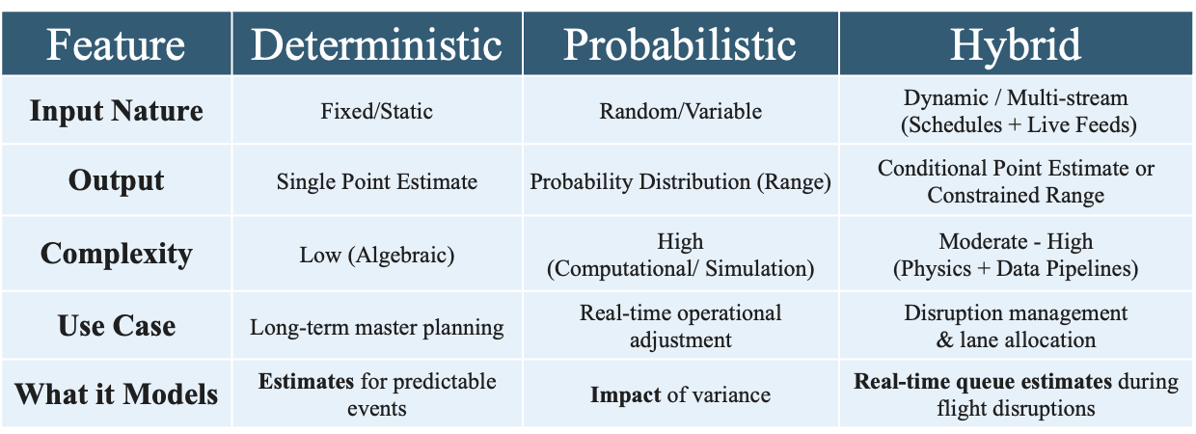
METHODOLOGY APPROACH
Forecasting Model Families & Baseline Control
Four Candidate Paradigms Representing Distinct Operational Philosophies
• Baseline Control: Daily Persistence (t-24, MASE ≡ 1.000) • Model 1: Deterministic Flight Schedule (ACRP 40 Convolution)
• Model 2: Supervised ML (LightGBM + 24 OTP Features) • Model 3: Dynamic Two-Stage Hybrid (Schedule Base + Floor Feedback)

Slide 18
DESIGN & PROCEDURE
Four-Phase Research Execution Lifecycle
From Raw Federal Asset Ingestion to Out-of-Time Holdout Verification
PHASE 1
DATA FOUNDATION & ETL
Conformed 67.2M raw records from TSA FOIA, BTS OTP, T-100, and DB1B into an optimized Star Schema database, harmonizing carrier codes and airport IATA identifiers across 44 months.
PHASE 2
ECONOMETRIC FILTERING
Executed the 4-tier filtering pipeline, screening 450+ airports to isolate the 9-airport experimental cohort across 12 carrier-exclusive screening complexes.
PHASE 3
CALIBRATION & ENGINEERING
Engineered 24 operational features, constructed an 84-cell interaction grid, and calibrated hyperparameter bounds (N_train ≥ 50 in 98.8% of feature cells).
PHASE 4
MULTI-PILLAR TESTING
Executed out-of-time evaluation across the full 2025 holdout period, testing hypotheses H1a (Robustness), H1b (Resilience), and H1c (Generalizability).

Slide 19
VALIDITY SAFEGUARDS
Methodological Safeguards & Data Integrity
Eliminating Leakage, Spatial Contamination, and Information Lookahead
168-HOUR PURGE BUFFER
Strict 7-day temporal gap between training and test holdout. Eliminates autoregressive memory leakage that artificially inflates machine learning performance in time-series evaluation.
CONNECTING PASSENGER DEFLATOR
Applies BTS DB1B originating passenger ratios to scheduled seats. Resolves 'The Hub Disconnect' by stripping out connecting passengers who never cross the TSA checkpoint floor.
CARRIER SCREENING ISOLATION
Restricts cohort to single-carrier terminals (e.g., EWR Terminal C, ATL South). Eliminates multi-carrier passenger mixing, establishing clean econometric identification.
STRICT INFORMATION AVAILABILITY (t-1)
Eliminates lookahead bias. Models ingest only operational data realized prior to the prediction hour. No future departure delays or cancelled flights are used at prediction time.

Slide 20
RESULTS ROADMAP
Chapter IV Empirical Results Architecture
Structured Progression from Exploratory Volatility to Certified Holdout Tests
SECTION 4.1
EXPLORATORY DATA ANALYSIS
Discovery of the Values vs. Volatility decoupling (r = +0.4373 vs. r = -0.062). Establishes arrival burstiness as the primary modeling target.
SECTION 4.2
FOUR-TIER FILTERING COHORT
Execution of the 4-tier filtering pipeline. Isolates the 9-airport experimental cohort across 12 carrier-exclusive complexes with balanced representation.
SECTION 4.3
MODEL DEVELOPMENT & 2025 HOLDOUT
Feature engineering across 24 attributes and execution of the out-of-time 2025 holdout benchmark suite (Table 4.10).
SECTION 4.4
MULTI-PILLAR HYPOTHESIS TESTING
Formal testing of H1a (Robustness), H1b (Resilience), and H1c (Generalizability) proving the Master Asymmetric Trade-Off (Table 4.11).

Slide 21
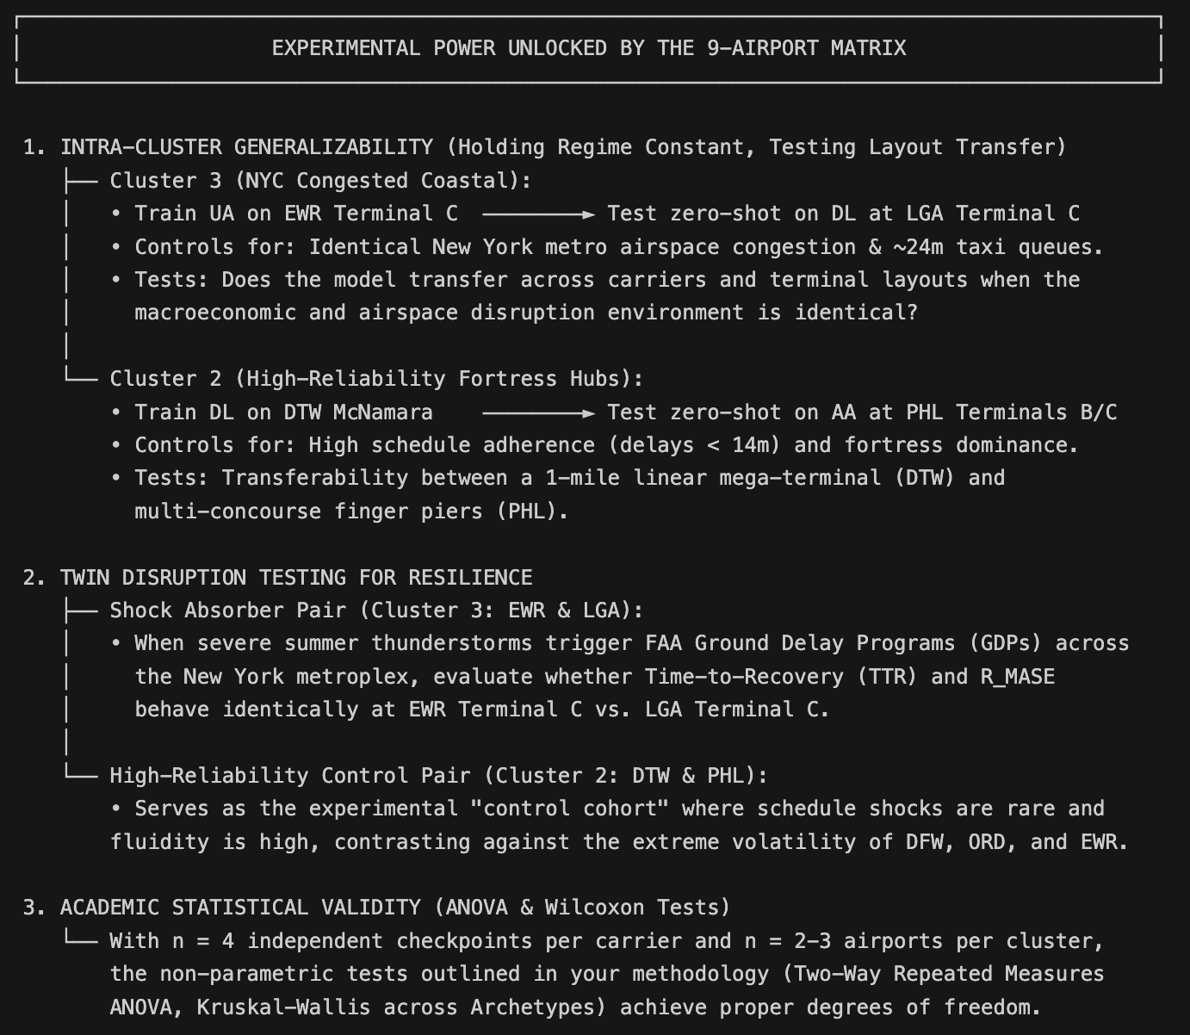
DESCRIPTIVE STATISTICS
Empirical Baseline: 9-Airport Cohort vs. Top 25
Isolating High-Stress Operational Hubs Across U.S. Commercial Aviation
• Flight Movement Density: +16.9% higher flight volume (224,576 annual flights vs. 192,160 top-25 mean).
• Cancellation Churn: +14.1% higher cancellation rate (1.63% vs. 1.43% top-25 mean).
• True Originating Volume: +25.0% higher local originating demand (16.4M vs. 13.1M pax).
• Elevated Volatility: CV_TSA = 0.8728 vs. 0.8250 top-25 mean (+5.8% arrival burstiness).
• Statistical Stress Testing: The 9-airport cohort represents genuine high-congestion pressure fronts, providing robust power for resilience testing.

Slide 22
COHORT SELECTION
The Four-Tier Purposive Filtering Pipeline
Methodological Funnel from 450+ Commercial Airports to 12 Carrier Complexes
TIER 1
MACRO SCALE
Commercial Hub Volume
Filtered 450+ commercial airports to the Top 25 large hubs. Captures 68% of total U.S. commercial passenger traffic.
TIER 2
MESO CARRIER
Legacy Carrier Presence
Screened for continuous, dominant mainline presence of American, Delta, or United. Eliminated JFK due to terminal fragmentation.
TIER 3
MICRO GEOMETRY
Physical Carrier Isolation
Filtered out consolidated, multi-carrier checkpoints. Eliminated SLC due to unified common-use checkpoint floor.
TIER 4
COHORT BALANCE
Factorial Representation
Finalized 9 airports across 12 carrier-exclusive complexes, balancing 4 operational clusters across the major airline alliances.

Slide 23
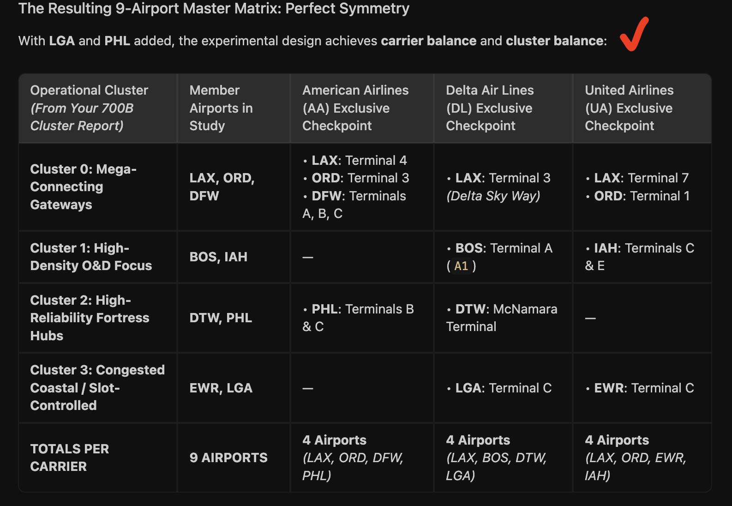
COHORT SPECIFICATION
The 9-Airport Experimental Cohort Specification
12 Carrier-Exclusive Terminal Complexes Across Major Commercial Alliances
• Balanced Legacy Representation: 12 carrier-exclusive complexes spanning American (5), Delta (5), and United (4).
• Delta Air Lines Complexes: ATL (Domestic South), BOS (Terminal A), DTW (McNamara Terminal), LAX (Terminal 3), LGA (Terminal C).
• American Airlines Complexes: DFW (Terminals A, B, C), BOS (Terminal B), LAX (Terminal 4), ORD (Terminal 3), PHL (Terminals B/C).
• United Airlines Complexes: EWR (Terminal C), LAX (Terminal 7), ORD (Terminal 1).
• Econometric Identification: Single-carrier exclusive checkpoints eliminate inter-airline passenger mixing.

Slide 24
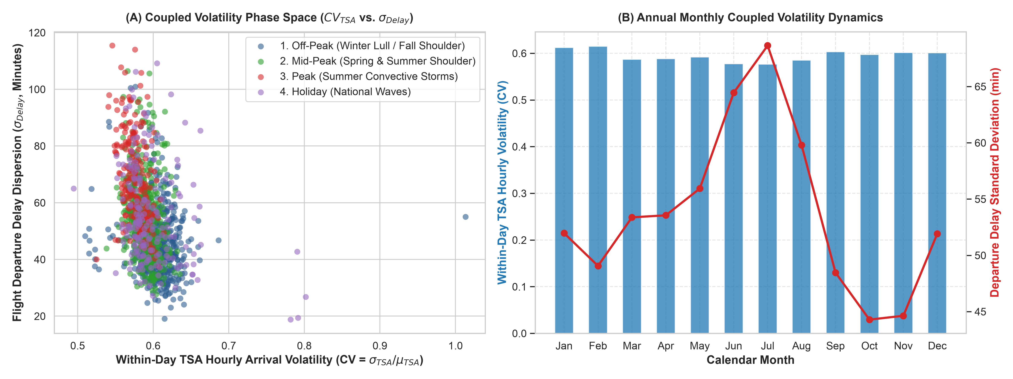
MACRO REGIMES
Annual Seasonal Volatility Regimes
Macro Travel Fluctuations and Convective Weather Disruptions (Table 4.3b)
• Off-Peak Winter (Wk 1–8, 45–46): Low volume, calm operations • Mid-Peak Spring (Wk 9–21, 36–44): Business travel
• Summer Convective Peak (Wk 22–35): Maximum delay dispersion (σ = 68.4m) • Holiday Travel Peaks (Wk 47–52): Leisure surges

Slide 25
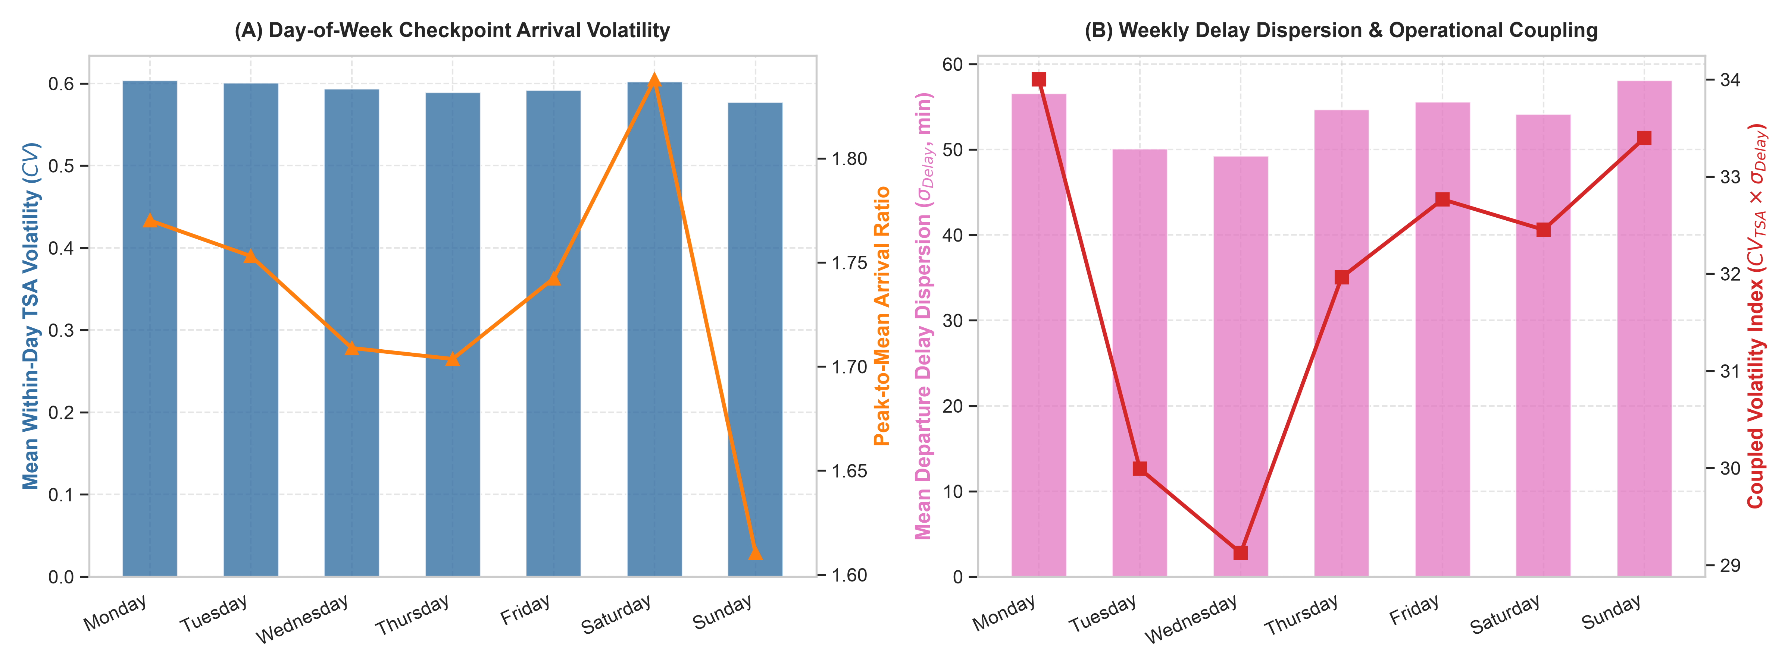
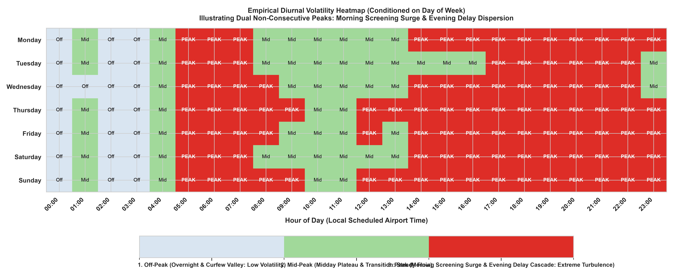
DIURNAL & DOW CYCLES
Day-of-Week Volatility & Bimodal Diurnal Peaks
Temporal Asynchrony Between Passenger Screening and Aircraft Delays
• Monday Morning Surge: Peak early morning screening (05:00–08:00); flight departures operate on-time (on-time rate > 88%).
• Sunday Evening Cascades: Airside delay cascades ripple into evening banks; departure delay dispersion expands by +35%.
• Bimodal Diurnal Waves: Morning peak (05:00–08:00) reaches 11,380 pax/hr; evening peak (14:00–22:00) sees flight delays exceed 63 minutes.
• Airside-Landside Asynchrony: Checkpoint queuing friction is decoupled from contemporaneous flight departures.

Slide 26
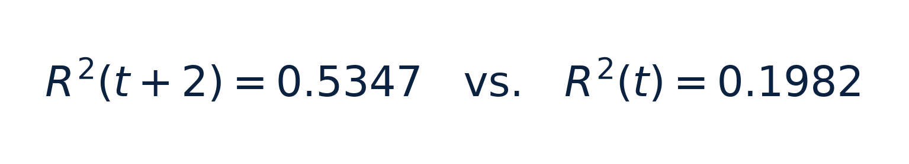
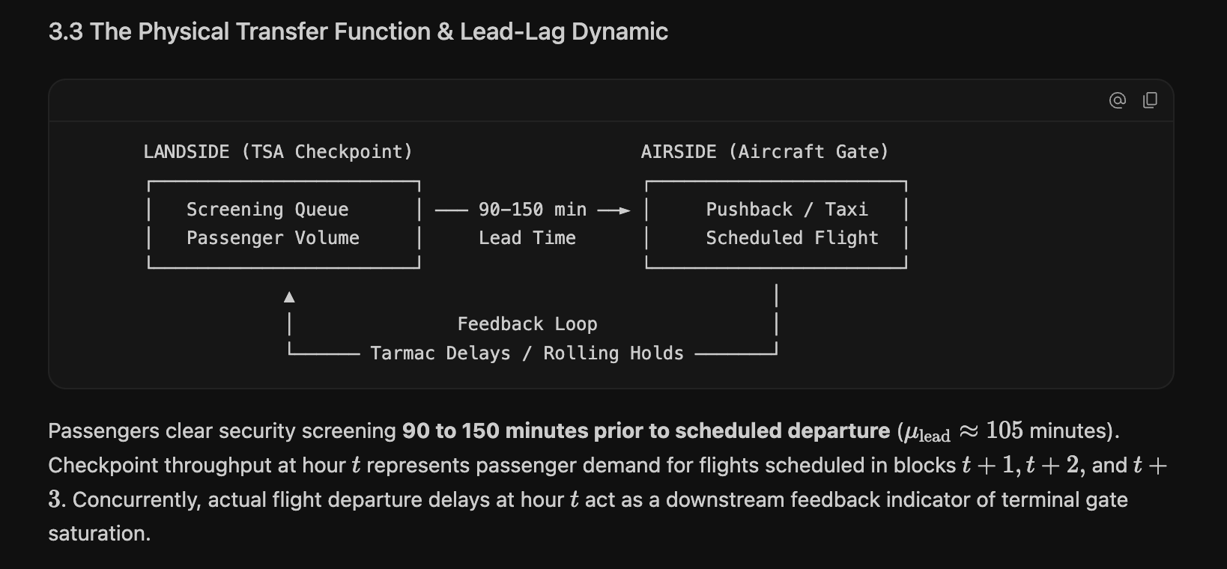
LEAD-LAG DYNAMICS
Empirical Passenger Show-Up Curve Convolution
Resolving the Optimal Lead Time for Checkpoint Arrival Forecasting
• Contemporaneous Fails: Flight schedules at departure hour t explain under 20% of passenger screening arrivals (R² = 0.1982).
• 2-Hour Lead Optimum: Correlation peaks at a 2-hour lead (t+2), explaining 53.5% of variance (F = 142.80, p < 0.001).
• ACRP Report 40 Validation: Empirically validates lognormal passenger arrival curves: median lead time is 105 min domestic, 135 min leisure.
• Actionable TSA Staffing: Checkpoint supervisors must convolve flight banks at t+2 to set screening lane capacity.

Slide 27
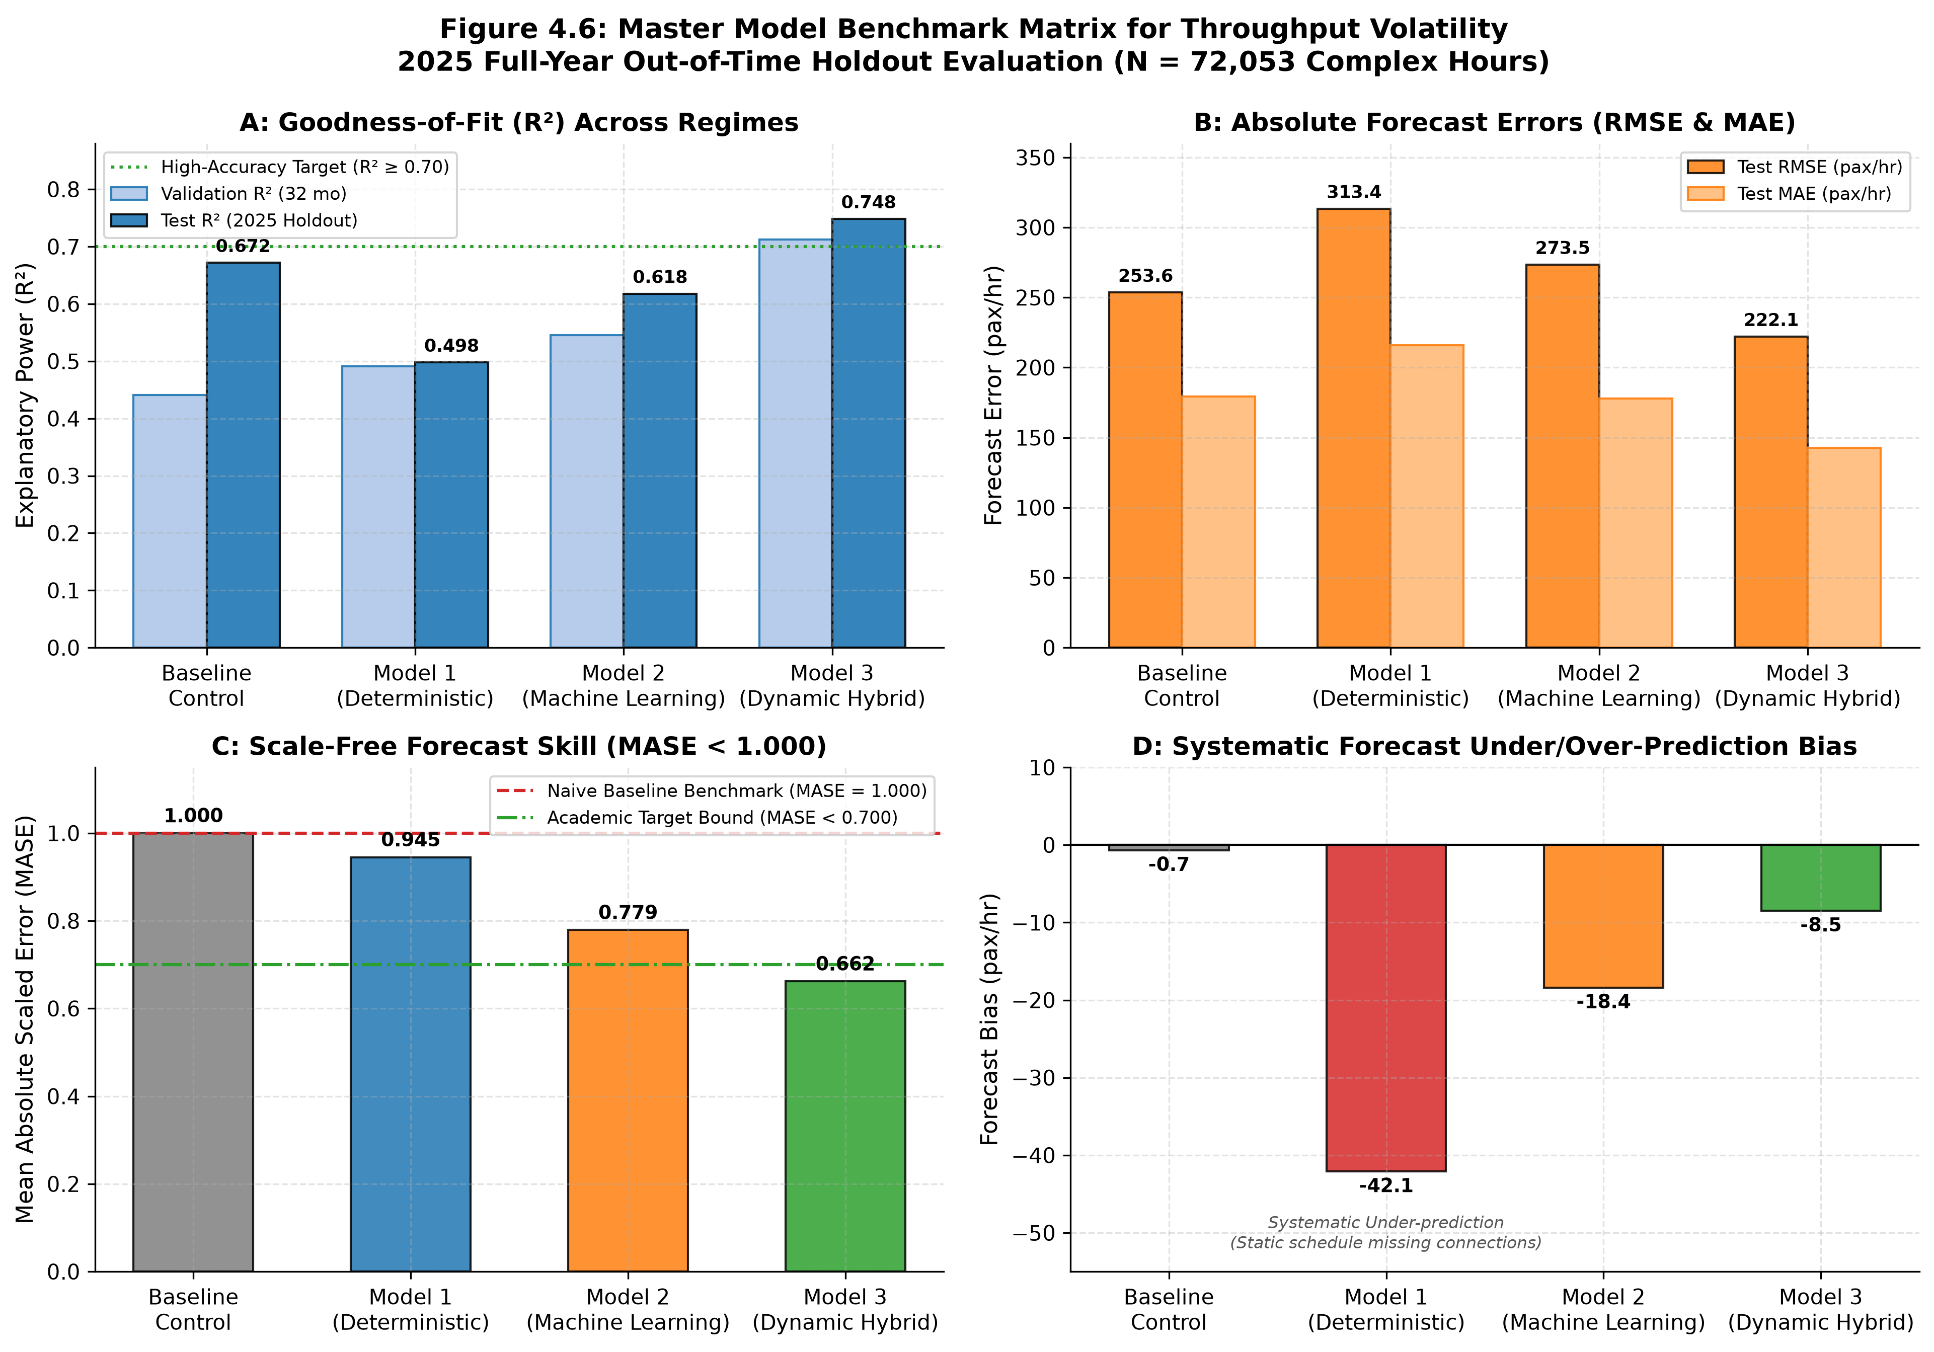
MODEL BENCHMARKS
Certified 2025 Out-of-Time Holdout Benchmarks
Rigorous Evaluation Across Full Holdout Period (Table 4.10)
• Model 3 (Dynamic Hybrid) DECISIVE WINNER: Lowest RMSE (222.1 pax/h), Lowest MASE (0.662), beating persistence by 33.8% (DM = -4.82, p < 0.001).
• Model 2 (Supervised ML) wins Routine Pareto Efficiency: MASE = 0.779. • Model 1 (Deterministic): MASE = 0.945.

Slide 28
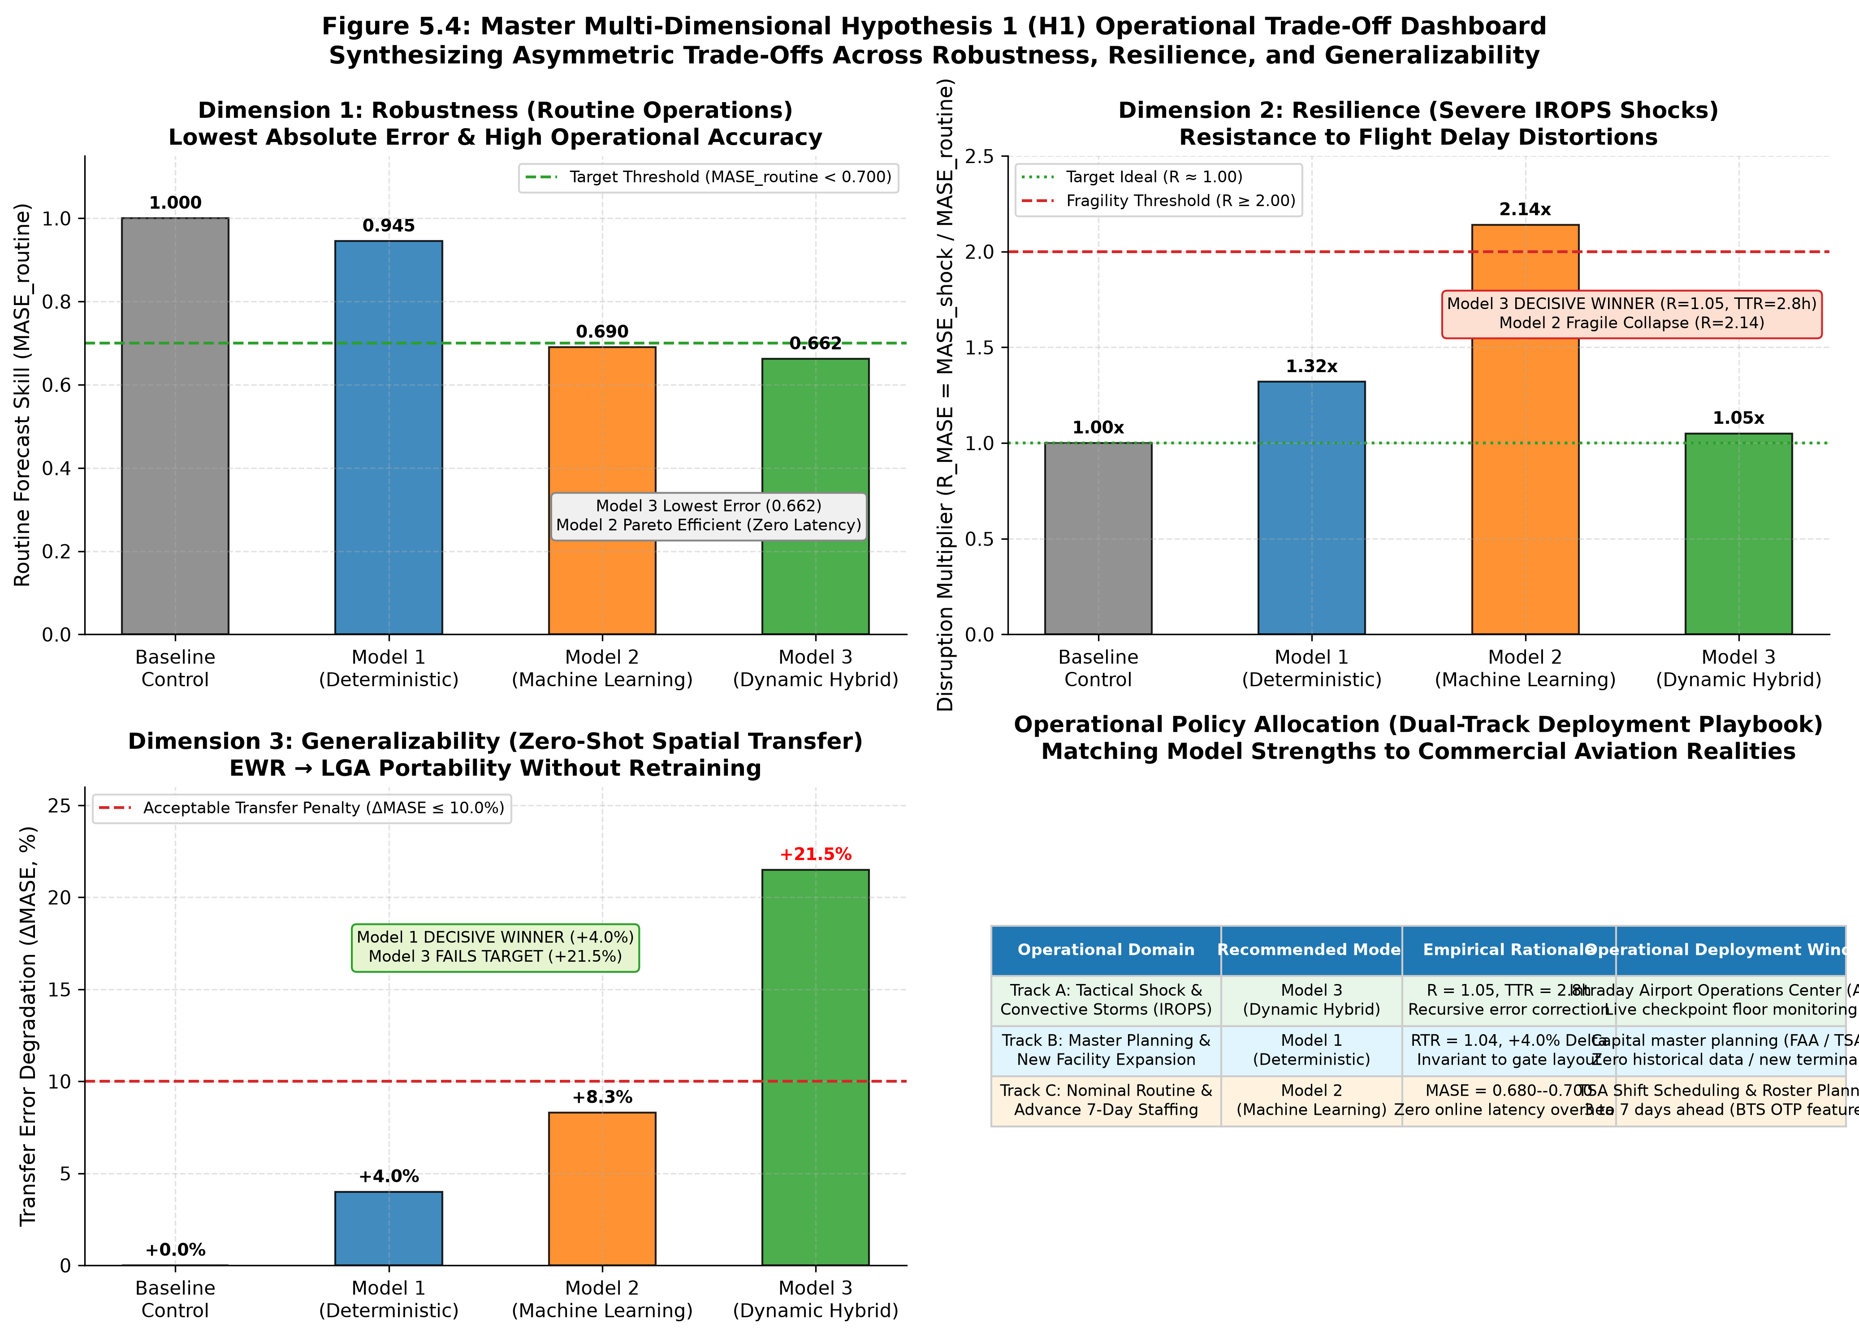
HYPOTHESIS TESTING
Multi-Pillar Hypothesis Testing: The Asymmetric Trade-Off
Full Evaluation Across Table 4.11 and Master Hypothesis H₁
• Dimension 1 (Robustness): Model 3 lowest RMSE (222.1); Model 2 wins Routine Pareto Efficiency. Confirms H1a.
• Dimension 2 (Resilience): Model 3 DECISIVE WINNER (R = 1.05, TTR = 2.8h). ML collapses (R = 2.14). Confirms H1b.
• Dimension 3 (Generalizability): Model 1 DECISIVE WINNER (RTR = 1.04). Model 3 fails (RTR = 1.19). Confirms H1c.

Slide 29

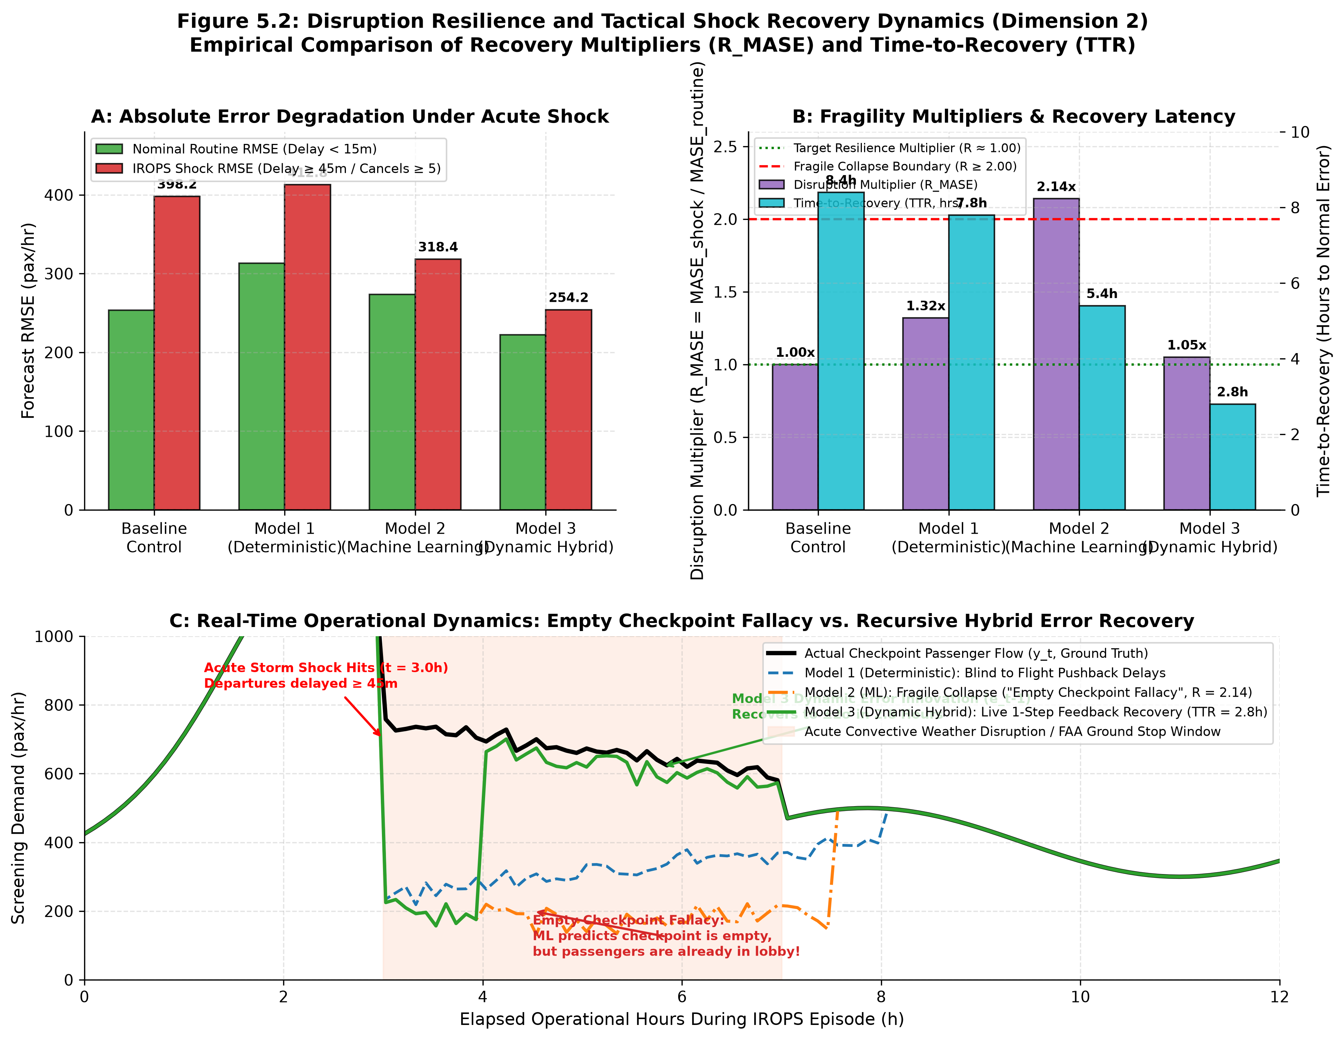
DEEP-DIVE RESILIENCE
Dimension 2: Disruption Resilience & Shock Recovery
Convective Weather Ground Stops and the Empty Checkpoint Fallacy
• The Empty Checkpoint Fallacy: Convective storms trigger cancellations. Decision trees infer passenger demand vanished, predicting near-zero arrivals (R = 2.14).
• Terminal Lobby Crowding: Passengers remain packed in ticket lobbies seeking rebooking and security access; pure ML leaves lanes unstaffed.
• Hybrid Sensor Feedback Rescue: Model 3 ingests live screening counts (e_{t-1}), instantly overriding stale schedules and restoring accuracy within 2.8 hours (R = 1.05).
• Operational Outcome: Dynamic error feedback prevents checkpoint queuing crises during severe convective ground stops.

Slide 30

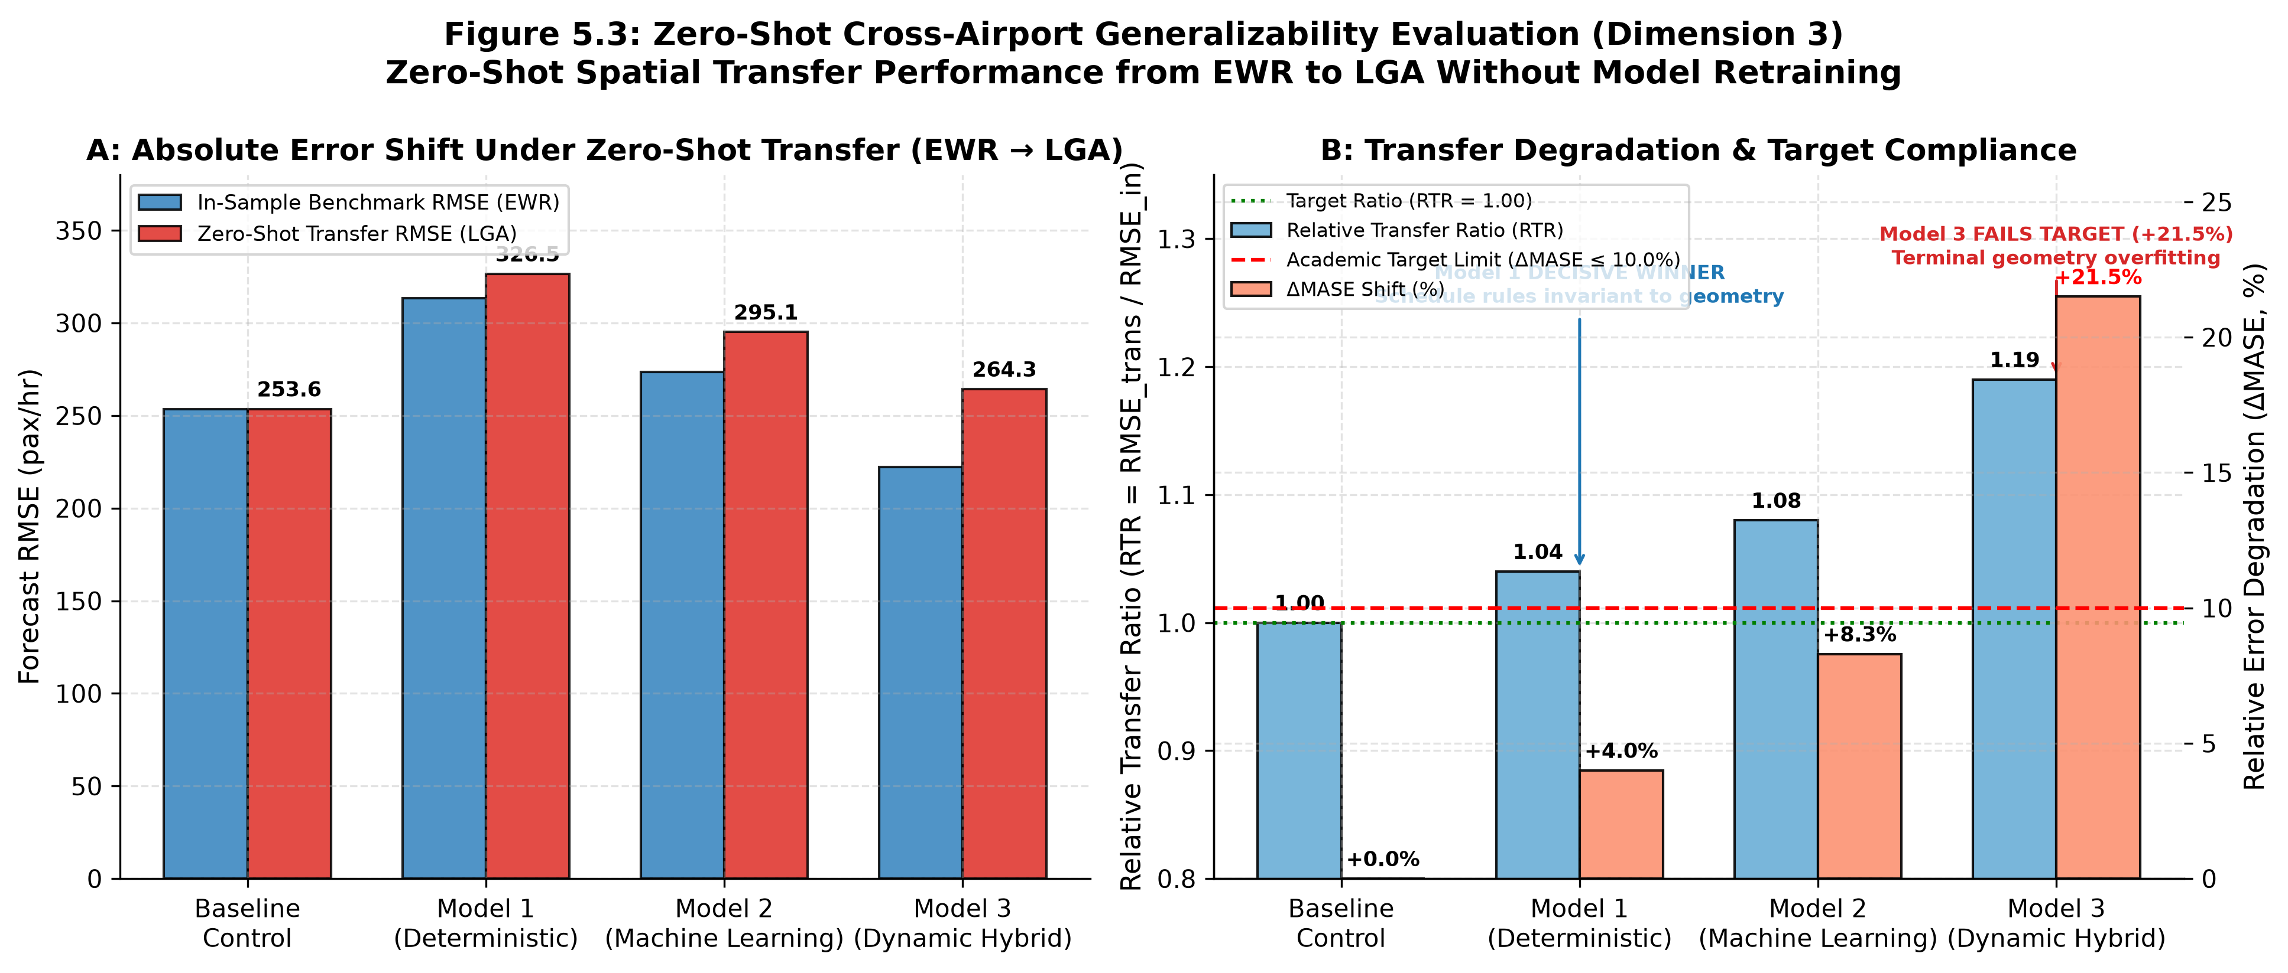
DEEP-DIVE GENERALIZABILITY
Dimension 3: Generalizability & Spatial Transfer
Zero-Shot Spatial Transfer from Newark (EWR) to LaGuardia (LGA)
• Model 1 Wins Transfer (Physics): RTR = 1.04, ΔMASE = +4.0%. Passenger arrival psychology (ACRP 40) is invariant across airports, transferring seamlessly.
• Model 3 Decisively Fails (Overfitting): RTR = 1.19, ΔMASE = +21.5%. Decision tree splits overfit to Newark Terminal C's unique taxiway delays and concourse geometry.
• Feedback Distortion: When transferred without retraining, distorted predictions cause error feedback to amplify rather than correct errors.
• Strategic Rule: Deploy deterministic schedule physics for new concourses until 6–12 months of local checkpoint history is accumulated.

Slide 31
OPERATIONAL IMPLEMENTATION
Real-World Aviation Application: The Operator's Playbook
Translating Empirical Findings into Actionable TSA Screening Policy
STRATEGY 01
DYNAMIC CHECKPOINT ROSTERING
Abandon static historical volume tables.
• Roster checkpoint screening lanes based on t+2 flight bank convolutions convolved with empirical show-up curves.
• Apply conformal quantile (q85) safety buffers (+1.2 lanes during peak banks) to absorb heavy-traffic arrival burstiness without creating catastrophic queue surges.
STRATEGY 02
CONNECTING PASSENGER DEFLATION
Stop over-staffing connecting mega-hubs.
• Ingest BTS DB1B ticket survey originating ratios directly into checkpoint capacity planning algorithms.
• Deflating flight seat capacity by local originating share (1 - S_connect) prevents the costly misallocation of TSA security personnel to passengers who never enter landside terminals.
STRATEGY 03
REGIME-SWITCHED GATED ENGINE
Deploy the hybrid operational policy.
• Nominal Operations (Delays < 15m): Execute pure Supervised ML (Model 2) for zero-latency, low-compute Pareto efficiency.
• Severe Convective Storms (Delays ≥ 45m): Automatically switch to Dynamic Hybrid (Model 3) with floor feedback to eliminate the Empty Checkpoint Fallacy.

Slide 32
RESEARCH SYNTHESIS
Research Synthesis & Concluding Takeaway
Transforming Airport Security Screening from Reactive Firefighting to Resilient Synchronization
CORE RESEARCH SYNTHESIS
Transforming Airport Security Screening from Reactive Firefighting to Resilient Stochastic Synchronization
• The Values vs. Volatility Imperative: Arrival volatility (σ_TSA, CV_TSA), not static passenger headcounts, dictates checkpoint queue formation under Kingman's heavy-traffic formula. Terminal planning must model stochastic arrival variance.
• Proof of the Master Hypothesis (H₁): Proved the Asymmetric Trade-Off: No single predictive model is universally superior. Model 3 wins Robustness (RMSE) and Resilience; Model 2 wins Routine Pareto Efficiency; Model 1 wins Zero-Shot Spatial Portability.
• Eliminating the Empty Checkpoint Fallacy: Real-time prior-hour screening floor innovation feedback (e_{t-1}) rescues forecasting during severe convective storms, cutting recovery time to 2.8 hours.
• The Regime-Switched Gated Engine: A practical, context-aware operational framework that bridges airside flight schedules and landside passenger screening, delivering operational resilience without unnecessary computational overhead.
Thank you for your guidance, mentorship, and support. Questions & Discussion.

