Slide 1
FUZZYLOGIC PROJECT
PRESENTATION
Failure analyzer Application

Slide 2
TABLE OF CONTENTS
About the Project
Project Stages
01
04
Project Goals
02
05
Flowchart of code and results
Major Requirements
03
06
Our Team
The steps we followed to create this work
Definition of fuzzy logic
Description of the Application
The objectives that we want to achieve
Different parts of code and simulation
The software chosen to realize the project
Team members of our group

Slide 3
ABOUT THE PROJECT
Fuzzy logic is a mathematical logic that deals with reasoning that is approximate rather than fixed and exact.
It is used to handle partial truth, where the truth value may range between completely true and false. In contrast, classical logic deals only with exact, binary true/false values.

Slide 4
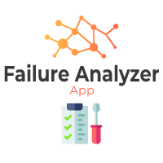
ABOUT THE PROJECT
Our idea is to create a fuzzy logic application that determines the industrial machine’s degree of failure.
The app can classify the failure as catastrophic, major, or minor, which can help in decision-making and scheduling maintenance

Slide 5
OUR GOALS
EXPANSION
EFFECIENCY
USABILITY
We want that our app can be upgraded in many ways
We want our application to work as it should, to define the failure degree
We want to create an easy-to-use application

Slide 6




MAJOR REQUIREMENTS
Python
Anaconda
Jupyter notebook
LyX
To write the code
To create the virtual environment
To write and execute the code in python
To write the report and the proposal

Slide 7
PROJECT STAGES
STEP 2
STEP 1
STEP 3
Code preparing and verifying results
Idea selecting and gatherin information
Designing an HTML web page for our interface

Slide 8
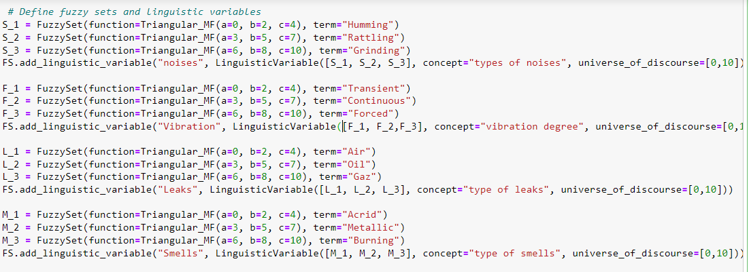


Flowchart of code

Slide 9
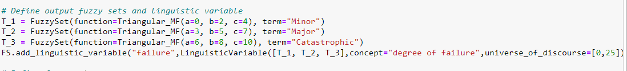
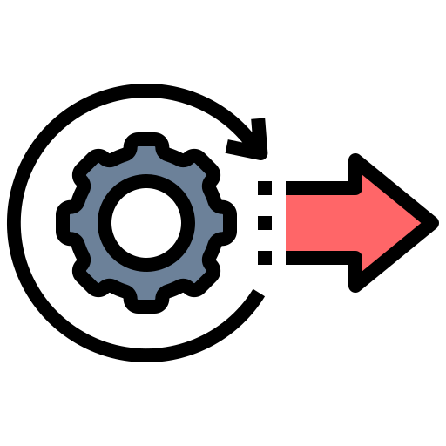
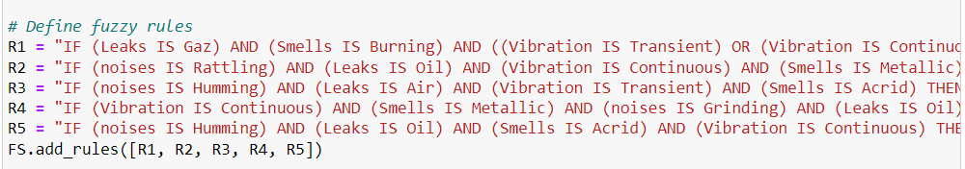
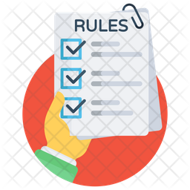
Flowchart of code
Define outputs
Rules List

Slide 10
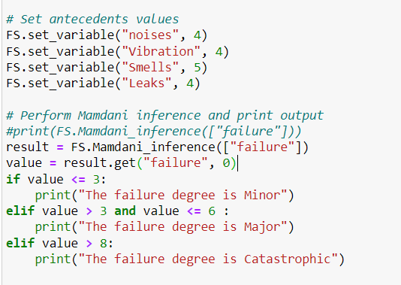
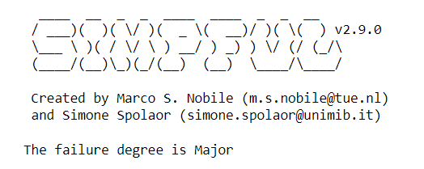
Flowchart of code

Slide 11



Our upgrade of the interface

Slide 12
Our upgrade of the interface
HEADER
TEXT
ICONS
SLIDER
This is the link to our webpage interface
C:\Users\megdiche leila\Documents\final.py

Slide 13
WHAT WE CAN WORK ON
SECURE
ACCESSIBLE
FAST AND RELIABLE
We wish to provide our app with a security system to preserve all the personal data
The possibility of linking the app with an HMI
We want to improve the processing of the app to become better

Slide 14
THE TEAM
Yosra Mechergui
Leila megdiche
Seif Eddine Khadhraoui

Slide 15
THANKS!
Does anyone have any questions?
addyourail@freepik.com

