Slide 1
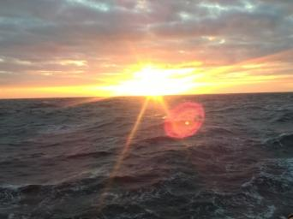
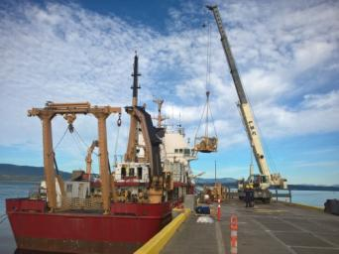
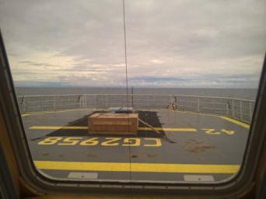
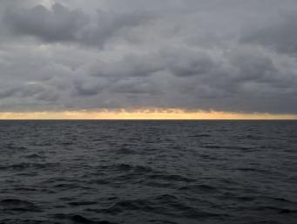
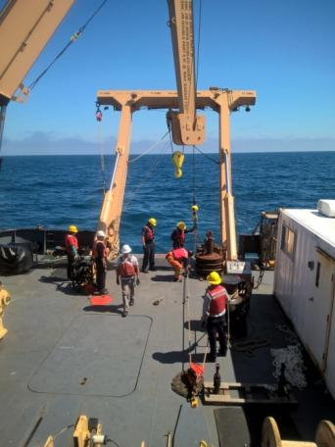
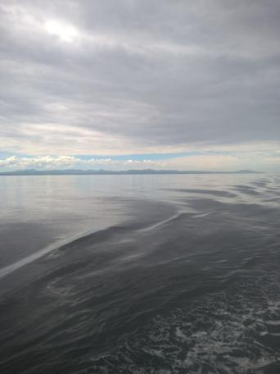
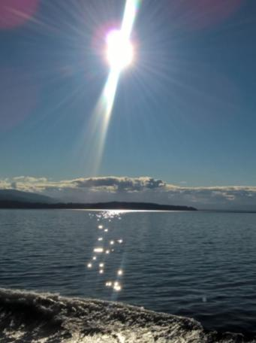
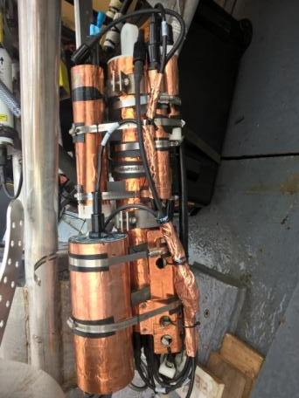
Cross-platform Comparison of Dissolved Oxygen data at Ocean Station Papa
Bo Yang
University of Washington

Slide 2
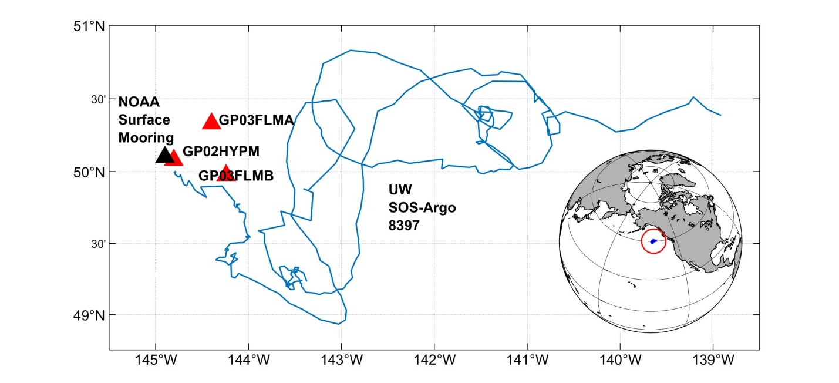
Ocean Station Papa
Pumped Aanderaa 4330 optode on NOAA surface mooring (5 m)
Aanderra 4831 on OOI GP03FLMA & GP03FLMA (30 m)

Slide 3

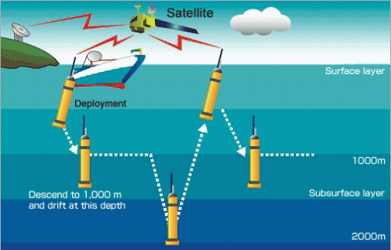
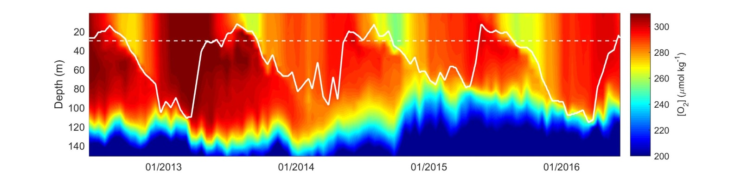
UW Special Oxygen Sensor Argo (SOS-Argo) with air calibration mechanism

Slide 4
OOI data availability

Slide 5
OOI data availability

Slide 6
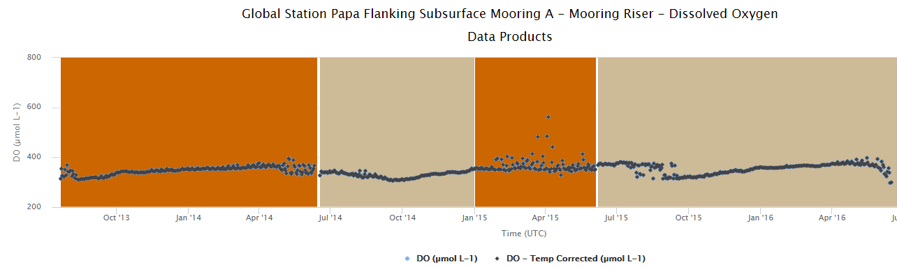
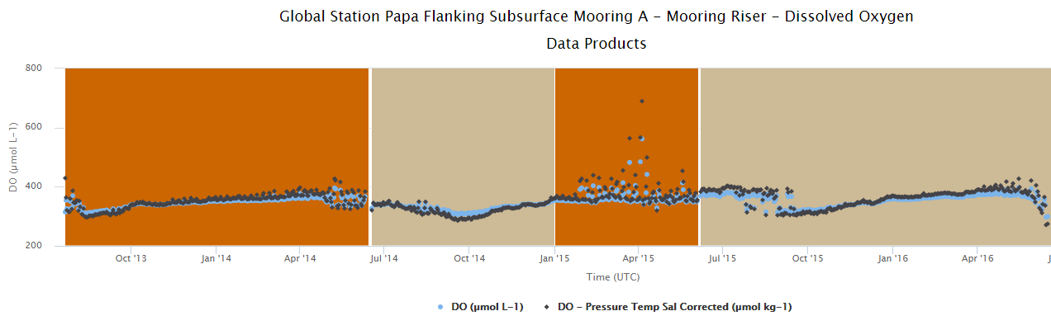
The GUI is a weird black box…

Slide 7
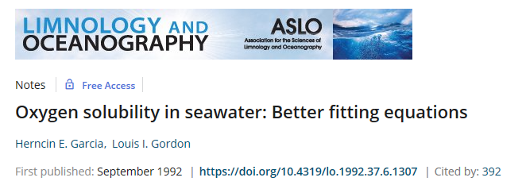
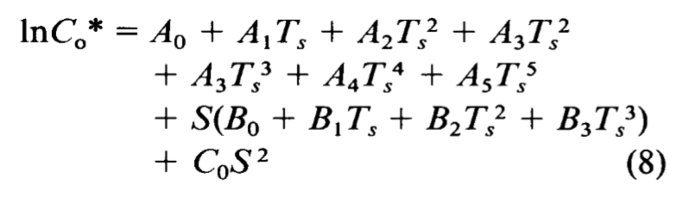
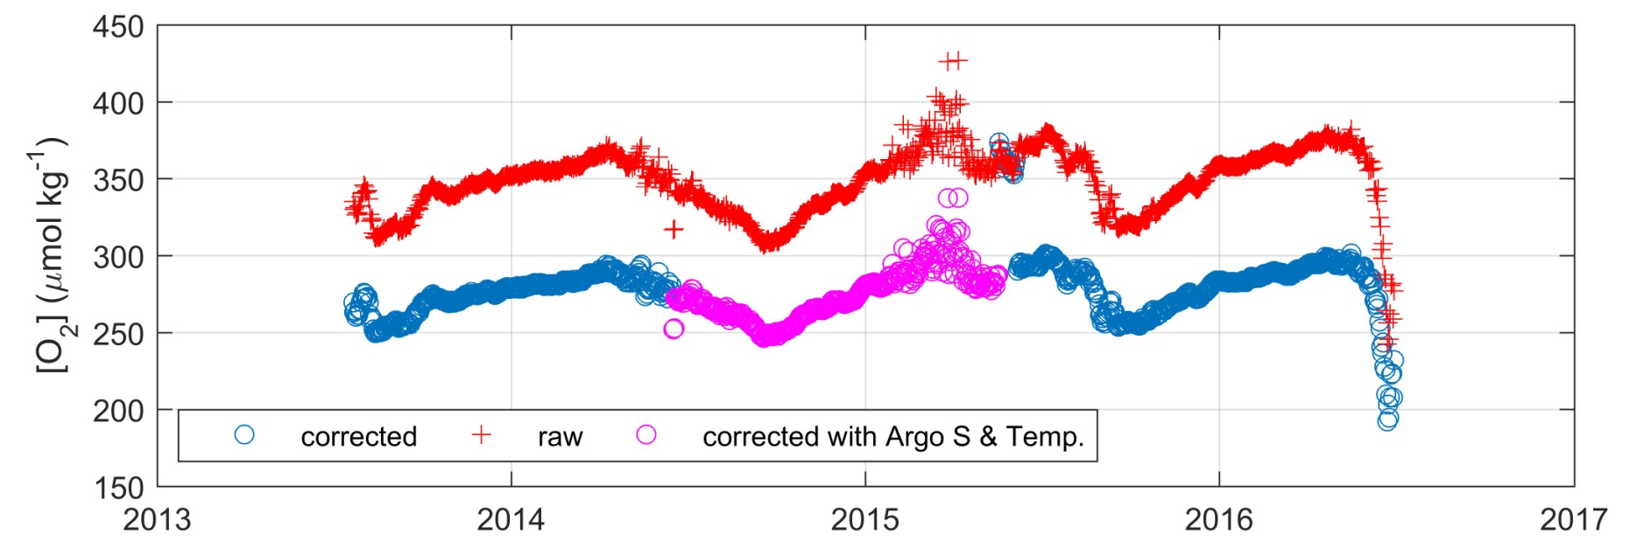
Salvage Mission
Temperature and salinity from UW SOS-Argo
+

Slide 8
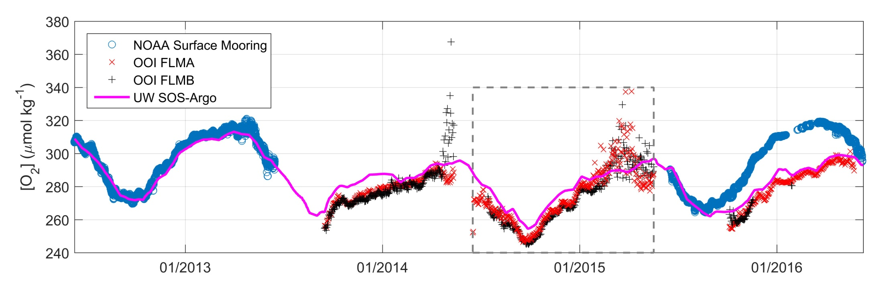
Comparison of oxygen data from 4 platforms

