Slide 1

Welcome to the 4TU Git Workshop

Slide 2
Program for today
10:00-12:30 – Unix shell
11:30-11:45- Break
12:30 – 13:30 – Lunch
13:30- 17:00 Git
14:30 – 14:45 Break I
15:45- 16:00 Break II
17:00 End of the workshop. Day 1

Slide 3
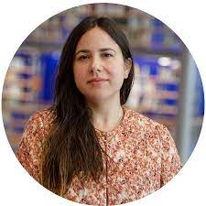
The team of the workshop
Instructor : Leila Inigo de la Cruz
Trainer at 4TU.ResearchData

Slide 4
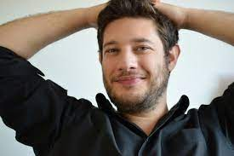
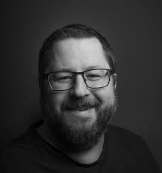
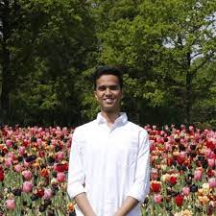
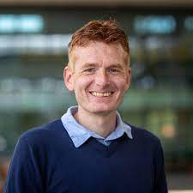
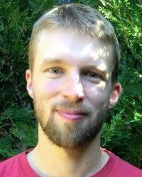
The team of the workshop
Helpers:

Slide 5
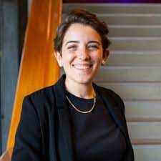
The team of the workshop
Host: Alessandra Soro
Community Manager at 4TU.ResearchData

Slide 6




The team of the workshop
YOU!

Slide 7
Code of conduct

Slide 8
Ice breaker
Write in the chat, the name of your university and what you like the most about it?

Slide 9
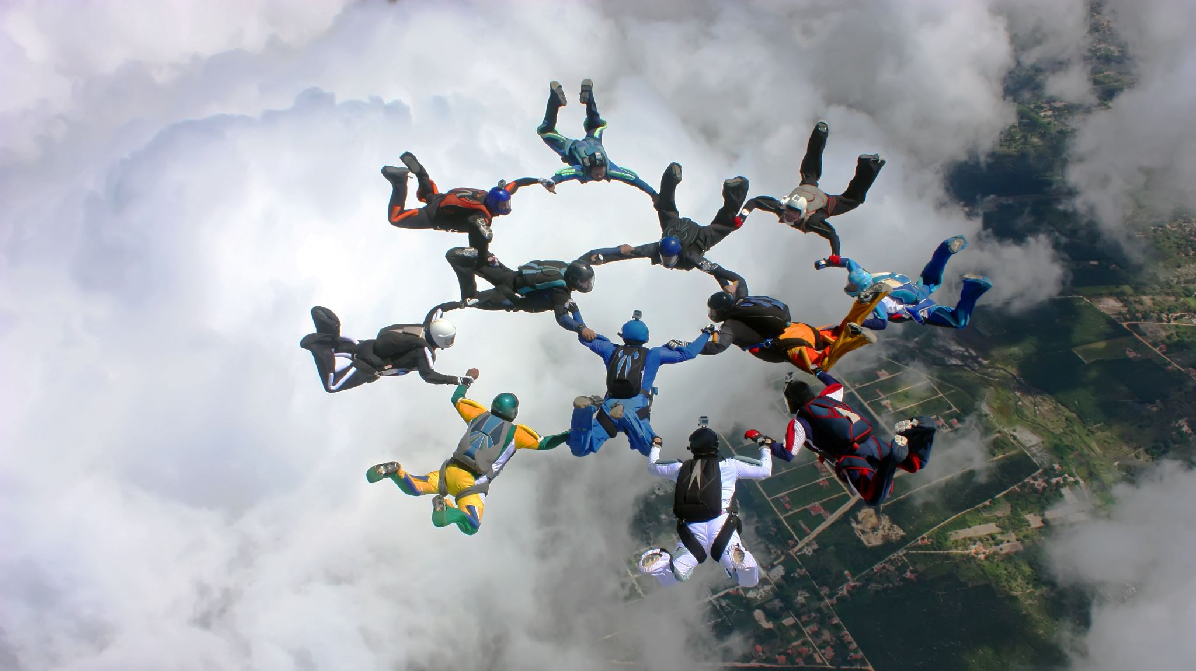
Enjoy!

