Slide 1

IIIF for Researchers in the Natural and Engineering Sciences
How the International Image Interoperability Framework is evolving from a cultural heritage standard into a practical research infrastructure for data-intensive science.

Slide 2

IIIF at 4TU.ResearchData
Since May 2025, 4TU.RD has been a production IIIF-enabled repository—built on the Djehuty Python backend. Three core components power the implementation:
IIIF Image API
IIIF Presentation API
On-demand delivery of image regions, thumbnails, and scaled resolutions—no full-file download required.
Structured manifests that describe datasets, sequences, and associated metadata for discovery and reuse.
Python Backend (Djehuty)
Native integration with the repository's API layer, enabling programmatic manifest generation and enrichment.

Slide 3
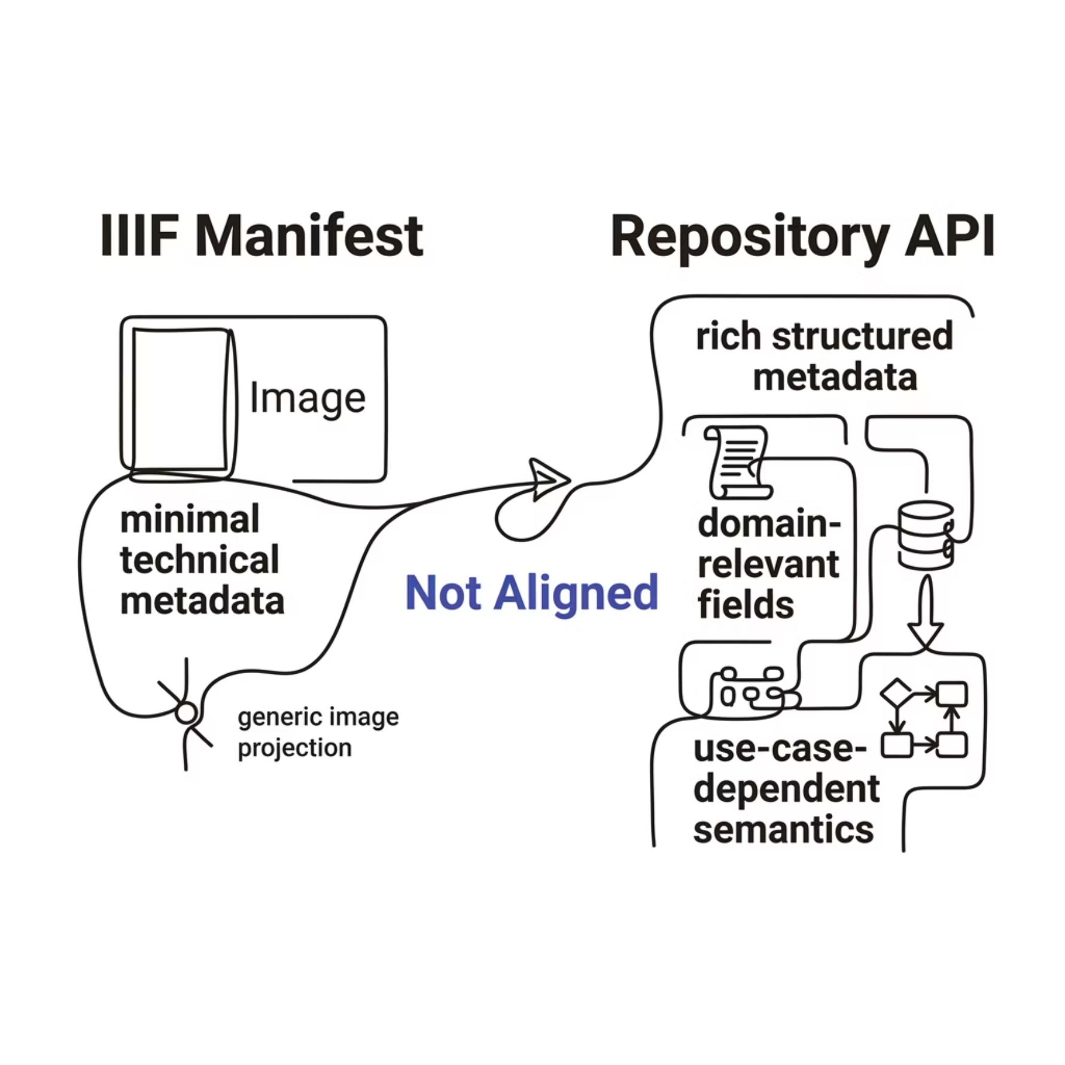

The Metadata Alignment Gap
Repository metadata is rich—but IIIF manifests don't reflect it. This misalignment limits downstream reuse.
These two layers are not aligned—repositories impose a single interpretation of what is "relevant," but relevance is use-case dependent.
What IIIF Manifests Expose
Minimal descriptive metadata
Technical image info only
Fixed, generic field projection
What the Repository API Offers
Rich, structured, domain-relevant metadata
Discipline-specific fields and semantics
Use-case-dependent relevance

Slide 4
Use Case 1: Enrich Manifests After Deposition
Static manifests cannot serve all reuse scenarios. Enabling post-deposition enrichment decouples metadata semantics from the repository's fixed projection.
User-Defined Projection
Late-Binding Semantics
Researchers inject domain-specific metadata fields at reuse time—not at deposition.
Metadata meaning is resolved when needed, not hardcoded at ingest.
Reproducible Pipelines
Decoupled Architecture
Enrichment logic is scriptable, versionable, and shareable across projects.
The repository serves raw manifests; enrichment happens externally without modifying the source.

Slide 5
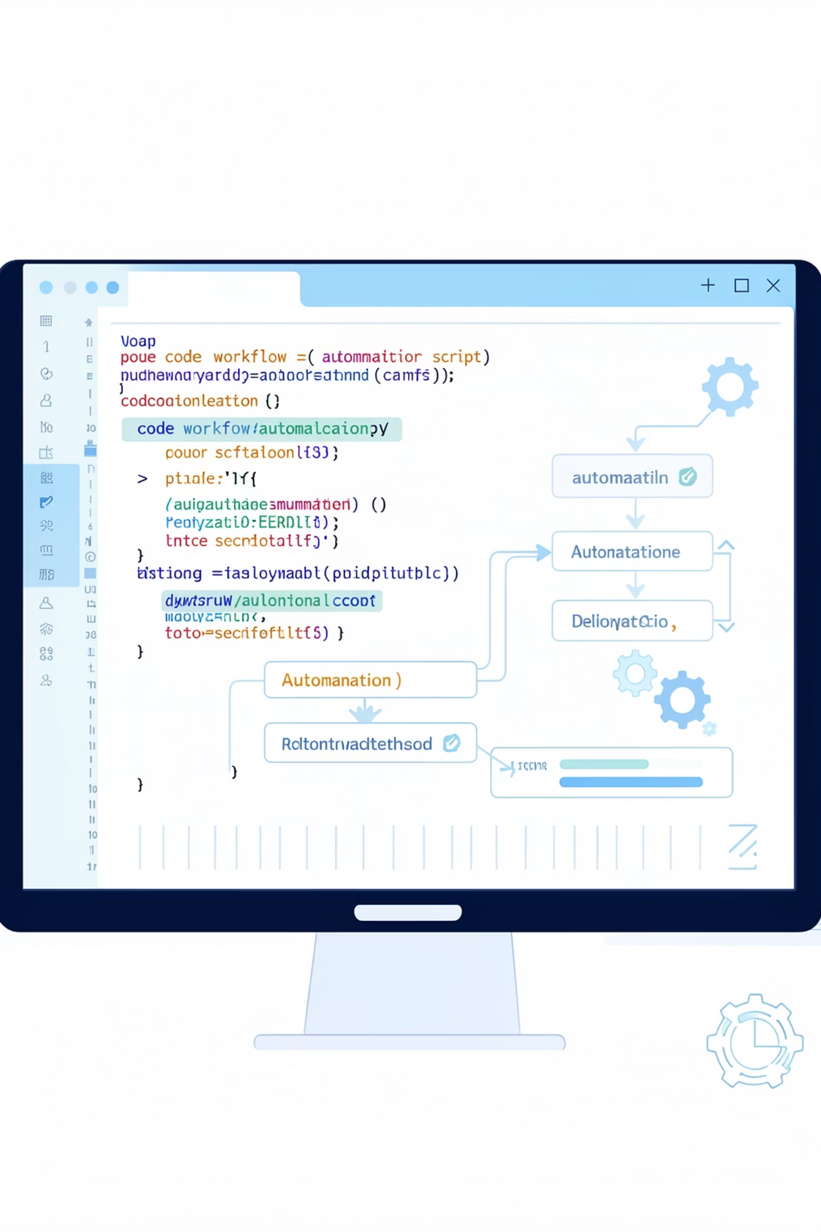
Workflow Demo: Manifest Enrichment in Action
A three-step process transforms a barebones IIIF manifest into a rich, domain-aware resource—without touching the original dataset.
API Request
1
Fetch the base manifest from 4TU.RD via the Presentation API.
Inject Metadata
2
Run a shell script that queries the repository API and merges domain-specific fields into the manifest.
Enriched Manifest
3
Output a fully enriched manifest ready for downstream tools, pipelines, or publication.

Slide 7
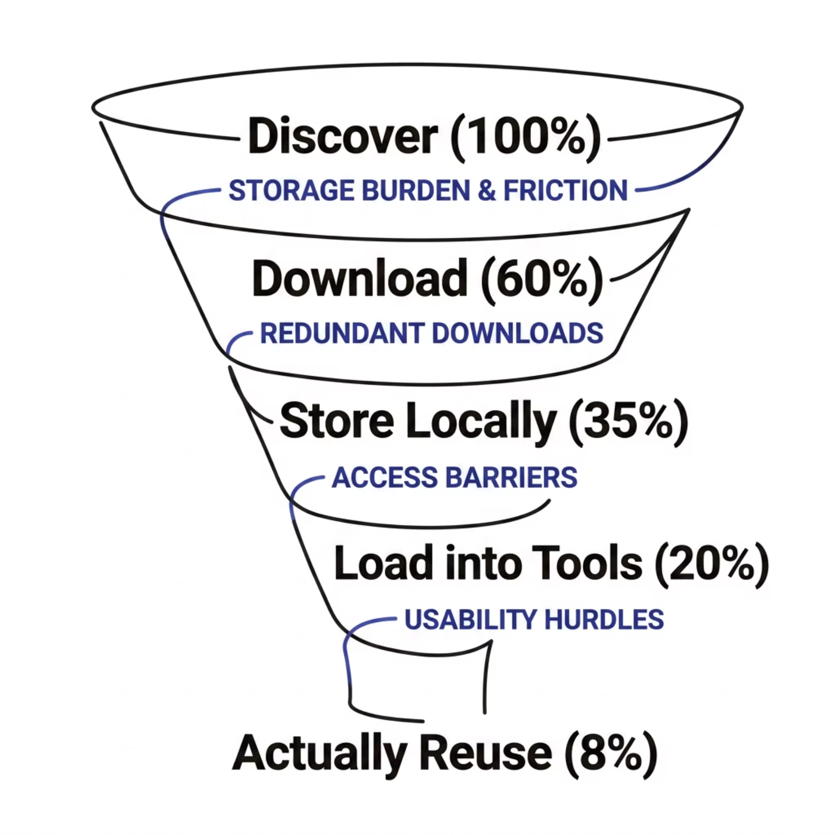
Use Case 2: The Download Barrier
Published image datasets are technically accessible but not operationally usable. The default workflow imposes a heavy tax on reuse:
Many datasets are never reused—not because they lack value, but because access is too heavy. Scientific images are often large, multi-resolution, and sparsely used, yet workflows treat them as monolithic files.
Discover dataset
Download files (GB–TB scale)
Store locally
4
Load into analysis tools
1
2
3

Slide 8
IIIF-Enabled On-the-Fly Image Analysis
Core idea: Image data is accessible but not computationally accessible. IIIF turns images into queryable resources—enabling analysis without download.
Partial Data Access
Direct Pipeline Integration
Cloud-Native Execution
Request thumbnails, regions (xywh), or downsampled images via the Image API. Retrieve only what is needed—no over-fetching.
Fetch image → convert to NumPy array → analyze. No intermediate storage. IIIF becomes a data access layer for computation, not just viewing.
Analysis happens in-memory, on-demand. Enables lightweight workflows in Binder, Jupyter notebooks, and distributed compute environments.

Slide 9
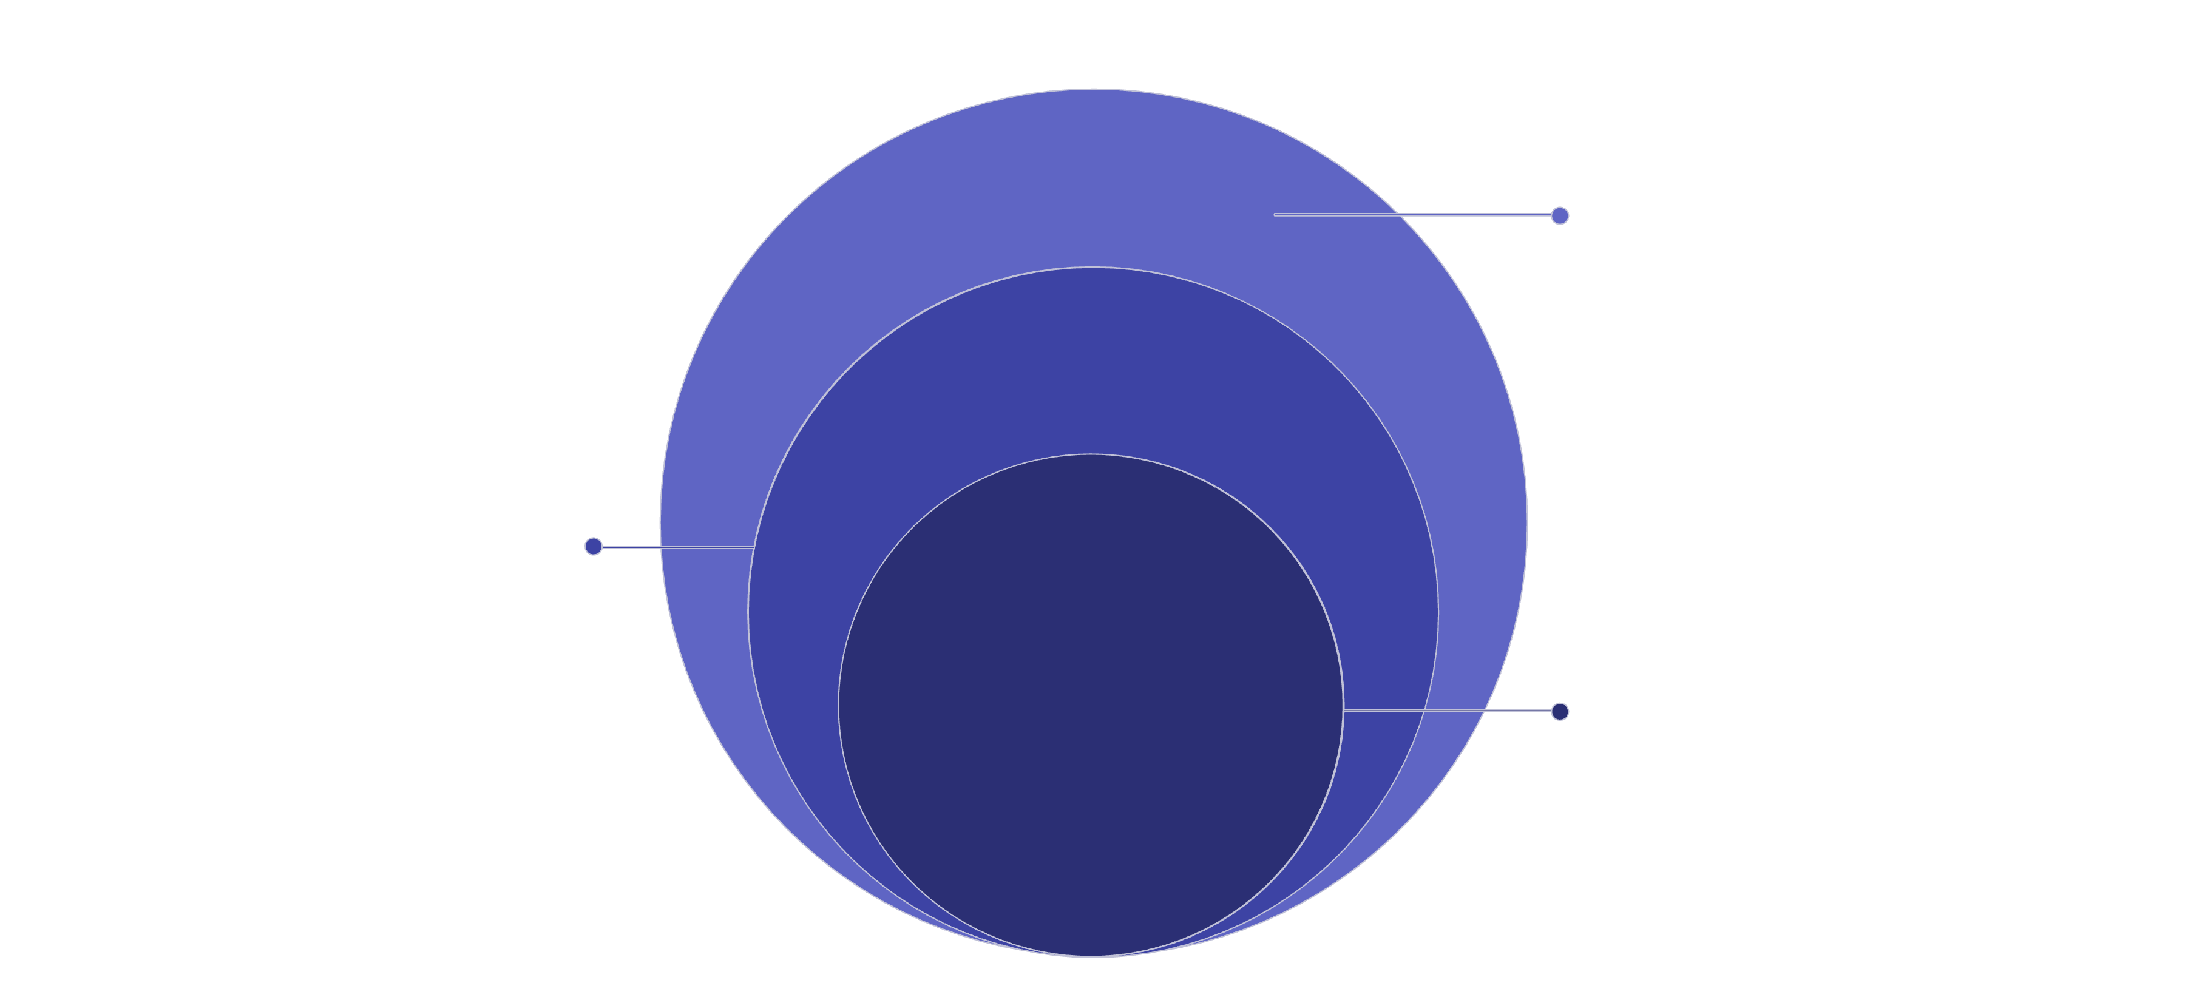
From Workflows to Services
The shift from manual download workflows to a service-oriented architecture transforms how researchers interact with image data—IIIF APIs become the connective tissue between discovery and computation.
IIIF APIs & Data
Image & Presentation APIs, repository files
Service Layer
Manifest builder, enrichment, analysis
Researcher
Notebooks, tools, and pipelines
Each layer communicates through standard IIIF interfaces, enabling modular, replaceable components. Researchers never touch raw storage directly—the service layer abstracts complexity while preserving reproducibility.

Slide 10

Performance Challenges
Streaming image analysis at scale introduces real infrastructure demands. Naive implementations will bottleneck under research workloads.
High Request Frequency
Analysis pipelines may issue thousands of region requests per session—requiring connection pooling and rate-limit awareness.
Large Image Sizes
Scientific images (GB–TB scale) demand tile-based delivery and aggressive downsampling strategies to remain responsive.
Dynamic Manifest Overhead
Enriched manifests generated on-the-fly add latency; pre-computation and invalidation strategies are essential.
API Latency
End-to-end latency compounds across pipeline stages. Caching at multiple layers—CDN, application, and in-memory—is non-optional.

Slide 11
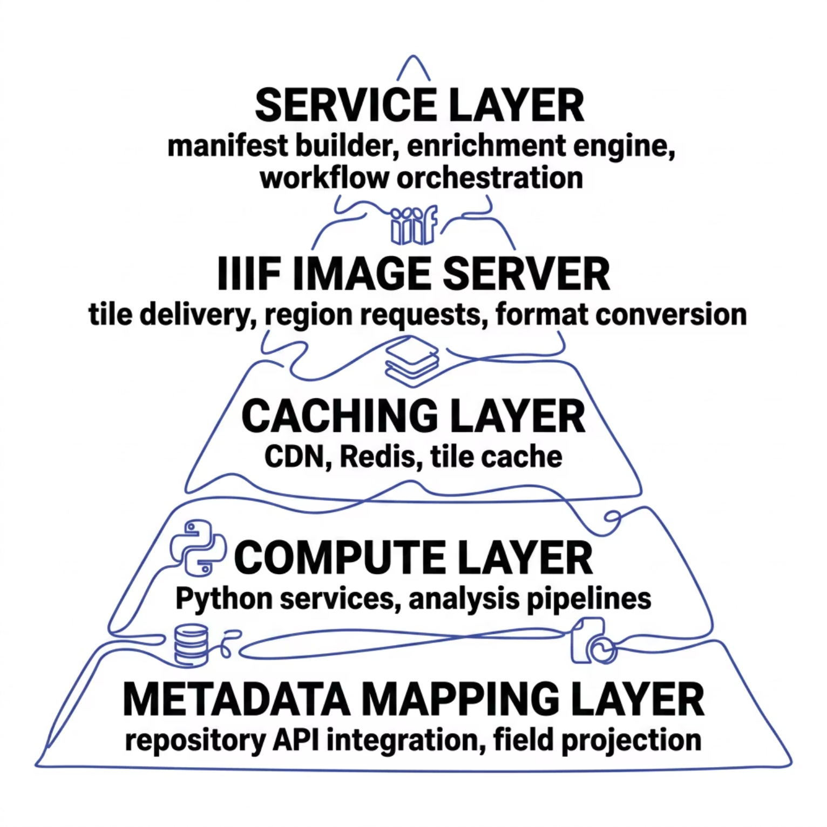


Infrastructure Requirements
A production-grade IIIF research infrastructure requires five coordinated layers—each addressable independently, but most powerful when integrated.
Key Takeaways
IIIF is ready for natural and engineering sciences—but requires intentional architecture
Metadata enrichment decouples repository constraints from reuse workflows
On-the-fly analysis eliminates the download barrier for large image datasets
Performance at scale demands caching, tiling, and service-layer abstraction
Next step: Pilot the enrichment workflow with a domain-specific dataset and measure reuse impact.

