Slide 1
Predicting Essential Genes in Different Genetic Backgrounds

Slide 2
Existing methods for the prediction of essential genes
Many of the methods are related to developing new thepeutic appraoches based on synthetic lethality
Gene A
Gene a
Gene B
Gene B
Healthy Cell
Cancer Cell

Slide 3
Existing methods for the prediction of essential genes
Many of the methods are related to developing new thepeutic appraoches based on synthetic lethality
Drug Targeting
Drug Targeting
Gene A
Gene a
Gene B
Gene B
Healthy Cell
Cancer Cell

Slide 4
Existing methods for the prediction of essential genes
Many of the methods are related to developing new thepeutic appraoches based on synthetic lethality
Cell Survives
Cell Dies
Drug Targeting
Drug Targeting
Gene A
Gene a
Gene B
Gene B
Healthy Cell
Cancer Cell

Slide 5
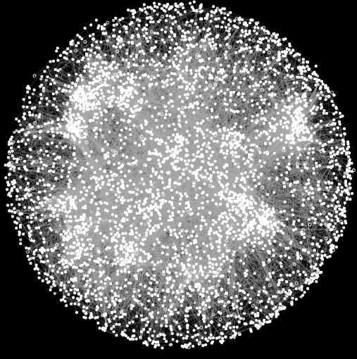
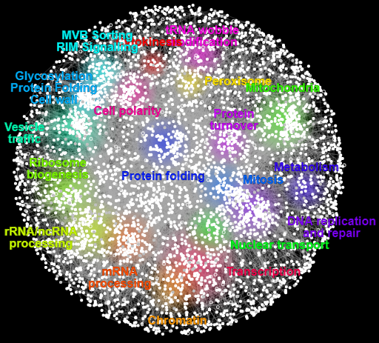
Existing methods for the prediction of essential genes
Current approaches are mostly oriented towards finding ‘missing’ genetic interactions
(Where ‘missing’ refers to those that have not been found by experimental methods)
Machine Learning Algorithm
Known network features
(including known SL/Essential genes)
New Essential Genes

Slide 6
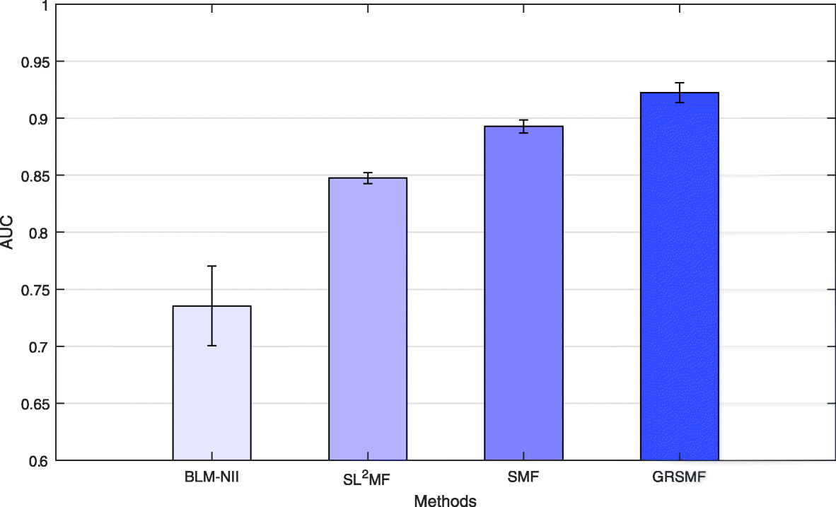
Existing methods for the prediction of essential genes
Such methods seem to have some success
Higher AUROC indicates better performance
(AUROC = Area Under the Receiving Operator Characteristics curve)
Huang, J., Wu, M., Lu, F. et al. Predicting synthetic lethal interactions in human cancers using graph regularized self-representative matrix factorization. BMC Bioinformatics 20, 657 (2019).

Slide 7
What we want to do
How does essentiality/syntetic lethality depend on genetic backgound?
Single gene deletion case
Non-essential
Non-essential
Gene A
Gene B

Slide 8
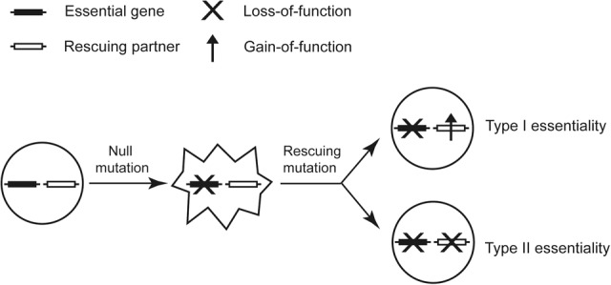
What we want to do
How does essentiality/syntetic lethality depend on genetic backgound?
Single gene deletion case
Non-essential
Essential
Gene A
Gene B
Chen P, Wang D, Chen H, Zhou Z, He X. The nonessentiality of essential genes in yeast provides therapeutic insights into a human disease. Genome Res. 2016;26(10):1355‐1362. doi:10.1101/gr.205955.116

Slide 9
What we want to do
How does essentiality/syntetic lethality depend on genetic backgound?
Single gene deletion case
Non-essential
Essential
Gene A
Gene B
SL due to redundant functions
Chen P, Wang D, Chen H, Zhou Z, He X. The nonessentiality of essential genes in yeast provides therapeutic insights into a human disease. Genome Res. 2016;26(10):1355‐1362. doi:10.1101/gr.205955.116

Slide 10
What we want to do
How does essentiality/syntetic lethality depend on genetic backgound?
Single gene deletion case
Non-essential
Essential
Gene A
Gene B

Slide 11
What we want to do
How does essentiality/syntetic lethality depend on genetic backgound?
Single gene deletion case
Non-essential
Non-essential
Gene A
Gene B
Chen P, Wang D, Chen H, Zhou Z, He X. The nonessentiality of essential genes in yeast provides therapeutic insights into a human disease. Genome Res. 2016;26(10):1355‐1362. doi:10.1101/gr.205955.116
Change in letality due to toxin accumulation

Slide 12
What we want to do
How does essentiality/syntetic lethality depend on genetic backgound?
Need to distinguish between these two different types?
(essentiality of genes involved in non-dispensable cell functions seems most interesting)
Chen P, Wang D, Chen H, Zhou Z, He X. The nonessentiality of essential genes in yeast provides therapeutic insights into a human disease. Genome Res. 2016;26(10):1355‐1362. doi:10.1101/gr.205955.116

Slide 13
What we want to do
How does essentiality/syntetic lethality depend on genetic backgound?
Three genes involved
Non-essential
Non-essential
Gene A
SL-interaction
Gene B

Slide 14
What we want to do
How does essentiality/syntetic lethality depend on genetic backgound?
Three genes involved
Non-essential
Non-essential
Gene A
SL-interaction
Gene B
?
How does presence/absence of gene C affect the SL interaction between Gene A and Gene B?
Gene C

Slide 15
Example from polarity
Based on interactions from SGD
Non-essential
Non-essential
BEM1
SL-interaction
BEM2

Slide 16
Example from polarity
Non-essential
Essential
BEM1
SL-interaction
BEM2

Slide 17
Example from polarity
Non-essential
Non-essential
BEM1
SL-interaction
BEM2
BEM3

Slide 18
Example from polarity
Non-essential
Essential
BEM1
SL-interaction
BEM2
BEM3

Slide 19
Example from polarity
Non-essential
Non-essential
BEM1
SL-interaction
BEM2
BEM3

Slide 20
Example from polarity
Requires not only predicting current interactions, but also how interactions change in different backgrounds
Non-essential
Non-essential
BEM1
SL-interaction
BEM2
BEM3

Slide 21
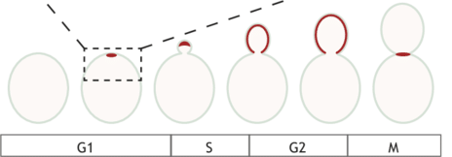
Suggestion: Start with a focus on cell polarity
Vendel et al. (2019). Minimal in vitro systems shed light on cell polarity. Journal of Cell Science. 132. jcs217554. 10.1242/jcs.217554

Slide 22
Suggestion: Start with a focus on cell polarity
Then:
We are sure that essentiality is linked to a cellular function that is not dispensable
We have a better overview of how protein function is related to the phenotype (and we can maybe use phenotype data)
We can compare networks across different species of budding yeasts
Vendel et al. (2019). Minimal in vitro systems shed light on cell polarity. Journal of Cell Science. 132. jcs217554. 10.1242/jcs.217554

