Slide 1
Flower Store Website Design
Leila Ghanbarinejad

Slide 2
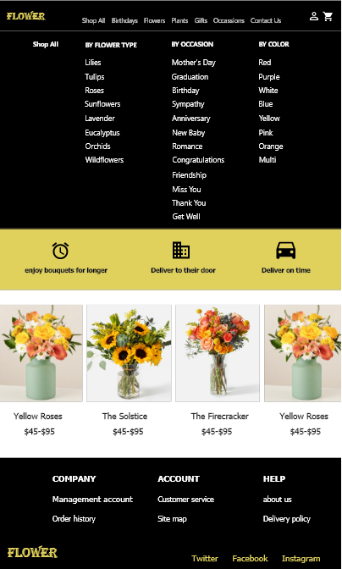
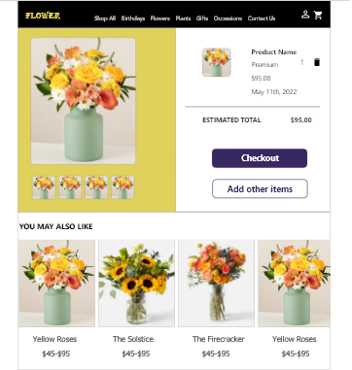
Project overview
The product:
Flower store strives to deliver fresh and beautiful flowers to customers. The typical user is between 18-60 years old, and most users are college students or career professionals. Flower store goal is to make shopping fun, fast, and easy for all types of users.
Project duration:
April 2022 to may 2022

Slide 3
Project overview
The problem:
Available online shopping websites have cluttered designs, inefficient systems for browsing through products, and confusing checkout processes.
The goal:
Design a flower store website to be user friendly by providing clear navigation and offering a fast checkout process.

Slide 4
Project overview
My role:
UX designer leading the flower store website design
Responsibilities:
Conducting interviews, paper and digital wireframing, low and high-fidelity prototyping, conducting usability studies, accounting for accessibility, iterating on designs and responsive design.

Slide 5
User research
Personas
Problem statements
User journey maps
Understanding
the user

Slide 6
User research: summary
I conducted user interviews, which I then turned into empathy maps to better understand the target user and their needs. I discovered that many target users treat online flower shopping when they want to send their love to their beloved ones and do not have time to go in person or are far from them. However, many shopping websites are overwhelming and confusing to navigate, which frustrated many target users. This caused their exciting experience to become challenging for them and prevent them from doing it as a continuous activity.

Slide 7
User research: pain points
1
2
3
Navigation
Interaction
Experience
Shopping website designs are often busy, which results in confusing navigation
Small buttons on shopping websites make item selection difficult, which sometimes leads users to make mistakes
Online shopping websites don’t provide an engaging browsing experience

Slide 8
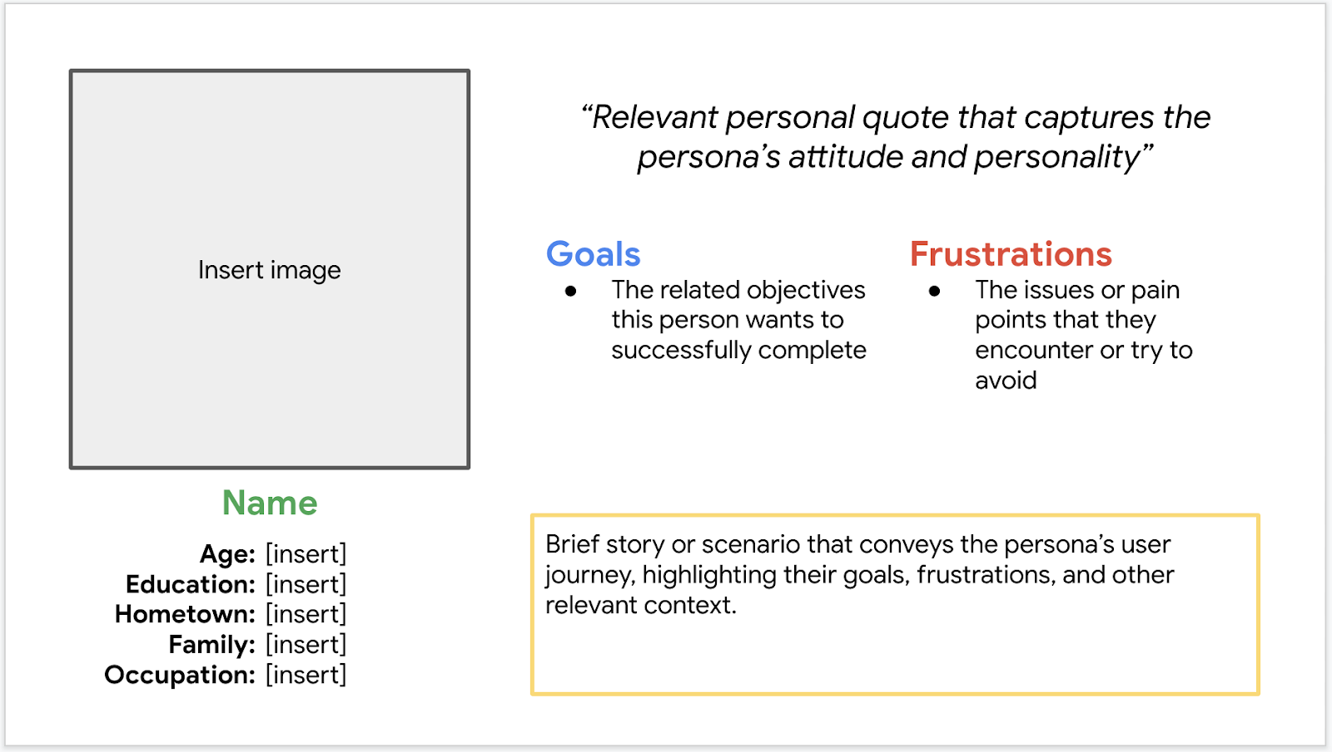
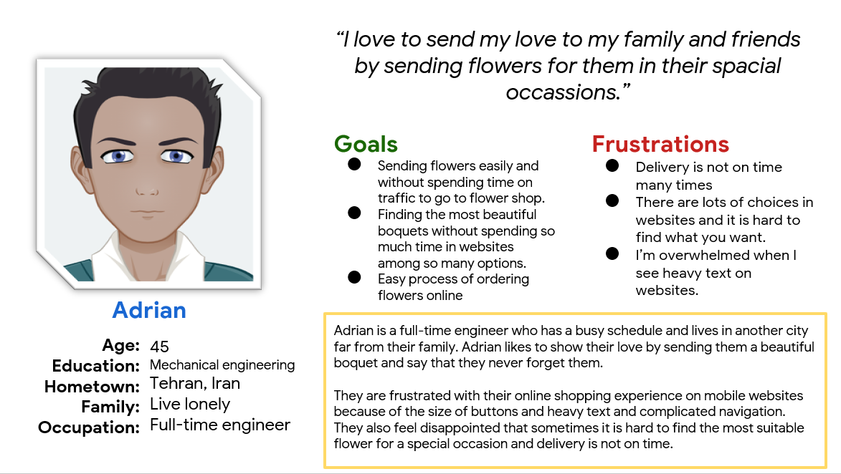
Persona: Name
Problem statement:
Adrian is a full-time engineer who needs to easily order flowers online because they are far from their beloved ones and wants to show them their love in their spacial occassions.

Slide 9
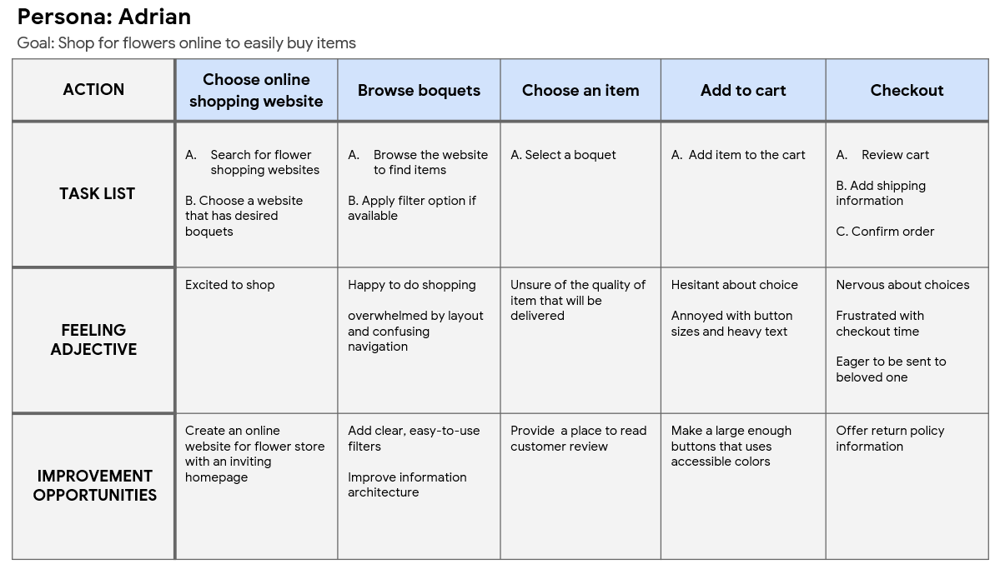
User journey map
I created a user journey map of Adrian’s experience using the site to help identify possible pain points and improvement opportunities.

Slide 10
Sitemap
Digital wireframes
Low-fidelity prototype
Usability studies
Starting
the design

Slide 11
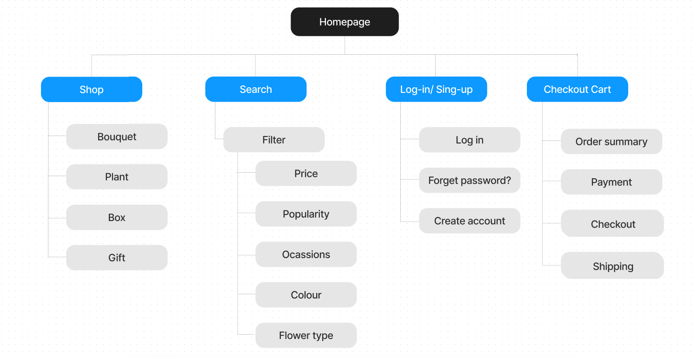
Sitemap
Difficulty with website navigation was a primary pain point for users, so I used that knowledge to create a sitemap.
My goal here was to make strategic information architecture decisions that would improve overall website navigation. The structure I chose was designed to make things simple and easy.

Slide 12
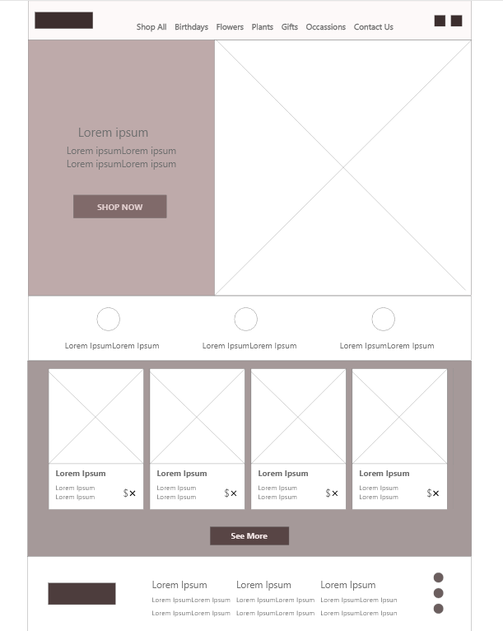
Digital wireframes
Homepage is optimized for easy browsing through the classification of products to access easily to want they’re looking for
Moving from paper to digital wireframes made it easy to understand how the redesign could help address user pain points and improve the user experience.
Prioritizing useful button locations and visual element placement on the home page was a key part of my strategy.
Easy access to shop products

Slide 13

Digital wireframe
screen size variation(s)

Slide 14
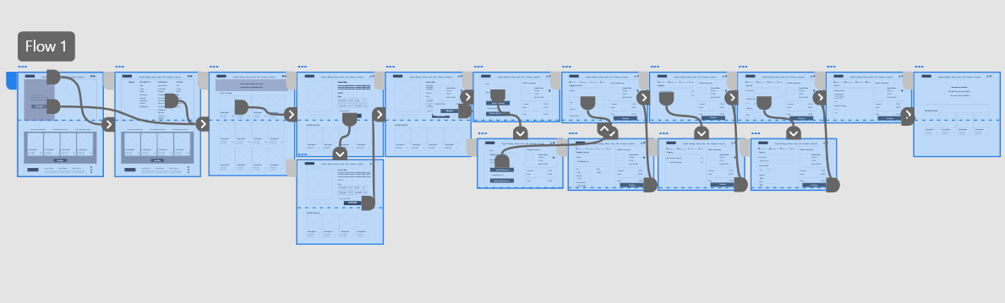
Low-fidelity prototype
To create a low-fidelity prototype, I connected all of the screens involved in the primary user flow of adding an item to the cart and checking out.

Slide 15
Usability study: parameters
Study type:
moderated usability study
Location:
Iran, in person
Participants:
5 participants
Length:
30-60 minutes

Slide 16
Usability study: findings
Insert a one to two sentence introduction to the findings shared below.
1
2
3
Cart
Checkout
Delivery
Users wanted to be able to edit their choices or add to their items before they enter to checkout process
Users needed to have access to an option to checkout without signing in or creating an account
Users wanted to choose their delivery date from a calendar

Slide 17
Refining
the design
Mockups
High-fidelity prototype
Accessibility

Slide 18
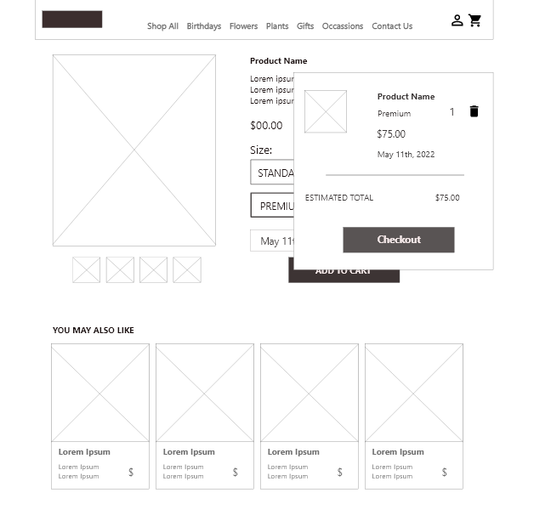
Mockups
Based on the insights from the usability study, I made changes to improve the site’s checkout flow. One of the changes I made was adding the option to edit items or add to them in a user’s cart using an extra button. This allowed users more freedom to edit their cart without going through a complicated process to add or remove items.
Before usability study
After usability study

Slide 19
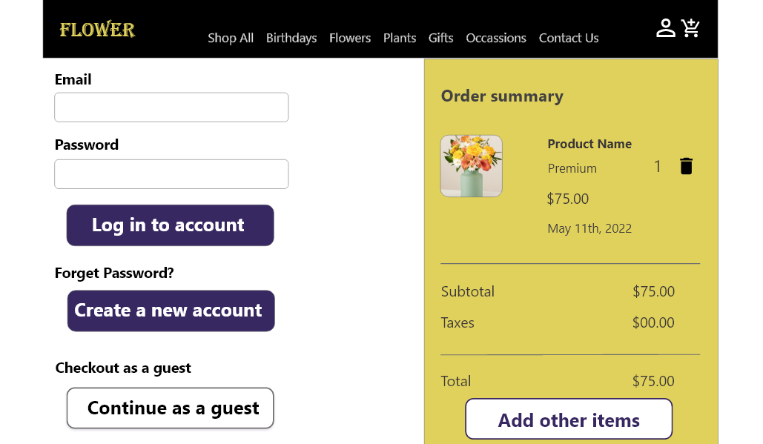
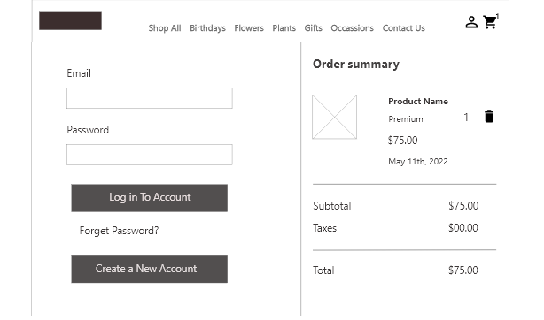
Mockups
To make the checkout flow even easier for users, I added an option that allowed users to checkout as a guest and create an account after
Before usability study
After usability study

Slide 20
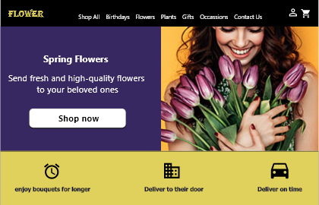
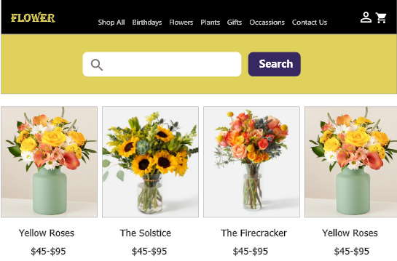
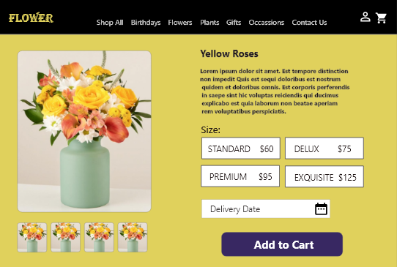
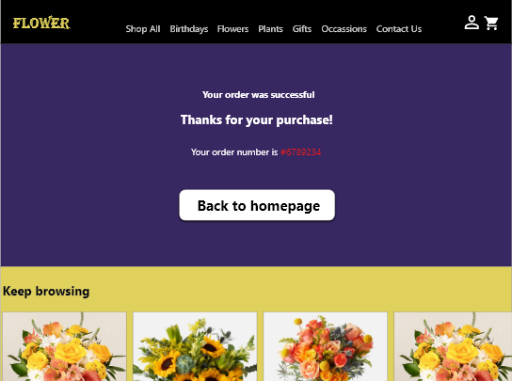
Mockups: Original screen size

Slide 21
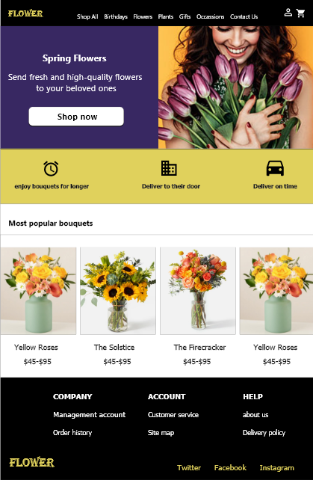
Mockups: Screen size variations
I included considerations for additional screen sizes in my mockups based on my earlier wireframes. Because users shop from a variety of devices, I felt it was important to optimize the browsing experience for a range of device sizes, such as mobile and tablet so users have the smoothest experience possible.

Slide 22
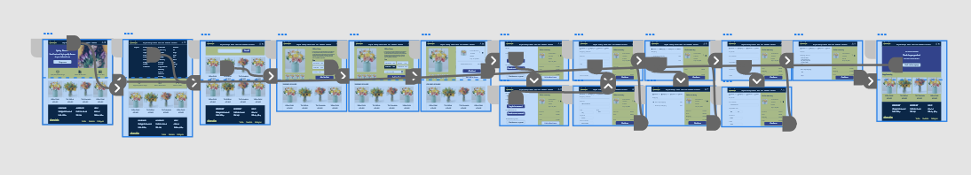
High-fidelity prototype
My hi-fi prototype followed the same user flow as the lo-fi prototype, and included the design changes made after the usability study.

Slide 23
Accessibility considerations
1
2
I used headings with different sized text for clear visual hierarchy
Clear labels for interactive elements that can be read by screen readers.

Slide 24
Going forward
Takeaways
Next steps

Slide 25
Takeaways
Impact:
Our target users shared that the design was intuitive to navigate through, more engaging with the images, and demonstrated a clear visual hierarchy.
What I learned:
I learned that even a small design change can have a huge impact on the user experience. The most important takeaway for me is to always focus on the real needs of the user when coming up with design ideas and solutions.

Slide 26
Next steps
1
2
Conduct follow-up usability testing on the new website
Identify any additional areas of need and ideate on new features

