Slide 1
An Ordering App Design for a Restaurant
Leila Ghanbarinejad

Slide 2
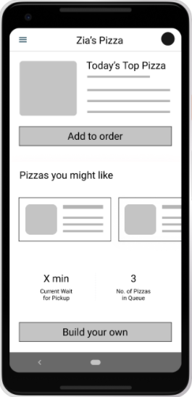
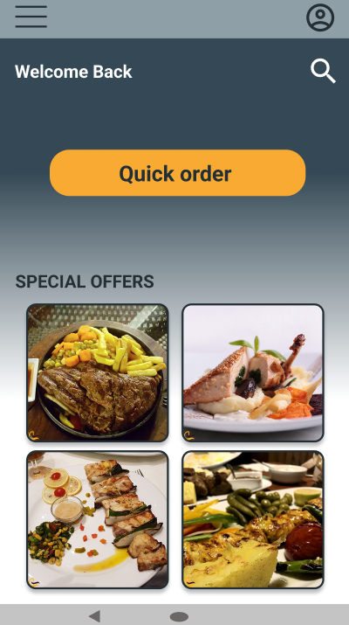
Project overview
The product:
We’re creating an ordering app for a restaurant to help people order food easily and quickly, and target customers are people who lack the time or ability to prepare a family meal.
Project duration:
September 2021 to March 2022.

Slide 3
Project overview
The problem:
Some people have busy schedule or lack the ability to prepare a meal.
The goal:
Design a mobile app for the restaurant that allows users to easily order their food. We like to understand what specific challenges our users might face in the ordering process and how we can help them fix these challenges.

Slide 4
Project overview
My role:
UX designer designing an app for the restaurant from conception to delivery.
Responsibilities:
Conducting interviews, paper and digital wireframing, low and high-fidelity prototyping, conducting usability studies, accounting for accessibility, and iterating on designs.

Slide 5
User research
Personas
Problem statements
User journey maps
Understanding
the user

Slide 6
User research: summary
I conducted interviews and created empathy maps to understand the users I’m
designing for and their needs. A primary user group identified through research
was adults who have less ability to cook.
Although this user group had presumed problem, research
also revealed that physical ability was not the only factor limiting users from cooking at home.
Other user needs was to have more time for leisure activity, family time and rest.

Slide 7
User research: pain points
1
2
3
Physical ability
Accessibity
Time
Many adults have less energya and physical ability to prepare meal on their own.
Many adults are not comfortable with technology to use.
Preparing food is time-consuming and waste the time for family time and rest.

Slide 8
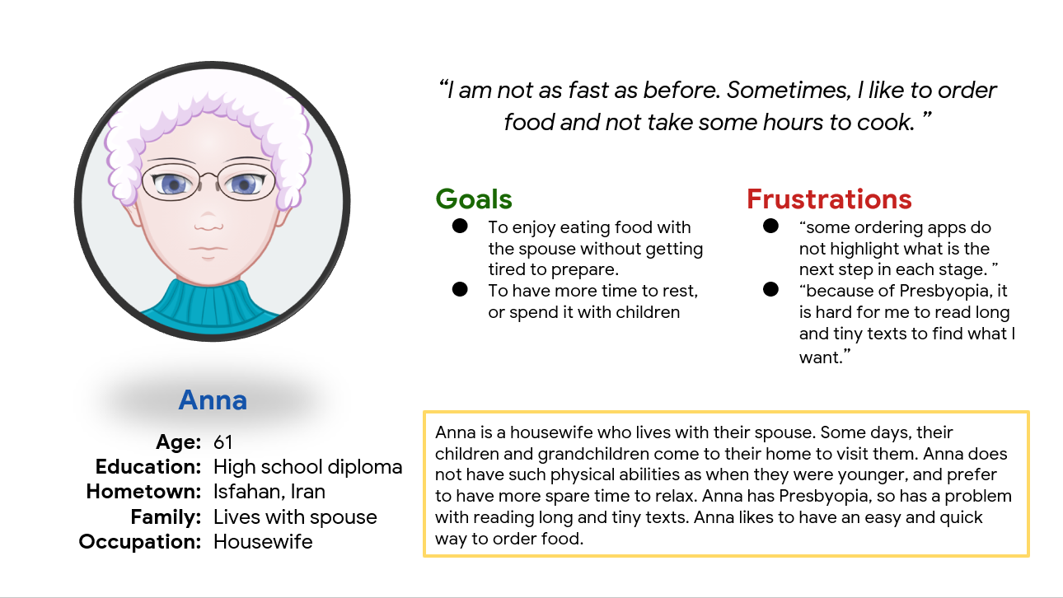
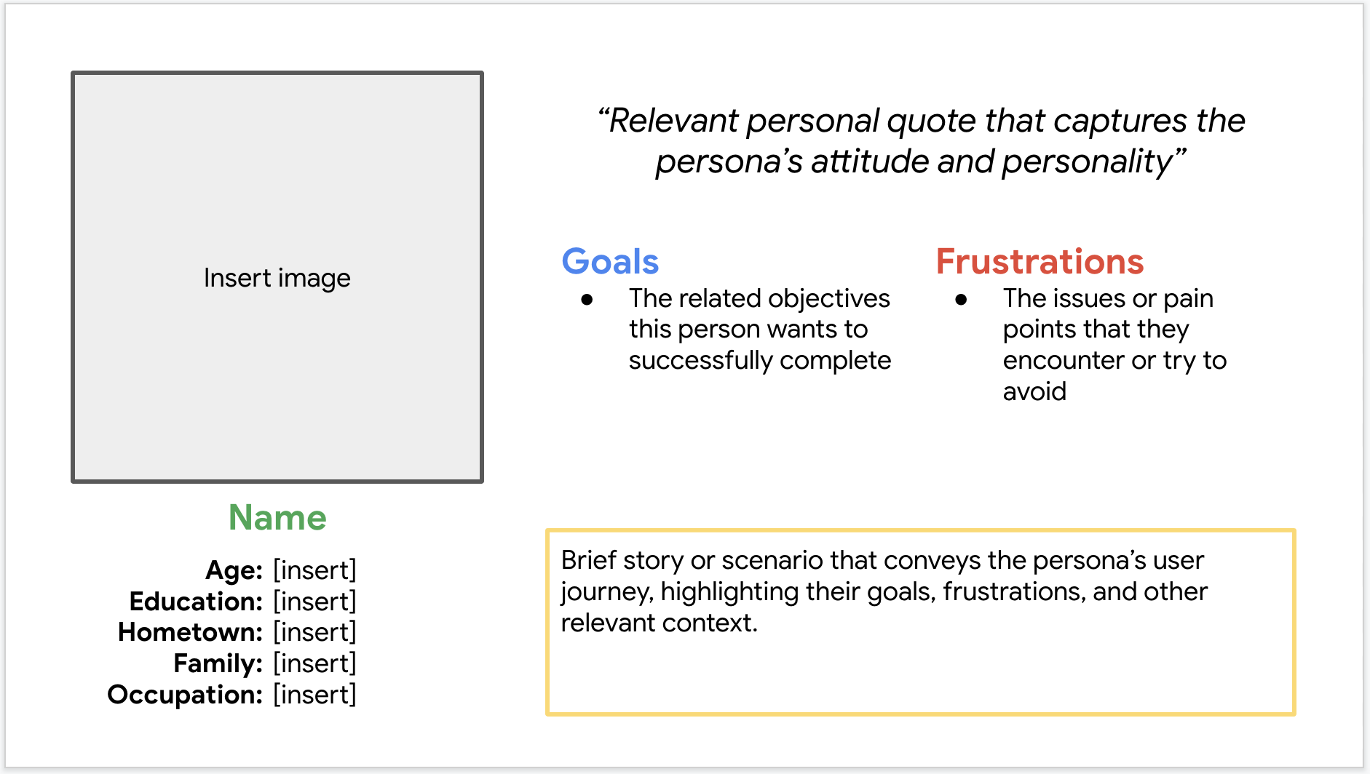
Persona: Anna
Problem statement:
Anna is a middle-aged housewife who needs an easy app experience to order food and get delivered food because they are uncomfortable with mobile apps and other technologies (she isn’t technologically savvy.)

Slide 9
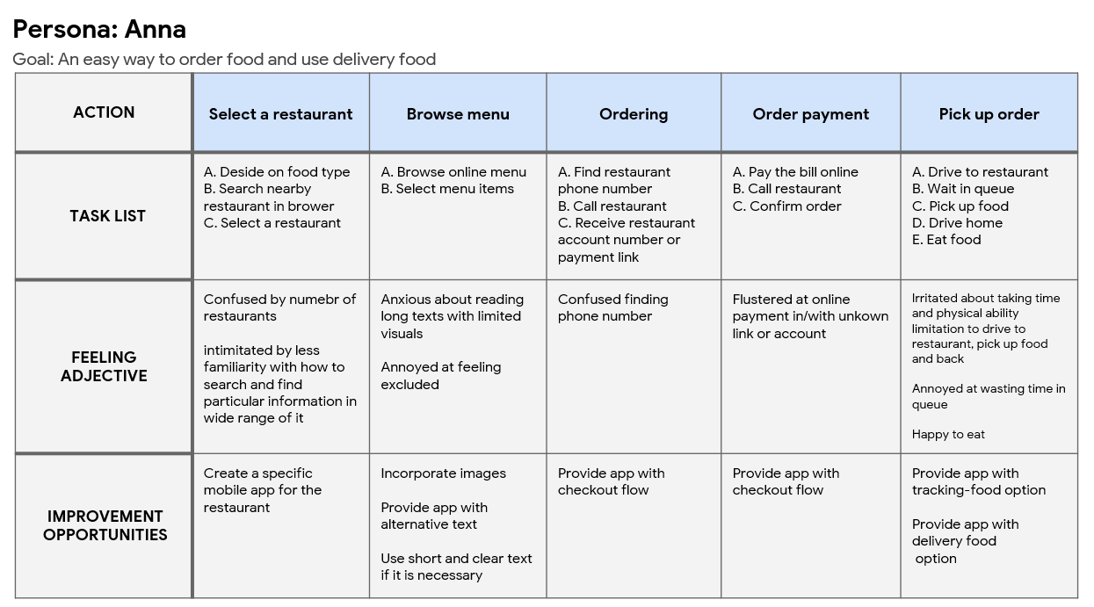
User journey map
Mapping Anna’s user journey revealed how helpful it would be for users to have access to a restaurant app.
Image of user journey map

Slide 10
Paper wireframes
Digital wireframes
Low-fidelity prototype
Usability studies
Starting
the design

Slide 11
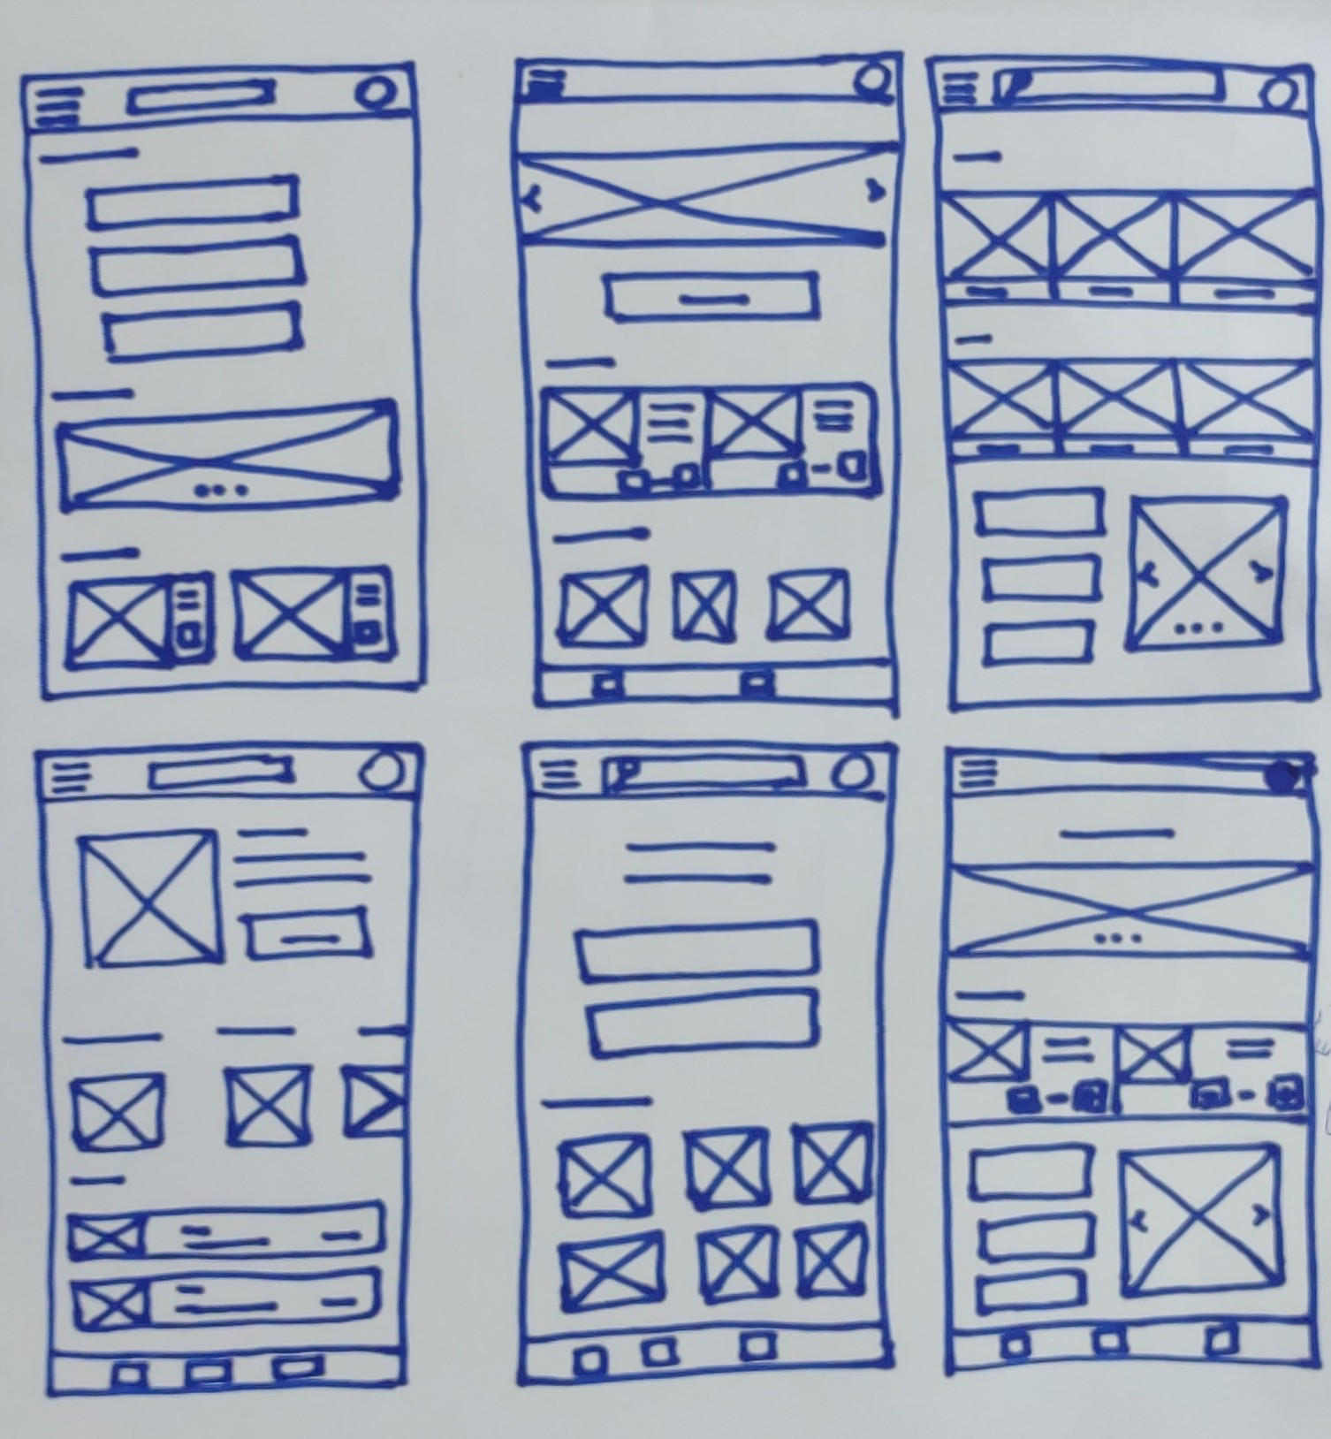
Paper wireframes
For the homepage, I prioritized a quick and easy ordering process to help users who are not tech-savvy.
Image of paper wireframes including five different versions of the same screen and one image of the new, refined version

Slide 12
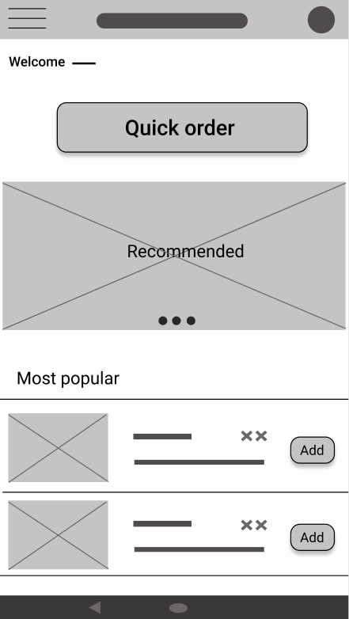
Digital wireframes
This button at the top of the home screen makes it fast and easy for users to order.
After user research and test, this is the homepage of my app for a quick access to order food.
Insert first wireframe example that demonstrates design thinking aligned with user research

Slide 13
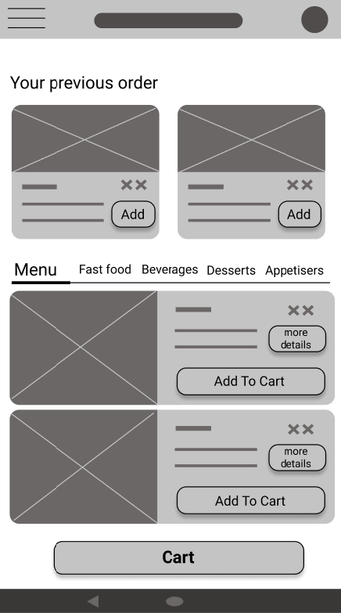
Digital wireframes
After test, I decided to add a button for better access to the cart.
This section helps users choose from their previous orders easily and quickly.
This button helps user to have access to their orders easily, especially those who are not tech-savvy or have visual impairment.

Slide 14
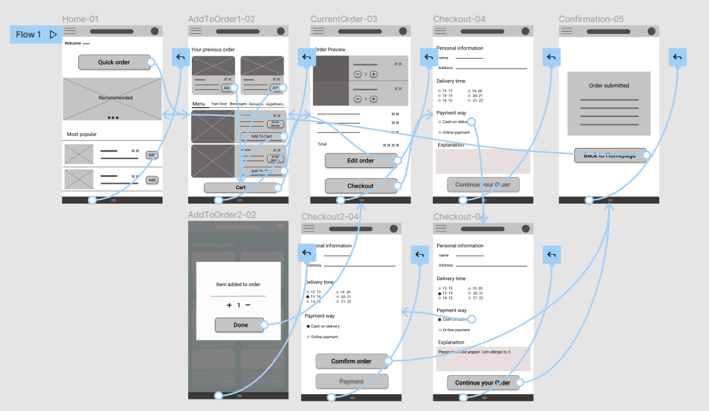
Low-fidelity prototype
Using the completed set of digital wireframes, I created a low-fidelity prototype. The primary user flow I connected was building and ordering food, so the prototype could be used in a usability study.
View the restaurant’s
Low-fidelity prototype
Screenshot of prototype with connections or prototype GIF

Slide 15
Usability study: findings
I conducted two rounds of usability studies. Findings from the first study helped guide the designs from wireframes to mockups. The second study used a high-fidelity prototype and revealed what aspects of the mockups needed refining.
Round 1 findings
Round 2 findings
1
Users need the menu to be categorized
1
Homepage creates distraction because of so many details.
2
users prefer to inform something about their orders
2
Uses believe that the combination of colors makes the buttons not distinctive to be found easily.
3
Users want the preview section that have more capabilities

Slide 16
Refining
the design
Mockups
High-fidelity prototype
Accessibility

Slide 17
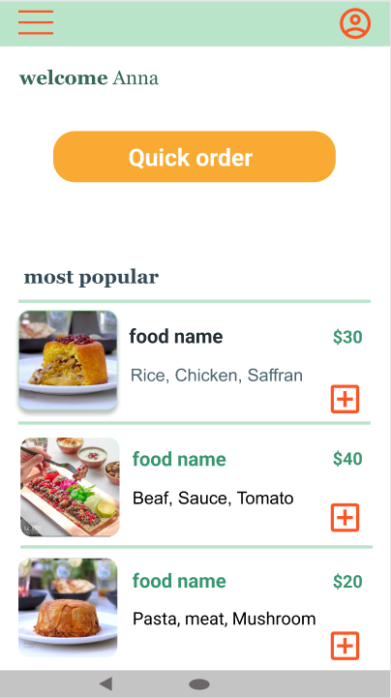
Mockups
Before usability study
After usability study
I changed colors and replaced most popular section with special offer section without any detail about foods to make the quick order button more clear for users.
Image of selected screen before usability study
Image of selected screen after usability study

Slide 18
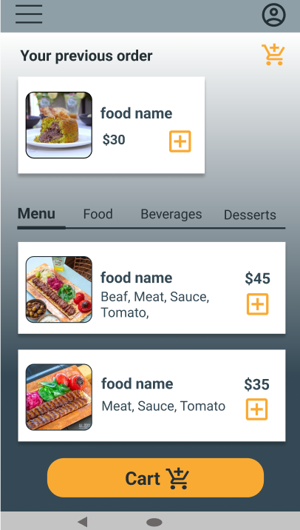
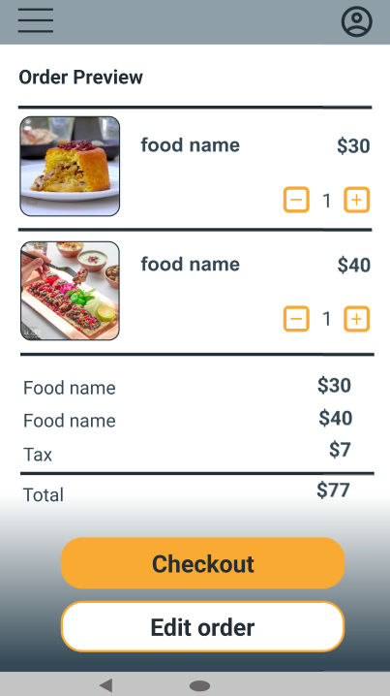
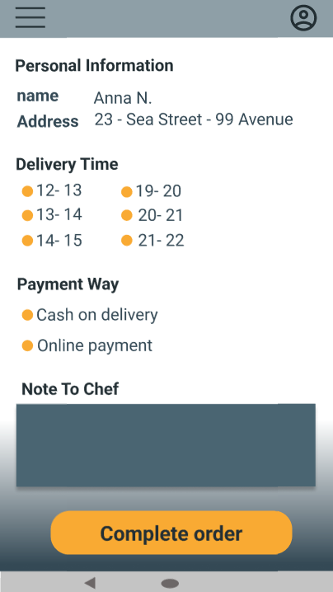
Mockups
Main mockup screen for display
Main mockup screen for display
Main mockup screen for display
Main mockup screen for display

Slide 19
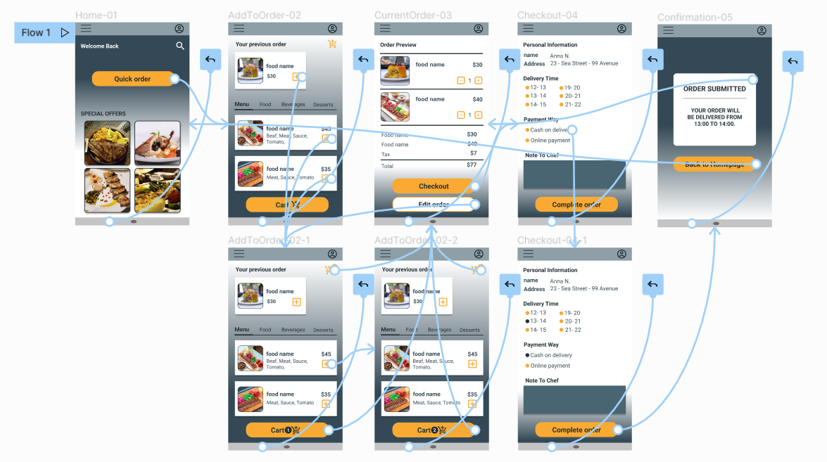
High-fidelity prototype
The final high-fidelity prototype presented a clear path for users to order their food easily and quickly.
View the restaurant’s
high-fidelity prototype
Screenshot of prototype with connections or prototype GIF

Slide 20
Accessibility considerations
1
2
3
Creating a distinct path for user’s who are not tech-savy to order their food easily.
Avoiding heavy texts and using icons for users with visual impairment.
Using colors that are suitable for users with visual impairment.

Slide 21
Going forward
Takeaways
Next steps

Slide 22
Takeaways
Impact:
The app has designed to make the ordering process easy to reach.
One quote from user feedback:
“I had tried some apps before but I couldn't finish my order. I'm glad that I could do that now easily.”
What I learned:
I learned that we need to put users first at each stage of the design process. It is important to conduct usability study and iteration during the whole process to find best solutions for their needs.

Slide 23
Next steps
1
2
Find other needs that might be necessary to be considered.
Determine whether user’s problems have properly addressed or not by conducting more usability studies.

Slide 24
Thank you!

