Slide 1
SageMaker Hyperparameter Tuning and Debugger

Slide 2
Outline
SageMaker Hyperparameter Tuning
SageMaker Debugger
Case Study-Stock Tweet Sentiment Classification
Useful Resources

Slide 3
SageMaker Hyperparameter Tuning
Hyperparameters impact machine learning model performance
For deep learning models, learning rate, batch size, number of neurons, etc.
SageMaker provides multiple hyperparameter optimization strategies
Random Search
Bayesian Optimization
Hyperband
Optuna [1]
SageMaker can tune up to 20 hyperparameters simultaneously [2]

Slide 4
SageMaker Debugger
Debug and profile data when training is going on
GPU/CPU Utilization
Performance Bottlenecks
Save time and cost by finding issues early

Slide 5
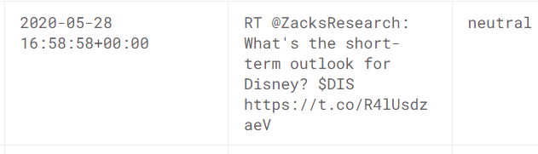
Case Study-Stock Tweet Sentiment Classification
Data:
Kaggle-Stock Market TWEETS Data-NLP-2021 [3]

Slide 6

Case Study-Stock Tweet Sentiment Classification
Data:
Kaggle-Stock Market TWEETS Data-NLP-2021 [3]
Positive: 4124
Neutral: 528
Negative: 348
Downsampling to make a balanced dataset
Code:
Reuse code from Coursera-Practical Data Science on the AWS Cloud [5]
Women’s Clothing Review Classification Project

Slide 7
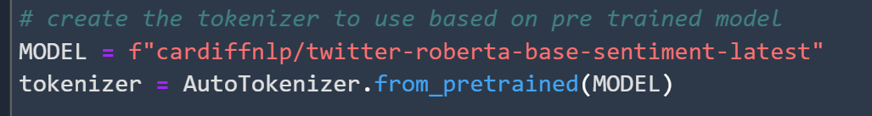
Case Study-Stock Tweet Sentiment Classification
Step 1: tokenization: twitter-roberta-base-sentiment-latest [4]
roBERTa-base model trained on ~124M tweets from January 2018 to December 2021

Slide 8
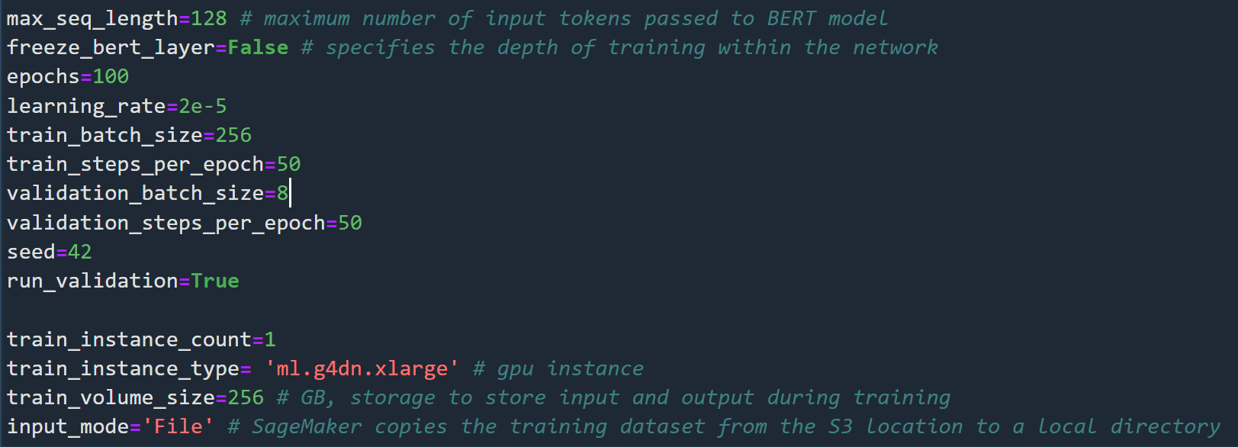
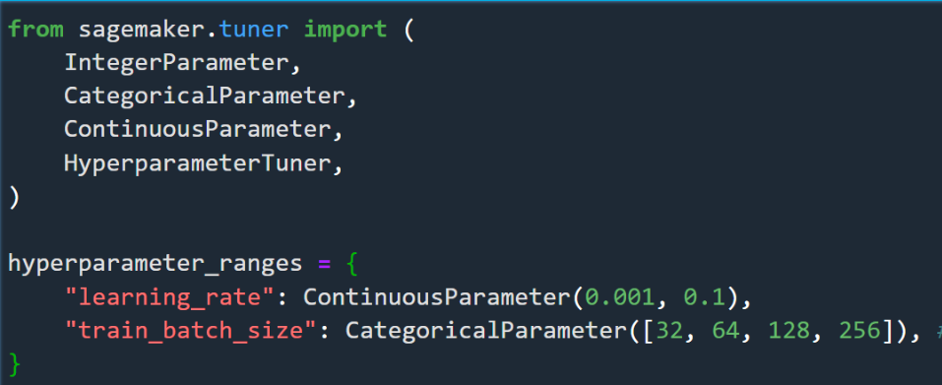
Case Study-Stock Tweet Sentiment Classification
Step 2: Hyperparameter Tuning
Define Hyperparameters

Slide 9
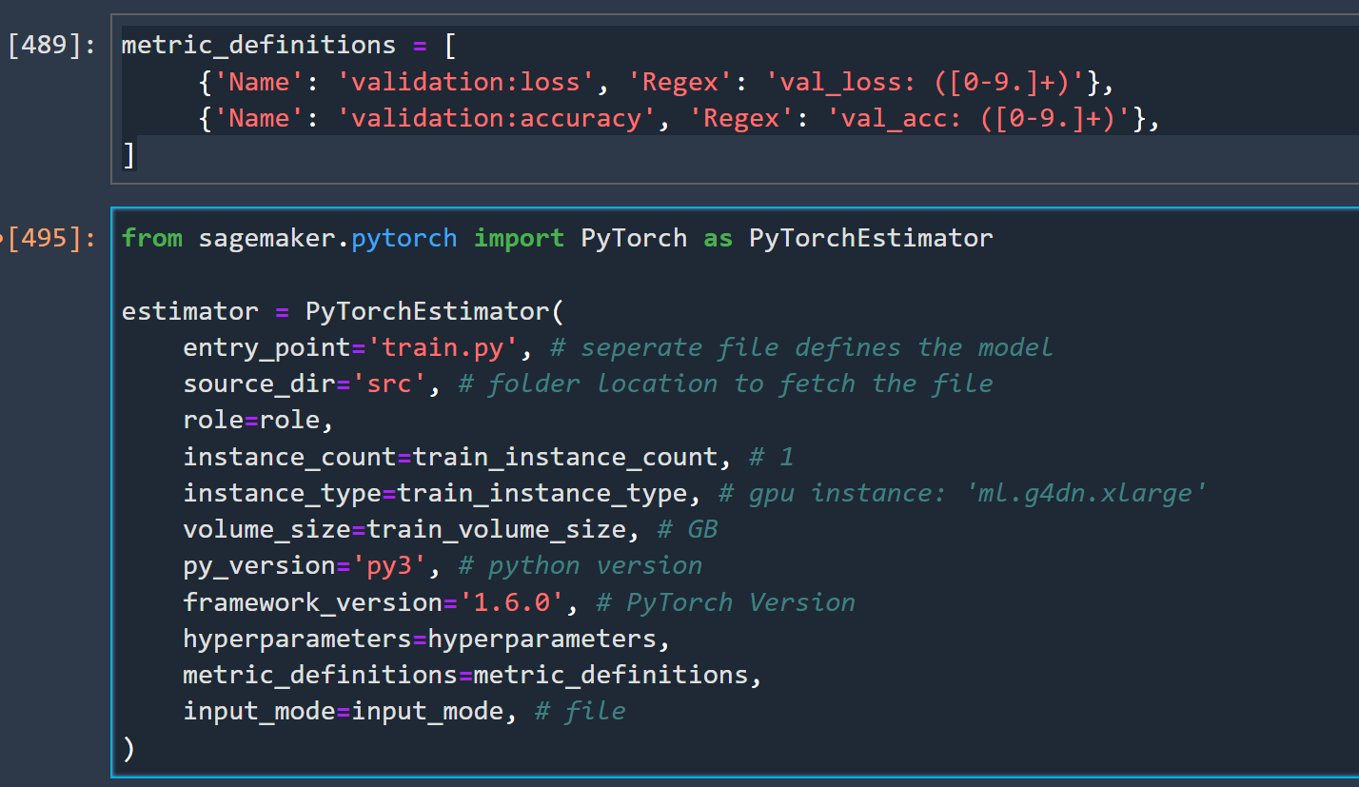
Case Study-Stock Tweet Sentiment Classification
Step 2: Hyperparameter Tuning
Next Define Estimator to train models

Slide 10
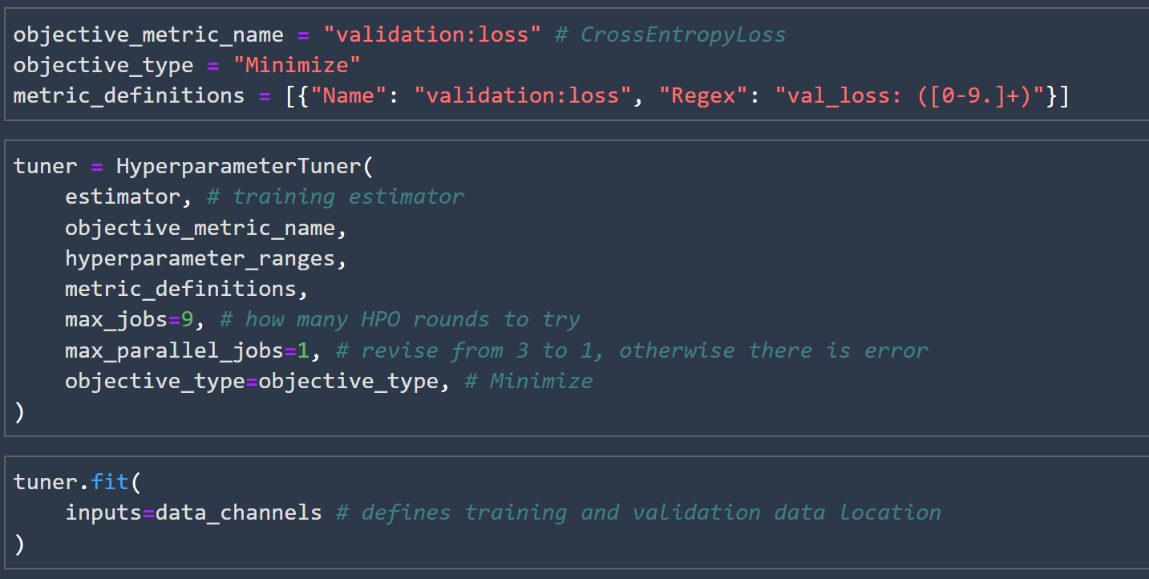
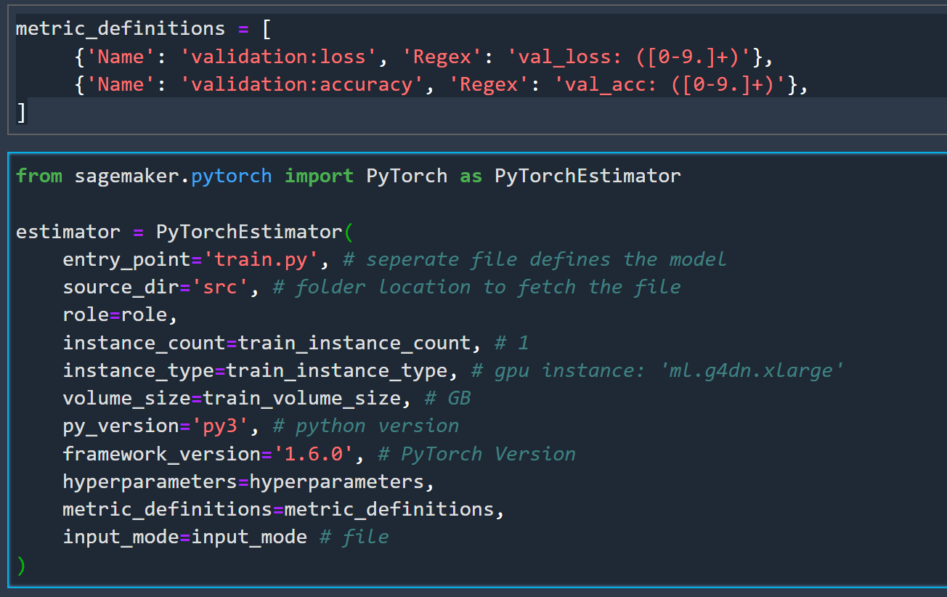
Case Study-Stock Tweet Sentiment Classification
Step 2: Hyperparameter Tuning
Connect HPO with Model Estimator
Define Estimator to train models

Slide 11
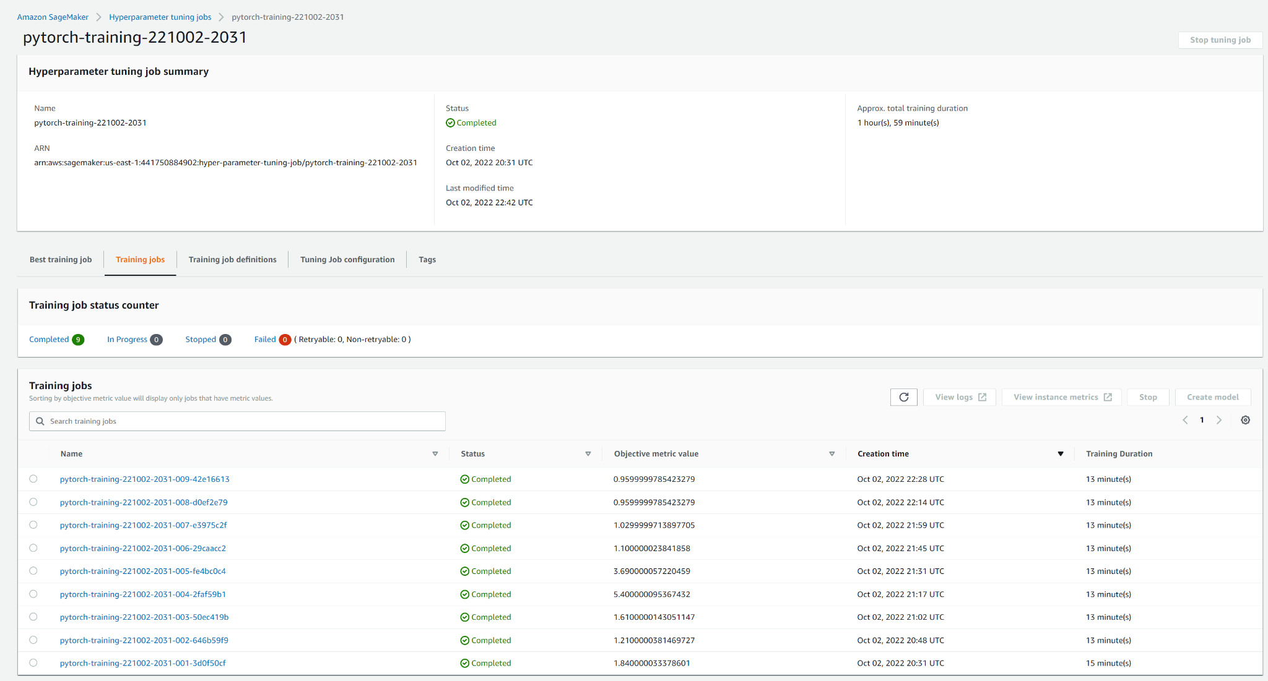
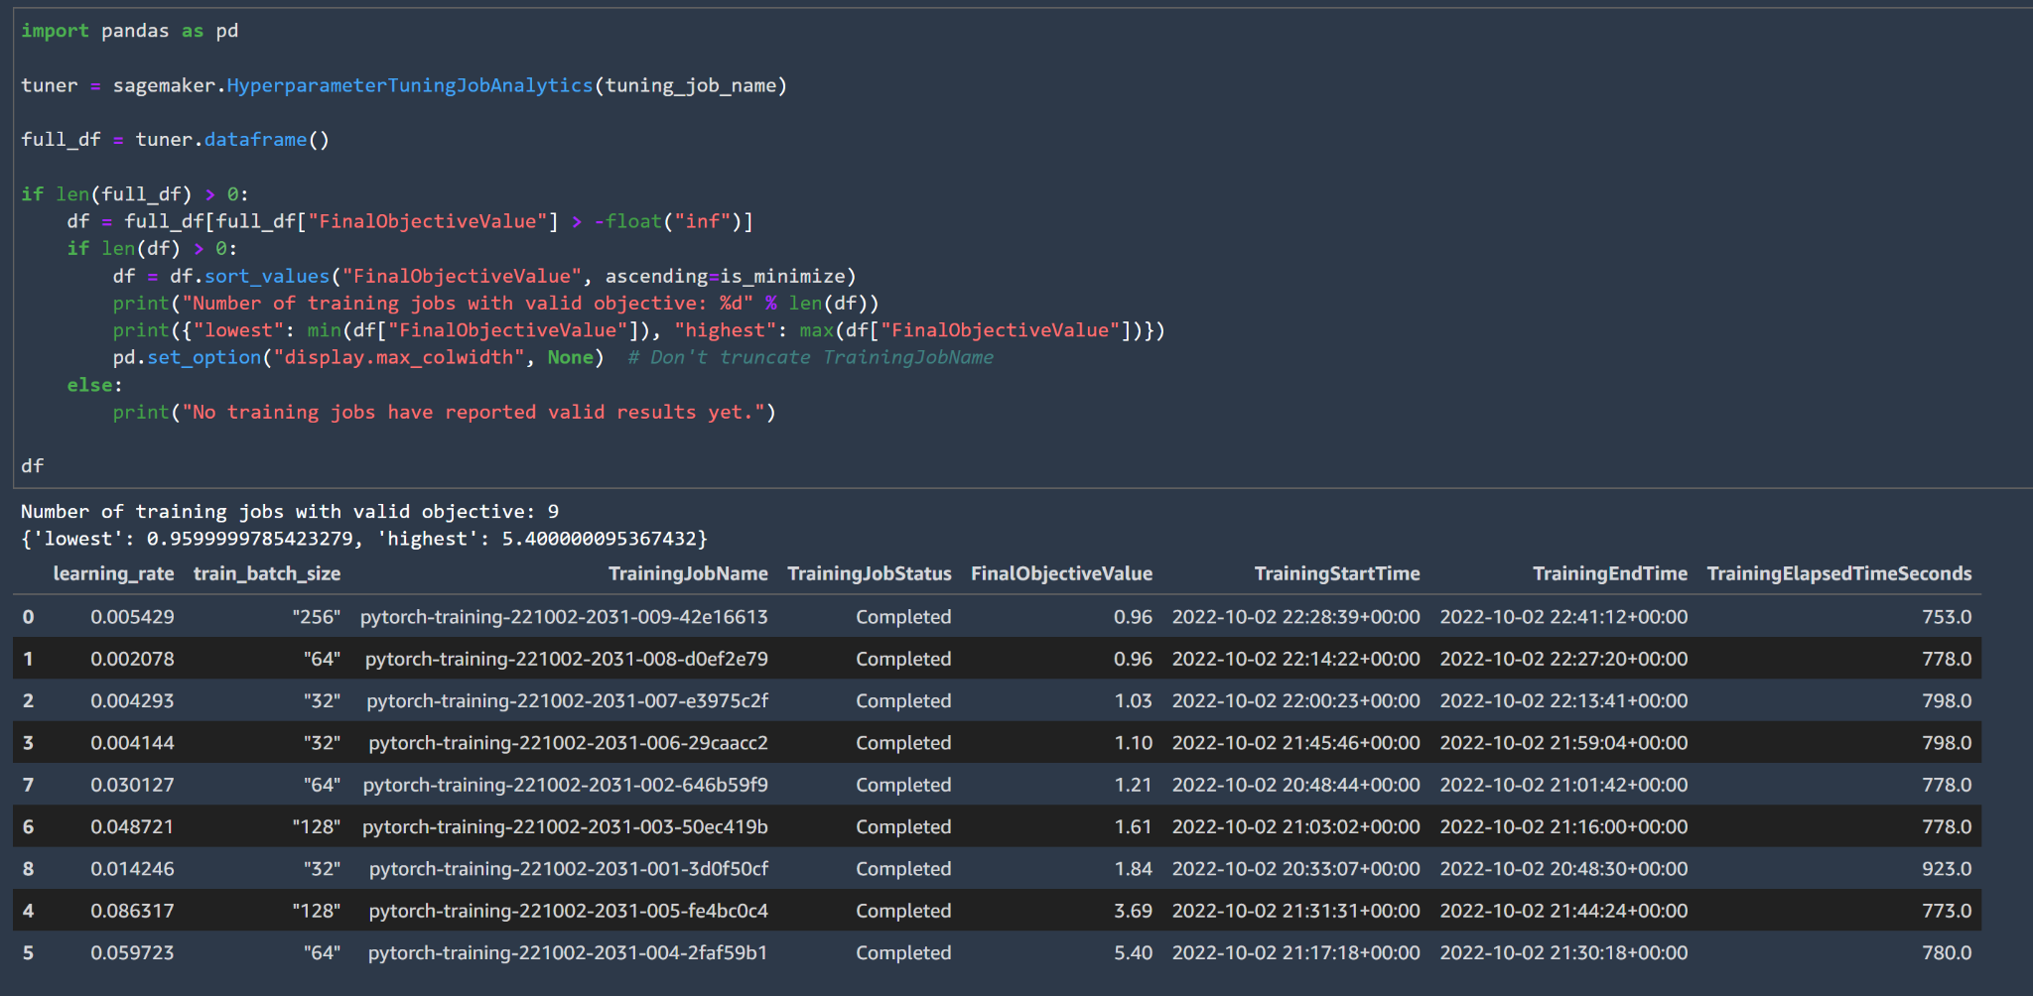
Case Study-Stock Tweet Sentiment Classification
Step 2: Hyperparameter Tuning
Check HPO Results through Python
Check HPO Results through SageMaker Studio

Slide 12
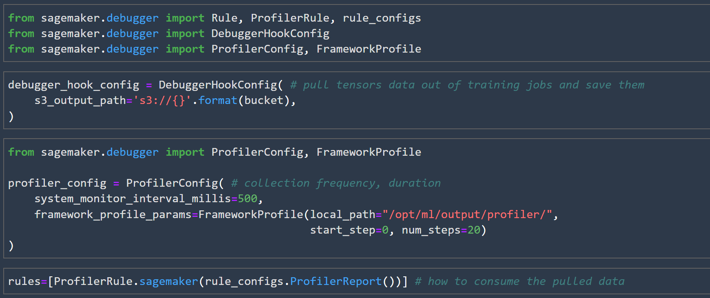
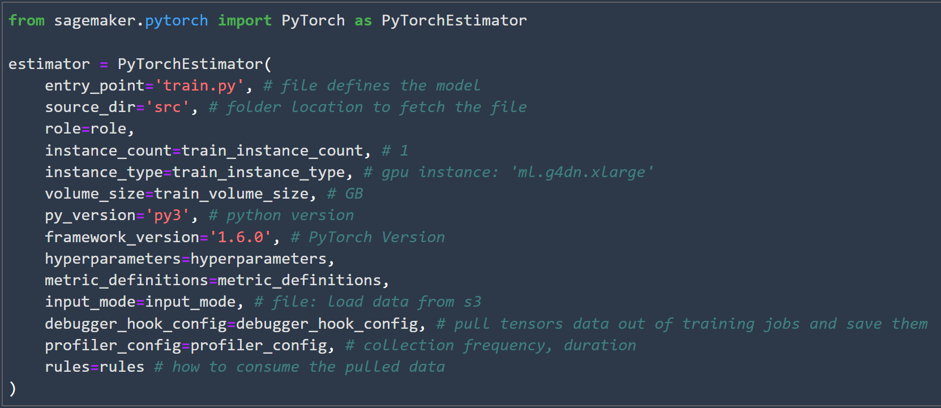
Case Study-Stock Tweet Sentiment Classification
Step 3: Implement SageMaker Debugger in Model Training [6]
Notes:
Using SageMaker Debugger is, broadly, a two-pronged approach. On one hand you have the production of debugging data, which is done through the Debugger Hook, and on the other hand you have the consumption of this data, which can be with rules (for continuous analyses) or by using the SageMaker Debugger SDK (for interactive analyses).
https://sagemaker.readthedocs.io/en/stable/amazon_sagemaker_debugger.html#continuous-analyses-through-rules

Slide 13
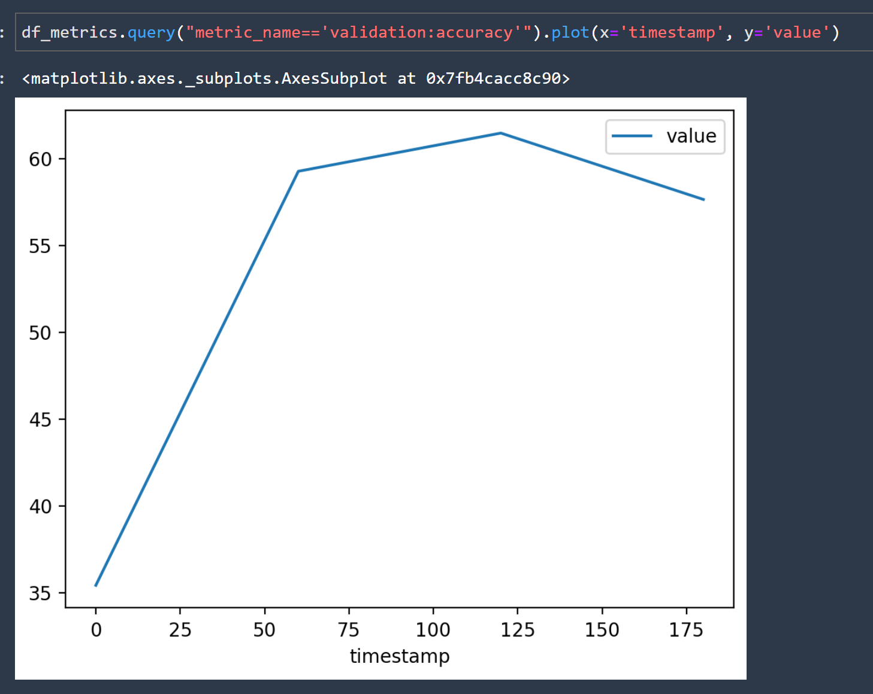
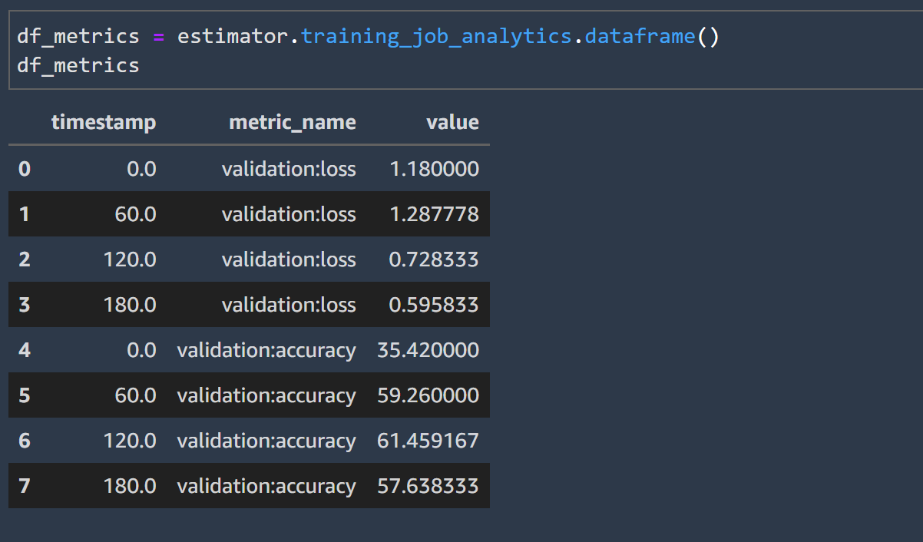
Case Study-Stock Tweet Sentiment Classification
Step 4: Analysing Training and SageMaker Profiler Results

Slide 14
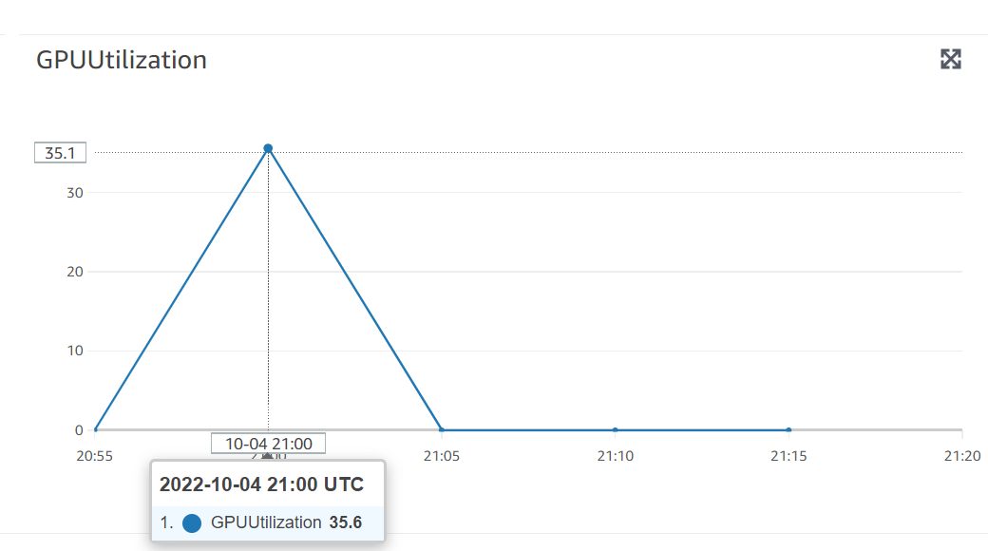
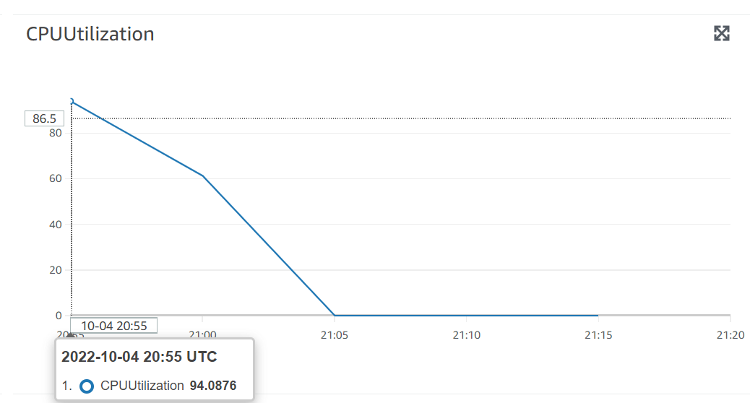
Case Study-Stock Tweet Sentiment Classification
Step 4: Analysing Training and SageMaker Profiler Results
Notes:
Using SageMaker Debugger is, broadly, a two-pronged approach. On one hand you have the production of debugging data, which is done through the Debugger Hook, and on the other hand you have the consumption of this data, which can be with rules (for continuous analyses) or by using the SageMaker Debugger SDK (for interactive analyses).
https://sagemaker.readthedocs.io/en/stable/amazon_sagemaker_debugger.html#continuous-analyses-through-rules

Slide 15
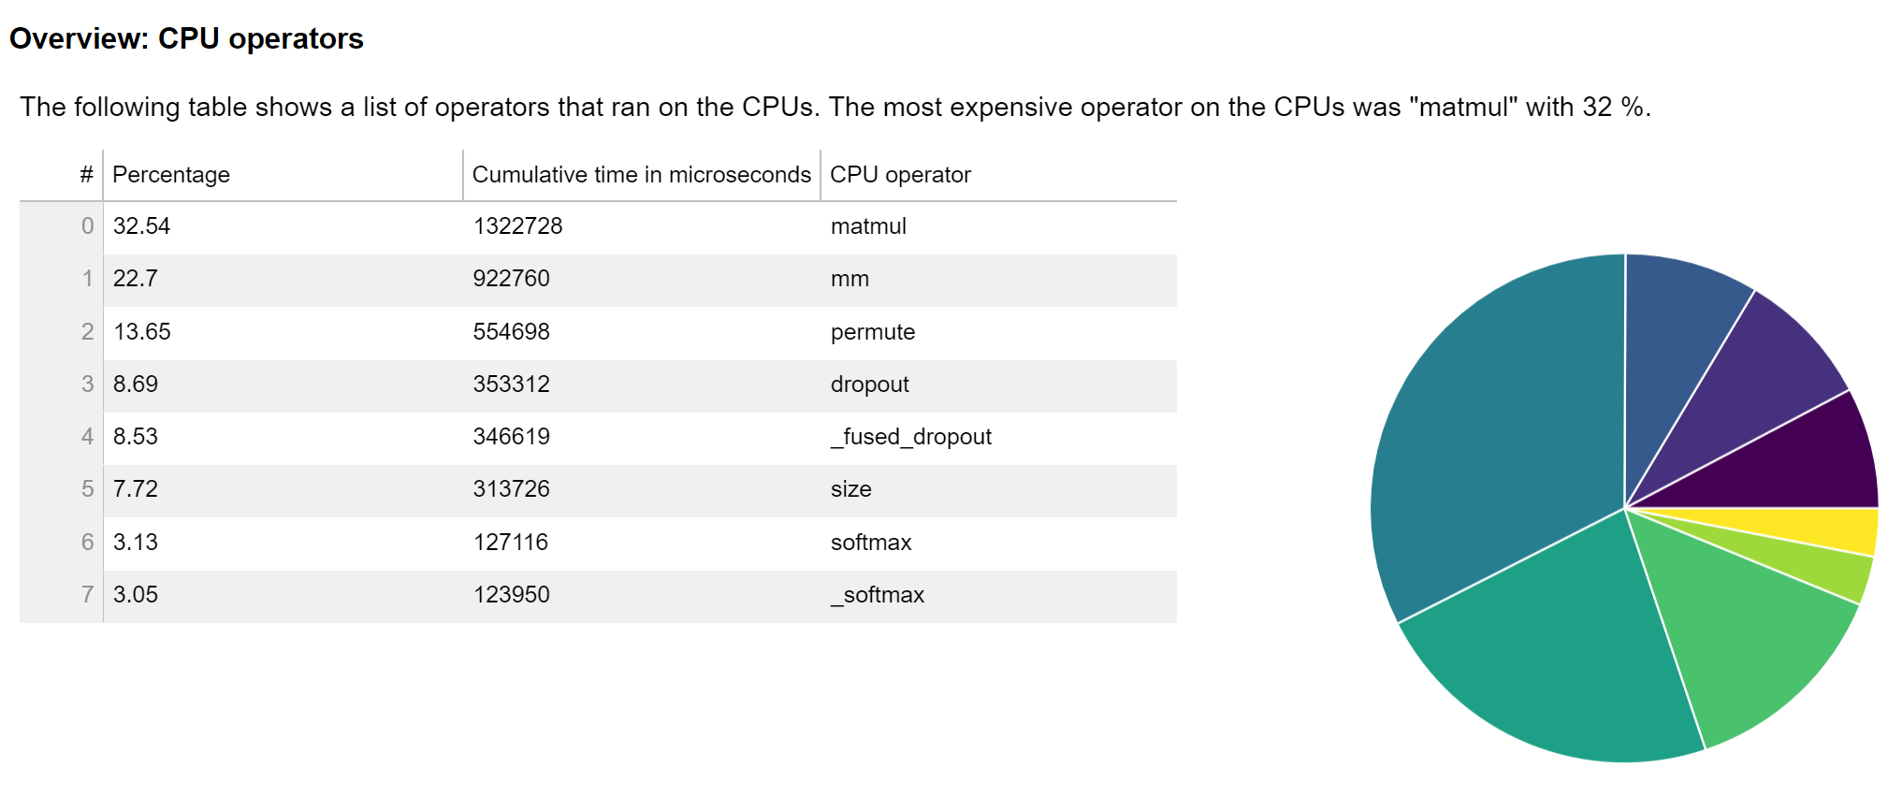
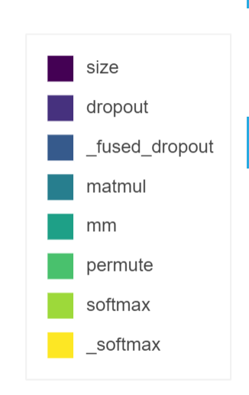
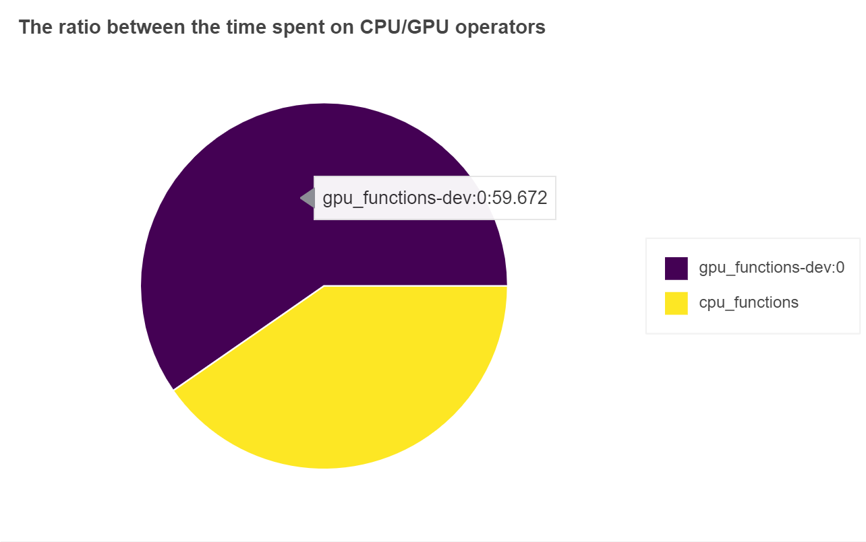
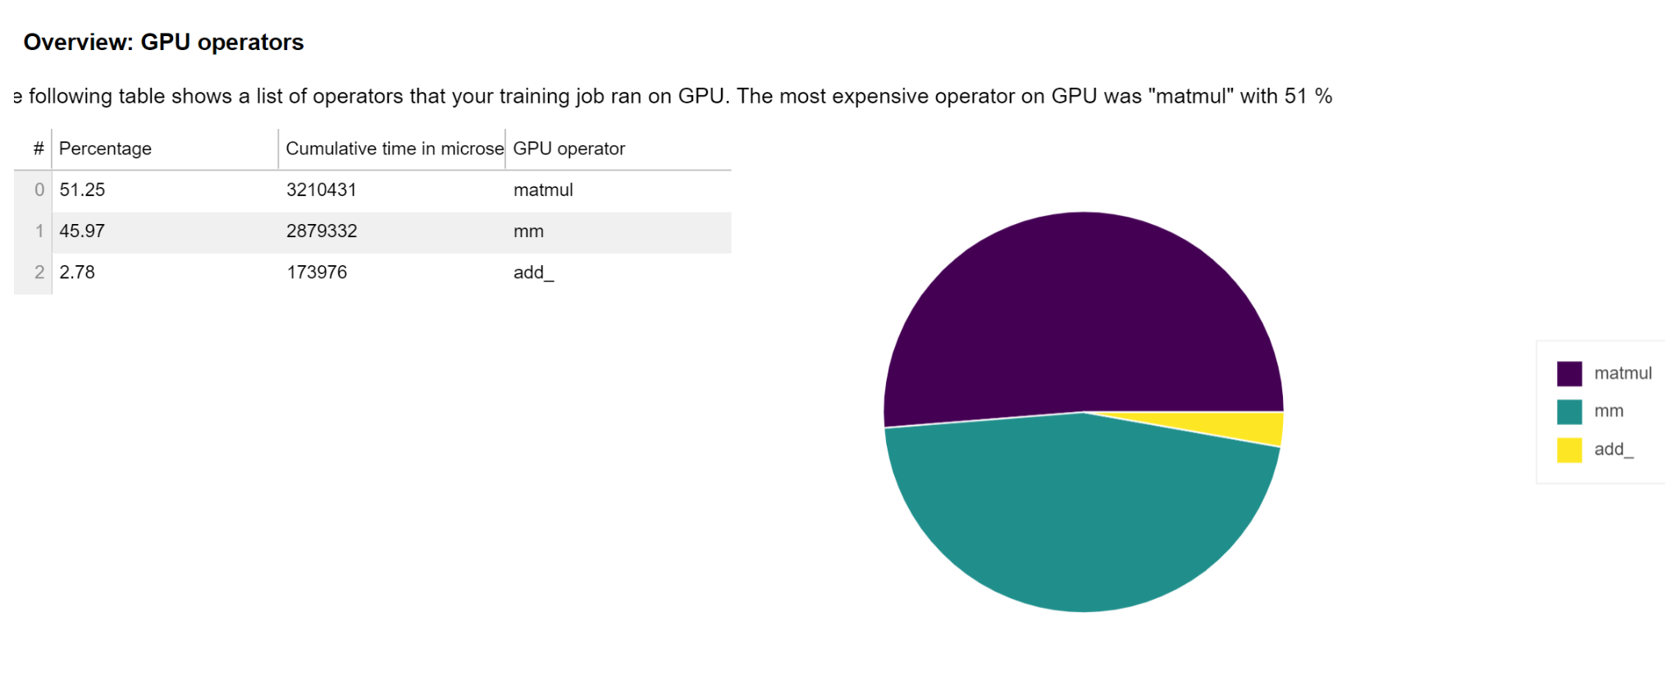
Case Study-Stock Tweet Sentiment Classification
Step 4: Analysing Training and SageMaker Profiler Results
Notes:
https://blog.actorsfit.com/a?ID=01000-226fbe97-714f-4043-bfde-1cc31c933b2d matmul: hidimensional matrix multplication

Slide 16
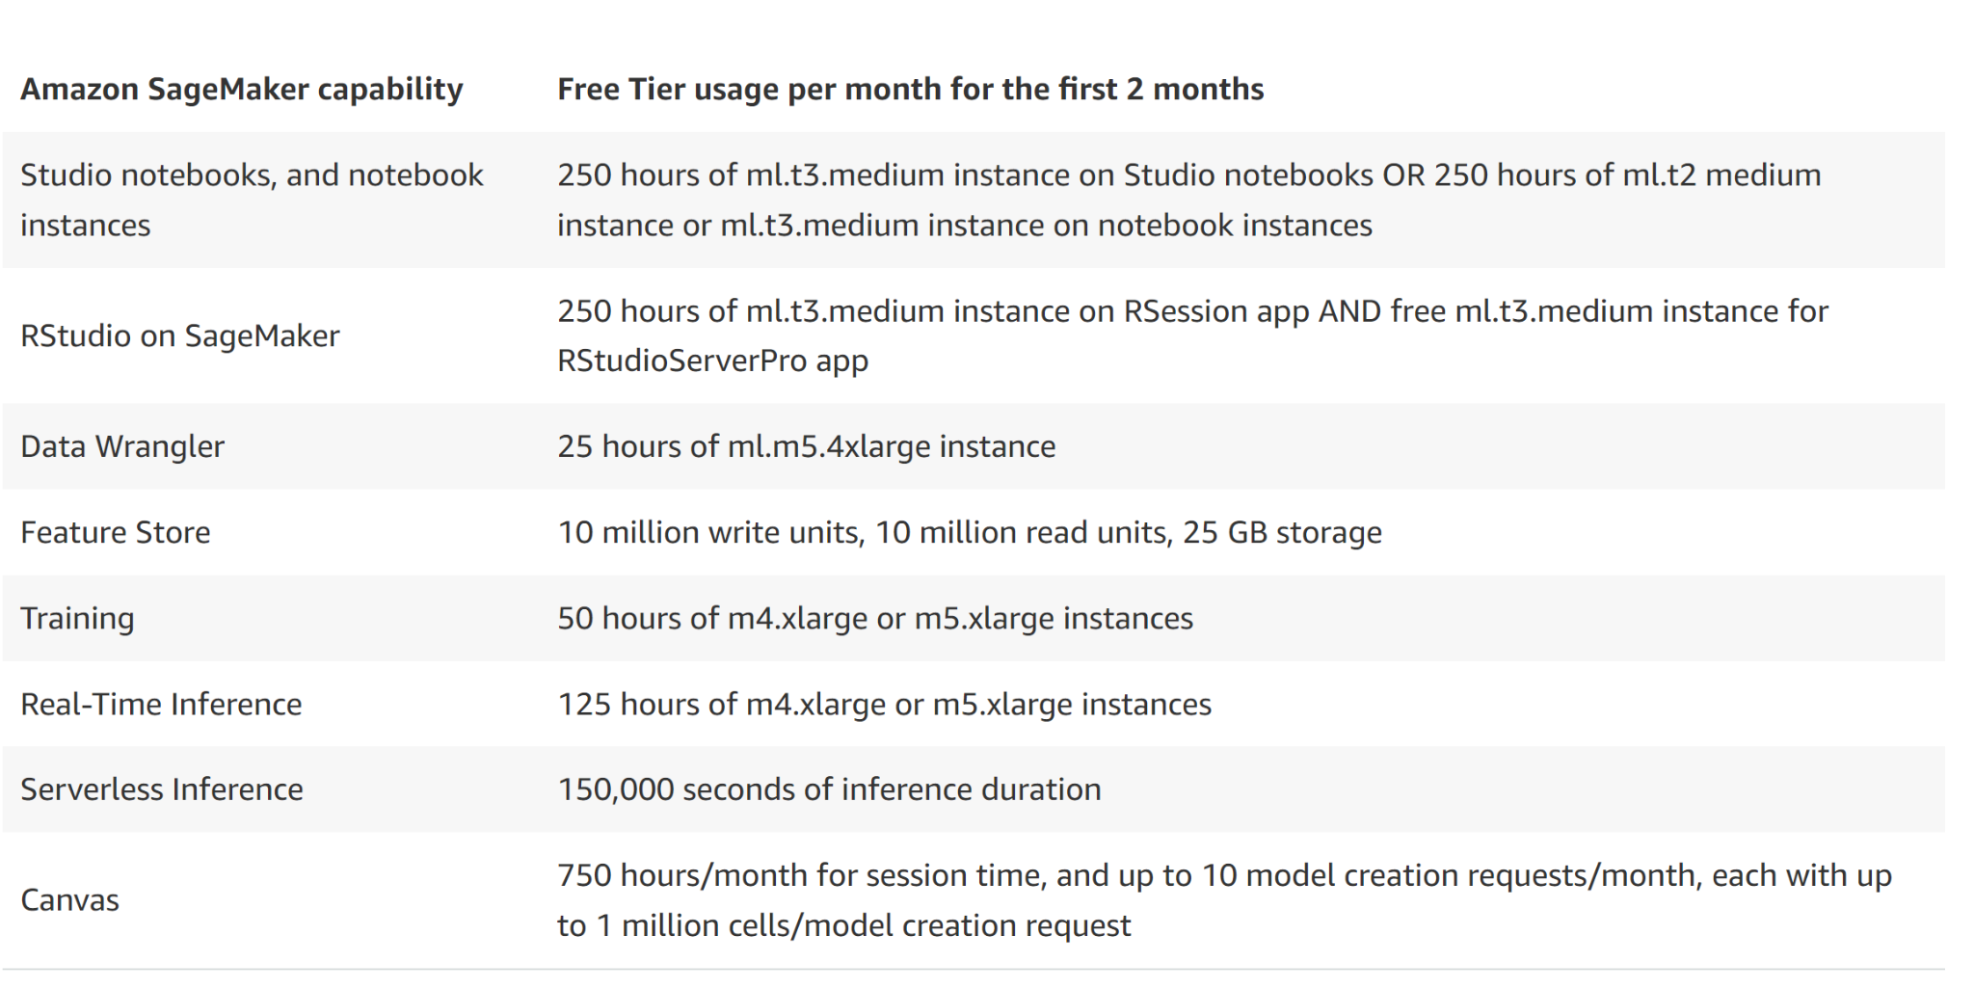
AWS SageMaker Free Tier

Slide 17
Useful Resources
[1] Hyperparameter Tuning with Optuna
[2] Hyperparameter Tuning
[3] Kaggle Stock Market Data Sentiment
[4] twitter-roberta-base-sentiment-latest
[5] Practical Data Science on the AWS Cloud
[6] SageMaker Debugger
[er

Slide 18
Back Up

