Slide 1
Smart Toys Co. Database Project

Slide 2
Agenda
Introduction
Database Schema
Create a relational database
Query data to answer business questions
Contact information

Slide 3
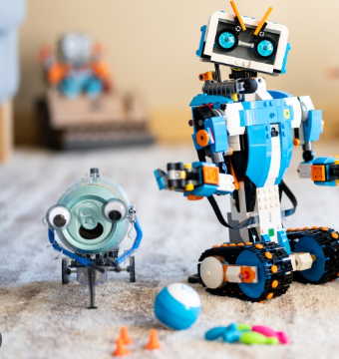
Introduction The project involves creating and querying a relational database for Smart Toys Co., focusing on sales and product data analysis.

Slide 4
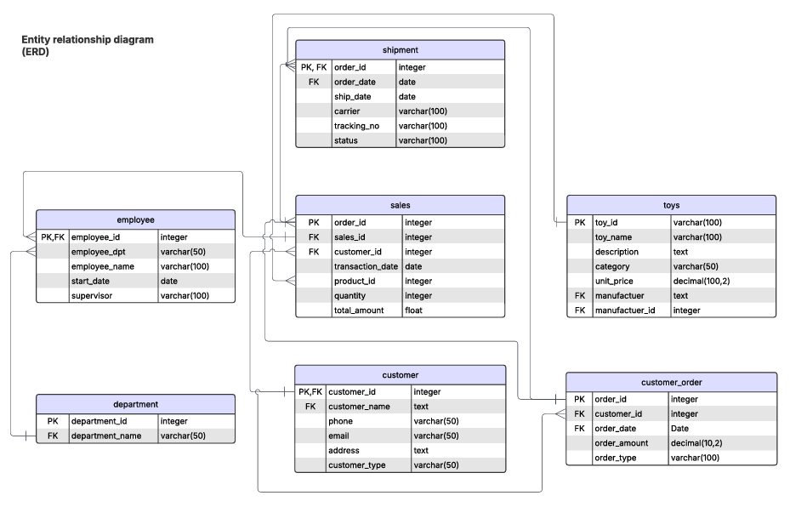

Slide 5
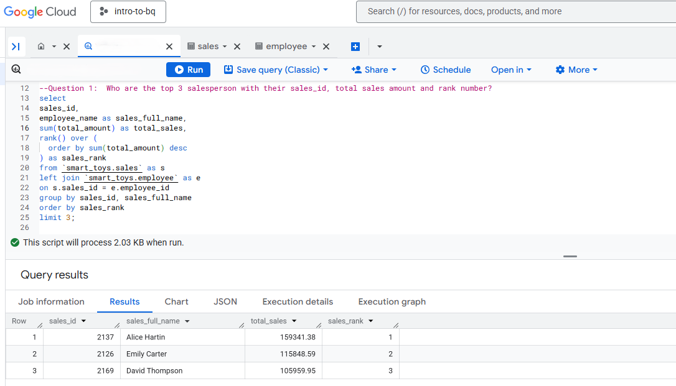
Question1: Who are the top 3 salesperson with sales_id? What is their total sales and corresponding sales rank?
Top Salespersons This query identifies the top three salespersons in 2023 based on total sales, highlighting their exceptional performance and contribution to the company's revenue.

Slide 6
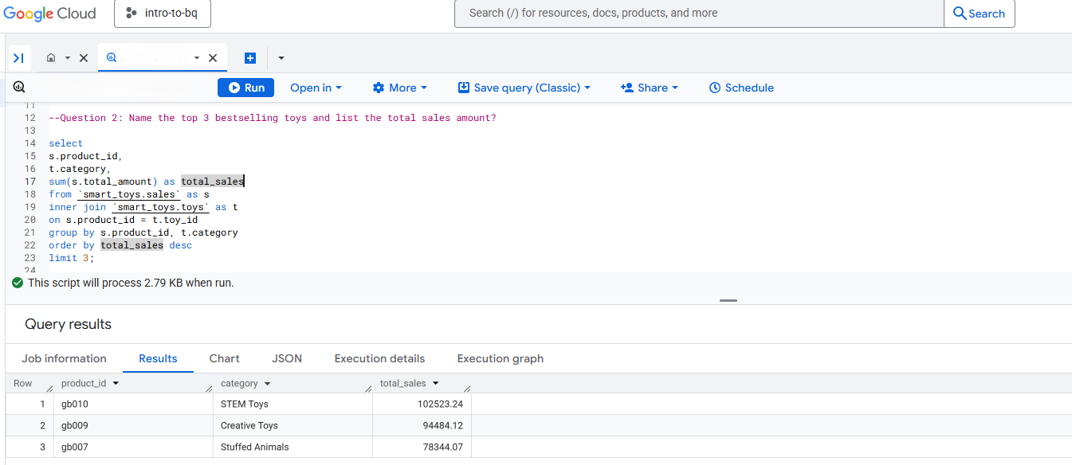
Question 2: What are the top 3 bestselling toys, their categories, and the total sales amount?
Bestselling Toys Based on this query, product GB010 in the STEM category achieved the highest total sales in 2023, indicating strong market demand and consumer interest in STEM-related products.

Slide 7
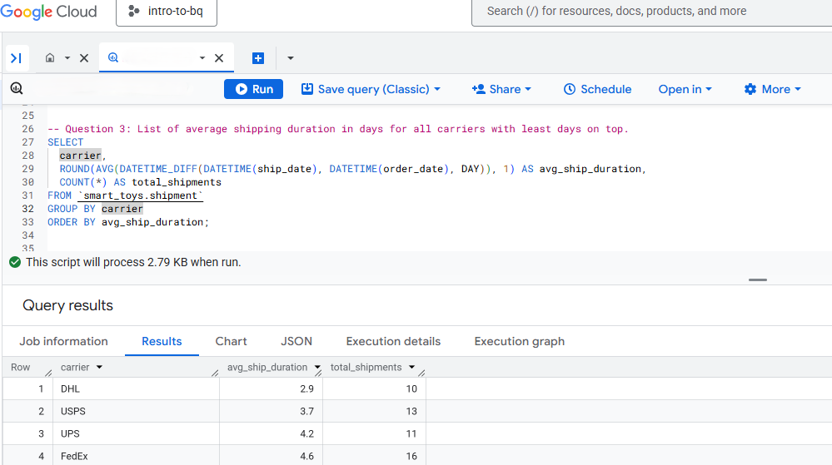
Question 3: What is the average shipping duration for each carrier and total shipment?
Shipping Performance
This query shows that among all the carriers, DHL has the shortest average delivery duration, indicating higher efficiency in order fulfillment.

Slide 8
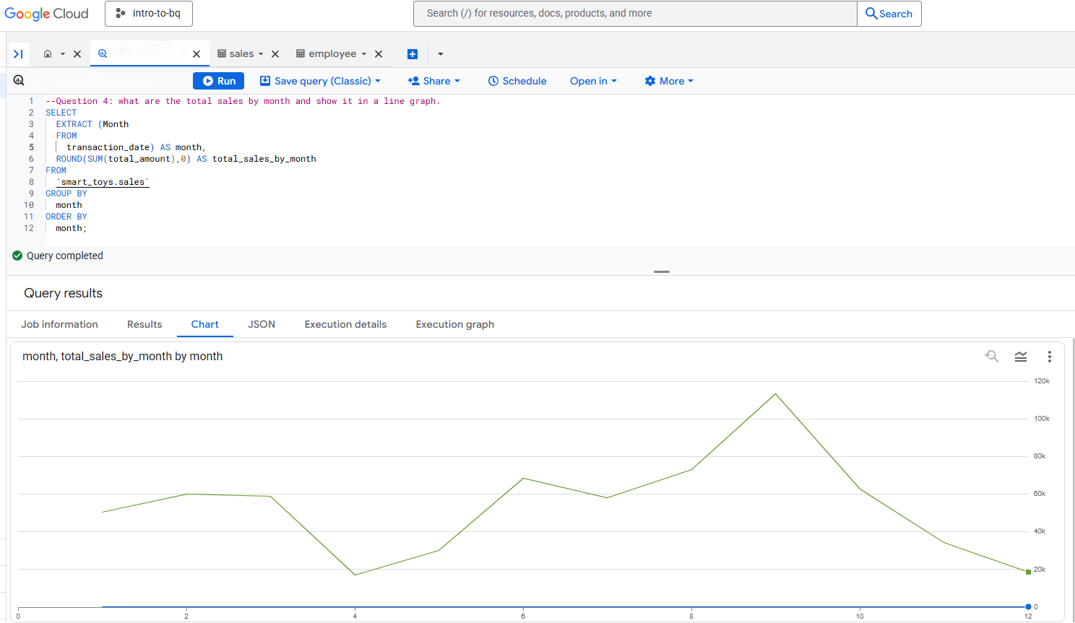
Question 4: What are the total sales by month and show it in a line graph.
Sales Seasonality This query demonstrates the seasonality of sales, with a noticeable drop in April followed by a sharp increase peaking in September.

Slide 9
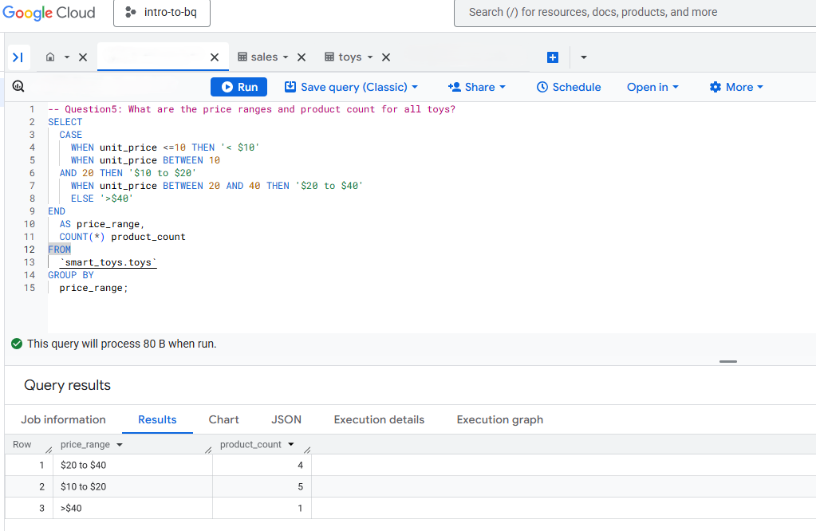
Question5: What are the price ranges and product count for all toys?
Product Pricing
This query shows that majority of products fall within the low to mid-level price range, suggesting a market strategy focused on affordability and broad consumer accessibility.

Slide 10
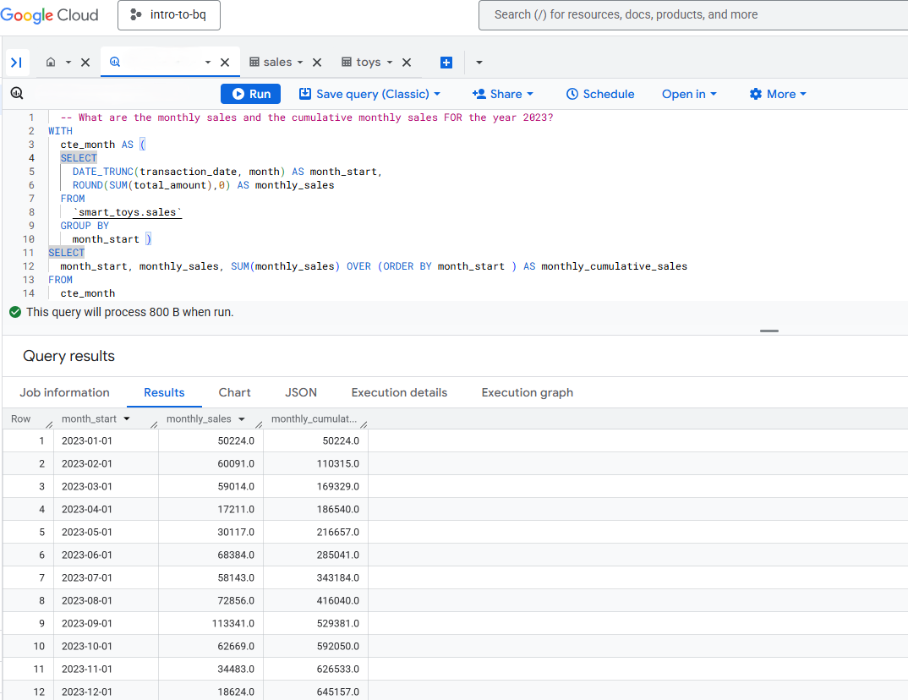
Question6: What are the monthly sales and the cumulative monthly sales in 2023?
Sales Performance Overview This query provides an overview of overall sales performance in 2023, including a breakdown of monthly sales and the cumulative sales progression throughout the year, serving as a valuable reference for the sales department in tracking trends and evaluating performance.

Slide 11
Any Questions?

Slide 12
Thank you
Lei Liu
469-892-8857
lauraliu1117@gmail.com

