Slide 1

Cats! How are they related?

Slide 2
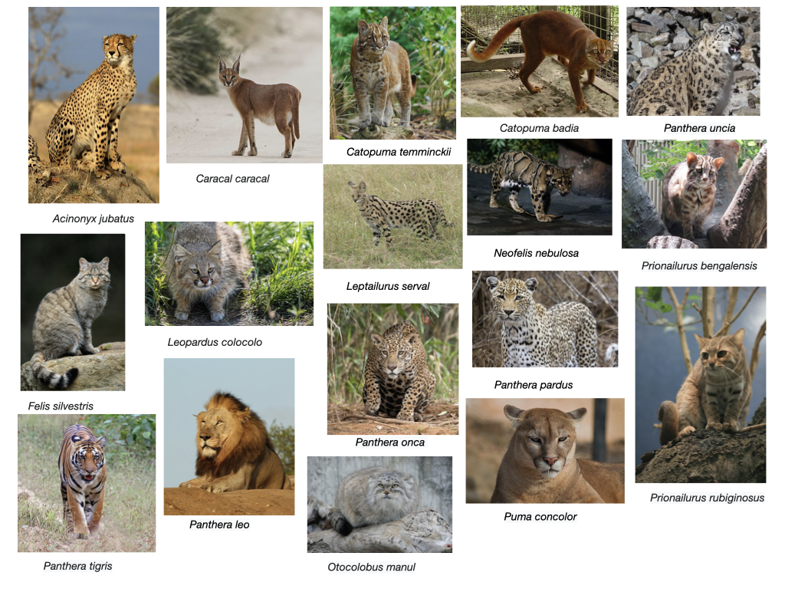

Slide 3
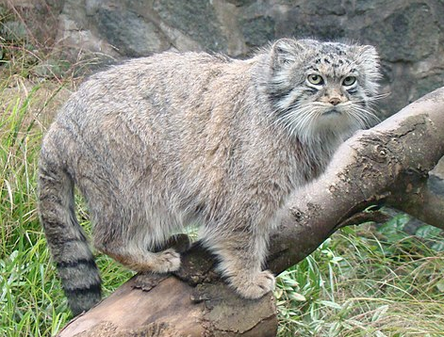
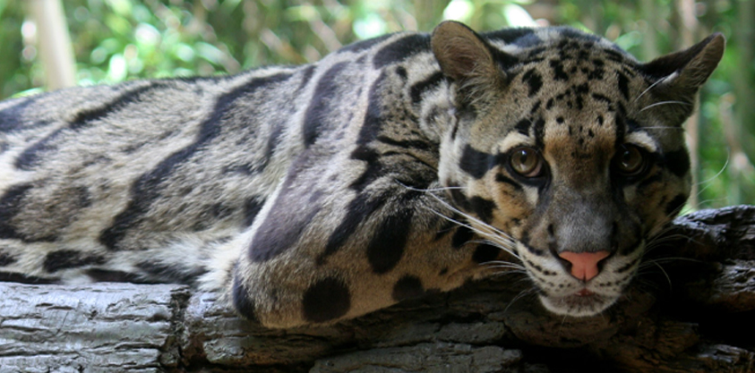
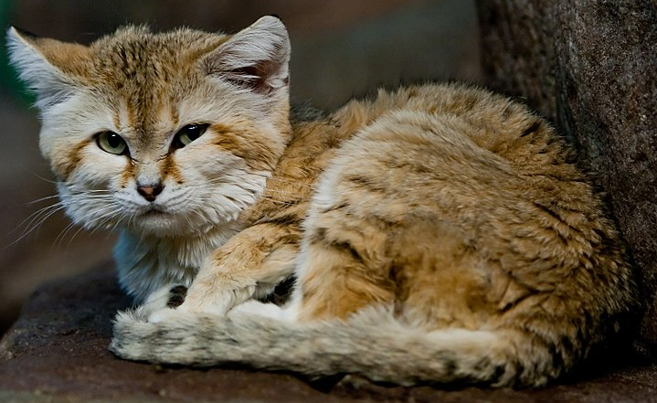
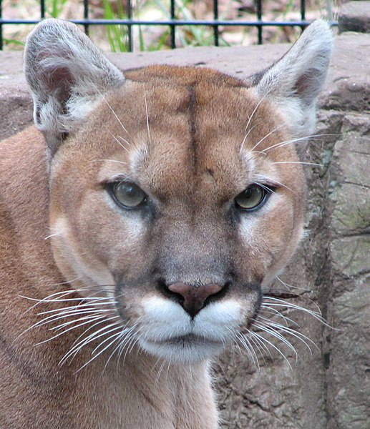
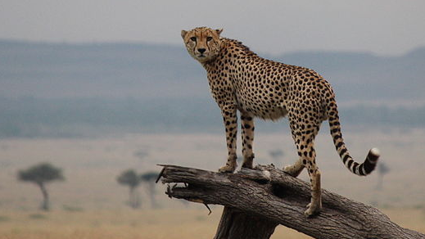
Q1
A- Otocolobus manul
B- Neofelis nebulosa
C- Felis margarita
D- Puma concolor
E- Acinonyx jubatus

Slide 4
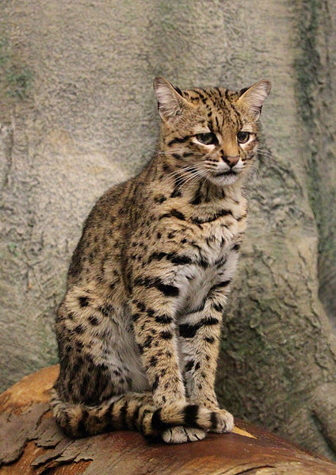
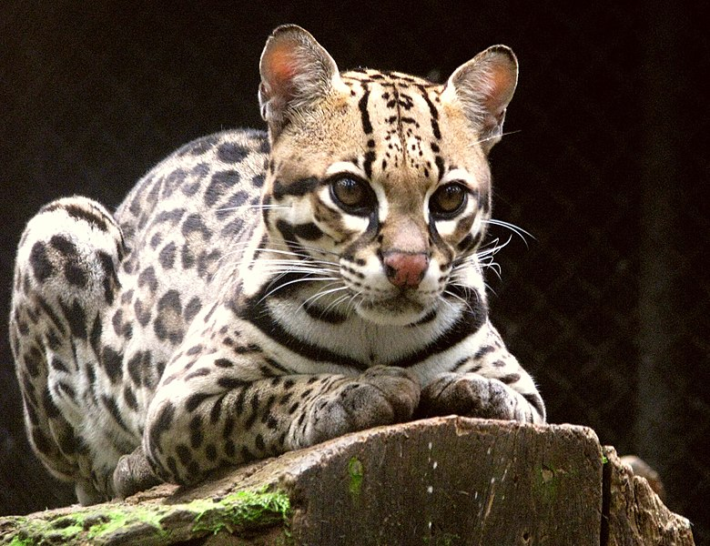
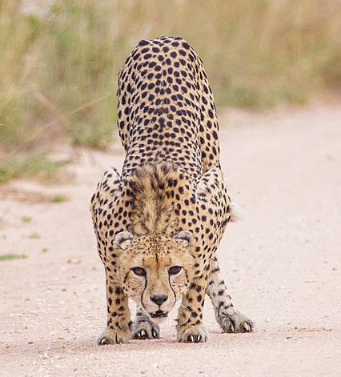
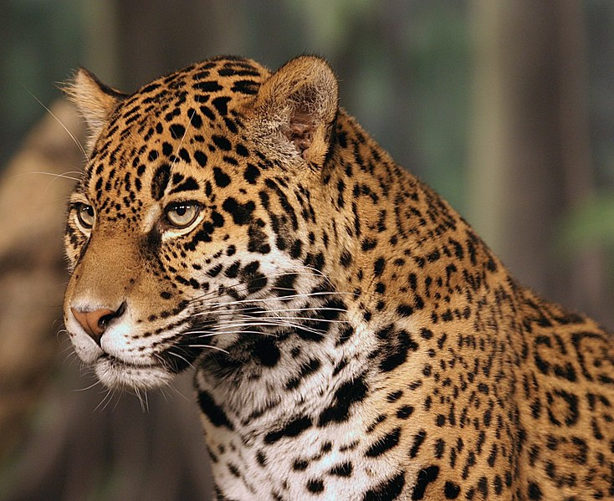
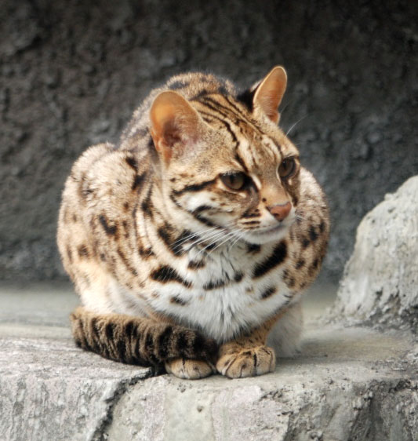
Q2
A- Geoffrey’s cat
Leopardus geoffroyi
D- Ocelot
Leopardus pardalis
B- Cheetah
Acinonyx jubatus
C- Jaguar
Panthera onca
E- Leopard cat
Prionailurus bengalensis

Slide 5
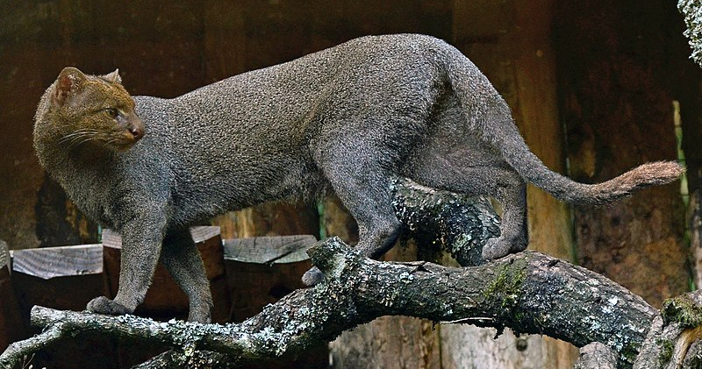
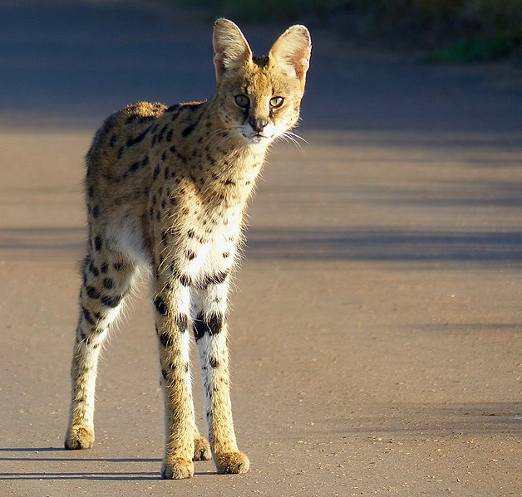
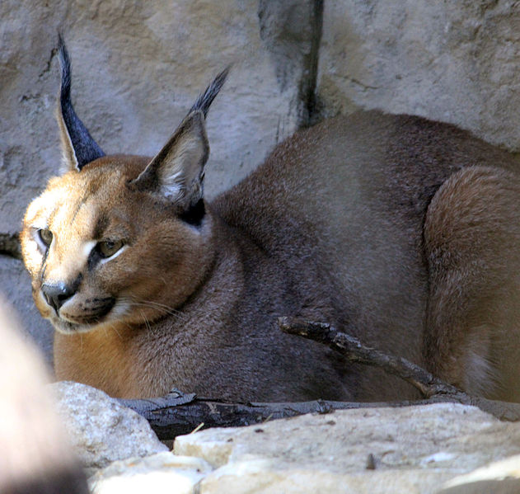
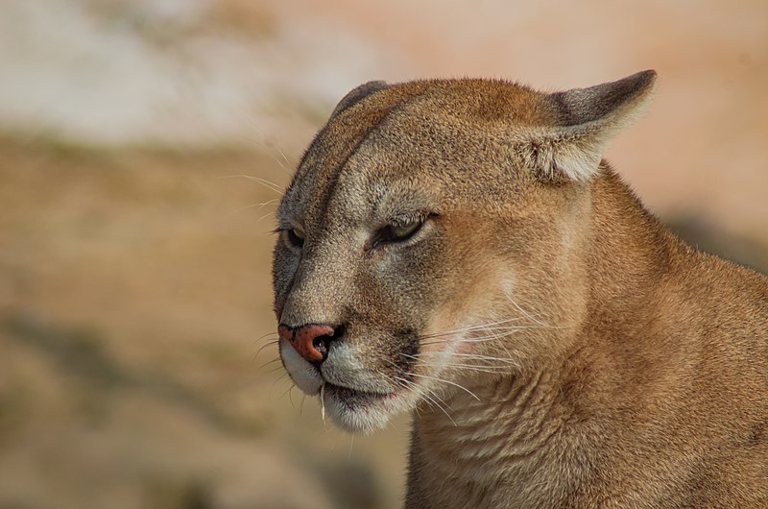
Q3
B-Herpailurus yagouaroundi
A-Leptailurus serval
C-Caracal caracal
D-Puma concolor

