Slide 1
Generic Online Services
Using Navigational Programming
AIST proposal discussion
Friday, 6/24/2011
Lei Pan
Jet Propulsion Laboratory
California Institute of Technology

Slide 2
Navigational Programming
NavP: Navigational Programming
  The programming of migrating computations
  Describe distributed computation following locus change, as opposed to at stationary locations
  Computations can actively migrate to follow (large-sized) data in the network
Demo-ed for parallel distributed programming
  Unifies shared- and distributed-memory programming models
  Construct mobile pipelines using distributed sequential computations (DSC)
  Incremental
  Parallelizes problems that are impossible/too hard for MPI
  As fast or faster than MPI
Propose to facilitate online services
  Leverage DSC (distributed sequential computing)
  Generic online services independent of applications, but programmable to do anything
  Dynamically configurable

Slide 3
Enabling NavP: The Daemon System
Developed at UCI
Daemon network
Hop() statement
Agent variables vs. node variables
Messengers
Logical
Network
Daemon
Network
Physical
Network
…
hop(L1)
...
E
L1
L4
A
C
L5
F
L2
L3
B
D
daemon
daemon
daemon
Host1 Host 2 Host 3

Slide 4
NavP: Navigational Programming
Execution model:
  Logical network with logical nodes
  Self-migrating computations (navigational statements hop())
  User-level multithreading
  Synchronization uses “events”
Memory model:
  Stationary data is put in “node variables”
  Carried data is put in “agent variables”
  DSV (distributed shared variable)
Efficiency considerations:
  Code does NOT move (more than once), computation does
  Overhead – book-keeping data (~200 bytes)

Slide 5
NavP Simple Example
n1
n2
A
(0.1) If (rank = n1)
v1 = diag(A)
(1.1) send(v1, n2)
(1.2) recv(v2, n2)
(3) v3 = Av2
(3.1) Else If (rank = n2)
(3.2) recv(v1, n1)
(2) v2 = Bv1
(2.1) send(v2, n1)
(2.2) End If
B
Data distribution
(1) v1 = diag(A)
(2) v2 = Bv1
(3) v3 = Av2
(a) Sequential
(b) SPMD

Slide 6
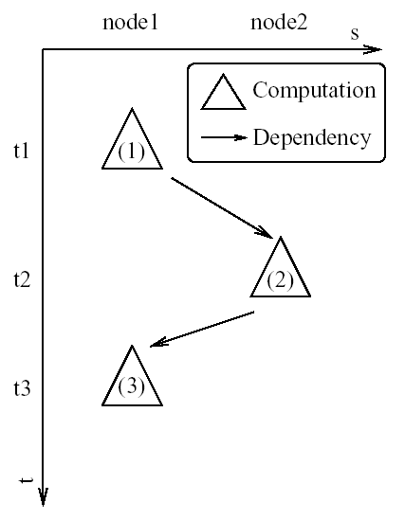
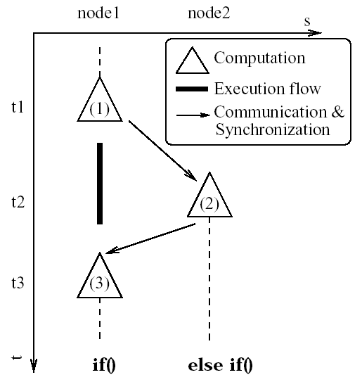
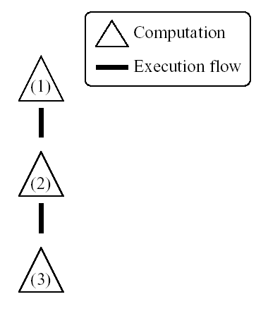
NavP Simple Example (cont’d)
Line (2) no longer in between (1) and (3)!
Sequential
Dependency & distribution
SPMD

Slide 7
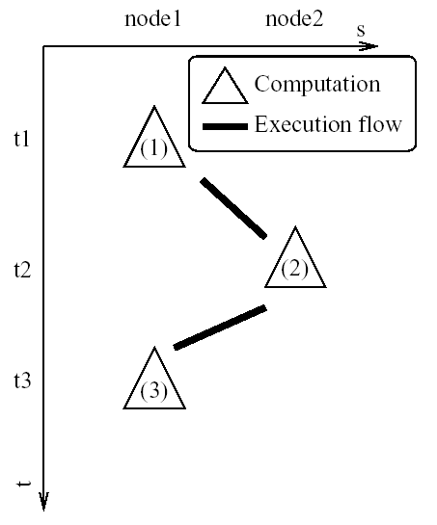
NavP Simple Example (cont’d)
v1 = diag(A)
(1.1) hop(n2)
(2) v2 = Bv1
(2.1) hop(n1)
(3) v3 = Av2
(c) NavP
hop(dest) -- pauses the computation, moves the computation locus to the destination, and resumes the computation
v1 and v2 are agent variables -- variables that follow the locus of computation
NavP

Slide 8
Structured Distributed Programming:
Uniprocessor Special Case
Send/Recv are goto in distributed programming
(0.1) If (rank = n1)
v1 = diag(A)
(1.1) send(v1, n2)
(1.2) recv(v2, n2)
(3) v3 = Av2
(3.1) Else If (rank = n2)
(3.2) recv(v1, n1)
(2) v2 = Bv1
(2.1) send(v2, n1)
(2.2) End If
(0.1)
v1 = diag(A)
(1.1) goto L1
(1.2) L2:
(3) v3 = Av2
(3.1)
(3.2) L1:
(2) v2 = Bv1
(2.1) goto L2
(2.2)
(a) SPMD
(b) SPSD

Slide 9
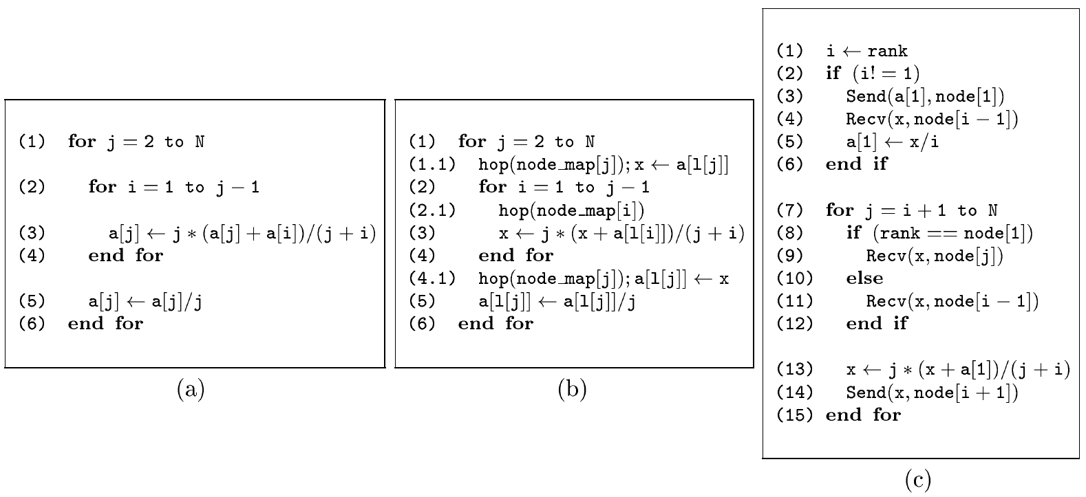
Nested Loops?
sequential
use DSC
(Distributed Sequential Computing, new)
Global view of data (as opposed to “fragmented view” in MP)
The principle of pivot-computes (new)
MPI
DBlock analysis (new)
The dependency hard to describe
efficiently (a class of problems)
spent 2+ months using MPI with
no success
spent 2 hours with NavP with
scalable performance
Use Mobile Pipelines (new, subsumes DOALL,
only possible with computation mobility)
Analogy:
factory vs. farmland
j
j+1
PE1
PE2
PE3
PE4
PE5

Slide 10

Analogy: Describing a girl on a train
How do you describe a girl sitting on a train?
  Hold a video camcorder and sit next to her (Lagrangian)
  Station a line of people along the railway to take snapshots of her as she passes them in the train, and assemble the pictures into a video later (Eulerian)

Slide 11
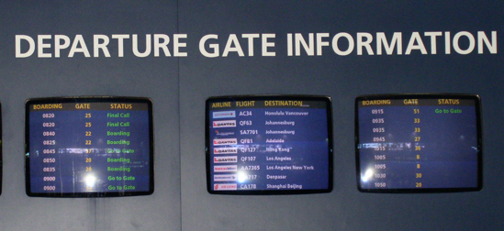
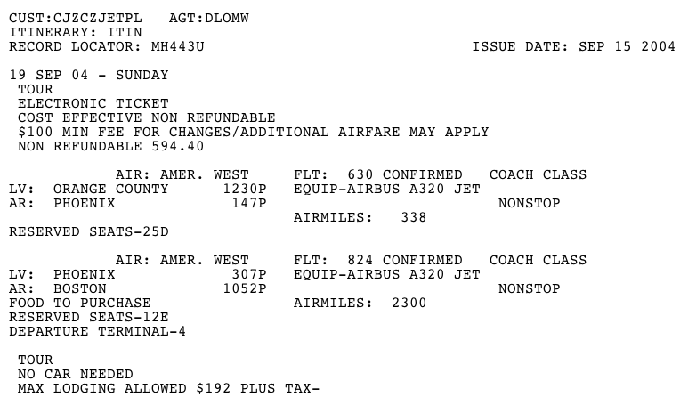
Analogy: Itinerary vs. Arrivals & Departures
Arrivals & Departures: a description of train information at locations
Itinerary: a description of trains following their movement
Arrivals & departures (description at locations)
Itinerary
(try inserting hops in between destinations)

Slide 12
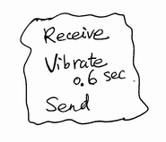
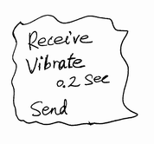
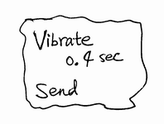
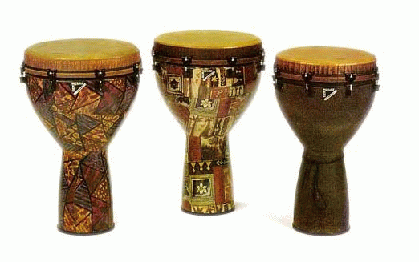
Analogy: Drums or Drummer?
Programming the drums?

Slide 13
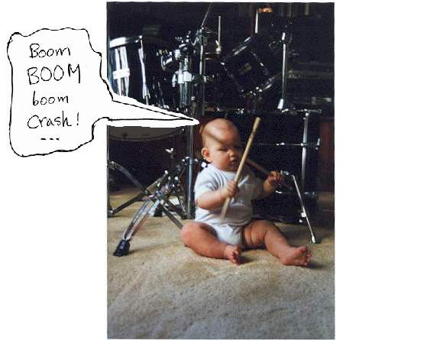
Analogy: Drums or Drummer? (cont’d)
Or the drummer?

Slide 14
More Analogies
Buffet vs. Banquet:
  Buffet: diners serve themselves – computation migration
  Banquet: diners sit, food rotates – stationary processing
Farmland vs. Factory:
  Farmland: machines (processing) move, large data (land) stationary
  Factory: parts (data) move, workers (processing) stationary

Slide 15
What to Build
Python interpreter network
Hop() statement
Agent variables vs. node variables
Local file I/O with URI
Python code translator
Messengers
HTTP Web
(resource, redirection)
Daemon
Network
Physical
Network
…
hop(URL)
...
python
interpreter
python
interpreter
python
interpreter
Host1 Host 2 Host 3

Slide 16
Advantages over Client-Server
One piece of code – the DSC code:
  The scientist owns it, runs it, and maintains it
Interactive exploratory execution:
  Try new algorithms at anytime
Dynamic configuration:
  More interactive functions, or more performance
  n! combinations for client-server (n: # of composing services)
No need to choose communication protocols:
  App. programmers do not need to choose to speak CORBA vs. SOAP vs. RESTful, or text vs. XML vs. Json
  Only use variables as in sequential programs (Shared Variable Programming Beyond Shared Memory)
Generic online services that are programmable:
  Services for OSCAR, ATrain co-location, Ocean Tidal Loading, MOWS (Malaria), … , are all the same, only the source data mounted may differ
  The user defines service behavior

Slide 17
Selected Publications
L. Pan, M.K. Lai, K. Noguchi, J.J. Huseynov, L.F. Bic, and M.B. Dillencourt, “Distributed Parallel Computing Using Navigational Programming,” International Journal of Parallel Programming (IJPP), Vol. 32, No. 1, Kluwer Academic Publishers, Feb. 2004.
L. Pan, L.F. Bic, M.B. Dillencourt, and M.K. Lai, “Distributed Sequential Computing,” Book chapter, In Parallel and Distributed Scientific and Engineering Computing: Practice and Experience, (Y. Pan and L.T. Yang Eds.), Nova Science Publishers, Inc., NY, 2004.
L. Pan, L.F. Bic, M.B. Dillencourt, and M. K. Lai, “NavP Versus SPMD: Two Views of Distributed Computation,” In 15th Int'l Conf. on Parallel and Distributed Computing and Systems (PDCS’03), Marina del Ray, CA, November 2003.
L. Pan, L.F. Bic, and M.B. Dillencourt, “Distributed Sequential Computing Using Mobile Code: Moving Computation to Data,” In 30th Int'l Conf. on Parallel Processing (ICPP’01), Valencia, Spain, September 2001.
L. Pan, W Zhang, A. Asuncion, M.K. Lai, M.B. Dillencourt, and L.F. Bic, “Incremental Parallelization Using Navigational Programming: A Case Study,” In 34th Int'l Conf. on Parallel Processing (ICPP’05), Oslo, Norway, June 2005.
L. Pan, M.K. Lai, M.B. Dillencourt, and L.F. Bic, “Mobile Pipelines: Parallelizing Left-looking Algorithms Using Navigational Programming,” In 12th Int'l Conf. on High Performance Computing (HiPC’05), Goa, India, Dec. 2005.
L. Pan, W Zhang, A. Asuncion, M.K. Lai, M.B. Dillencourt, L.F. Bic, and L.T. Yang, “Toward Incremental Parallelization Using Navigational Programming,” The IEICE Trans. Inf. & Syst., Vol. E89-D, No. 2, pp. 390-398, Feb. 2006.
L. Pan, J. Xue, M.K. Lai, M.B. Dillencourt, and L.F. Bic, “Toward Automatic Data Distribution for Migrating Computations,” Submitted to 20th Int'l Conf. on Supercomputing (ICS’06), Cairns, Australia, June--July. 2006.
L. Pan, “Navigational Programming: Toward Structured Distributed Parallel Programming,” Tutorial at 14th Int'l Conf. on Parallel Architectures and Compilation Techniques (PACT’05), St. Louis, MO, Sept. 2005.
L. Pan and J. Xue, “NavP: Structured and Multithreaded Distributed Parallel Programming,” Tutorial at 20th Int'l Conf. on Supercomputing (ICS’06), Cairns, Australia, June--July. 2006.

Slide 20
Backup slides

Slide 21
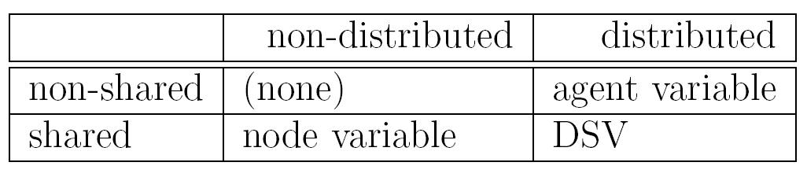
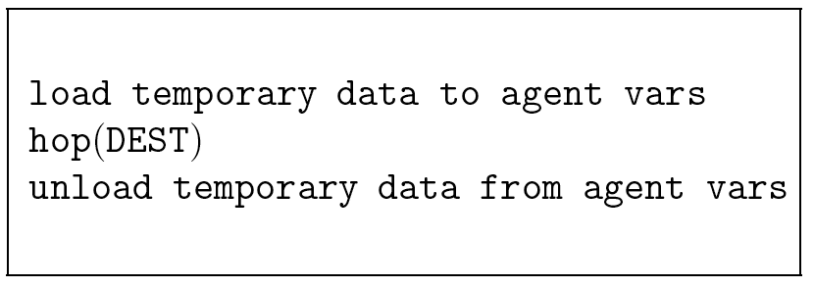
NavP: Shared Variable Programming Beyond Shared Memory
Node vs. agent variables
DSV: Distributed Shared Variable
A compound navigational statement

Slide 22
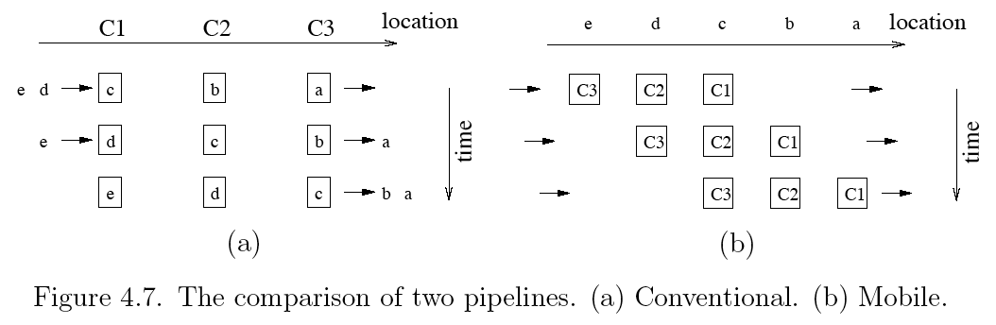
NavP Simple Example (cont’d)
Animation: pipe.swf
conventional vs. mobile pipelines
  factory work vs. farmland work
  carpet cleaning vs. laundry
  Chinese banquet vs. western buffet

Slide 23
Difficulties with MP Implementation
Adapting to arbitrary data distribution
  Irregular communication pattern
  Partial sorting and queuing needed
Code restructuring
  Loops broken
  Repeated core code lines
  Large amount of auxiliary code
Termination complicated
  Anticipate number of messages a node will receive
Self-sending using shared memory
  Use queues (sending to a node itself is expensive with MPI)
Deadlock
  Balance receiving, processing, and sending (need MPI_THREAD_MULTIPLE)
  Or learn the tricks of posting recv’s at the right place

Slide 24
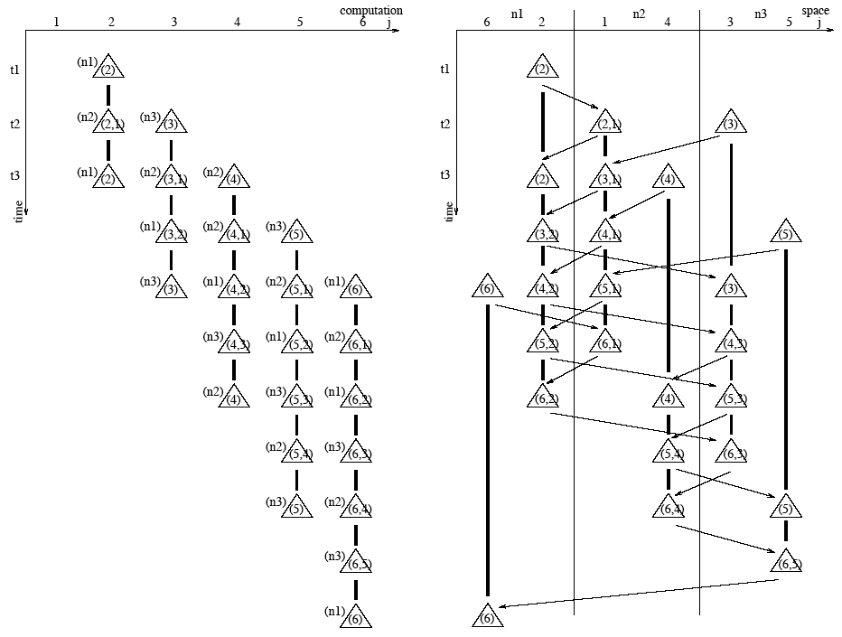
Regular vs. Irregular Communication Patterns
NavP
MP

Slide 25
Section 5: Case Studies
Case selection rationale
Solving linear systems accounts for the majority of CPU time in numerical computation
Direct solvers are harder to parallelize than iterative solvers
Real-world examples
Crout factorization: A “left-looking” matrix factoring algorithm
Cholesky factorization: A “right-looking” matrix factoring algorithm
Matrix multiplication: A lot of parallelism
Performance
NavP implementations of the algorithms perform well
NavP Cholesky code performs as fast as ScaLAPACK
NavP matrix multiplication performs faster than ScaLAPACK

Slide 26
Case Study 1: Crout Factorization (cont’d)
MP implementation is left as an open problem
NavP code performance

Slide 27
Remember the Software Crisis in the 1960s?
Goto Statement Considered Harmful
  by Edsger W. Dijkstra, Communications of the ACM, Vol. 11, No. 3, March 1968, pp. 147-148
  Suggestion: Abolish goto and use structured programming
Send-recv considered harmful: Myths and realities of mesg passing
  by Sergei Gorlatch, ACM Transactions on Programming Languages and Systems, Vol. 26 , Issue 1, January 2004
  Suggestion: Use collective operations, e.g., broadcast, reduction, etc. to replace send and recv <--- not scalable!
Current approaches inherently limited
  MPI uses “goto” hence unstructured programming and difficult
  High level languages rely on compilers; not fast enough without human inputs
  OpenMP: relatively easy but only for shared memory
  MPI+ OpenMP hybrid: fast but more difficult than MPI
  X10 and Cascade both use threads? Need to return (similar to RPC,still SPMD)
NavP uses hop() (not a temporal goto)
  Distributed computations are fundamentally Lagrangian
  Analogy: travel with an itinerary or with arrivals-and-departures

Slide 28
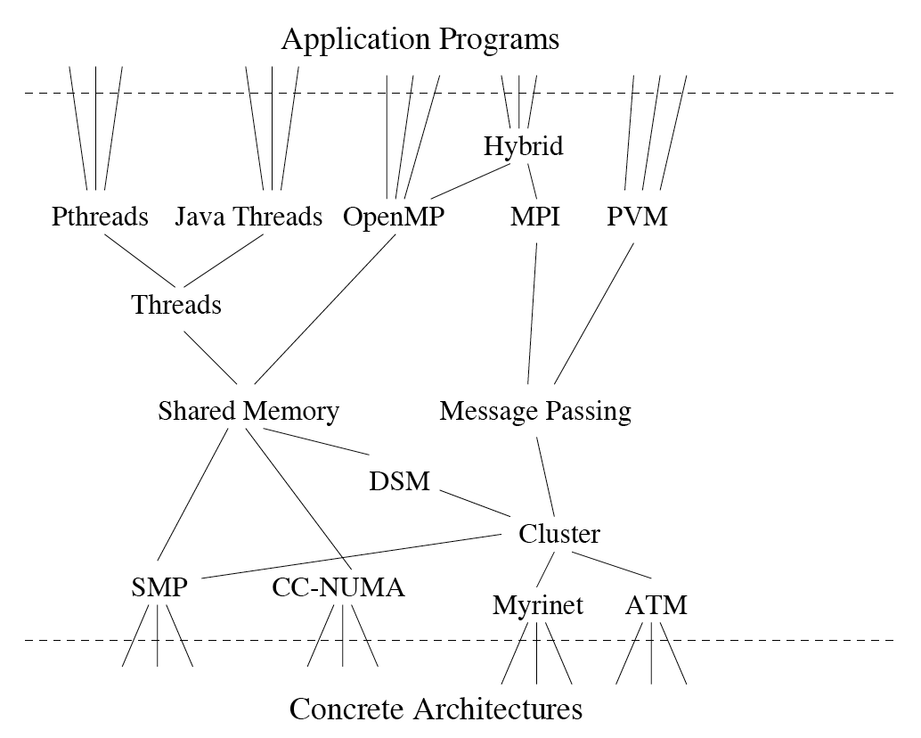
NavP Contribution?
NavP
computation mobility
Main Features:
Exploits both fine (multithreading) and coarse (pipelined tasks) grained parallelism and hence promises higher performance
Unifies programming models and hence reduces the complexity of code porting
Relies more on system-level capabilities/optimization
Automatable
(Adapted from Leopold 2001)

