Slide 1
bread crumbs

Slide 2
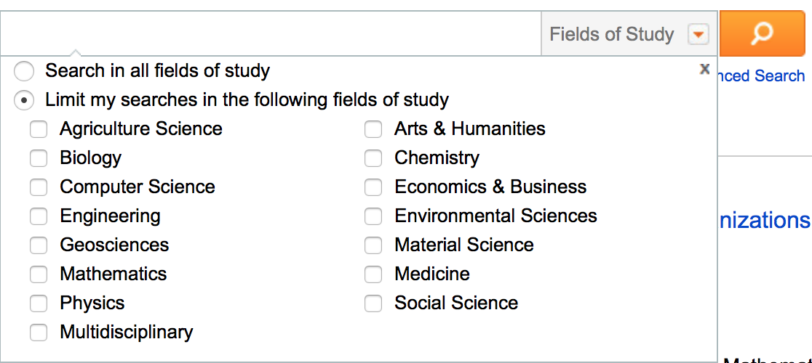

filtering

Slide 3
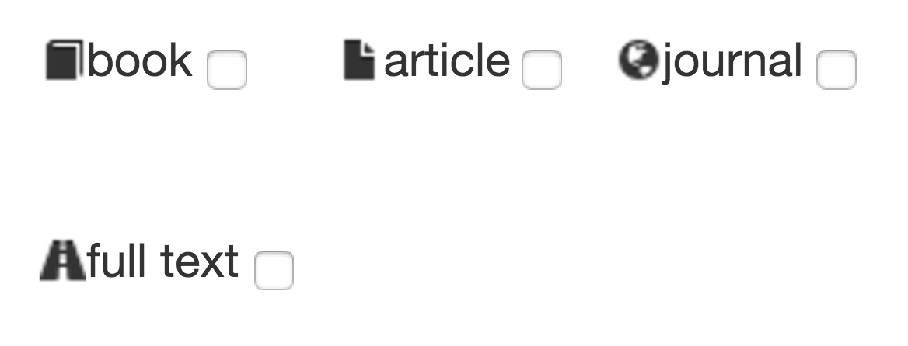
dynamic queries

