Slide 1

WIC AI INNOVATOR CAPSTONE
Lumen
Defensible AML Decision Workbench
91.1%
765
9
7
Evidence Completeness
Tests Passing
Claim Types Locked
Control Layers
Leishka · Shivani · Ryan · Suli
Notes:
Leishka – Lumen is not another AI chatbot. It is an AML decision workbench built around one principle: the AI must prove its claims before a human can rely on them. "Hello. I'm Leishka Pagan, team lead and engineer for Lumen. Our team also includes Shivani, Ryan, and Suli.
Lumen helps bank investigators review anti-money-laundering alerts without blindly trusting AI. It brings the evidence into one place, checks every AI claim against the source records, and records why a person made the final decision.
The numbers show the controls behind it. In our demo data, ninety-one percent of the required evidence is ready when a case opens. The AI is limited to nine checkable claim types, governed by seven control layers, and backed by seven hundred and sixty-five automated tests.
The goal is simple: AI can help with speed, but it never gets the final word.
Here is the problem we built Lumen to solve."

Slide 2



The Problem
95%
Alert Fatigue
Analysts open 5 to 7 browser tabs per case just to find a customer ID, transaction history, and prior alerts.
of AML alerts are false positives
AI Hallucinations Go Unchecked
Source: LexisNexis Risk Solutions
Existing tools pass AI summaries directly to analysts. When the AI is wrong, no technical control catches it.
45 min
Rubber-Stamp Culture
manual data-gathering per case
(ACAMS benchmark)
Time pressure turns human review into a checkbox. Regulatory risk follows every unchallenged approval.
Notes:
Leishka - But alert volume is only half the problem. AI-generated summaries can enter that same queue without a system checking whether the claims match the bank's records. When analysts are already under pressure, review becomes a checkbox instead of a real investigation. If the AI is wrong, the bank is left defending a decision based on a claim that was never verified.
That is the gap Lumen was built to close.

Slide 3
Our Answer
The model drafts. Code verifies. Humans decide.
01
02
03
Structured Claims First
Deterministic Verification Second
Human Approval Last
The AI emits JSON claims from a closed 9-type vocabulary. No free prose. Every claim is a checkable data object.
Python code checks every claim against source tables. Returns PASS, FAIL, or NEEDS REVIEW. No LLM judging another LLM.
Anti-rubber-stamp gate. A review is not complete until evidence, rationale, and a final action are recorded. The AI never decides.
Most AI compliance tools try to make analysts trust AI faster. Lumen does the opposite.
Notes:
Leishka - So we started from a different question. Most AI tools ask how to get analysts to trust AI faster. We asked how to make the AI prove itself first.
Three steps, always in this order. The AI drafts a checkable claim with a type, a value, and a source reference. Deterministic code checks it against the bank's records and returns supported, contradicted, or needs review. Then the analyst decides, after seeing which claims survived.
Suli - The vocabulary this all runs on, the nine claim types and the terminology, was standardized by our teammate Suli.
The model drafts. Code verifies. Humans decide.

Slide 4





What We Actually Built
This separates us from teams who made a concept deck.
data/
src/schema.py
src/llm_drafter.py
Synthetic AML dataset (8 sources + audit)
30 customers, 187 transactions
Seeded demo cases and review records
Evidence completeness averages 91.1%
Pydantic v2 validation models
Closed 9-type claim vocabulary
Single source of truth for all tables
Anthropic tool-use API call
Forced structured claim output
3-gate schema enforcement
Never-raise fallback behavior
src/verifier.py
src/pipeline.py
tests/ (765 tests)
9 deterministic verifier functions
PASS / FAIL / NEEDS_REVIEW
Field-based and pattern-based checks
Intended production wiring
Chains draft, verify, and gate
Demo calls the verifier directly
Data integrity and demo cases
LLM drafter mock coverage
Verifier + negative paths
Demo seed governance
Notes:
Leishka - Here is what sits behind the workbench. Lumen starts with synthetic banking data: thirty customers, one hundred and eighty-seven transactions, and thirty-nine alerts.
In the intended production flow, the AI drafter turns those records into one of nine structured claim types. The schema rejects anything malformed, and nine code-based checks compare each claim with the source records, returning PASS, FAIL, or NEEDS REVIEW.
The pipeline connects those pieces, while this demonstration calls the verifier directly for consistency. Reviews and overrides are then written to the audit trail.
That gives Lumen a working path from source data to a traceable human decision. Now let me show you the controls around it.

Slide 5
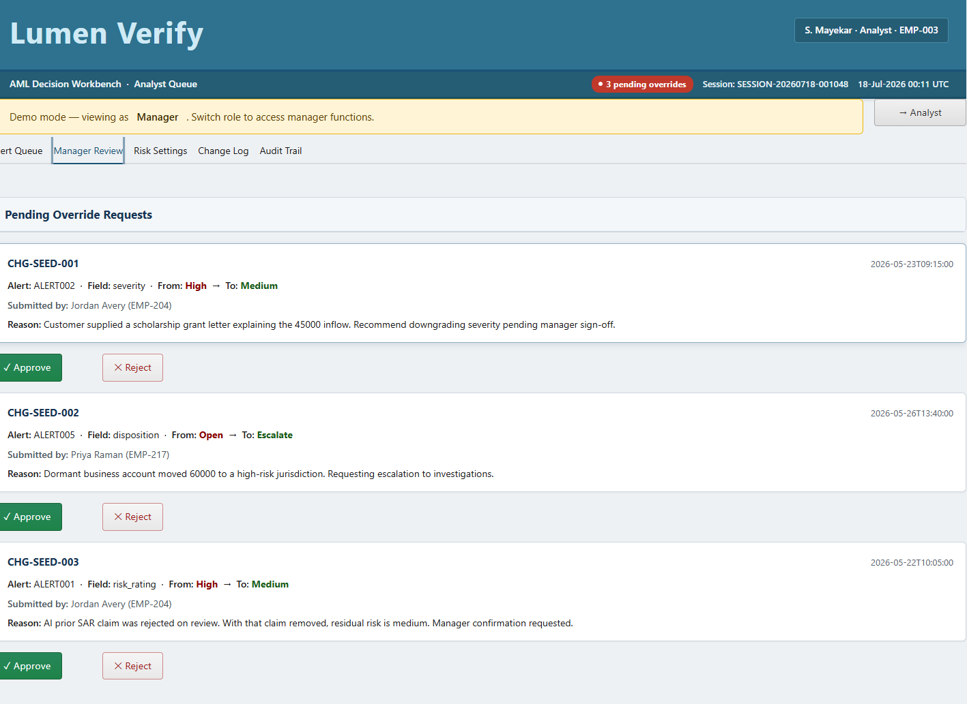
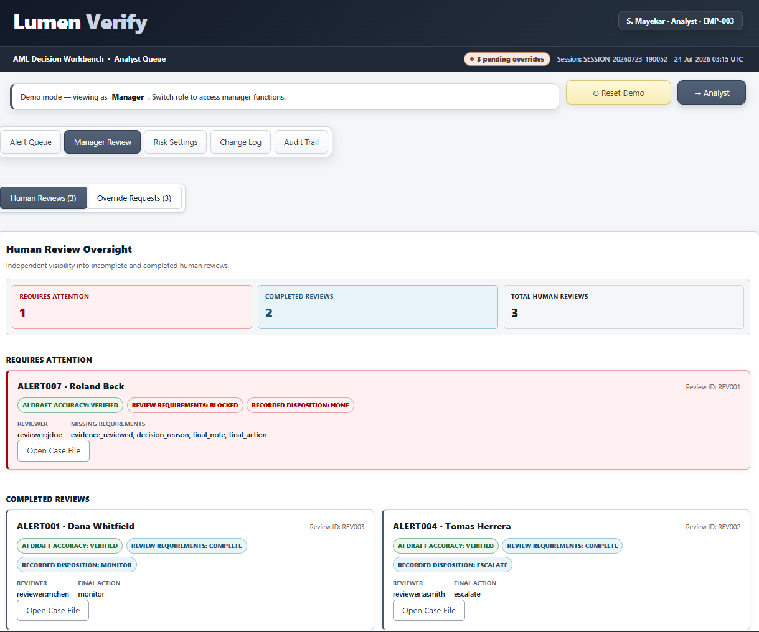
From Alert Queue to Decision Workbench
One screen, built in two stages.
STAGE ONE
The Alert Queue
Where the work arrives
STAGE TWO
The Decision Workbench
Where the work gets decided
ALERT QUEUE
CASE FILE
SEVERITY
STATUS
SUPPORTED
CONTRADICTED
HUMAN-REVIEW GATE: BLOCKED
The work becomes visible.
Built by Shivani Mayekar
The decision becomes defensible.
Built by Leishka Pagan
Every commit is public in the linked repository.
Notes:
Leishka - The queue tells the analyst where to start. Stage two makes sure the case cannot end with a quick click.
When a case opens, the source evidence appears beside each AI claim. Every claim receives a clear result: supported when the records agree, contradicted when they do not, or needs review when the source data is missing.
Then comes the human-review gate. Before the review can be completed, the analyst must confirm the evidence, record whether the AI draft was accepted, edited, or rejected, explain the decision, leave a final note, and select the final action.
Opening a case is not the same as completing a defensible review. Lumen enforces the difference.

Slide 6
The Lumen Control Stack
AI output is not trusted until it passes every control.
Closed Claim Vocabulary
Human Approval Gate
1
5
AI can only emit 9 approved claim types. Anything outside is rejected.
A review is not complete until evidence, rationale, and a final note are recorded. Enforced in review_gate.py.
Structured JSON Output
Controlled Audit Vocabulary
2
6
No free-form prose. Every claim is a typed, checkable data object.
Every audit event must use an approved action name. Phantom events are caught by tests.
Schema Enforcement
Examiner Replay
3
7
Tool schema + Python validation gates reject invalid AI output before verification.
Examiner-reviewable audit trail reconstructs any decision with actor, action, timestamp, and approved event vocabulary.
Deterministic Verifier
4
Python checks each claim against source tables. PASS, FAIL, or NEEDS_REVIEW.
We did not just add AI. We built seven controls around AI.
Notes:
Leishka - Everything I have shown you so far is one of seven controls.
The vocabulary the AI is locked to, the structured output that made checking possible, the verifier that just ran, the gate you saw block a sign-off.
Three more sit around them: schema validation before the verifier ever runs, a controlled audit vocabulary so events cannot drift, and examiner replay so any decision can be reconstructed.
Every bank already has a policy that says review the evidence. We did not write a better policy. We made it impossible to skip

Slide 7
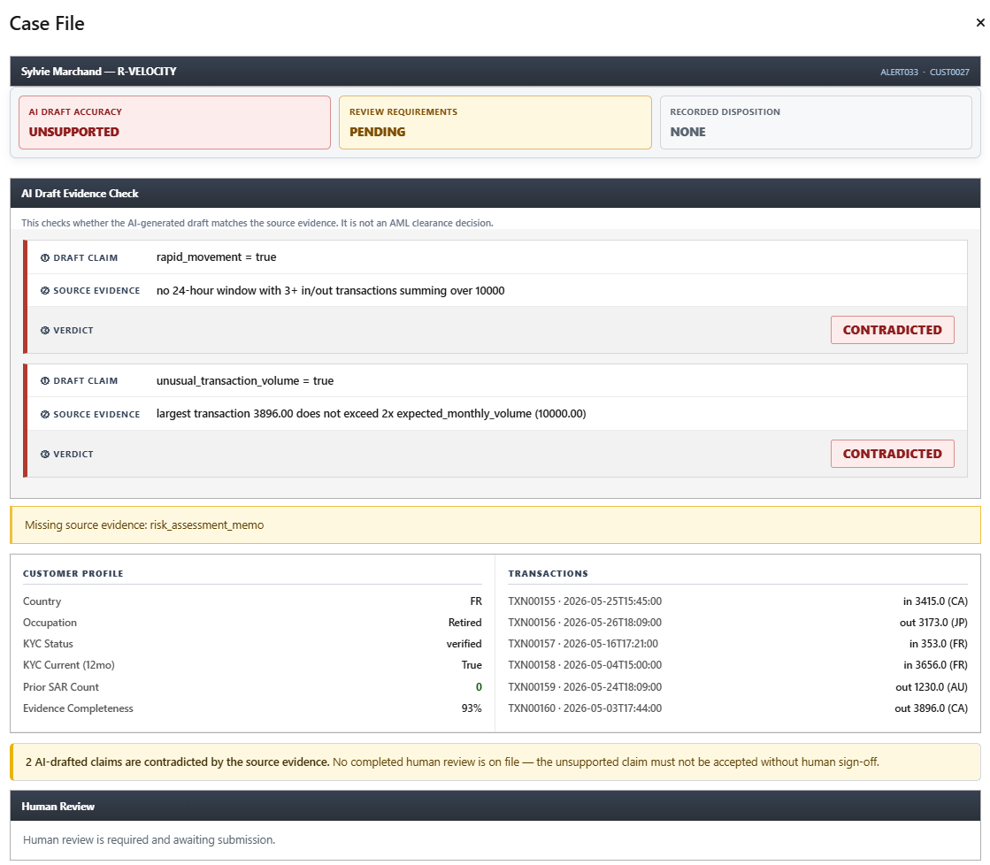
Hero Moment 1: The AI Gets Caught
AI DRAFT
AI asserts funds moved rapidly through the account
Why This Wins
rapid_movement = true
The AI asserted two findings the source data does not support
SOURCE DATA
transactions table does not support the pattern
Deterministic Python caught it before the analyst ever saw it
no qualifying transfer pattern
Verifier returns FAIL, not a warning, not a suggestion
VERIFIER
Deterministic Python catches it. The analyst sees CONTRADICTED.
FAIL
32 of 93 AI claims across the dataset were contradicted by source evidence
RESULT
Second claim fails the same check. Both contradicted.
Every step is logged with actor and timestamp
UNSUPPORTED
Notes:
Leishka - "ALERT033 shows what happens when the AI sounds confident, but the records disagree.
First, it said money moved rapidly through the account. The rule requires at least three transactions, with money coming in and going out, totaling more than ten thousand dollars within twenty-four hours. The records show only two, totaling about seventy-five hundred. Contradicted.
Then it called the transaction volume unusual. The rule flags transactions over twice this customer's expected monthly volume. Their expected monthly is five thousand, so the threshold is ten thousand. The largest transaction was under thirty-nine hundred. Contradicted again.
This was code checking the records, not another AI. The case was marked unsupported. Across the dataset, thirty-two of ninety-three AI claims were contradicted, and every one was flagged before an analyst could rely on it

Slide 8
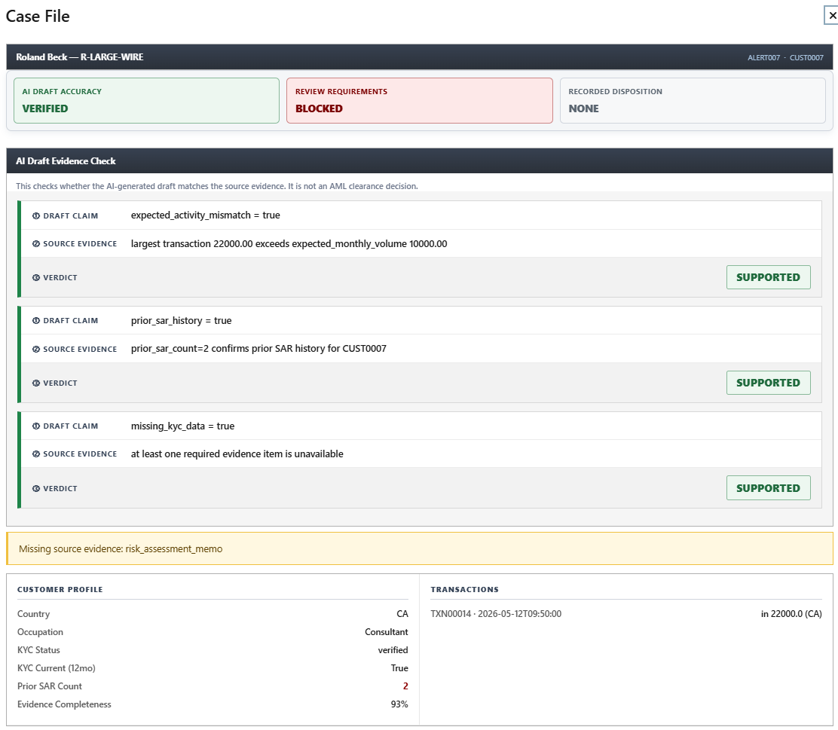
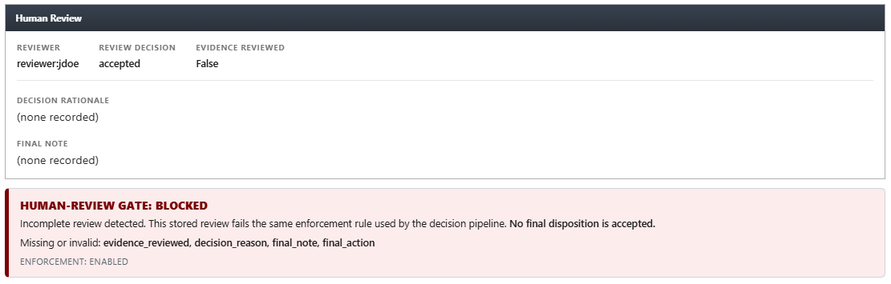
Hero Moment 2: No Rubber-Stamping
Required before a review counts as complete:
Seeded Demo Case: ALERT007, AI draft VERIFIED
Evidence reviewed by analyst
REV001 (ALERT007) in human_reviews.csv has draft_disposition = accepted but decision_reason and final_note are empty and evidence_reviewed = false.
AI draft accepted, edited, or rejected
The gate detects this and blocks.
Decision reason written (minimum one sentence)
Current model-risk guidance reinforces the need for documented oversight, validation, and controls. This gate turns human accountability into a technical requirement, not a policy suggestion.
Final analyst note written
Final action selected
REVIEW BLOCKED
Notes:
Leishka - Now look at the opposite risk. In ALERT007, the AI was right. All three claims matched the records.
But the gate is still blocked. The analyst accepted the AI draft without confirming the evidence, explaining the decision, or completing the final note and action.
Watch what happens when I complete those steps. The gate changes from blocked to complete.
That distinction matters. Lumen is not checking whether the analyst agrees with the AI. It is checking whether the analyst reviewed the evidence and documented the decision. A correct AI answer still does not replace human accountability.

Slide 9
Hero Moment 3: The Happy Path
Structuring Alert. CUST0004. Two supported claims. Complete review, 100% evidence completeness.
1
2
3
AI Drafts
Verifier Confirms
Analyst Decides
llm_drafter pulls transaction history and KYC profile. Emits structuring claim via JSON schema.
Python checks: 2+ deposits in 72 hours, each between $9,000 and $9,999. Returns PASS.
Pre-assembled verified summary. SUPPORTED badges. Analyst reviews, writes justification, records the disposition.
45 min
10 min
35 min
3x
Manual prep (ACAMS)
Lumen review (est.)
Time saved (est.)
Throughput (est.)
Notes:
Ryan

Slide 10
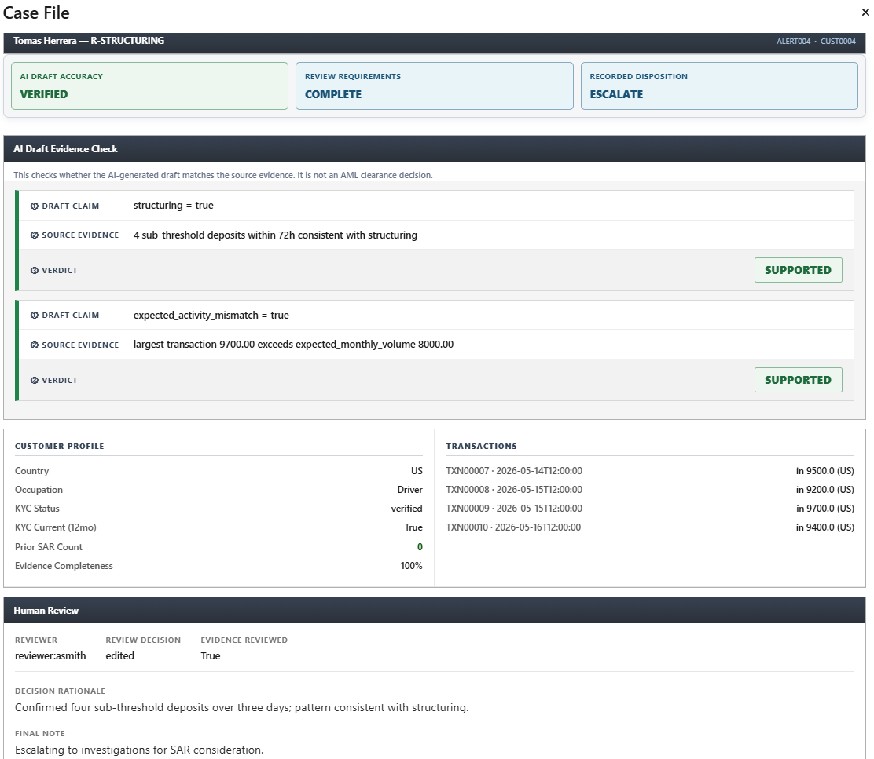
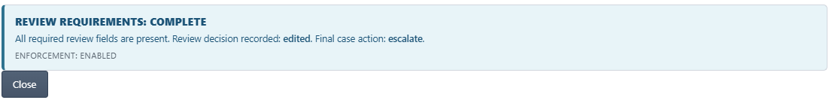
The Same Story,
In the App
Hero Moment 3 in the actual Case File
Two SUPPORTED verdicts
AI Draft Evidence Check panel
100% Evidence Completeness
Customer Profile block
Complete human review
Rationale, evidence, and action
Gate opens
REVIEW REQUIREMENTS: COMPLETE

Slide 11
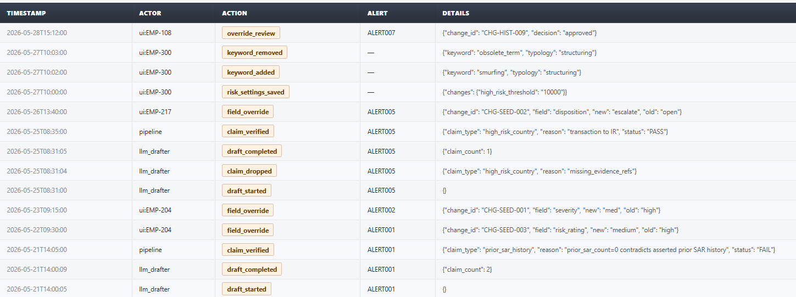
System Architecture
Six architecture layers. Five run in the demo path. AI drafting is captured live and replayed deterministically.
0
1
2
3
4
5
Data Layer
Triage + Readiness
AI Draft
Verification
Human Gate
Audit Trail
9 synthetic CSVs
Severity matrix
llm_drafter.py
verifier.py
Anti-rubber-stamp
audit.py
LIVE
LIVE
REPLAYED
LIVE
LIVE
LIVE
Streamlit UI · Surfaces all 6 layers to the analyst in a single workbench view
Notes:
Leishka - Six layers behind everything you just watched. The data, the triage that produced the readiness scores, the AI draft, the verifier that returned the verdicts, the human gate, and the audit trail.
The audit strip at the bottom of the slide is a live capture. Every review and override decision writes to it with the actor, the action, the alert, and a timestamp, from a controlled vocabulary.
Draft events, verification events, and human decisions, all in one trail. This is what an examiner reads eighteen months later when they ask why a case closed.

Slide 12
Evidence Completeness Engine
91.1% is not hardcoded. It is computed from source evidence.
Evidence Completeness = available evidence items / total required evidence items
50%
1 Blocked Case
ALERT006 only. Review gate blocks completion.
60-70%
2 Below Threshold
ALERT002 at 60%, ALERT005 at 70%. Review proceeds with caution.
93-94%
36 Ready Cases
Pre-assembled by Lumen. Analyst can review.
91.1%
Overall Average
Evidence completeness computed from source data. Not hardcoded.
Notes:
What slide 12 uniquely does: it proves ninety-one point one percent is measured, not chosen, and it shows the queue's readiness split before any AI is involved.
Leishka - "Ninety-one point one percent is not a chosen number. For every alert, Lumen counts the required evidence items and how many are actually on file. That average comes out of the records.
Thirty-six of thirty-nine cases have the evidence to be reviewed today. Two need a closer look before proceeding. One is blocked, because a required item is missing entirely.
The completeness score sits on every row of the queue, so an analyst sees which cases are ready before opening any of them.

Slide 13
What Changes on Monday Morning
What the analyst faces | Manual review today | With Lumen
The analyst’s hour | Most of it goes to gathering data from five systems. | Evidence arrives 91.1% assembled. The hour goes to judgment.
Catching AI mistakes | The analyst has to notice the error while reading. | Code flags the contradicted claim before the case is opened.
The examiner’s file | Written up afterward, from memory, if at all. | A case cannot close without a rationale. The file writes itself.
Knowing where to start | Every alert looks equally reviewable until you dig in. | 36 of 39 cases are review-ready. 1 is blocked on missing evidence.
When the AI is wrong | The wrong claim reaches the human and may be believed. | 32 of 93 claims were contradicted. None reached an analyst.
The analyst stops collecting evidence and starts judging it. That change does not depend on the AI being good.
Notes:
Leishka - Every row here is a before and after. Today, most of the analyst's hour goes to gathering data from five systems. With Lumen, the evidence arrives already assembled, so the hour goes to judgment.
Today, if the AI is wrong, a tired analyst has to notice while reading. With Lumen, the code flags it before the case opens. And the examiner's file is no longer written from memory afterward. It is captured as the review happens.
The analyst stops collecting evidence and starts judging it. And notice: none of that depends on the AI being good. The checking is what delivers it.

Slide 14
Built for Volume: What Happens at 10,000 Alerts
Cost to check one claim
AI errors stopped
1,000 alerts
10,000
100,000
1,000 alerts
10,000
100,000
Flat. Verification is code reading a table, with no AI call involved.
Rises with volume. Roughly one claim in three needs catching.
Only drafting scales in cost
Governance cannot loosen
More volume, more value
and that is the piece a bank can throttle or route by severity.
a tenth claim type requires writing its check first, at any size.
the control layer is worth more at scale, not less.
The checking never gets more expensive. The errors it stops keep growing. Volume works in your favor, not against you.
Notes:
Slide 14, Built for Volume.
Leishka – Here is the scale advantage. If one AI checked another, every claim would require a second paid AI review, and that cost would grow with volume.
Lumen uses fixed rules in code to compare each claim with the source records instead. No second AI charge, no matter the volume.
That is the left chart. The right shows the benefit. As more alerts pass through the system, more contradicted claims are caught.
Lumen scales the protection without paying another AI to provide it.

Slide 15
Business Value
35 min
3x
$45/hr
saved per alert
analyst throughput
analyst loaded cost
Estimate. 45 min manual vs 10 min Lumen
Estimate. More low-level alerts cleared per day
BLS avg + 30% overhead
Sources
False-positive rate 90-95%: LexisNexis Risk Solutions
Case prep 30-45 min: ACAMS benchmarks. Lumen-side times are design estimates, not measured.
Analyst cost $90K loaded: BLS + Glassdoor + 30% overhead

Slide 16
Governance and Regulatory Alignment
SR 26-2
April 2026. Supersedes SR 11-7 and SR 21-8. Explicitly excludes generative AI from the legacy model risk framework. Lumen's verification spine is designed as a practical control layer around GenAI-assisted compliance work.
FinCEN Oct 2025 SAR FAQ
Supports disciplined SAR decisioning and value-over-volume reporting. Lumen preserves the evidence trail and human rationale behind AI-assisted case decisions.
FFIEC Examination
SAR narratives and supporting records must be accurate, complete, and explainable. Lumen preserves claim-level verification results and an examiner-reviewable audit trail.
If this system were deployed tomorrow at a global bank, would it align with regulator expectations?
Notes:
Ryan – Leishka – "The current model-risk guidance, SR 26-2 from April 2026, deliberately leaves generative AI outside the legacy framework.
That gap is the space Lumen was built into: verification, documented human oversight, and an examiner-reviewable trail.
We are not claiming regulatory approval. We are showing that when an examiner asks why a decision was made, Lumen can show the evidence, the reasoning, and who made it.

Slide 17
How Lumen Differs From Common AI Compliance Tools
Category | Common AI-First Approach | Lumen Verify
AI Output | Natural-language summary | Structured claim object
Claim Scope | Open-ended model response | Closed 9-type vocabulary
Validation | Mostly prompt-based | Tool schema + Python gates
Verification | AI-assisted confidence | Deterministic source-table check
Failure Behavior | Analyst still sees weak output | Contradiction flagged before review
Human Review | Checkbox approval | Required rationale gate
Audit Trail | Activity log | Controlled audit vocabulary
Demo Reliability | Live model dependency | Seeded deterministic default
Regulatory Posture | Trust AI with review | Distrust AI until proven
Lumen does not make AI more autonomous. Lumen makes AI prove whether it deserves to be used.
Notes:
Leishka – The difference between Lumen and common AI compliance tools is posture. Most tools trust the AI and rely on the analyst to catch problems.
Lumen distrusts the AI until code proves each claim.
Lumen is not built to make AI more powerful. It is built to make sure AI has no influence without evidence.

Slide 18

Testing Is Part of the Governance Model
765 passing tests prove the system behaves as claimed.
Data Integrity
Closed Vocabulary
Contradiction Detection
All 9 CSV tables exist and validate against Pydantic models. Core data is correct before any AI runs.
AI claims must match the approved 9-type vocabulary. Any claim outside it is rejected automatically.
AI claims a pattern the source tables do not support. Verifier returns FAIL. Proven in test, not just data.
Review Gate
Verifier Behavior
Demo Seed Governance
A review with no evidence check and no rationale evaluates as incomplete. The gate rule is tested and proven.
Unknown claim types do not crash. Missing source returns NEEDS_REVIEW. Known claims route to real checks.
Pending overrides, audit history, and evidence readiness are generated deterministically. No surprises on demo day.
Notes:
Leishka - Lumen includes seven hundred and sixty-five automated tests covering the behaviors that matter.
They confirm that contradicted claims fail, incomplete reviews stay blocked, unknown claim types are rejected, and missing evidence goes to human review instead of crashing the system.
They prove the controls still behave the way they should after every change.
That is why testing belongs in the governance model. The safeguards are not just written down. They can be checked again and again.

Slide 19
If this system were deployed tomorrow
at a global bank
Would executives trust it?
Would it align with regulator expectations?
Would investigators use it?
Yes.
Yes.
Yes.
91.1% evidence completeness. Documented audit trail. Model-risk-control aligned.
Aligned with SAR documentation discipline. FFIEC examination-ready. Hard human gate.
Pre-assembled, verified evidence instead of a manual hunt across systems.
The model drafts. Code verifies. Humans decide.
github.com/leishka-pagan/Lumen
Notes:
Leishka – If Lumen were evaluated tomorrow, three groups would ask three different questions.
Executives would ask whether the process is controlled. In our demo dataset, cases open with an average of ninety-one percent of the required evidence already assembled. Every AI claim is checked against the records, and every final decision is tied to a named reviewer and rationale.
Examiners would ask whether that decision can be reconstructed. Lumen preserves the evidence, the reasoning, the action taken, and the timestamp on each. That is what makes the process aligned with documented oversight expectations, without claiming regulatory approval.
Investigators would ask whether it helps them do the work. Instead of hunting across multiple systems, they open one case file with the evidence and verified claims together, while the final judgment remains theirs.
That is Lumen. The model drafts. Code verifies. Humans decide.

Slide 20
References
Source backup for all statistics, regulatory citations, and industry benchmarks used in this presentation.
ROI + Industry Benchmarks
False-positive rate (90-95%)
LexisNexis Risk Solutions. True Cost of Financial Crime Compliance Study. Annual report. Also corroborated by Reuters AML industry reporting.
Manual case prep time (30-45 min)
ACAMS (Association of Certified Anti-Money Laundering Specialists). Industry benchmark data on manual triage process time across core banking systems.
Analyst loaded cost ($90K / $45/hr)
U.S. Bureau of Labor Statistics (BLS) occupational wage data for Compliance Officers + Glassdoor salary data for AML Analysts, with 30% standard corporate overhead applied.
Regulatory Framework
SR 26-2 (April 2026)
Federal Reserve Board. SR 26-2: Revised Guidance on Model Risk Management. April 2026. Supersedes SR 11-7 and SR 21-8. Excludes generative and agentic AI from scope.
FinCEN SAR FAQ (October 2025)
Financial Crimes Enforcement Network. Suspicious Activity Report (SAR) Filing FAQ. October 2025. Addresses SAR narrative completeness and value-over-volume reporting standards.
FFIEC SAR Examination Guidance
Federal Financial Institutions Examination Council. Bank Secrecy Act / Anti-Money Laundering Examination Manual. SAR narrative accuracy, completeness, and explainability standards.
Appendix · Not presented unless asked · Available for judge review
Notes:
References – no need to presentation audio.

Slide 21
Explore Lumen
See the code. Try the app. Read the finding.
LIVE INTERACTIVE SITE
SOURCE CODE
leishka-pagan.github.io/Lumen
github.com/
leishka-pagan/Lumen
Architecture
Six-layer control stack, click any layer.
765 tests · full audit history · public
Playground
Run the deterministic verifier yourself.
CONNECT
The Finding
The prompt-vs-code research result.
Leishka Pagan
Team Lead & Engineer of Record
Scaling
Cost model, 100 to 100,000 alerts.
linkedin.com/in/
leishka-pagan
The model drafts. Code verifies. Humans decide.

