Slide 1
Photogram
Nobody Can Escape Your Selfies
Alexander Leishman

Slide 2
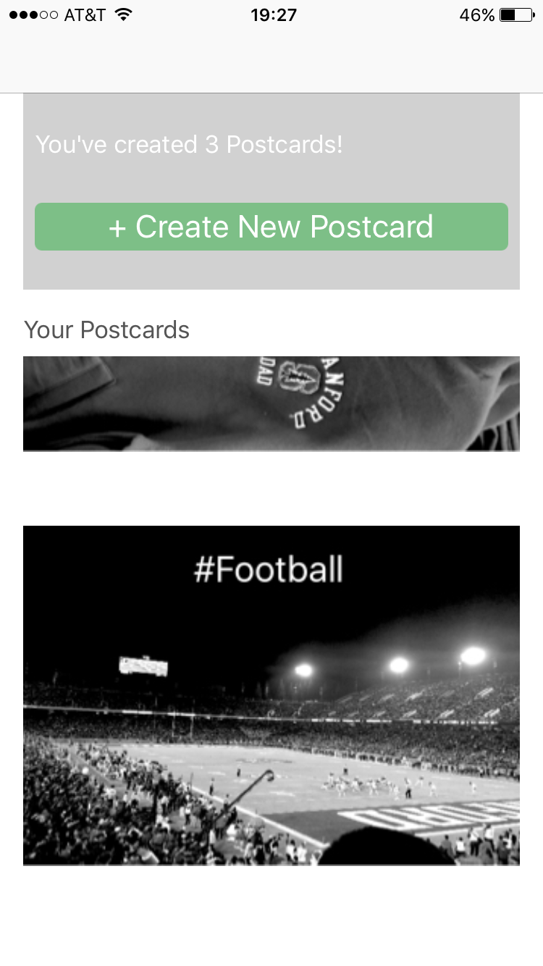
Home Page

Slide 3
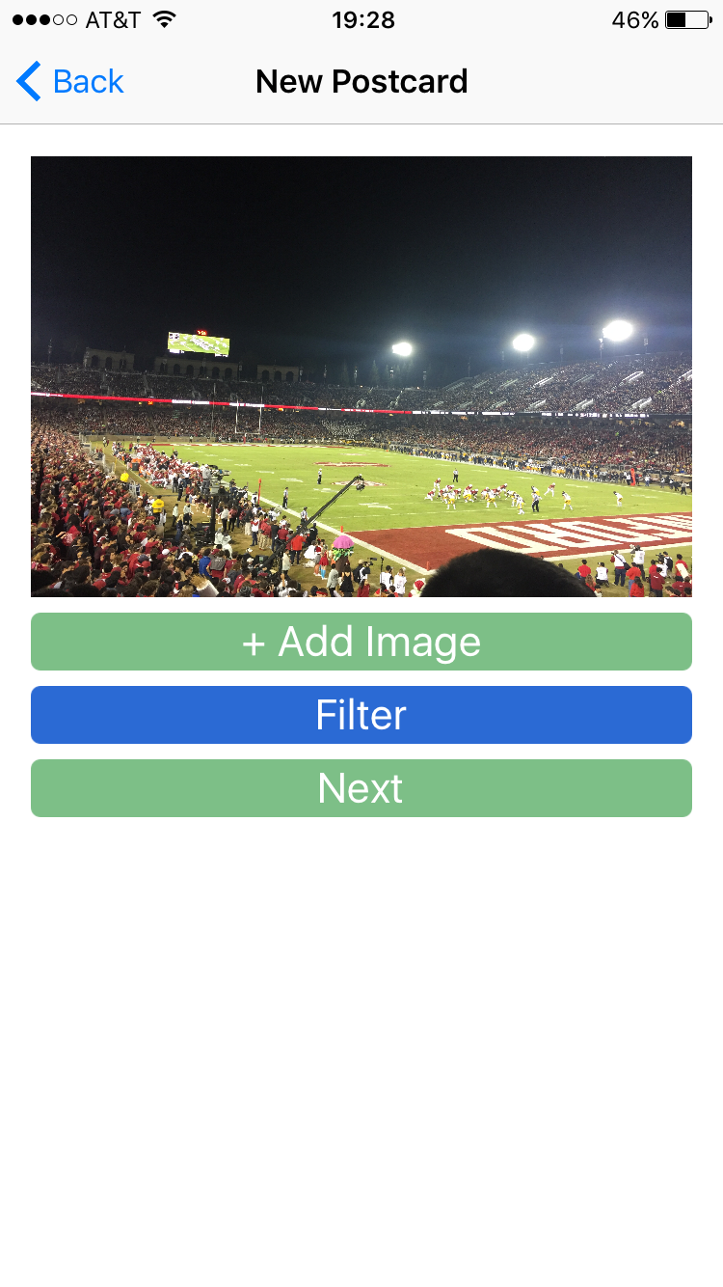
Add Photo

Slide 4
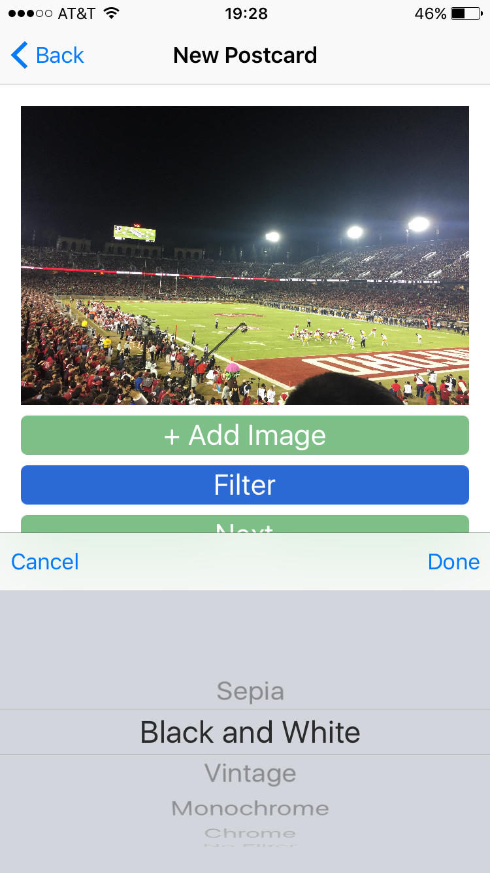
Filter and Crop

Slide 5
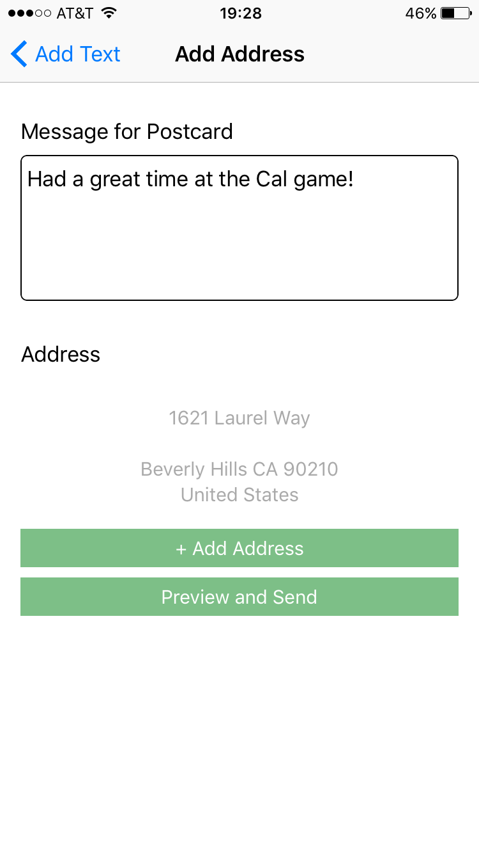
Add Message and Address

Slide 6
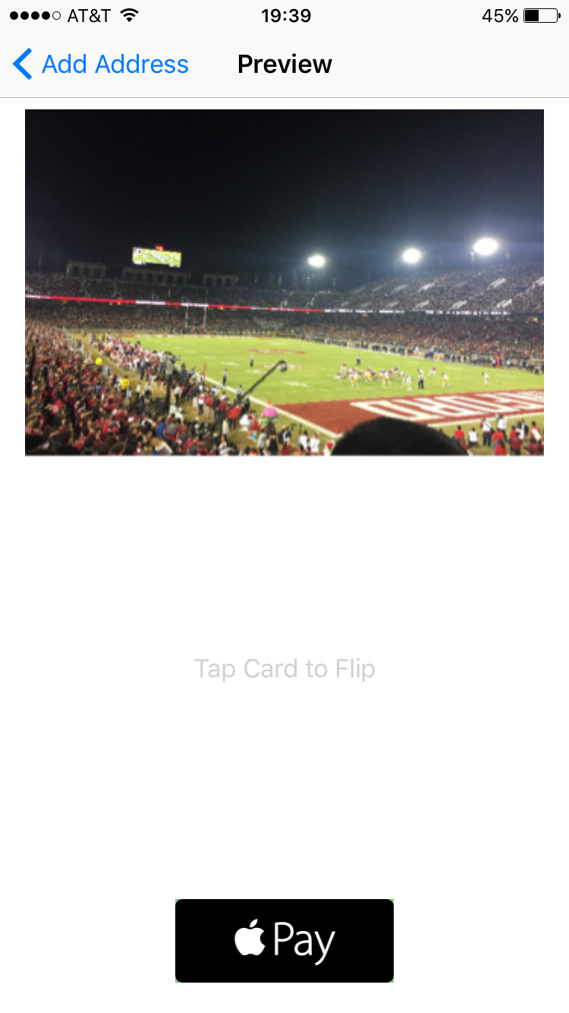
Review and Pay

