Slide 1

Team 25
Daniel
Lei
Vincent

Slide 2

Edusense

Slide 3
What is Edusense?
Edusense
This app involves AI and machine learning which helps to improve the learning experience of students in their daily life, recommend learning curriculums and custom learning path based on student data

Slide 4
Why we came up with this idea?
Problems:
Traditional education is one-size-fits-all, making it hard for students to learn at their own pace. Educators struggle to personalize lessons and track individual progress effectively.
Solutions:
Our AI app analyzes student data using a neural network to classify learning styles. It then adapts content dynamically, ensuring personalized learning and data-driven insights for better outcomes.

Slide 5
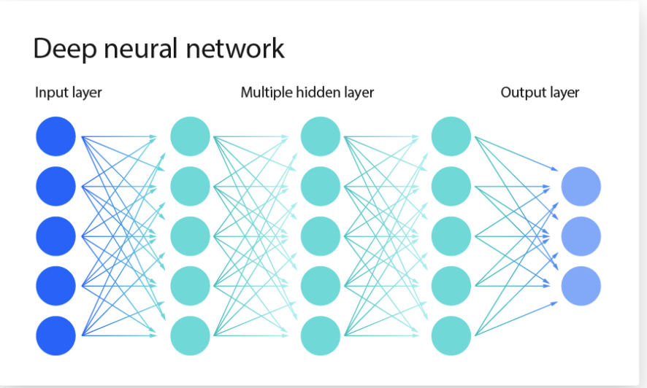

Slide 6
Features
Personalized Learning Journey
Interactive Data Input
AI-Driven Classification
Display Content accurately
Data-Driven Insights & Recommendations
How much learners can gain from this?
Find an effective way of learning
Track one’s performance easier
Save time

Slide 7
Ethical Impact
Team 25

Slide 8
Ethical impact
Transparent Classification:
We're transparent about User Information, clearly informing users that their input data determines content personalization
User Control and Consent:
Students actively provide their information through web forms, maintaining agency in the personalization process.
Limited Data Collection:
only collect information directly relevant to learning style classification, avoiding unnecessary personal data collection.
Bias Mitigation:
Using diverse training data representing various learning styles
Regularly reviewing classification outcomes for potential bias patterns
Avoiding demographic data that could lead to discriminatory outcomes
Explainable Recommendations:
Avoiding demographic data that could lead to discriminatory outcomes

Slide 9
AI Consideration
Team 25

Slide 10
consideration
AI Enhances Education:
Personalized Learning:
Accessibility & Inclusion
Data-Driven Insights
Challenges (Fairness & Transparency)
Bias in AI Algorithms
Transparency & Explainability
Data Privacy & Security
Dependency on AI

Slide 11

Thank you
Team 25

