Slide 1
The Design and Implementation of a Log-Structured File System
Presented by Carl Yao

Slide 2
Main Ideas
Memory becomes cheaper, file systems use bigger buffer caches in memory, most reads don't go to disk, most disk accesses are writes
Regular data writes can be delayed a little bit, at the risk of losing some updates
Meta data writes cannot be delayed, because risk is too high
Results: most disk accesses are meta data writes
FFS uses "update-in-place," spends lot of time seeking meta data and regular data on disk, causing low disk bandwidth usage
LFS gives up "update-in-place," writes new copy of updates together
  Advantage: Writing is fast (main problem of FFS solved)
  Disadvantage: Complexity in reading (but cache relieves this problem), overhead in segment cleaning

Slide 3
Technology Trend
• Processor speed improving exponentially
• Memory capacity improving exponentially
• Disk capacity improving exponentially
– But, not transfer bandwidth and seek times
• Transfer bandwidth can be improved with RAID
• Seek times hard to improve

Slide 4
Problems with Fast File System
• Problem 1: File information is spread around the disk
– inodes are separate from file data
– 5 disk I/O operations required to create a new file
• directory inode, directory data, file inode (twice for the
sake of disaster recovery), file data
Results: less than 5% of the disk’s potential bandwidth is used for writes
• Problem 2: Meta data updates are synchronous
• application does not get control until completion of I/O
operation
Notes:
Which 5 operations? Can we make metadata updates asynchronous with cache?

Slide 5
Solution: Log-Structured File System
Improve write performance by buffering a sequence of file system changes to disk sequentially in a single disk write operation.
Logs written include all file system information, including file data, file inode, directory data, directory inode.

Slide 6
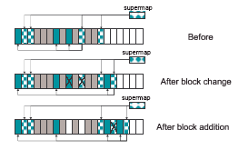
Simply Example of LFS

Slide 7
File Location and Reading
Still uses FFS’s inode structure. But inodes are not located at fixed positions.
Inode map is used to locate a file’s latest version of inode. Inode map itself is located in different places of the disk, but its latest version is loaded into memory for fast access.
This way, file reading performance of LFS is similar to FFS. (Really?)

Slide 8


File Reading Example
Pink: file data
Green: inode
Brown: inode map (written to logs but loaded in memory)

Slide 9
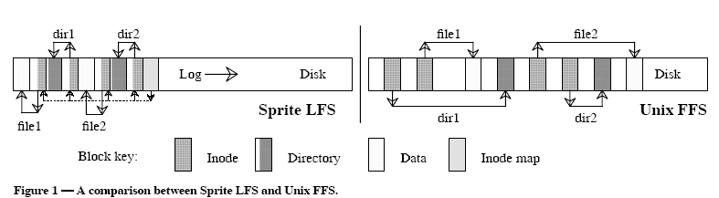
File Writing Performance Improved

Slide 10
Reclaiming Space in Log
Eventually, the log reaches the end of the disk partition
– so LFS must reuse disk space
• deleted files
• overwritten blocks
– space can be reclaimed in the background or on-
demand
– goal is to maintain large free extents on disk

Slide 11
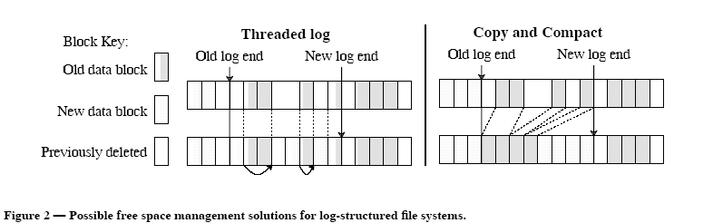
Two Approaches to Reclaim Space
Problem with threaded log—fragmentation
Problem with copy and compact—cost of copying data

Slide 12
Sprite LFS’ Solution:
Combination of Both Approaches
Combination of copying and threading
– divide disk up into fixed-size segments
– copy live blocks to free segments
    - try to collect long-lived data (not accessed for a while) permanently into segments
– Log is threaded on a segment-by-segment
basis

Slide 13
Segment Cleaning
• Cleaning a segment
– read several segments into memory
– identify the live blocks
– write live data back (hopefully into a smaller
number of segments)
• How are live blocks identified?
– each segment maintains a segment summary
block to identify what is in each block and which
inode this block belongs to
– crosscheck blocks with owning inode’s block
pointers

Slide 14
Segment Cleaning Policy
When to clean?
  Sprite starts cleaning when number of clean segments drops below a threshold (say 50 segments).
How many segments to clean?
  A few tens of segments at a time until the number of clean segments surpasses another threshold (say 100 segments)
Which segments to clean?
  cleaning segments with little dead data gives little benefit
  want to arrange it so that most segments have good utilization, and the cleaner works with the few that don’t
  how should one do this?

Slide 15
Which Segments to Clean?
Two kinds of segments
  hot segments: very frequently accessed
    however, cleaning them yields small gains
  cold segments: very rarely accessed
    cleaning these yields big gains because it will take a while for it to reaccumulate unused space
U = utilization; A = age (most recent modified time of any block in the segment);
Benefit to cost = (1–U)*A/(U+1)
  Pick the segment that maximizes the above ratio
  This policy reaches a sweet spot where reusable blocks in cold segments are frequently cleaned, while those in hot segments are infrequently cleaned

Slide 16
Segment Cleaning Result
The disk becomes a bimodal segment distribution:
  Most of the segments are nearly full
  A few are empty or nearly empty
  The cleaner can almost always work with the empty segments

Slide 17
Crash Recovery
Crash in UNIX is a mess
  disk may be in inconsistent state
    e.g., middle of file creation, file created but directory not updated
  running fsck takes a long time
Not a mess in LFS
  just look at end of log; scan backward to last consistent state

Slide 18
Checkpoints
A checkpoint is a position in the log where all file systems structures are consistent
Creation of a checkpoint:
  1. Write out all modified info to log, including metadata
  2. Write checkpoint region to special place on disk
On reboot, read checkpoint region to initialize main-memory data structures
  use 2 checkpoints in case checkpoint write crashes!

Slide 19
Roll-Forward
Try to recover as much data as possible
Look at segment summary blocks
  if new inode and data blocks, but no inode map entry, then update inode map; new file is now integrated into file system
  if only data blocks, then ignore
Need special record for directory change
  this avoid problems with inode written, but directory not written
  appears before the corresponding directory block or inode
  again, roll-forward

Slide 20
Test Results
Sprite LFS clearly beat SunOS in small-file read and write performance
Sprite LFS beat SunOS in large-file writing, made a draw with SunOS in large-file reading, lost to SunOS in reading a file sequentially after it has been written randomly.
  In the last case, LFS lost because it requires seeks, but SunOS does not.

