Slide 1
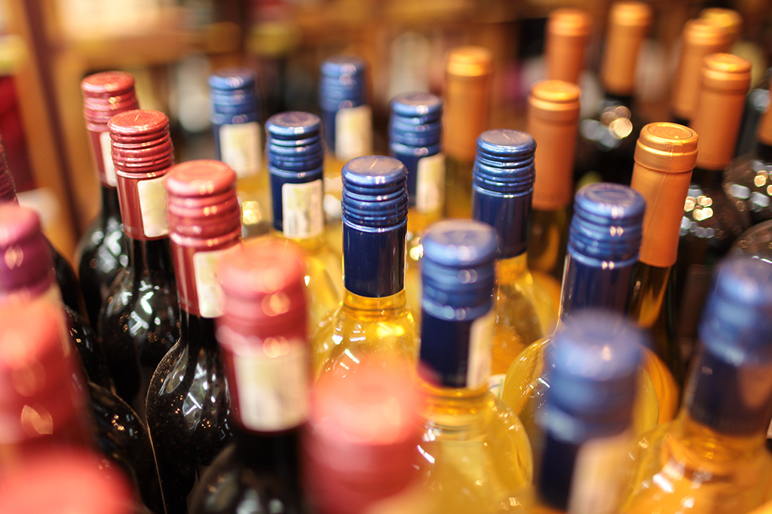
The Sales Situation of Liquors in Different Regions of Iowa 2017

Slide 2
Team Members:
Mingxuan Zhang
Lei Teng
Yuxiang Wang

Slide 3
Questions sought to answer:
Our project works for analyzing the name, date, kind, price, quantity, and location of sales of individual containers or packages of containers of alcoholic beverages of Iowa 2017.
1.Sale situation:
Which category of alcoholic beverages gains the maximum revenue ?
Which brand of alcoholic beverages gains the maximum revenue?
Which category of alcoholic beverages is the most popular?
As for each vender, which regions gains the maximum revenue?
How can we predict the category if know the store and vendor?
Which weekday or month gains the maximum revenue?
2.Drink Behavior：
Which category of alcoholic beverages is the most popular in different regions?
People in which regions consumed the most alcoholic beverages?
\
.

Slide 4
Data Preparation Work:
Realize the background knowledge about our data set
2. Data Cleaning
We delete the rows which have missing values , because we need build a accurate Bayesian
Classification Model, the missing values have the negative effects about veracity for our model.
Data Reduction
The original datasets contains from 2012 to current , its over 12 millions. Our project is working for
2017, so we did the reduction only left datasets about 2017.
There are 24 attributes in the dataset. Since we don’t need all 24 attributes, we have to do
Dimensionality reduction. We will remove irrelevant attributes like Invoice/Item Number. We also
have to remove redundant attributes, for example, Volume Sold (Liters) and Volume Sold (Gallons)
are redundant attributes, we will use Volume Sold(Liters) instead of Volume Sold (Gallons).
4. Data Transformation
Sales numbers contain “$” which is causing panda to not see them as numbers. So we deleted the “$” and transfer from type string to type float.
\
.

Slide 5
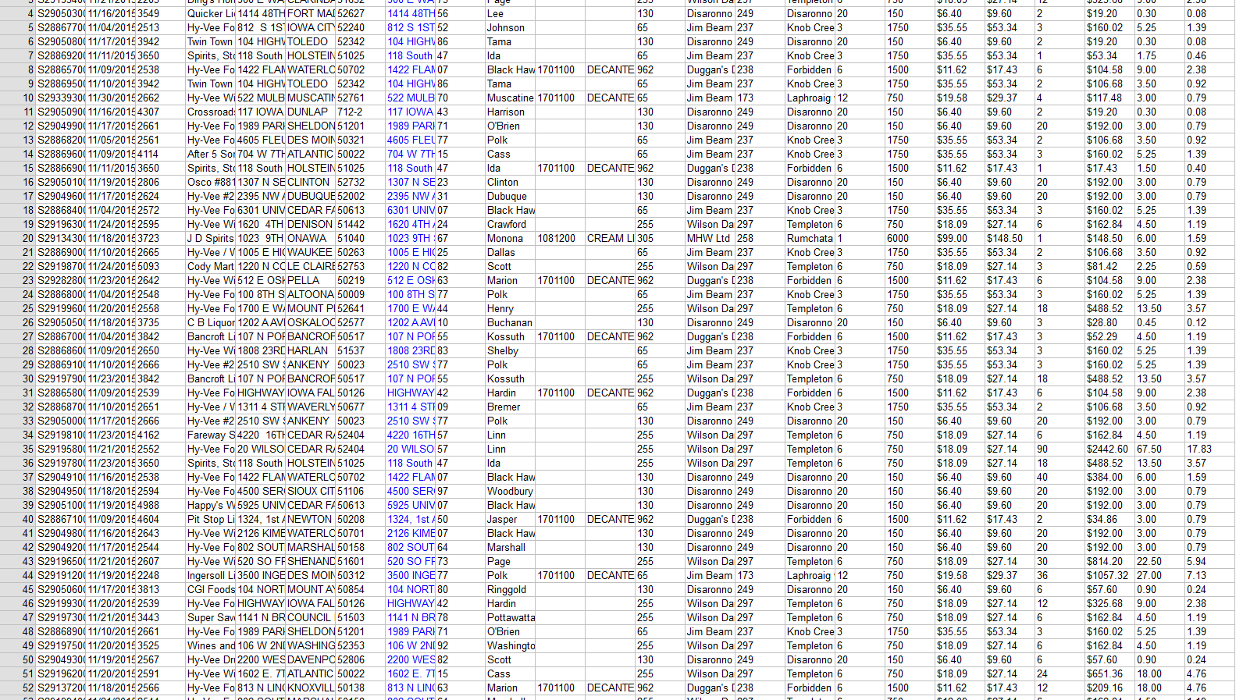

Slide 6
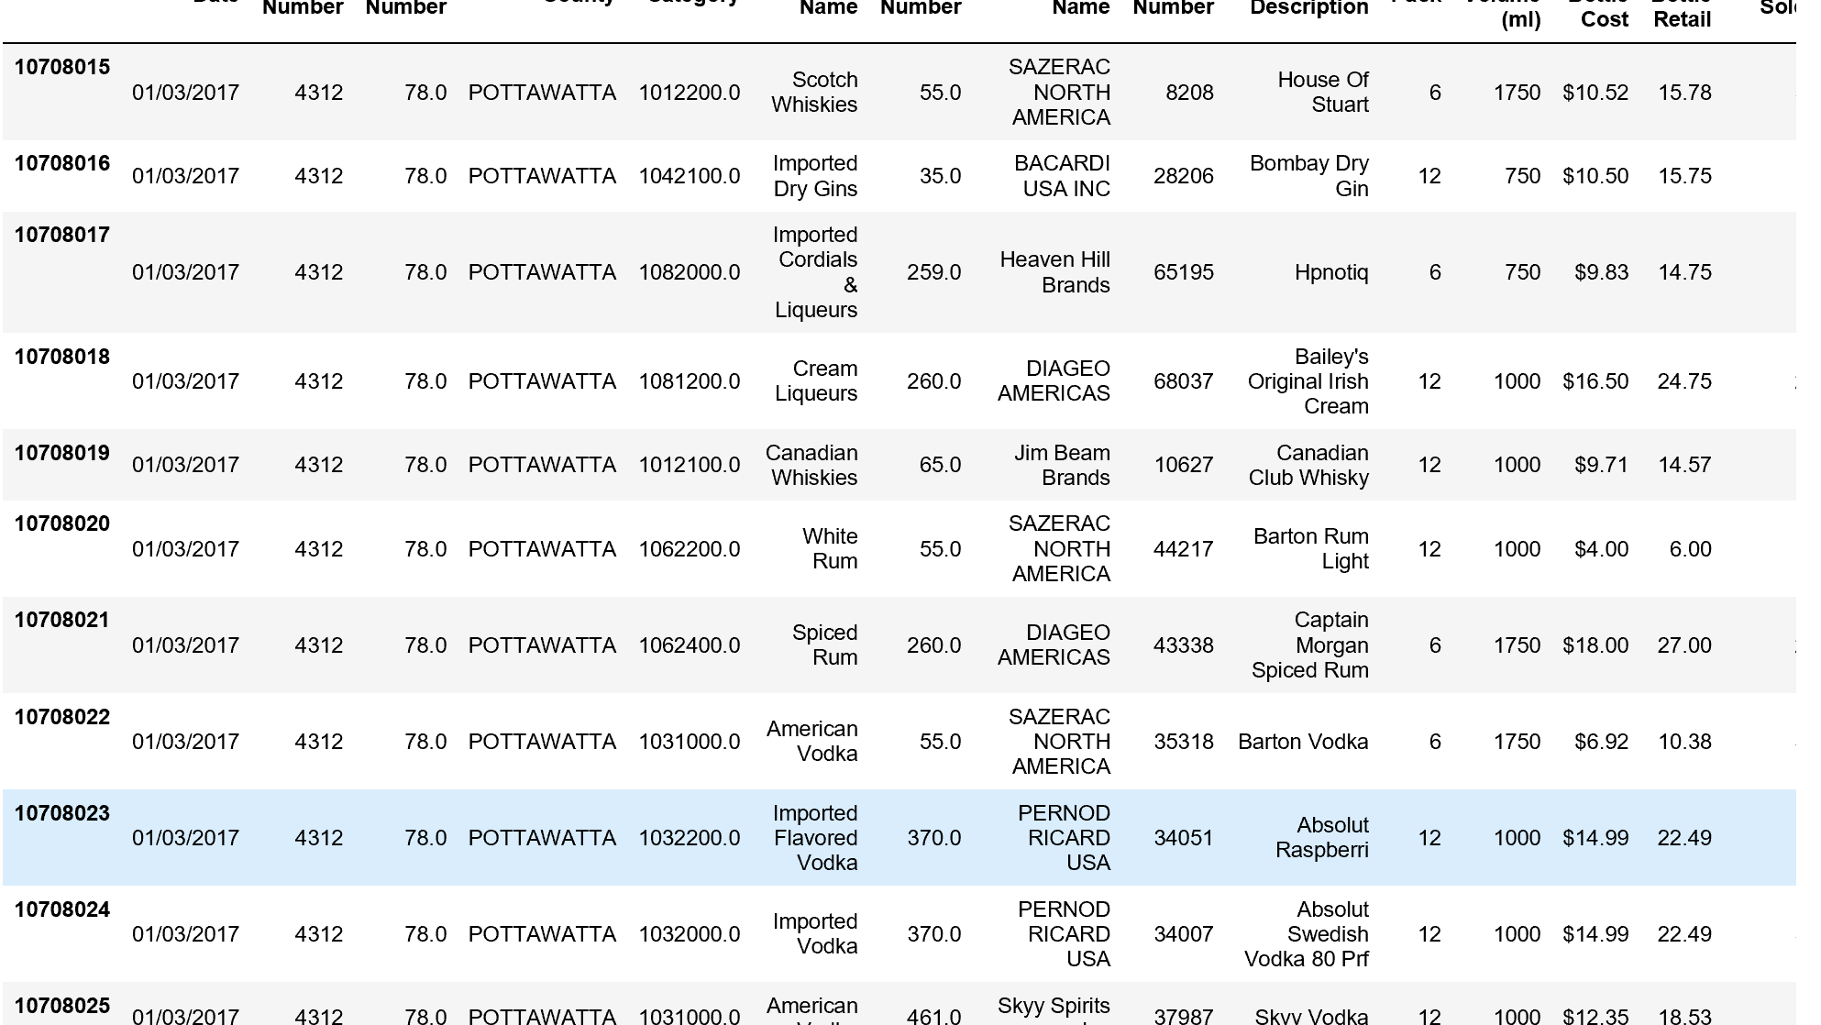

Slide 7
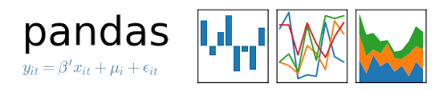




List of tools:
Delimit(datasets)
Pandas
Python
Numpy
Matplotlib
Jupyter Notebook

Slide 8
Classification :
Bayesian Classification:
We build a model:
P ( category| store number, vendor number)
If we have the store number and vender number, we can get the posterior probability distribution for the categories. We used this to predict the values for category attribute, we can pick the one with highest probability or we can use this posterior distribution to draw samples for category attribute.
We can us this for predict the category attribute after 2017(like 2018), and fill in the missing data.

Slide 9
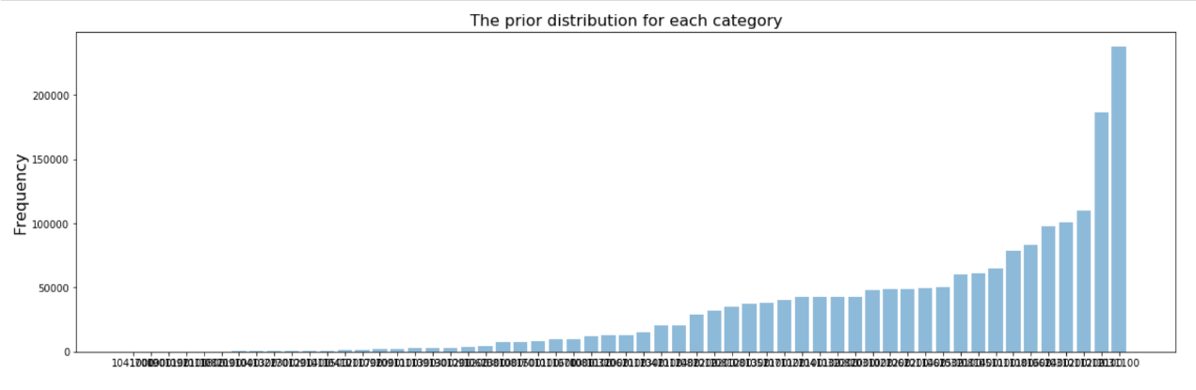
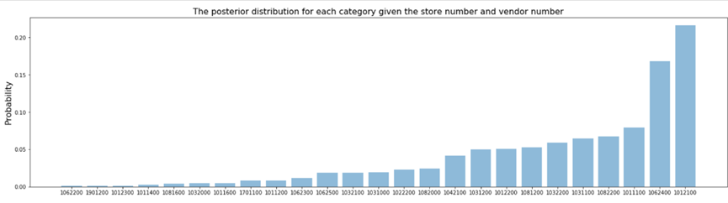

Slide 10
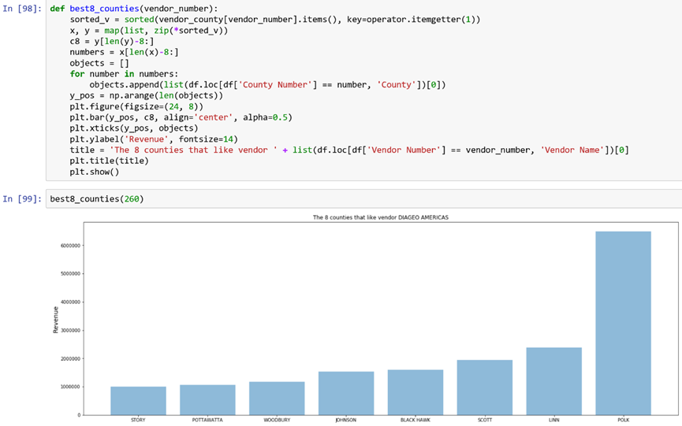
Classification :
Build Function to Analyzing:
1. We build a function to analyze the data to get the top 8 counties
which brought the best revenue for each vender. Vender number as a
input.

Slide 11
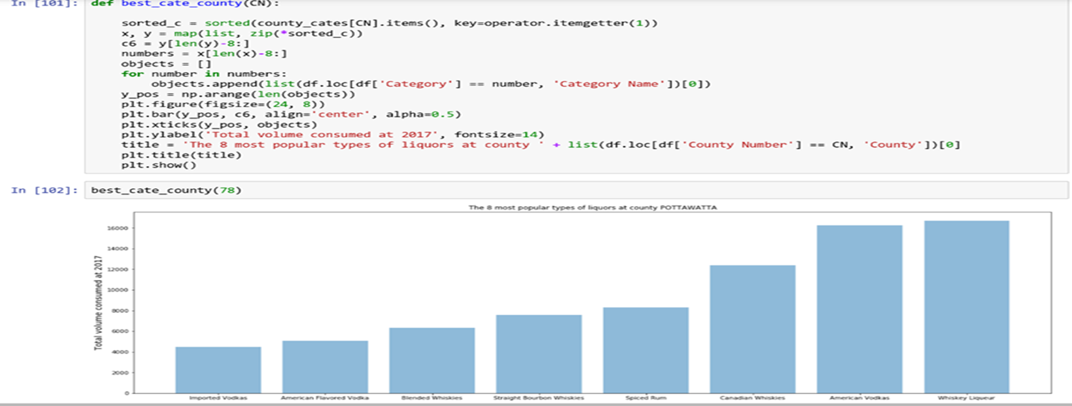
Classification :
2. We build a function to analyze the data to get the top 8 categories
consumed in different regions. County number as a input.

Slide 12
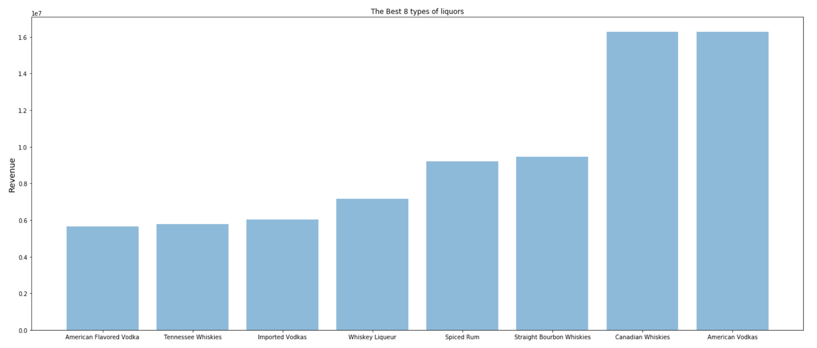
Classification :
Revenue and Category analyzing:

Slide 13
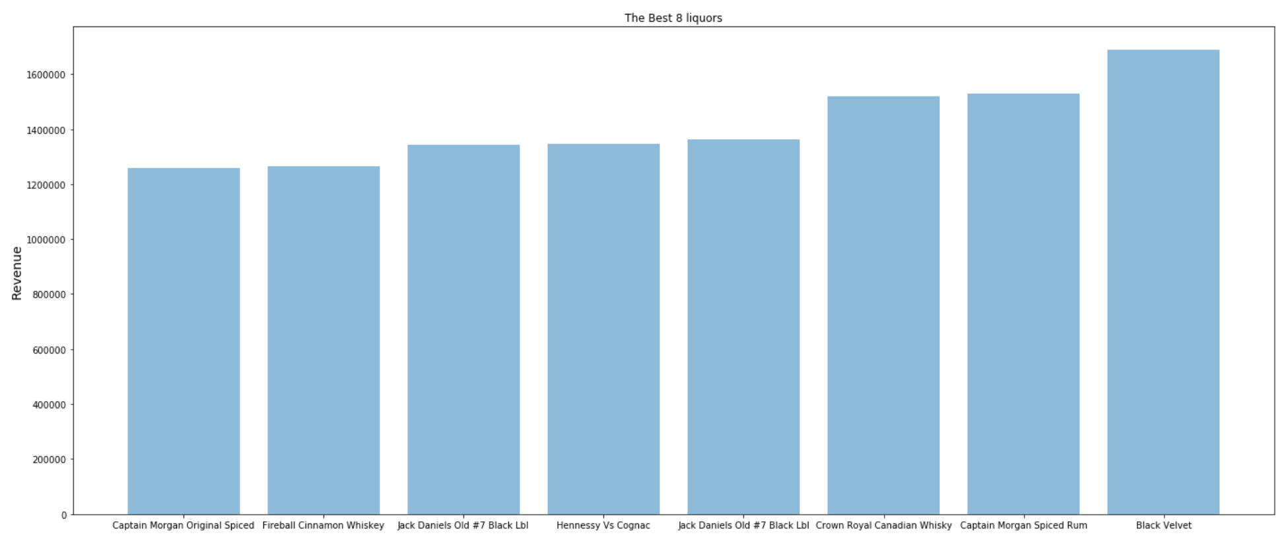
Classification :
Revenue and Brand analyzing:

Slide 14
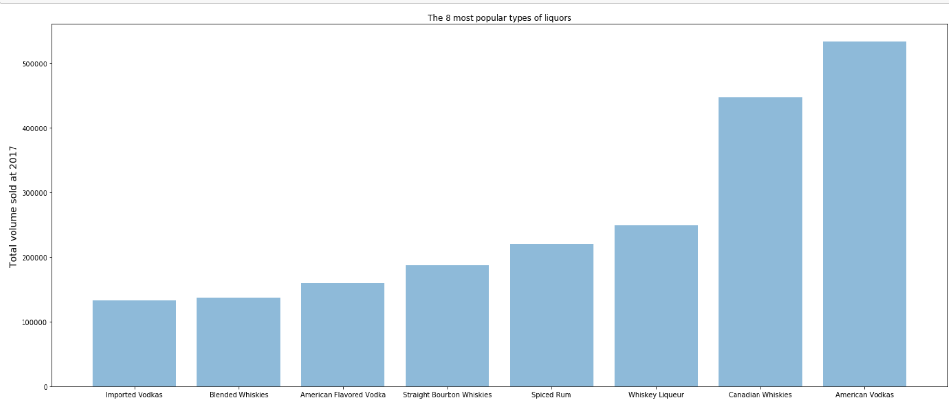
Classification :
Total volume sold and Category analyzing:

Slide 15
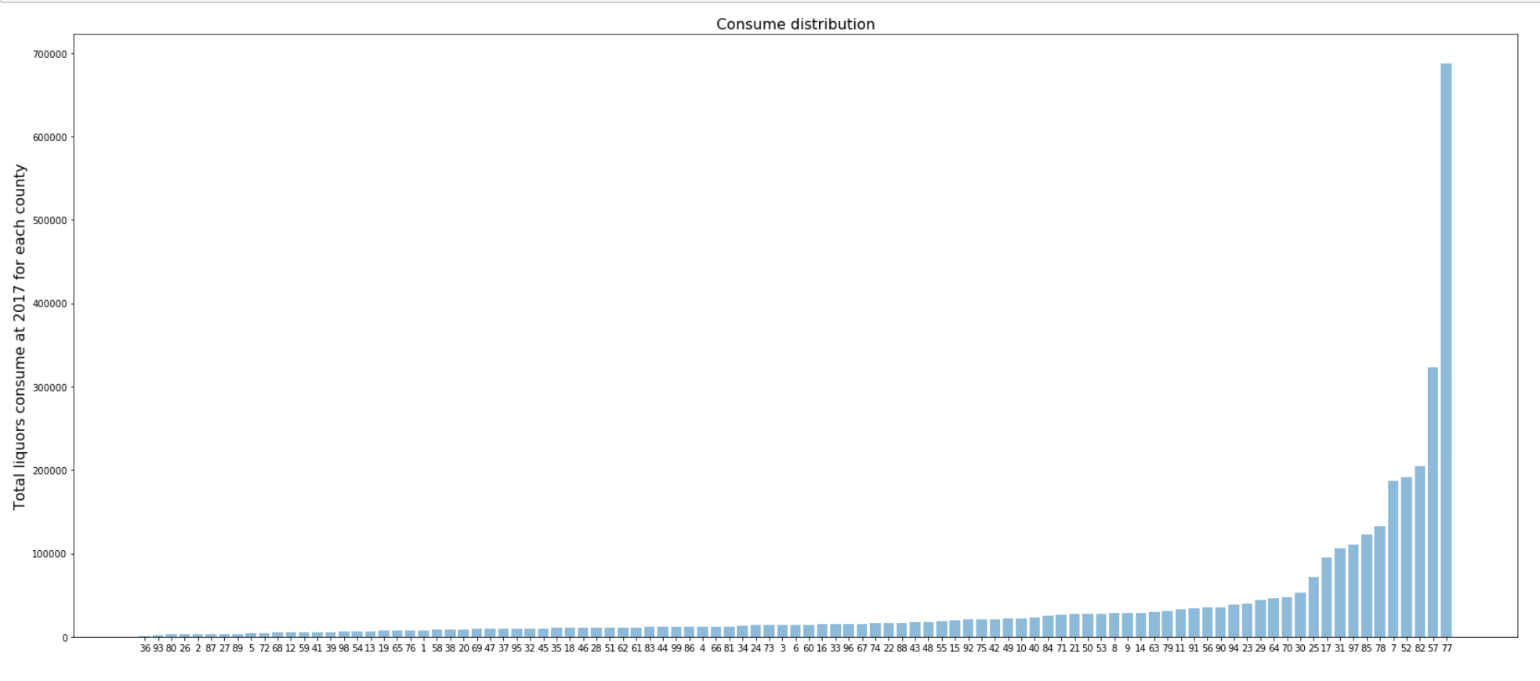
Classification :
The consume distribution for each county:

Slide 16
Knowledge gained :
The American Vodkas is the most popular category of alcoholic beverages in 2017
because it gains the maximum volume sold and maximum revenue.
The American Vodkas and Canadian Whiskies have the pretty same volume sold, but they have a wide margin of revenue.
High Volume sold doesn’t mean high revenue.
The Brand which gains the maximum revenue in 2017 is Black Velvet Which is Canadian Whiskies.
As for Diageo America Company, the county POLK brought the maximum revenue.
The Whisker Liqueur is the most popular category of alcoholic beverages in county POTTAWATTA.
The people in POLK consumed the most alcoholic beverages.

Slide 17
How that knowledge can be applied:
Help vender to get more profits:
Let vender know people in which region consumed more alcoholic beverages then vender can increase the supply for that region.
Let vender know which region brought less revenue then vender can increase the advertising to attract more users.
Let vender know which alcoholic beverage can brought
more revenue then vender can extend the production.
Let vender know which alcoholic beverage gains more volume sold then
vender can make a good market planning to get more profits.
Help customers to choose better alcoholic beverage :
We can let customer know which alcoholic beverage is the most popular to help them to make a right choose.

