Slide 1
B
BigBlueBam
Project management built for human-AI teams.
Engineers set the strategy. AI agents handle the grunt work. Everyone sees it on the board.
140 MCP Tools
14 Docker Services
530+ Tests
4 Apps, 1 Stack

Slide 2
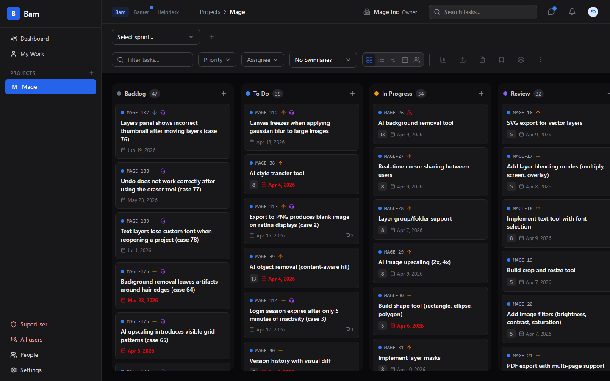
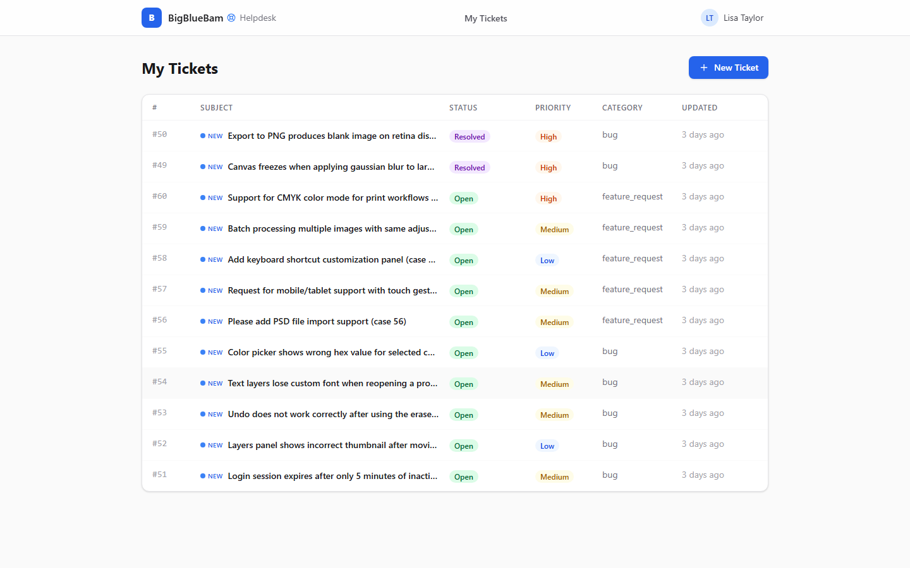
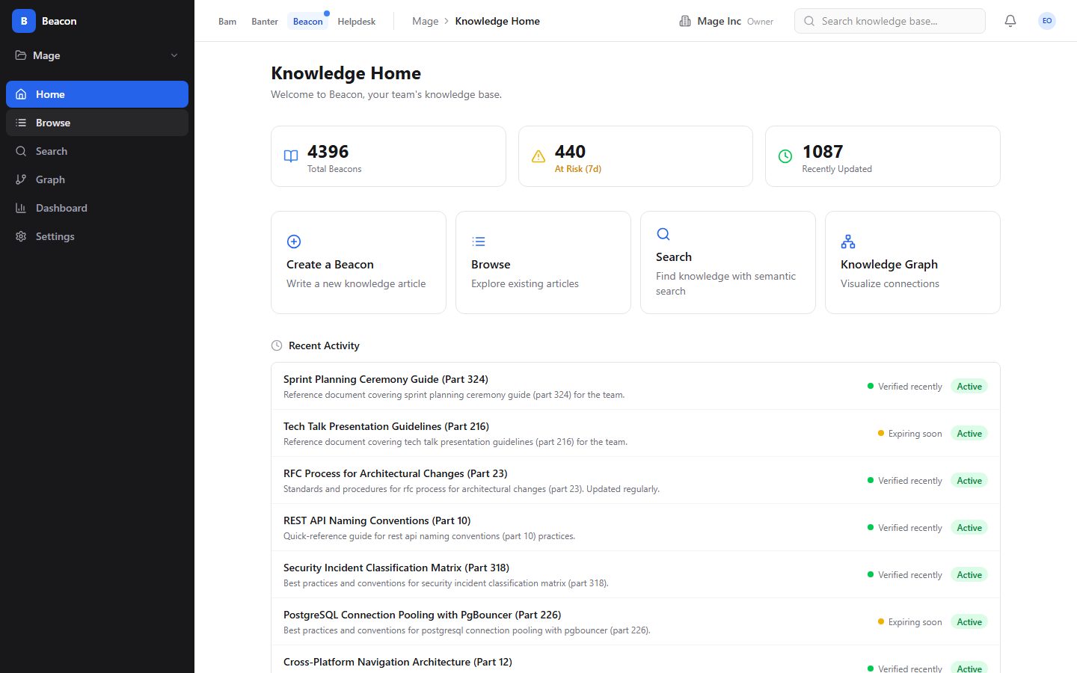
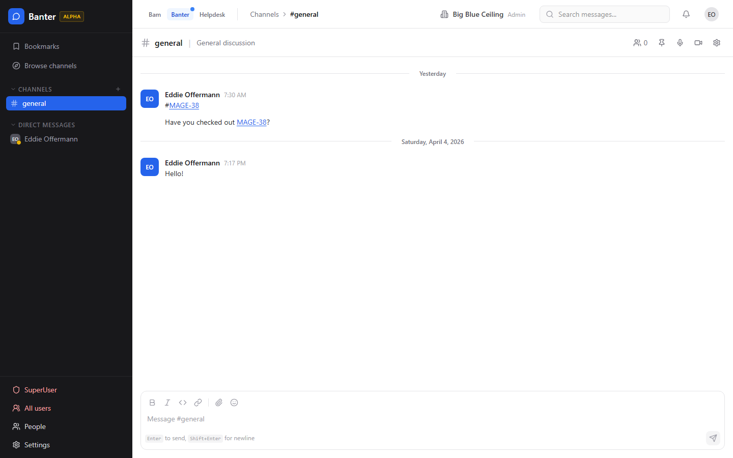
Four apps, one platform
Shared auth, shared database, shared MCP server — zero integration overhead.
Bam
Helpdesk
Beacon
Banter
Kanban boards, sprints, tasks, project dashboard, team management
Customer support tickets, AI triage, auto-linked tasks
Knowledge base, semantic search, graph explorer, expiry governance
Team messaging, channels, DMs, threads, voice/video, AI agents

Slide 3
Rapid-Fire Feature Tour
One slide per major capability

Slide 4
Kanban Board — Drag-and-Drop with Spring Physics
5 configurable phases · WIP limits · Priority, assignee, points, due date on every card

Slide 5
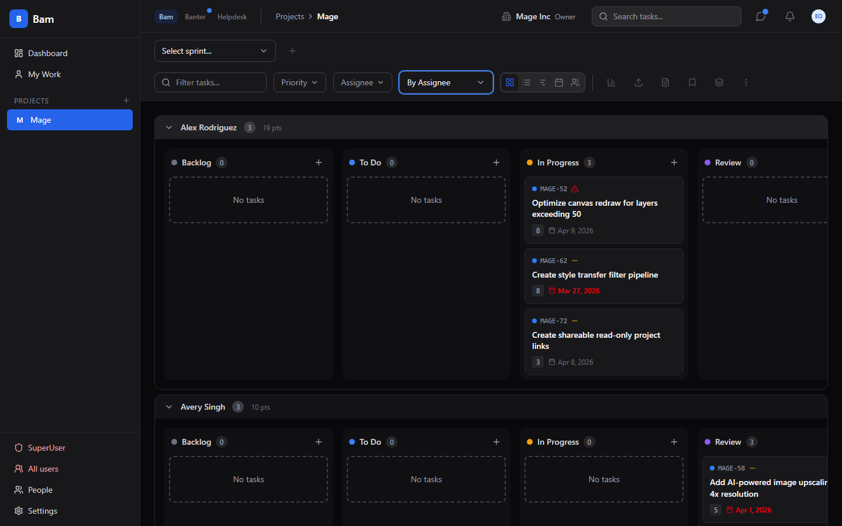
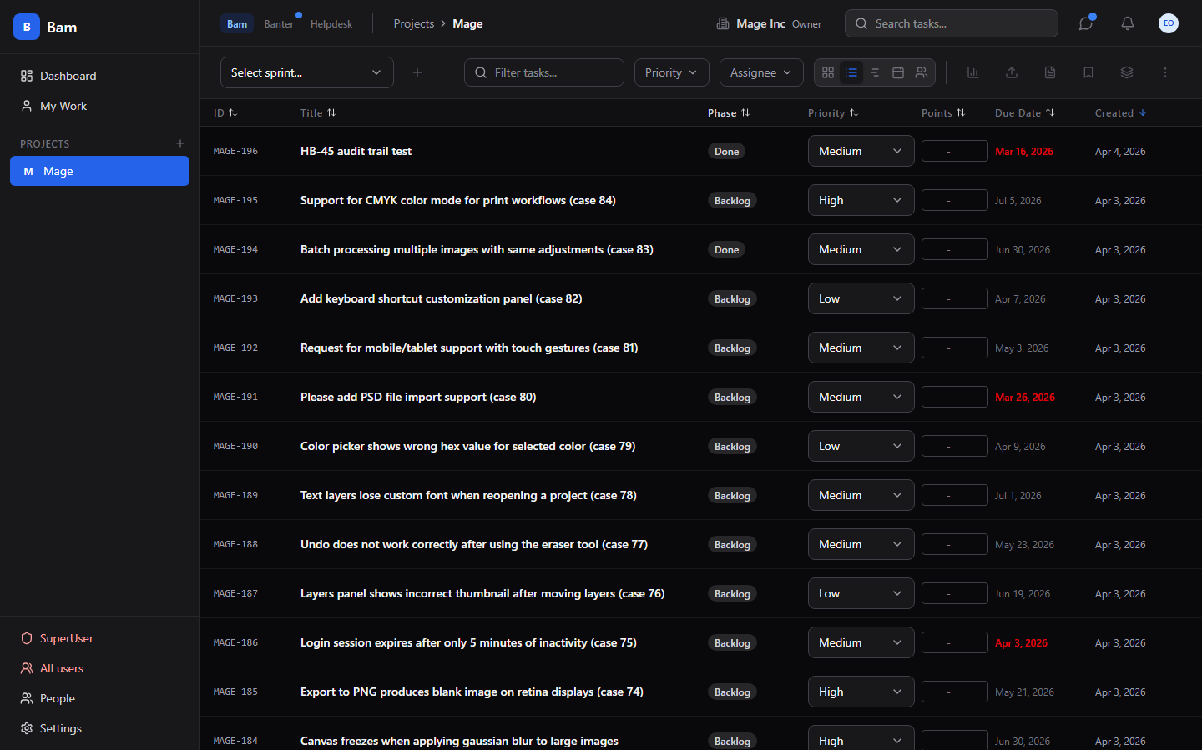
Swimlanes & Multiple Views
Swimlanes — group by assignee, priority, or epic
List view — sortable columns, inline editing

Slide 6
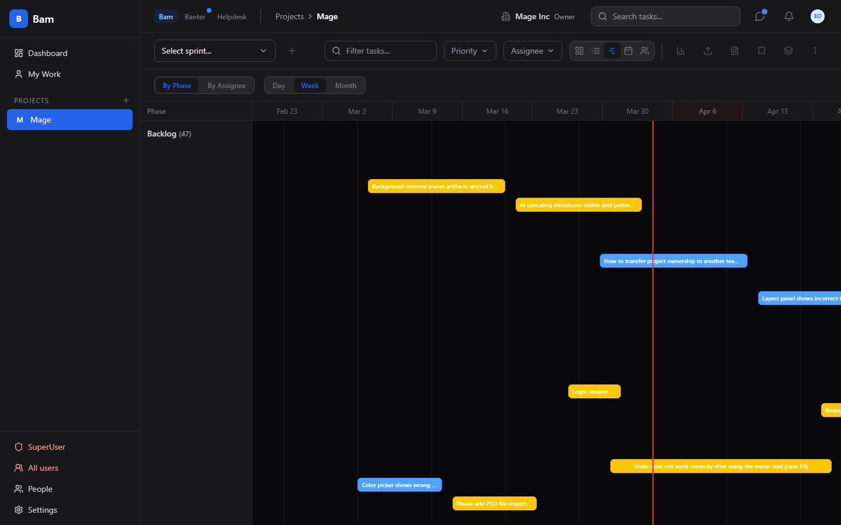
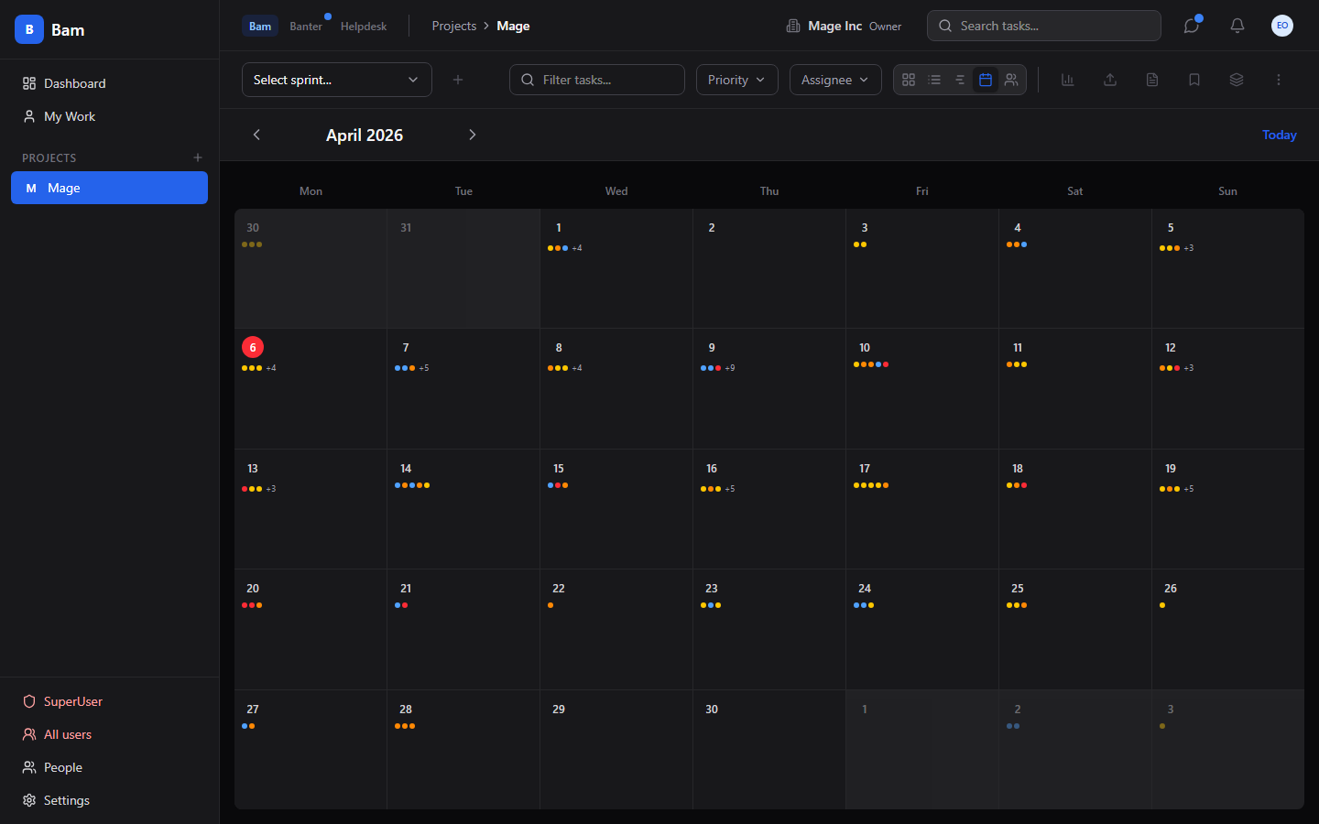
Timeline & Calendar
Gantt-style timeline with today marker
Monthly calendar with task due dates

Slide 7
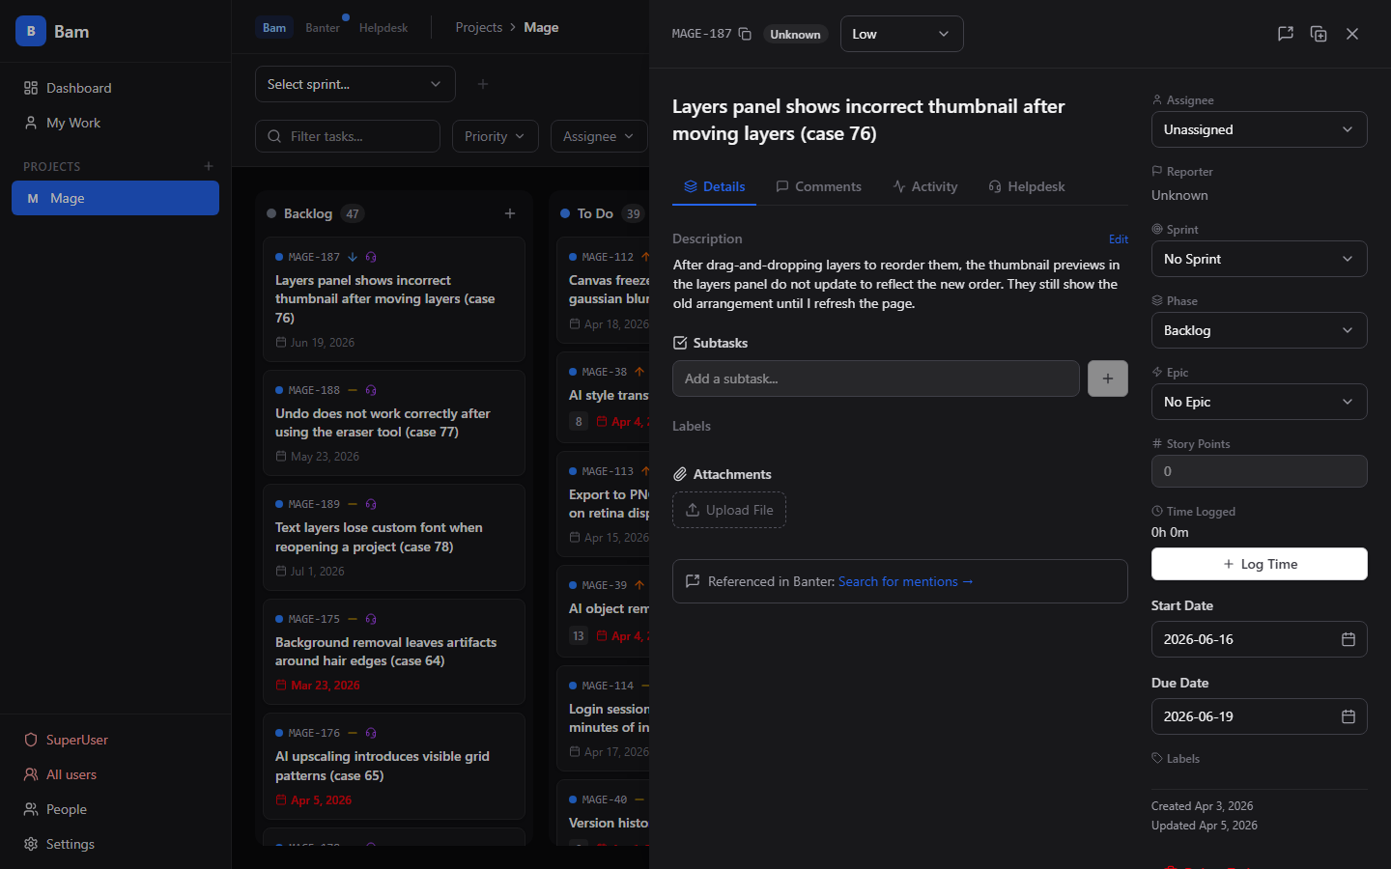
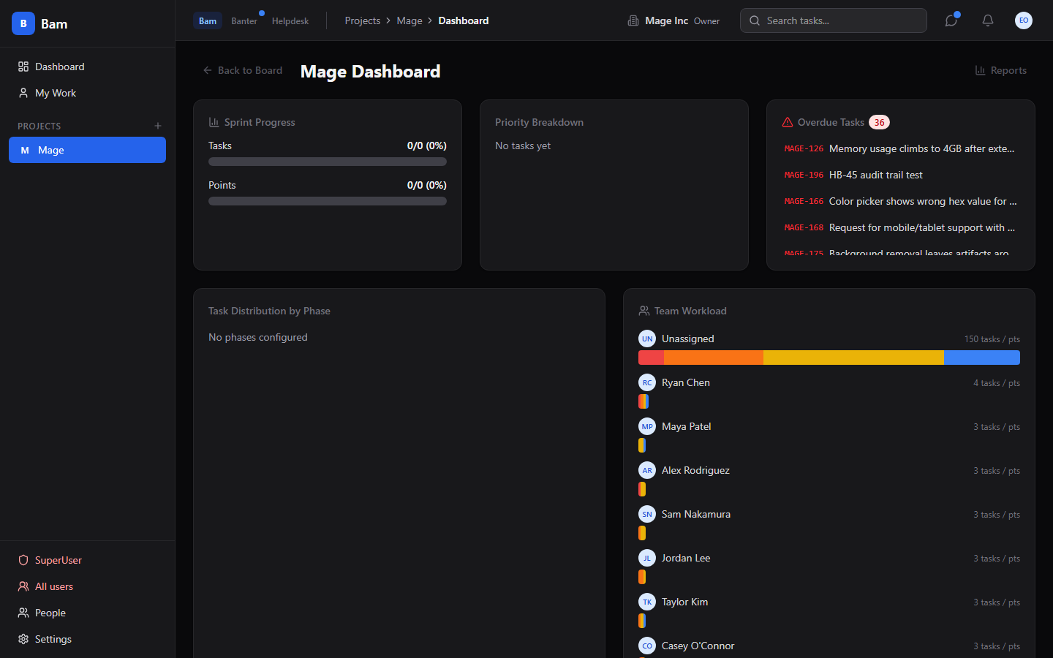
Task Detail & Project Dashboard
Rich-text, subtasks, attachments, comments, activity
Sprint progress, priority breakdown, overdue tasks

Slide 8
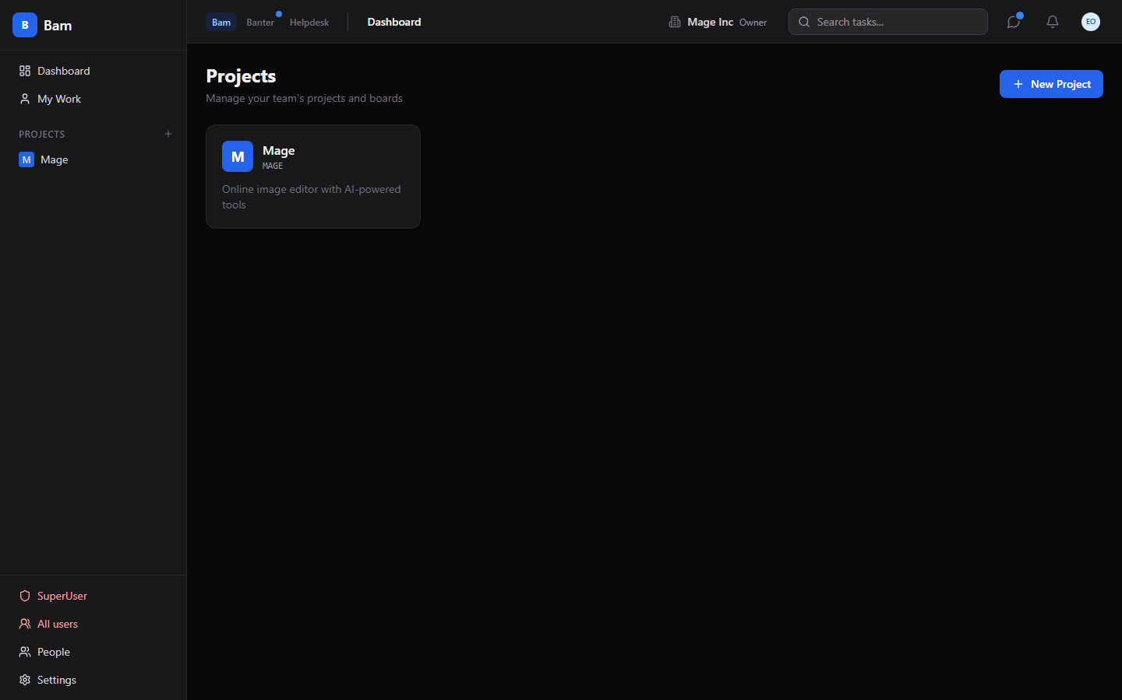
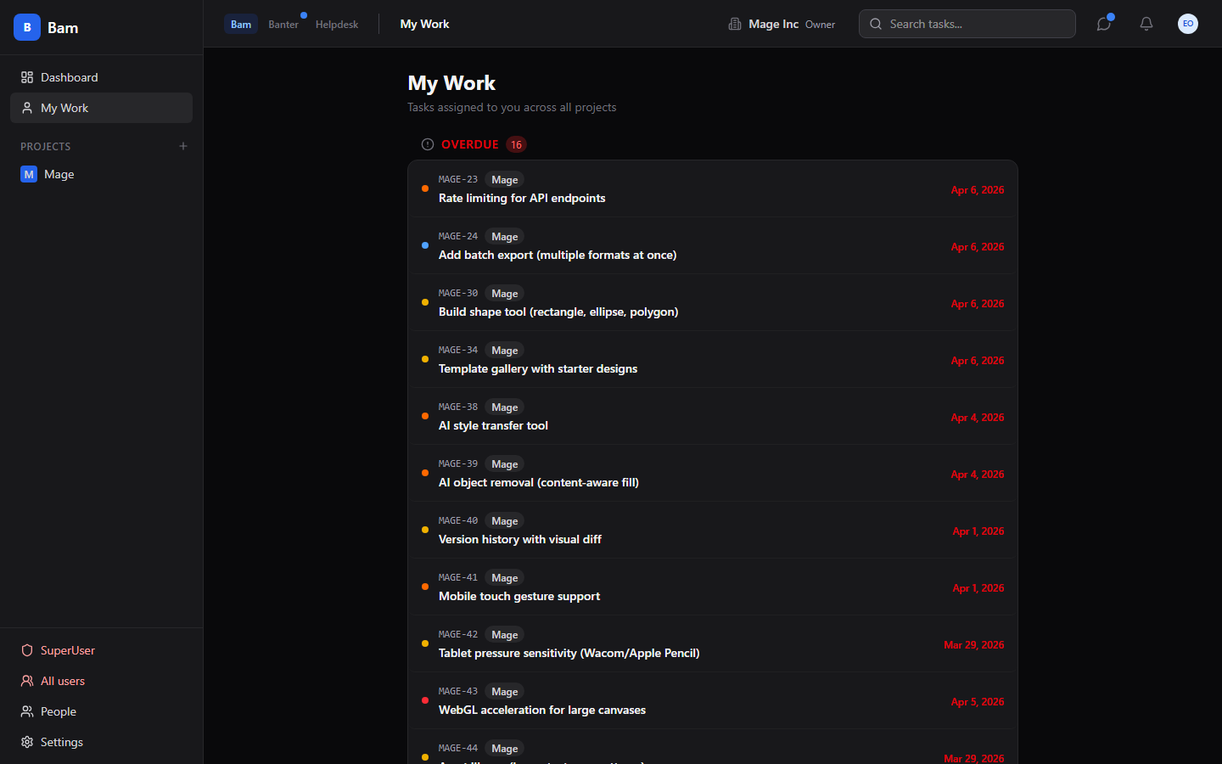
Power User Tools
Command palette — Ctrl+K to search and navigate
My Work — cross-project view of your assignments

Slide 9
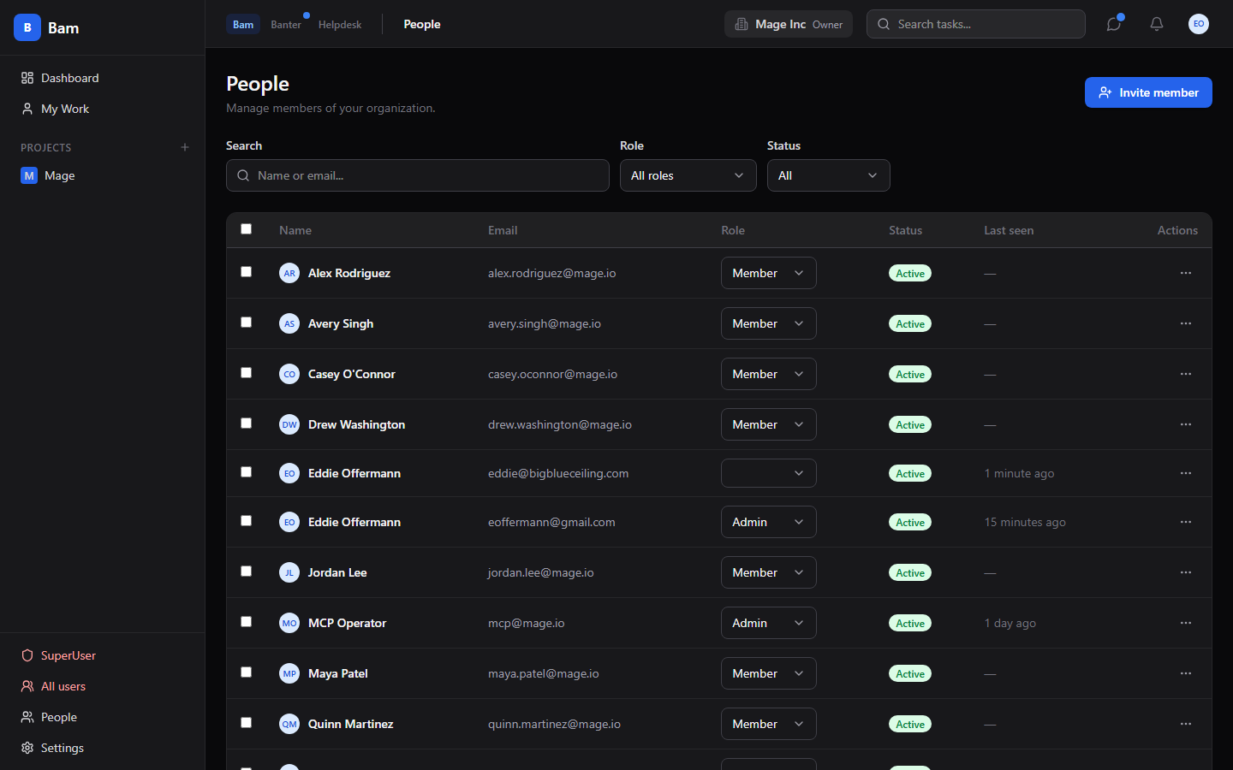
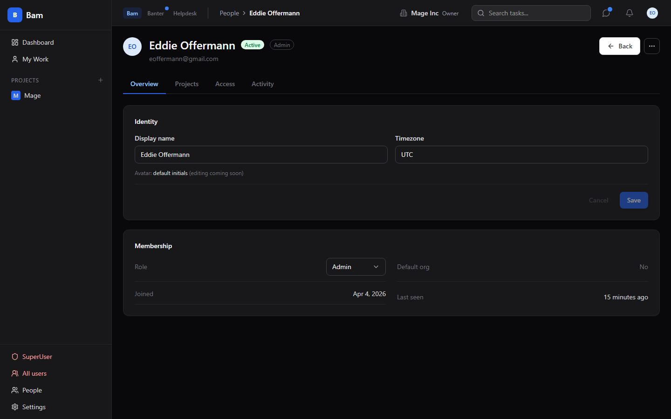
Organization & People Management
Searchable, filterable, bulk-selectable people list
Per-user detail with identity, projects, access, activity

Slide 10
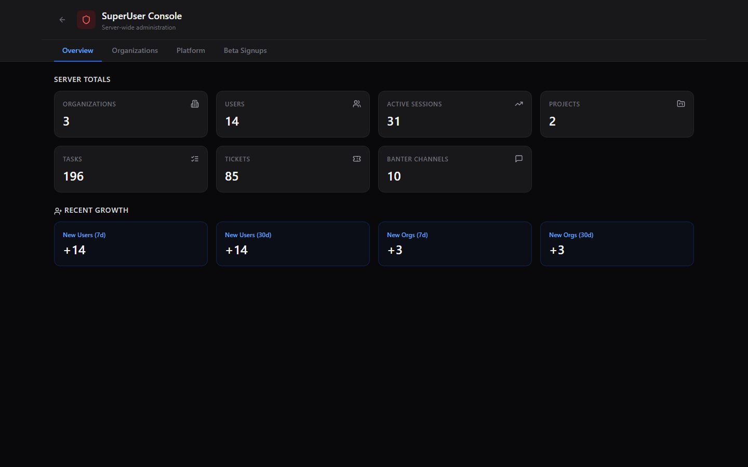
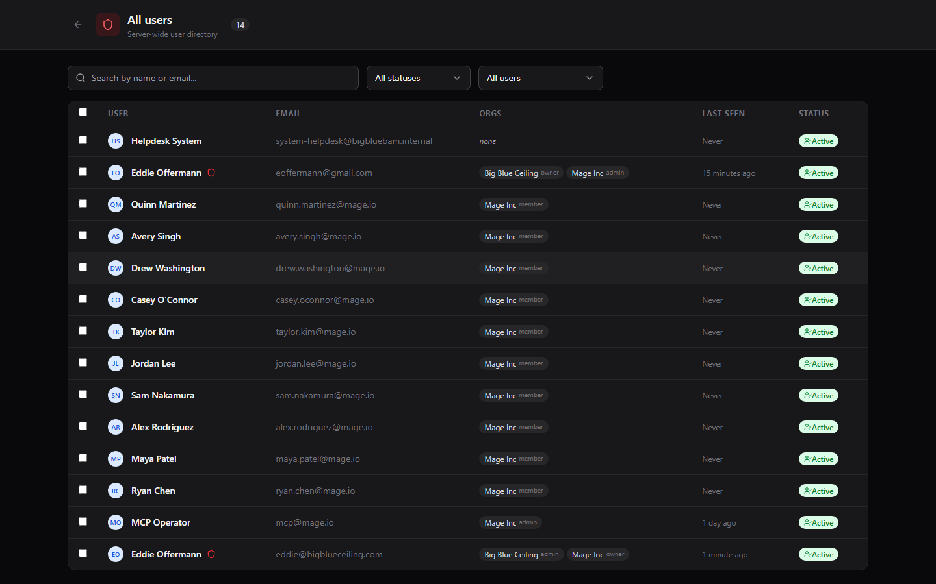
SuperUser Console
Cross-org platform overview
Global user management — every user across every org

Slide 11
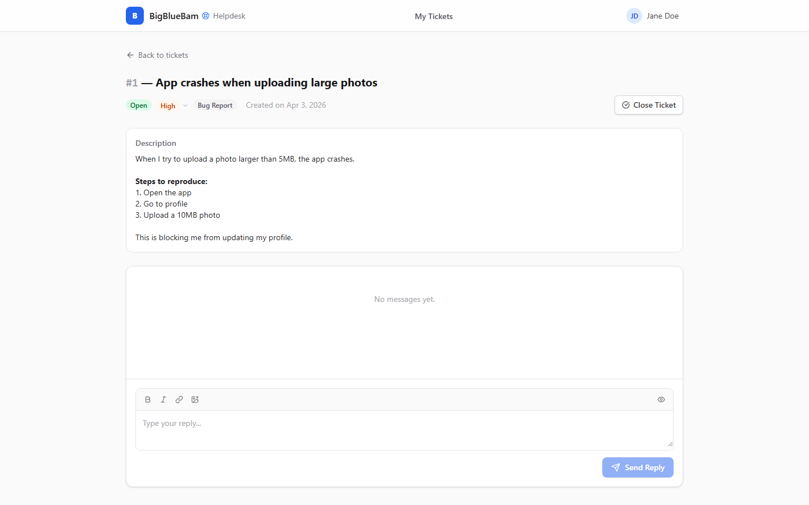
Helpdesk — Customer Support Portal
Customers submit and track support tickets
Ticket detail with full conversation thread

Slide 12
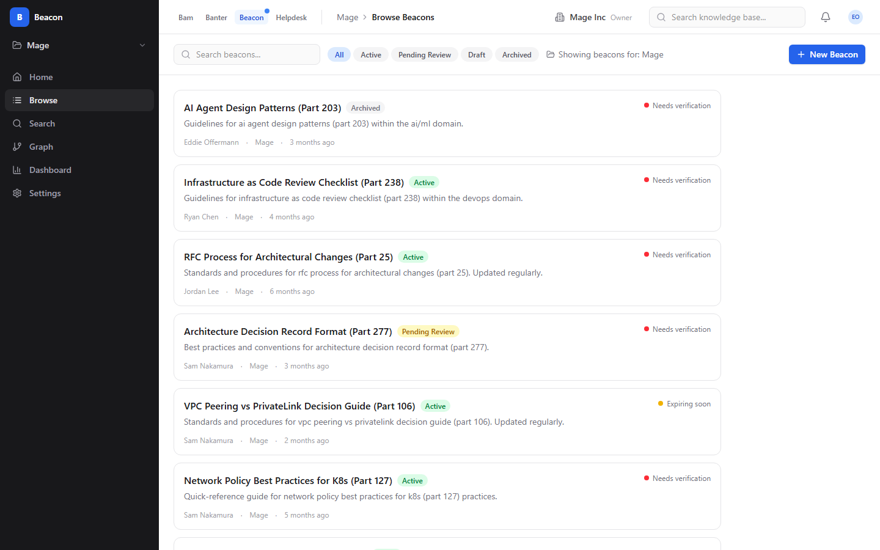
Beacon — Knowledge Base
Knowledge Home with stats, recent activity, quick actions
Browse beacons by status, project, and tags

Slide 13
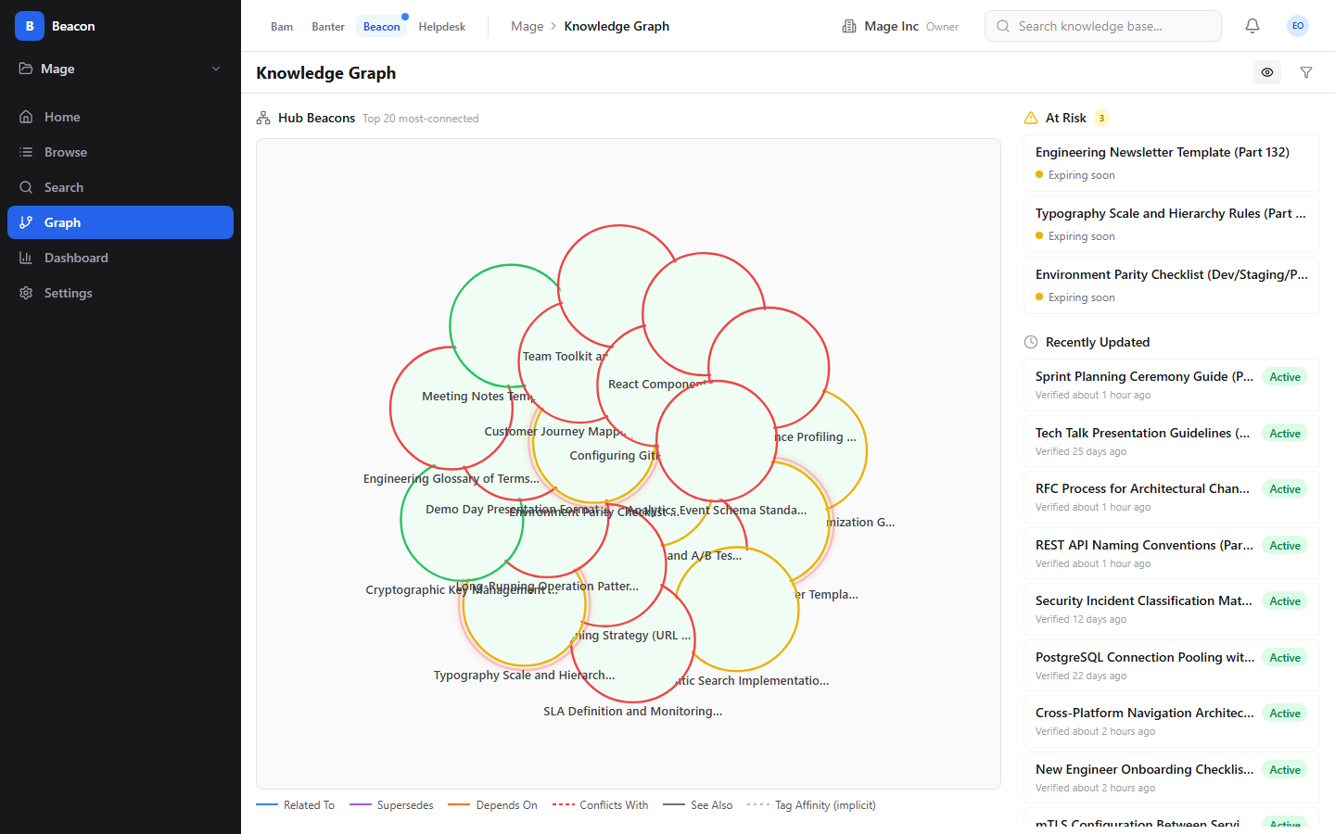
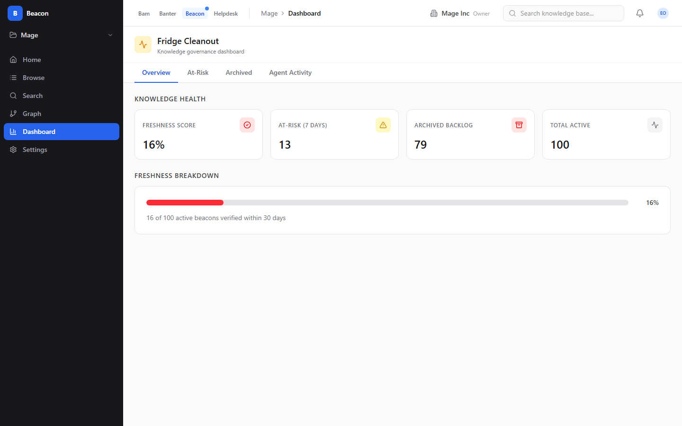
Beacon — Graph & Governance
Knowledge Graph — connections via links and tag affinity
Governance dashboard — freshness score, at-risk beacons

Slide 14
Banter — Team Messaging
Real-time channels with rich message compose
Full-text search across messages and channels

Slide 15
140 MCP Tools — AI Agents at Full Parity
Bam — 64 tools
Banter — 47 tools
Beacon — 29 tools
• Tasks, sprints, comments, labels
• Board positions, bulk operations
• Sprint reports, analytics
• Members, settings, views
• Channels, DMs, threads
• Messages, reactions, pins
• Voice calls, admin settings
• Retention policies, search
• CRUD, publish, retire, verify
• Semantic + graph search
• Tags, links, saved queries
• Governance policies, graph
What AI Agents Can Do
• Create and manage tasks — set priority, assignee, move cards across phases, add subtasks
• Run sprints — create sprints, assign tasks, start/complete sprints, generate reports
• Triage helpdesk tickets — auto-create tasks, adjust priority, assign, respond to customers
• Manage knowledge via Beacon — create, search, verify, link, manage policies
• Collaborate on Banter — post to channels, reply to threads, summarize conversations
• Generate reports — sprint velocity, task distribution, team workload, overdue items

Slide 16
Deep Dive: Bam
Kanban boards, sprints, views, and team management

Slide 17
The Board — Your Shared Workspace
Cards flow left to right through configurable phases · WIP limits prevent bottlenecks · Motion spring physics

Slide 18
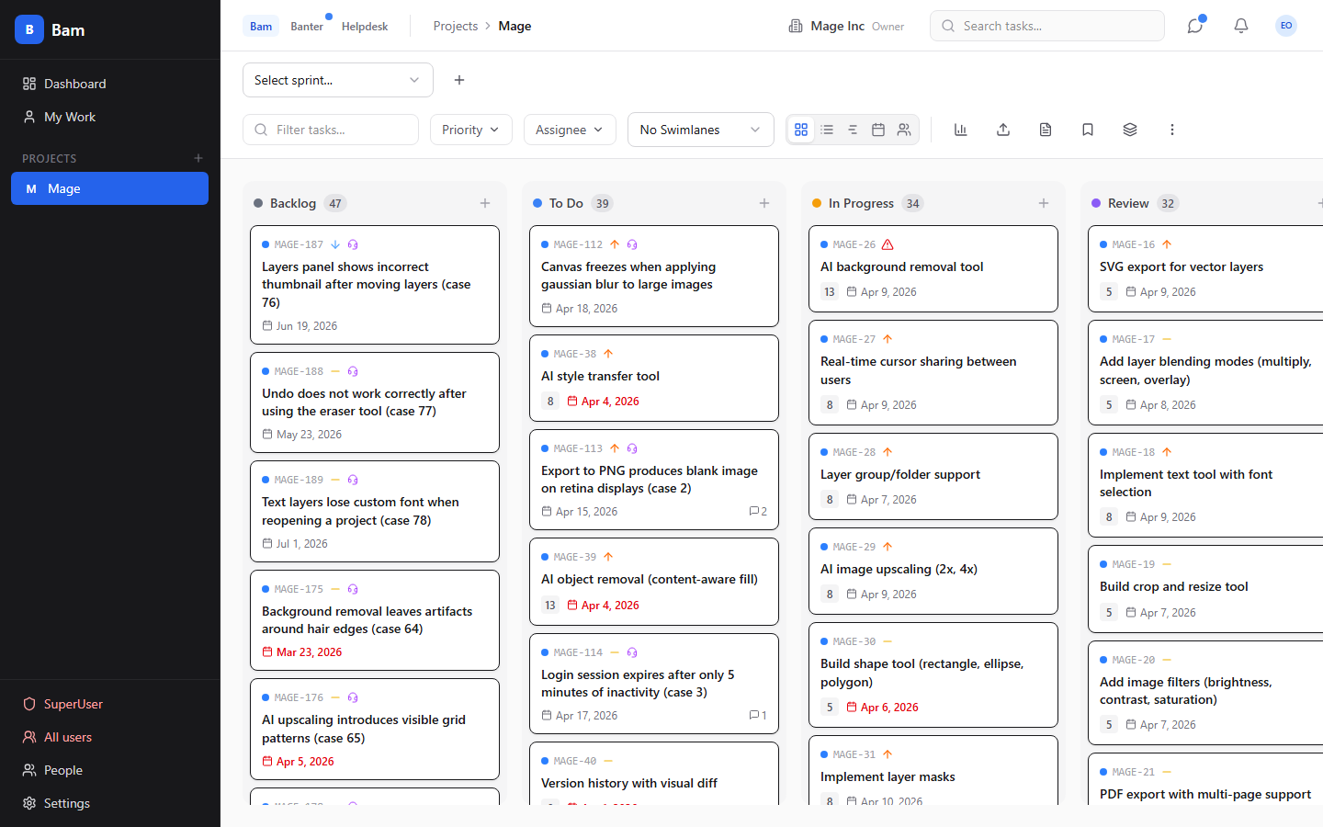
Board Features
5 Configurable Phases
Customize column names, WIP limits, and done-states per project
Drag-and-Drop
Motion spring physics — cards animate naturally between phases
Swimlanes
Group by assignee, priority, or epic with collapsible rows
5 Views
Board, List, Timeline, Calendar, Workload — switch without losing filters
Sprint Integration
Assign tasks to sprints, track velocity, auto carry-forward
Real-time Updates
WebSocket + Redis PubSub — changes broadcast instantly to all users
Optimistic UI
TanStack Query mutations update immediately, rollback on failure
Keyboard Shortcuts
Ctrl+K command palette, vim-style navigation

Slide 19
Task Detail — Everything in One Drawer
Rich text · Subtasks · File attachments · Comments with reactions · Activity feed · Custom fields

Slide 20
Sprints & Analytics
Project dashboard — velocity, burndown, priority breakdown
My Work — cross-project task list, grouped by project

Slide 21
Deep Dive: People & Access
Organization management, API keys, SuperUser console

Slide 22
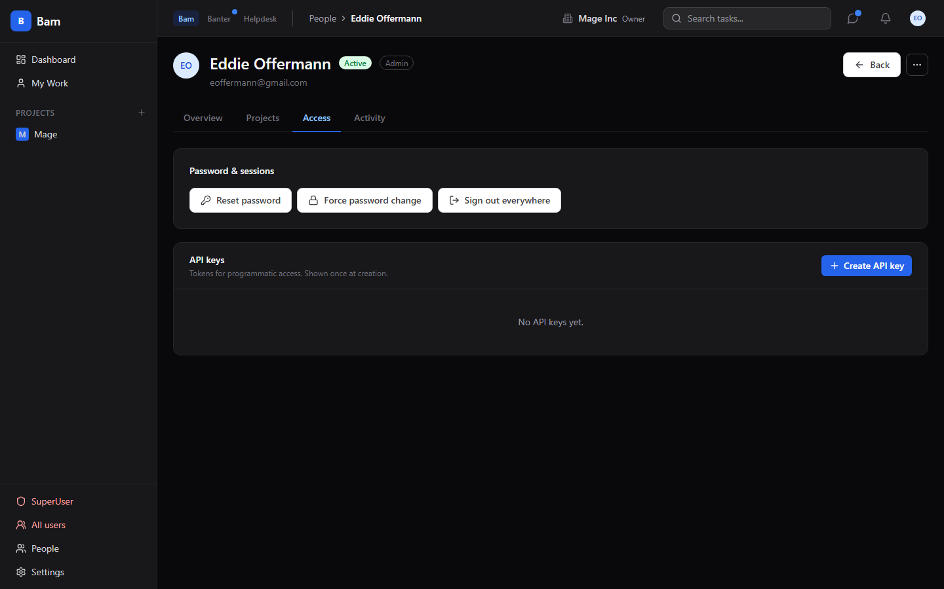
People Management
Searchable list with role/status filters and bulk actions
Access tab — API keys, sessions, password management

Slide 23
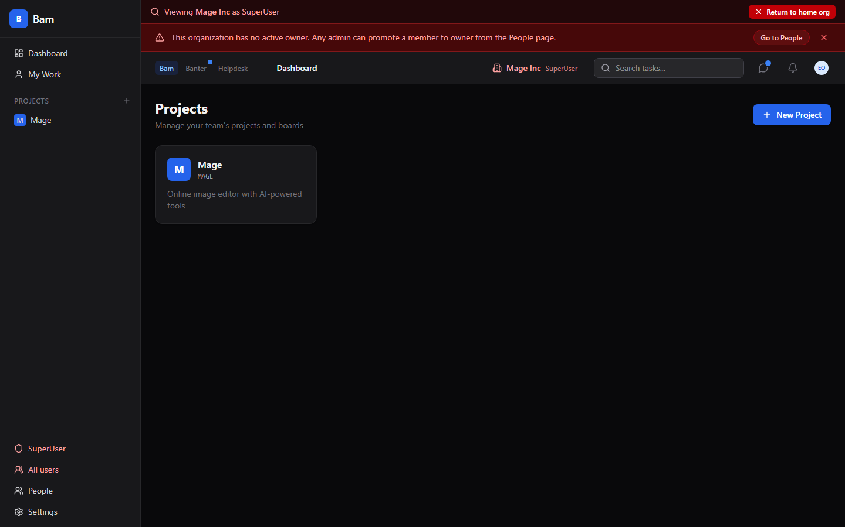
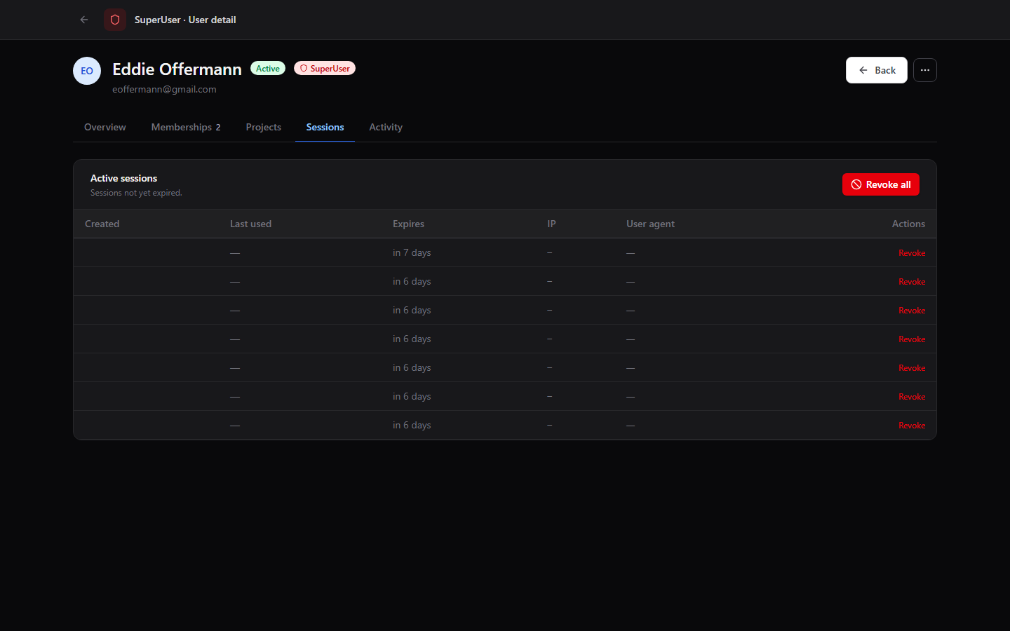
SuperUser Platform Console
Context-switched into another org — red banner warns operators
Active sessions with IP, device, and revoke controls

Slide 24
Deep Dive: Helpdesk
Customer-facing support portal with AI triage

Slide 25
Helpdesk → Board Pipeline
1
Customer submits ticket
2
AI agent triages
3
Board syncs ticket
Client reports issue via the helpdesk portal with category, priority, and description.
A task is auto-created on the board. AI sets priority, assigns, and responds.
Moving the task through phases auto-updates the ticket status. Clients see progress.

Slide 26
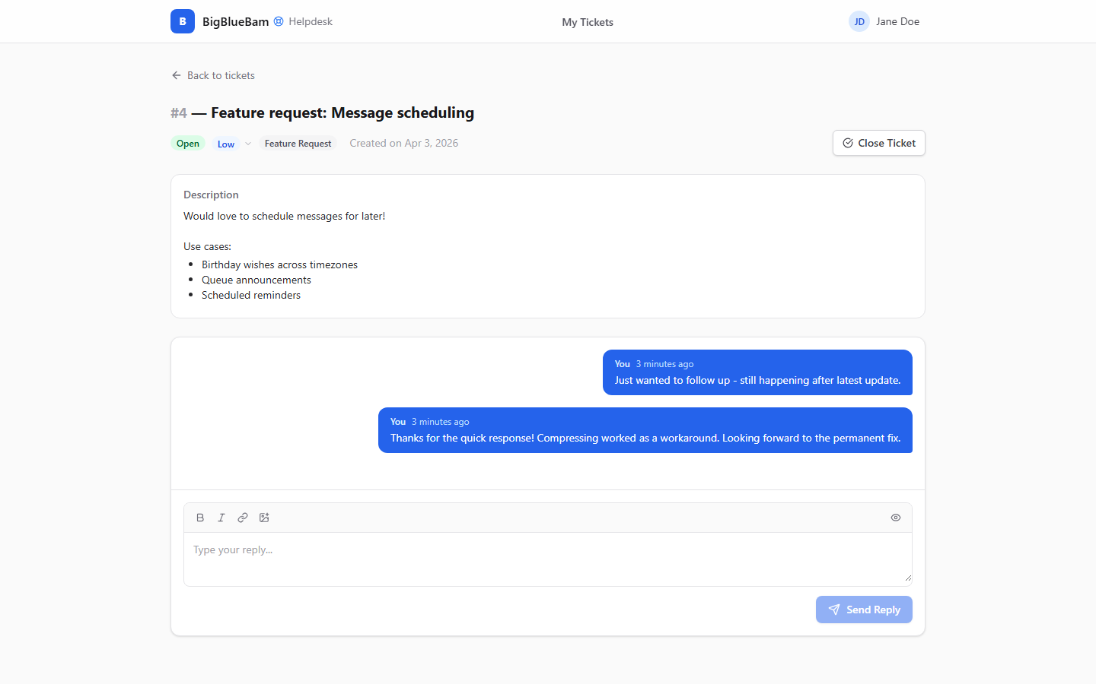
Helpdesk Portal
Customer ticket list with status and priority
Threaded conversation — agent and client messages

Slide 27
Deep Dive: Beacon
Knowledge base with expiry governance and semantic search

Slide 28
Knowledge Home
4,396 beacons · 440 at risk · 1,087 recently updated · Quick actions and recent activity

Slide 29
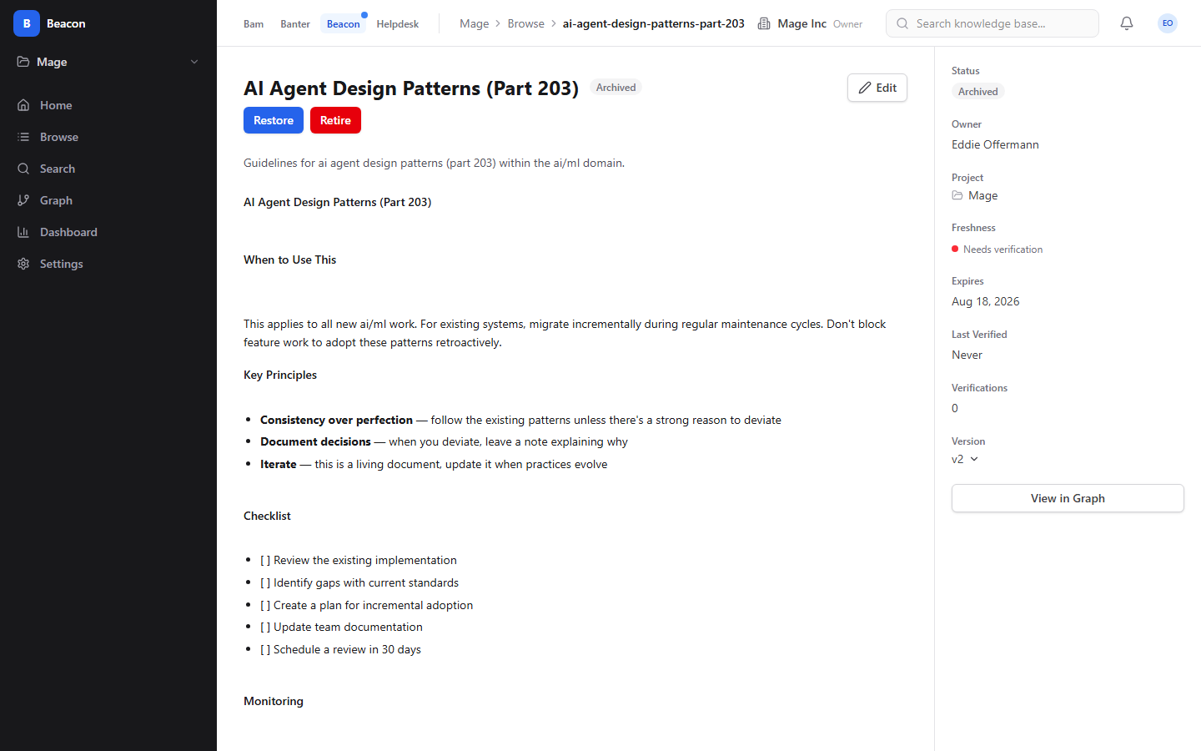
Beacon Key Features
Expiry Governance
Every beacon has a shelf life. Stale knowledge is surfaced before it misleads.
Semantic + Graph Search
Hybrid retrieval: vector similarity (Qdrant), graph expansion, full-text fallback.
Knowledge Graph Explorer
Visualize connections via typed links and implicit tag-affinity edges.
Agent Verification
AI agents verify and challenge beacons within confidence bounds.
Versioned Content
Every edit creates a new version with full diff history.
Governance Policies
Org-level defaults with project-level overrides for verification intervals.
Saved Queries
Named search configurations — private, project, or org-scoped.

Slide 30
Knowledge Graph Explorer
Hub nodes sized by authority · Freshness-colored rings · At-risk pulsing · Implicit + explicit edges

Slide 31

Browse & Search
Browse by status, project, tags — infinite scroll pagination
Semantic search with multi-signal retrieval pipeline

Slide 32
Deep Dive: Banter
Real-time team messaging with AI agent participation

Slide 33
Channels & Search
Real-time channels with rich compose and member list
Full-text search across all messages and channels

Slide 34
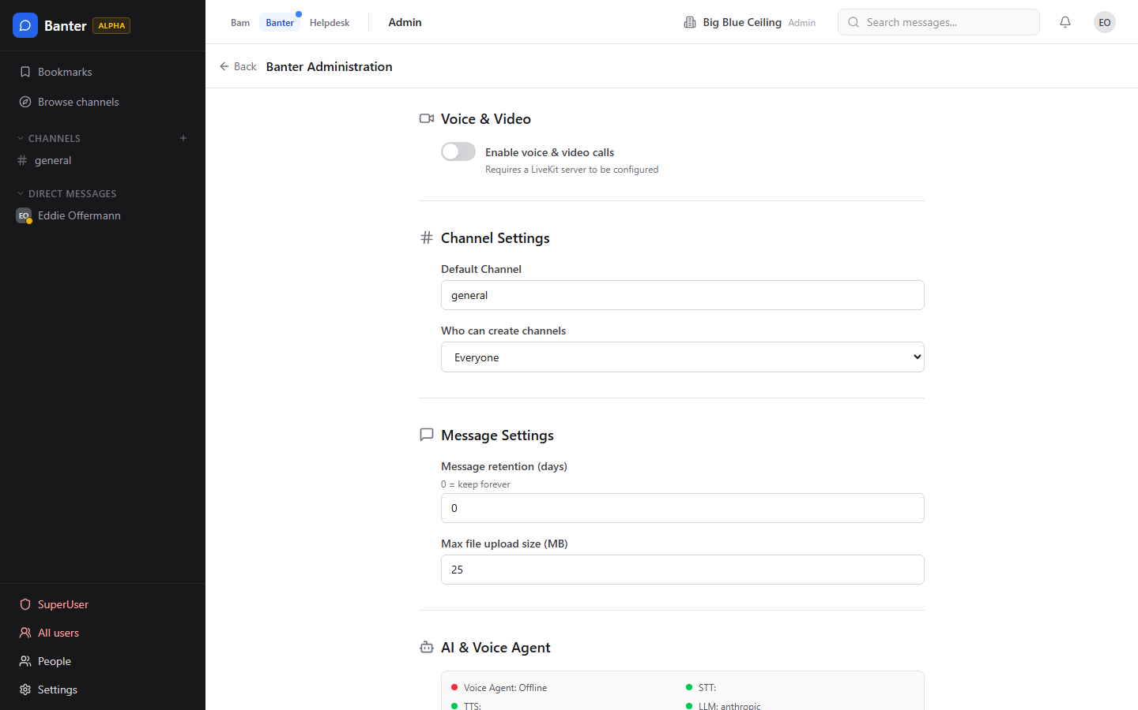
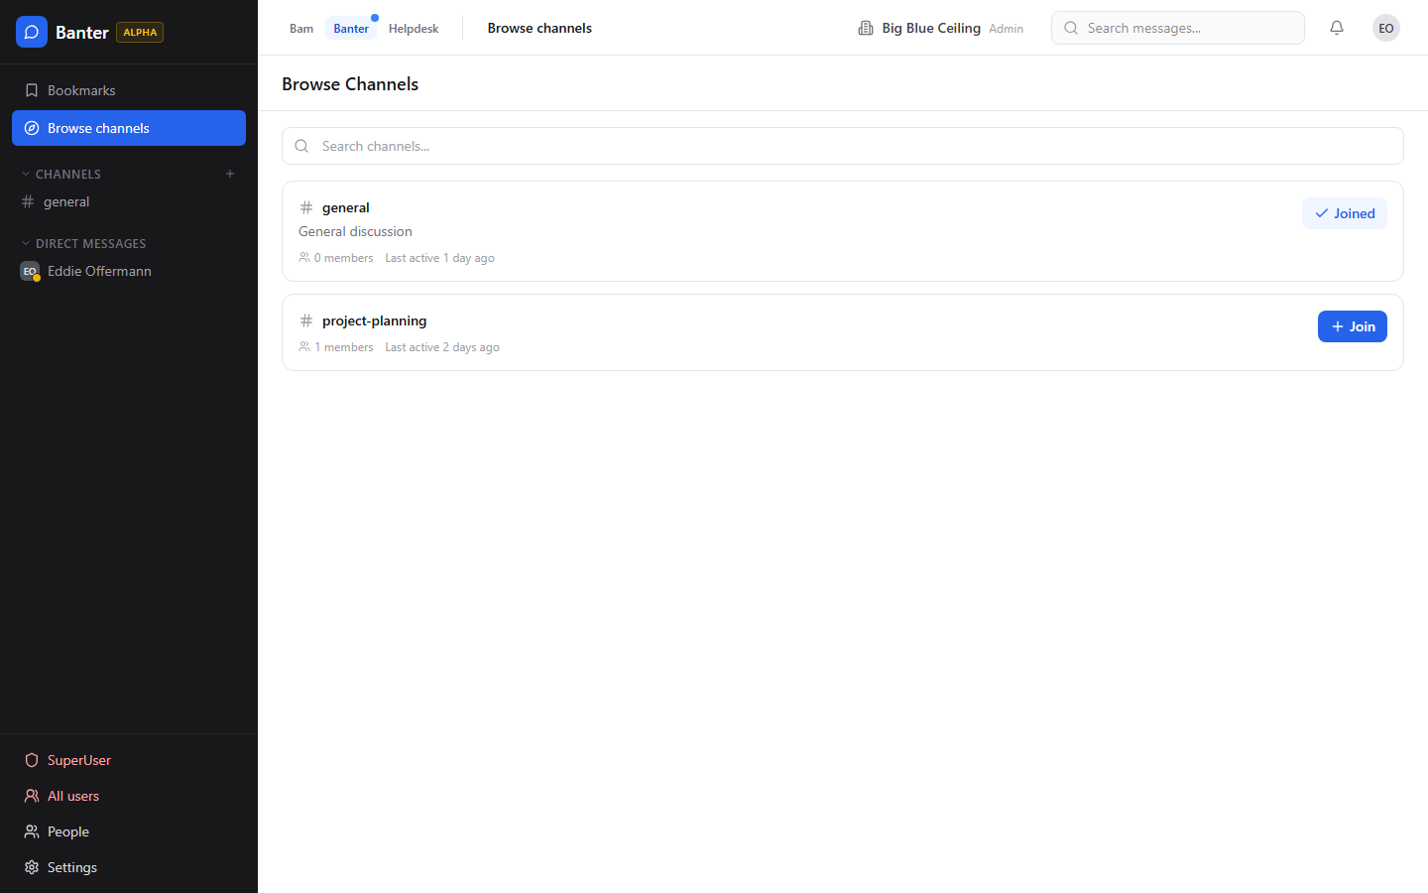
Admin & Discovery
Admin panel — channel management and retention policies
Browse and discover channels across the organization

Slide 35
Why Not Just Use Slack?
Because Banter shares authentication, database, and deep cross-linking with BigBlueBam.
• Mention BBB-247 in a channel → links directly to the task
• AI agent triages a helpdesk ticket → posts update to #support-triage
• Sprint reports shared to channels with one click
• No webhooks, no bridges, no sync lag
• AI agents participate natively — same MCP tools, same permissions
• 47 dedicated MCP tools for messaging automation

Slide 36
Deep Dive: Tech Stack
Architecture, infrastructure, and developer experience

Slide 37
Architecture Overview
Frontend Layer
API Layer
Data Layer
• React 19 SPAs (Bam, Helpdesk, Beacon, Banter)
• TailwindCSS v4 · Motion (Framer Motion v11+)
• TanStack Query v5 · Zustand · dnd-kit
• Radix UI · Tiptap rich text · Zod validation
• Node.js 22 LTS · Fastify v5
• Drizzle ORM · Zod (shared with frontend)
• WebSocket + Redis PubSub (real-time)
• BullMQ worker (email, export, notifications)
• PostgreSQL 16 (RLS, JSONB, partitioned logs)
• Redis 7 (sessions, cache, PubSub, queues)
• MinIO / S3 (file attachments)
• Qdrant (vector search for Beacon)
Infrastructure
• Docker Compose — 14 services, single docker compose up
• nginx reverse proxy — all SPAs and APIs behind one port
• Turborepo + pnpm workspaces monorepo
• Multi-stage Dockerfiles — dev and production modes
• LiveKit SFU for voice/video · Python voice agent (STT/TTS)
• MCP Server — Streamable HTTP + SSE + stdio transports

Slide 38
Key Numbers
14
140
530+
40+
4
38
Docker Services
MCP Tools
Test Cases
Database Tables
React SPAs
API Route Modules
Monorepo Structure
• apps/api/ — Bam Fastify REST API + WebSocket (23 route modules, ~63 source files)
• apps/frontend/ — Bam React SPA (~55 source files, 8 pages, command palette)
• apps/banter-api/ — Banter Fastify API + WebSocket (15 routes, 18 DB tables)
• apps/banter/ — Banter React SPA (14 components, 7 pages)
• apps/beacon-api/ — Beacon Fastify API (knowledge base, search, graph, policies)
• apps/beacon/ — Beacon React SPA (knowledge home, graph explorer, editor)
• apps/helpdesk-api/ + apps/helpdesk/ — Customer support portal
• apps/mcp-server/ — MCP protocol server (140 tools, 10+ resources, 8 prompts)
• apps/worker/ — BullMQ background jobs (email, notifications, export, retention)
• packages/shared/ — Zod schemas, TypeScript types, constants

Slide 39
B
BigBlueBam
Project management built for human-AI teams.
localhost/b3/ · localhost/beacon/ · localhost/banter/ · localhost/helpdesk/
docker compose up — and you're running.

