Slide 1

ToDo App
WEB&CLOUD COMPUTING
20 Oct 2016

Slide 2
Team 4Cast is:
Michael Bradvica
Brent Hoskins
Noe Hernandez
Dan Sullivan

Slide 3

Overview
Functional Specification
Architecture
Presentation
Business Logic
Database
Deployment
Demo

Slide 4
Functional Specification
TodoMVC is an Application Specification in which many different libraries have presented their version of this application to allow comparison of complexity to perform this basic functionality with a common look & feel.
Functionality
Add Todos
Edit Todos
Mark Todo Complete
Remove Todos
Clear Completed Todos
Display dynamic metrics (all, active, completed)
(standard) static html / css file is provided through the TodoMVC page

Slide 5
Layered Architecture
Presentation
Business Logic
RESTful API
Database

Slide 6
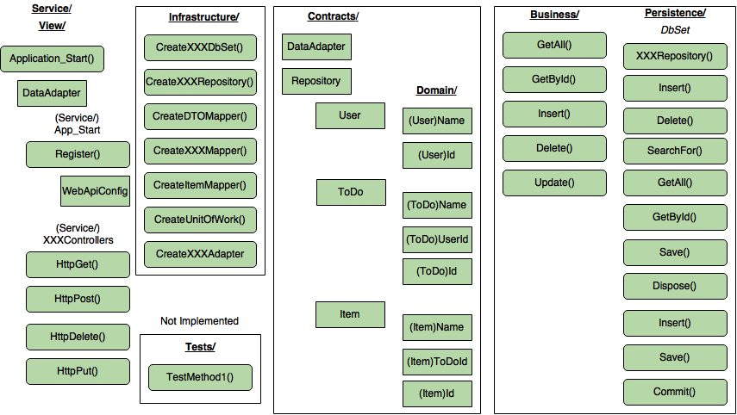

Slide 7
Presentation
HTML, CSS
“input” to create todos
“todo-list” lists todos (each is an “li”
“completed” class
“editing” class
“view” class for neither editing or completed state
“label” is the title
“checkbox” to toggle complete
“destroy” button to delete

Slide 8
Business Logic

Slide 9
RESTful API
Resource Representations
URI

Slide 10
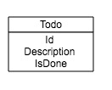
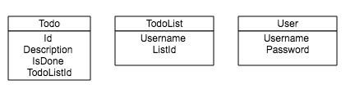
Database - Entities
Create, Read, Update, Delete (CRUD)
SQL Database Entities
multi-user, multi-list

Slide 11
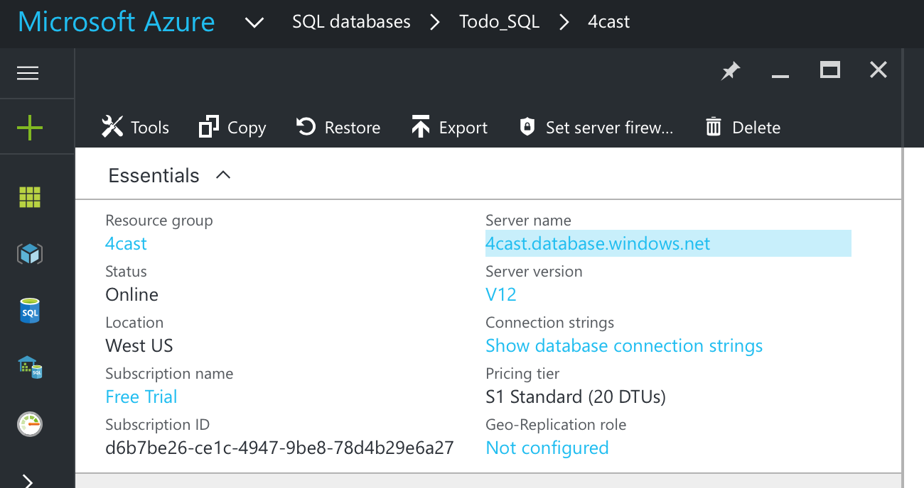
Database Configuration
Microsoft Azure SQL Connection

Slide 12
Database Connection Strings
Pre-configured connection strings are available for cut/paste
ADO.NET (SQL authentication)
Server=tcp:4cast.database.windows.net,1433;Initial …
ODBC (including Node.js)
Driver={ODBC Driver 13 for SQL Server}; …
PHP
Server: 4cast.database.windows.net,1433 \r\n …
JDBC
jdbc:sqlserver://4cast.database.windows.net:1433;database= …

Slide 13
Deployment
Windows Azure
Database Server

Slide 14
Security
Configure Azure SQL server-level firewall
IP-address limited administration
Username/Password connection configured “bobjones/10birds!”

Slide 15
Demo

Slide 16
Lessons Learned
What we learned
Micrsoft’s Web services (Azure):
Database, Web hosting, PaaS
User friendly. Well-supported, Intuitive
Fully-integrated with GitHub! (realtime updates!)
GitHub is a powerful collaboration tool
Sync often!
Postman: Excellent tool for testing interaction with WebApi
What could have been better
Use .gitignore!
Visual Studio auto-generates A LOT of files ( 1,000 )
Make better use of branches and sync to master more often
Had to launch several distinct cloud instances because of firewall issues.
Make use of GitHub’s Wiki feature. Readme.md as a progress/status log could have linked to Wiki pages.

Slide 17
Questions?

