Slide 1

ToDo App
WEB&CLOUD COMPUTING

Slide 2
Team 4Cast is:
Michael Bradvica
Brent Hoskins
Noe Hernandez
Dan Sullivan

Slide 3

Overview
Functional Specification
Architecture
Presentation
Business Logic
Database
Deployment
Demo

Slide 4
Functional Specification
TodoMVC is an Application Specification in which many different libraries have presented their version of this application to allow comparison of complexity to perform this basic functionality with a common look & feel.
Functionality
Add Todos
Edit Todos
Mark Todo Complete
Remove Todos
Clear Completed Todos
Display dynamic metrics (all, active, completed)
(standard) static html / css file is provided through the TodoMVC page

Slide 5
Layered Architecture
Presentation
Business Logic
RESTful API
Database

Slide 6
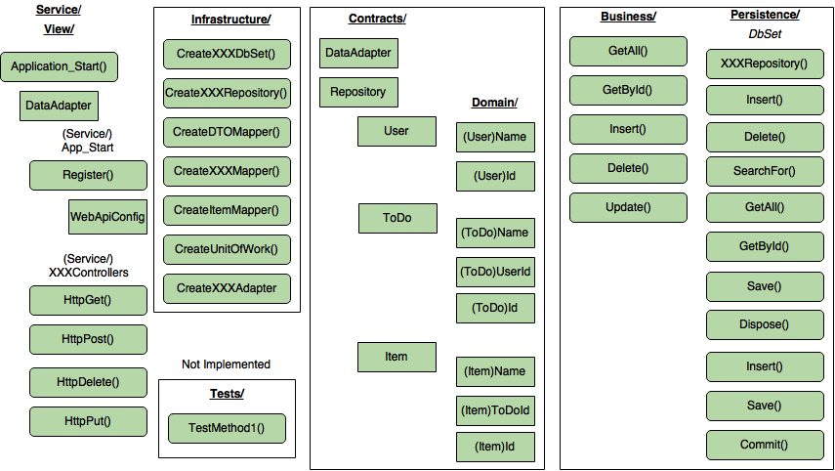

Slide 7
Presentation
HTML, CSS
“input” to create todos
“todo-list” lists todos (each is an “li”
“completed” class
“editing” class
“view” class for neither editing or completed state
“label” is the title
“checkbox” to toggle complete
“destroy” button to delete

Slide 8
Business Logic

Slide 9
RESTful API
Resource Representations
URI

Slide 10
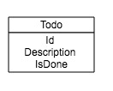
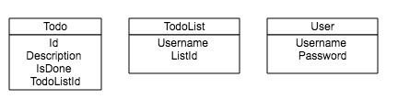
Database - Entities
Create, Read, Update, Delete (CRUD)
SQL Database Entities
multi-user, multi-list

Slide 11
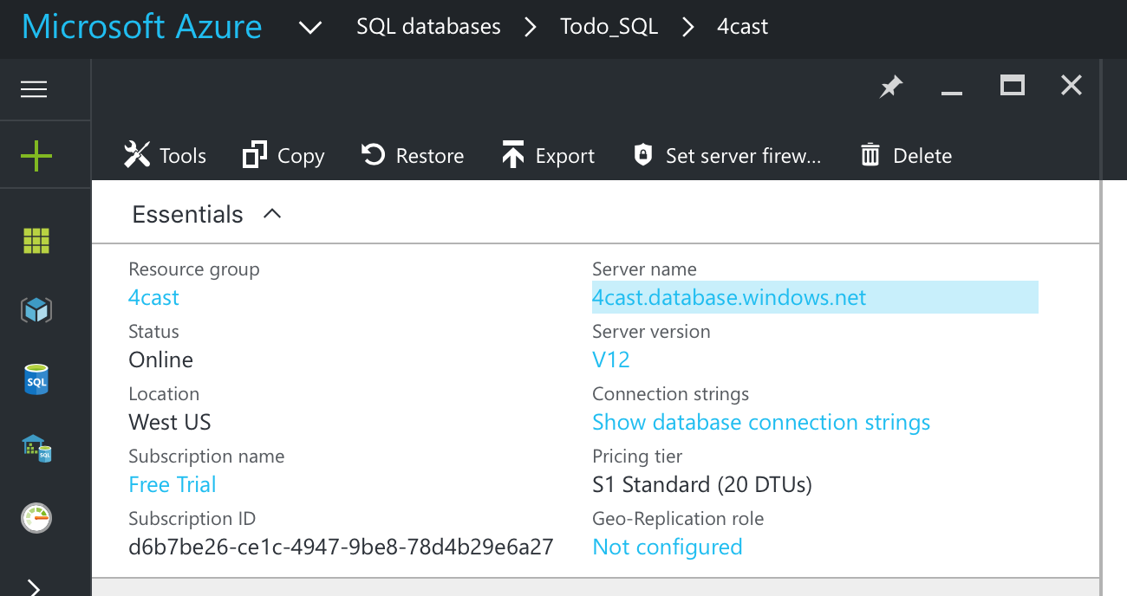
Database Configuration
Microsoft Azure SQL Connection
ADO.NET (SQL authentication)
Server=tcp:4cast.database.windows.net,1433;Initial Catalog=Todo_SQL;Persist Security Info=False;User ID={your_username};Password={your_password};MultipleActiveResultSets=False;Encrypt=True;TrustServerCertificate=False;Connection Timeout=30;
ODBC (including Node.js)
Driver={ODBC Driver 13 for SQL Server};Server=tcp:4cast.database.windows.net,1433;Database=Todo_SQL;Uid=bobjones@4cast;Pwd={your_password_here};Encrypt=yes;TrustServerCertificate=no;Connection Timeout=30;
PHP

Slide 12
Database Connection Strings
Pre-configured connection strings are available for cut/paste
ADO.NET (SQL authentication)
Server=tcp:4cast.database.windows.net,1433;Initial …
ODBC (including Node.js)
Driver={ODBC Driver 13 for SQL Server}; …
PHP
Server: 4cast.database.windows.net,1433 \r\n …
JDBC
jdbc:sqlserver://4cast.database.windows.net:1433;database= …

Slide 13
Deployment
Windows Azure
Database Server

Slide 14
Security
Configure Azure SQL server-level firewall
IP-address limited administration
Username/Password connection configured “bobjones/10birds!”

Slide 15
Demo

Slide 16
Lessons Learned
What we learned
What could have been better

Slide 17
Questions?

