Slide 1
apns
dexter

Slide 2
APNS的认识
APNS：Apple Push Notification service
问题：
1、无法保证消息是否被发送成功
2、给某人同时推送多条消息，APNs就只给最后一条
3、推送内容只能是 256 字节
2015年12月17日起，发布 “基于 HTTP/2 的全新 APNs 协议”,iOS 系统以及 OS X 系统，统一将最大 payload 大小提升到4KB。

Slide 3
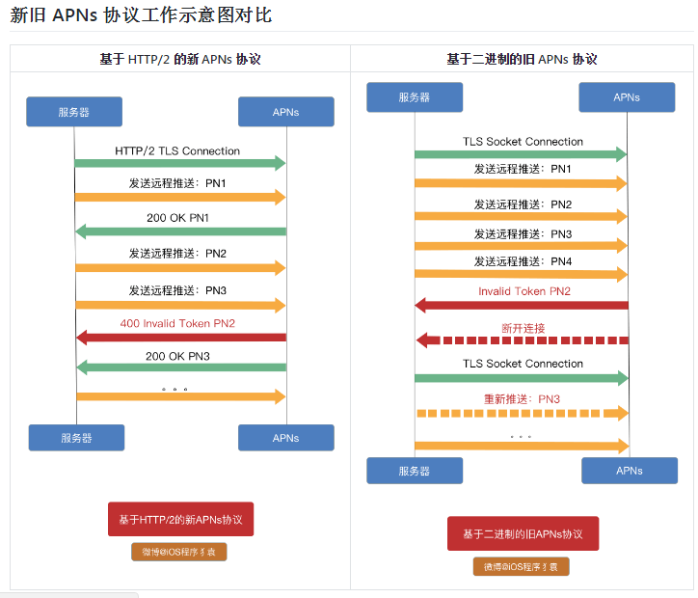

Slide 4
Pushy
发送 APNs (iOS, OS X, 或 Safari) 推送通知的Java类库

Slide 5
Pushy最佳实践
https://github.com/relayrides/pushy/wiki/Best-practices

Slide 6
代码参考
通过Semaphore来进行流控，防止缓存过大，内存不足
通过CountDownLatch来标记消息是否发送完成
使用AtomicLong完成匿名内部类operationComplete方法中的计数
使用Netty的Future对象进行消息推送结果的判断

Slide 7
代码参考
public class IOSPush { private static final Logger logger = LoggerFactory.getLogger(IOSPush.class); private static final ApnsClient apnsClient = null; private static final Semaphore semaphore = new Semaphore(10000); public void push(final List<String> deviceTokens, String alertTitle, String alertBody) { long startTime = System.currentTimeMillis(); if (apnsClient == null) { try { EventLoopGroup eventLoopGroup = new NioEventLoopGroup(4); apnsClient = new ApnsClientBuilder().setApnsServer(ApnsClientBuilder.DEVELOPMENT_APNS_HOST) .setClientCredentials(new File("/path/to/certificate.p12"), "p12-file-password") .setConcurrentConnections(4).setEventLoopGroup(eventLoopGroup).build(); } catch (Exception e) { logger.error("ios get pushy apns client failed!"); e.printStackTrace(); } } long total = deviceTokens.size(); final CountDownLatch latch = new CountDownLatch(deviceTokens.size()); final AtomicLong successCnt = new AtomicLong(0); long startPushTime = System.currentTimeMillis(); for (String deviceToken : deviceTokens) { ApnsPayloadBuilder payloadBuilder = new ApnsPayloadBuilder(); payloadBuilder.setAlertBody(alertBody); payloadBuilder.setAlertTitle(alertTitle); String payload = payloadBuilder.buildWithDefaultMaximumLength(); final String token = TokenUtil.sanitizeTokenString(deviceToken); SimpleApnsPushNotification pushNotification = new SimpleApnsPushNotification(token, "com.example.myApp", payload); try { semaphore.acquire(); } catch (InterruptedException e) { logger.error("ios push get semaphore failed, deviceToken:{}", deviceToken); e.printStackTrace(); } final Future<PushNotificationResponse<SimpleApnsPushNotification>> future = apnsClient.sendNotification(pushNotification); future.addListener(new GenericFutureListener<Future<PushNotificationResponse>>() { @Override public void operationComplete(Future<PushNotificationResponse> pushNotificationResponseFuture) throws Exception { if (future.isSuccess()) { final PushNotificationResponse<SimpleApnsPushNotification> response = future.getNow(); if (response.isAccepted()) { successCnt.incrementAndGet(); } else { Date invalidTime = response.getTokenInvalidationTimestamp(); logger.error("Notification rejected by the APNs gateway: " + response.getRejectionReason()); if (invalidTime != null) { logger.error("\t…and the token is invalid as of " + response.getTokenInvalidationTimestamp()); } } } else { logger.error("send notification device token={} is failed {} ", token, future.cause().getMessage()); } latch.countDown(); semaphore.release(); } }); } try { latch.await(20, TimeUnit.SECONDS); } catch (InterruptedException e) { logger.error("ios push latch await failed!"); e.printStackTrace(); } long endPushTime = System.currentTimeMillis(); logger.info("test pushMessage success. [共推送" + total + "个][成功" + (successCnt.get()) + "个], totalcost= " + (endPushTime - startTime) + ", pushCost=" + (endPushTime - startPushTime)); } }

Slide 8
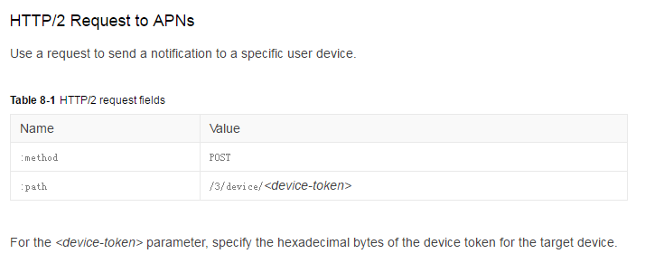
APNs Notification API

Slide 9
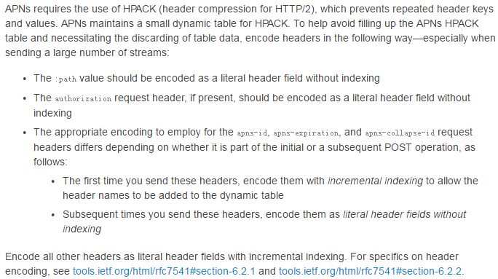
Http2 Request

Slide 10
Http2 Request
APNs ignores request headers other than the ones listed in Table 8-2.
Header | Description
authorization | The provider token that authorizes APNs to send push notifications for the specified topics. The token is in Base64URL-encoded JWT format, specified as bearer <provider token>. When the provider certificate is used to establish a connection, this request header is ignored.
apns-id | A canonical UUID that identifies the notification. If there is an error sending the notification, APNs uses this value to identify the notification to your server. The canonical form is 32 lowercase hexadecimal digits, displayed in five groups separated by hyphens in the form 8-4-4-4-12. An example UUID is as follows: 123e4567-e89b-12d3-a456-42665544000 If you omit this header, a new UUID is created by APNs and returned in the response.
apns-expiration | A UNIX epoch date expressed in seconds (UTC). This header identifies the date when the notification is no longer valid and can be discarded. If this value is nonzero, APNs stores the notification and tries to deliver it at least once, repeating the attempt as needed if it is unable to deliver the notification the first time. If the value is 0, APNs treats the notification as if it expires immediately and does not store the notification or attempt to redeliver it.
apns-priority | The priority of the notification. Specify one of the following values: 10–Send the push message immediately. Notifications with this priority must trigger an alert, sound, or badge on the target device. It is an error to use this priority for a push notification that contains only the content-available key. 5—Send the push message at a time that takes into account power considerations for the device. Notifications with this priority might be grouped and delivered in bursts. They are throttled, and in some cases are not delivered. If you omit this header, the APNs server sets the priority to 10
apns-topic | The topic of the remote notification, which is typically the bundle ID for your app. The certificate you create in your developer account must include the capability for this topic. If your certificate includes multiple topics, you must specify a value for this header. If you omit this request header and your APNs certificate does not specify multiple topics, the APNs server uses the certificate’s Subject as the default topic. If you are using a provider token instead of a certificate, you must specify a value for this request header. The topic you provide should be provisioned for the your team named in your developer account.
apns-collapse-id | Multiple notifications with the same collapse identifier are displayed to the user as a single notification. The value of this key must not exceed 64 bytes. For more information, see Quality of Service, Store-and-Forward, and Coalesced Notifications.

Slide 11
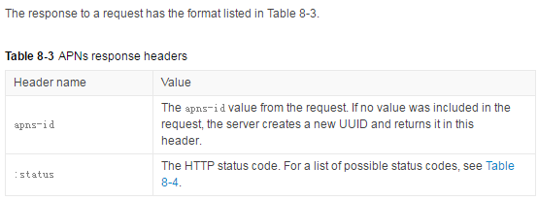
HTTP/2 Response from APNs

Slide 12
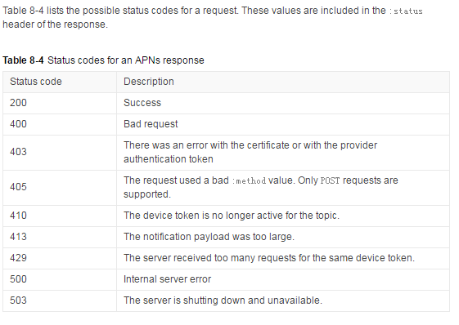
HTTP/2 Response from APNs

Slide 13
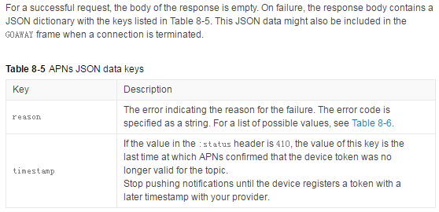
APNs响应信息（错误信息）

Slide 14
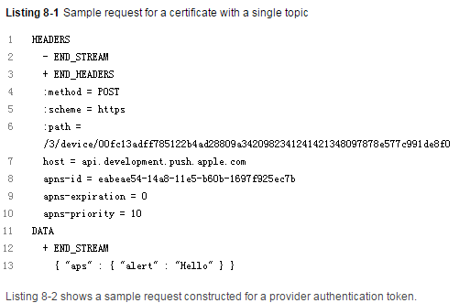
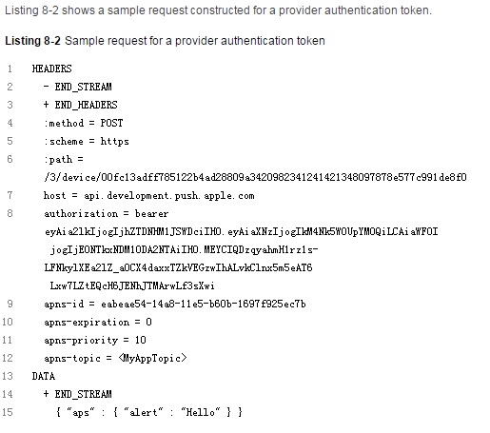
HTTP/2 Request/Response Examples for APNs

Slide 15
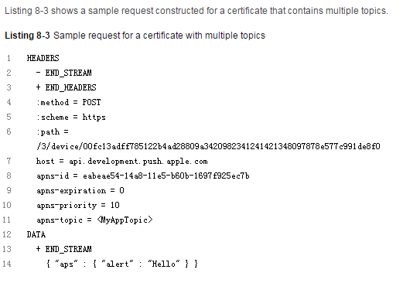
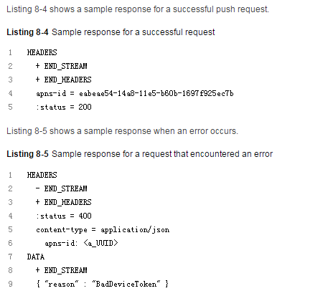
HTTP/2 Request/Response Examples for APNs

Slide 16
APNs响应信息（错误信息）
Table 8-6 lists the possible error codes included in the reason key of a response’s JSON payload
Table 8-6Values for the APNs JSON reason key
Status code | Error string | Description
400 | BadCollapseId | The collapse identifier exceeds the maximum allowed size
400 | BadDeviceToken | The specified device token was bad. Verify that the request contains a valid token and that the token matches the environment.
400 | BadExpirationDate | The apns-expiration value is bad.
400 | BadMessageId | The apns-id value is bad.
400 | BadPriority | The apns-priority value is bad
400 | BadTopic | The apns-topic was invalid.
400 | DeviceTokenNotForTopic | The device token does not match the specified topic.
400 | DuplicateHeaders | One or more headers were repeated.
400 | IdleTimeout | Idle time out.
400 | MissingDeviceToken | The device token is not specified in the request :path. Verify that the :pathheader contains the device token.
400 | MissingTopic | The apns-topic header of the request was not specified and was required. The apns-topic header is mandatory when the client is connected using a certificate that supports multiple topics.
400 | PayloadEmpty | The message payload was empty.
400 | TopicDisallowed | Pushing to this topic is not allowed
403 | BadCertificate | The certificate was bad.
403 | BadCertificateEnvironment | The client certificate was for the wrong environment.
403 | ExpiredProviderToken | The provider token is stale and a new token should be generated.
403 | Forbidden | The specified action is not allowed.
403 | InvalidProviderToken | The provider token is not valid or the token signature could not be verified.
403 | MissingProviderToken | No provider certificate was used to connect to APNs and Authorization header was missing or no provider token was specified.
404 | BadPath | The request contained a bad :path value.
405 | MethodNotAllowed | The specified :method was not POST.
410 | Unregistered | The device token is inactive for the specified topic. Expected HTTP/2 status code is 410; see Table 8-4.
413 | PayloadTooLarge | The message payload was too large. See Creating the Remote Notification Payload for details on maximum payload size.
429 | TooManyProviderTokenUpdates | The provider token is being updated too often.
429 | TooManyRequests | Too many requests were made consecutively to the same device token.
500 | InternalServerError | An internal server error occurred
503 | ServiceUnavailable | The service is unavailable.
503 | Shutdown | The server is shutting down.

