Slide 1
Tau-Vee Convolution
An alternative to the “sliding function” method of convolution

Slide 2
Contents
What is Convolution (Slides 3-5)
Preliminaries (Slides 6-7)
A Detailed Example (Slides 8-47)
Additional Examples (Slides 48-62)
Summary (Slides 63-77)

Slide 3
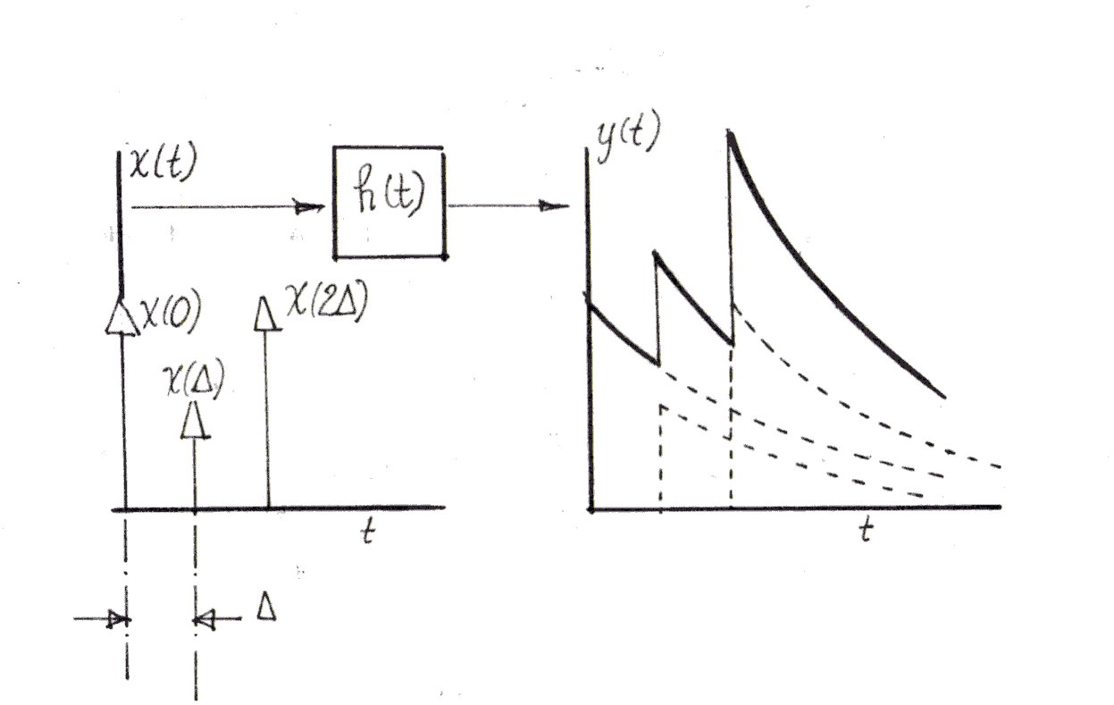
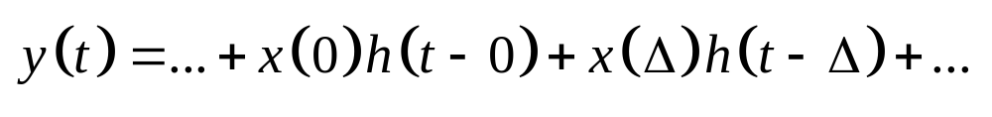
Convolution with Impulses

Slide 4
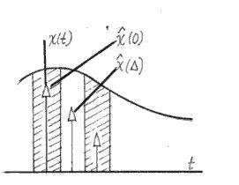
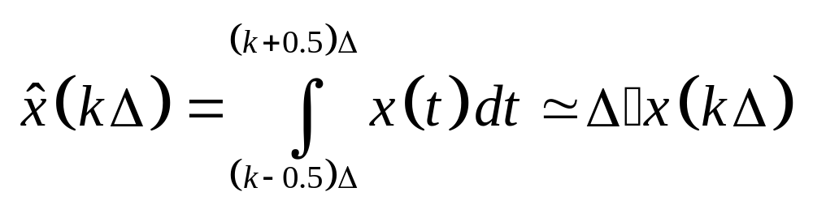
Approximating Continuous Data

Slide 5
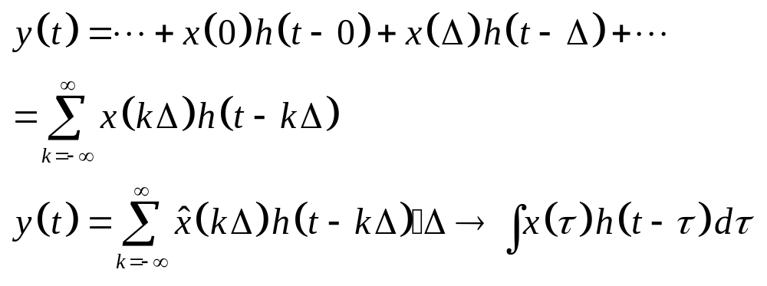
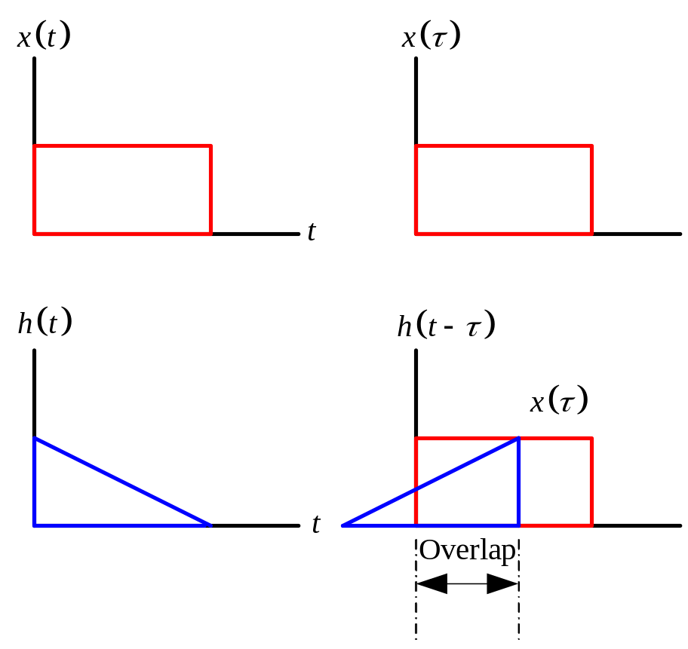

Slide 6
Disclaimer
This presentation is free, without any restrictions, to anyone who wants to use it.
There is no copyright on this presentation.

Slide 7
What you will need
A pencil (possibly with an eraser if you make mistakes).
A printer because you may find the presentation easier to follow if you print out a few slides.

Slide 8
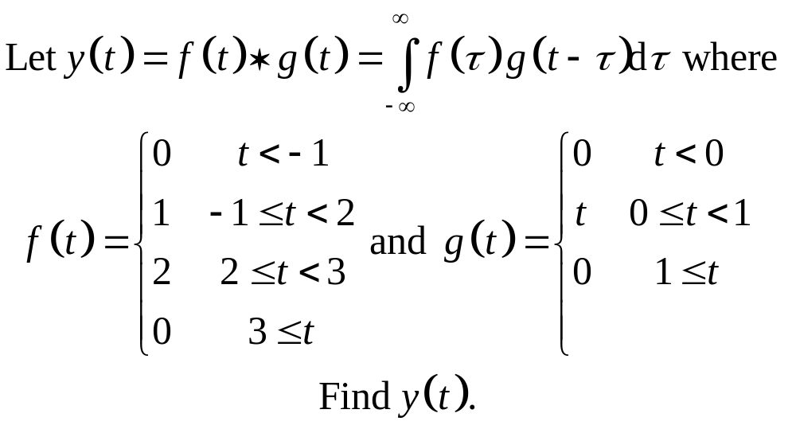
Let’s get started

Slide 9
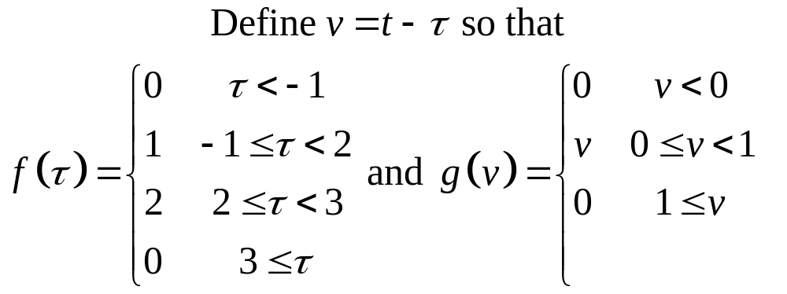
Change of variables

Slide 10
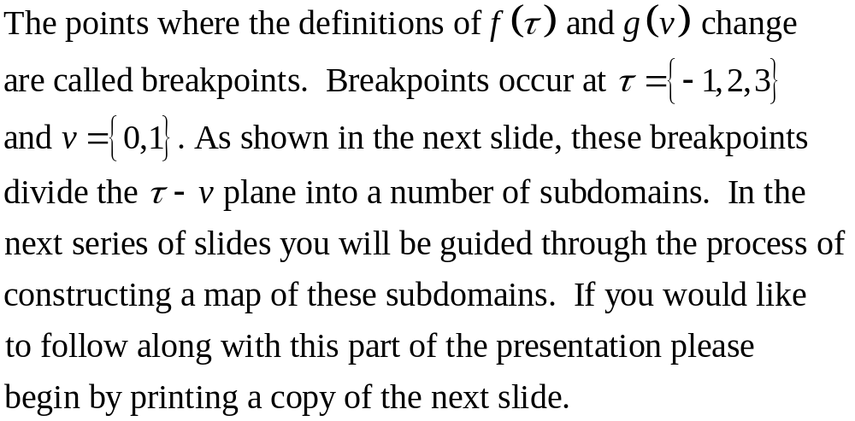
Breakpoints

Slide 11
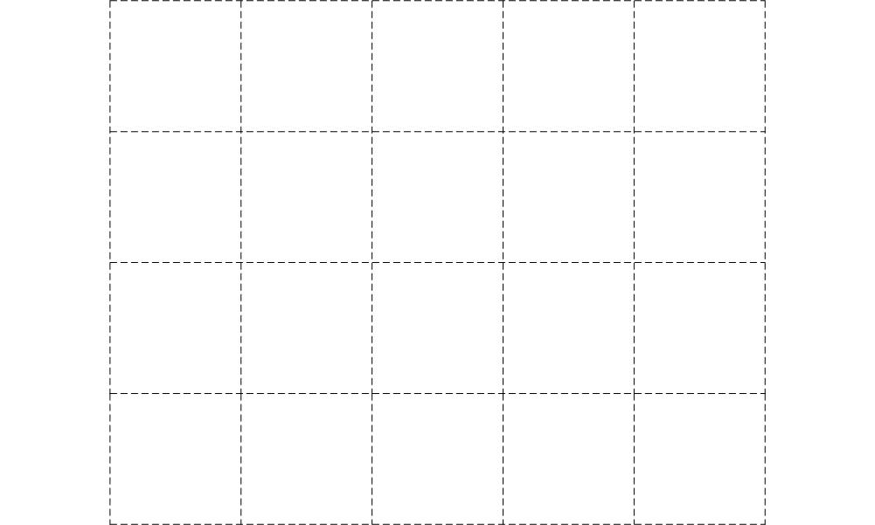
Print this slide

Slide 12
Follow Along if You Dare
Copy the next series of lines and points onto your printed slide.

Slide 13
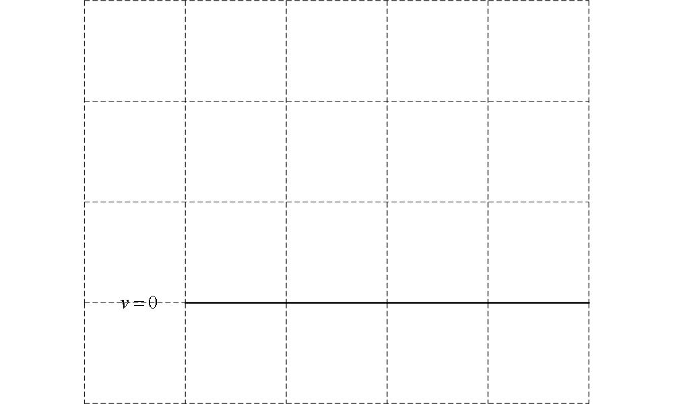

Slide 14
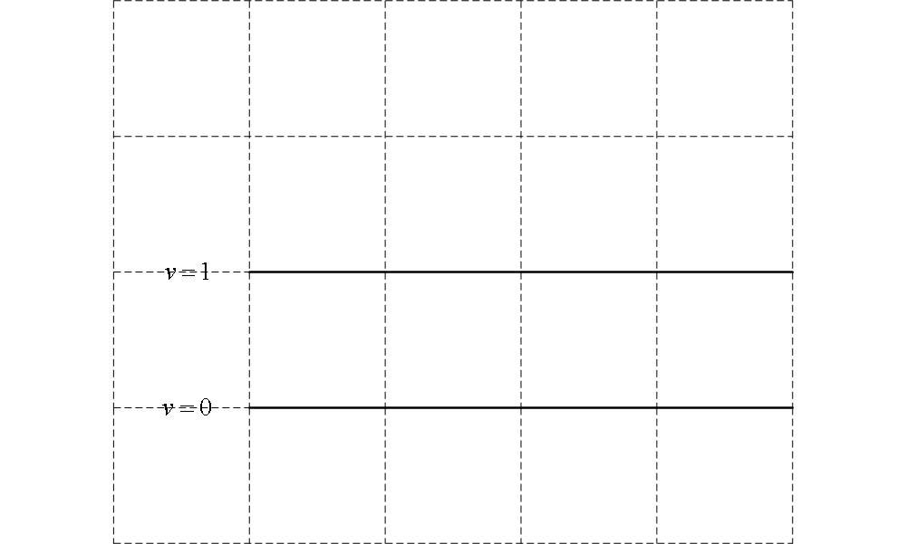

Slide 15
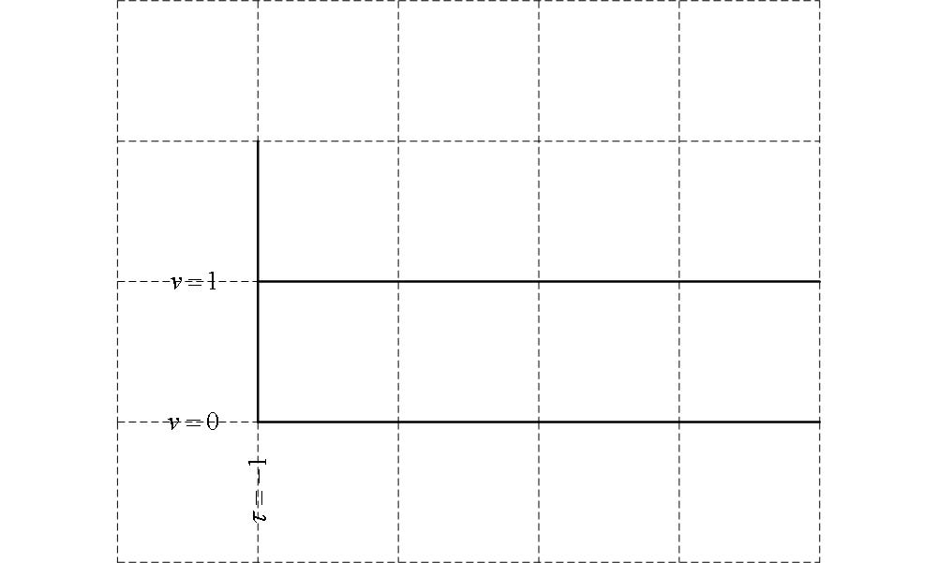

Slide 16
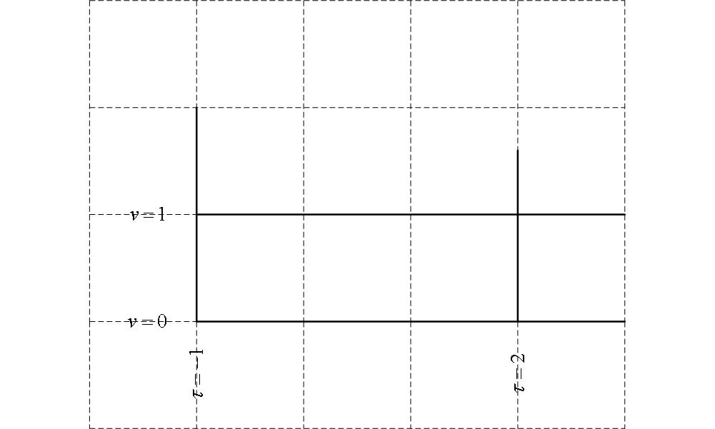

Slide 17
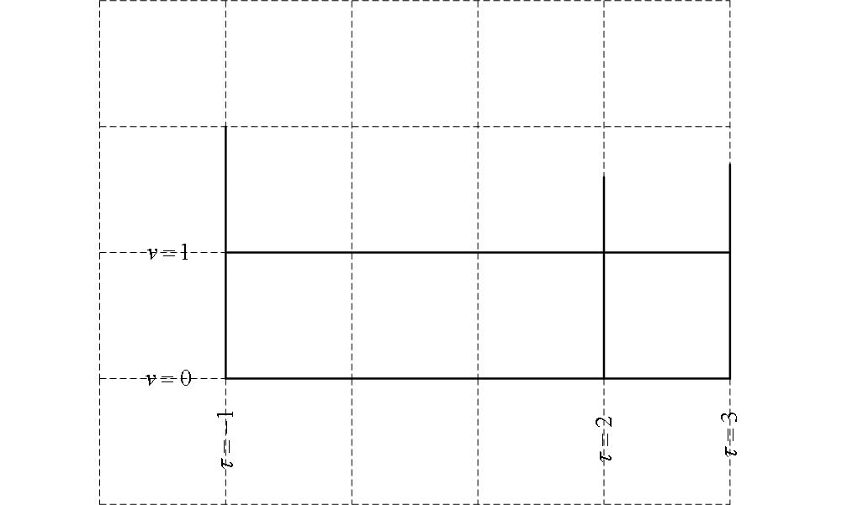

Slide 18
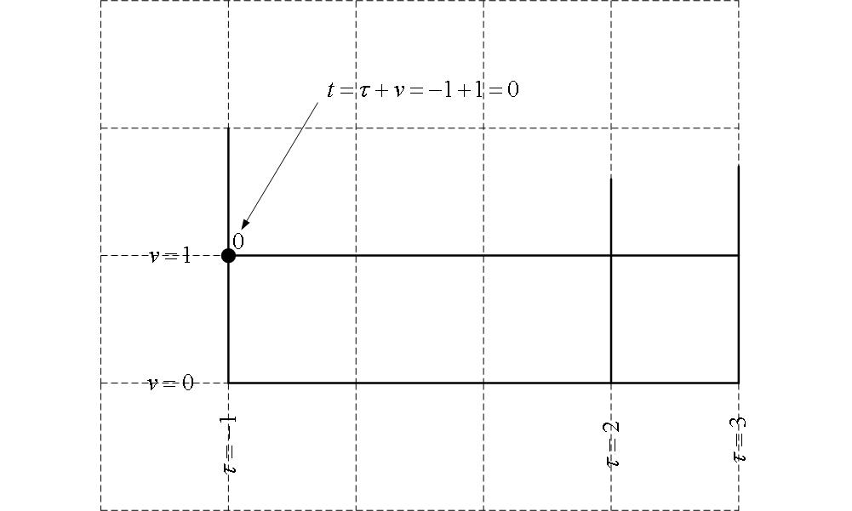

Slide 19
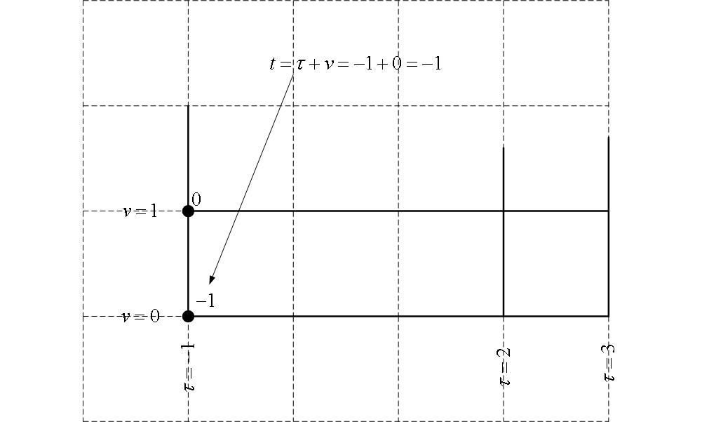

Slide 20
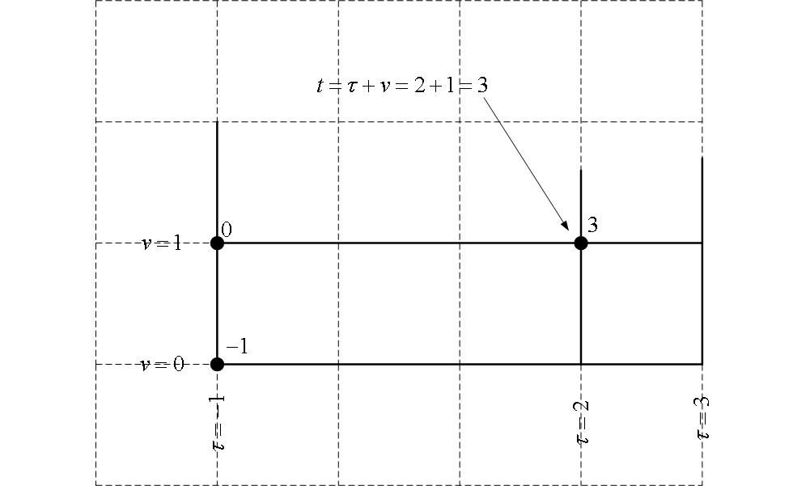

Slide 21
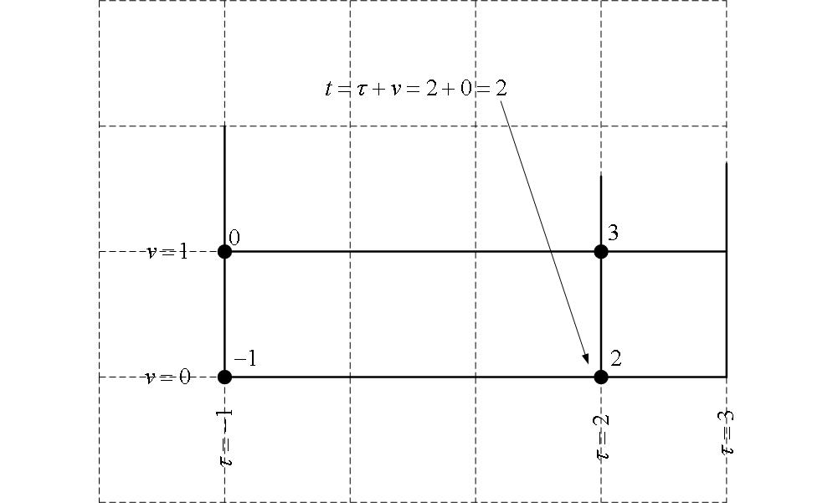

Slide 22
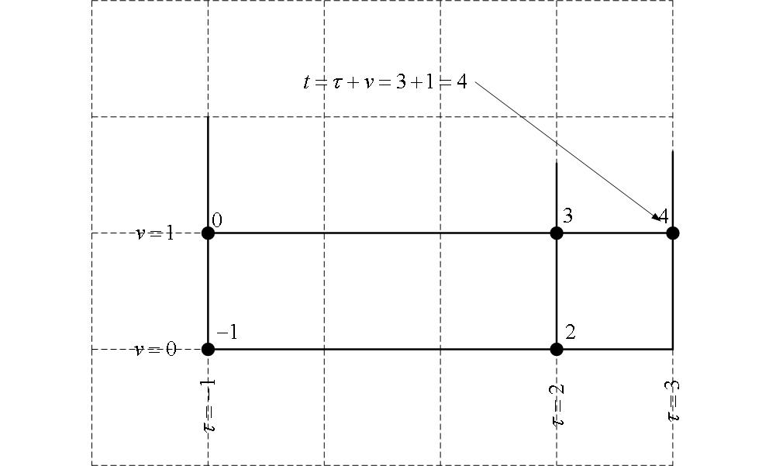

Slide 23
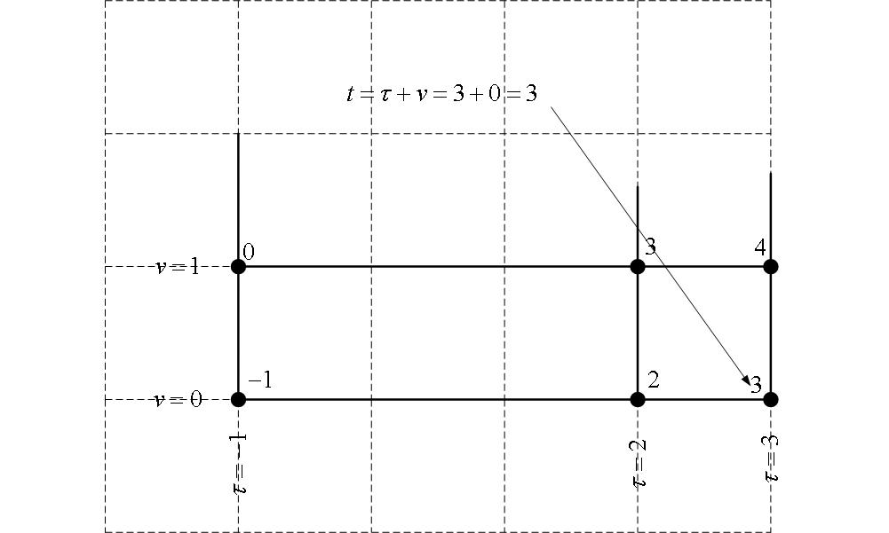

Slide 24
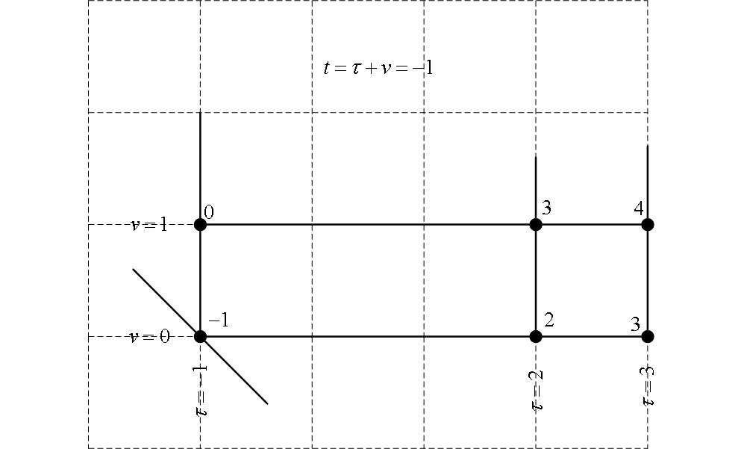

Slide 25
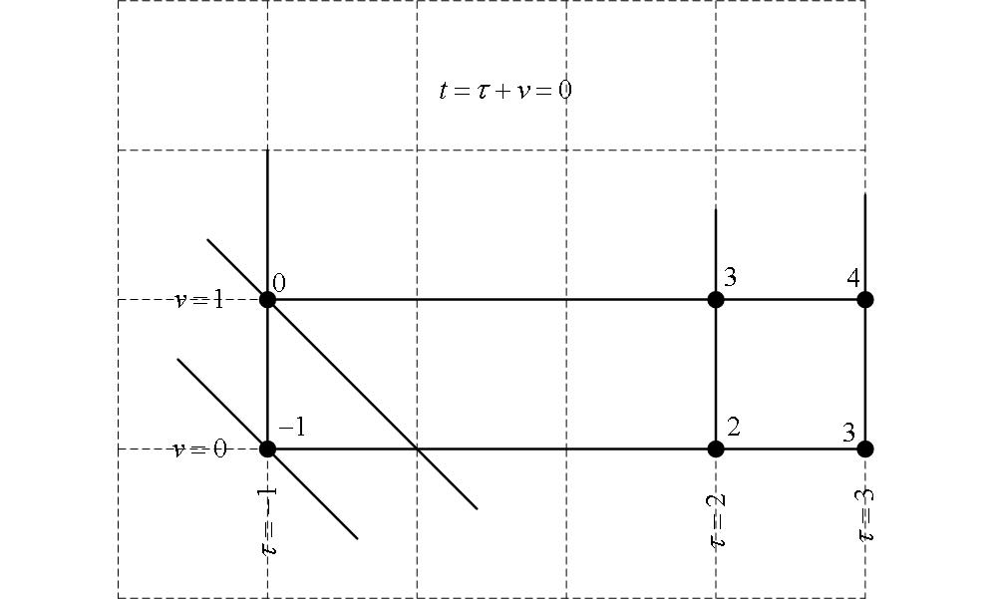

Slide 26
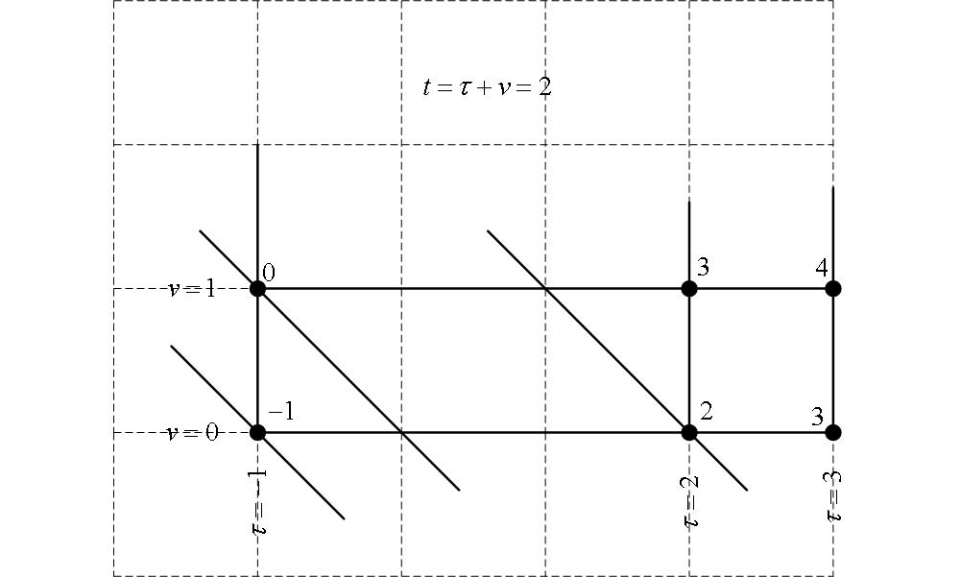

Slide 27
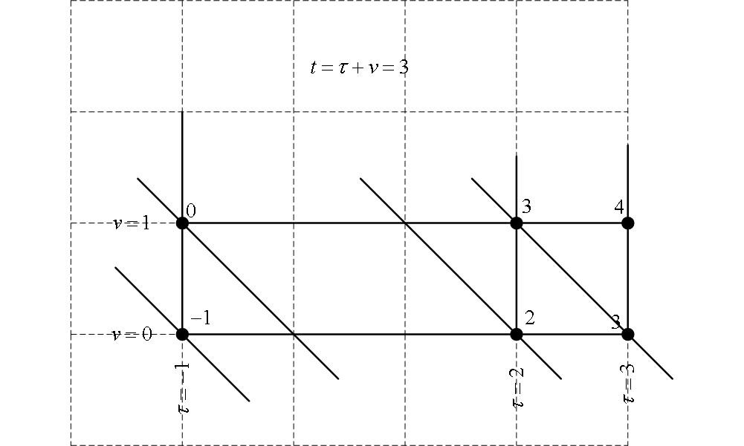

Slide 28
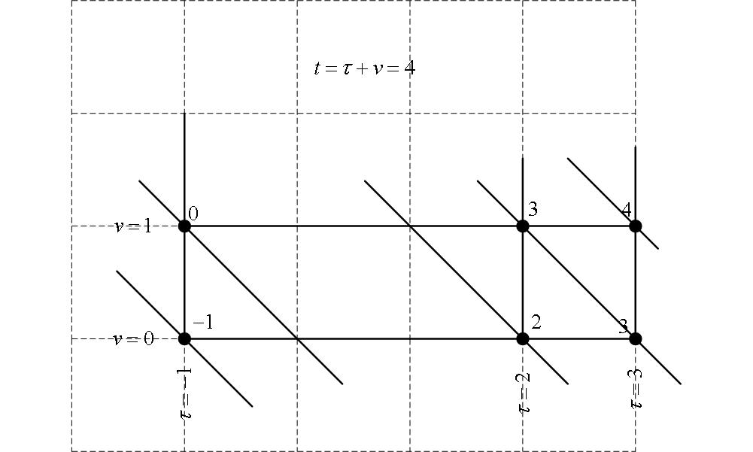
Done!

Slide 29
So what?
You have now divided the plane into 6 diagonal bands with each band corresponding to one range of time:
Band 1: t less than -1
Band 2: t between -1 and 0
Band 3: t between 0 and 2
Band 4: t between 2 and 3
Band 5: t between 3 and 4
Band 6: t greater than 4

Slide 30
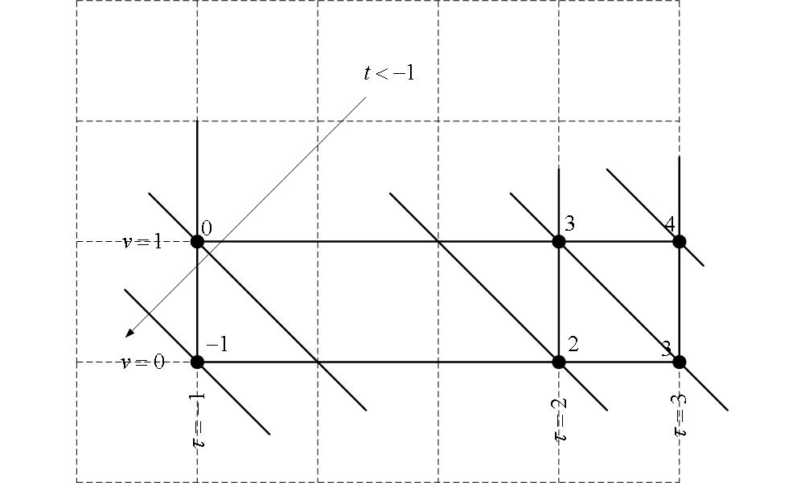

Slide 31
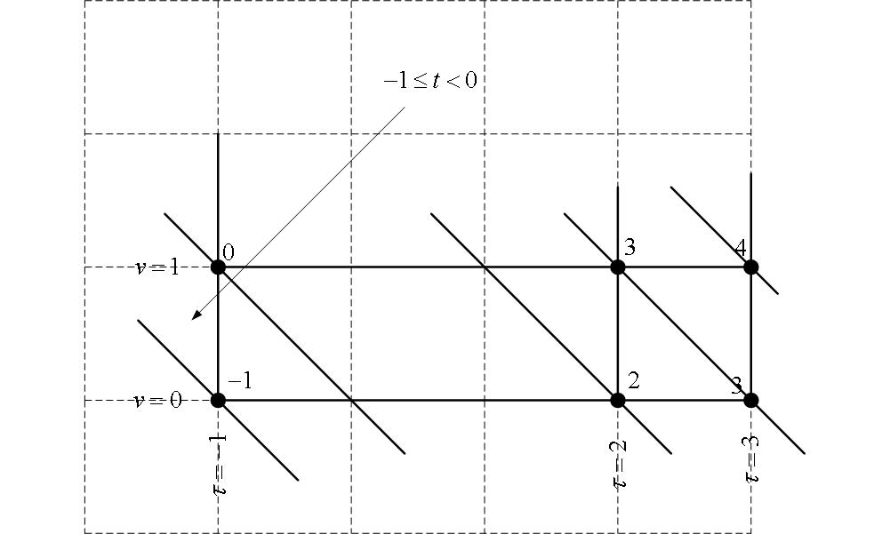

Slide 32
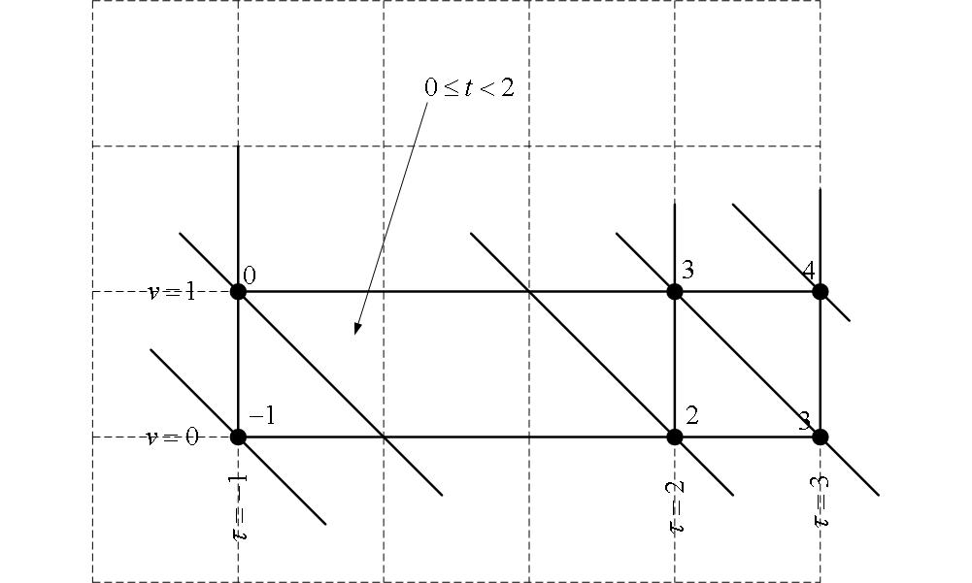

Slide 33
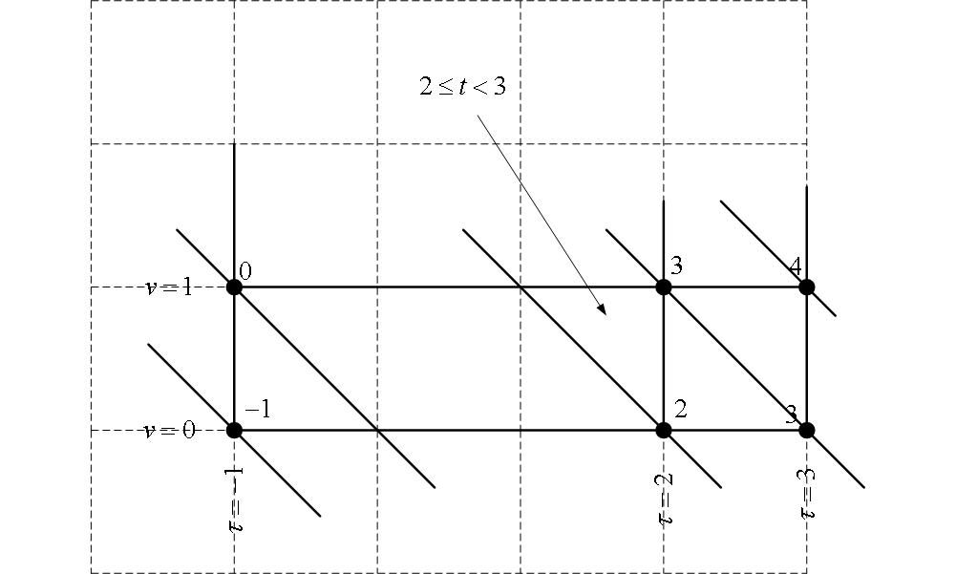

Slide 34
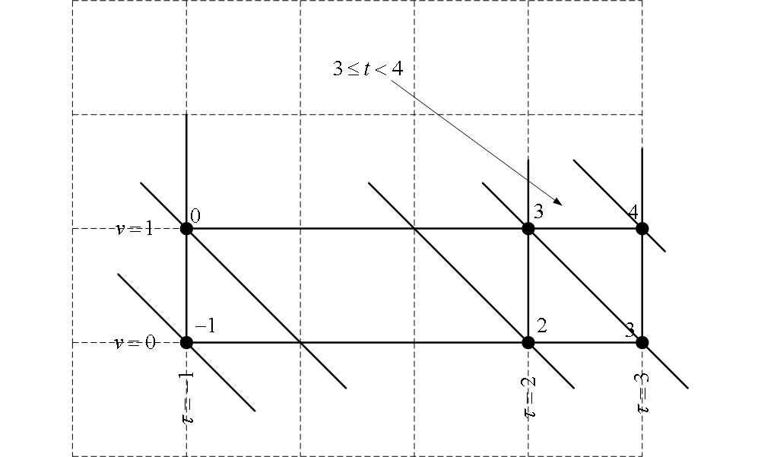

Slide 35
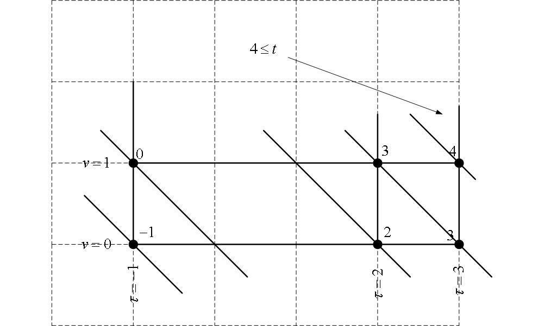

Slide 36
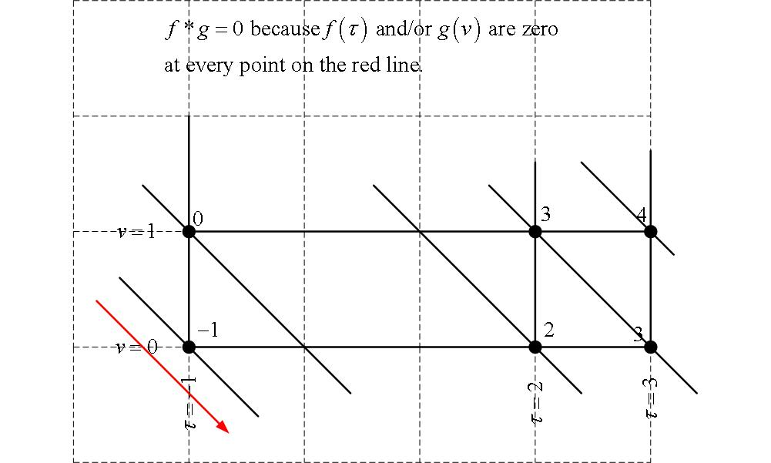
Band 1:Tau-Vee Method

Slide 37
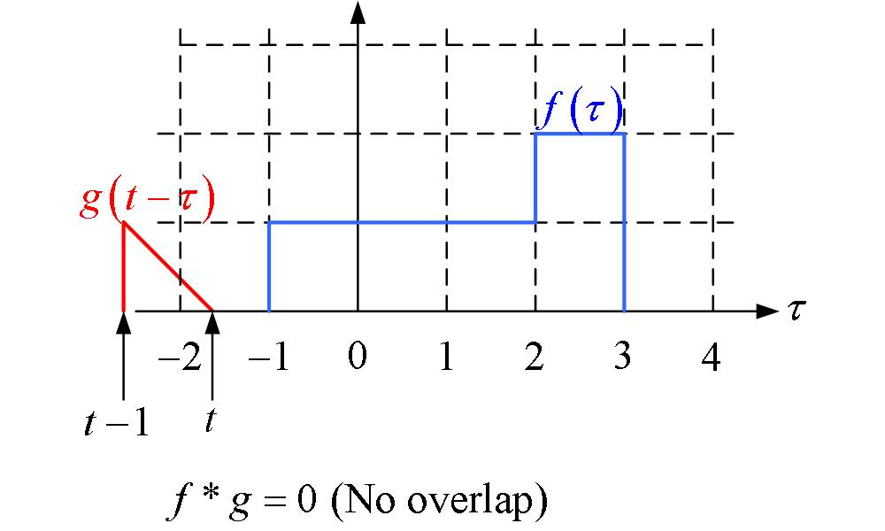
Band 1: Sliding Function Method

Slide 38
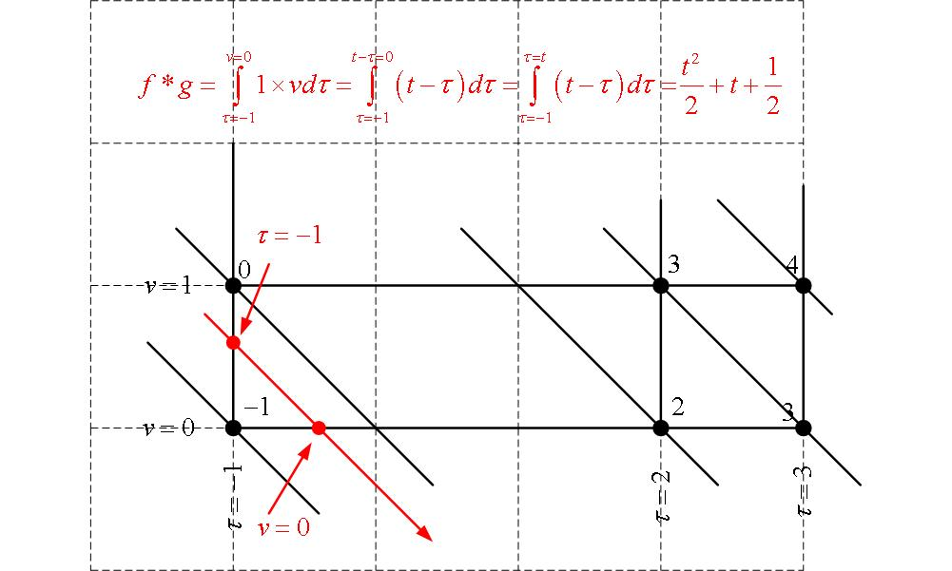
Band 2:Tau-Vee Method

Slide 39
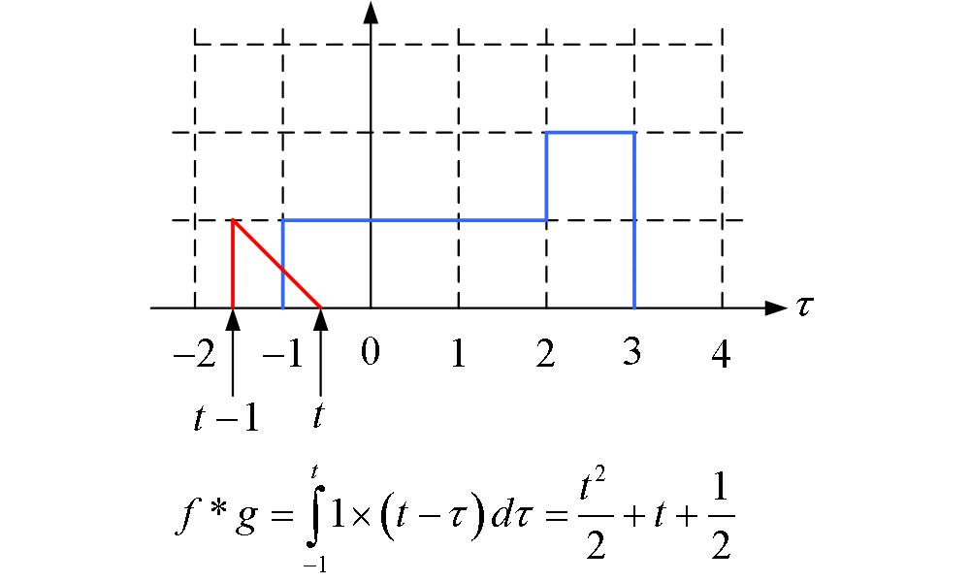
Band 2: Sliding Function Method

Slide 40
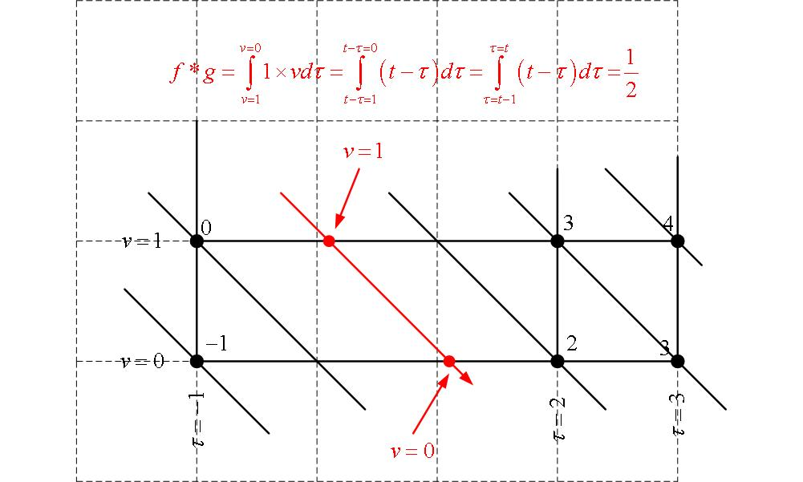
Band 3:Tau-Vee Method

Slide 41
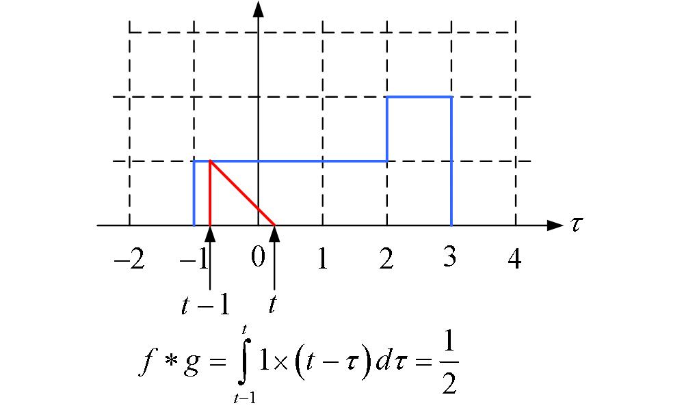
Band 3: Sliding Function Method

Slide 42
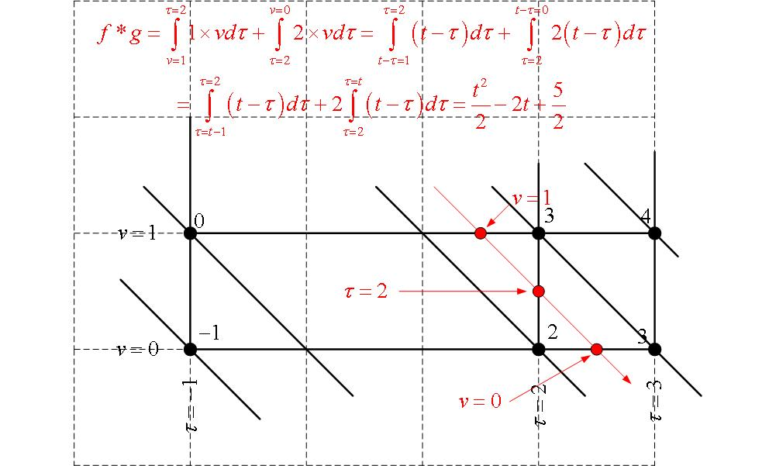
Band 4: Tau-Vee Method

Slide 43
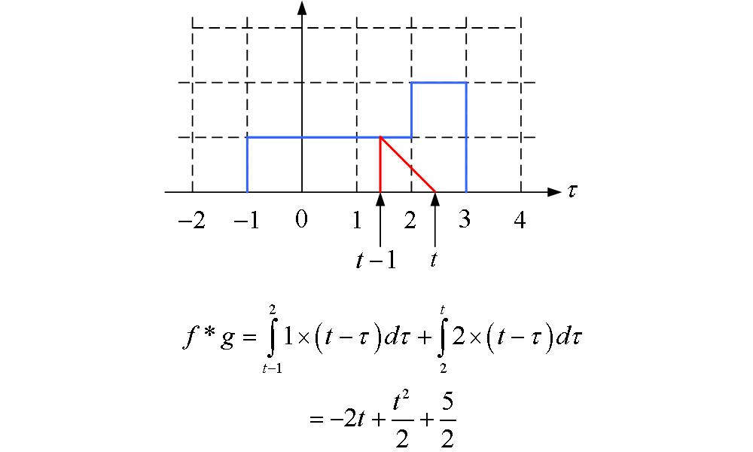
Band 4: Sliding Function Method

Slide 44
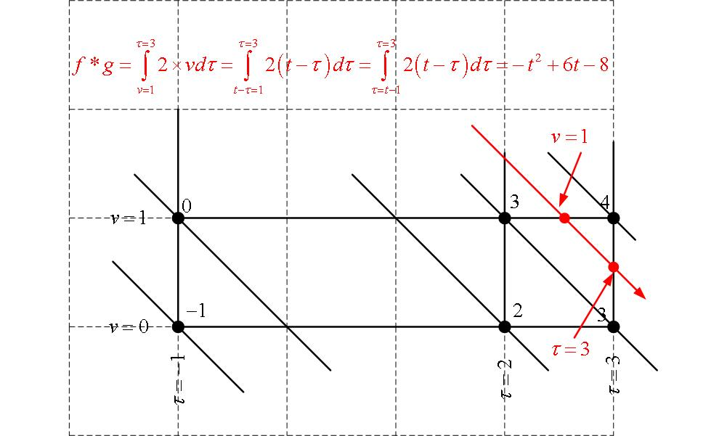
Band 5: Tau-Vee Method

Slide 45
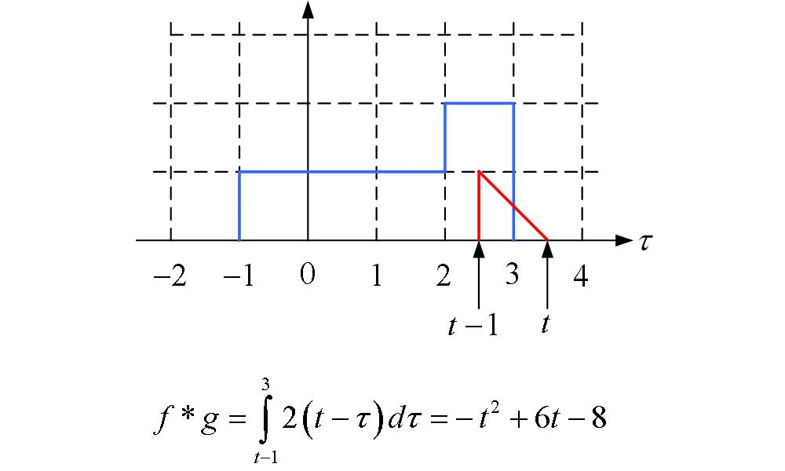
Band 5: Sliding Function Method

Slide 46
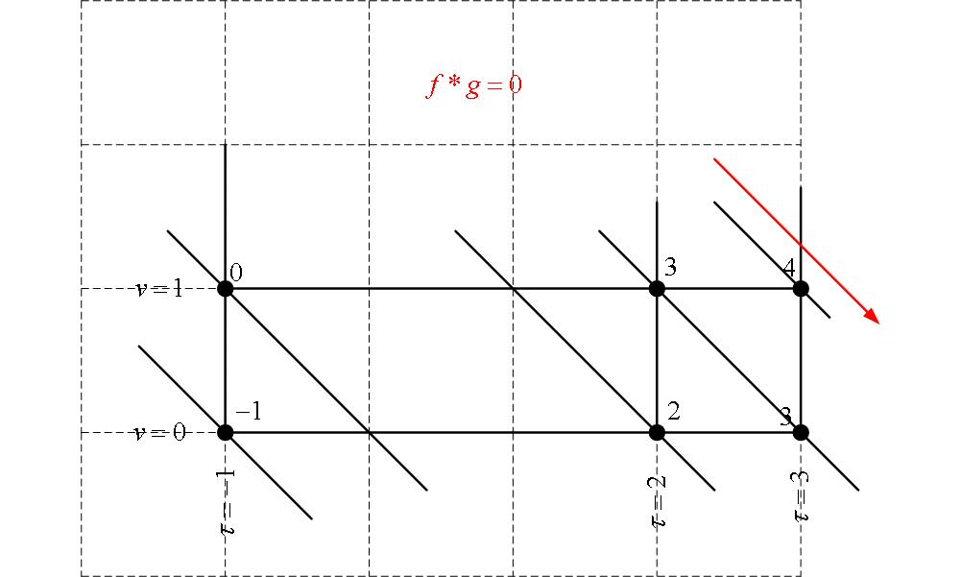
Band 6:Tau-Vee Method

Slide 47
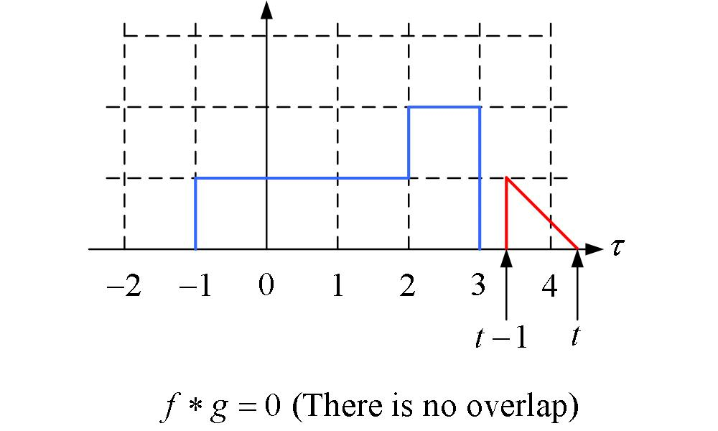
Band 6: Sliding Function Method

Slide 48
Further Comments

Slide 49
Question: Do these drawings have to be very carefully drawn in order to work?
Answer: Probably as long as you have the breakpoints in order it will still work. The next slide shows a pretty messy free-hand version of the diagram for the same example.

Slide 50
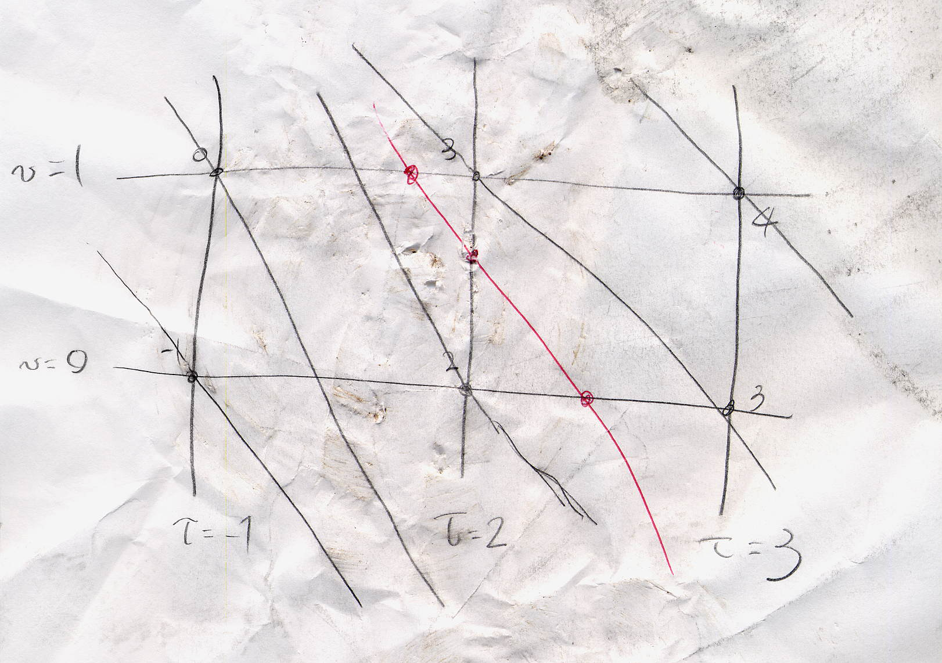
Another fine mess

Slide 51
This drawing was pretty crummy when I drew it. To make it worse, I spilled weak coffee on it , rode over it with a bicycle, crumpled it up, uncrumpled it, and stomped it on the ground. Only then did I scan it into this presentation. You can still see the 6 diagonal bands and should be able to figure out the integrands and integration limits for all 6 bands! It is still usable! Amazing!

Slide 52
I also deliberately did not use the correct scale. You can see that the distance from tau=-1 to tau=2 is almost equal to the distance between tau=2 and tau=3. That’s part of the reason why the lines of constant t are deformed into curves instead of nice straight lines at a 45 degree angle. Just try to avoid “time catastrophes”—two different constant time lines intersecting!

Slide 53
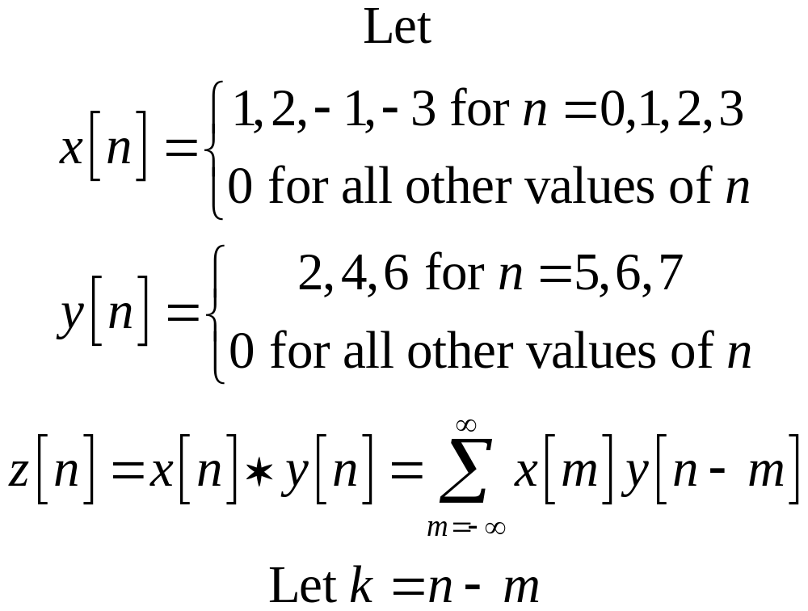
Can this method work for discrete convolution?

Slide 54
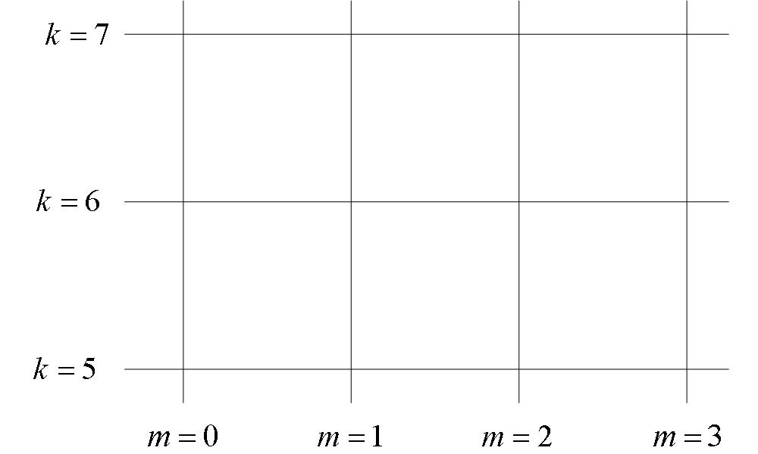

Slide 55
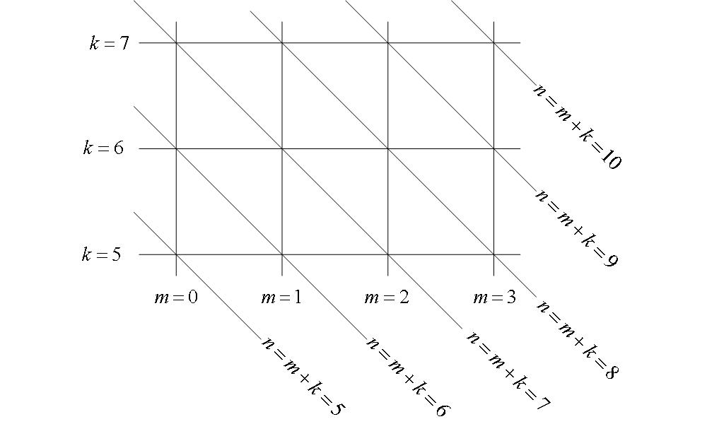

Slide 56
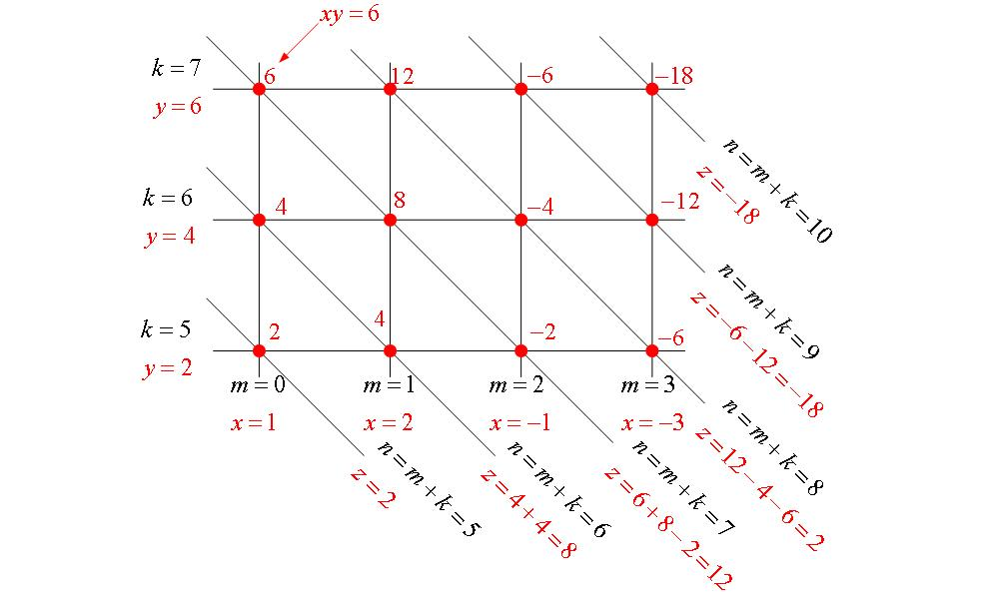

Slide 57
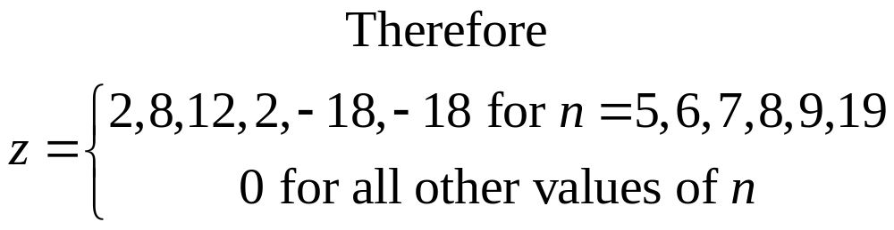

Slide 58
Reference
The tau-vee method for discrete convolution is essentially identical to a method previously described in the following reference:
Enders A. Robinson, “The Minimum Delay Concept in System Design, Part I”, Digital Electronics, Dec. 1963.

Slide 59
Functions that Extend to Infinity
All functions in the previous examples were nonzero only over a finite interval of time. Does this method work for functions that start and or stop at infinity?

Slide 60

Example

Slide 61


Slide 62



Slide 63

Summary of Tau-Vee Method

Slide 64

Lines of constant v

Slide 65

Lines of constant v

Slide 66

Lines of constant tau

Slide 67

Lines of constant tau

Slide 68

Corners

Slide 69

Corners

Slide 70

Lines of Constant t

Slide 71

Lines of Constant t

Slide 72

Integration Path

Slide 73

Integration Path

Slide 74

Integration Path

Slide 75

Integration limits

Slide 76

Integration Limits

Slide 77

Eliminating the variable, v

