Slide 1
CRF Recitation
Kevin Tang

Slide 2
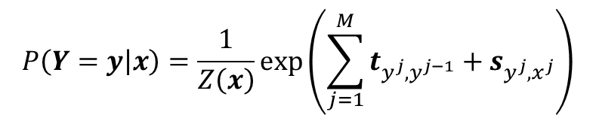
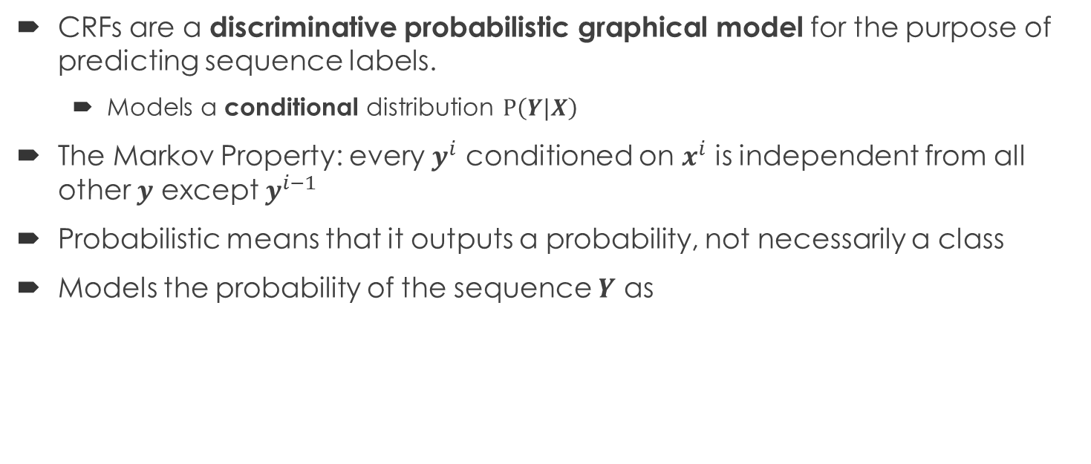
Conditional Random Field Definition
CRFs are a discriminative probabilistic graphical model for the purpose of predicting sequence labels.
Models a conditional distribution $P\left(Y|X\right)$
The Markov Property: every $y^{i}$ conditioned on $x^{i}$ is independent from all other $y$ except $y^{i−1}$
Probabilistic means that it outputs a probability, not necessarily a class
Models the probability of the sequence $Y$ as
$$P\left(Y=y | x\right)=\frac{1}{Z\left(x\right)}exp⁡\left(\sum_{j=1}^{M}{t_{y^{j},y^{j−1}}+s_{y^{j},x^{j}}}\right)$$

Slide 3
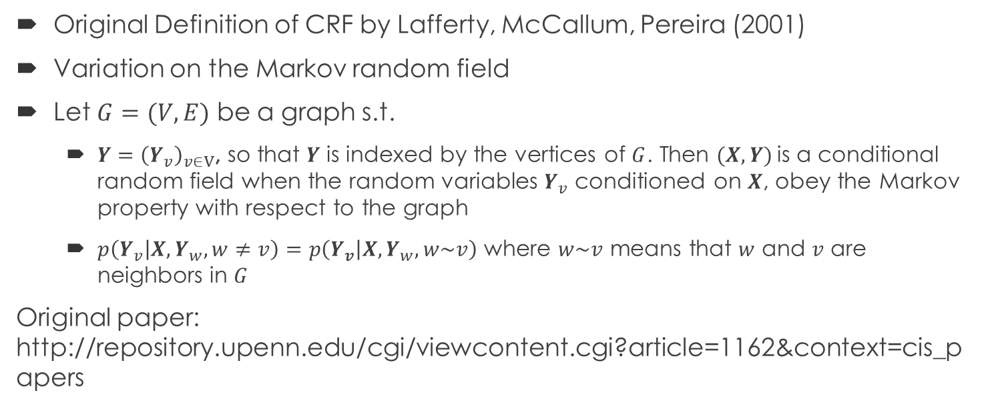
Meaning of Graphical Model
Original Definition of CRF by Lafferty, McCallum, Pereira (2001)
Variation on the Markov random field
Let $G=(V,E)$ be a graph s.t.
$Y={\left(Y_{v}\right)}_{v∈V}$, so that $Y$ is indexed by the vertices of $G$. Then $(X,Y)$is a conditional random field when the random variables $Y_{v}$ conditioned on $X$, obey the Markov property with respect to the graph
$p\left(Y_{v} | X,Y_{w}, w≠v\right)=p\left(Y_{v} | X,Y_{w},w\sim v\right)$ where $w\sim v$ means that $w$ and $v$ are neighbors in $G$
Original paper: http://repository.upenn.edu/cgi/viewcontent.cgi?article=1162&context=cis_papers

Slide 4
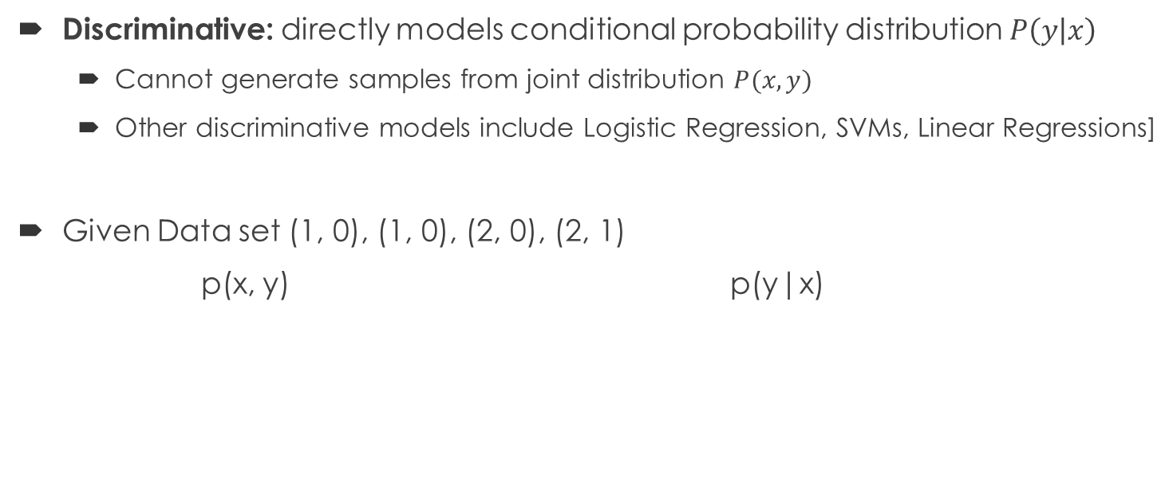
Discriminative v.s. Generative
Discriminative: directly models conditional probability distribution $P\left(y | x\right)$
Cannot generate samples from joint distribution $P(x,y)$
Other discriminative models include Logistic Regression, SVMs, Linear Regressions]
Given Data set (1, 0), (1, 0), (2, 0), (2, 1)
p(x, y) p(y|x)
 | Y=0 | Y=1
X=1 | 1/2 | 0
X=2 | 1/4 | 1/4
 | Y=0 | Y=1
X=1 | 1 | 0
X=2 | 1/2 | 1/2
Stolen from: http://stackoverflow.com/questions/879432/what-is-the-difference-between-a-generative-and-discriminative-algorithm
Also, see http://papers.nips.cc/paper/2020-on-discriminative-vs-generative-classifiers-a-comparison-of-logistic-regression-and-naive-bayes.pdf

Slide 5
Comparison To HMMs
Audience thoughts?

Slide 6
Comparison To HMMs
Similarities:
Both probabilistic models
Both use the Markov Property as an assumption
Differences
CRFs are discriminative while HMM’s are generative
CRFs may have more accuracy with sequence tagging as it directly models p(y|x)
HMMs use Bayes Rule to model tagging
HMMs can generate samples from the distribution p(x, y) and are often more robust (missing labels, unsupervised, or semisupervised)
Hmms can handle missing labels

Slide 7
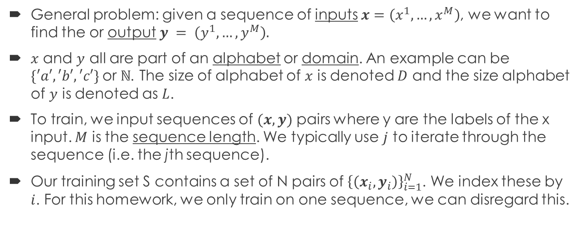
Let’s summarize terminology and symbols
General problem: given a sequence of inputs $x=\left(x^{1}, …, x^{M}\right)$, we want to find the or output $y = \left(y^{1}, …,y^{M}\right).$
$x$ and $y$ all are part of an alphabet or domain. An example can be $\{′a′, ′b′, ′c′\}$or $ℕ$. The size of alphabet of $x$ is denoted $D$ and the size alphabet of $y$ is denoted as $L$.
To train, we input sequences of $(x, y)$ pairs where y are the labels of the x input. $M$ is the sequence length. We typically use $j$ to iterate through the sequence (i.e. the jth sequence).
Our training set S contains a set of N pairs of ${\left\{\left(x_{i},y_{i}\right)\right\}}_{i=1}^{N}$. We index these by $i$. For this homework, we only train on one sequence, we can disregard this.

Slide 8
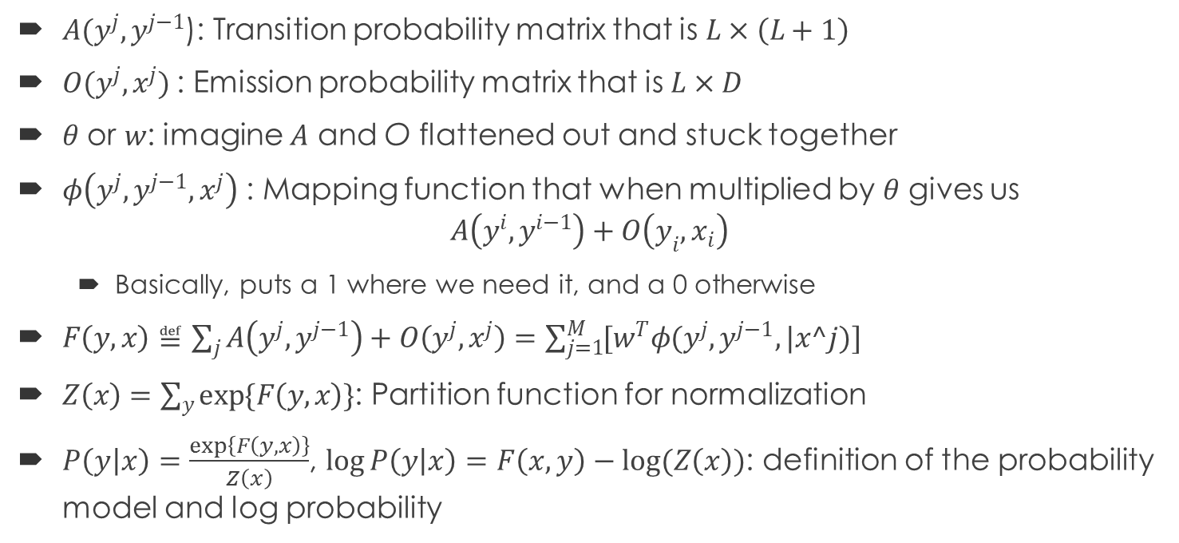
Other Formulae/Symbols we may see
$A(y^{j}, y^{j−1}$): Transition probability matrix that is $L×\left(L+1\right)$
$O(y^{j}, x^{j})$: Emission probability matrix that is $L×D$
$θ$ or $w$: imagine $A$ and O flattened out and stuck together
: Mapping function that when multiplied by $θ$ gives us $A\left(y^{i},y^{i−1}\right)+O\left(y_{i},x_{i}\right)$
Basically, puts a 1 where we need it, and a 0 otherwise
$F\left(y,x\right)≝\sum_{j}{A\left(y^{j},y^{j−1}\right)+O\left(y^{j},x^{j}\right)}=\sum_{j=1}^{M}{[w^{T}φ(y^{j}, y^{j−1},|x^j)]}$
$Z\left(x\right)=\sum_{y}{\exp{\{F\left(y,x\right)\}}}$: Partition function for normalization
$P\left(y | x\right)=\frac{\exp\left\{F\left(y,x\right)\right\}}{Z\left(x\right)}$, $\log{P\left(y | x\right)}=F\left(x,y\right)−log⁡(Z\left(x\right))$: definition of the probability model and log probability

Slide 9
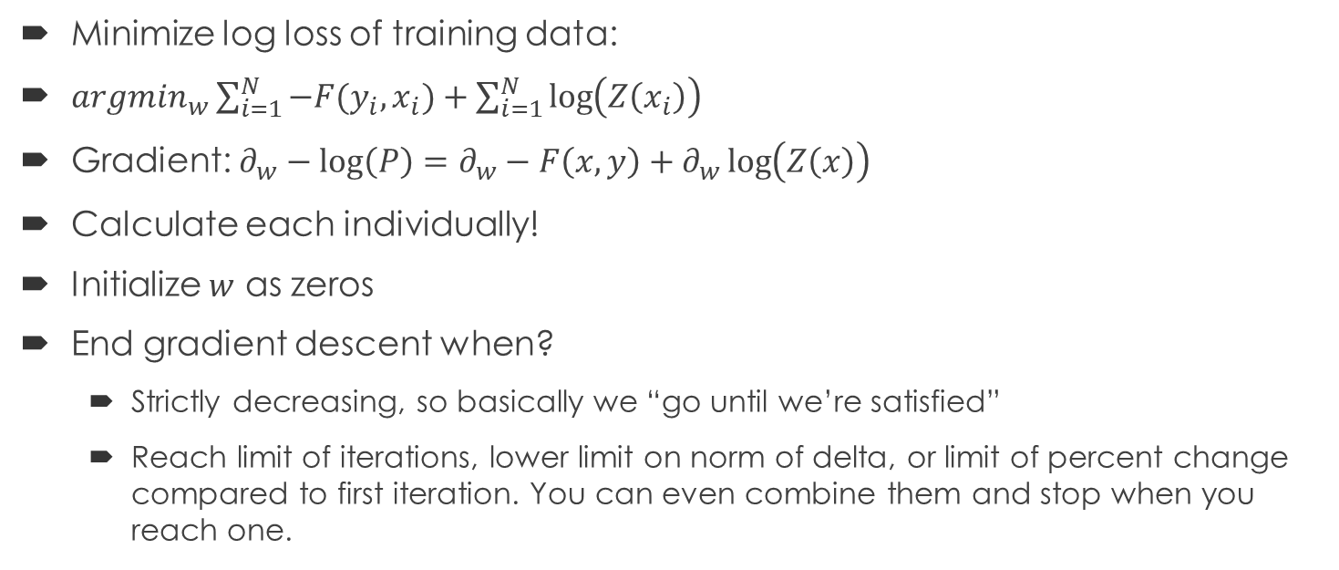
Objective of Gradient Descent
Minimize log loss of training data:
$argmin_{w}\sum_{i=1}^{N}{−F(y_{i},x_{i})}+\sum_{i=1}^{N}{\log\left(Z\left(x_{i}\right)\right)}$
Gradient: $∂_{w}−\log\left(P\right)=∂_{w}−F\left(x,y\right)+∂_{w}\log\left(Z\left(x\right)\right)$
Calculate each individually!
Initialize $w$ as zeros
End gradient descent when?
Strictly decreasing, so basically we “go until we’re satisfied”
Reach limit of iterations, lower limit on norm of delta, or limit of percent change compared to first iteration. You can even combine them and stop when you reach one.

Slide 10
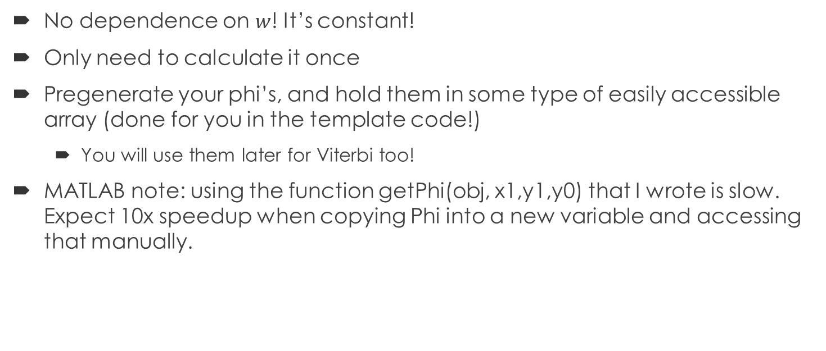

$$d_{w}−F\left(y,x\right)$$
No dependence on $w$! It’s constant!
Only need to calculate it once
Pregenerate your phi’s, and hold them in some type of easily accessible array (done for you in the template code!)
You will use them later for Viterbi too!
MATLAB note: using the function getPhi(obj, x1,y1,y0) that I wrote is slow. Expect 10x speedup when copying Phi into a new variable and accessing that manually.

Slide 11
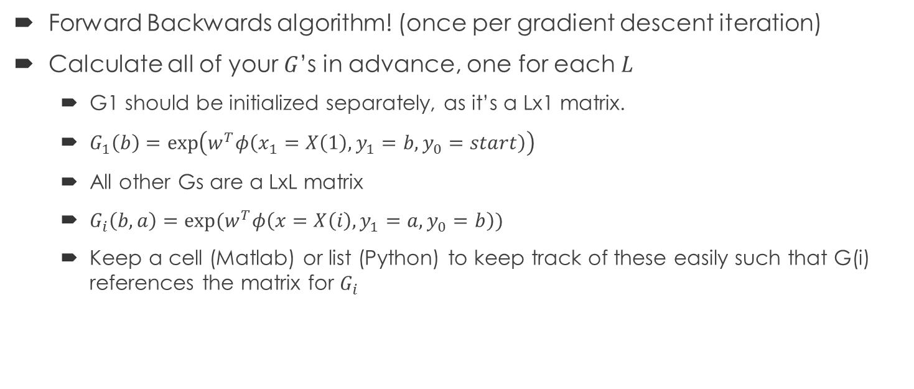

$$∂_{w}\log\left(Z\left(x\right)\right) (1)$$
Forward Backwards algorithm! (once per gradient descent iteration)
Calculate all of your $G$’s in advance, one for each $L$
G1 should be initialized separately, as it’s a Lx1 matrix.
$G_{1}\left(b\right)=\exp\left(w^{T}φ\left(x_{1}=X\left(1\right), y_{1}=b, y_{0}=start\right)\right)$
All other Gs are a LxL matrix
$G_{i}\left(b,a\right)=\exp{(w^{T}φ\left(x=X\left(i\right),y_{1}=a, y_{0}=b\right))}$
Keep a cell (Matlab) or list (Python) to keep track of these easily such that G(i) references the matrix for $G_{i}$

Slide 12
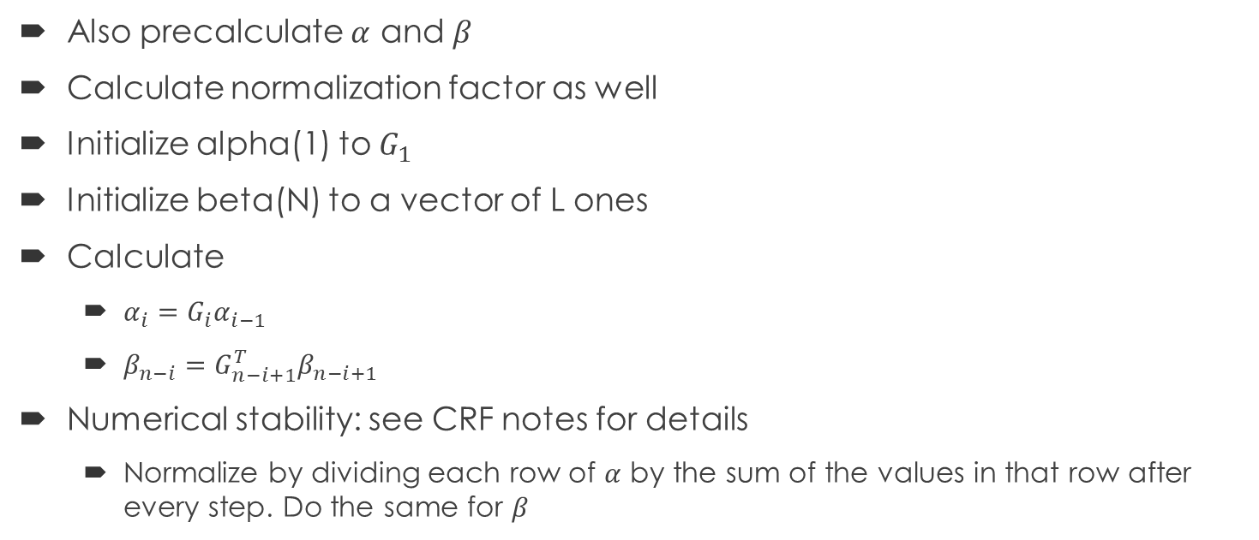

$$∂_{w}\log\left(Z\left(x\right)\right) (2)$$
Also precalculate $α$ and $β$
Calculate normalization factor as well
Initialize alpha(1) to $G_{1}$
Initialize beta(N) to a vector of L ones
Calculate
$α_{i}=G_{i}α_{i−1}$
$β_{n−i}=G_{n−i+1}^{T}β_{n−i+1}$
Numerical stability: see CRF notes for details
Normalize by dividing each row of $α$ by the sum of the values in that row after every step. Do the same for $β$

Slide 13
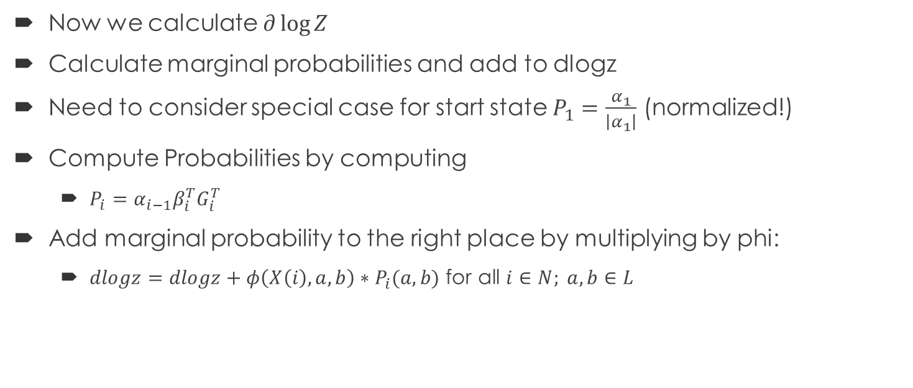

$$∂_{w}\log\left(Z\left(x\right)\right) (3)$$
Now we calculate $∂\log{Z}$
Calculate marginal probabilities and add to dlogz
Need to consider special case for start state $P_{1}=\frac{α_{1}}{\left|α_{1}\right|}$ (normalized!)
Compute Probabilities by computing
$P_{i}=α_{i−1}β_{i}^{T}G_{i}^{T}$
Add marginal probability to the right place by multiplying by phi:
$dlogz=dlogz+φ\left(X\left(i\right),a,b\right)∗P_{i}(a,b)$ for all $i∈N; a,b∈L$

Slide 14
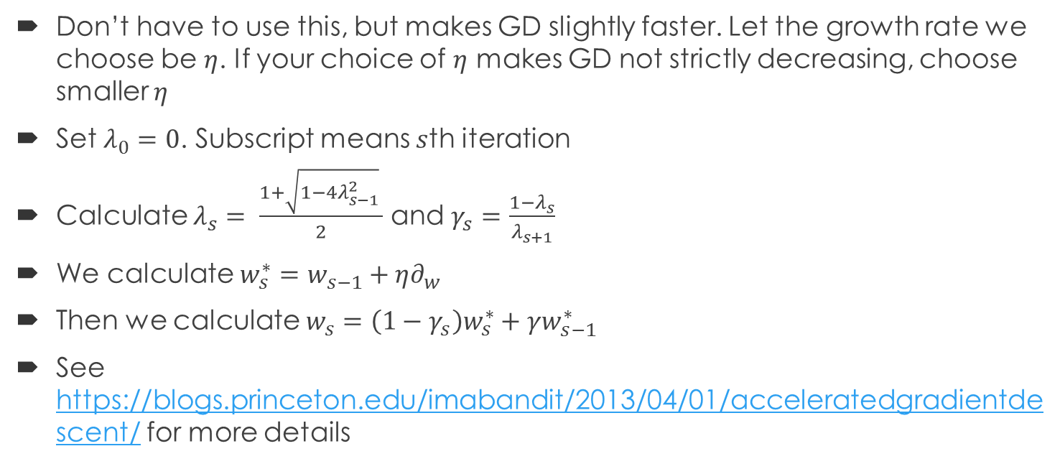
Nesterov’s accelerated gradient descent
Don’t have to use this, but makes GD slightly faster. Let the growth rate we choose be $η$. If your choice of $η$ makes GD not strictly decreasing, choose smaller $η$
Set $λ_{0}=0$. Subscript means $s$th iteration
Calculate $λ_{s}= \frac{1+\sqrt{1−4λ_{s−1}^{2}} }{2}$ and $γ_{s}=\frac{1−λ_{s}}{λ_{s+1}}$
We calculate $w_{s}^{∗}=w_{s−1}+η∂_{w}$
Then we calculate $w_{s}=\left(1−γ_{s}\right)w_{s}^{∗}+γw_{s−1}^{∗}$
See https://blogs.princeton.edu/imabandit/2013/04/01/acceleratedgradientdescent/ for more details

Slide 15
Summary of Gradient Descent
Pregenerate phis
Calculate dF
Calculate dlogZ
Generate Gs, generate alphas, betas
Run forward backwards algorithm with normalization
Calculate dw = dF – dlogZ
Update w = w + dw or use Nesterov
End after number of iterations, or when change hits a minimum, or percent change hits a minimum.

Slide 16
Some numbers for sanity purposes
Stuff that I got
~250 iterations with Nesterov acceleration (will vary depending on your growth factor)
~5 minutes computational time in Matlab Much faster when outside of a Matlab Class…(more like 1 minute)
~30 minutes on a very unoptimized solution (but hey, it worked)
Could get faster with more vectorization, but I’m lazy.
You probably will have better luck in Python (grumble grumble)
~50% hamming loss

