Slide 1
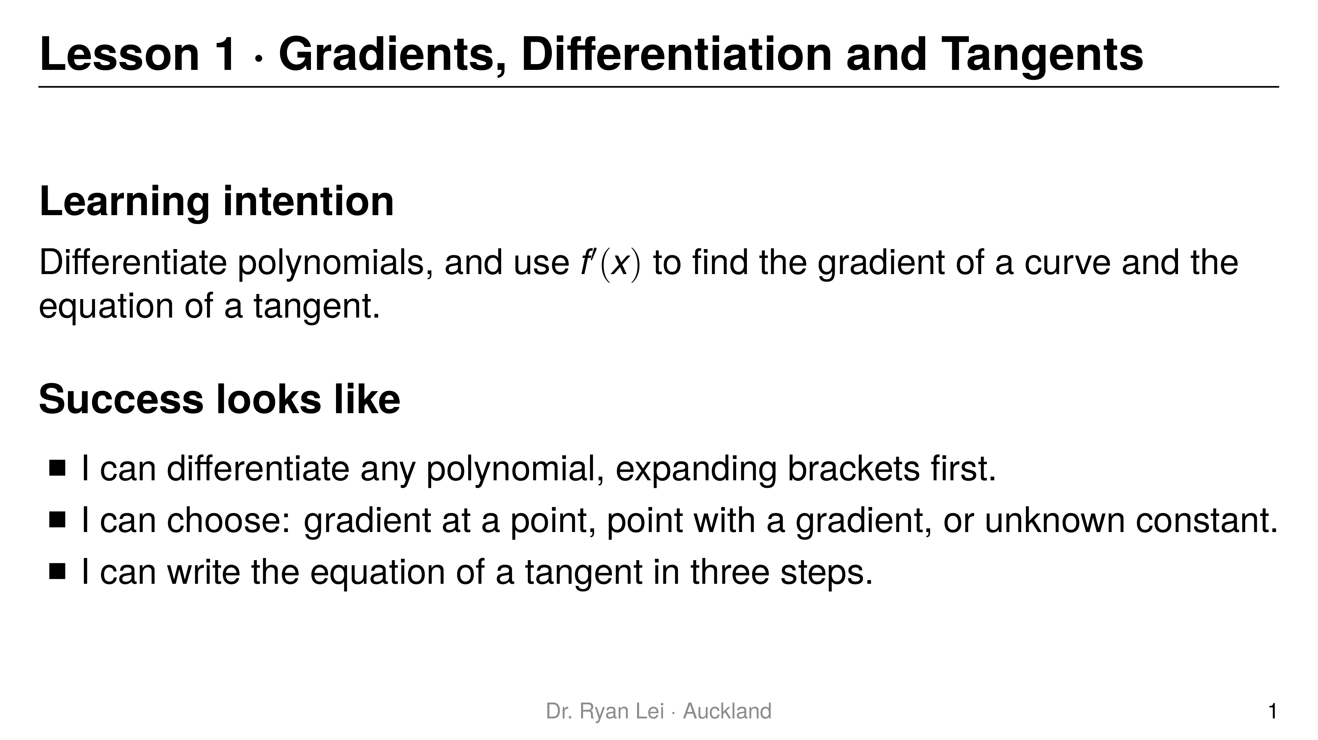
Notes:
Teaching line, not a question slide.
Say: calculus is about gradients of curves. Today is the toolkit every later lesson uses.
Timing: Do Now 10 min, three teach-and-practise rounds about 20 min each, practice sheet 30 min, wrap-up 5 min.

Slide 2
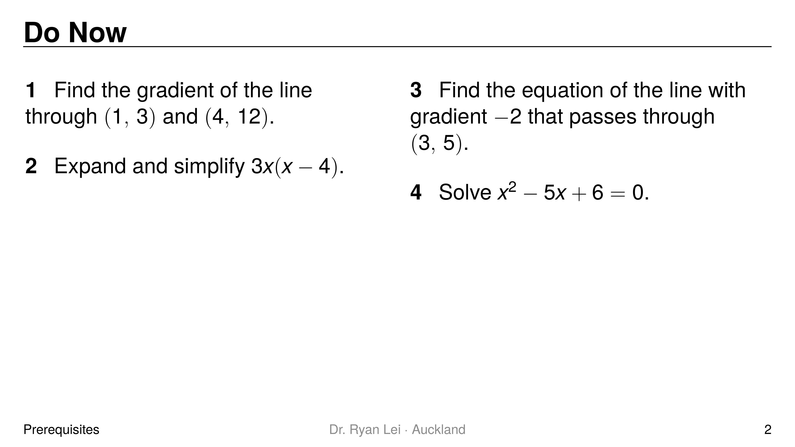
Notes:
Q1 $3$
Q2 $3x^{2}−12x$
Q3 $y=−2x+11$
Q4 $x=2$ or $x=3$
Short solution:
Q1 $m=\frac{12−3}{4−1}=\frac{9}{3}=3$
Q2 $3x×x−3x×4$
Q3 $y−5=−2\left(x−3\right)$, so $y=−2x+6+5$
Q4 $\left(x−2\right)\left(x−3\right)=0$
Watch for:
Q1 run over rise gives $\frac{1}{3}$
Q3 sign error when expanding $−2\left(x−3\right)$
Diagnostic:
Q1 wrong: gradient idea is shaky; spend longer on the one-idea slide
Q2 wrong: expect L1 errors (expanding before differentiating)
Q3 wrong: the tangent step (round 3) will fail; re-teach $y−y_{1}=m\left(x−x_{1}\right)$ first
Q4 wrong: allow the calculator EQUA menu for quadratics today

Slide 3
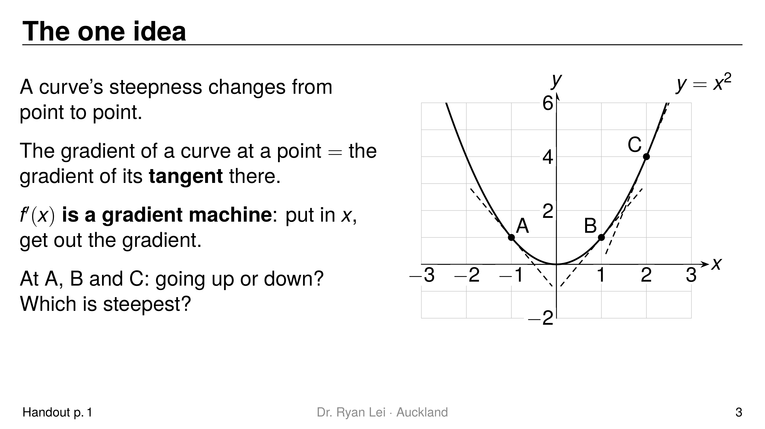
Notes:
A down, gradient $−2$
B up, gradient $2$
C up and steepest, gradient $4$
Short solution:
for $y=x^{2}$ the gradient machine is $f′\left(x\right)=2x$: $2\left(−1\right)=−2$, $2\left(1\right)=2$, $2\left(2\right)=4$
Watch for:
students reading steepness from height; C is steeper because the tangent rises faster, not because it is higher

Slide 4
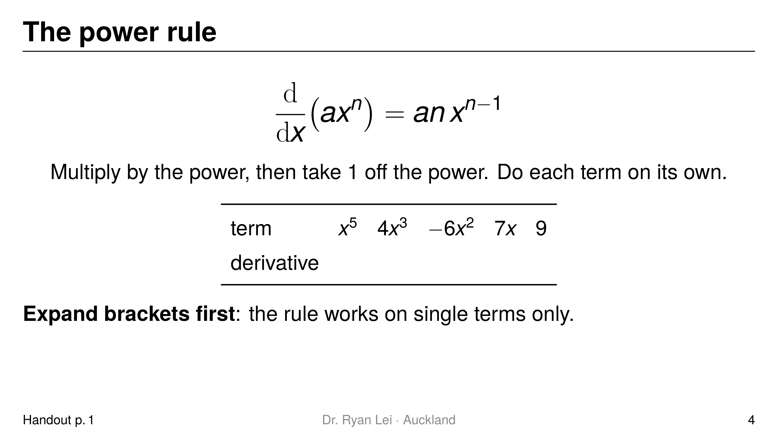
Notes:
$x^{5}→5x^{4}$
$4x^{3}→12x^{2}$
$−6x^{2}→−12x$
$7x→7$
$9→0$
Short solution:
$7x=7x^{1}→7×1×x^{0}=7$; a constant is a flat line, gradient $0$
Watch for:
$7x→7x$ or $7x→0$ (L3)
the sign travels with the term: $−6x^{2}→−12x$

Slide 5
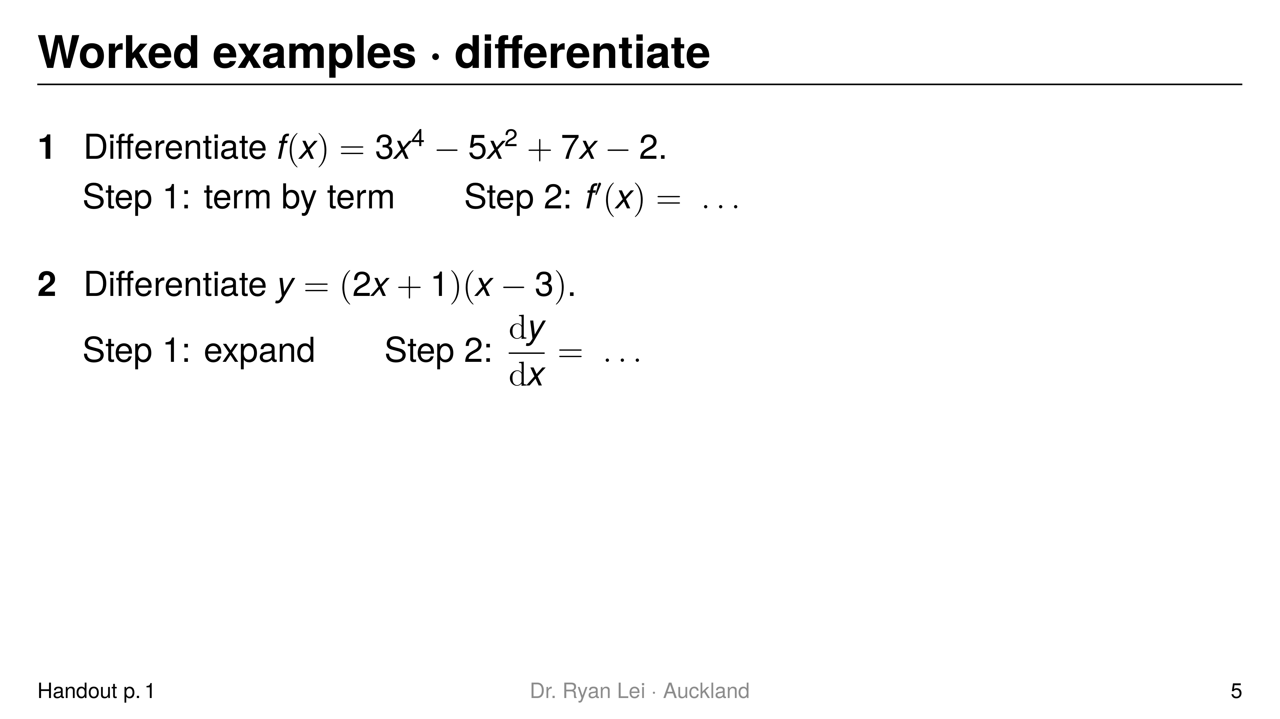
Notes:
Q1 $f′\left(x\right)=12x^{3}−10x+7$
Q2 $\frac{dy}{dx}=4x−5$
Short solution:
Q1 $3x^{4}→12x^{3}$, $−5x^{2}→−10x$, $7x→7$, $−2→0$
Q2 $y=2x^{2}−6x+x−3=2x^{2}−5x−3$
Watch for:
Q2 differentiating each bracket and multiplying gives $2×1=2$ (L1)

Slide 6
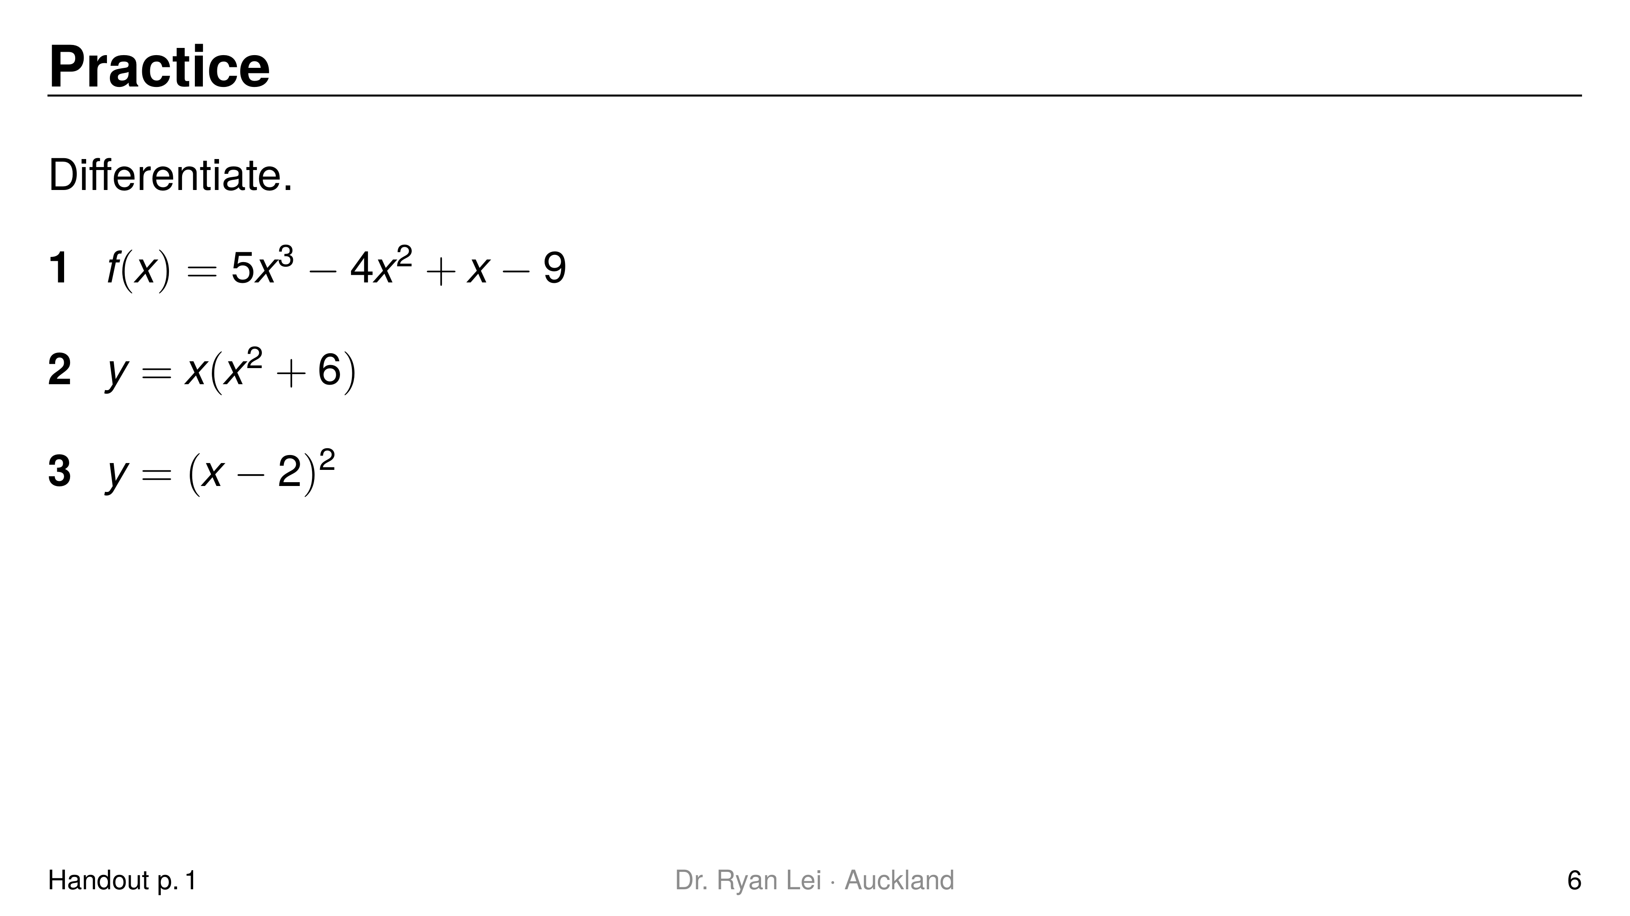
Notes:
Q1 $f′\left(x\right)=15x^{2}−8x+1$
Q2 $\frac{dy}{dx}=3x^{2}+6$
Q3 $\frac{dy}{dx}=2x−4$
Short solution:
Q2 expand: $y=x^{3}+6x$
Q3 expand: ${\left(x−2\right)}^{2}=x^{2}−4x+4$
Watch for:
Q3 ${\left(x−2\right)}^{2}≠x^{2}+4$; the middle term $−4x$ is the one that matters
Q1 the $x$-term gives $1$, not $0$

Slide 7
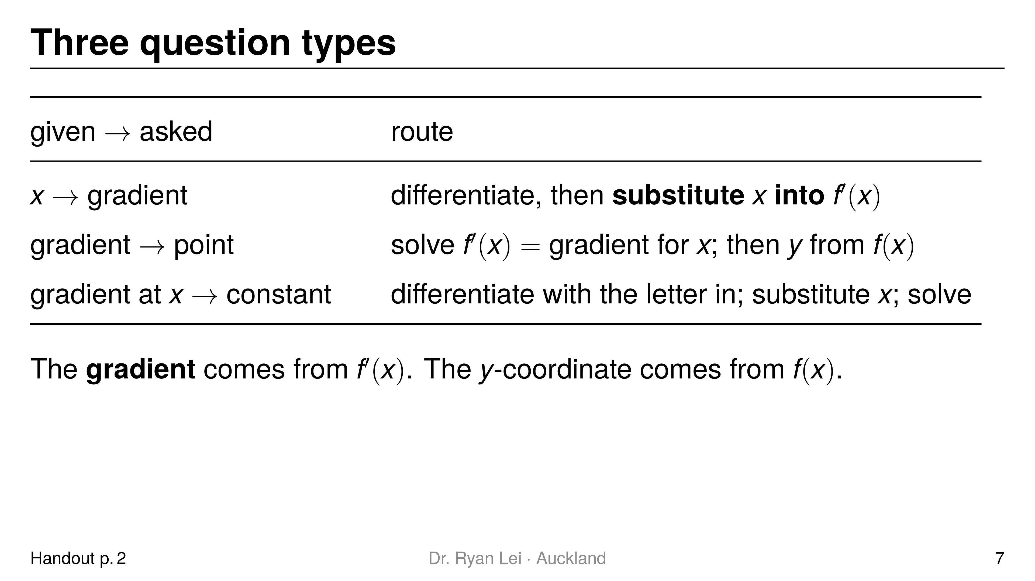
Notes:
Teaching line, not a question slide.
Ask the student to underline what is given and circle what is asked before choosing a row.
L2 (substituting into the wrong function) is the most common slip in this lesson.

Slide 8
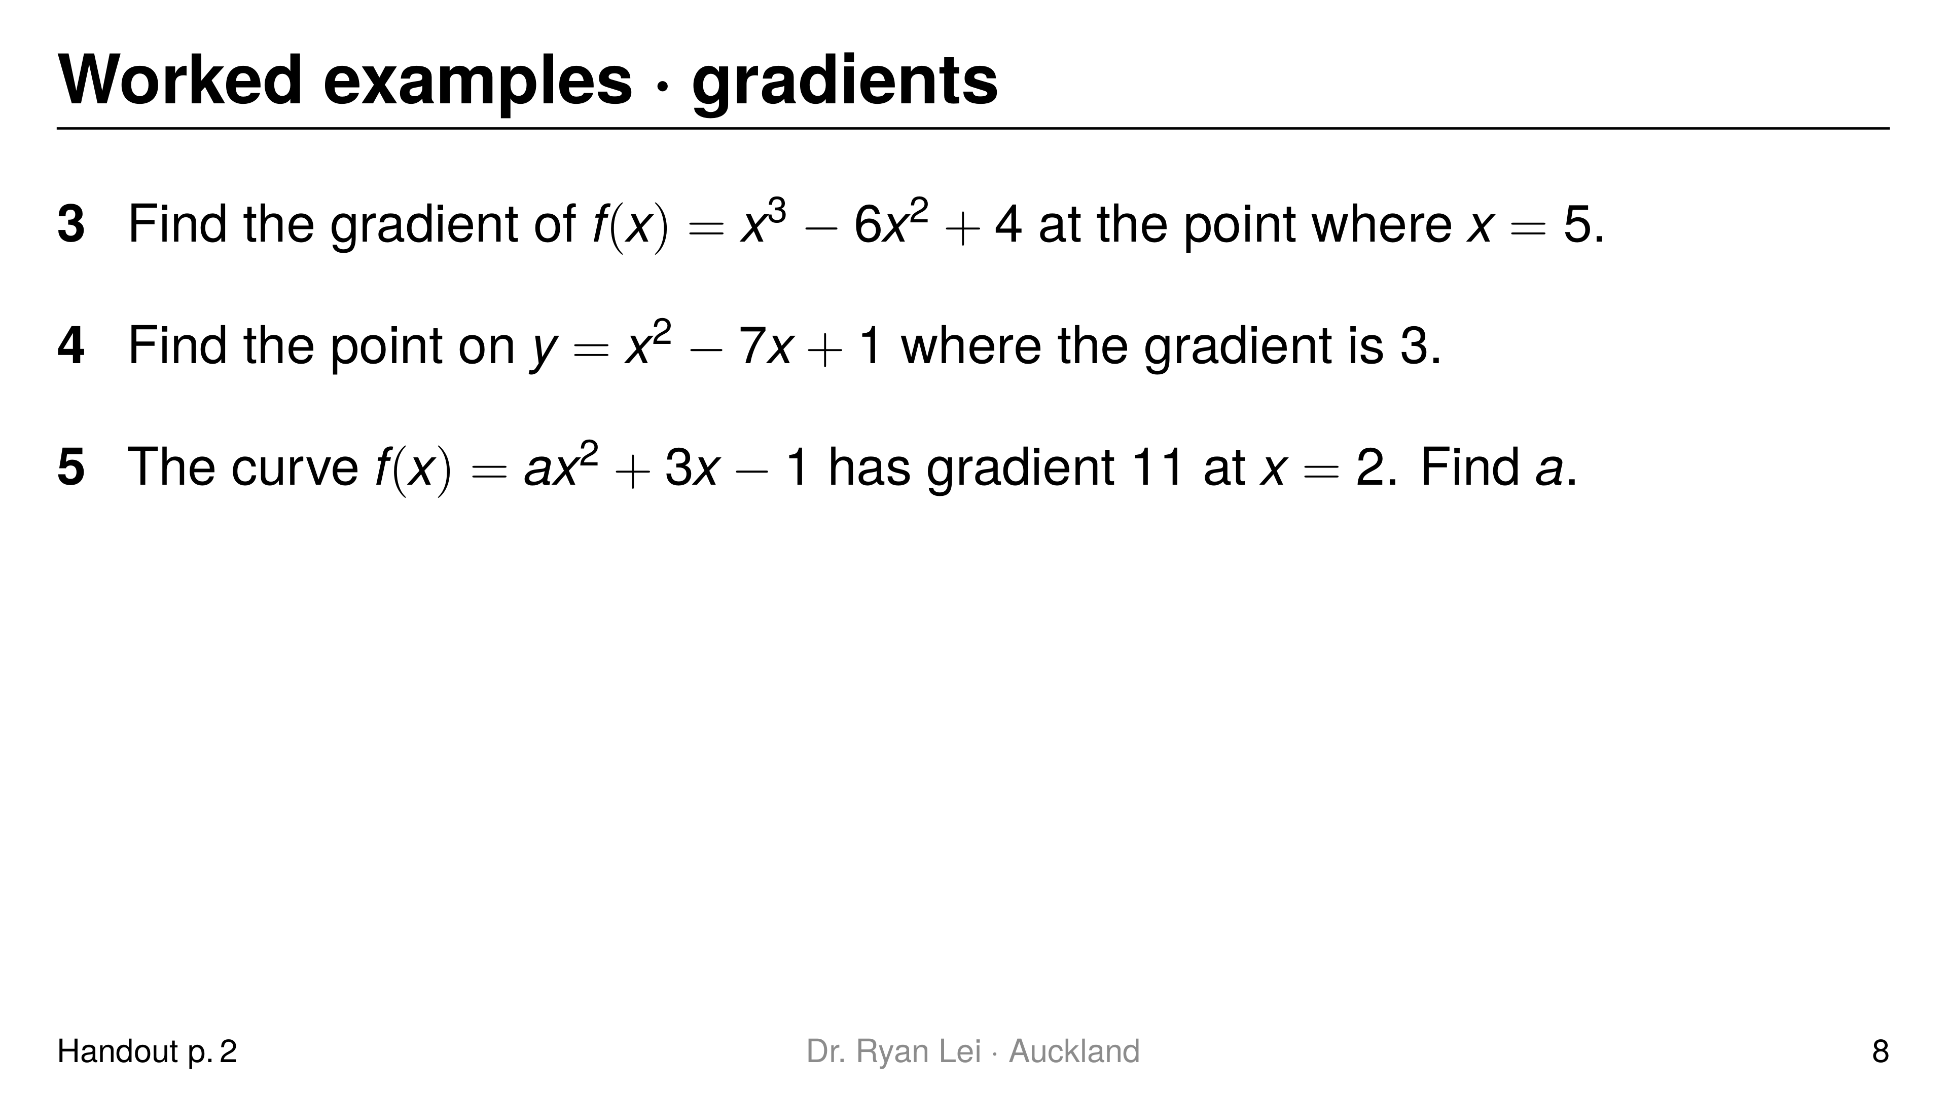
Notes:
Q3 $15$
Q4 $\left(5, −9\right)$
Q5 $a=2$
Short solution:
Q3 $f′\left(x\right)=3x^{2}−12x$; $f′\left(5\right)=75−60$
Q4 $2x−7=3$ gives $x=5$; $y=25−35+1$
Q5 $f′\left(x\right)=2ax+3$; $4a+3=11$
Watch for:
Q4 stopping at $x=5$: a point needs $y$ as well
Q5 differentiating $a$ away; $a$ is a number and stays

Slide 9
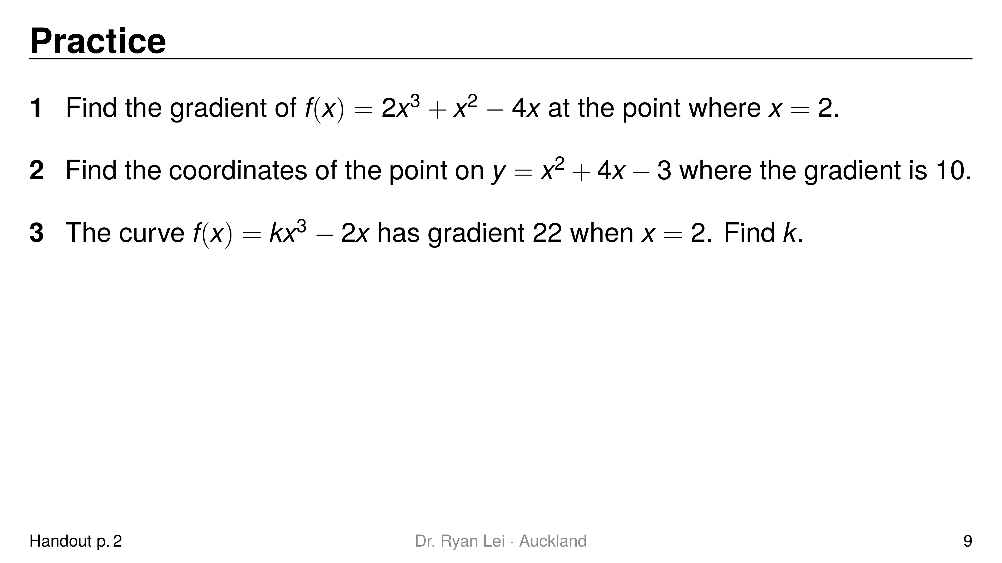
Notes:
Q1 $24$
Q2 $\left(3, 18\right)$
Q3 $k=2$
Short solution:
Q1 $f′\left(x\right)=6x^{2}+2x−4$; $f′\left(2\right)=24+4−4$
Q2 $2x+4=10$ gives $x=3$; $y=9+12−3$
Q3 $f′\left(x\right)=3kx^{2}−2$; $12k−2=22$
Watch for:
Q1 substituting into $f\left(x\right)$ gives $16$ (L2)
Q3 $3kx^{2}$ at $x=2$ is $12k$, not $6k$

Slide 10
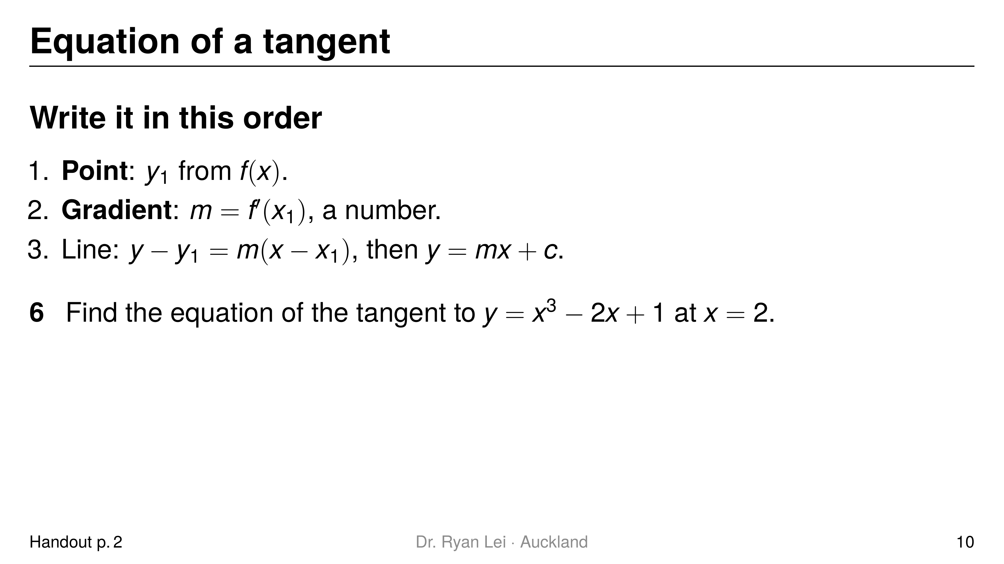
Notes:
Q6 $y=10x−15$
Short solution:
Q6 point $\left(2, 5\right)$; $\frac{dy}{dx}=3x^{2}−2$, $m=10$; $y−5=10\left(x−2\right)$
Watch for:
using $f′\left(x\right)$ for $y_{1}$ gives $\left(2, 10\right)$ (L2)
writing $y−5=\left(3x^{2}−2\right)\left(x−2\right)$: the gradient must be a number (L4)

Slide 11
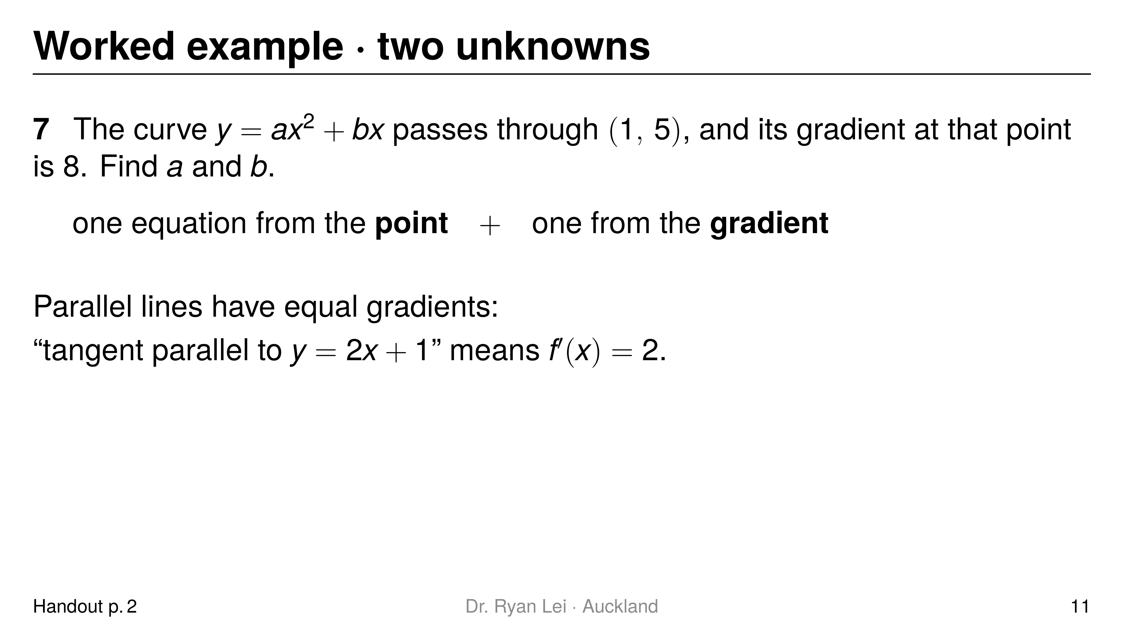
Notes:
Q7 $a=3$, $b=2$
Short solution:
Q7 point: $a+b=5$; gradient: $2a+b=8$; subtract: $a=3$
Watch for:
Q7 using only one condition and guessing the other letter
Merit marker: two linked conditions, clearly labelled

Slide 12
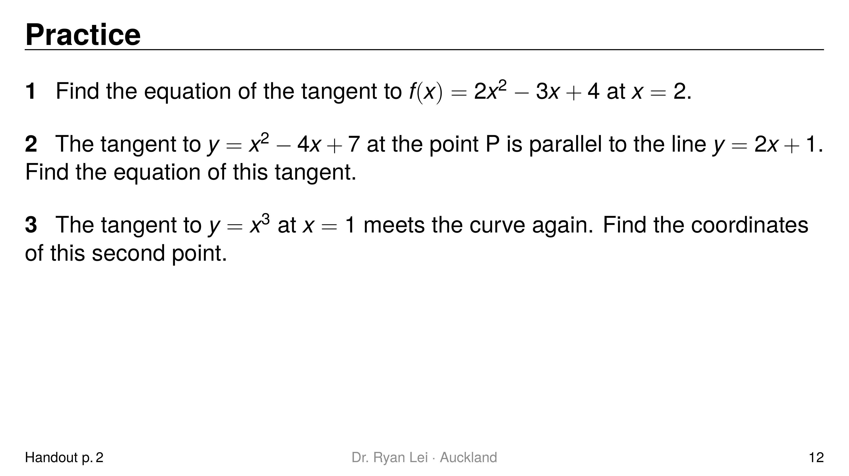
Notes:
Q1 $y=5x−4$
Q2 $y=2x−2$
Q3 $\left(−2, −8\right)$
Short solution:
Q1 point $\left(2, 6\right)$; $f′\left(x\right)=4x−3$, $m=5$; $y−6=5\left(x−2\right)$
Q2 $2x−4=2$ gives $x=3$; point $\left(3, 4\right)$; $y−4=2\left(x−3\right)$
Q3 tangent $y=3x−2$; $x^{3}−3x+2=0$; ${\left(x−1\right)}^{2}\left(x+2\right)=0$, so $x=−2$
Watch for:
Q2 the point P is not given: find it from the gradient first (Merit)
Q3 Excellence stretch; the repeated root $x=1$ is the point of contact

Slide 13
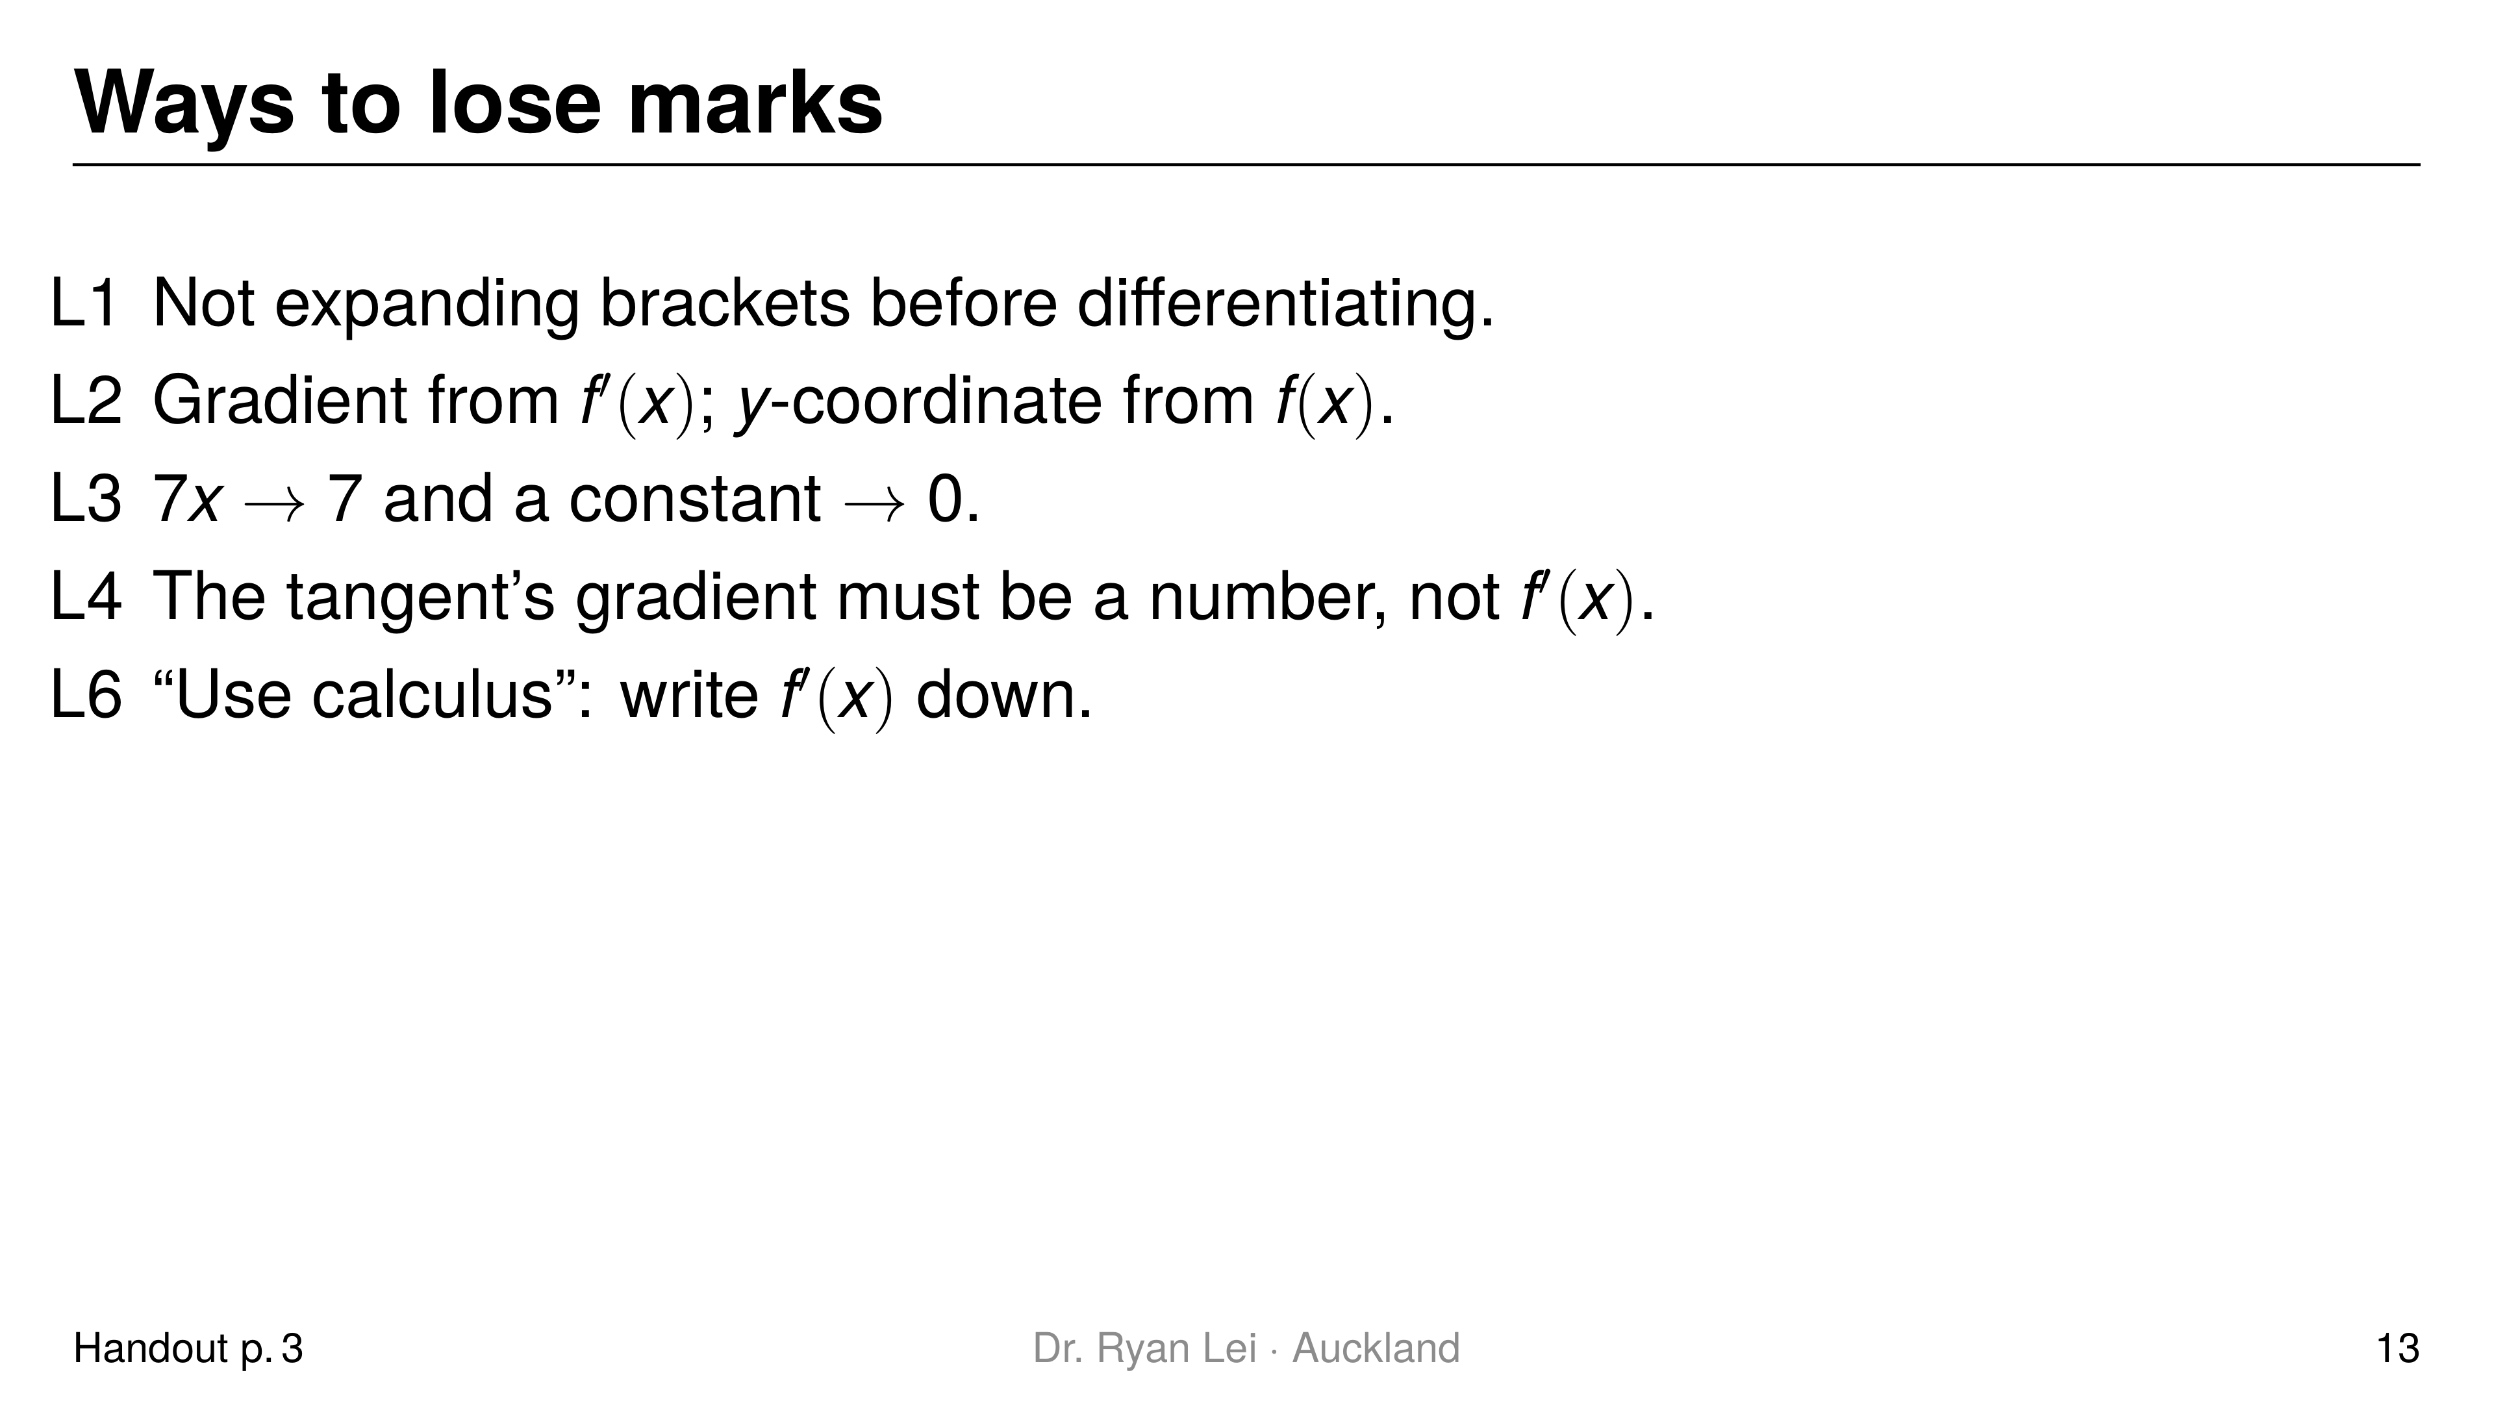
Notes:
Teaching line, not a question slide.
Full list L1 to L6 is in the handout; L5 (brackets around negative $x$) is there too.
Ask: which of these did you do today? Tick them in the handout.

Slide 14
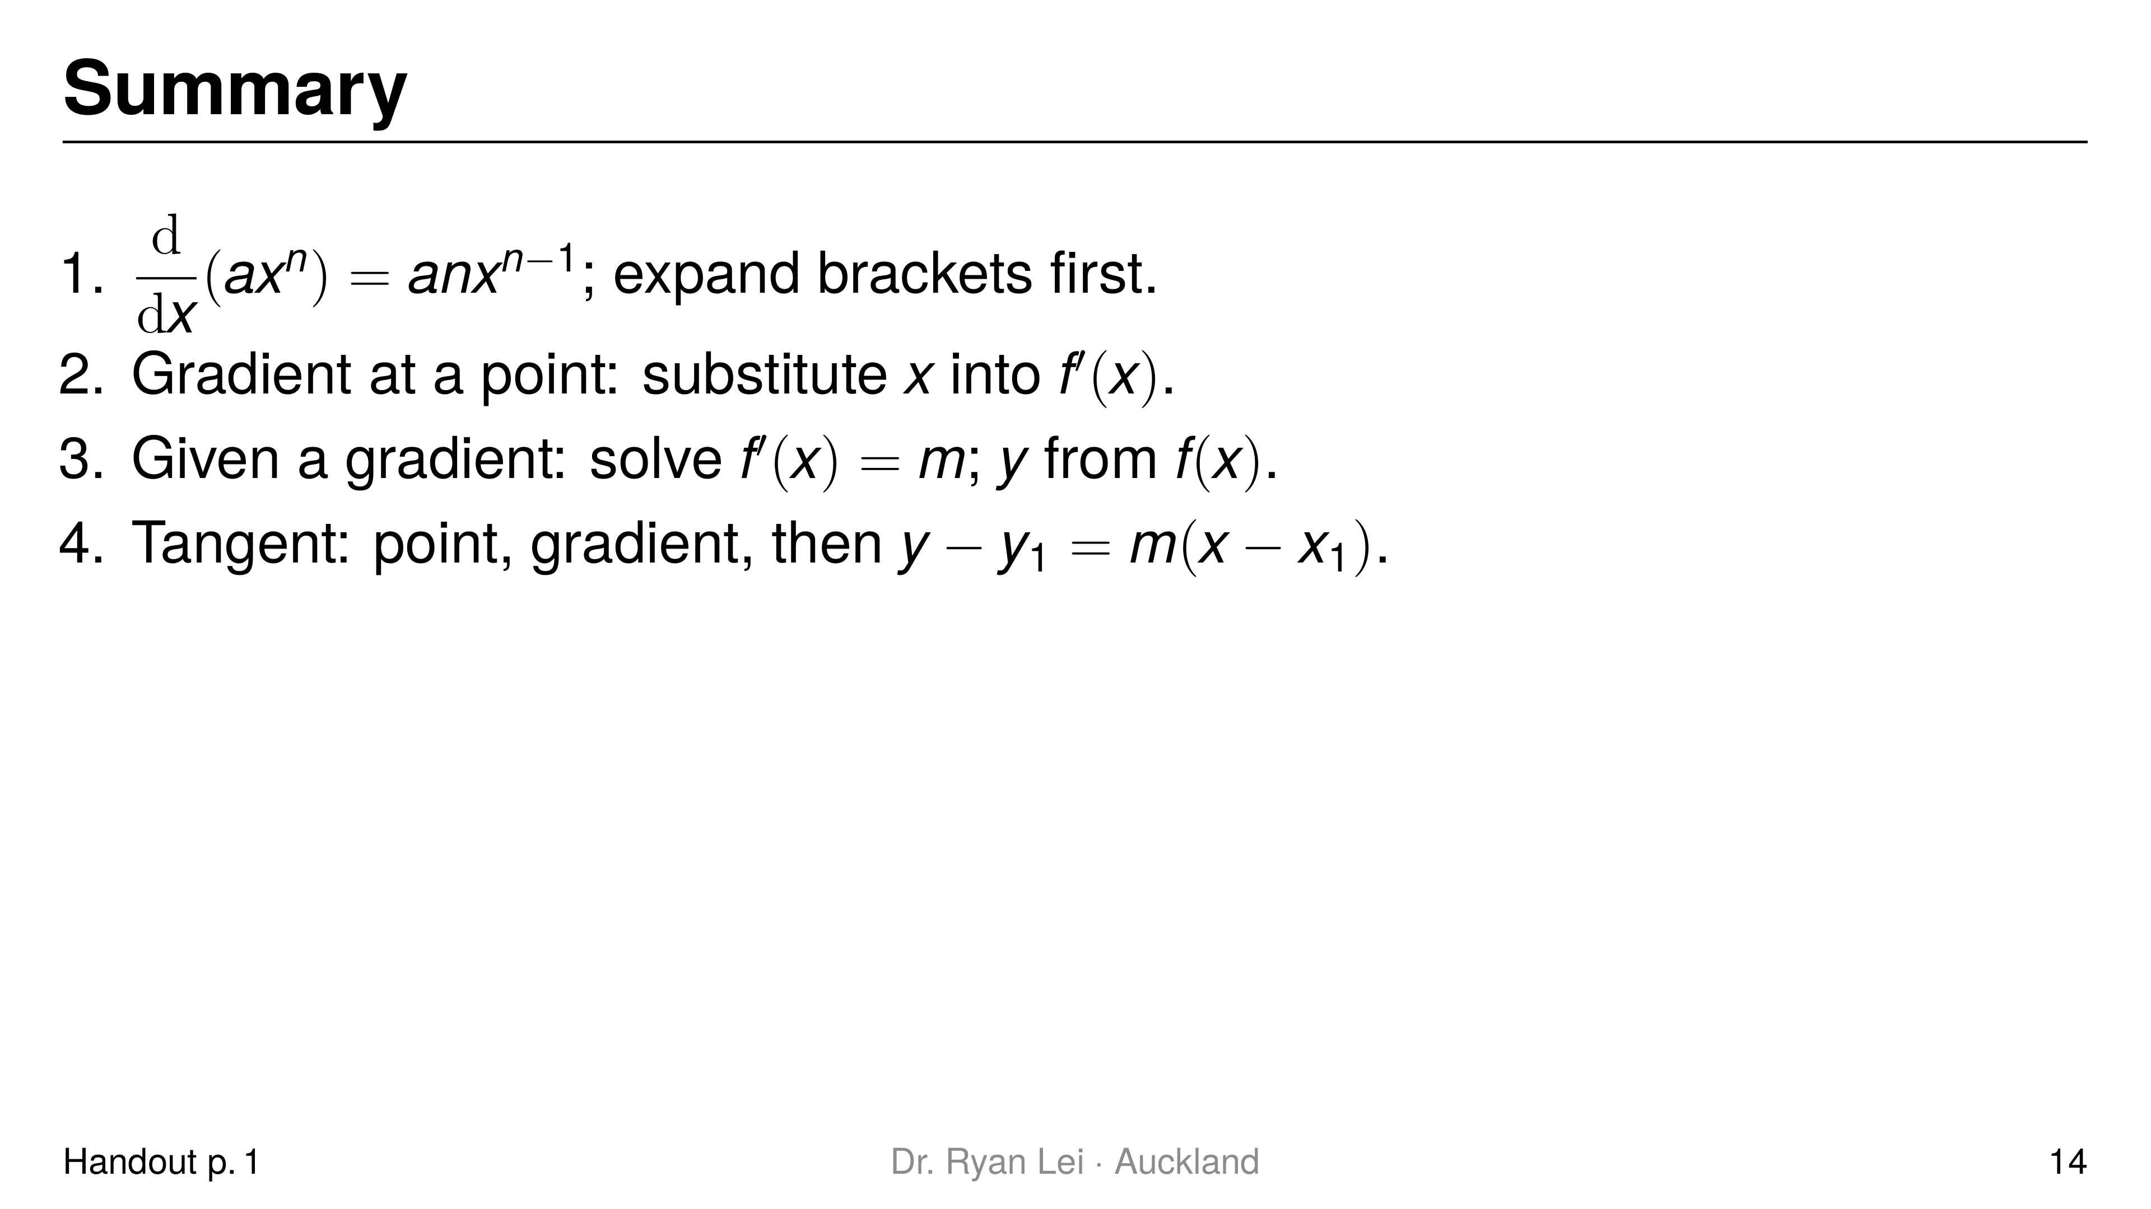
Notes:
Teaching line, not a question slide.
Ask the student to say each line back before looking at the screen.

Slide 15
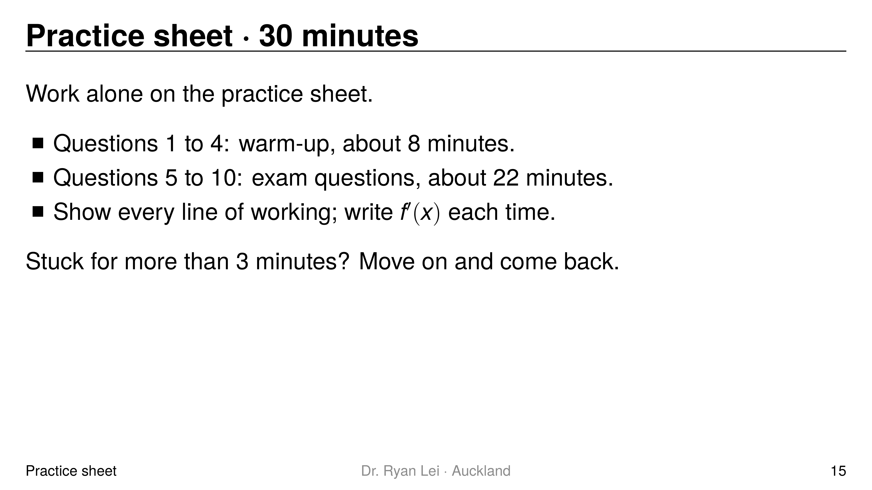
Notes:
Q1 $f′\left(x\right)=24x^{3}−9x^{2}+2$
Q2 $11$
Q3 $\left(3, −7\right)$
Q4 $y=9x−25$
Q5 $89$
Q6 $y=6.5x−8$
Q7 $c=4$
Q8 $204$
Q9 $p=−4$, $q=0.5$
Q10 $y=−2x−2$
Short solution:
Q6 point $\left(2, 5\right)$; $f′\left(x\right)=1.5x^{2}+0.5$, $m=6.5$
Q7 $f′\left(x\right)=3+2cx−6x^{2}$; $f′\left(2\right)=4c−21=−5$
Q9 point: $2p−4q=−10$; gradient: $p−4q=−6$; subtract: $p=−4$
Q10 expand $y=2x^{2}−6x$; point $\left(1, −4\right)$; $m=4−6=−2$
Watch for:
Q6 halves: keep $\frac{1}{2}x^{3}→\frac{3}{2}x^{2}$
Q10 must expand first (L1)
Full working: practice answer version (tutor's working, not an official mark scheme)

Slide 16
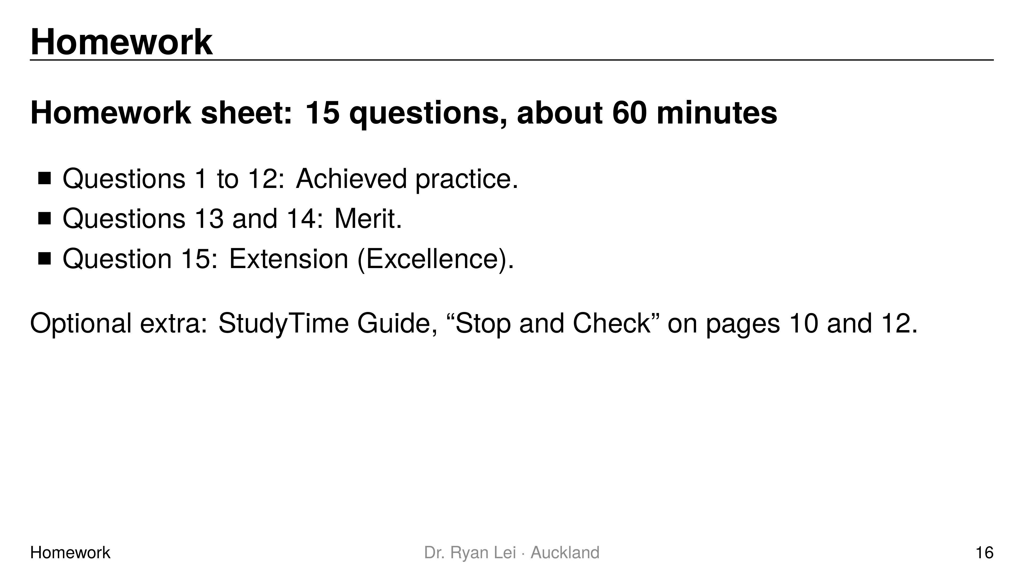
Notes:
Teaching line, not a question slide.
Answers: homework answer version (tutor's working, not an official mark scheme).
Next lesson Do Now checks Q2 style (differentiate after expanding) and gradient at a point.

