Slide 1
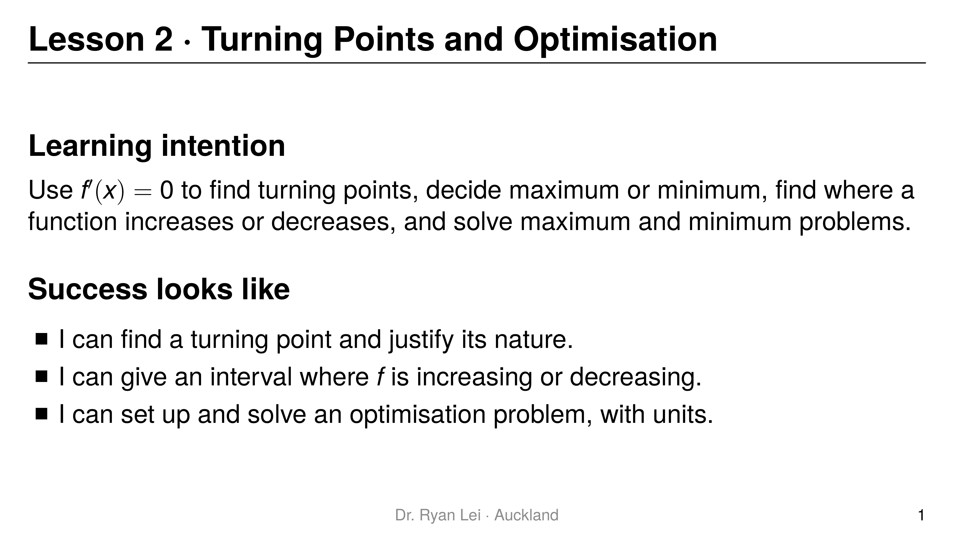
Notes:
Teaching line, not a question slide.
Timing: Do Now 10 min, three rounds about 20 min each, practice sheet 30 min, wrap-up 5 min.

Slide 2
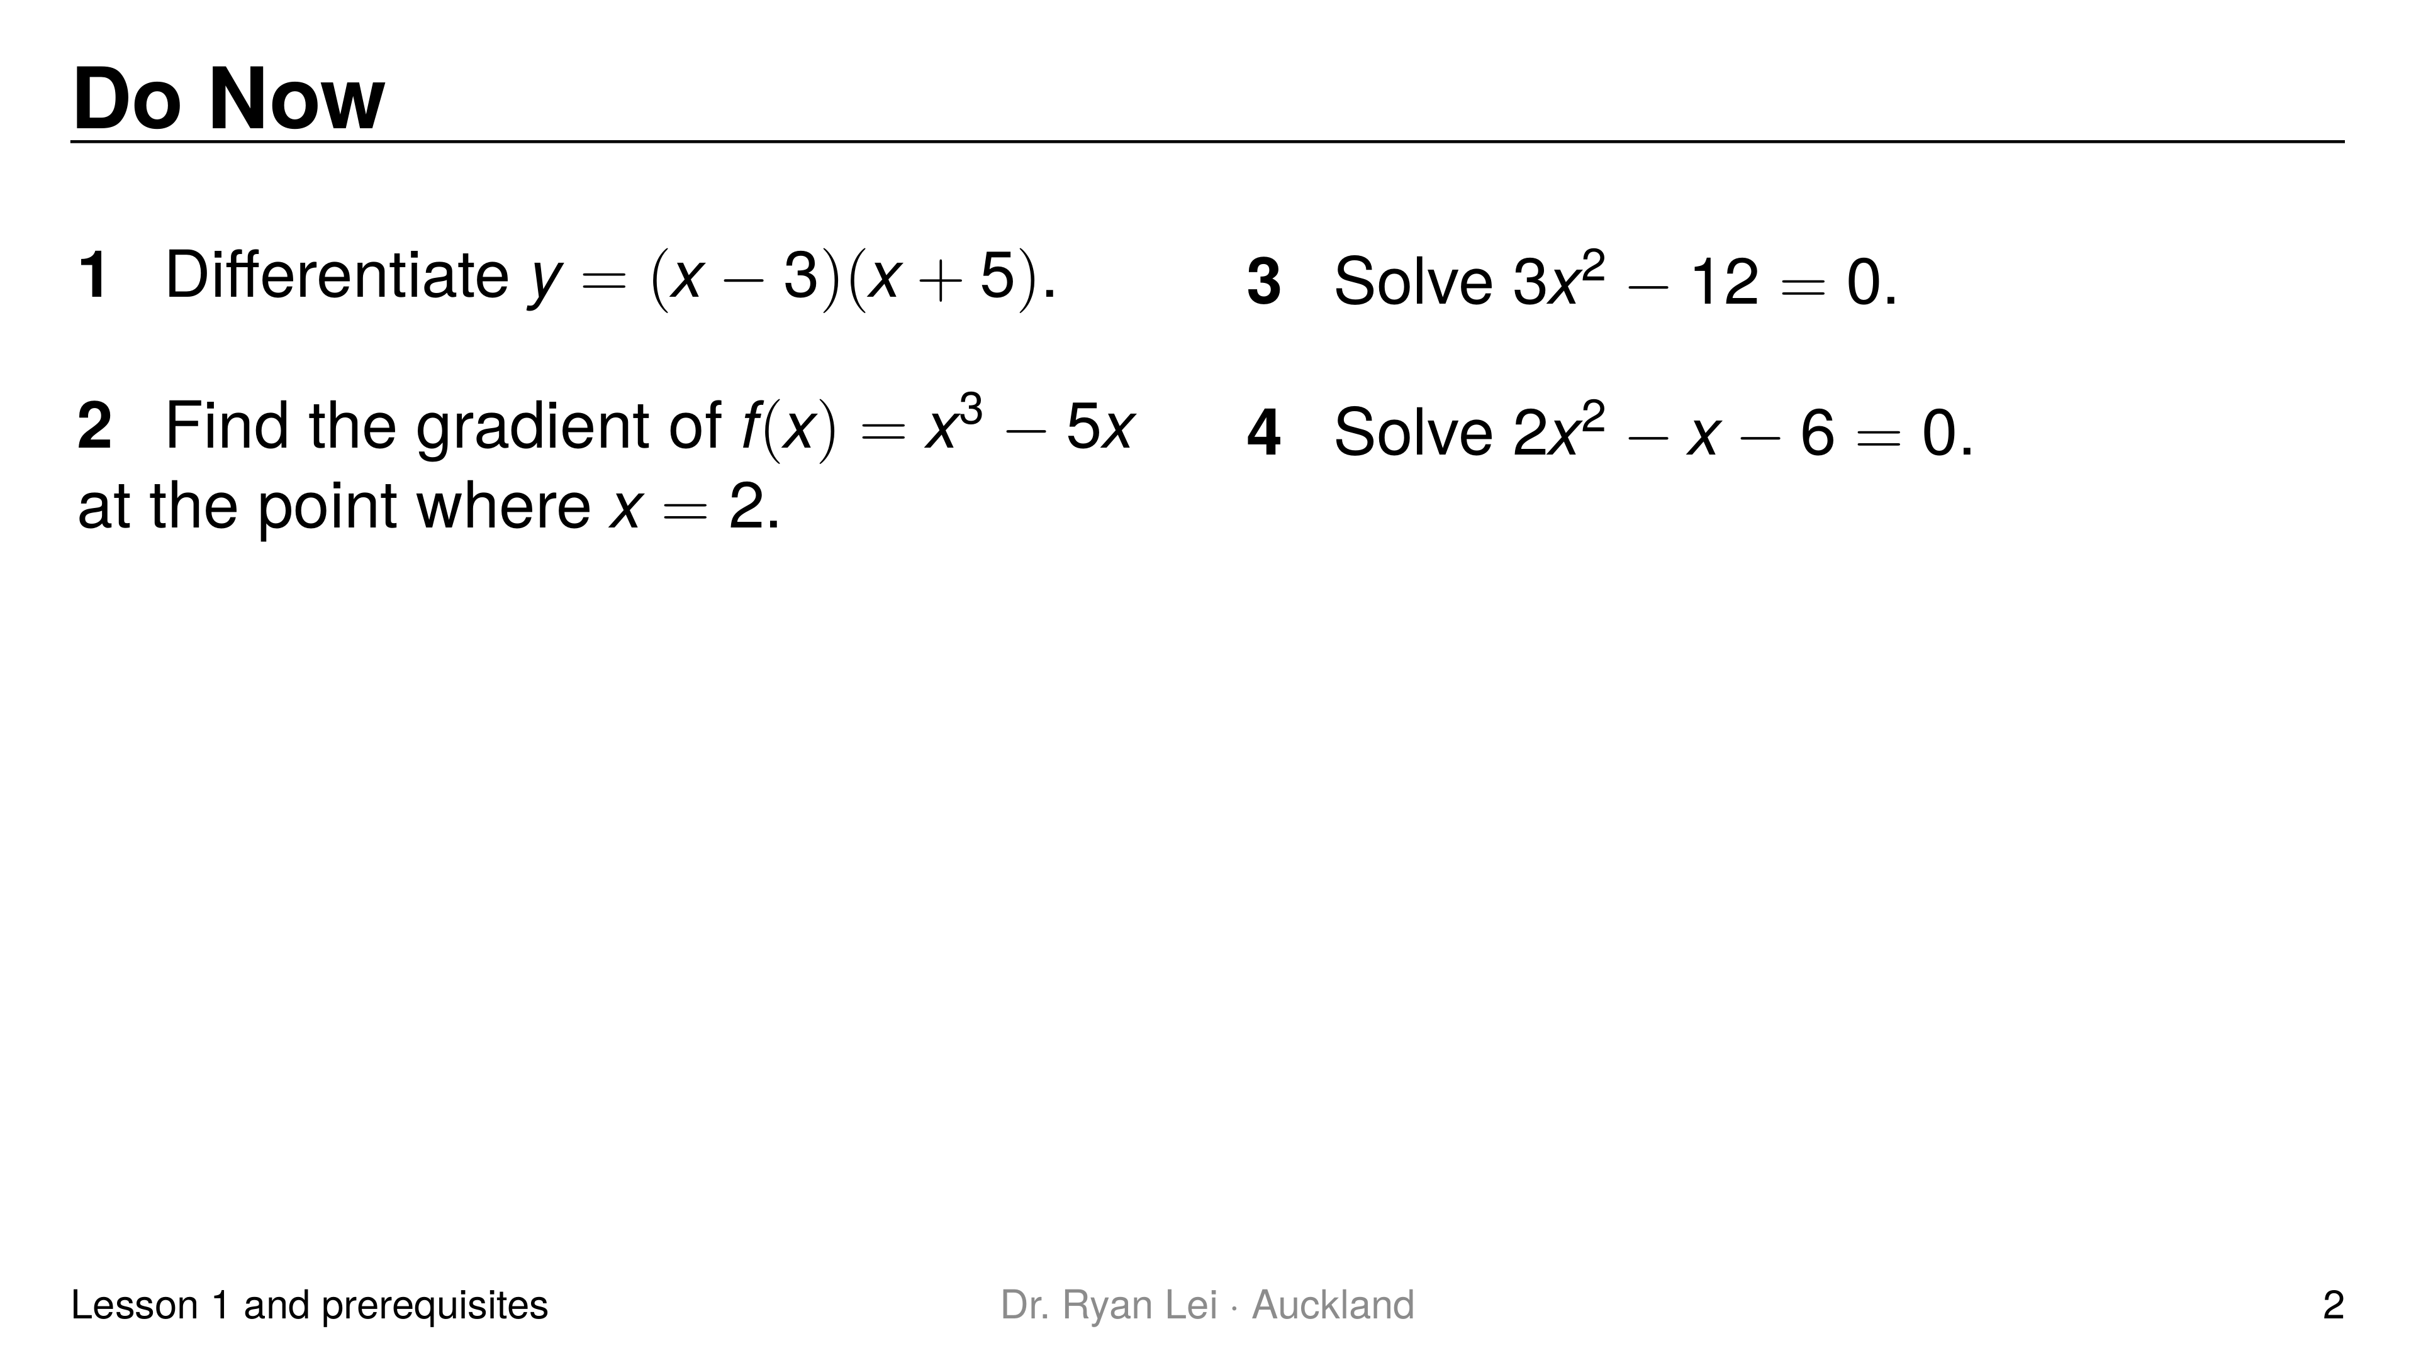
Notes:
Q1 $\frac{dy}{dx}=2x+2$
Q2 $7$
Q3 $x=2$ or $x=−2$
Q4 $x=2$ or $x=−1.5$
Short solution:
Q1 expand: $y=x^{2}+2x−15$
Q2 $f′\left(x\right)=3x^{2}−5$; $f′\left(2\right)=12−5$
Q3 $x^{2}=4$
Q4 $\left(2x+3\right)\left(x−2\right)=0$
Watch for:
Q3 missing the negative root
Q4 sign of the $−1.5$ root
Diagnostic:
Q1 or Q2 wrong: Lesson 1 not secure; re-teach the power rule before round 1
Q3 wrong: expect missing turning points today (both roots of $f′\left(x\right)=0$)
Q4 wrong: let the student use EQUA for $f′\left(x\right)=0$ today

Slide 3
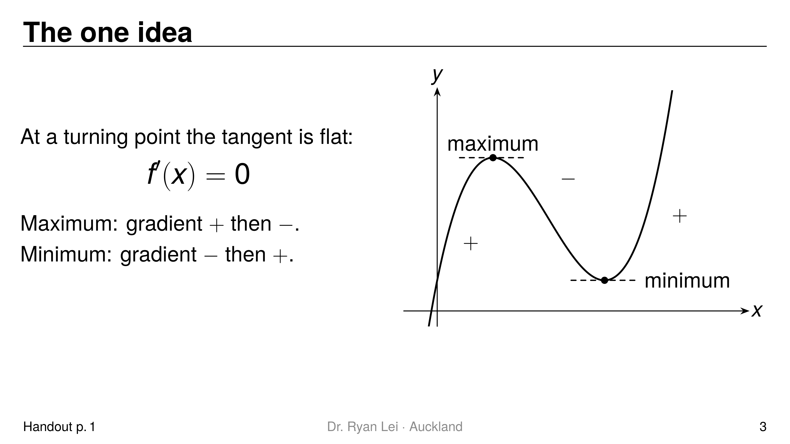
Notes:
Teaching line, not a question slide.
Trace the curve with a finger: up, flat, down, flat, up.
Ask: what is the gradient exactly at the top? Zero, because the tangent is horizontal.

Slide 4
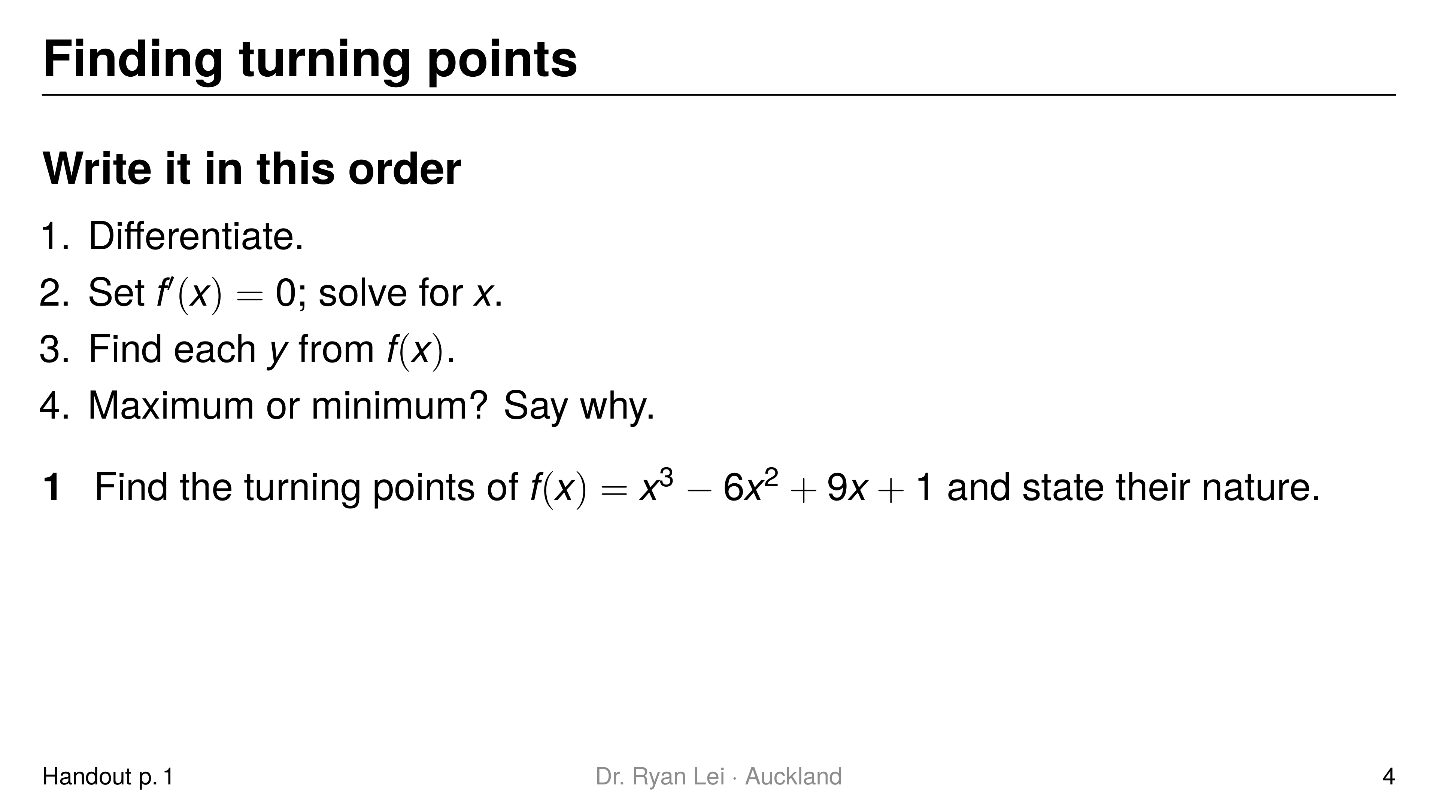
Notes:
Q1 maximum $\left(1, 5\right)$; minimum $\left(3, 1\right)$
Short solution:
Q1 $f′\left(x\right)=3x^{2}−12x+9=3\left(x−1\right)\left(x−3\right)$; $x=1$ or $x=3$
Q1 $f\left(1\right)=5$, $f\left(3\right)=1$
Q1 $f″\left(x\right)=6x−12$: $f″\left(1\right)=−6<0$ max; $f″\left(3\right)=6>0$ min
Watch for:
stopping at $x=1$, $x=3$ (L1)
$y$-values from $f′\left(x\right)$ give $0$, a sign of the wrong function

Slide 5
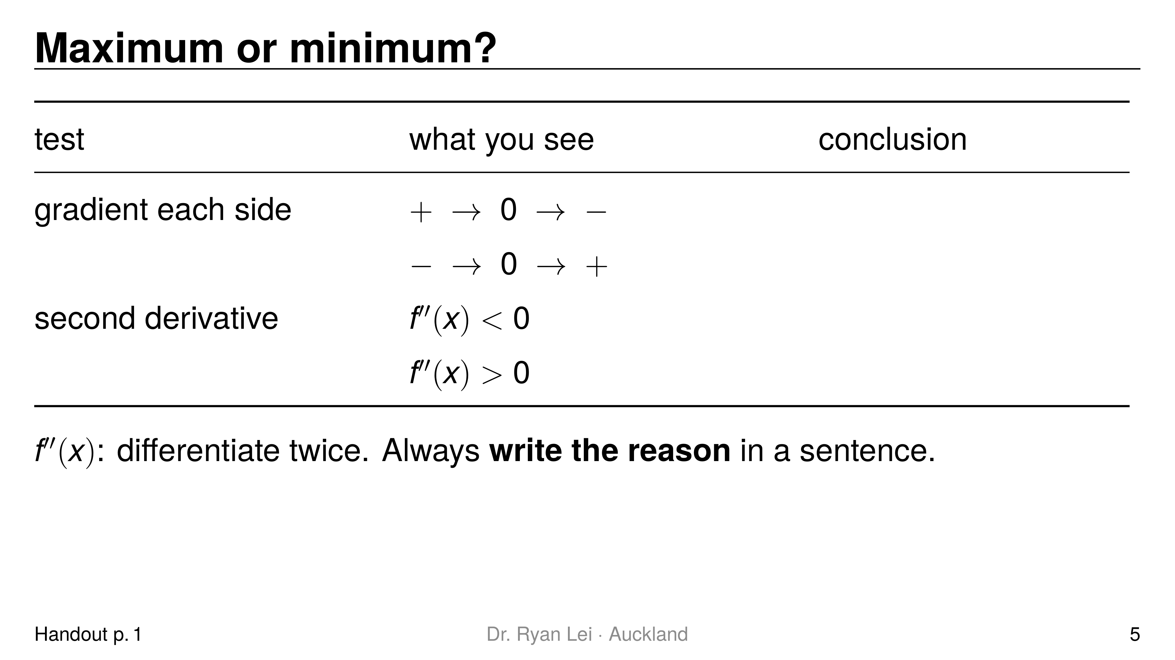
Notes:
Row 1 maximum
Row 2 minimum
Row 3 maximum, bends down
Row 4 minimum, bends up
Short solution:
sentence frame: $f″\left(1\right)=−6<0$, so the turning point at $\left(1, 5\right)$ is a maximum
Watch for:
L2: a bare “maximum” with no test is not a justification
$f″=0$: the test fails; use the gradient either side instead

Slide 6
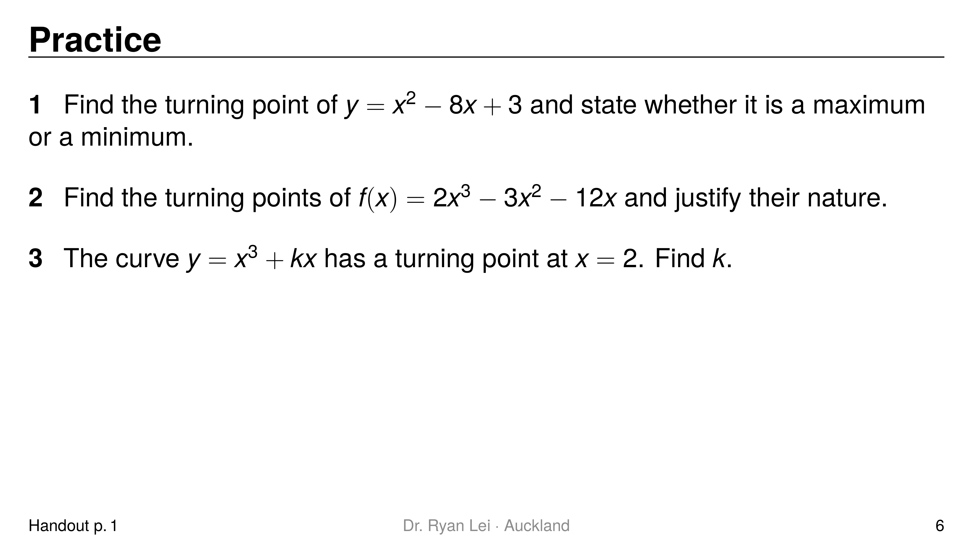
Notes:
Q1 $\left(4, −13\right)$, minimum
Q2 maximum $\left(−1, 7\right)$; minimum $\left(2, −20\right)$
Q3 $k=−12$
Short solution:
Q1 $2x−8=0$; $y=16−32+3$; $y″=2>0$
Q2 $6x^{2}−6x−12=6\left(x−2\right)\left(x+1\right)$; $f″\left(x\right)=12x−6$: $f″\left(−1\right)=−18$, $f″\left(2\right)=18$
Q3 $3x^{2}+k=0$ at $x=2$: $12+k=0$
Watch for:
Q2 forgetting to divide out the $6$ is fine, but check both roots are found
Q3 is a Merit step: a turning point means $f′=0$, not $f=0$

Slide 7
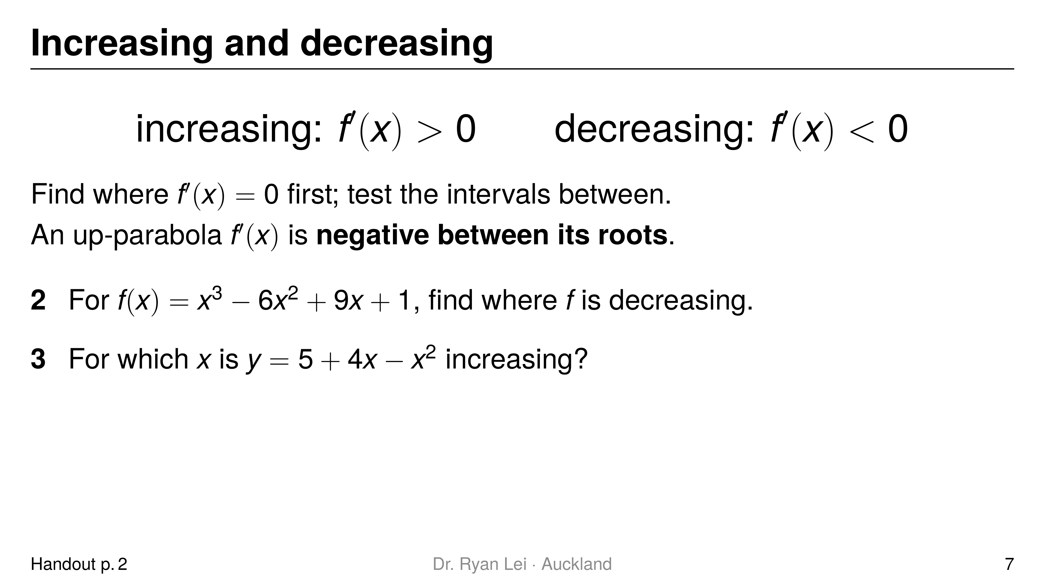
Notes:
Q2 $1<x<3$
Q3 $x<2$
Short solution:
Q2 $f′\left(x\right)=3\left(x−1\right)\left(x−3\right)$, up-parabola, negative between $1$ and $3$
Q3 $\frac{dy}{dx}=4−2x>0$
Watch for:
L3: an answer like “$x=1$ and $x=3$” is the turning points, not an interval
Q3 dividing by a negative flips the inequality if the student writes $−2x>−4$

Slide 8
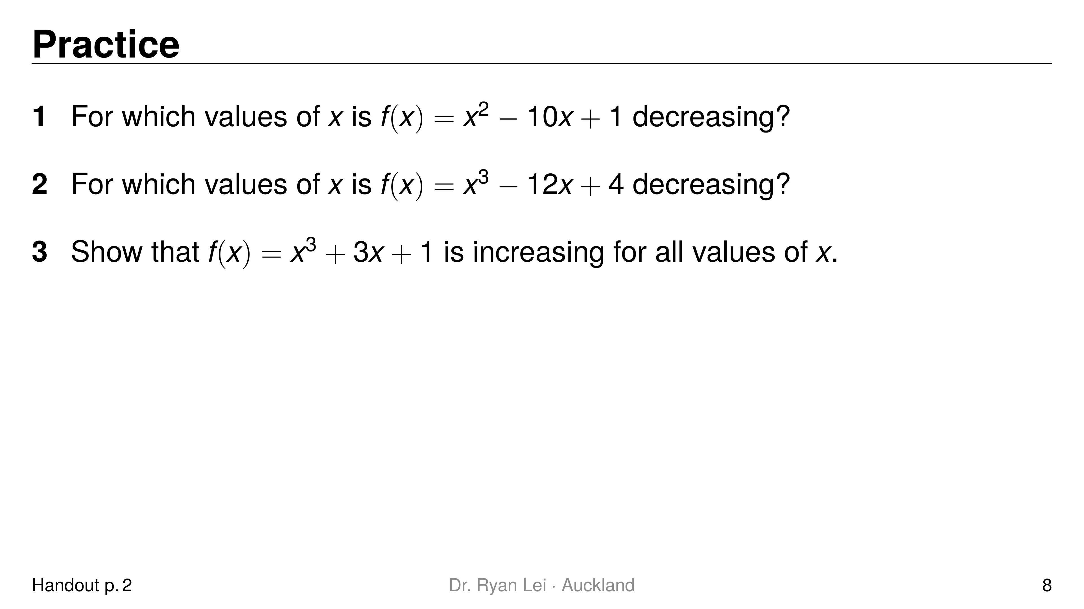
Notes:
Q1 $x<5$
Q2 $−2<x<2$
Q3 $f′\left(x\right)=3x^{2}+3>0$ for all $x$
Short solution:
Q1 $f′\left(x\right)=2x−10<0$
Q2 $f′\left(x\right)=3x^{2}−12=3\left(x−2\right)\left(x+2\right)<0$ between the roots
Q3 $x^{2}≥0$, so $3x^{2}+3≥3>0$
Watch for:
Q2 writing $x<2$ only; the up-parabola is negative on a bounded interval
Q3 Merit: the reason ($x^{2}≥0$) must be stated

Slide 9
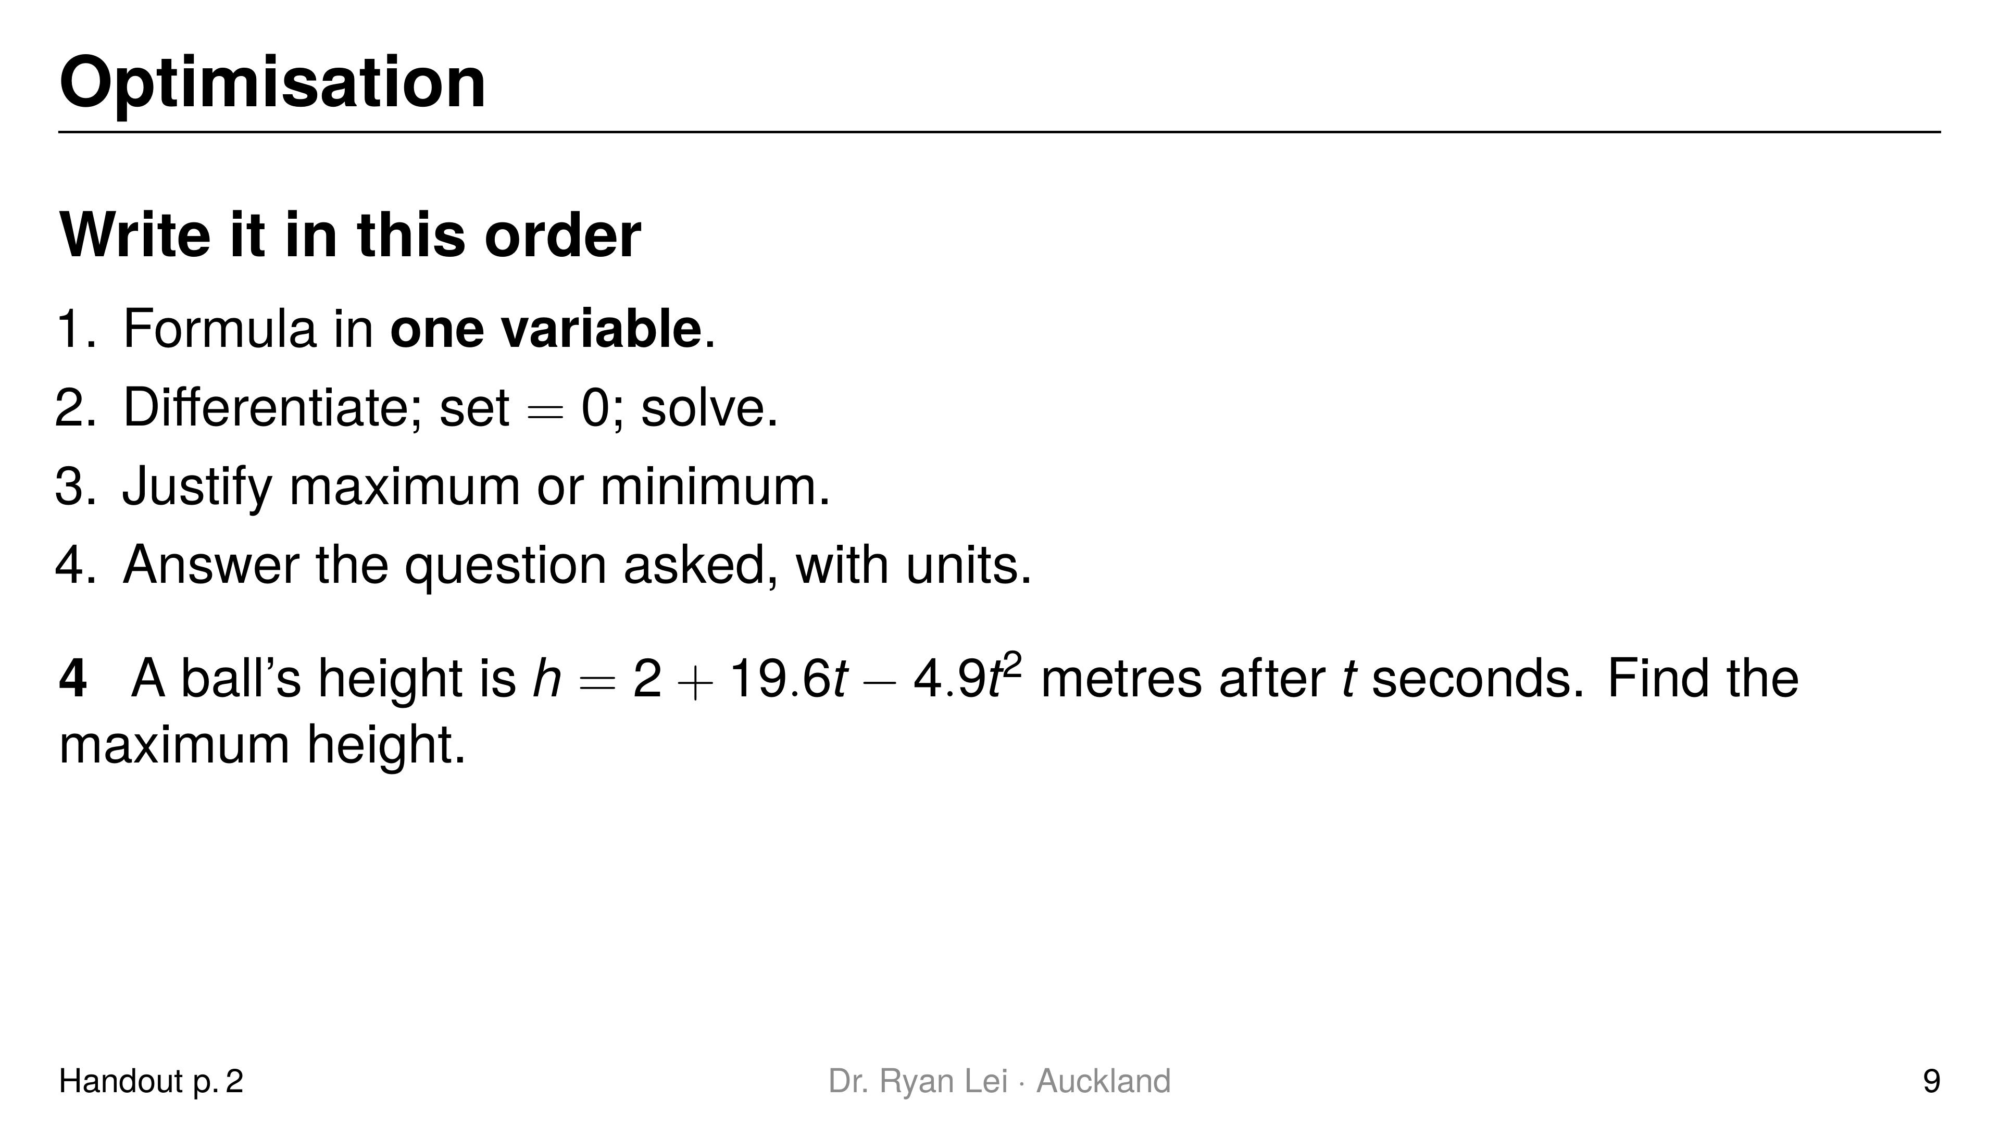
Notes:
Q4 $21.6$ m
Short solution:
Q4 $\frac{dh}{dt}=19.6−9.8t=0$, $t=2$
Q4 $h=2+39.2−19.6$; $\frac{d^{2}h}{dt^{2}}=−9.8<0$
Watch for:
L5: answering $t=2$ s instead of the height
L6: the unit (m)

Slide 10
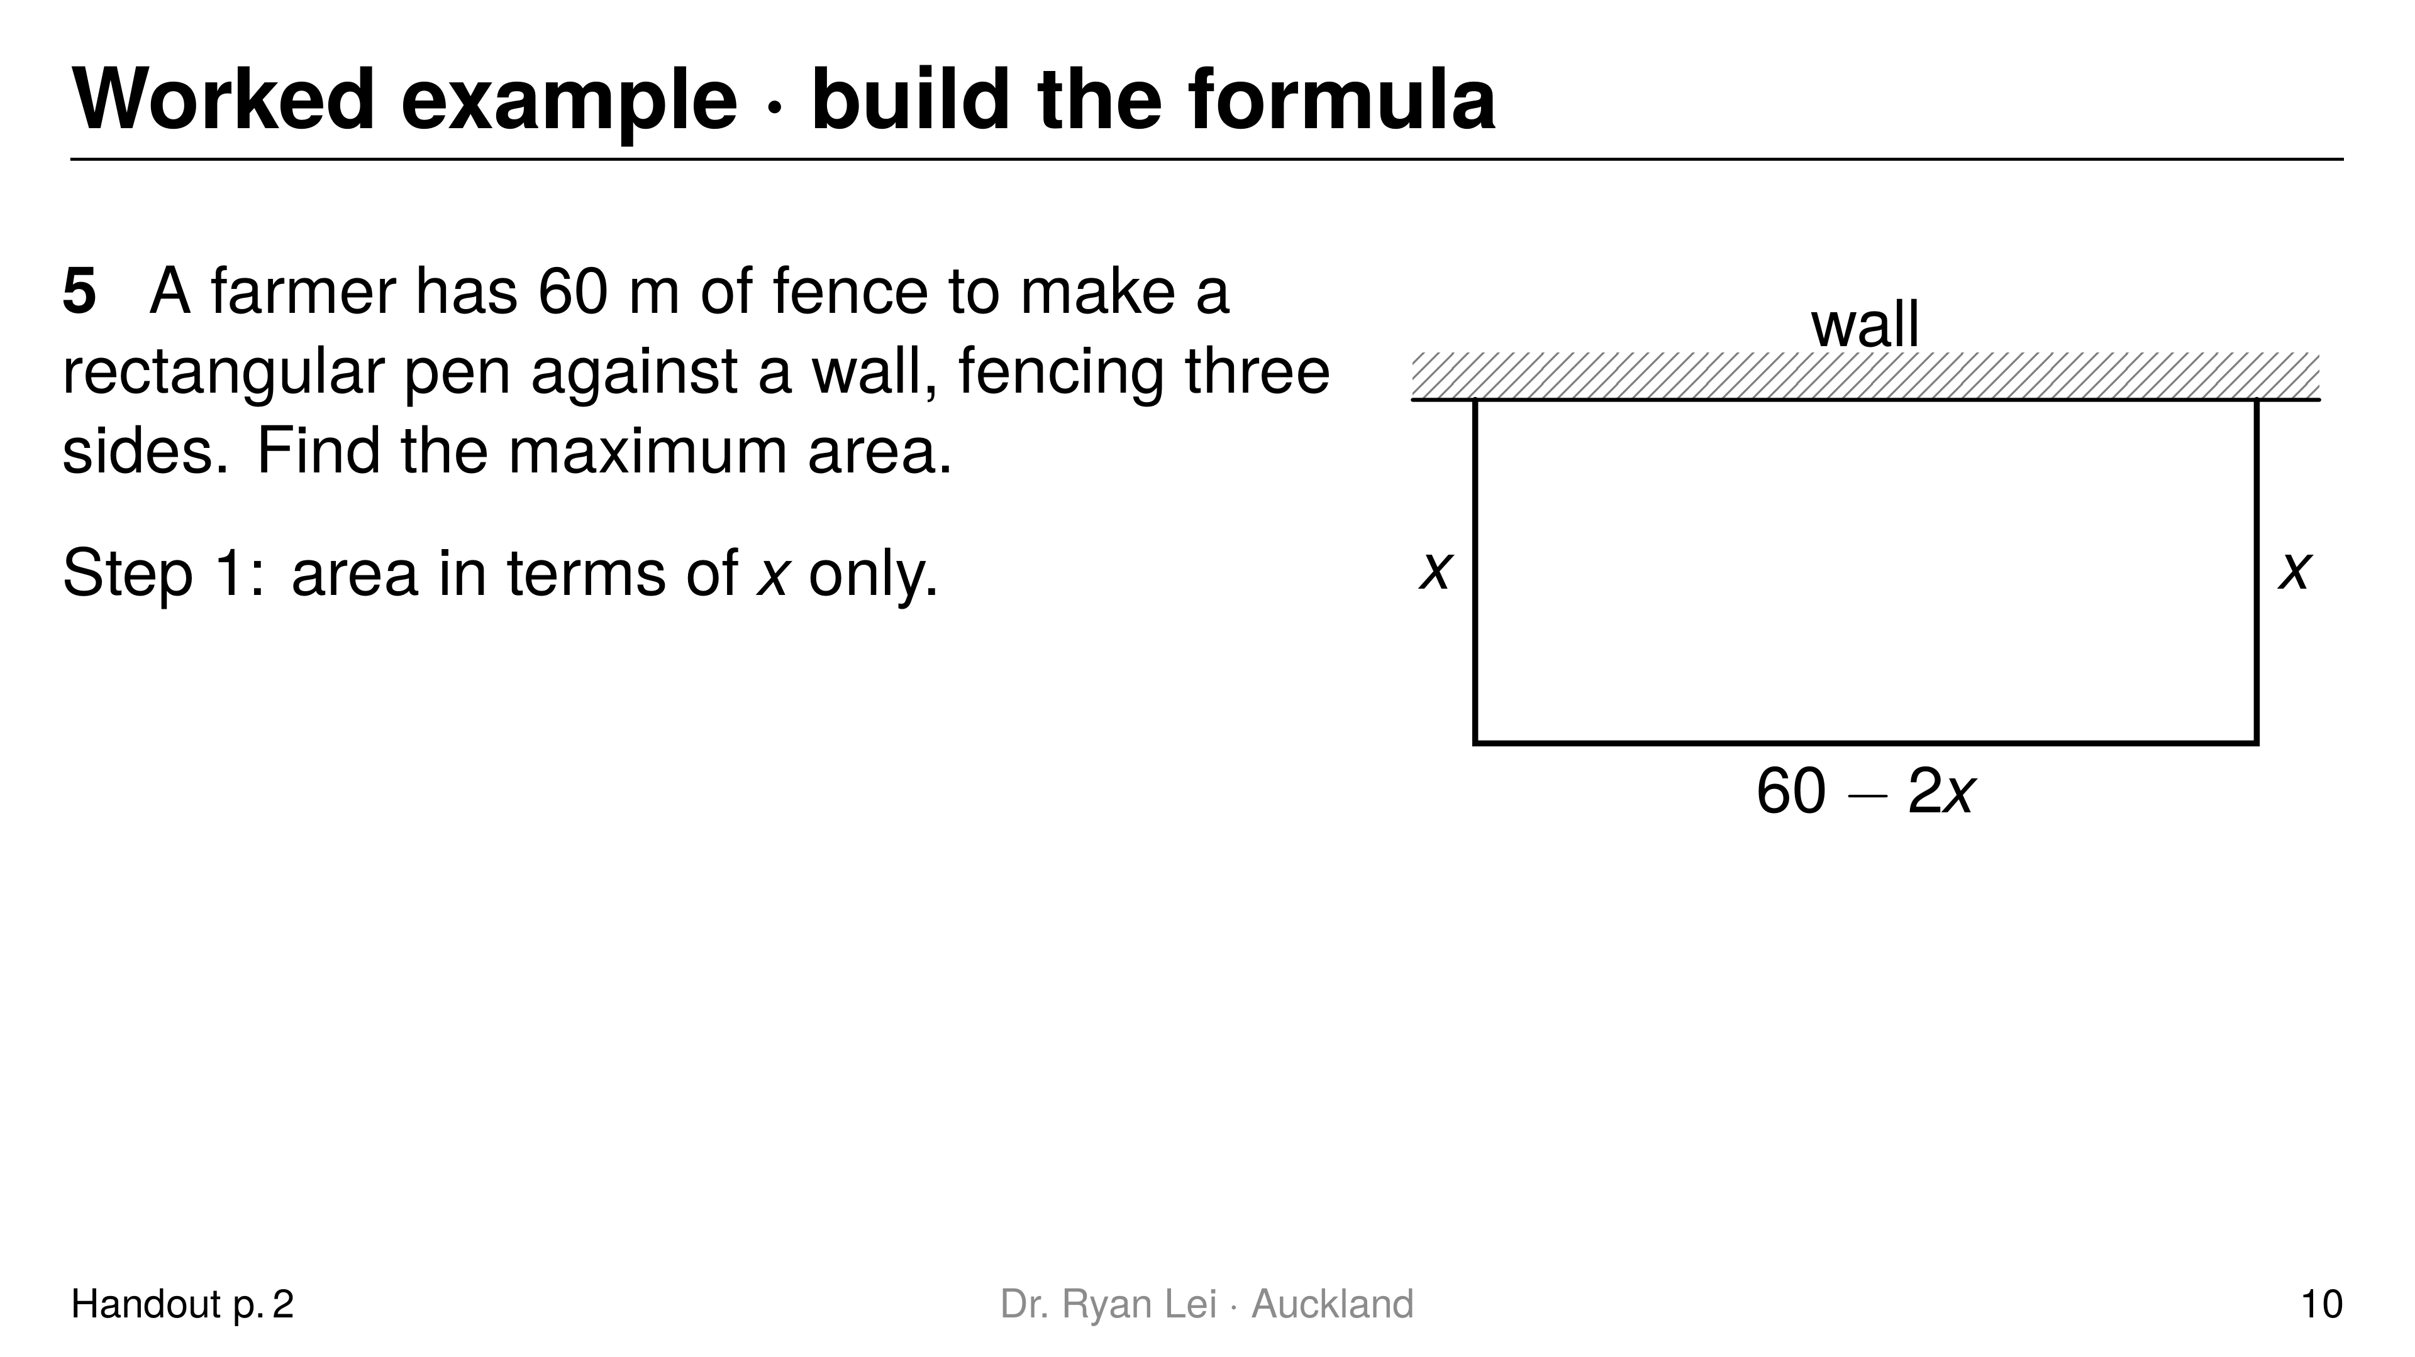
Notes:
Q5 $450 m^{2}$ (pen $15$ m by $30$ m)
Short solution:
Q5 $A=x\left(60−2x\right)=60x−2x^{2}$
Q5 $\frac{dA}{dx}=60−4x=0$, $x=15$; $\frac{d^{2}A}{dx^{2}}=−4<0$
Watch for:
L4: writing $A=xy$ and differentiating with two letters
using $2x+2y=60$ (four sides) when the wall is one side

Slide 11
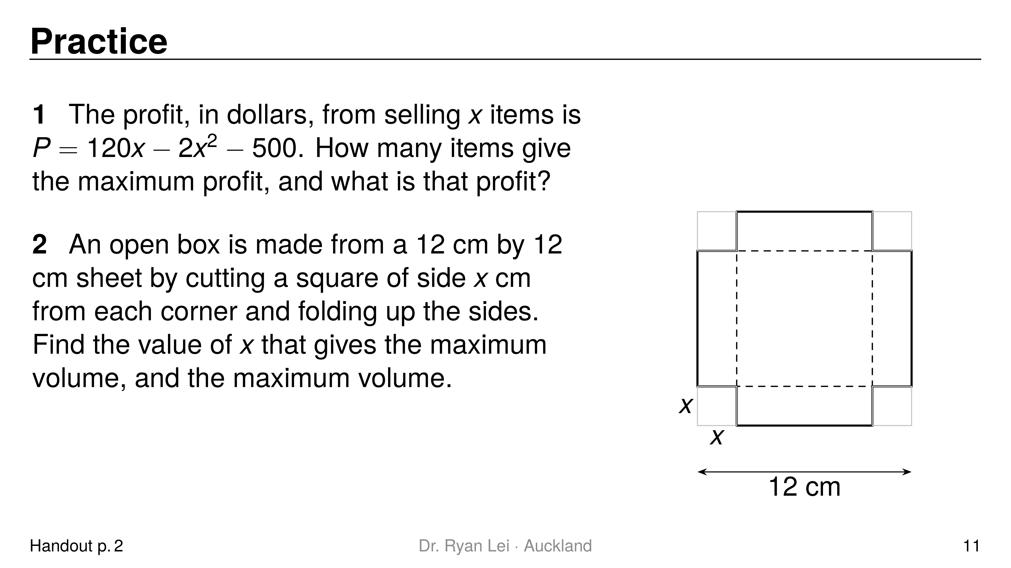
Notes:
Q1 $30$ items; profit 1300 dollars
Q2 $x=2$ cm; volume $128 {cm}^{3}$
Short solution:
Q1 $P′=120−4x=0$; $P=3600−1800−500$; $P″=−4<0$
Q2 $V=x{\left(12−2x\right)}^{2}=4x^{3}−48x^{2}+144x$
Q2 $V′=12x^{2}−96x+144=12\left(x−2\right)\left(x−6\right)$; $x=6$ gives no box
Q2 $V″=24x−96=−48<0$ at $x=2$
Watch for:
Q2 Excellence: the model must be built and the impossible root rejected with a reason

Slide 12
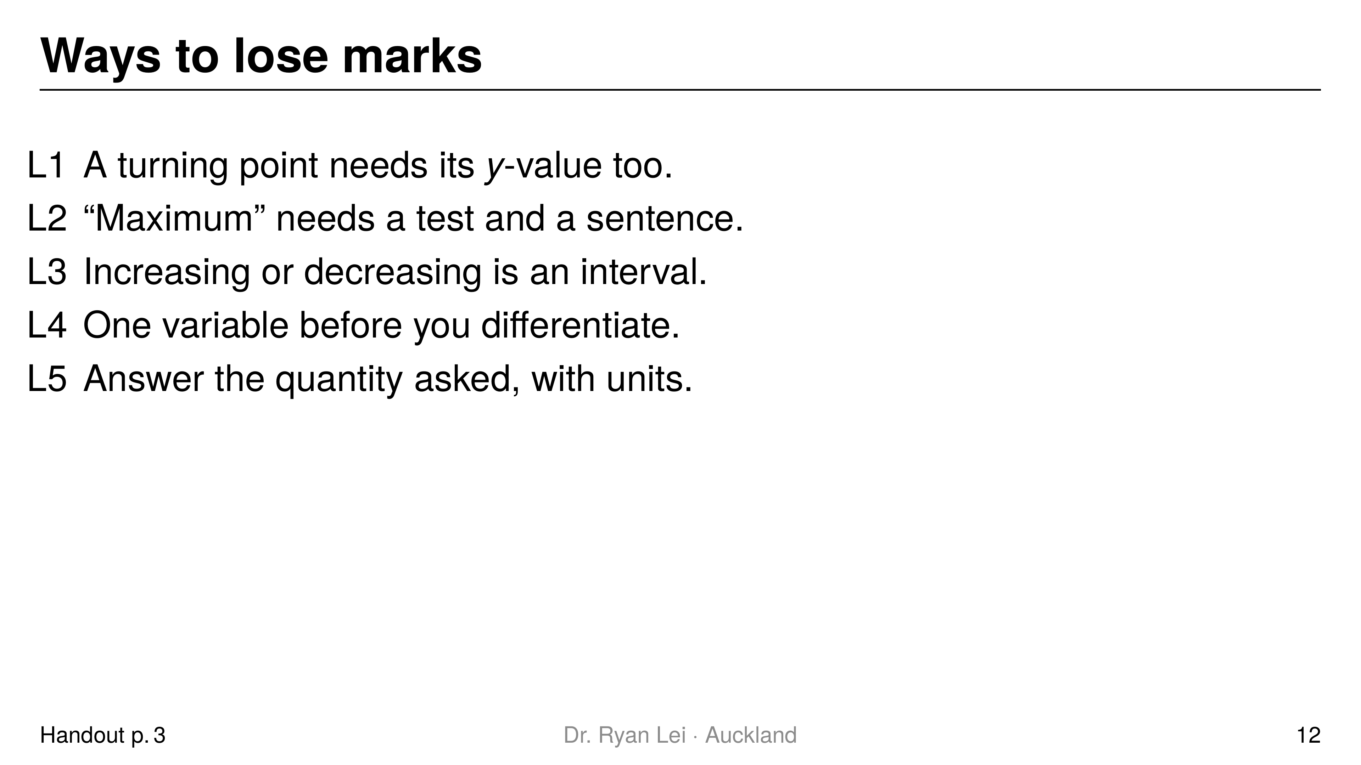
Notes:
Teaching line, not a question slide.
Full list L1 to L6 in the handout; L6 (units and context) applies to every answer.

Slide 13
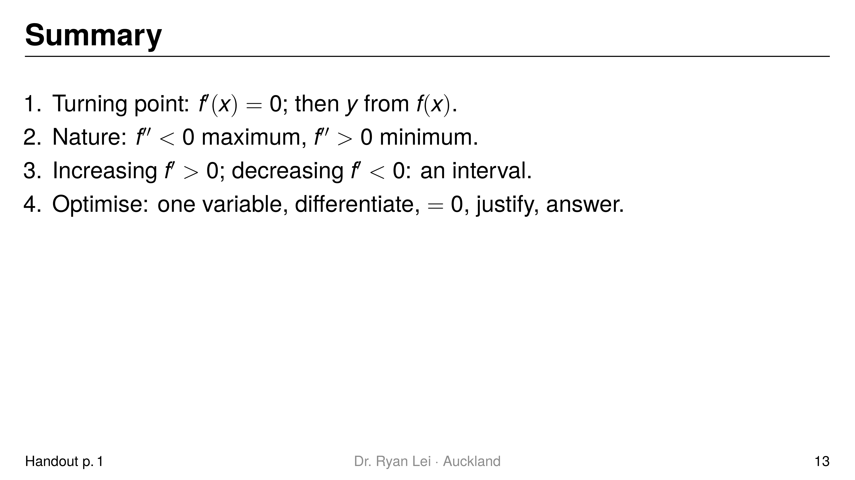
Notes:
Teaching line, not a question slide.
Ask the student to say each line back before looking at the screen.

Slide 14
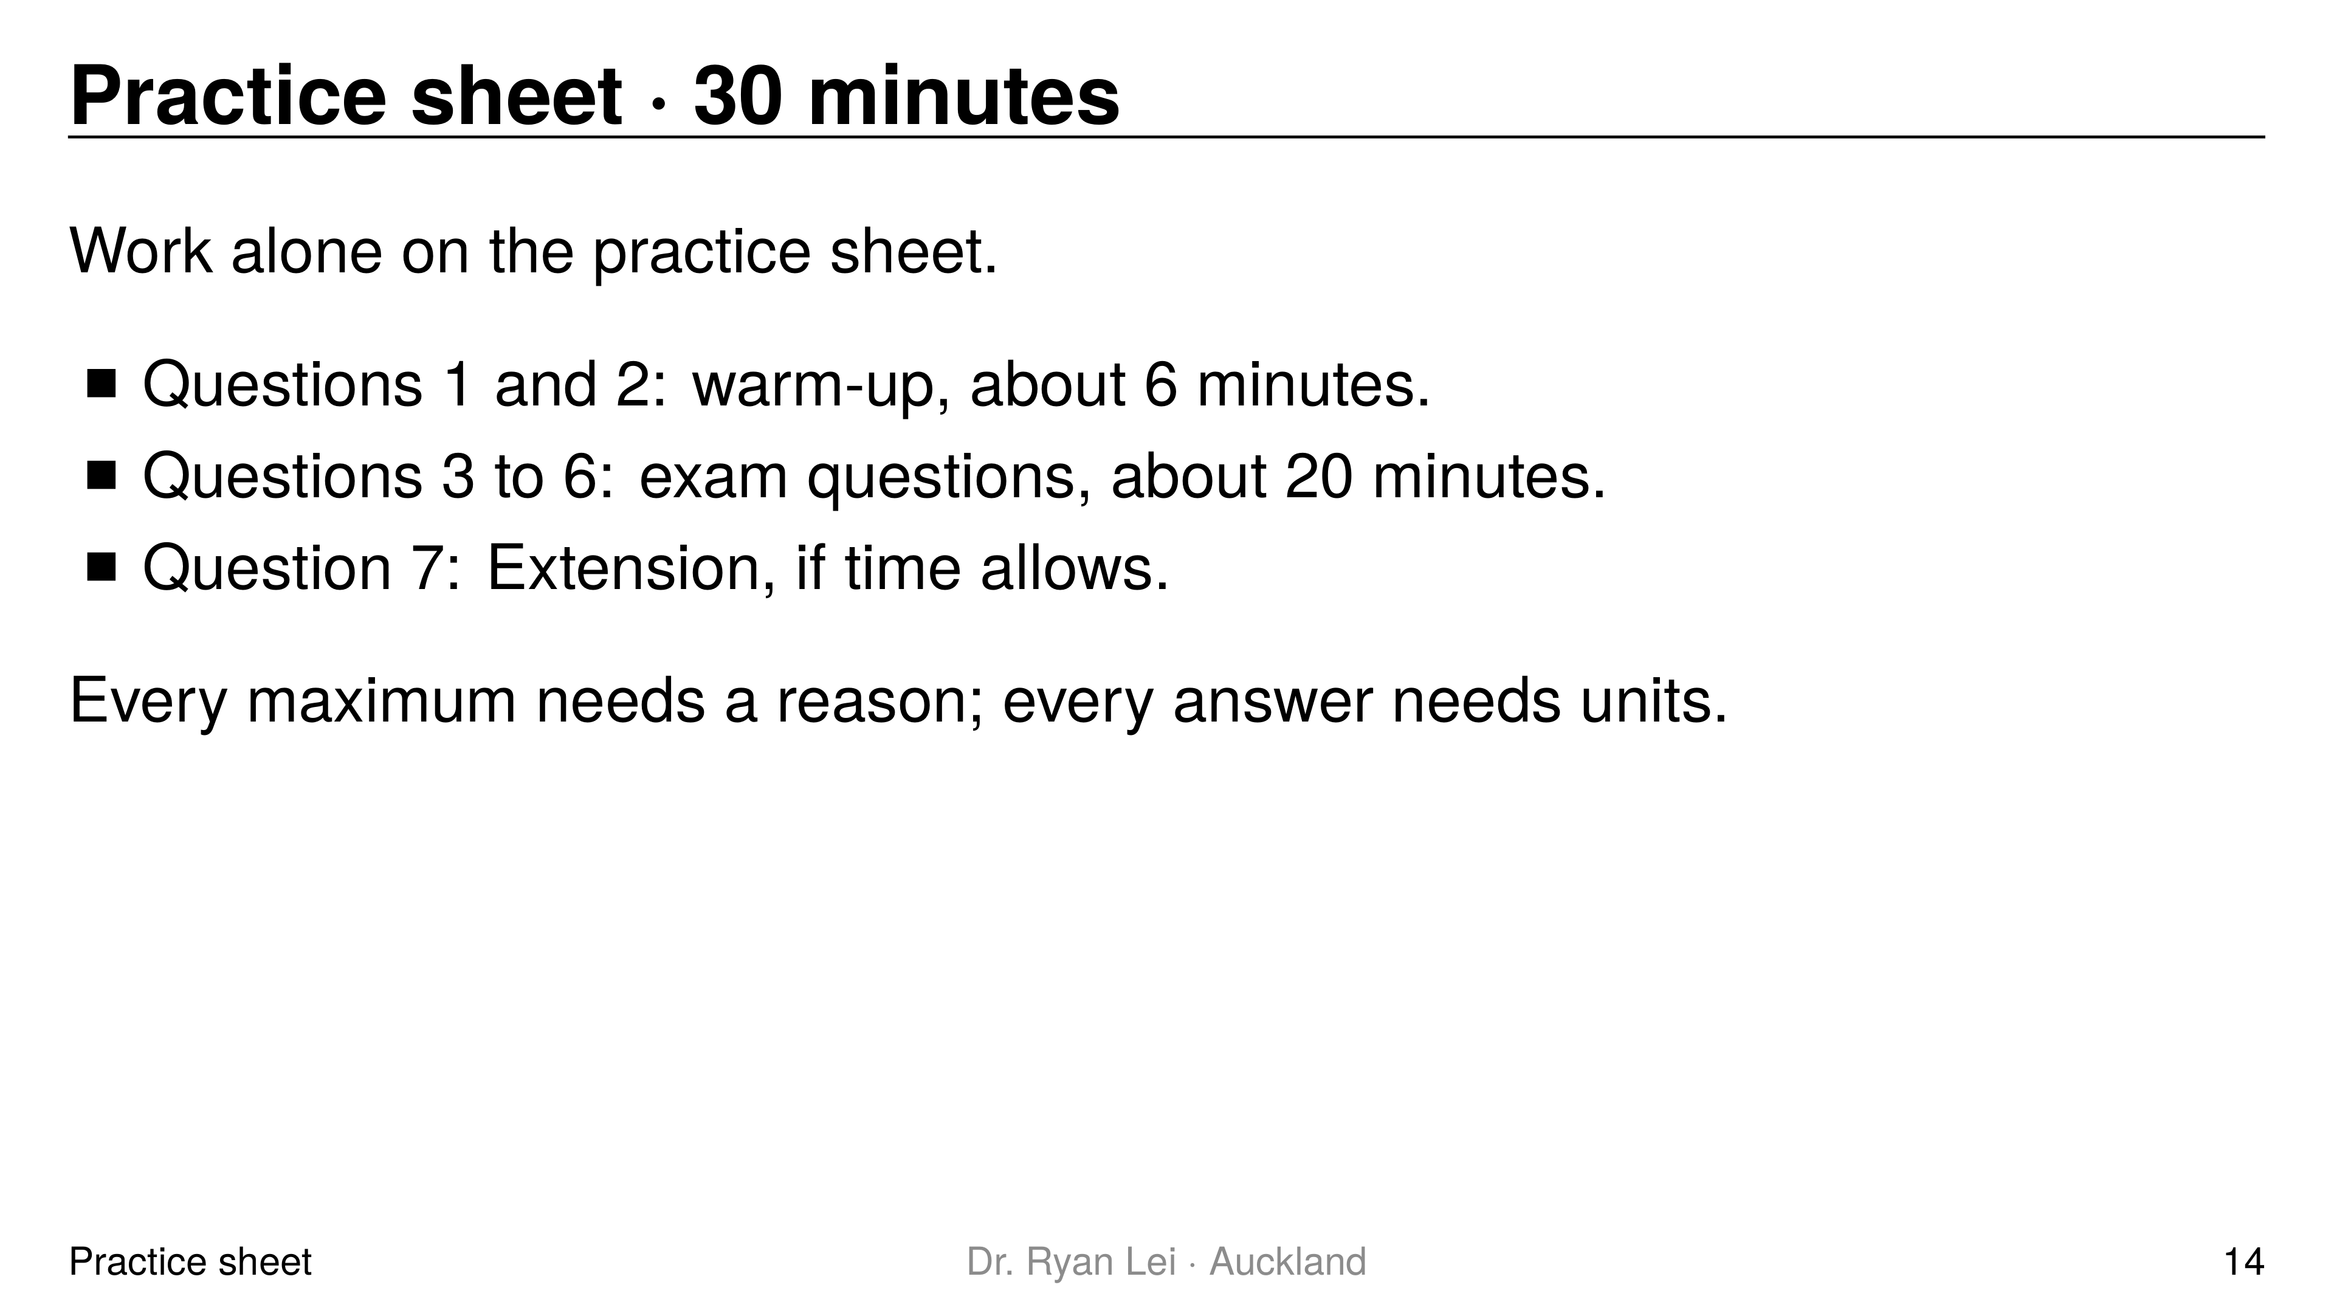
Notes:
Q1 maximum $\left(−3, 64\right)$; minimum $\left(3, −44\right)$
Q2 $12.5$ m (at $t=1.5$ s)
Q3 $−4<x<2.5$
Q4 $26.8$ m
Q5 (i) $352$ and $−352$ viewers per month; (ii) $6336$ viewers
Q6 wall height $3$
Q7 (i) $169.8 {cm}^{2}$; (ii) $A″=−6π<0$
Short solution:
Q3 $f′\left(x\right)=2x^{2}+3x−20=\left(2x−5\right)\left(x+4\right)$, negative between the roots
Q4 $h′=22.5−9.8t=0$, $t=2.296$; $h″=−9.8<0$
Q5 (i) $t^{2}−48t+320=0$, $t=8$ or $40$; $V′=−22t+528$; (ii) $t=24$
Q6 $A=2x\left(9−x^{2}\right)+x⋅x^{2}=18x−x^{3}$; $x^{2}=6$; wall $9−6$
Q7 $L=40−πr$; $A=2rL−πr^{2}=80r−3πr^{2}$; $r=\frac{40}{3π}$
Watch for:
Q5 (i) two times give two rates, one positive, one negative
Q6 the triangle's height is $x^{2}$, not $9$
Full working: practice answer version (tutor's working, not an official mark scheme)

Slide 15
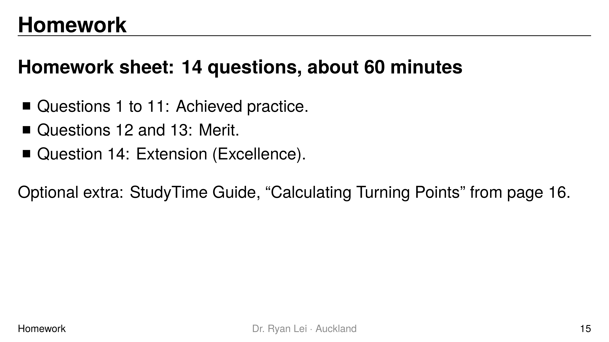
Notes:
Teaching line, not a question slide.
Answers: homework answer version (tutor's working, not an official mark scheme).
Next lesson Do Now checks a turning point and a decreasing interval.

