Slide 1
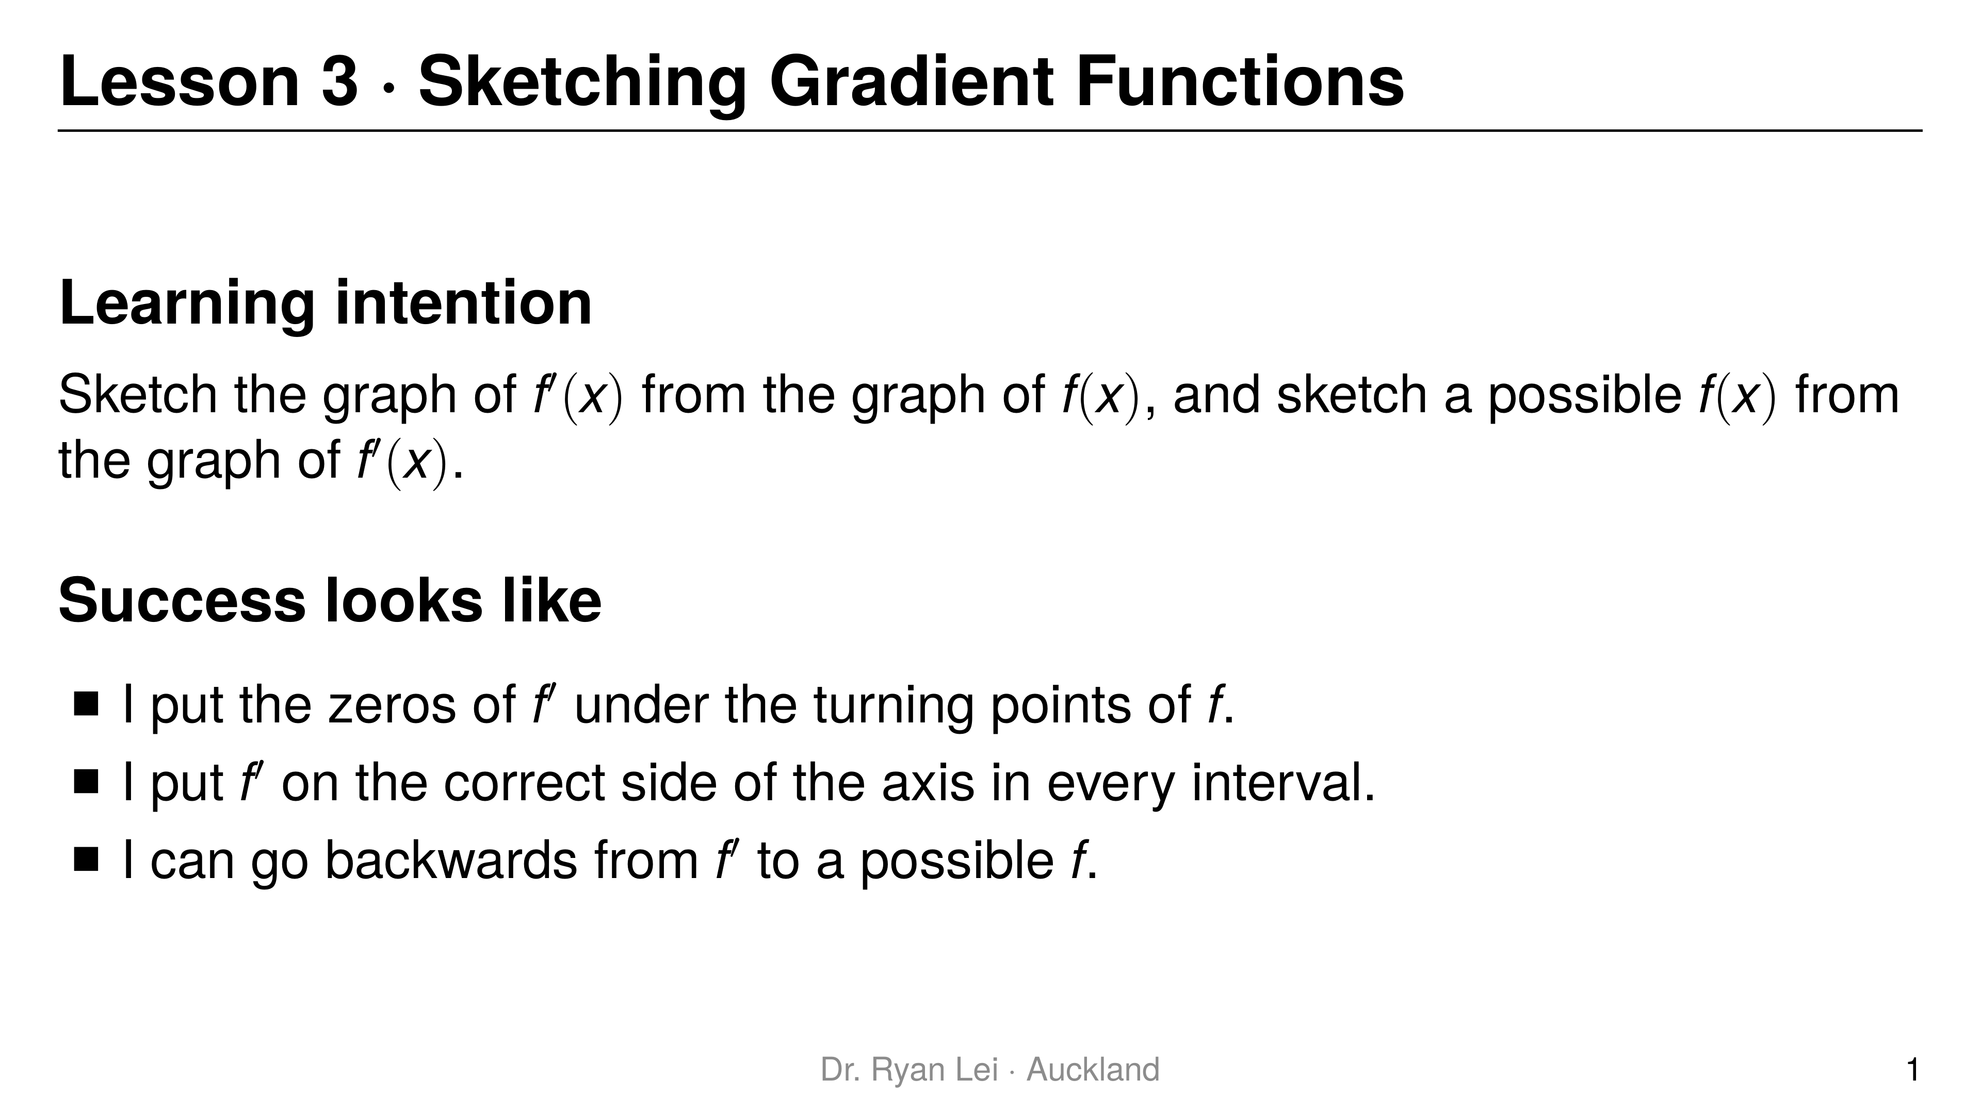
Notes:
Teaching line, not a question slide.
Materials: the practice sheet starts with a sketch page; grids 1 to 6 are for the three practice rounds.
Timing: Do Now 10 min, three rounds about 20 min each, practice sheet 30 min, wrap-up 5 min.

Slide 2
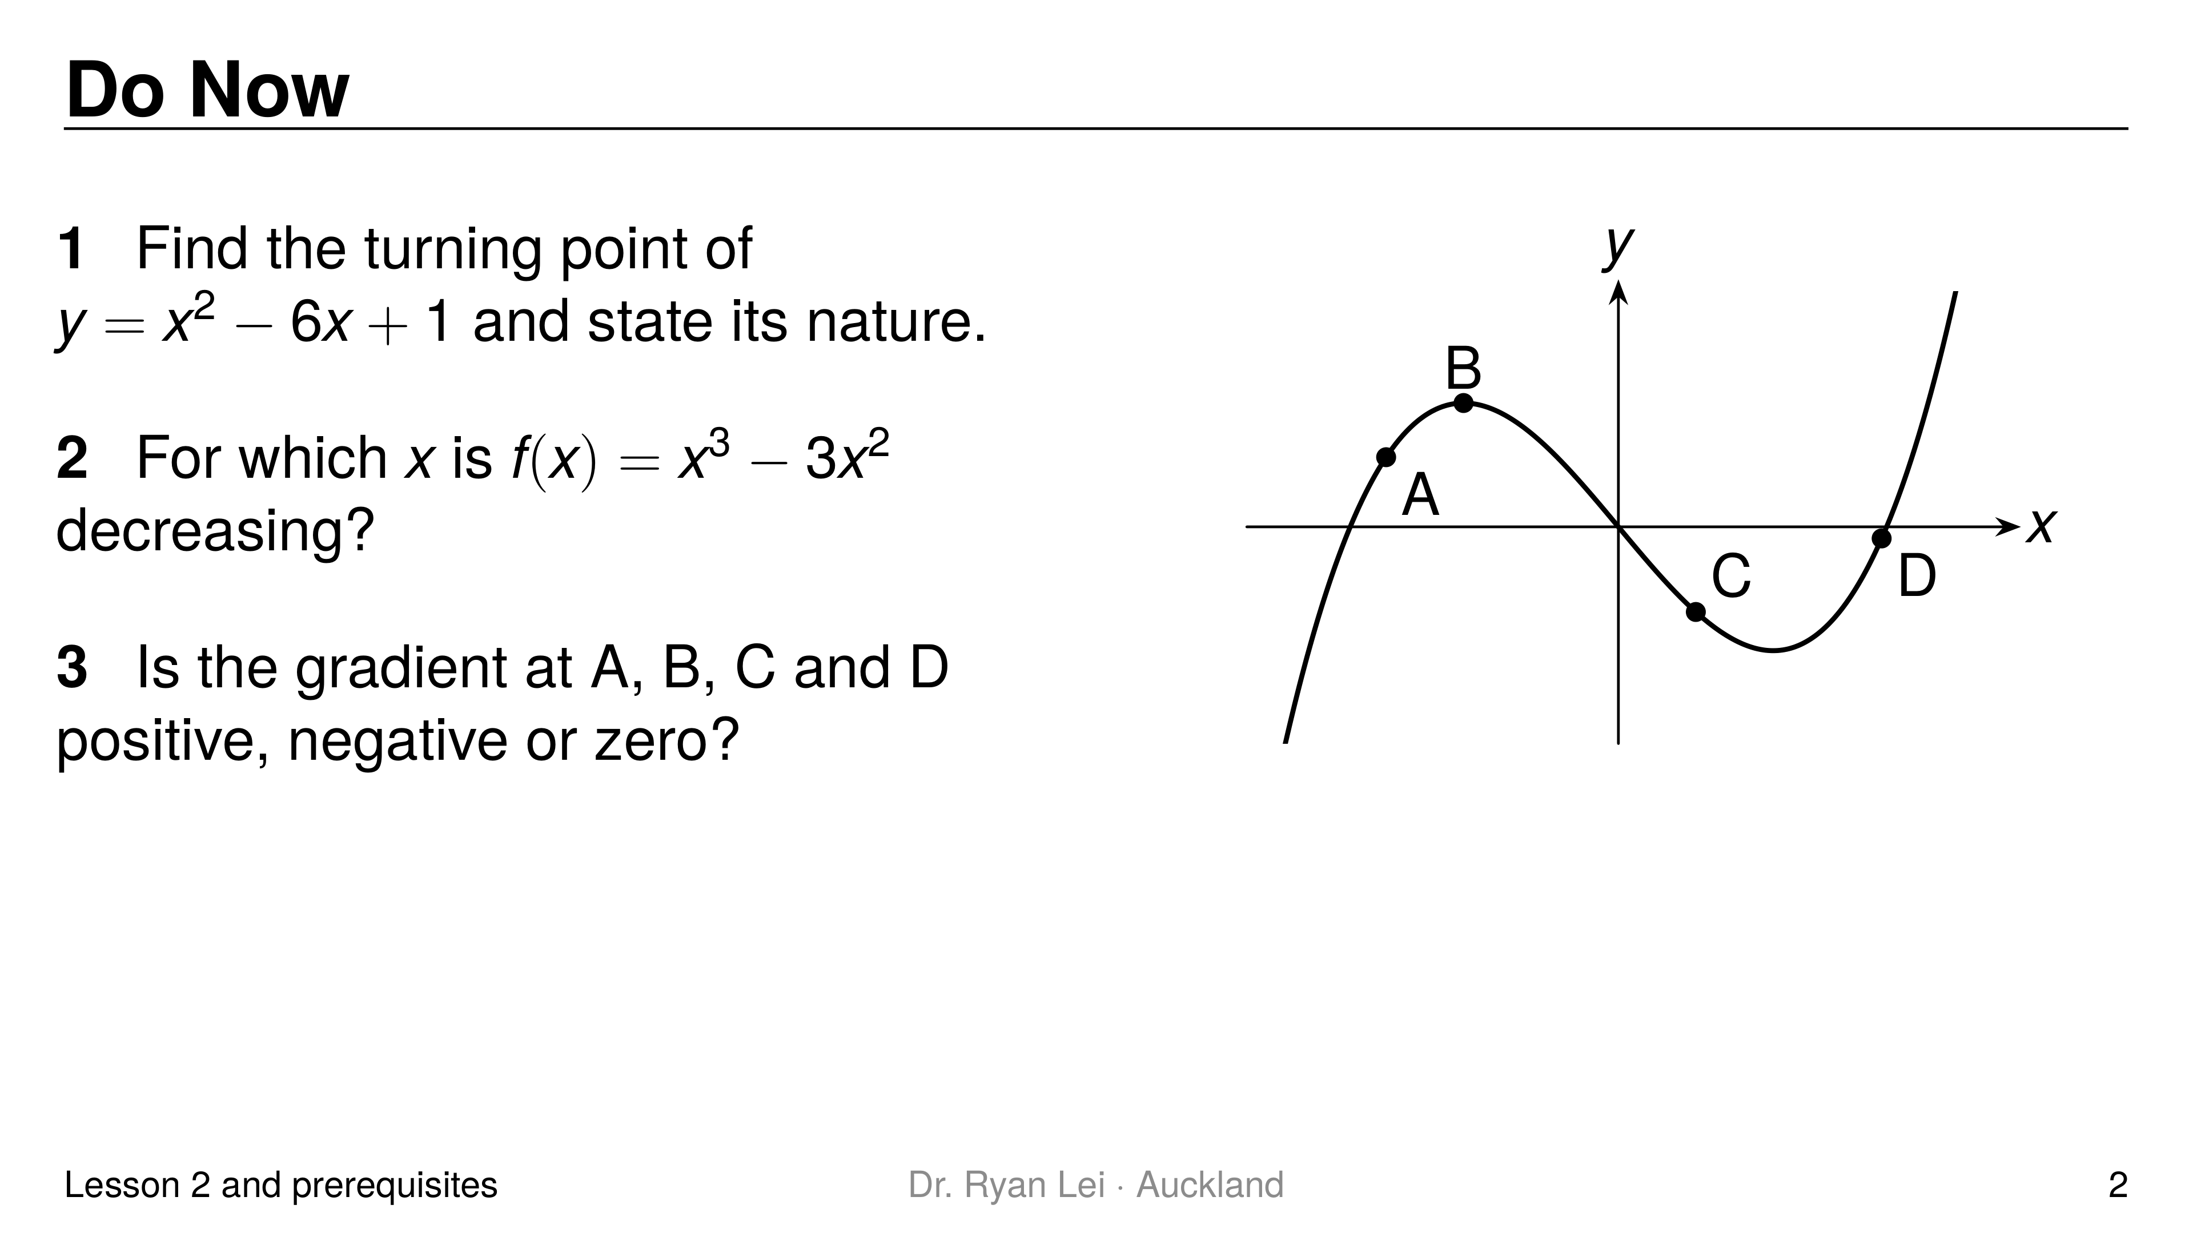
Notes:
Q1 $\left(3, −8\right)$, minimum
Q2 $0<x<2$
Q3 A positive; B zero; C negative; D positive
Short solution:
Q1 $2x−6=0$; $y=9−18+1$; $y″=2>0$
Q2 $f′\left(x\right)=3x^{2}−6x=3x\left(x−2\right)<0$ between the roots
Q3 $f′\left(x\right)=3x^{2}−3$: $3.75$, $0$, $−2.25$, $5.67$
Watch for:
Q3 reading the sign of $y$ instead of the direction of the curve (A is below the axis but going up)
Diagnostic:
Q1 or Q2 wrong: Lesson 2 needs a recap before round 2
Q3 wrong: the student confuses height and gradient, the exact confusion this lesson fixes; spend longer on the one idea

Slide 3
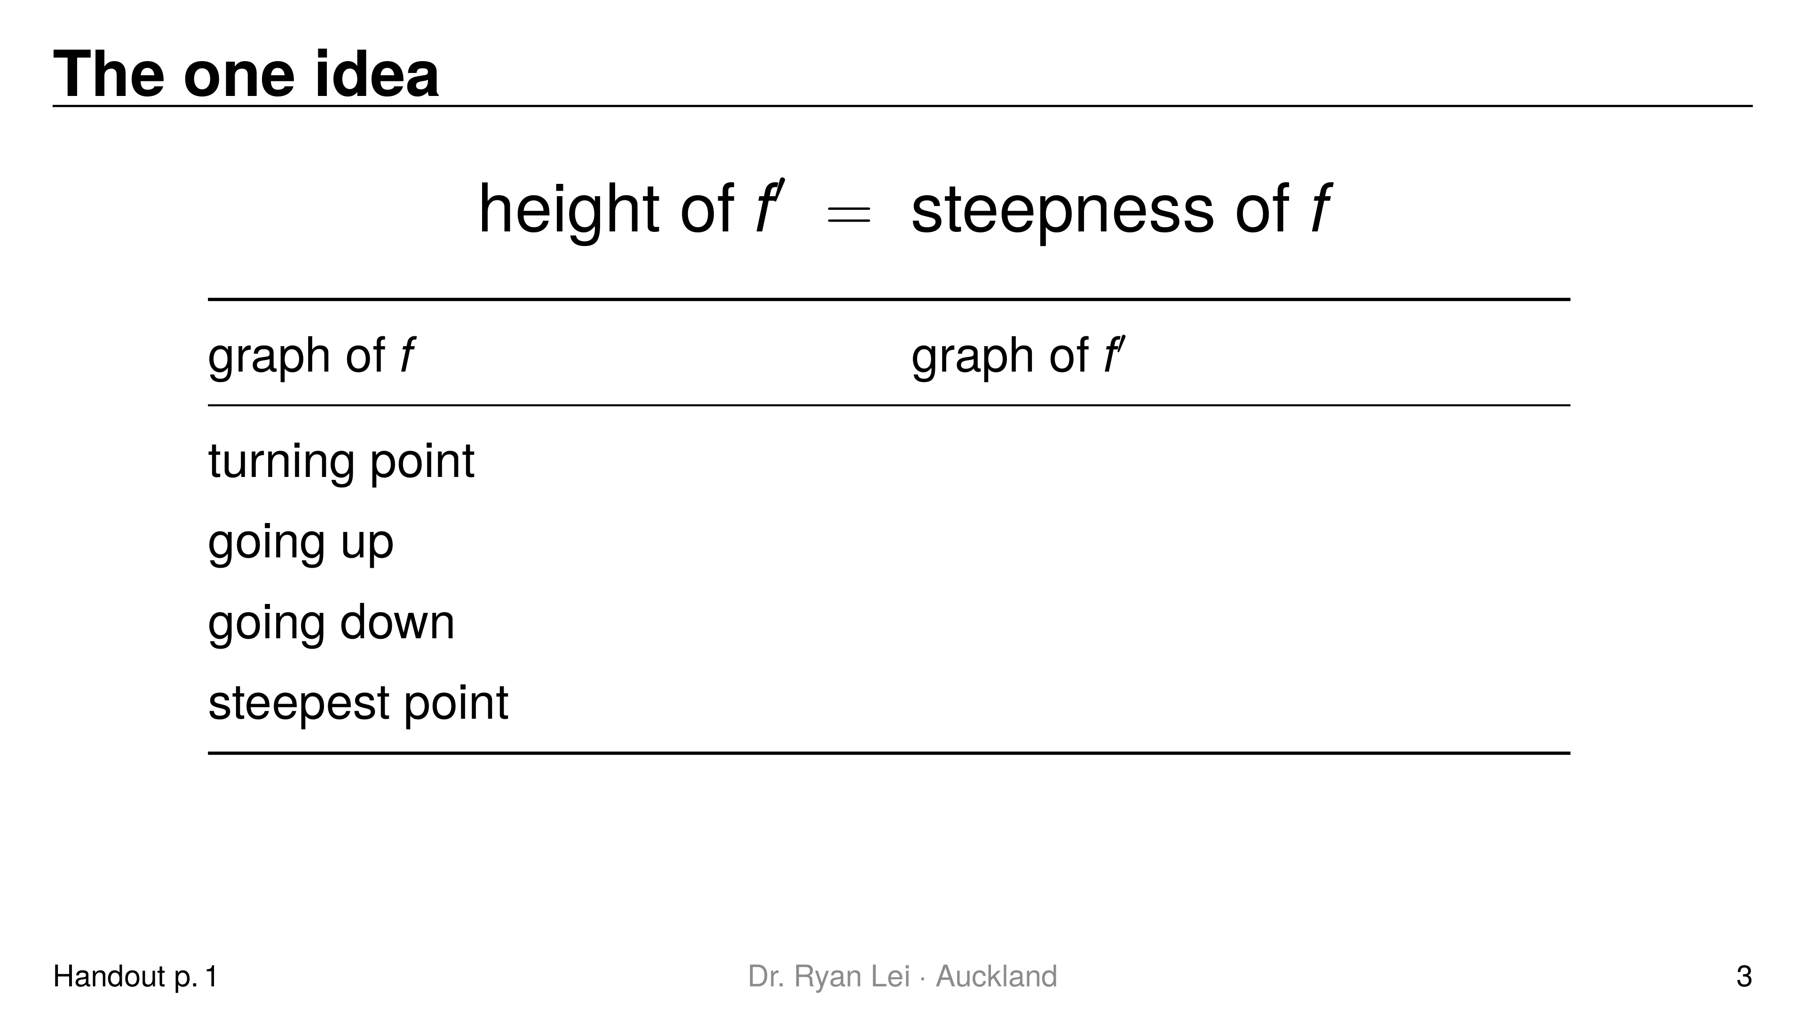
Notes:
Row 1 on the $x$-axis ($f′=0$)
Row 2 above the $x$-axis
Row 3 below the $x$-axis
Row 4 turning point of $f′$
Short solution:
fill the table with the student before any graph; keep it on the whiteboard all lesson
Watch for:
L1: students expect the same hump in the same place; say “flat means zero”

Slide 4
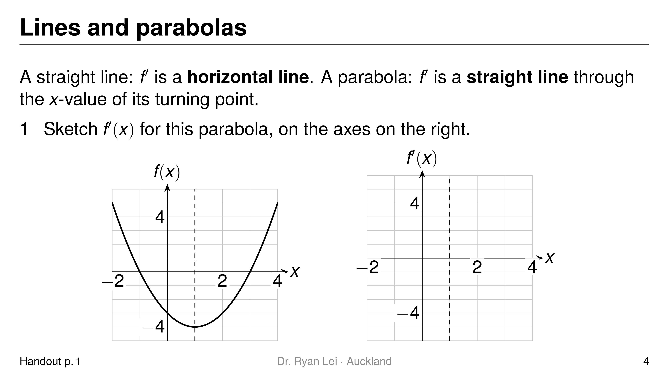
Notes:
Q1 straight line crossing the $x$-axis at $x=1$, below the axis for $x<1$, above for $x>1$
Short solution:
Q1 here $f\left(x\right)=x^{2}−2x−3$, so $f′\left(x\right)=2x−2$: through $\left(1, 0\right)$ and $\left(0, −2\right)$
Watch for:
L3: drawing $f′$ as a curve
the dashed line at $x=1$ is the ruler line: the zero of $f′$ sits on it

Slide 5
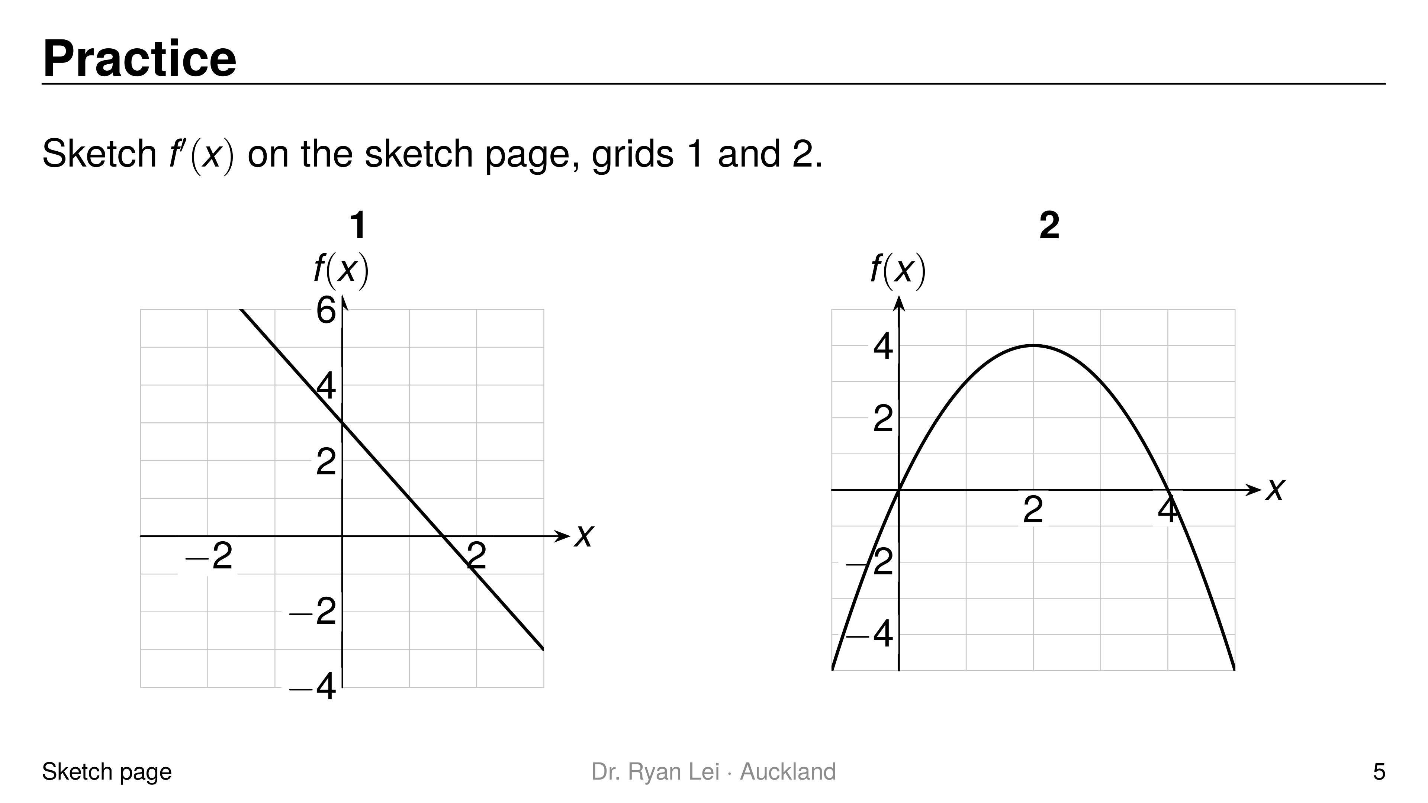
Notes:
Q1 horizontal line at height $−2$
Q2 straight line through $\left(2, 0\right)$, above the axis for $x<2$, below for $x>2$
Short solution:
Q1 the line falls $2$ for every $1$ across: gradient $−2$ everywhere
Q2 maximum at $x=2$; $f\left(x\right)=−x^{2}+4x$, so $f′\left(x\right)=−2x+4$, through $\left(0, 4\right)$
Watch for:
Q1 drawing $f′$ as a sloping line
Q2 slope direction: up then down means $f′$ goes from $+$ to $−$

Slide 6
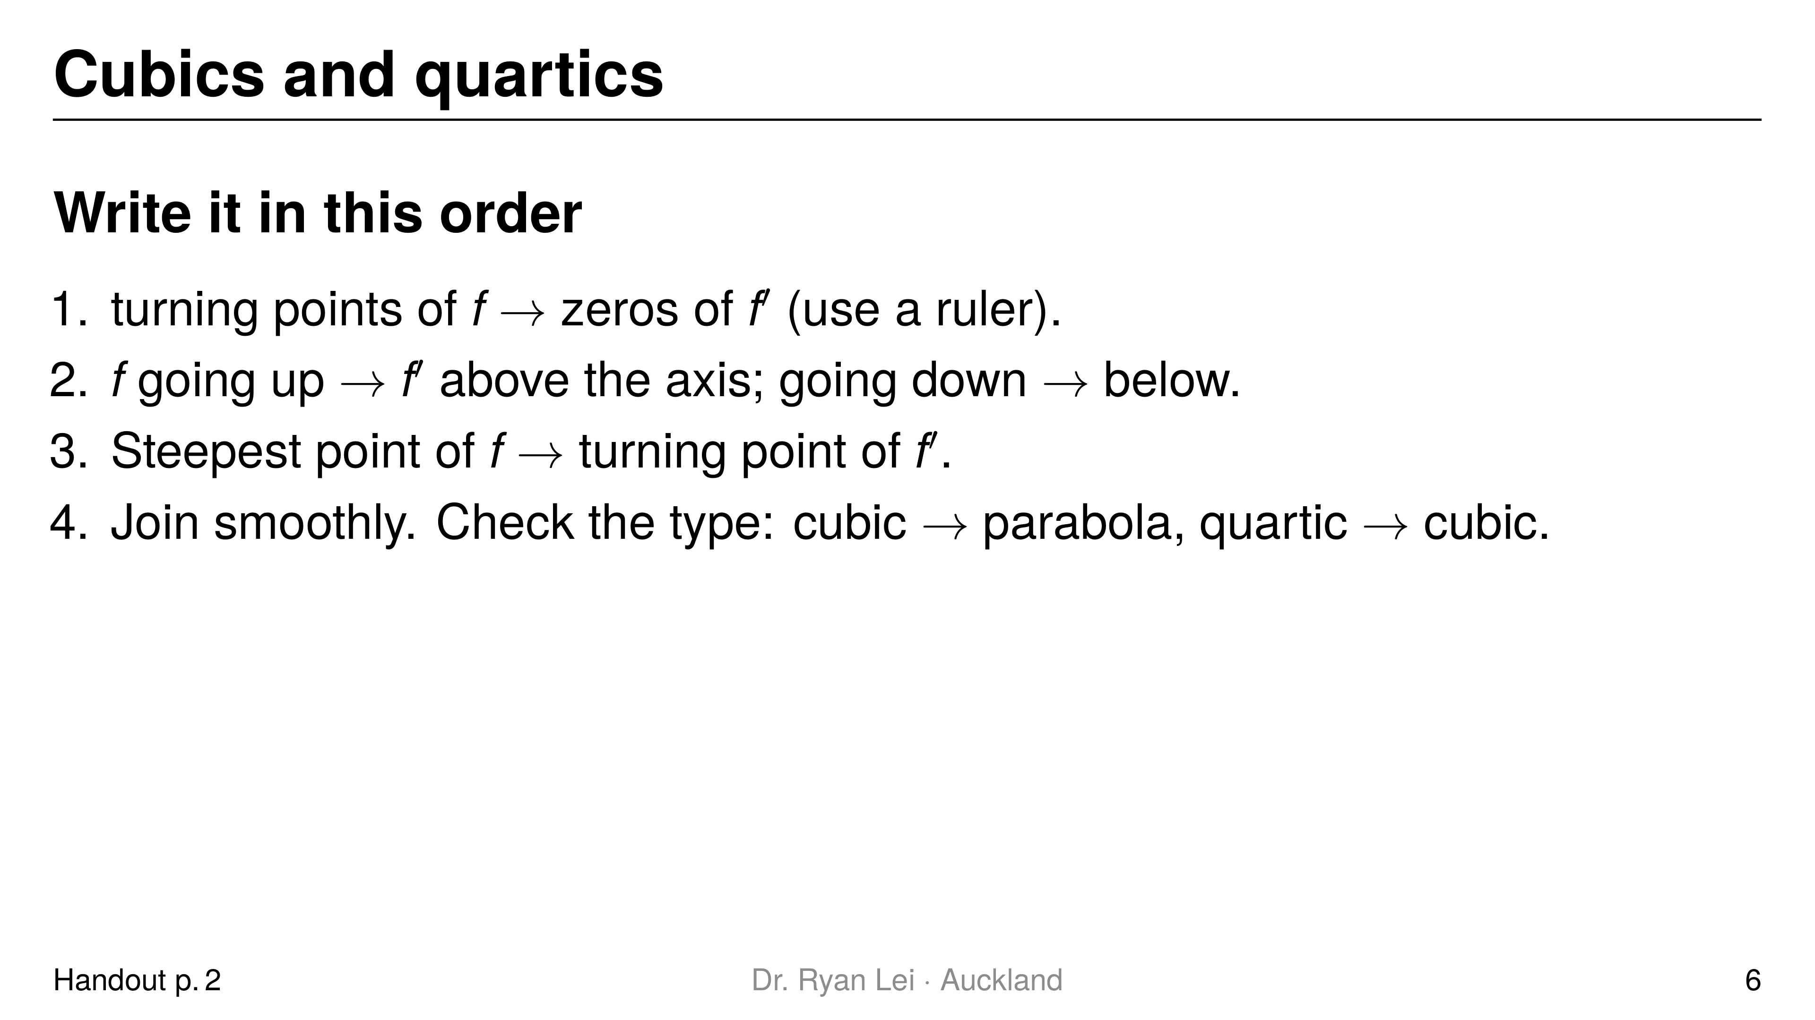
Notes:
Teaching line, not a question slide.
Model step 1 with a ruler on the whiteboard: vertical lines from each turning point down to the new axis.

Slide 7
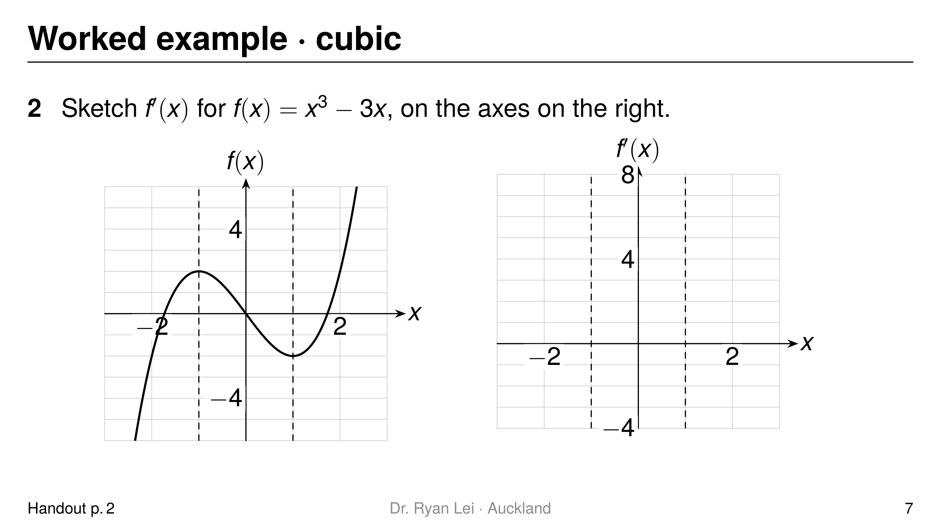
Notes:
Q2 up-parabola with zeros at $x=−1$ and $x=1$, lowest point at $x=0$
Short solution:
Q2 up, down, up gives above, below, above; $f′\left(x\right)=3x^{2}−3$, minimum $−3$
Watch for:
L4: the lowest point of $f′$ must be under the steepest downhill part of $f$ ($x=0$)

Slide 8
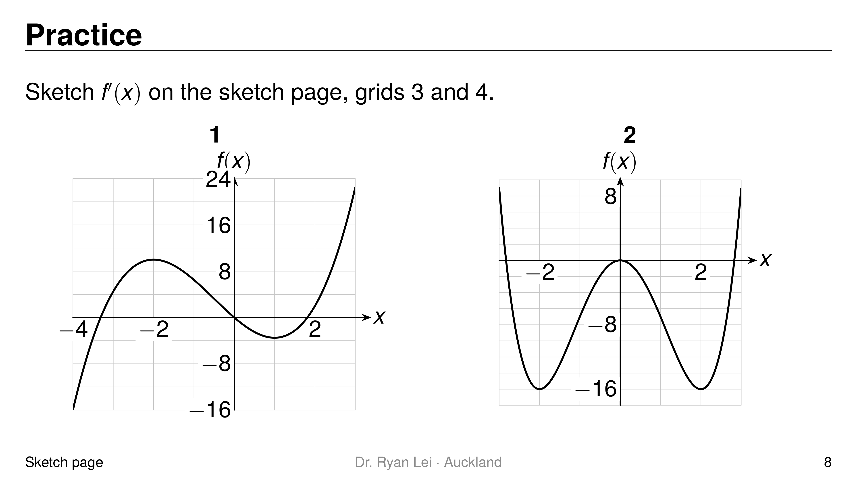
Notes:
Q1 up-parabola with zeros at $x=−2$ and $x=1$
Q2 cubic with zeros at $x=−2$, $0$ and $2$: below, above, below, above
Short solution:
Q1 maximum at $x=−2$, minimum at $x=1$; $f′\left(x\right)=3x^{2}+3x−6=3\left(x+2\right)\left(x−1\right)$
Q2 quartic with minimums at $x=±2$ and a maximum at $x=0$; $f′\left(x\right)=4x^{3}−16x$
Watch for:
Q1 lowest point of $f′$ at $x=−0.5$, halfway between the zeros
Q2 Merit: a quartic gives a cubic with three zeros

Slide 9
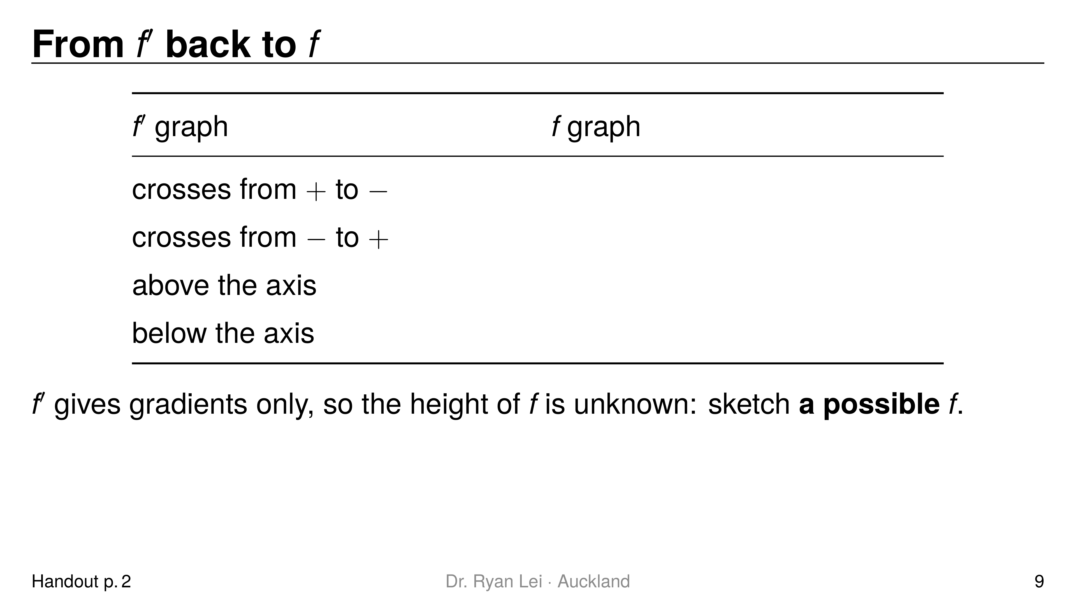
Notes:
Row 1 maximum
Row 2 minimum
Row 3 increasing
Row 4 decreasing
Short solution:
read each row from the $f′$ graph left to right
Watch for:
L5: the zeros of $f′$ are turning points of $f$, not its $x$-intercepts

Slide 10
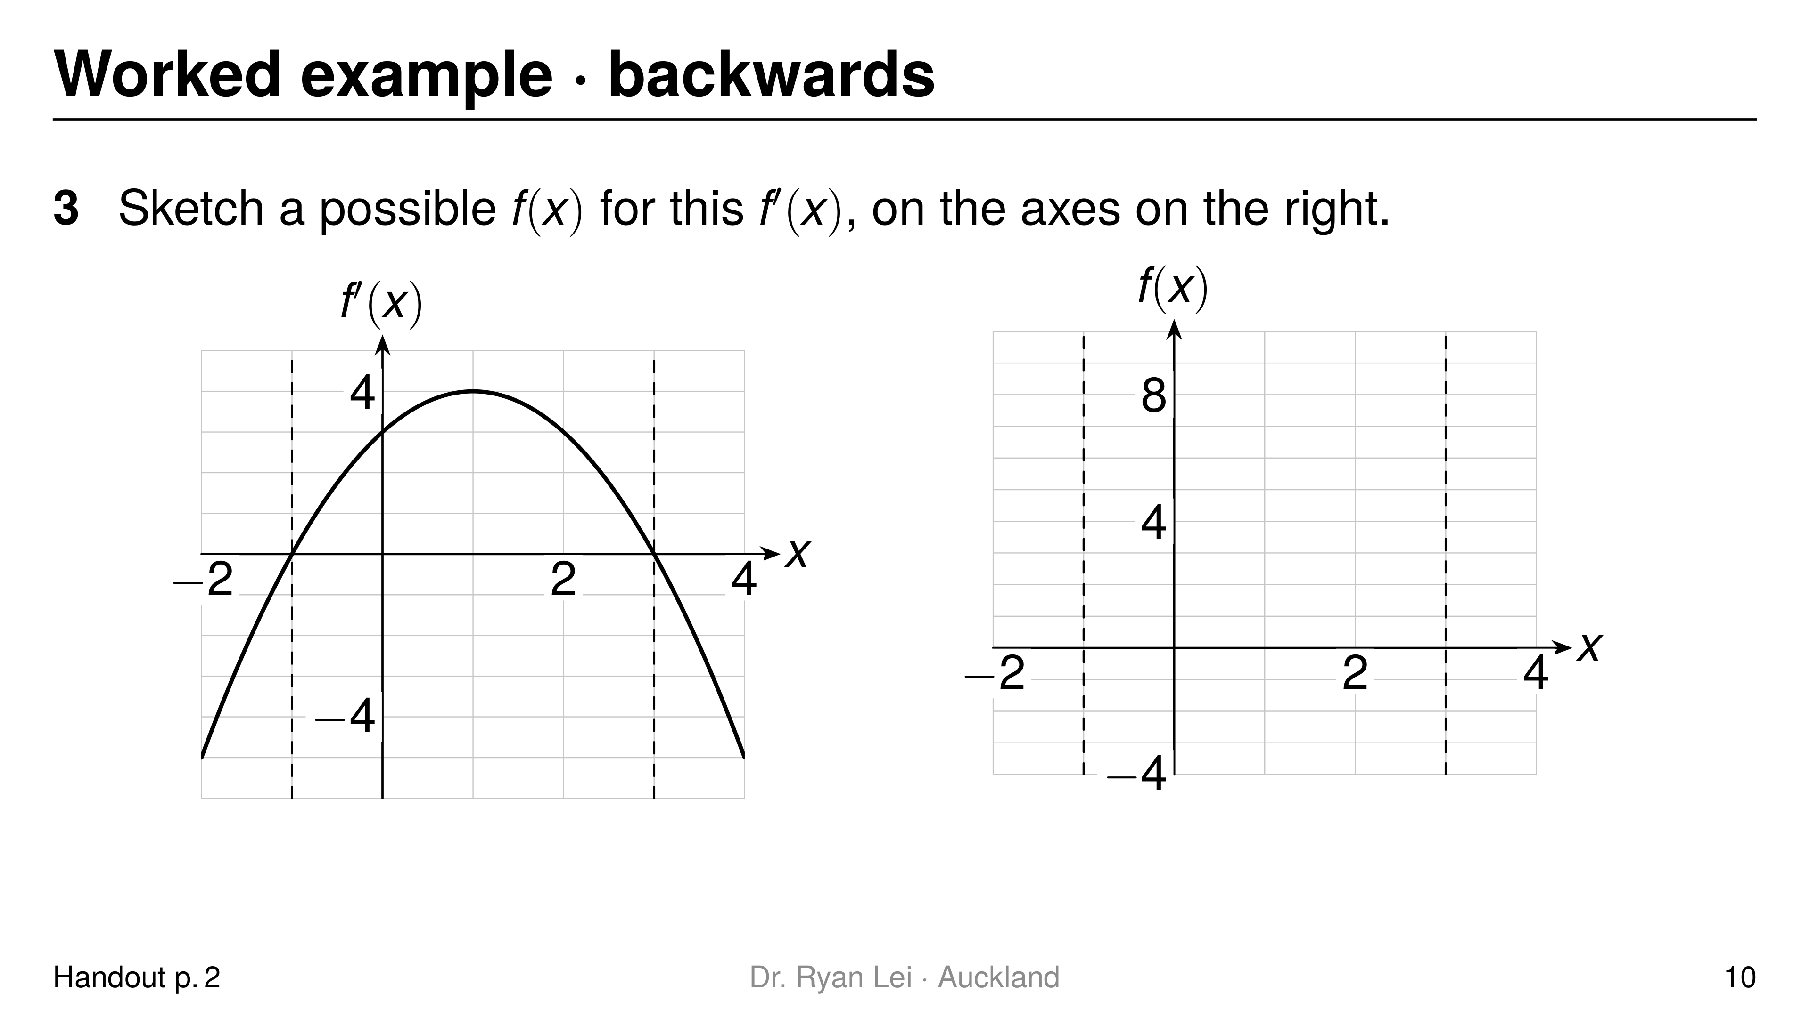
Notes:
Q3 minimum at $x=−1$, maximum at $x=3$, decreasing, increasing, decreasing
Short solution:
Q3 one possible $f\left(x\right)=−\frac{1}{3}x^{3}+x^{2}+3x$: minimum $\left(−1, −1.67\right)$, maximum $\left(3, 9\right)$
Watch for:
L5: drawing $f$ through $x=−1$ and $x=3$ on the axis

Slide 11
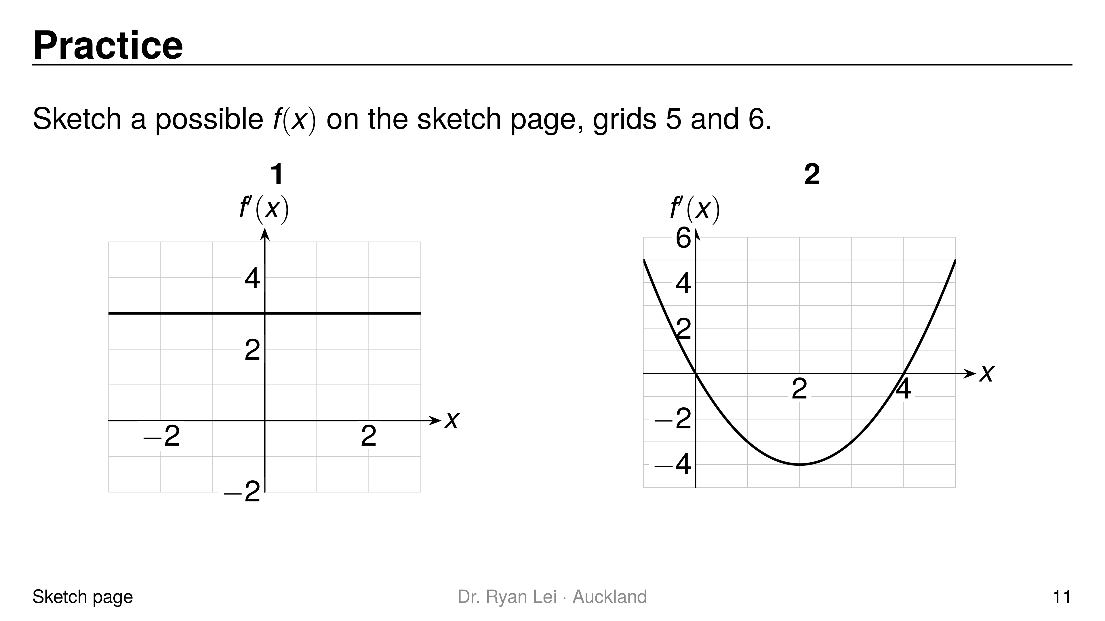
Notes:
Q1 any straight line with gradient $3$
Q2 maximum at $x=0$, minimum at $x=4$
Short solution:
Q1 $f′$ is $3$ everywhere, so $f$ rises $3$ for every $1$ across, e.g. $f\left(x\right)=3x$
Q2 $f′$ goes $+$ to $−$ at $0$ and $−$ to $+$ at $4$; one possible $f\left(x\right)=\frac{1}{3}x^{3}−2x^{2}+4$
Watch for:
Q1 drawing a horizontal line (copying $f′$)
Q2 steepest downhill at $x=2$, under the lowest point of $f′$

Slide 12
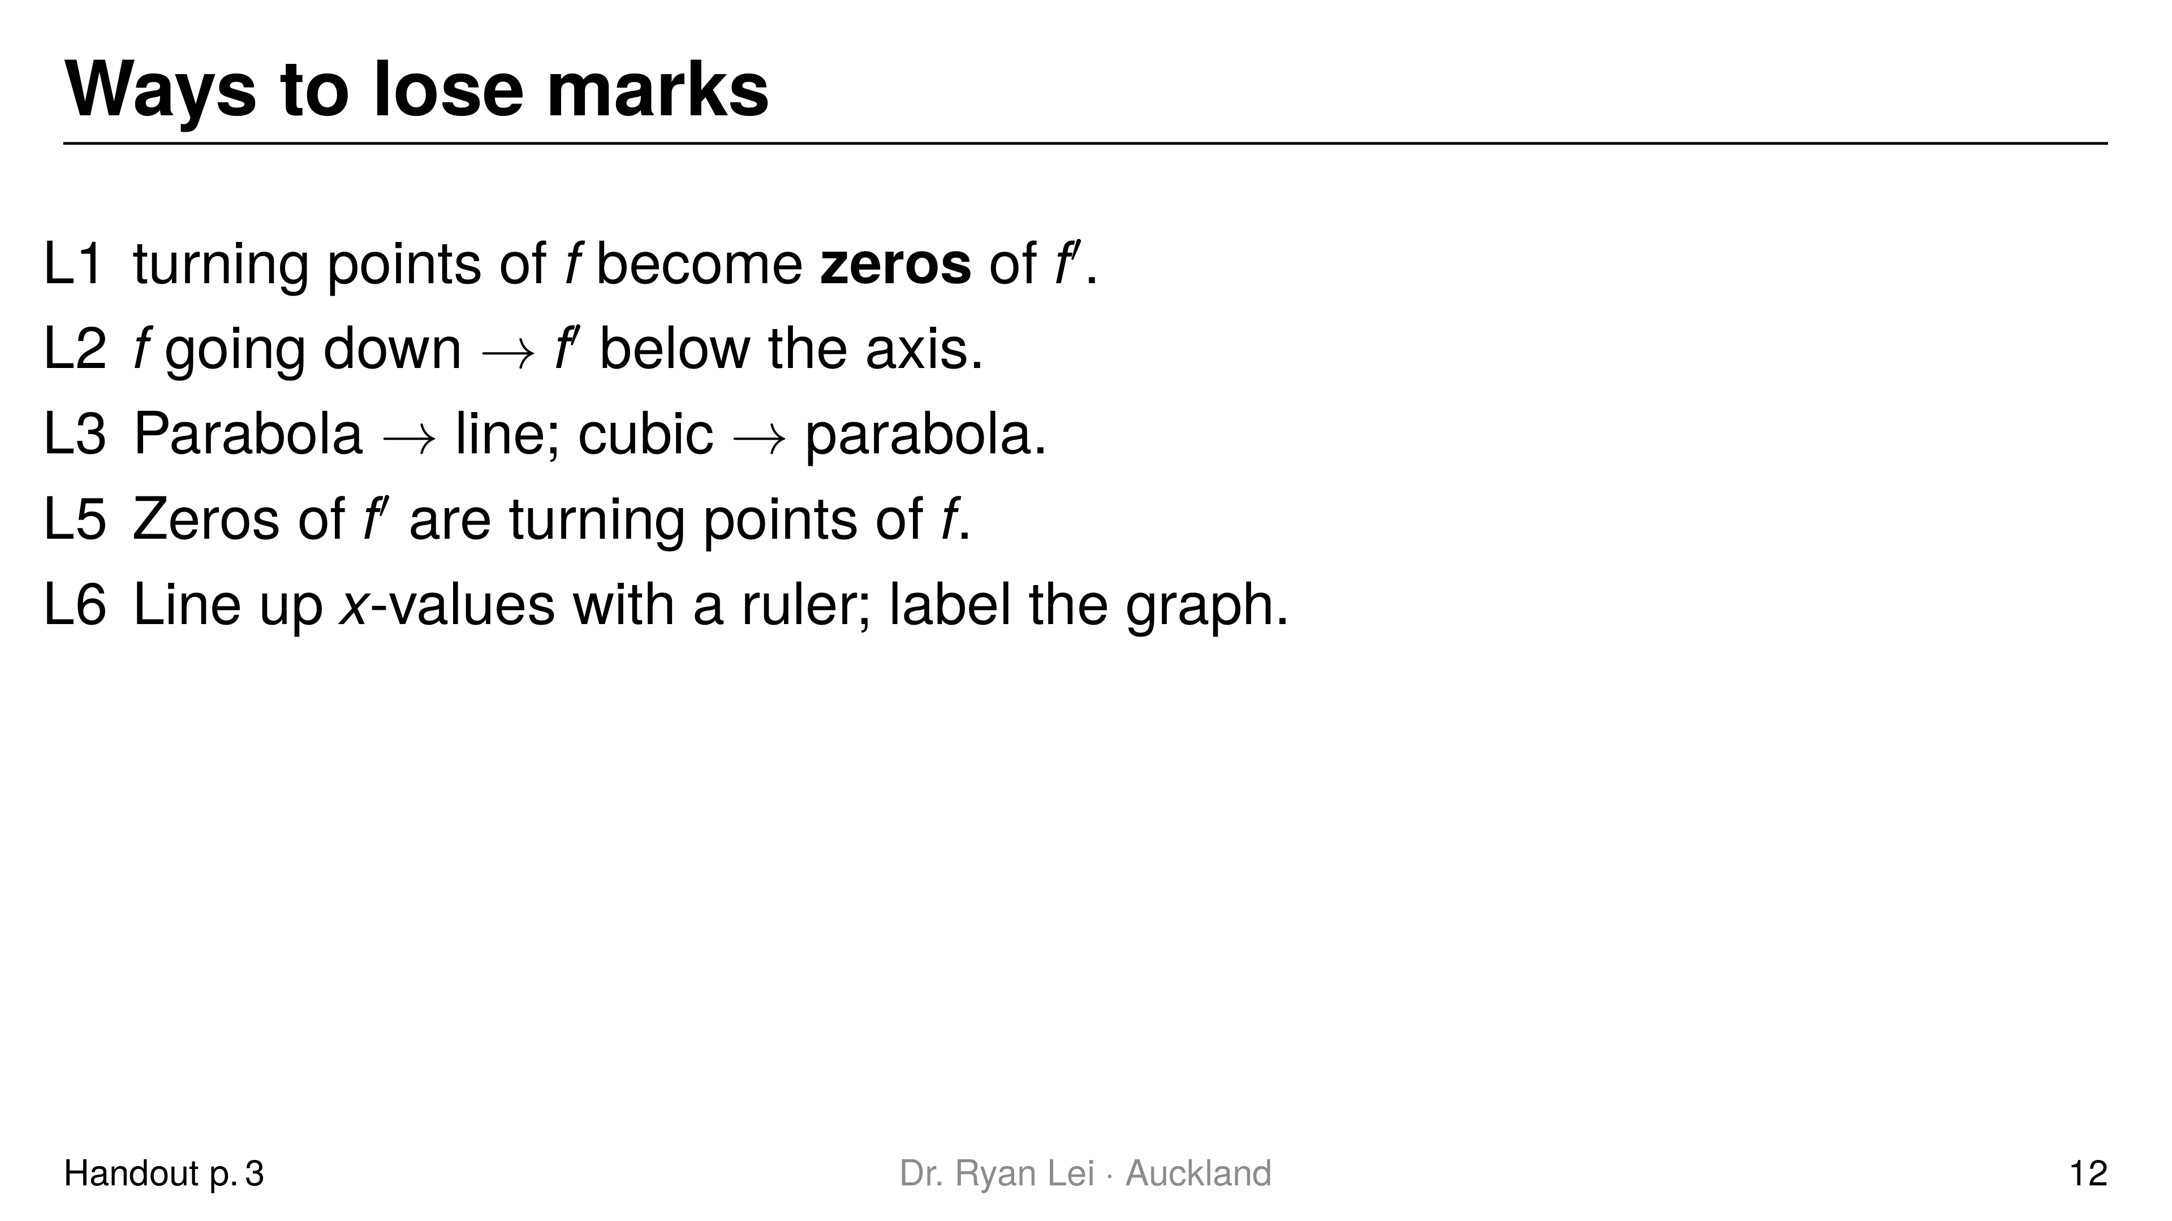
Notes:
Teaching line, not a question slide.
Full list L1 to L6 in the handout, with the versions that get no credit.

Slide 13
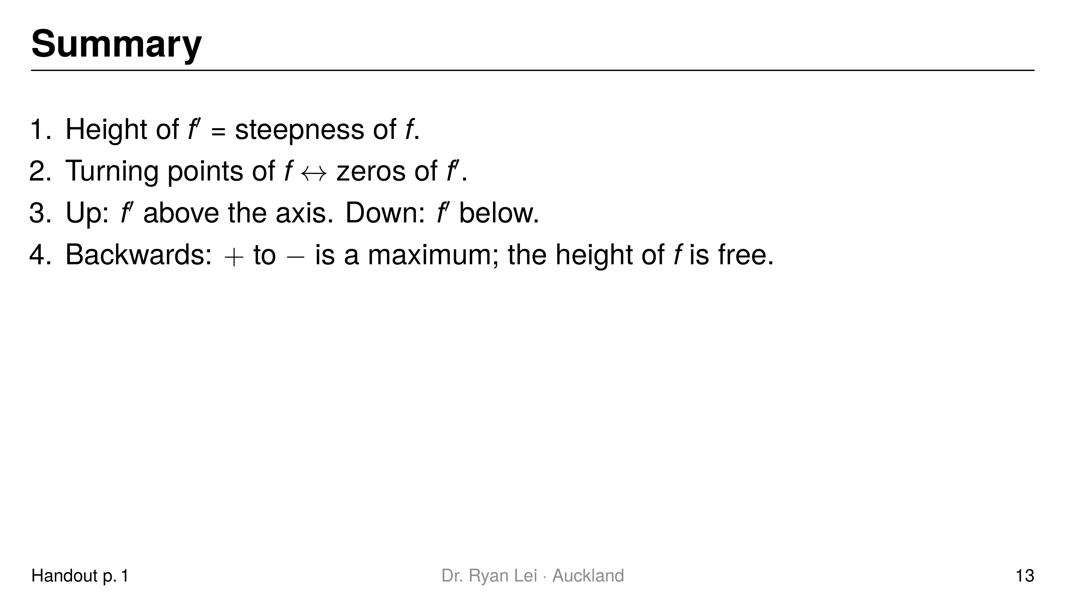
Notes:
Teaching line, not a question slide.
Ask the student to say each line back before looking at the screen.

Slide 14
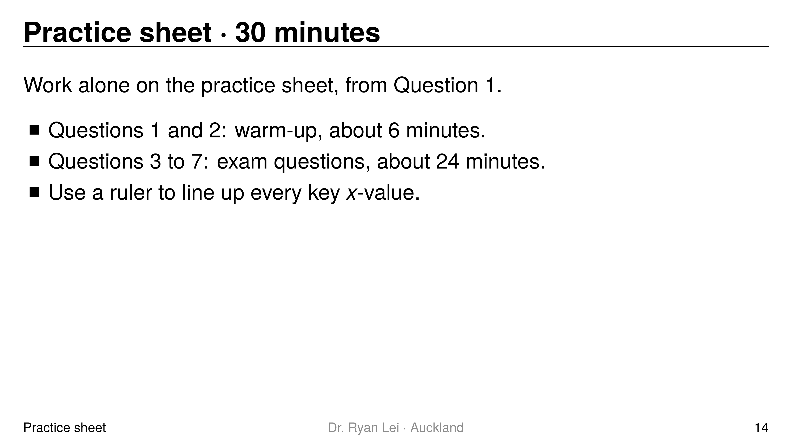
Notes:
Q1 up-parabola, zeros at $x=−1$ and $x=3$
Q2 parabola with a maximum at $x=2$
Q3 cubic: zeros under the three turning points; negative, positive, negative, positive
Q4 cubic shape: minimum under the left zero of $f′$, maximum under the right zero
Q5 negative quartic shape: maximum at $x=−3$, minimum at $x=−1$, maximum at $x=3.5$
Q6 (i) $f′=−1$, $g′=1$, $h′\left(x\right)=2x$
Q7 (ii) $p′=−1$ for $x<0$ and $p′=1$ for $x>0$; (iii) no
Short solution:
Q1 $f′\left(x\right)=x^{2}−2x−3=\left(x+1\right)\left(x−3\right)$
Q2 $f′$ is $+$ then $−$, crossing at $x=2$
Q5 $f′$ crosses $+$ to $−$ at $−3$ and $3.5$, $−$ to $+$ at $−1$
Q7 (iii) $p$ has a sharp corner at $x=0$; the gradient jumps from $−1$ to $1$, so it is not defined there, not zero
Watch for:
Q6 (i) straight lines give horizontal lines; $h′$ passes through the origin
Q7 open circles at $x=0$ on $p′$
Full working: practice answer version (tutor's working, not an official mark scheme)

Slide 15
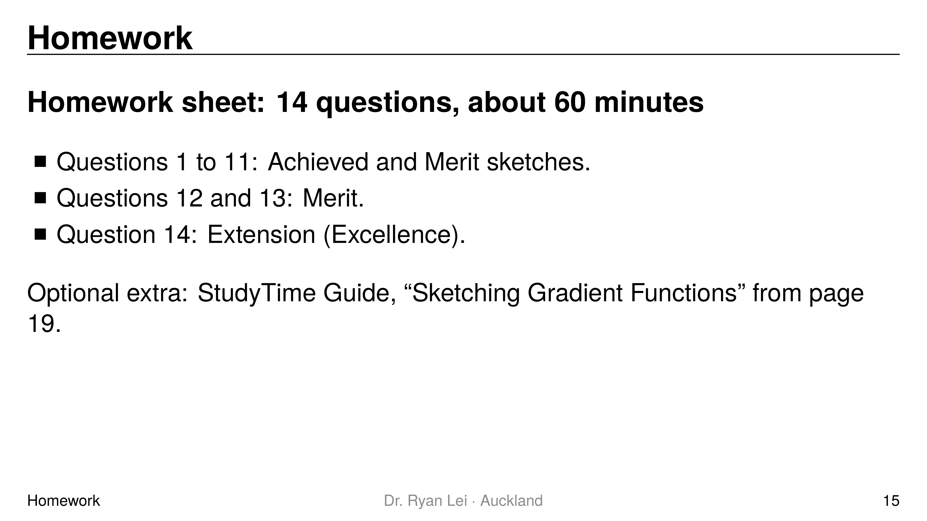
Notes:
Teaching line, not a question slide.
Answers: homework answer version (tutor's working, not an official mark scheme).
Next lesson Do Now checks one $f$ to $f′$ sketch in words.

