Slide 1
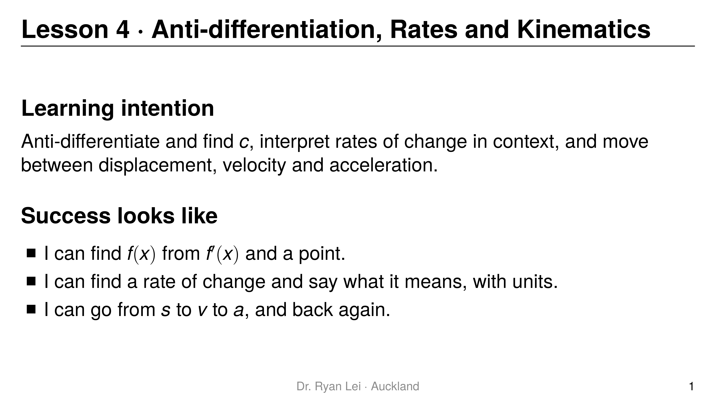
Notes:
Teaching line, not a question slide.
Timing: Do Now 10 min, three rounds about 20 min each, practice sheet 30 min, wrap-up 5 min.

Slide 2
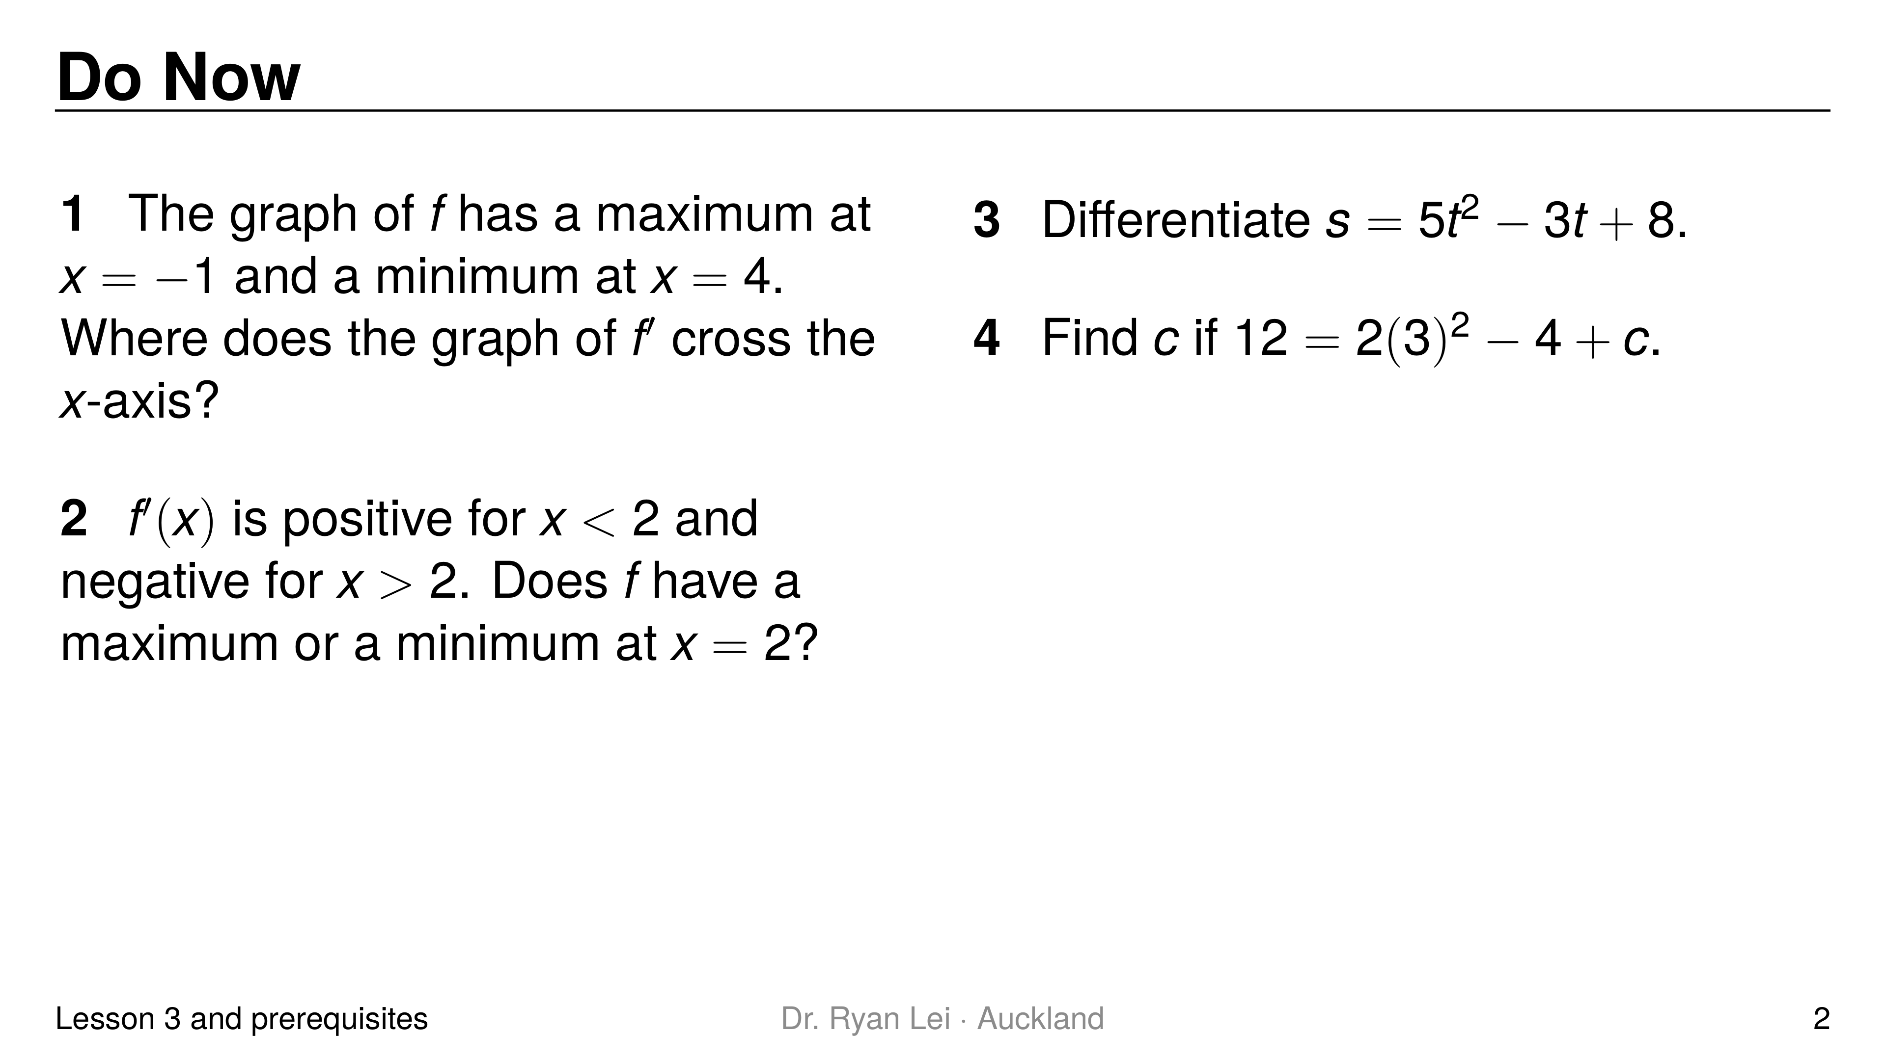
Notes:
Q1 $x=−1$ and $x=4$
Q2 maximum
Q3 $\frac{ds}{dt}=10t−3$
Q4 $c=−2$
Short solution:
Q2 gradient $+$ then $−$: up then down
Q4 $12=18−4+c$
Watch for:
Q3 the variable is $t$: same rule, different letter
Diagnostic:
Q1 or Q2 wrong: Lesson 3 link between turning points and zeros of $f′$ not secure; revisit before homework
Q3 wrong: a letter other than $x$ throws the student; say “$t$ works exactly like $x$”
Q4 wrong: finding $c$ will be slow today; model one more example in round 1

Slide 3
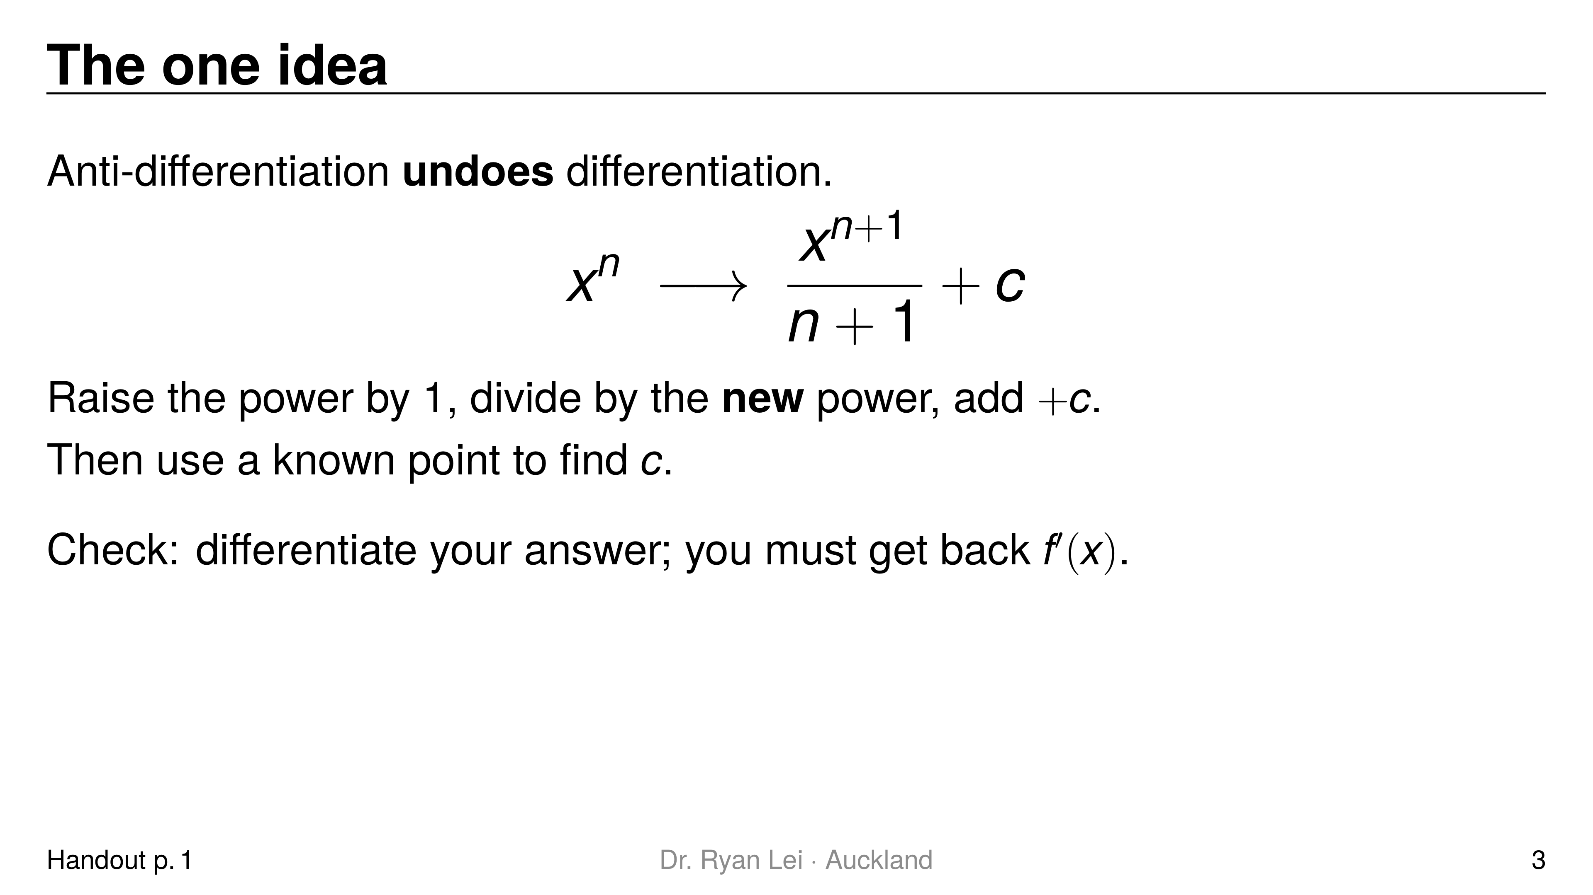
Notes:
Teaching line, not a question slide.
Ask: differentiate $2x+3$ and $2x+10$. Both give $2$, so going back we cannot know the constant: that is $c$.

Slide 4
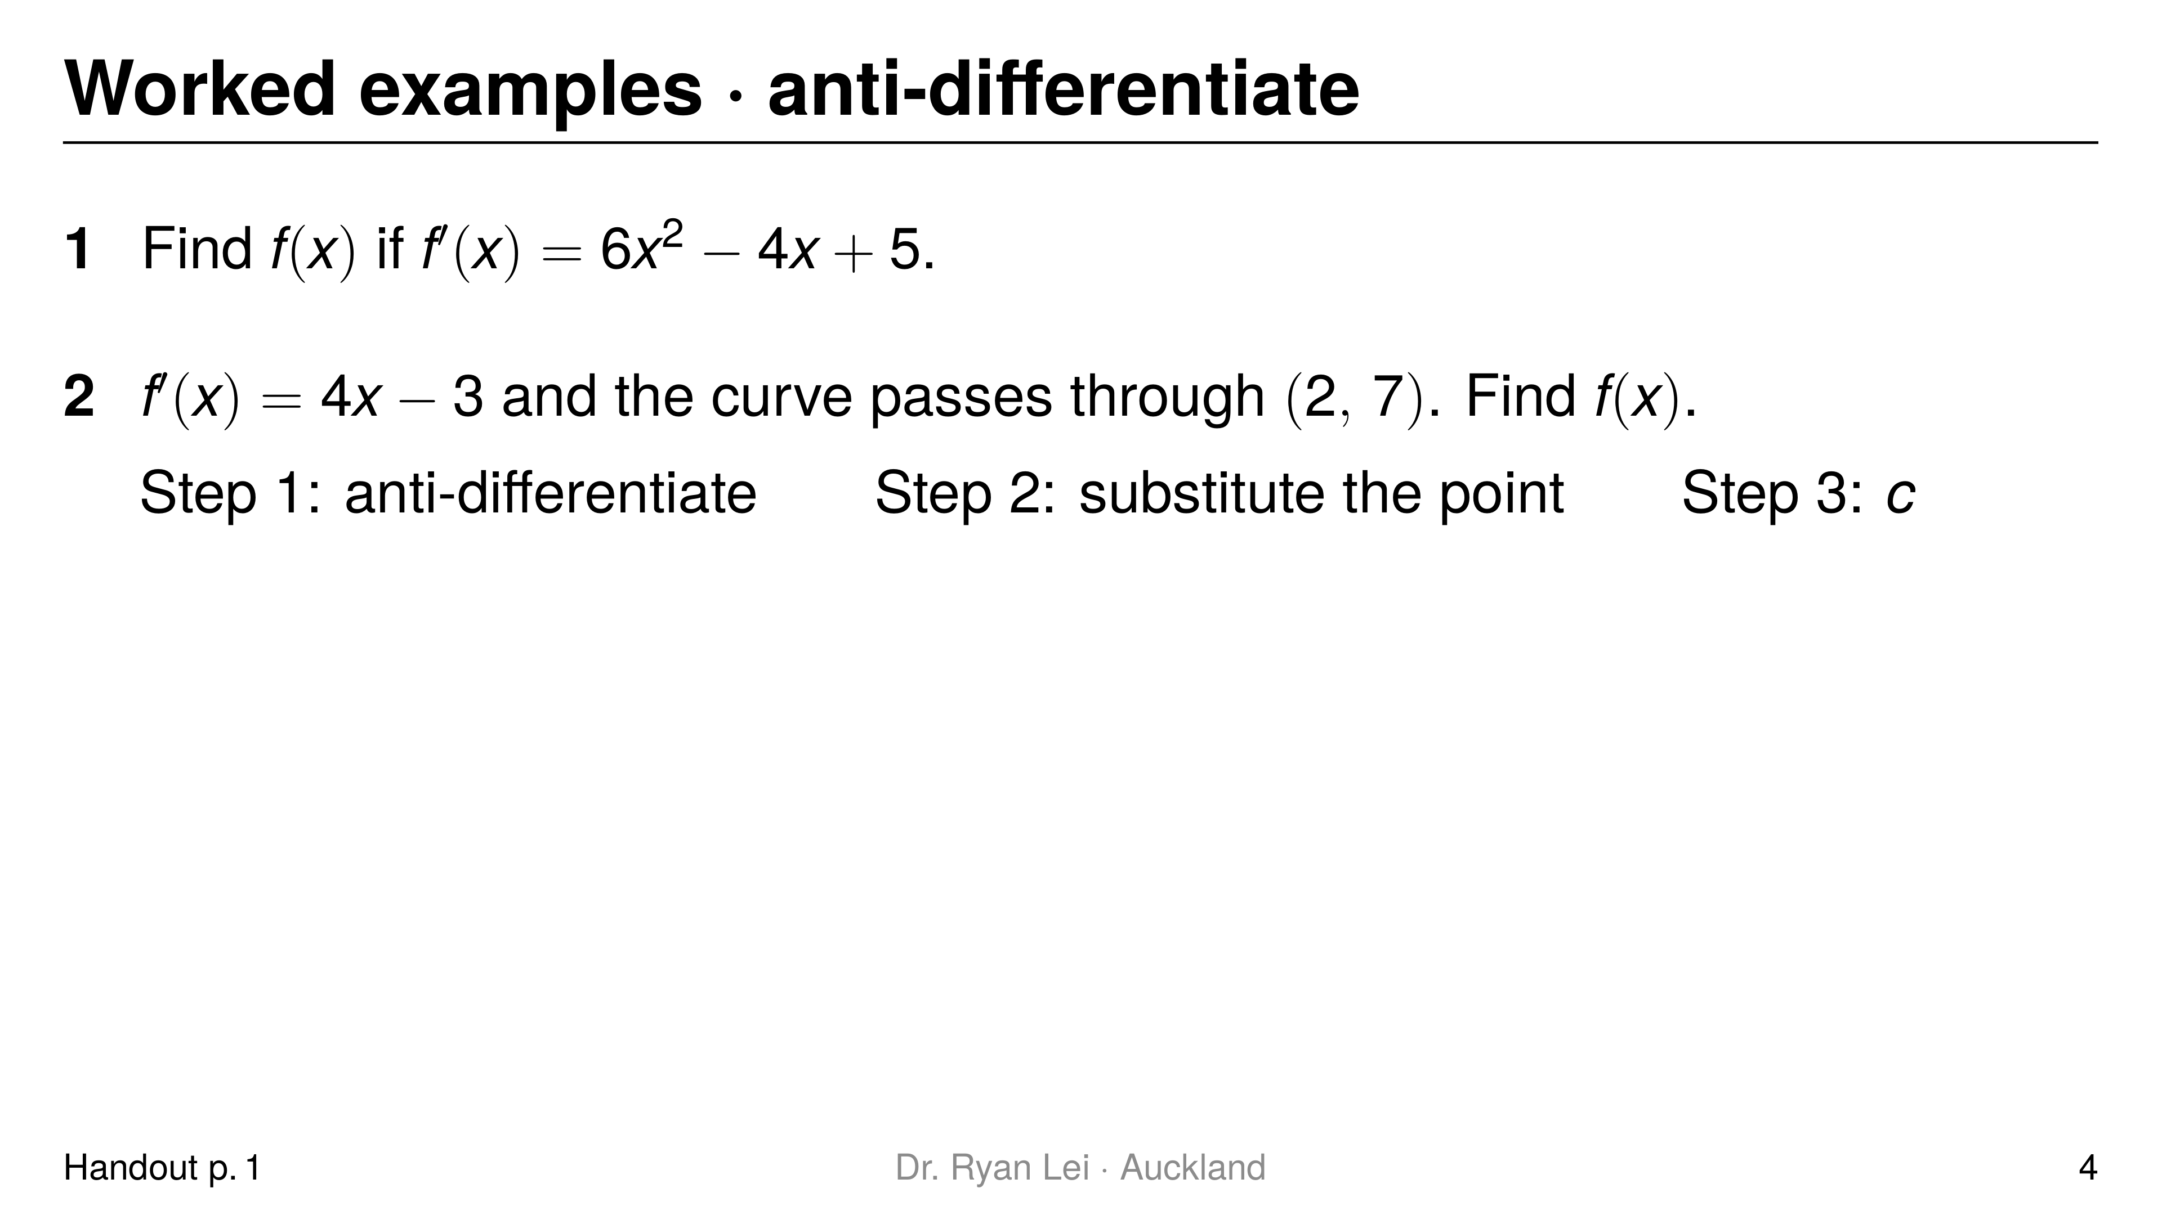
Notes:
Q1 $f\left(x\right)=2x^{3}−2x^{2}+5x+c$
Q2 $f\left(x\right)=2x^{2}−3x+5$
Short solution:
Q1 $\frac{6x^{3}}{3}−\frac{4x^{2}}{2}+5x$
Q2 $7=2\left(4\right)−6+c=2+c$, so $c=5$
Watch for:
L2: $6x^{2}→\frac{6x^{3}}{2}$ (old power)
L1: leaving $c$ in the final answer to Q2

Slide 5
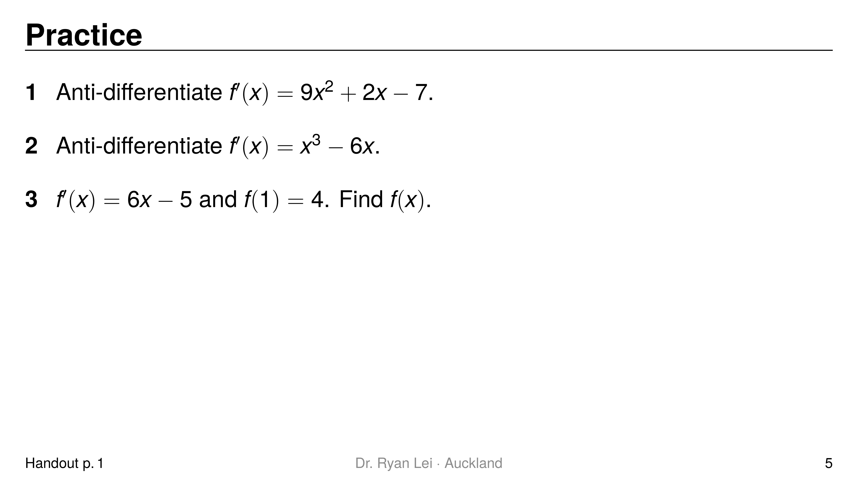
Notes:
Q1 $f\left(x\right)=3x^{3}+x^{2}−7x+c$
Q2 $f\left(x\right)=\frac{1}{4}x^{4}−3x^{2}+c$
Q3 $f\left(x\right)=3x^{2}−5x+6$
Short solution:
Q2 $\frac{x^{4}}{4}−\frac{6x^{2}}{2}$
Q3 $f\left(x\right)=3x^{2}−5x+c$; $3−5+c=4$
Watch for:
Q1 the constant term: $−7→−7x$
Q3 “$f\left(1\right)=4$” is the point $\left(1, 4\right)$

Slide 6
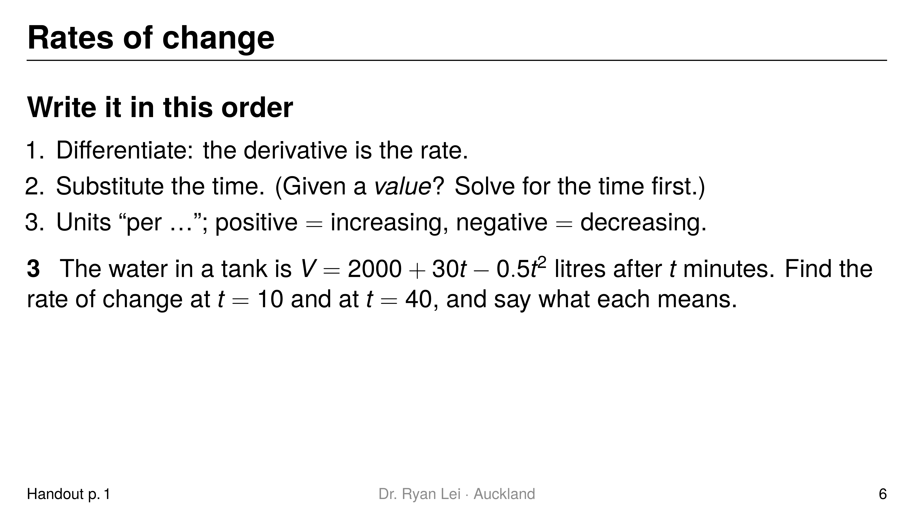
Notes:
Q3 $t=10$: increasing at $20$ litres per minute; $t=40$: decreasing at $10$ litres per minute
Short solution:
Q3 $\frac{dV}{dt}=30−t$
Watch for:
L3: substituting into $V$ gives the amount of water, not the rate
L4: “$−10$” alone is not an interpretation

Slide 7
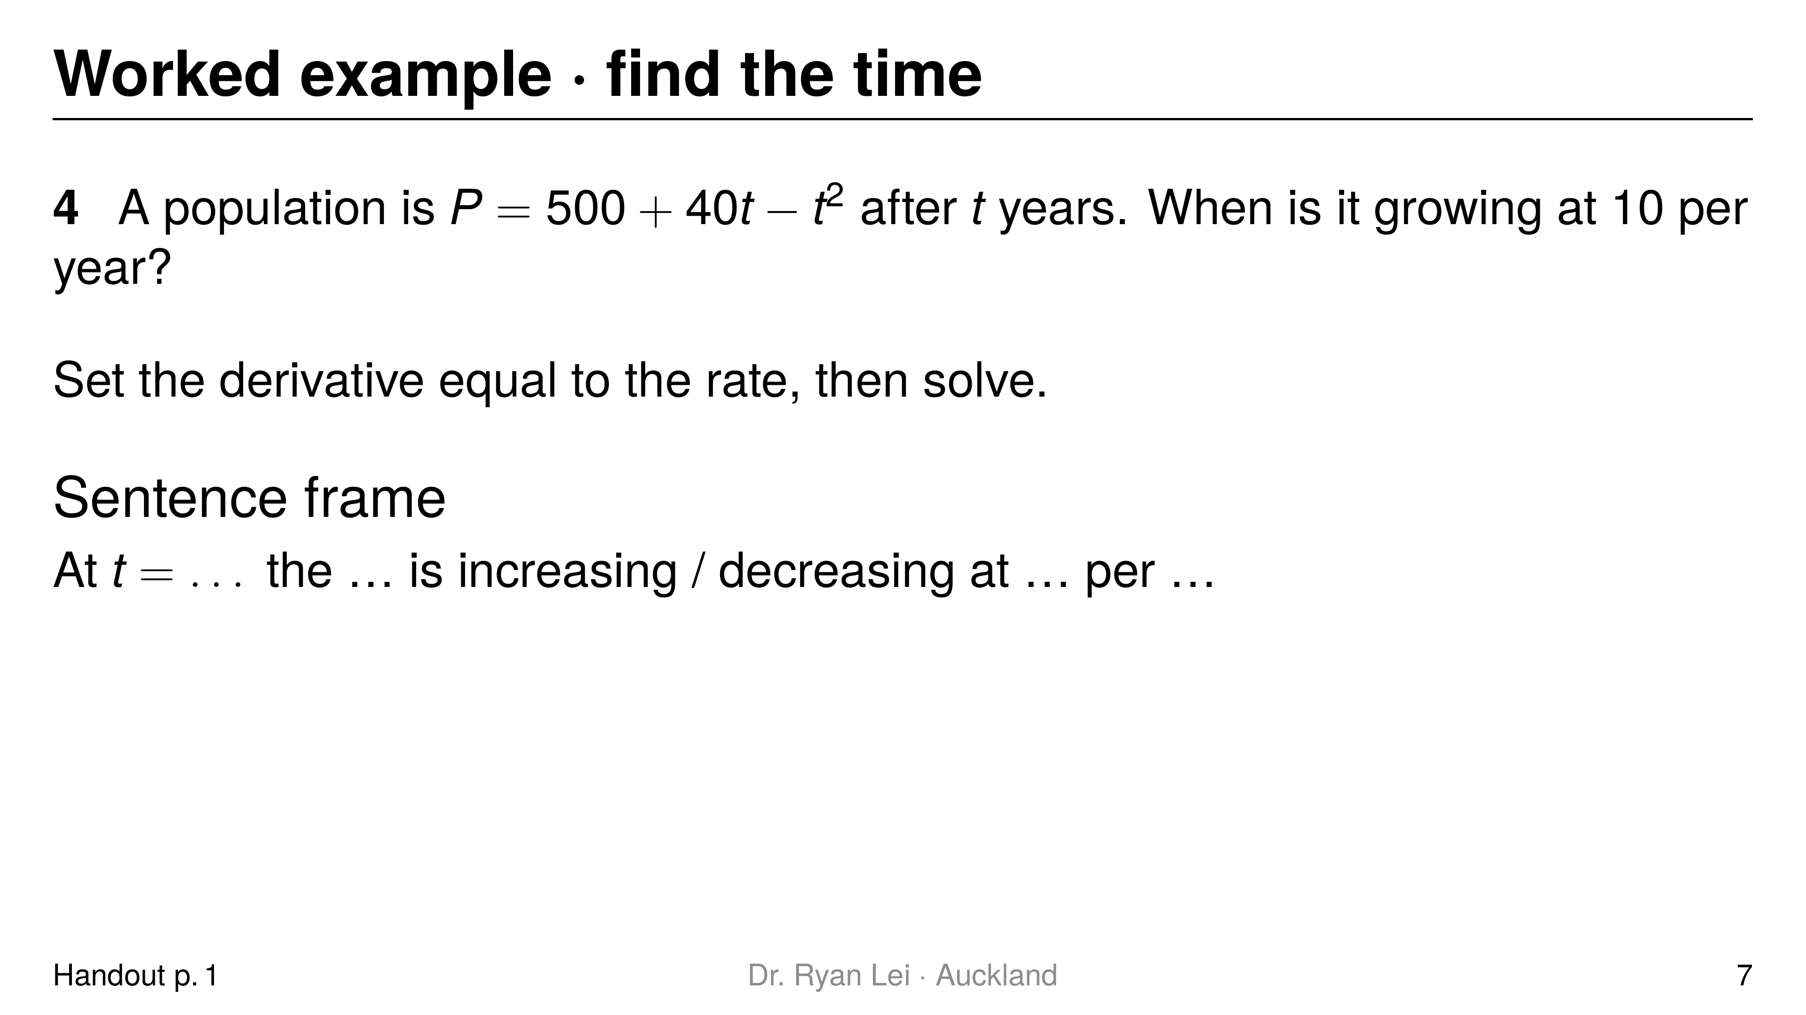
Notes:
Q4 $t=15$ years
Short solution:
Q4 $\frac{dP}{dt}=40−2t=10$
Watch for:
setting $P=10$ instead of $\frac{dP}{dt}=10$ (L3)

Slide 8
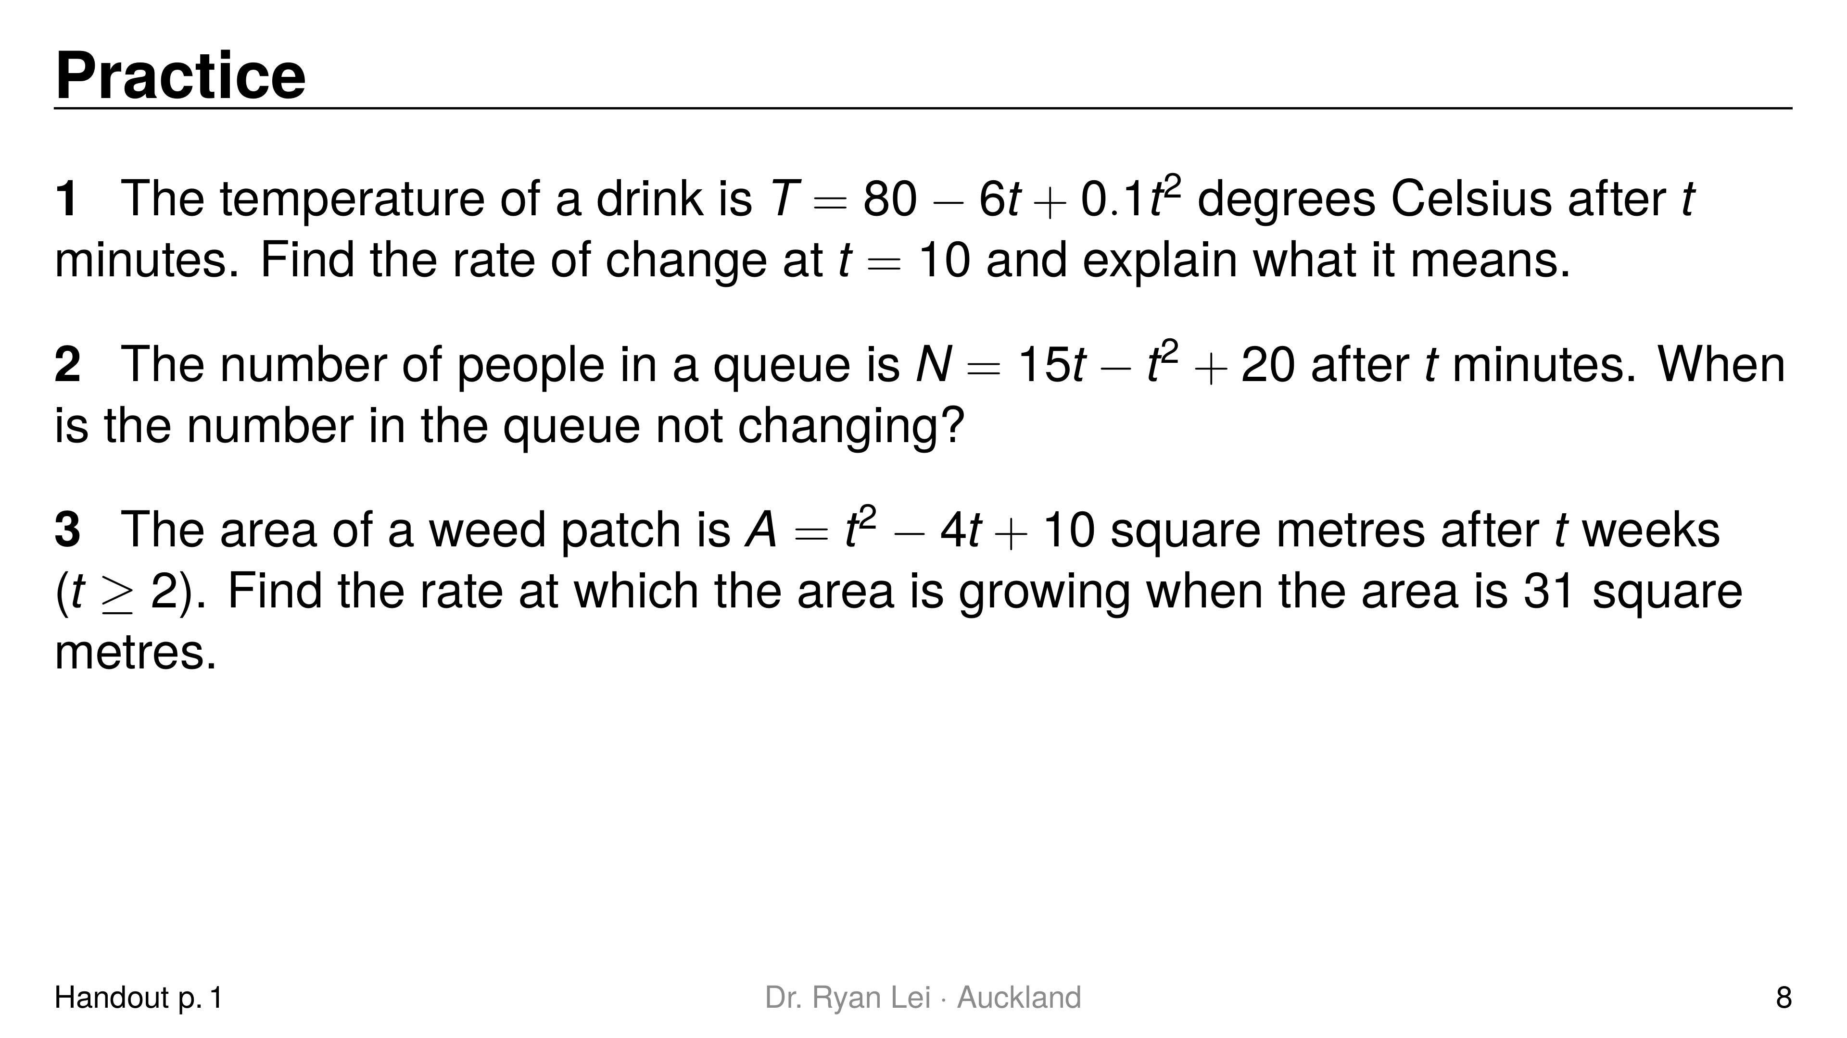
Notes:
Q1 $−4$: cooling at $4$ degrees per minute
Q2 $t=7.5$ minutes
Q3 $10$ square metres per week
Short solution:
Q1 $\frac{dT}{dt}=−6+0.2t$; at $t=10$: $−4$
Q2 $\frac{dN}{dt}=15−2t=0$
Q3 $t^{2}−4t+10=31$, so $t^{2}−4t−21=0$, $t=7$; $\frac{dA}{dt}=2t−4=10$
Watch for:
Q3 Merit: solve for the time first; reject $t=−3$ ($t≥2$)

Slide 9
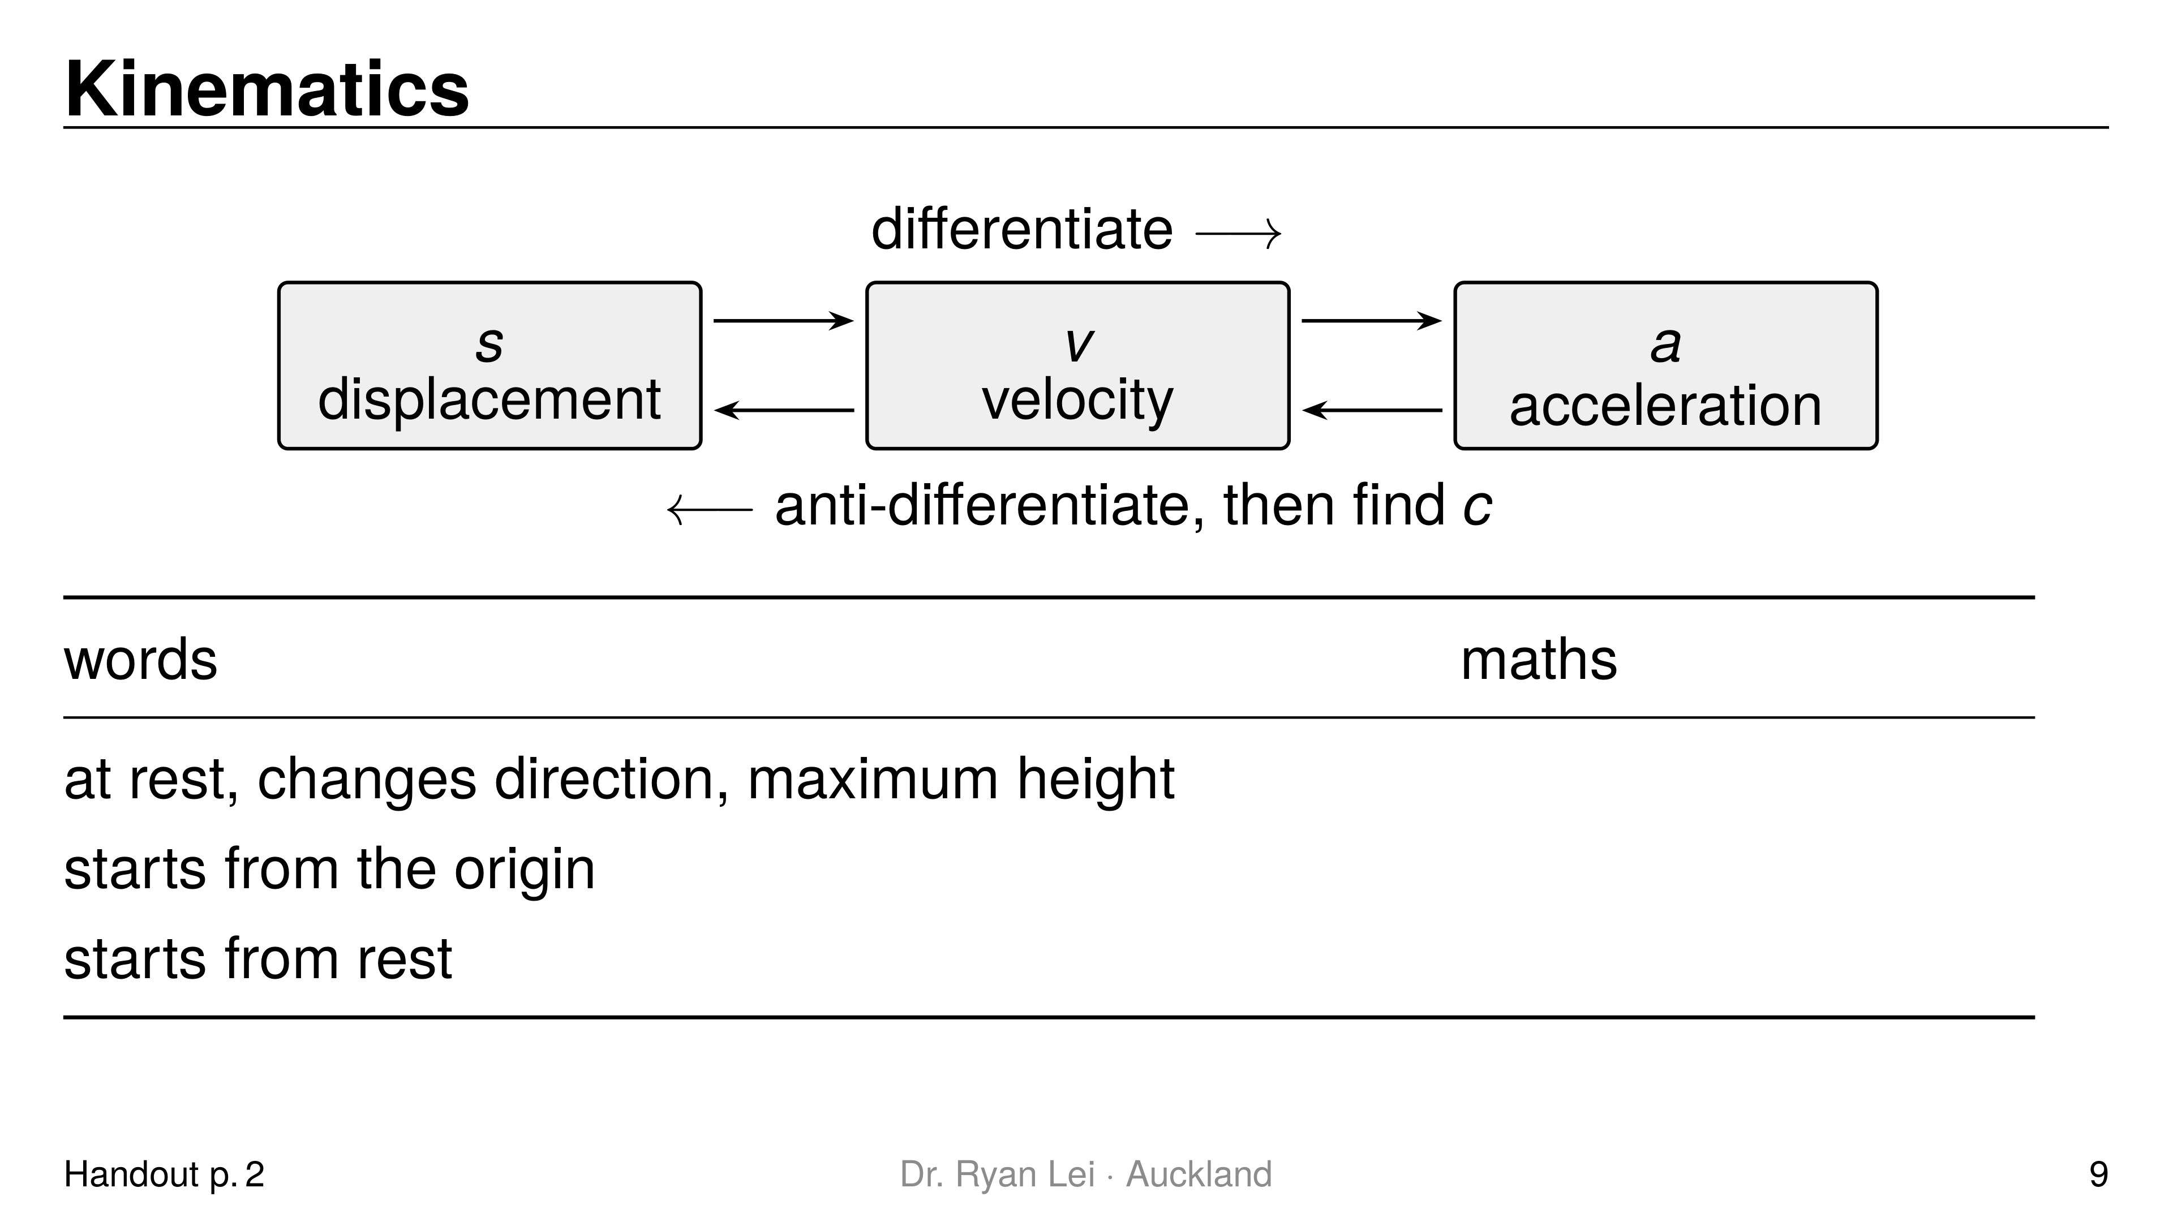
Notes:
Row 1 $v=0$
Row 2 $s=0$ when $t=0$
Row 3 $v=0$ when $t=0$
Short solution:
right: differentiate ($s→v→a$); left: anti-differentiate and find each $c$
Watch for:
L5: maximum height is $v=0$, not $a=0$

Slide 10
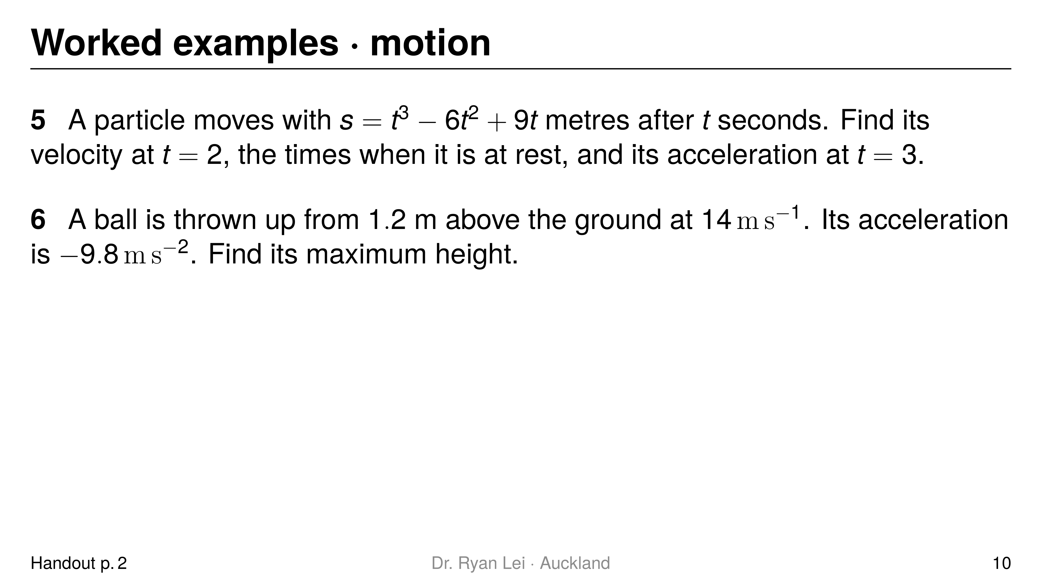
Notes:
Q5 $v\left(2\right)=−3 m s^{−1}$; at rest at $t=1$ and $t=3$; $a\left(3\right)=6 m s^{−2}$
Q6 $11.2$ m
Short solution:
Q5 $v=3t^{2}−12t+9=3\left(t−1\right)\left(t−3\right)$; $a=6t−12$
Q6 $v=−9.8t+14$; $s=−4.9t^{2}+14t+1.2$; $v=0$ at $t=1.4286$
Watch for:
Q5 a negative velocity means moving backwards, not an error
Q6 two constants: $v\left(0\right)=14$ and $s\left(0\right)=1.2$

Slide 11
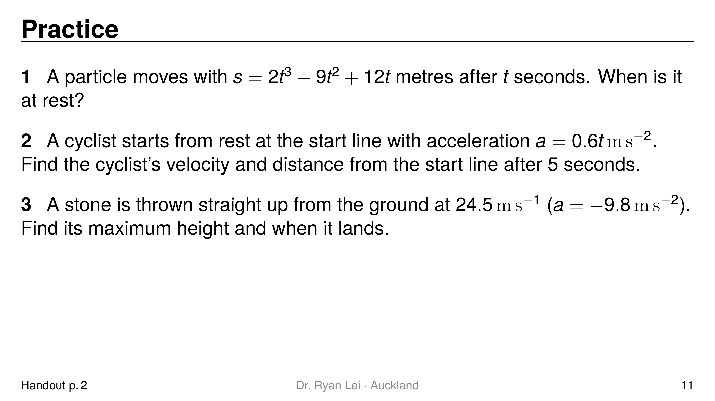
Notes:
Q1 $t=1$ s and $t=2$ s
Q2 $7.5 m s^{−1}$; $12.5$ m
Q3 $30.6$ m; lands at $t=5$ s
Short solution:
Q1 $v=6t^{2}−18t+12=6\left(t−1\right)\left(t−2\right)$
Q2 $v=0.3t^{2}$ (from rest), $s=0.1t^{3}$ (from the start line)
Q3 $v=24.5−9.8t=0$ at $t=2.5$; $s=24.5t−4.9t^{2}$; $s=0$ at $t=5$
Watch for:
Q2 both constants are $0$ here; say why
Q3 Merit: “when it lands” is $s=0$, the second root

Slide 12
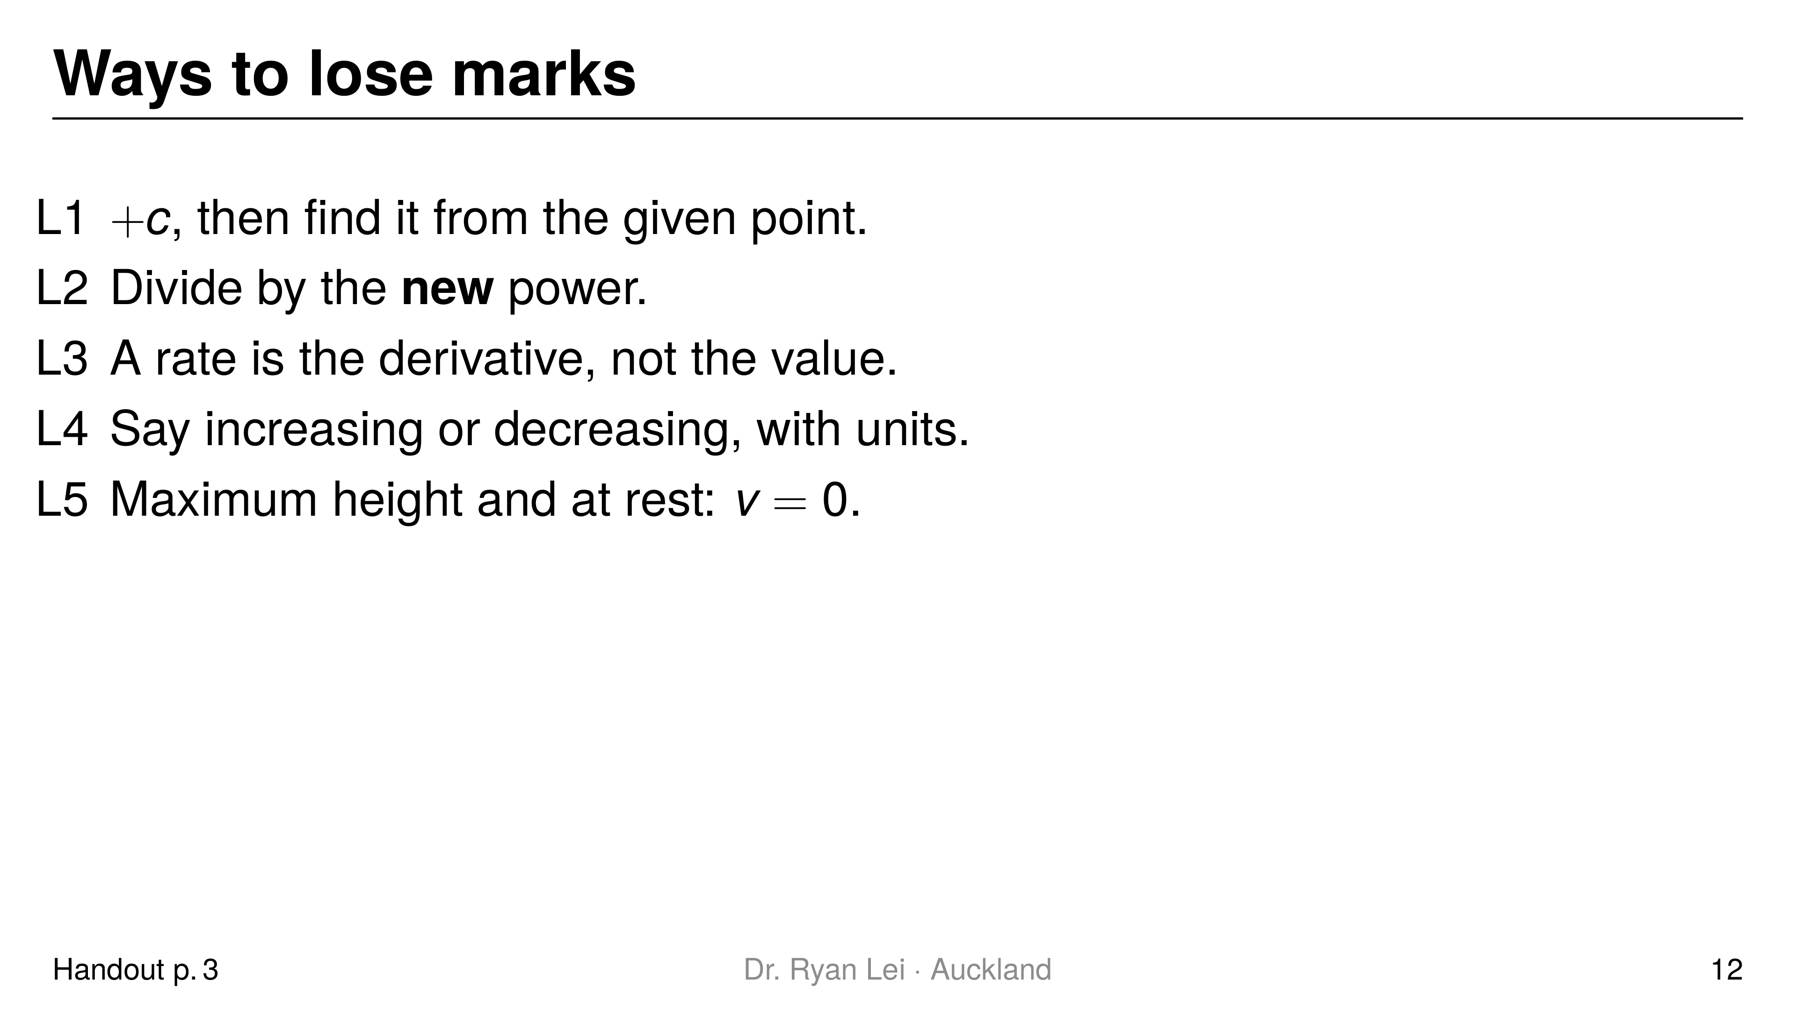
Notes:
Teaching line, not a question slide.
Full list L1 to L6 in the handout; L6 (distance and displacement) is the homework extension.

Slide 13
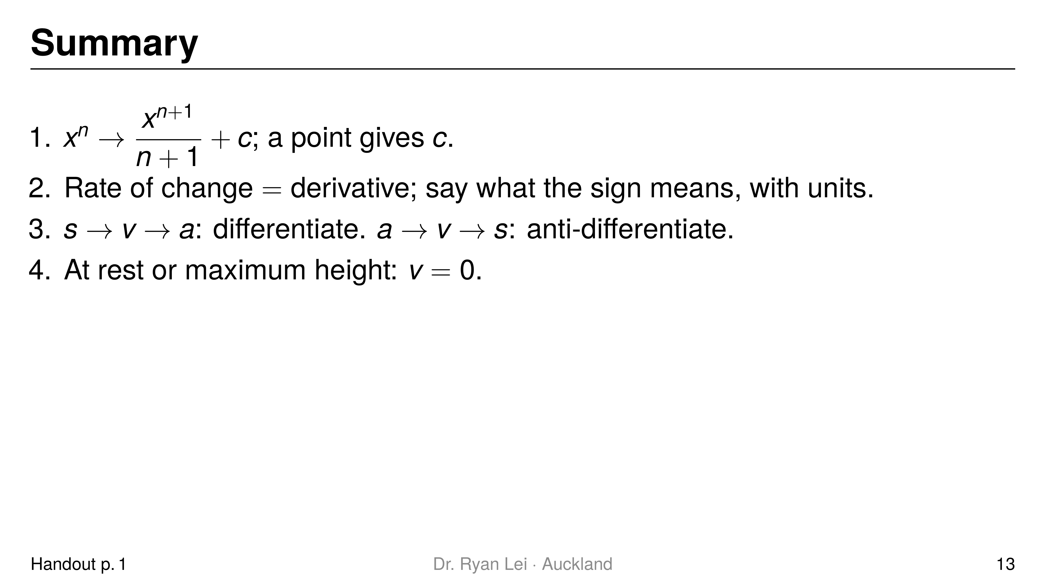
Notes:
Teaching line, not a question slide.
Ask the student to say each line back before looking at the screen.

Slide 14
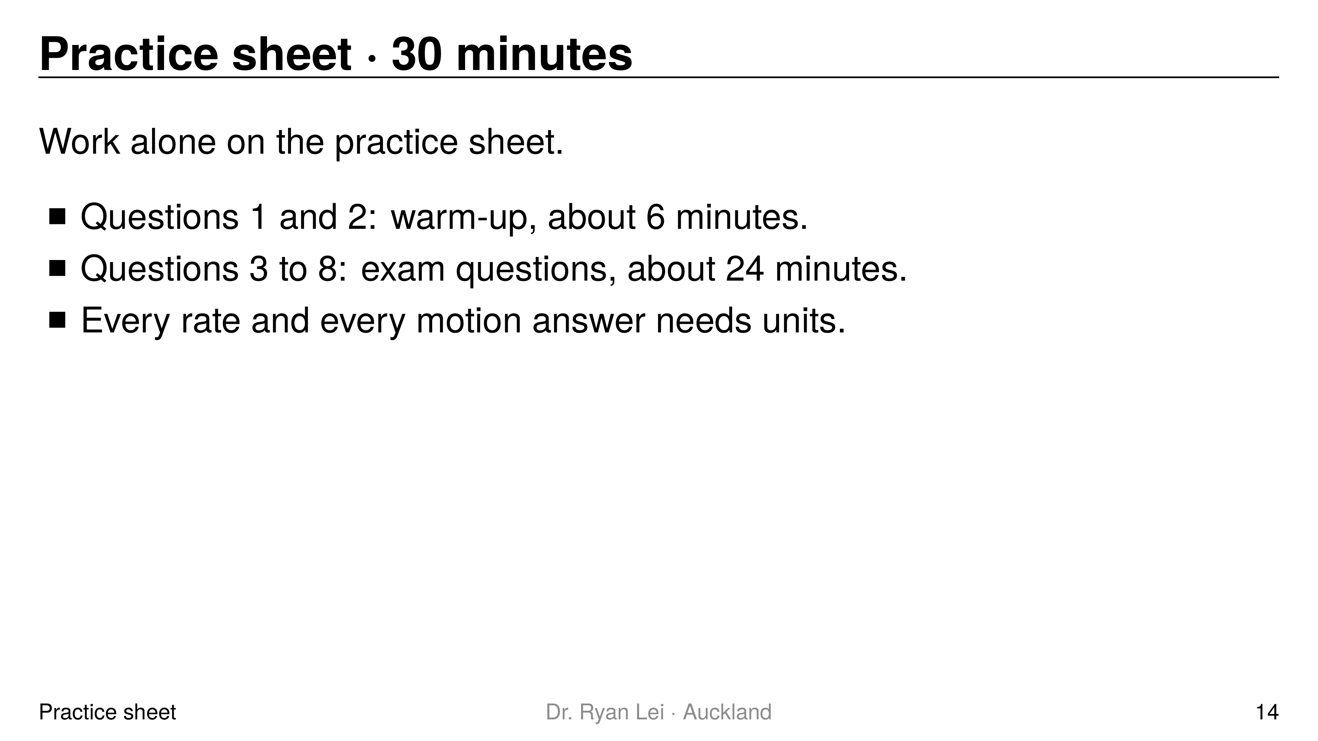
Notes:
Q1 $f\left(x\right)=4x^{3}−x^{2}+3x+4$
Q2 $s\left(3\right)=20$ m; at rest at $t=4$ s
Q3 $\left(2, 23\right)$
Q4 $f\left(x\right)=\frac{2}{3}x^{3}−3x^{2}+4x+1$
Q5 $5.7$ m
Q6 $−7 m s^{−1}$
Q7 $26.2$ m above the water
Q8 (i) $P′\left(6\right)=−528$; (ii) decreasing at $528$ people per hour
Short solution:
Q3 $f\left(x\right)=2x^{3}+2.5x^{2}−x+c$; $f\left(1\right)=2.5$ gives $c=−1$
Q4 $f\left(3\right)=12−27+18+c=4$, so $c=1$
Q5 $s=0.1t^{3}+t$ with $s\left(0\right)=0$
Q7 lands at $t=2.6$; cliff $25.844$ m; top at $t=0.2857$
Watch for:
Q7 Excellence: needs the cliff height first; heights are above the water
Q8 (ii) people are leaving: the crowd is shrinking
Full working: practice answer version (tutor's working, not an official mark scheme)

Slide 15
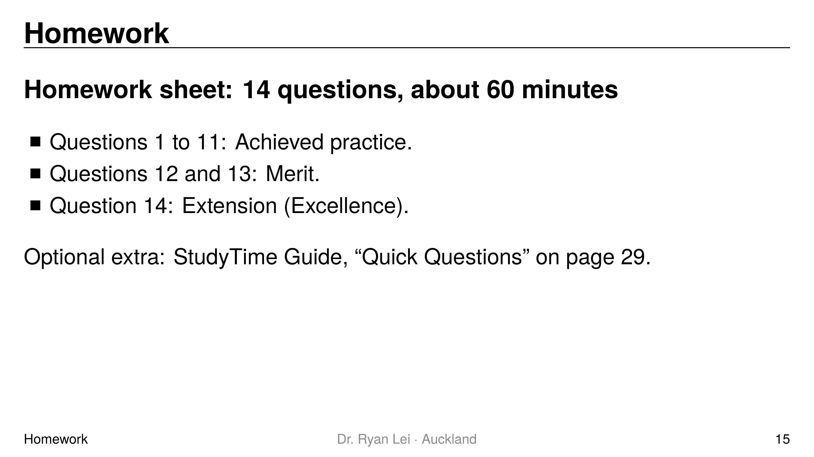
Notes:
Teaching line, not a question slide.
Answers: homework answer version (tutor's working, not an official mark scheme).
Next lesson is the mixed practice lesson; its Do Now covers all four lessons.

