Slide 1
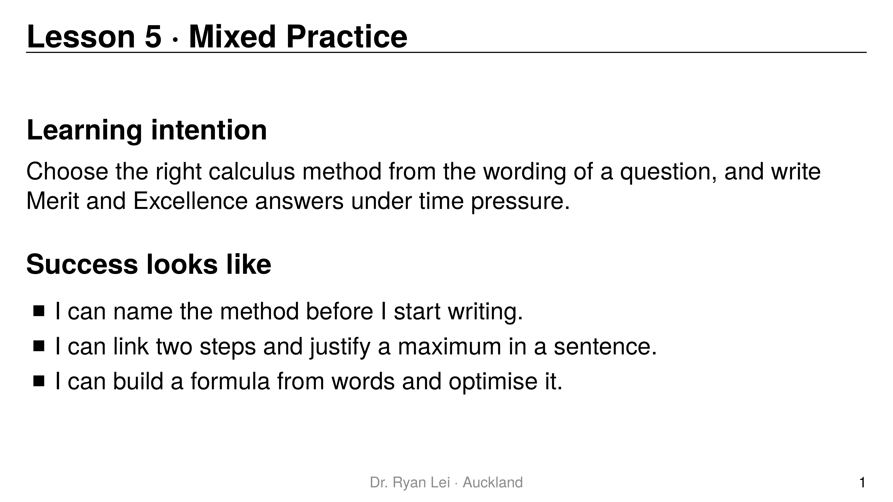
Notes:
Teaching line, not a question slide.
Timing: Do Now 10 min, three rounds about 20 min each, timed practice sheet 30 min, wrap-up 5 min.
The handout is the exam guide: point to it throughout.

Slide 2
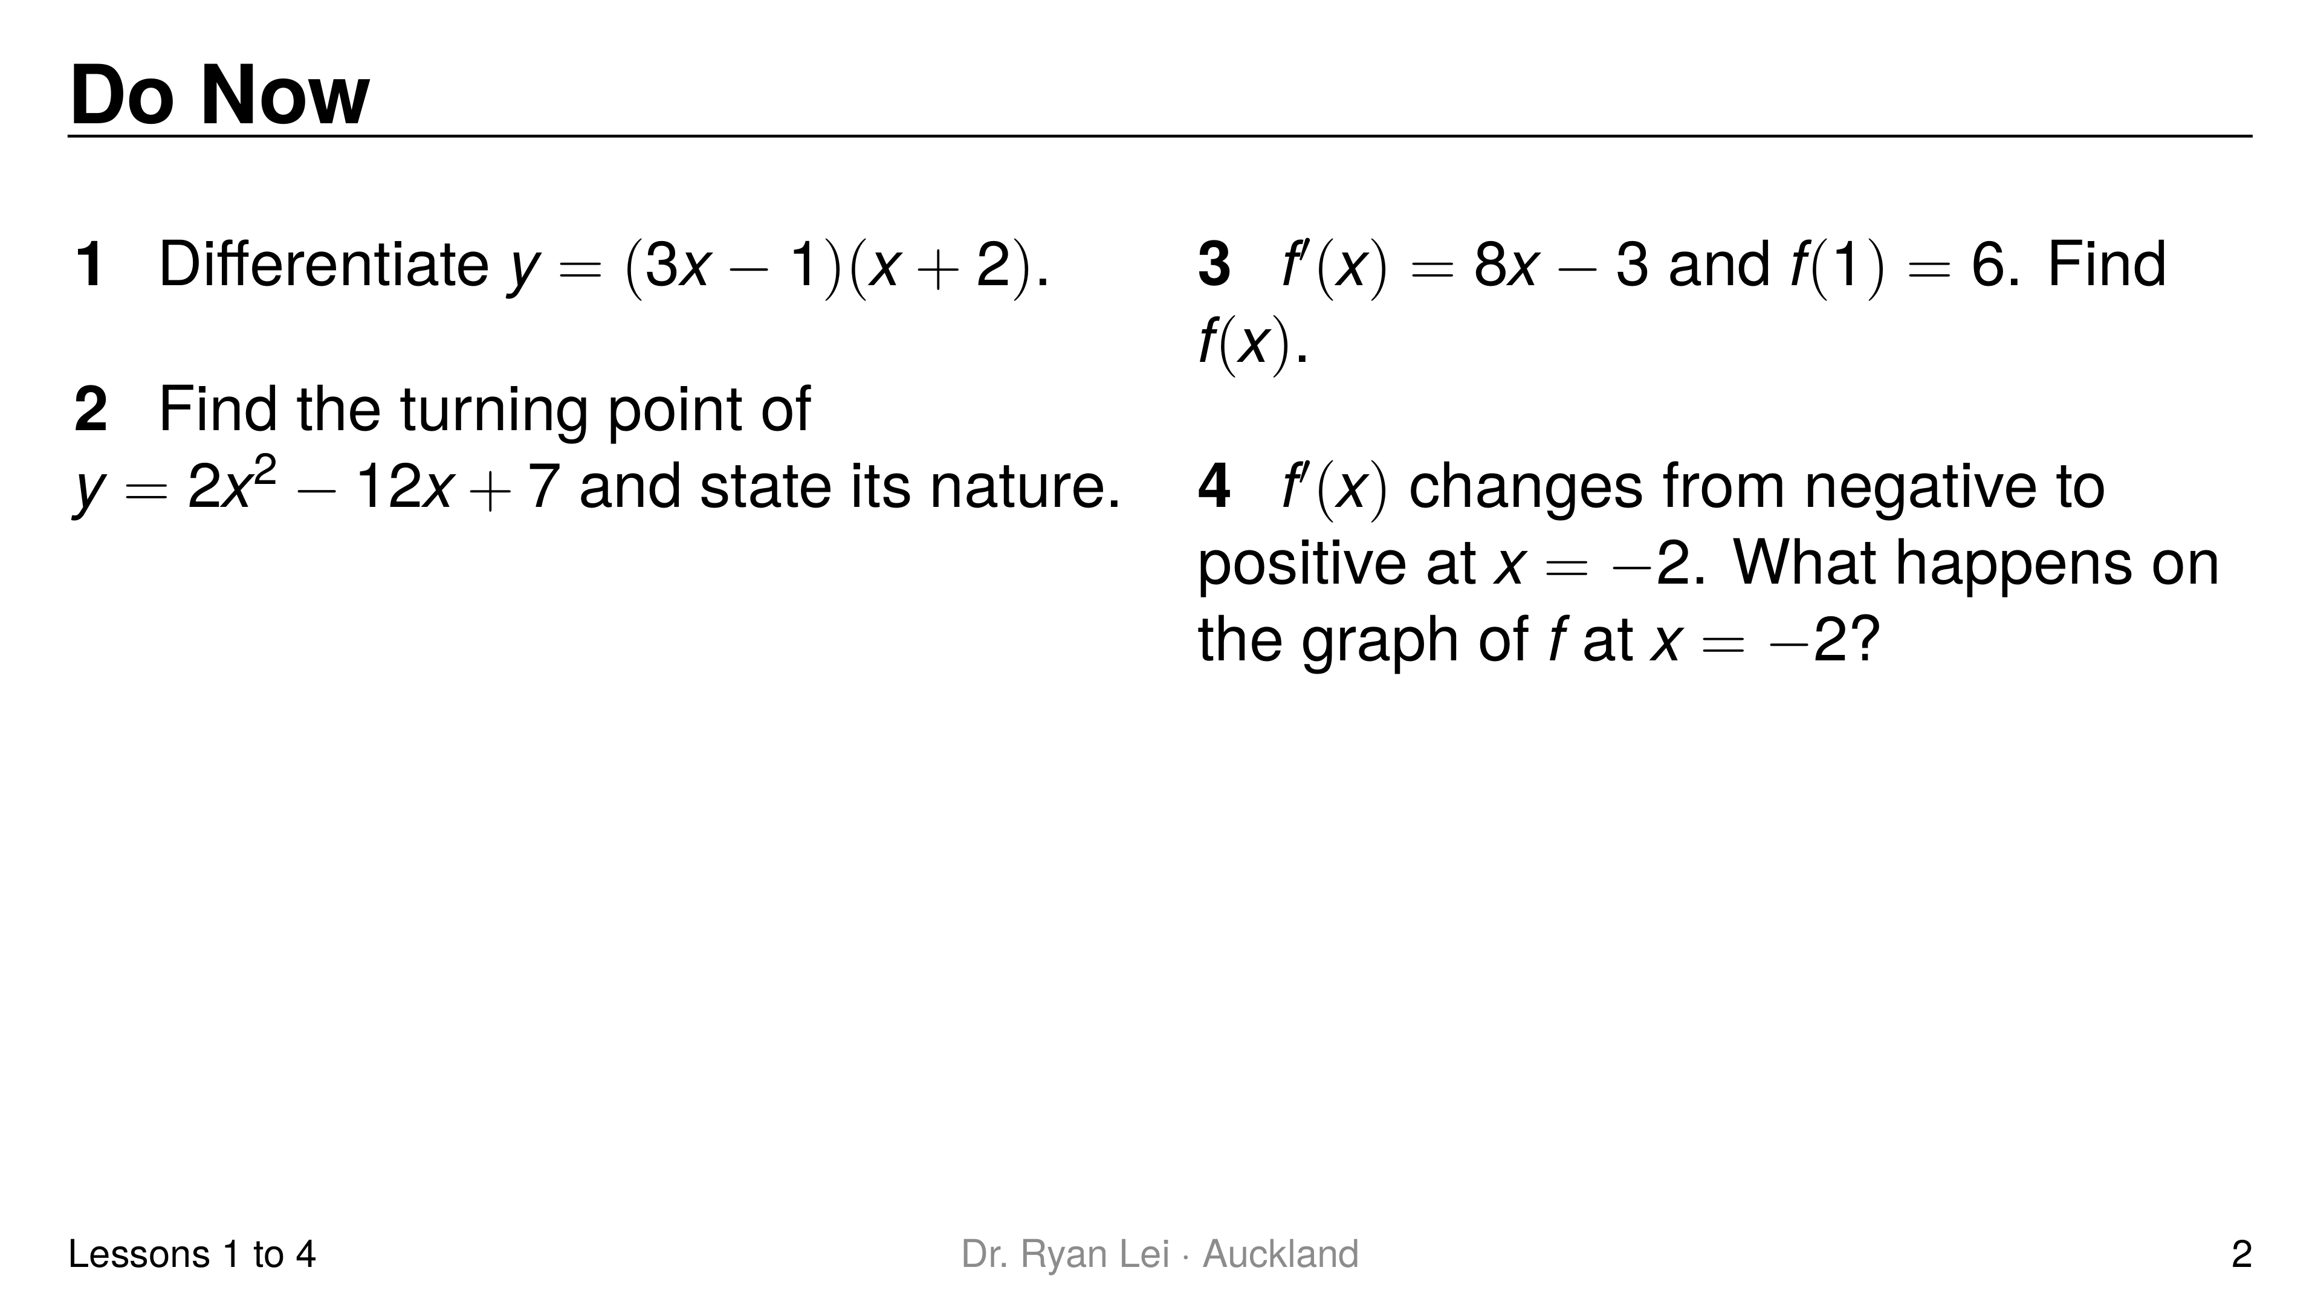
Notes:
Q1 $\frac{dy}{dx}=6x+5$
Q2 $\left(3, −11\right)$, minimum
Q3 $f\left(x\right)=4x^{2}−3x+5$
Q4 a minimum (a turning point)
Short solution:
Q1 expand: $3x^{2}+5x−2$
Q2 $4x−12=0$; $y=18−36+7$; $y″=4>0$
Q3 $4x^{2}−3x+c$; $4−3+c=6$
Watch for:
Q3 forgetting to find $c$
Diagnostic:
one question per lesson (1, 2, 4, 3): a wrong answer shows which lesson to revisit in round 1
Q4 wrong: Lesson 3 needs a quick recap with the translation table

Slide 3
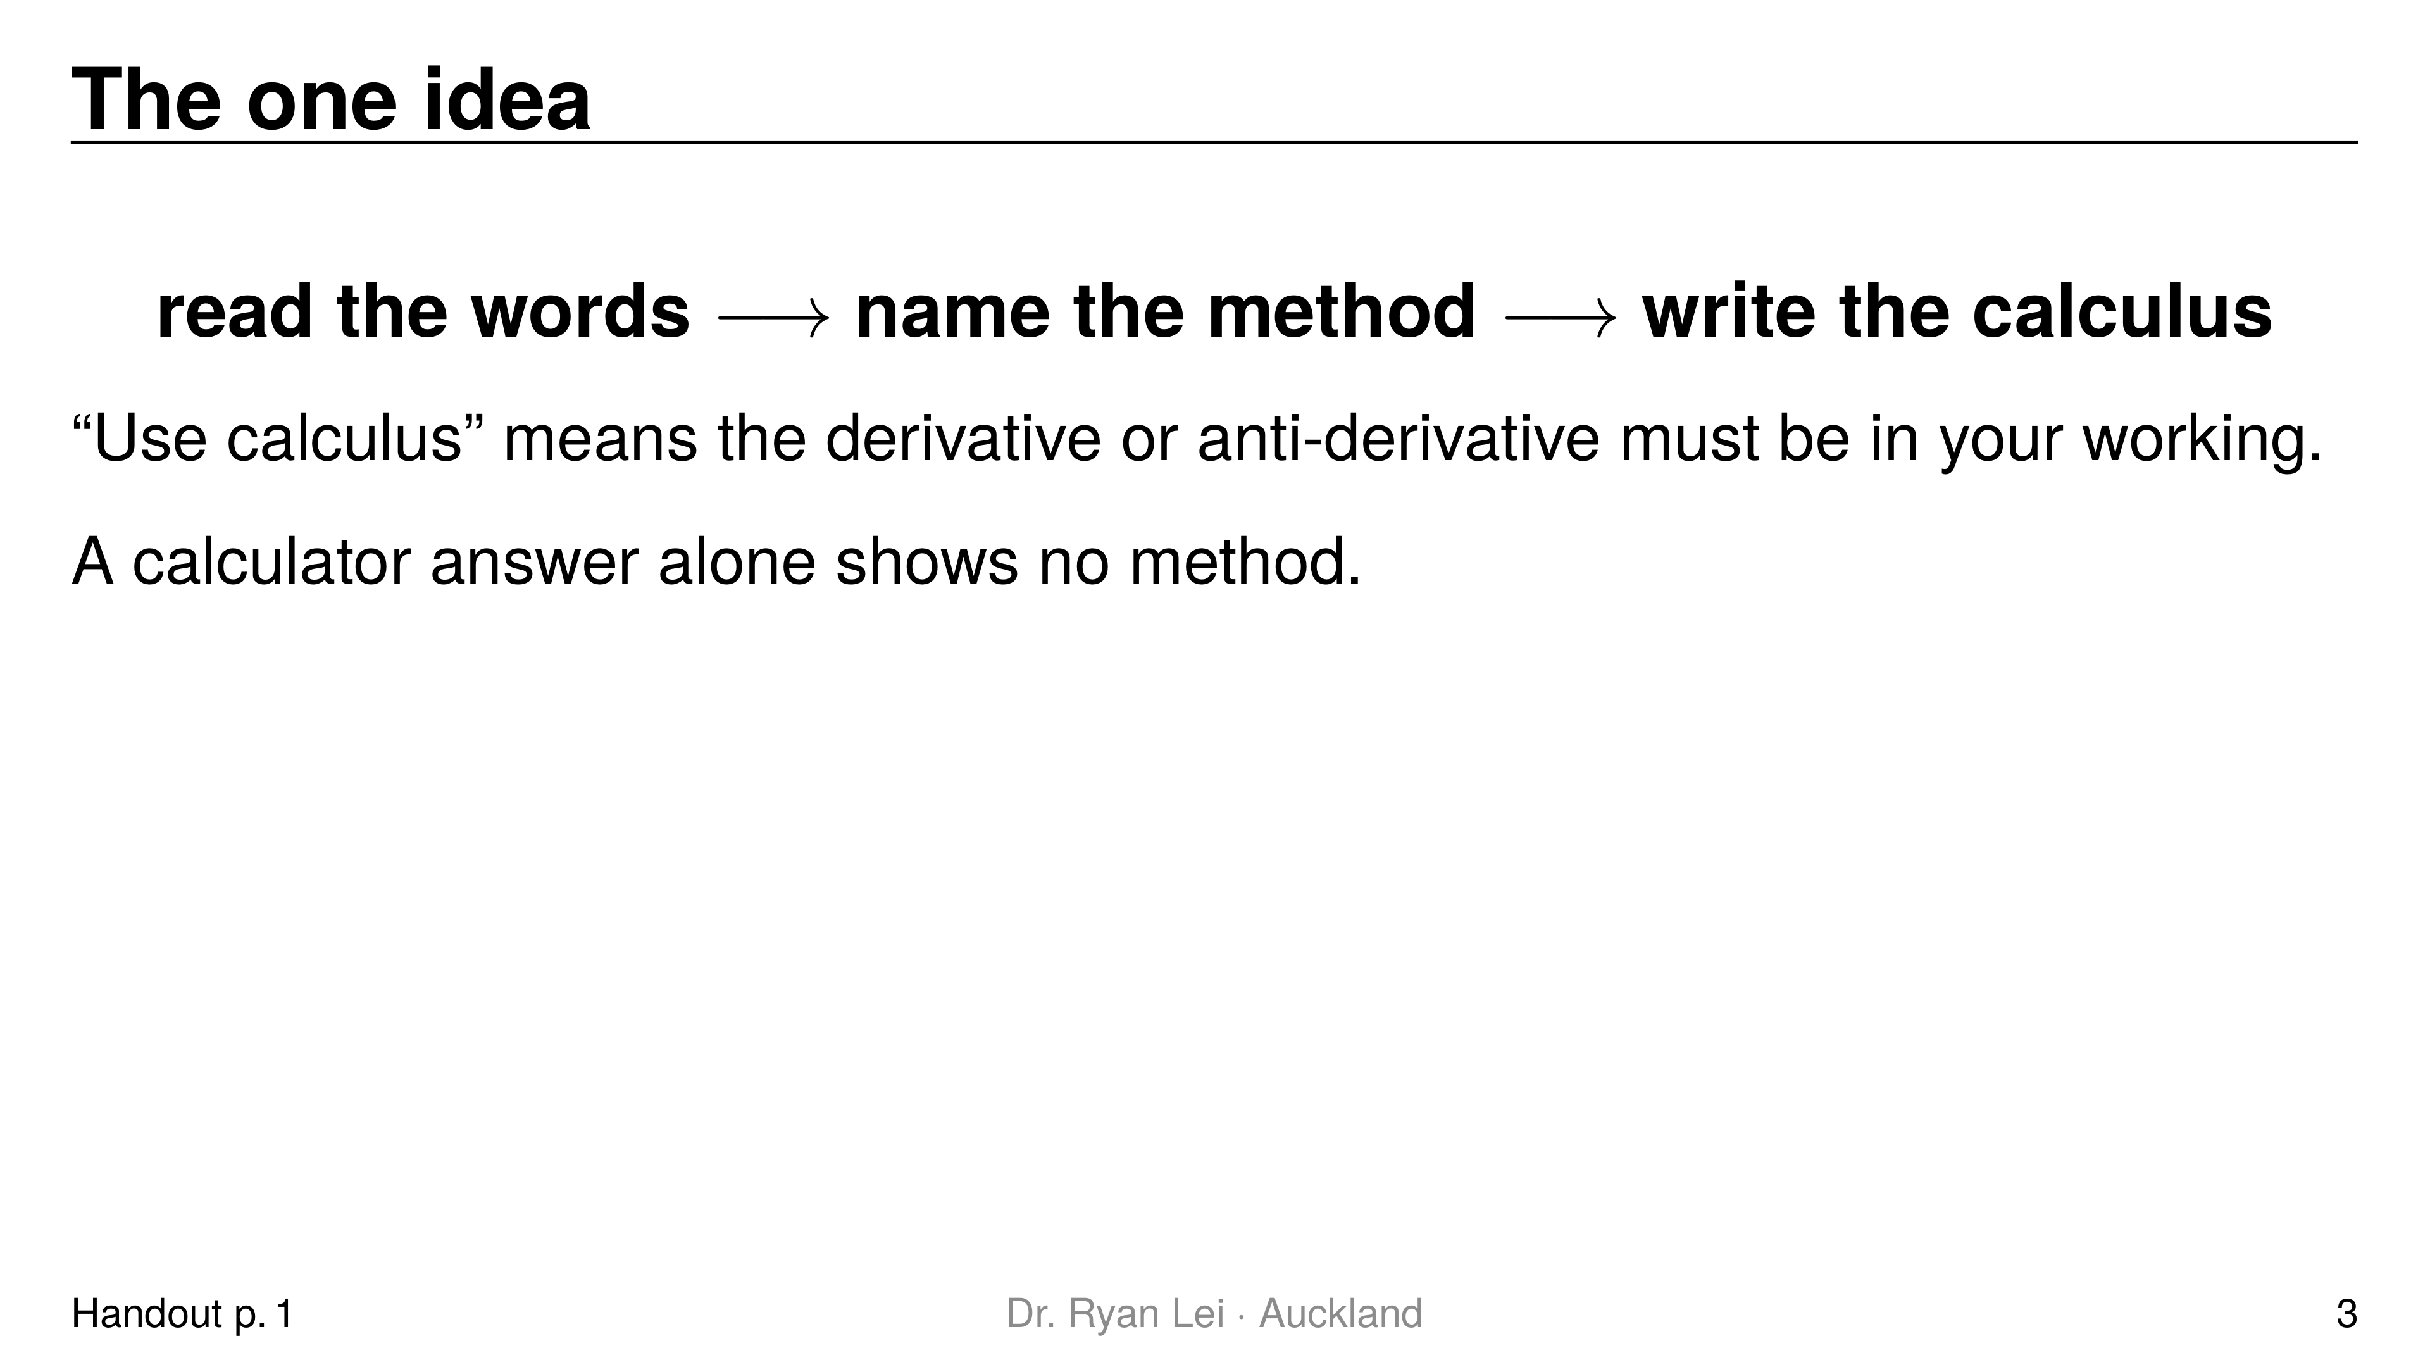
Notes:
Teaching line, not a question slide.
The method chooser on handout page 1 is the reference for round 1.

Slide 4
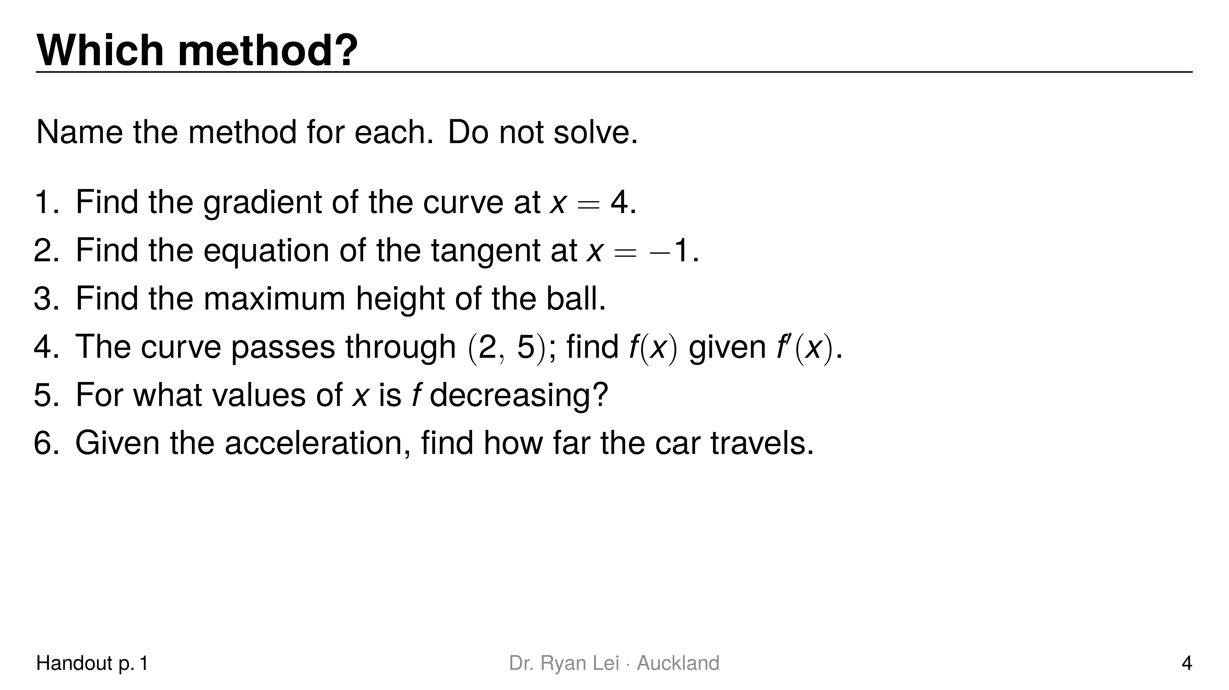
Notes:
1 differentiate, substitute $x=4$ into $f′\left(x\right)$
2 point from $f$, gradient from $f′$, then $y−y_{1}=m\left(x−x_{1}\right)$
3 $h′=0$, solve for $t$, substitute into $h$, justify with $h″$
4 anti-differentiate, $+c$, substitute $\left(2, 5\right)$
5 solve $f′\left(x\right)<0$: an interval
6 anti-differentiate twice ($a→v→s$), a constant each time
Short solution:
say the method aloud; the student points to the matching row of the chooser
Watch for:
item 6 is distance, so check whether the car turns round

Slide 5
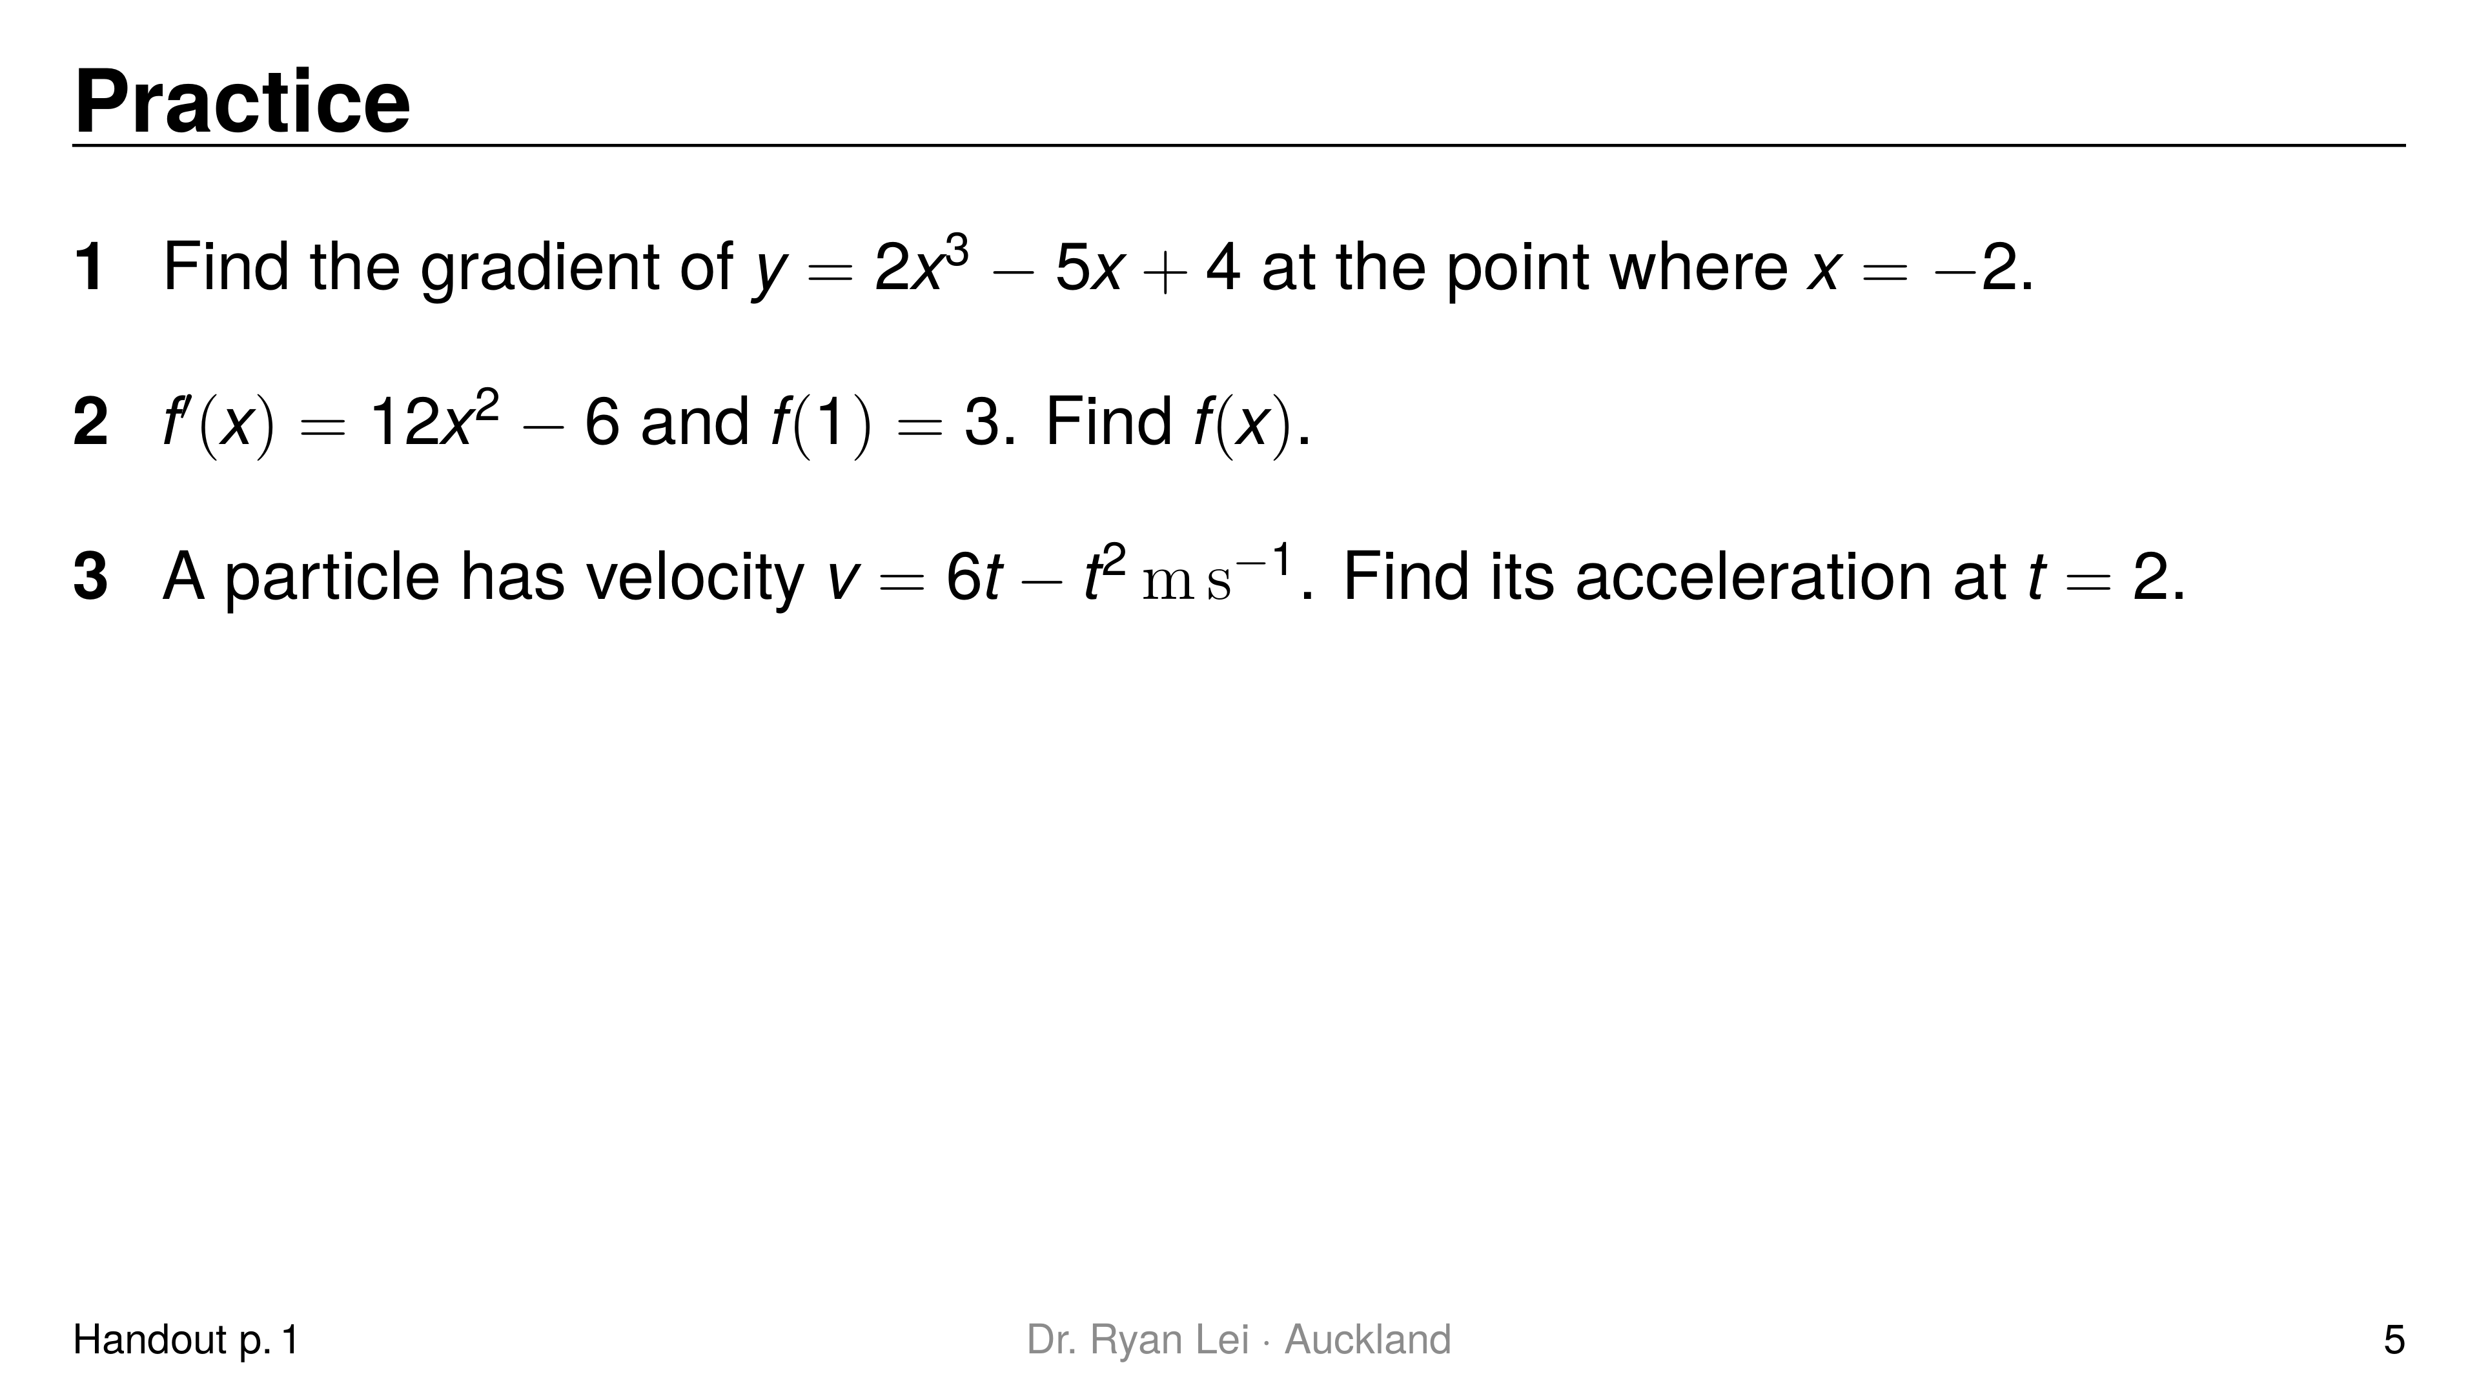
Notes:
Q1 $19$
Q2 $f\left(x\right)=4x^{3}−6x+5$
Q3 $2 m s^{−2}$
Short solution:
Q1 $\frac{dy}{dx}=6x^{2}−5$; $6\left(4\right)−5$
Q2 $4x^{3}−6x+c$; $4−6+c=3$
Q3 $a=6−2t$
Watch for:
Q1 $6{\left(−2\right)}^{2}=24$, not $−24$
Q3 differentiate $v$ once, not twice

Slide 6
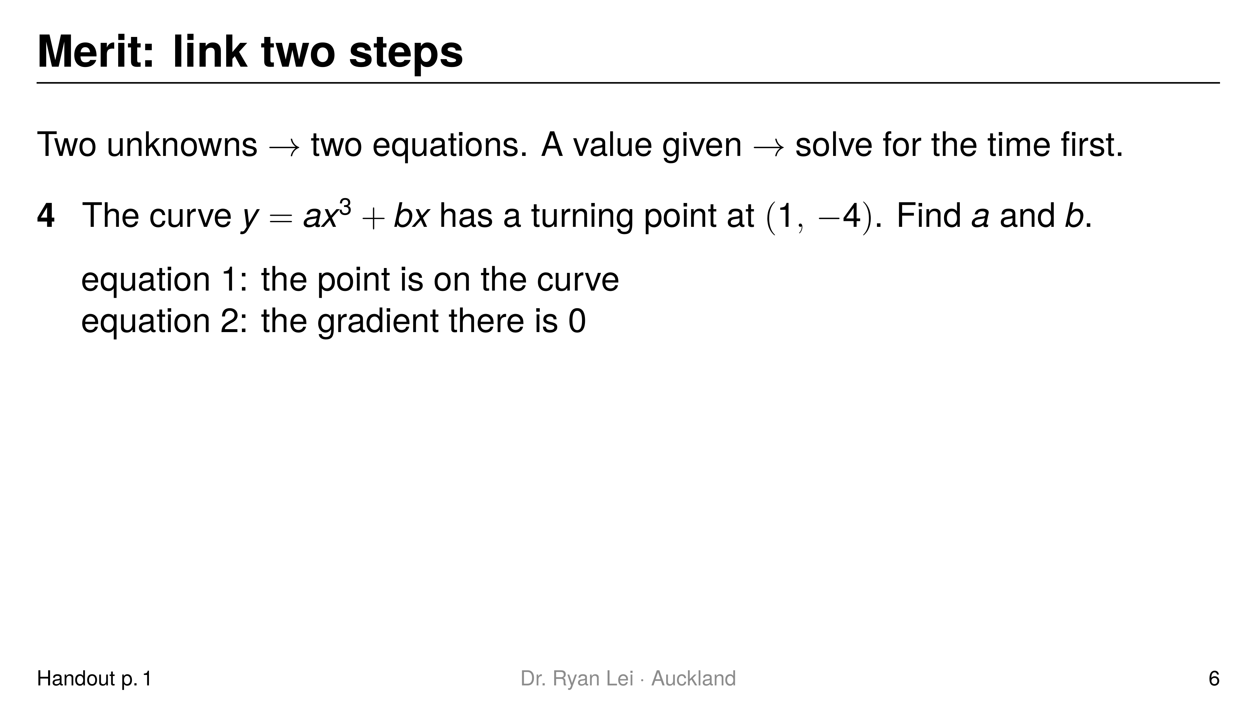
Notes:
Q4 $a=2$, $b=−6$
Short solution:
Q4 point: $a+b=−4$; turning point: $3a+b=0$; subtract: $2a=4$
Watch for:
using only “gradient $=0$” and guessing the second letter
Merit marker: both conditions written as labelled equations

Slide 7
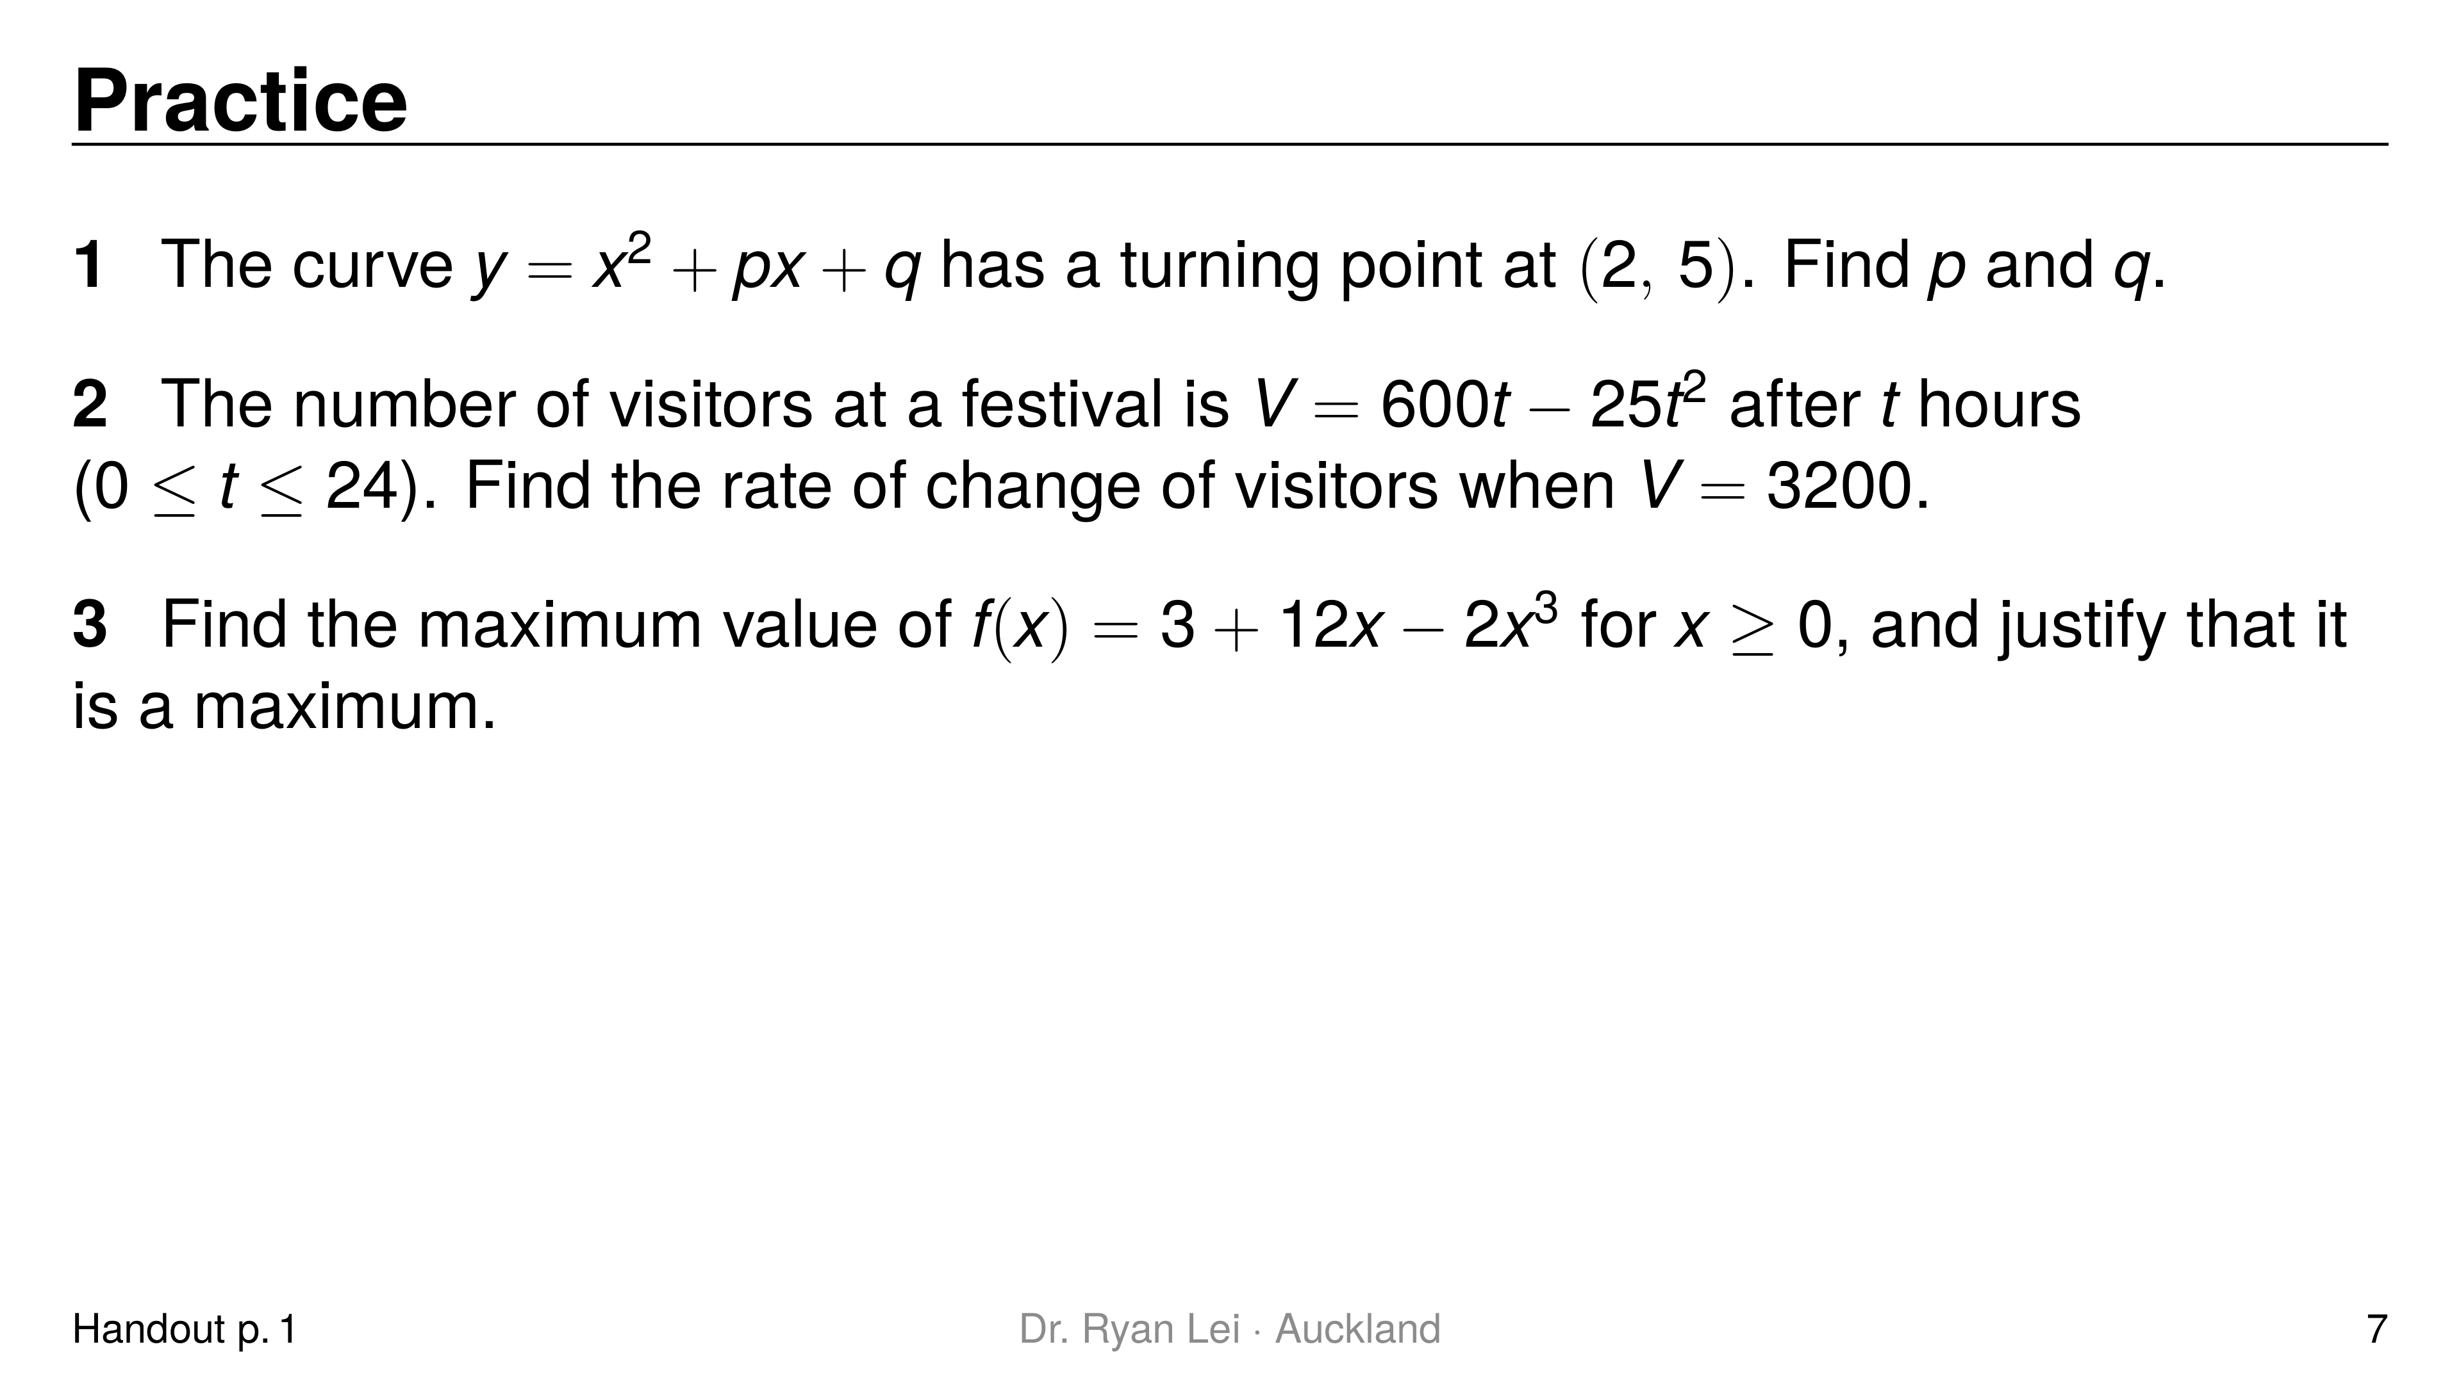
Notes:
Q1 $p=−4$, $q=9$
Q2 $200$ and $−200$ visitors per hour
Q3 $3+8\sqrt{2}≈14.3$ at $x=\sqrt{2}$
Short solution:
Q1 gradient: $4+p=0$; point: $4+2p+q=5$
Q2 $25t^{2}−600t+3200=0$, so $t=8$ or $16$; $V′=600−50t$
Q3 $f′=12−6x^{2}=0$, $x=\sqrt{2}$; $f″=−12x<0$
Watch for:
Q2 two times give two rates: increasing at $t=8$, decreasing at $t=16$
Q3 reject $x=−\sqrt{2}$ because $x≥0$

Slide 8
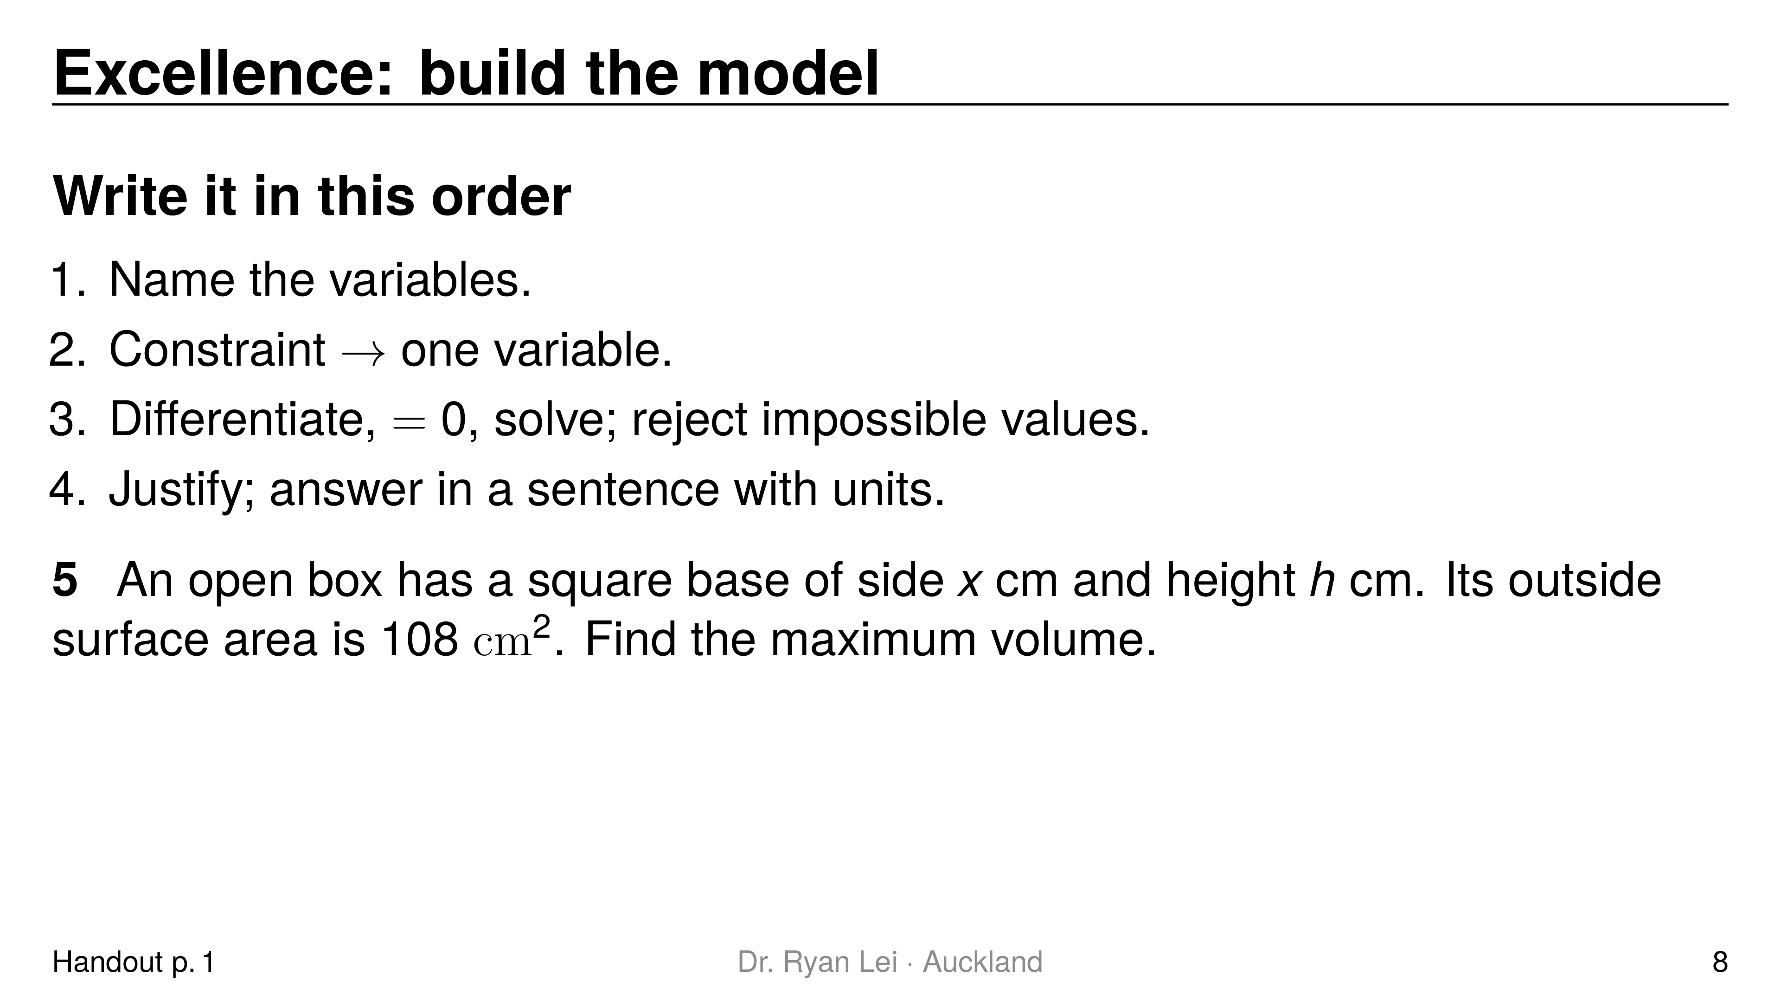
Notes:
Q5 $108 {cm}^{3}$ ($x=6$, $h=3$)
Short solution:
Q5 $x^{2}+4xh=108$, so $h=\frac{108−x^{2}}{4x}$
Q5 $V=x^{2}h=27x−\frac{1}{4}x^{3}$; $V′=27−\frac{3}{4}x^{2}=0$, $x=6$
Q5 $V″=−\frac{3}{2}x=−9<0$
Watch for:
an open box has one base, not two: $x^{2}+4xh$
the answer is the volume, not $x$ (L3)

Slide 9
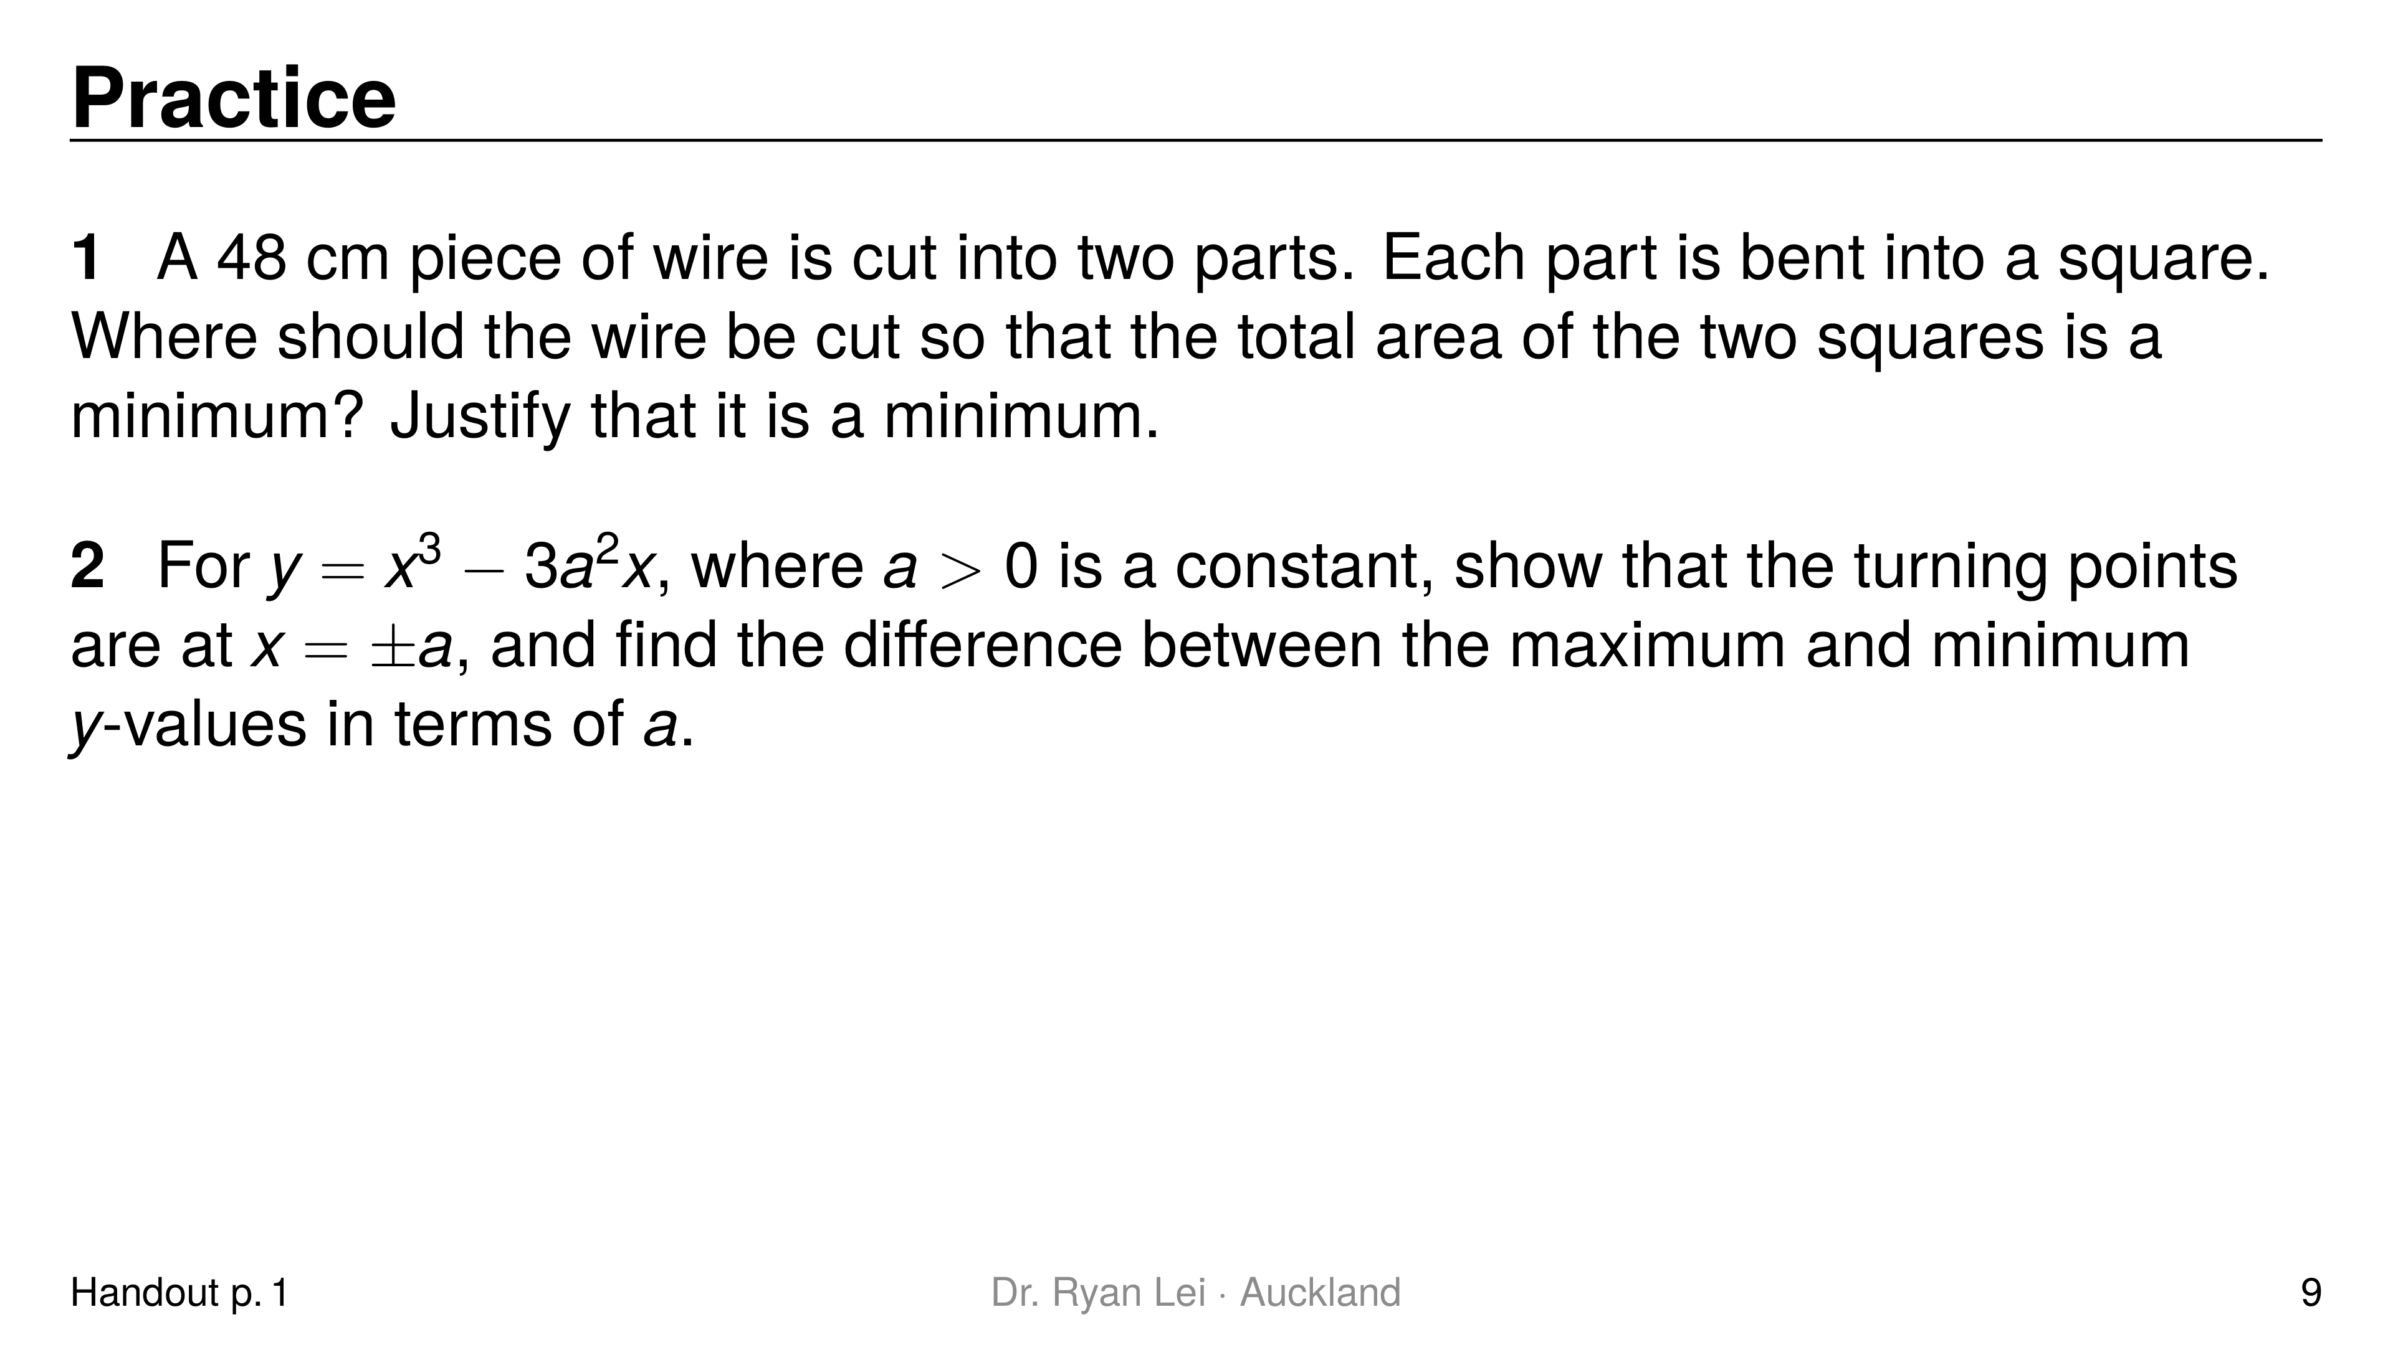
Notes:
Q1 cut it in the middle ($24$ cm each); minimum total area $72 {cm}^{2}$
Q2 turning points at $x=±a$; difference $4a^{3}$
Short solution:
Q1 pieces $x$ and $48−x$: $A=\frac{x^{2}}{16}+\frac{{\left(48−x\right)}^{2}}{16}$; $A′=\frac{x}{8}−\frac{48−x}{8}=0$; $A″=\frac{1}{4}>0$
Q2 $y′=3x^{2}−3a^{2}=0$; $y\left(−a\right)=2a^{3}$ (max), $y\left(a\right)=−2a^{3}$ (min)
Watch for:
Q1 the side of each square is a quarter of its piece
Q2 Excellence: keep $a$ as a letter all the way; justify which is the maximum

Slide 10
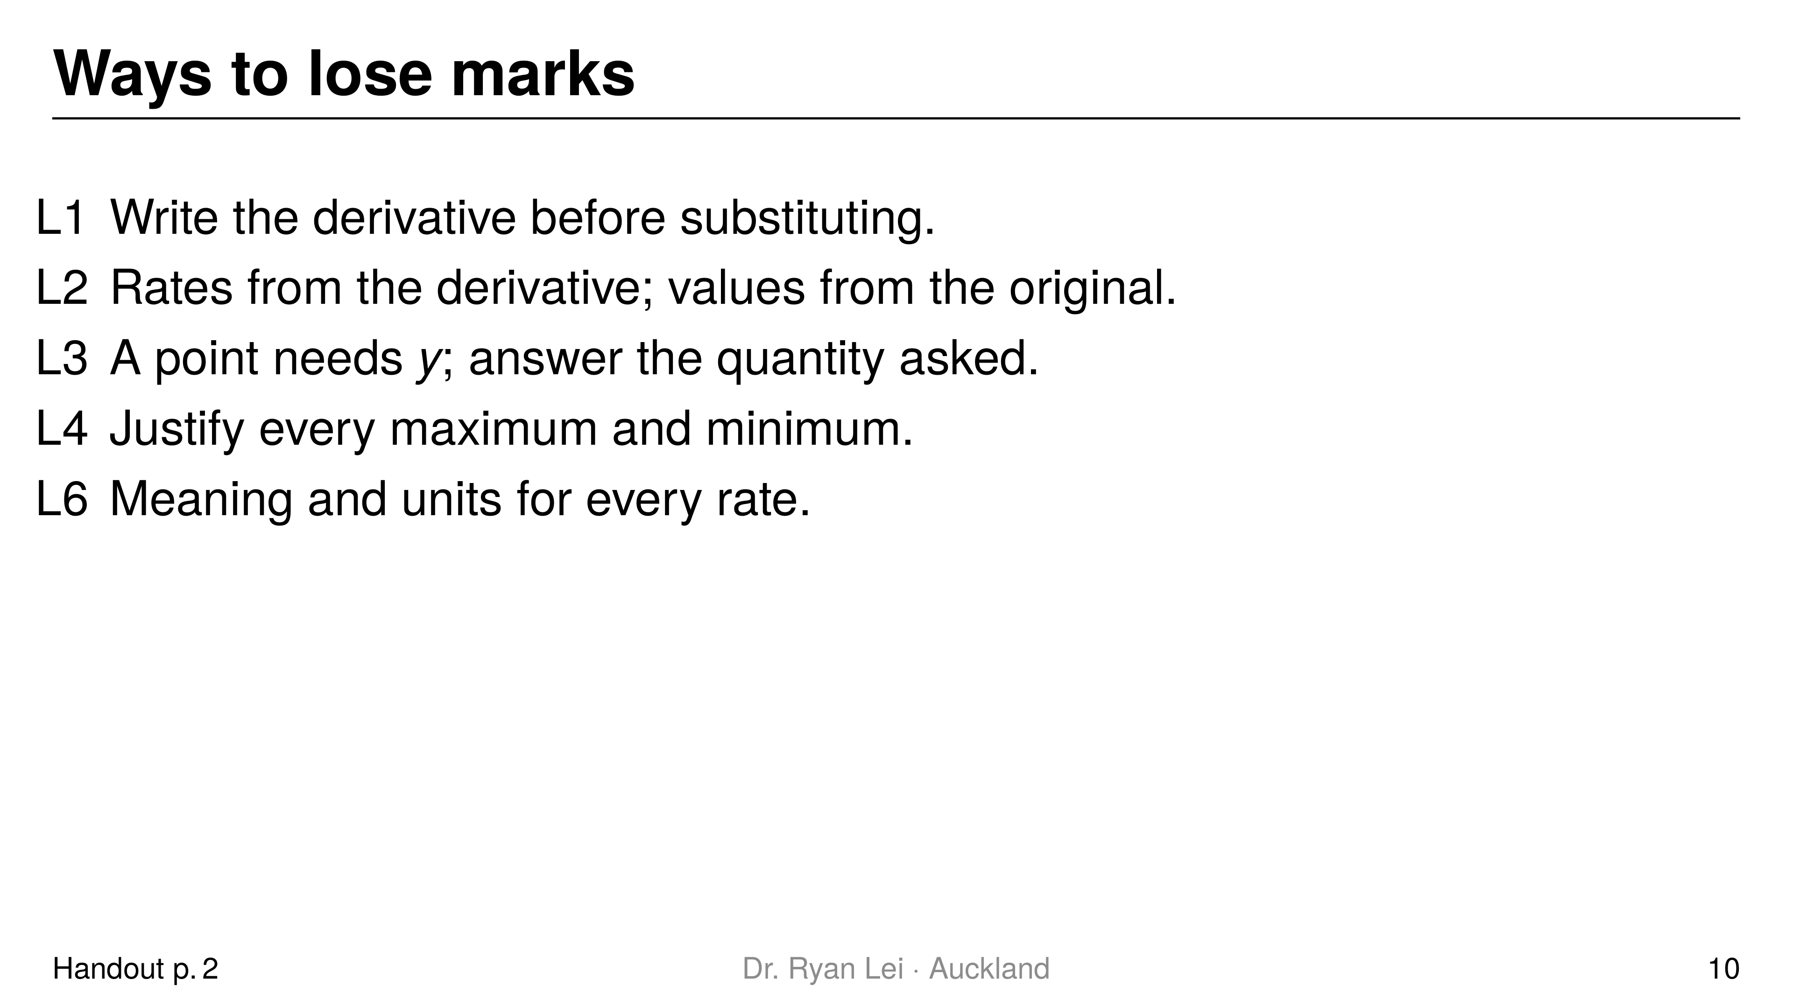
Notes:
Teaching line, not a question slide.
Full list L1 to L6 in the handout; ask which one the student is most likely to make under time pressure.

Slide 11
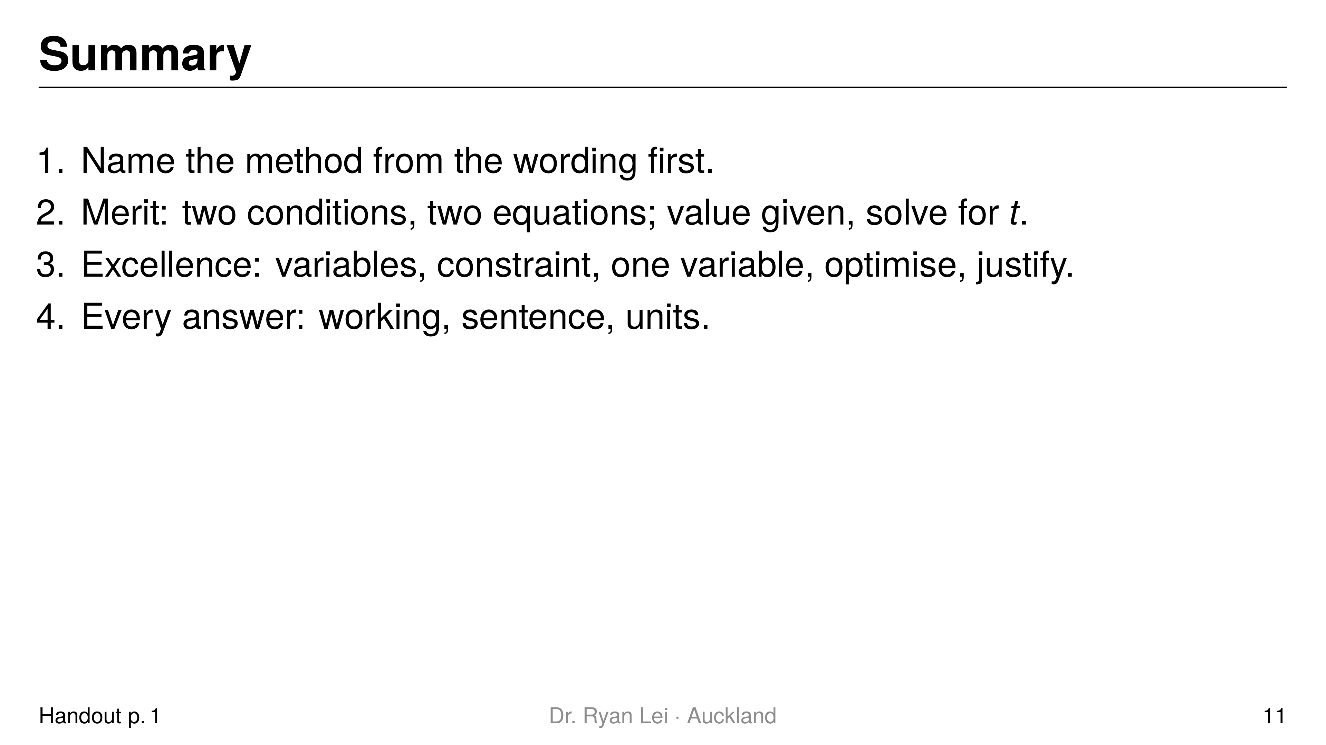
Notes:
Teaching line, not a question slide.
Ask the student to say each line back before looking at the screen.

Slide 12
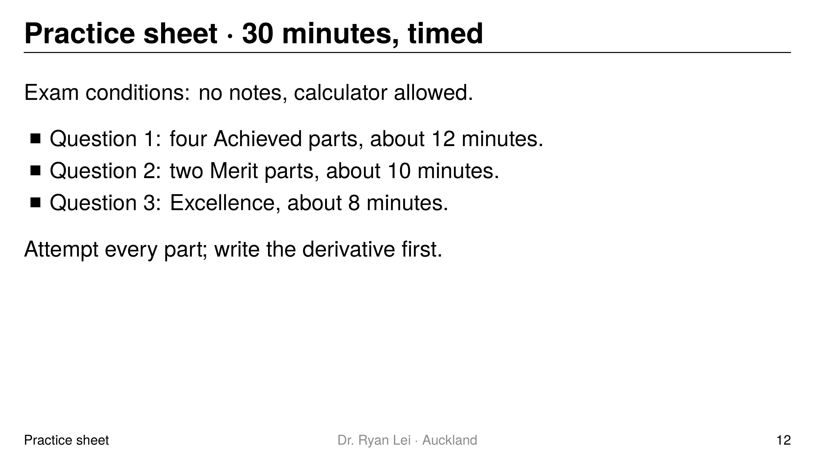
Notes:
Q1 (a) $4$; (b) $y=7x−17$; (c) $c=5$; (d) $0<x<4$
Q2 (a) $t=0.5$ s and $t=2$ s; (b) $36$ m
Q3 $k=192$
Short solution:
Q1 (a) $f′\left(x\right)=4x^{3}−6x+2$ at $x=−1$
Q1 (b) point $\left(3, 4\right)$, $m=4\left(3\right)−5=7$
Q1 (d) $3x^{2}−12x=3x\left(x−4\right)<0$
Q2 (a) $v=12t^{2}−30t+12=6\left(2t−1\right)\left(t−2\right)$
Q2 (b) $v≥0$ for $0≤t≤6$, so highest at $t=6$: $s=3t^{2}−\frac{1}{3}t^{3}$
Q3 growing fastest when $P′$ is a maximum: $P″=2k−24t^{2}=0$ at $t=4$
Watch for:
Q2 (b) the maximum is at the end of the interval, where $v=0$
Q3 check $P‴<0$ and $P′\left(4\right)>0$
Full working: practice answer version (tutor's working, not an official mark scheme)

Slide 13
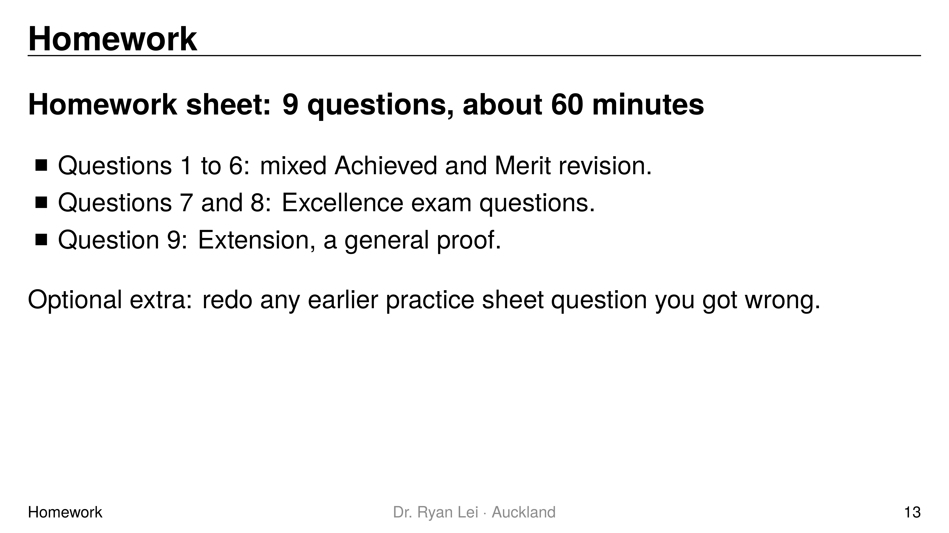
Notes:
Teaching line, not a question slide.
Answers: homework answer version (tutor's working, not an official mark scheme).
Mark Questions 7 to 9 together with the student next lesson; they are the longest exam-style questions in the unit.

